Slide 1

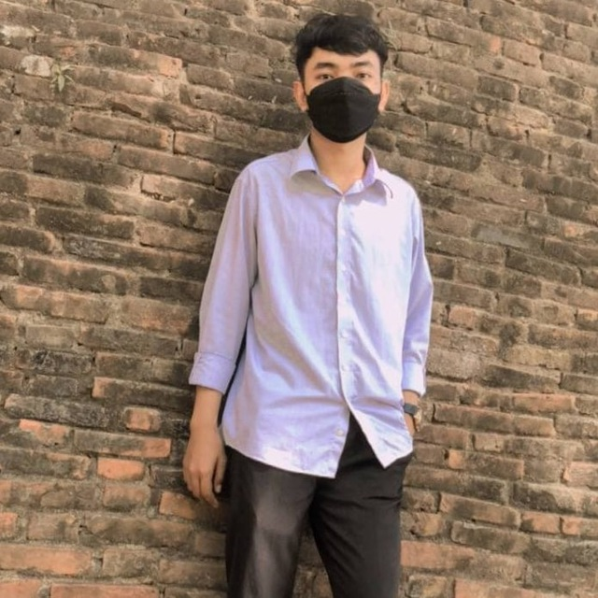

Restaurant System
Team member
&
Phanith chhim
Koev song

Slide 2

A
G
E
N
D
A
PNC Restaurant
System can do
Demo UML staff management
Demo UML Order management
Feedback
Koev song

Slide 3
Our System can manage
staff
Receipt
Order list
Table
Customer
Koev song

Slide 4

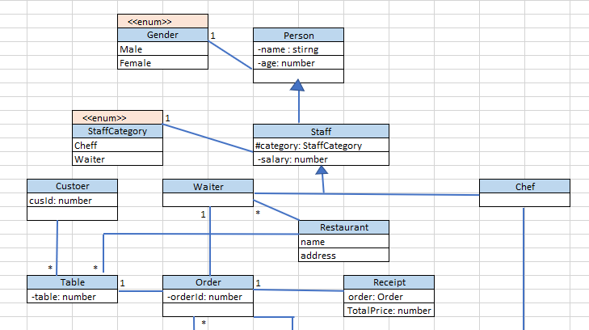
Koev song

Slide 5
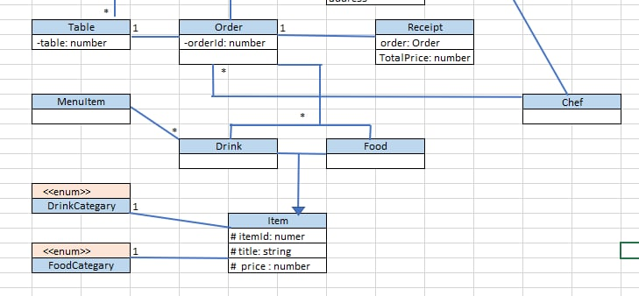
Phanith chhim

Slide 6
What we had been learnt.
Hard Skill
Critical thinking on UML
Clarify about Enum, extends, abstract
Clarify about Private, Protected, Publics
Soft Skill
Team work ,Time management, Task management, Problem solving
Phanith chhim

Slide 7



