Slide 1
RESEARCH · 01
Should the Fouled Player Take the Penalty Himself?
A ONE-TAILED Z-TEST · TOP 5 EUROPEAN LEAGUES
2026-05
renball

Slide 2
TL;DR
Three sentences
THE QUESTION
When a goalkeeper fouls a player who then takes the penalty himself, does conversion drop?
THE TEST
One-tailed two-proportion z-test. Treatment n = 100 (75.0%). Control n = 3,757 (78.25%).
THE RESULT
Δ = -3.25 pp (predicted direction) but p = 0.218, one-tailed — fail to reject H₀ at the available power.
renball
02 / 12

Slide 3
THE THEORY
Why we'd expect a drop
The just-fouled player walks straight to the spot.
Theory of the taker: physically jarred — body contact, hit the ground, adrenaline. Emotionally agitated, narrowed focus.
Theory of the keeper: locked in. The foul that gave the penalty was his fault. Nothing left to lose. Maximum motivation.
→ If both pull conversion down, the bench should hand the ball to a designated specialist.
renball
03 / 12

Slide 4
DATA
What we built the test on
4,110
3,322
100
5
PENALTIES (LOOSE FILTER)
SINGLE-PENALTY MATCHES
TREATMENT-CELL N
LEAGUES
Seasons in scope: 2017-2018 → 2023-2024
Competitions: Premier League, La Liga, Serie A, Bundesliga, Ligue 1.
Source: FBref player-match data, consolidated locally as FULL_DICT_ROWS.pkl.
Strict filter = matches with at most one penalty event (unambiguous GK-caused / taker-was-fouled attribution).
renball
04 / 12

Slide 5
METHOD
One-tailed two-proportion z-test
TREATMENT
CONTROL
GK fouled the taker
All other penalties
Matches where the goalkeeper conceded the foul AND the fouled player is the same player who took the penalty.
Every other strict-filter match — GK fouled but a different player took, or outfielder caused the foul (any taker).
H₀: conversion_treatment = conversion_control · H₁: conversion_treatment < conversion_control (one-tailed, α = 0.05) · 95% Wilson CIs · statsmodels.proportions_ztest
renball
05 / 12

Slide 6
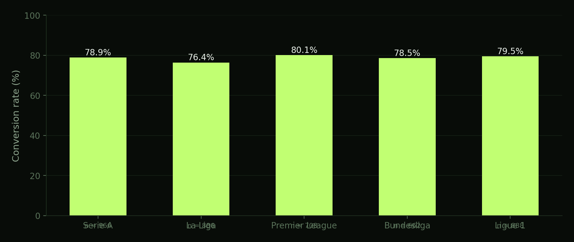
CONTEXT
Conversion rate by league
Across the top 5 leagues conversion clusters tightly in the high 70s — league of origin is not a major source of variation.
renball
06 / 12

Slide 7
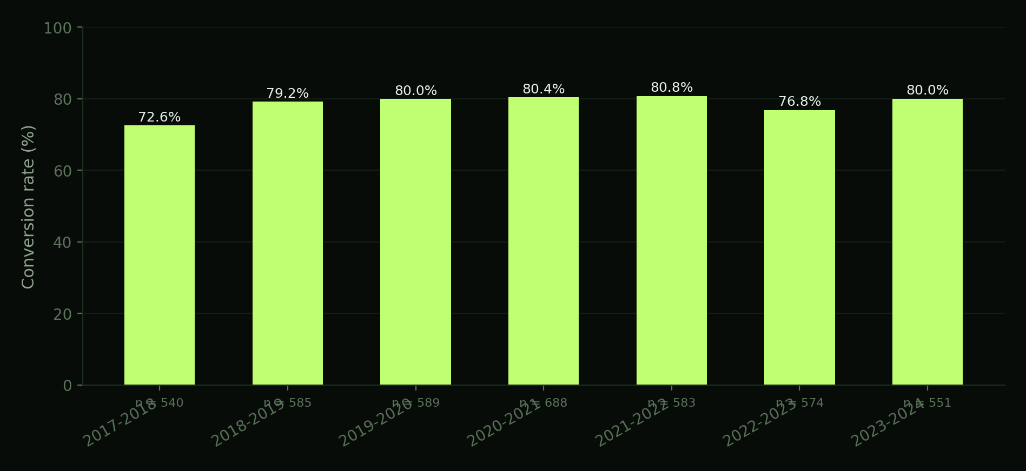
CONTEXT
Conversion across seasons
Year-on-year stability is high — the ~77–80% band holds across the period in scope.
renball
07 / 12

Slide 8
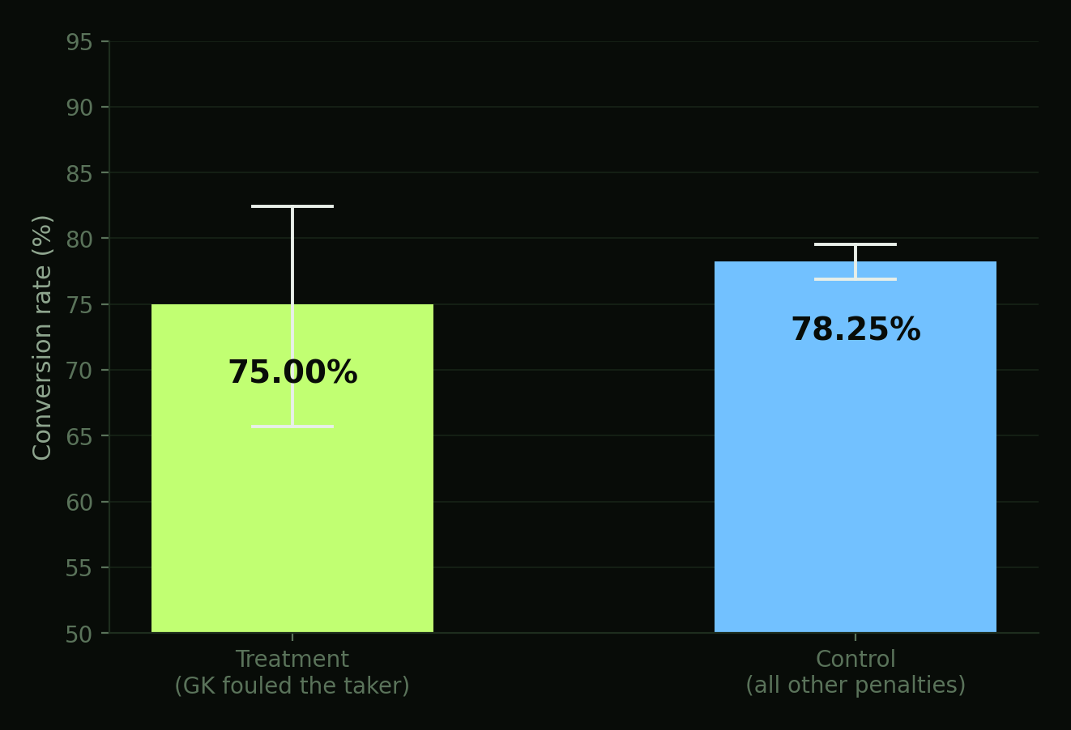
PRIMARY TEST · ONE-TAILED
Treatment vs control
TREATMENT
75.00%
n = 100 · 95% CI [65.70%, 82.45%]
CONTROL
78.25%
n = 3,757 · 95% CI [76.91%, 79.54%]
Δ = -3.25 pp z = -0.777
p = 0.2185 (one-tailed) · Fail to reject H₀
Whiskers: 95% Wilson confidence intervals. Treatment CI is wide — n is the binding constraint.
renball
08 / 12

Slide 9
2×2 CONTEXT
Where the treatment cell sits
GOALKEEPER CAUSED THE FOUL
OUTFIELDER CAUSED THE FOUL
TREATMENT
75.00%
78.87%
TAKER = THE PLAYER WHO WAS FOULED
N = 100
N = 549
78.11%
78.15%
TAKER = A DIFFERENT PLAYER
N = 265
N = 2,943
Accent-bordered cell = treatment. The other three pool into control.
renball
09 / 12

Slide 10
PER-LEAGUE REPLICATION
The same test, league by league
LEAGUE
T. RATE
T. N
C. RATE
C. N
Z
P (1-T)
SIG
Serie A
80.95%
21
77.70%
888
+0.354
0.6383
No · low n
La Liga
57.89%
19
77.46%
803
-2.003
0.0226
Yes · low n
Premier League
88.00%
25
78.59%
626
+1.131
0.8710
No · low n
Bundesliga
61.54%
13
78.18%
614
-1.429
0.0765
No · low n
Ligue 1
77.27%
22
79.42%
826
-0.245
0.4030
No · low n
Per-league treatment cells of 13–25 leave each test severely underpowered — pooled is the only inference to take seriously.
renball
10 / 12

Slide 11
CONCLUSION
What the data says
The bench answer: can't yet tell.
Conversion is 3.25 pp lower when the fouled player takes the kick himself (75.00% vs 78.25% for everyone else). The point estimate moves in the predicted direction, but the treatment cell is too small to rule chance out (p = 0.218, one-tailed).
→ No statistical warrant to override the fouled player who wants to take it himself. Equally, no clean evidence he's at full strength.
renball
11 / 12

Slide 12
Full methodology, source code and data:
Full methodology, source code and data:
renball.com
/PROJECTS/01-PENALTY-ANALYSIS/
→ methodology formal H₀ / H₁, test assumptions, limitations
→ analysis.html interactive dashboard, live numbers from data.json
→ code/build.py Python pipeline — raw pickles → aggregated JSON
renball

