Slide 1
RESEARCH · 02
Not All Goals Are Equal.
A TIME-AWARE EXPECTED-POINTS MODEL · TOP 5 LEAGUES + EREDIVISIE
2026·05
renball

Slide 2
TL;DR
TL;DR — three sentences
—
A goal that takes a team from 0–0 to 1–0 in the final fifteen minutes is worth 1.68 expected points — 2.1× the same transition in the opening fifteen.
—
Across 39,381 goals in six leagues and seven seasons we observed 82 of 90 theoretical (gd × minute_bin) states.
—
The model's biggest gainer over the time-blind baseline is Mário Rui (+3.43 ΔEP on 28 G+A) — a late-equaliser specialist the scoreboard underrates.
renball
02 / 13

Slide 3
THE QUESTION
Are all goals equal?
Three goals, three different lengths of game ahead. Should we treat them the same?
EARLY OPENER
0–0 to 1–0 in the 5th minute. 85 minutes still to play, everyone resets.
LATE EQUALISER
1–2 to 2–2 in the 88th minute. Pulls a point out of a lost match.
CONSOLATION
4–0 down, you score in stoppage. Doesn't move the table.
→ The standard scoreboard treats them the same. We won't.
renball
03 / 13

Slide 4
DATA
What we built the framework on
39,381
6
7
82
GOALS ANALYZED
LEAGUES
SEASONS
MODELLED STATES
Seasons in scope: 2017-2018 → 2023-2024
Leagues: Bundesliga, Eredivisie, La-Liga, Ligue-1, Premier-League, Serie-A
Source: FBref-derived shot tables, one pickle per league (match_data_final_<league>.pkl).
Variables: scoring team, outcome=goal, goalscorer, SCA1 (assist), minute (parsed including stoppage suffixes).
renball
04 / 13

Slide 5
THE VALUE FUNCTION
How a goal gets priced
For every pre-goal state (goal_difference, minute_bin) we compute the empirical expected points.
EP(gd, minute_bin) = 3 · P(W | state) + 1 · P(D | state)
Mean of final-match points over every team that entered this (gd, bin) state.
A goal's value is the difference between the two states it connects:
ep_collected = EP(gd_after, bin) − EP(gd_before, bin)
renball
05 / 13

Slide 6
STATE VALUE TABLE
Expected final points at each (GD, minute)
0-15
15-30
30-45
45-60
60-75
75-90
−4 TO −3
0.00
0.00
0.02
0.00
0.00
−3 TO −2
0.00
0.00
0.04
0.05
0.03
0.00
−2 TO −1
0.38
0.33
0.24
0.21
0.18
0.07
−1 TO 0
0.75
0.75
0.74
0.70
0.64
0.56
0 TO +1
1.40
1.40
1.39
1.40
1.41
1.46
+1 TO +2
2.07
2.07
2.07
2.08
2.10
2.07
+2 TO +3
2.53
2.56
2.66
2.70
2.73
2.88
+3 TO +4
3.00
3.00
2.93
2.93
2.95
3.00
+4 TO +5
3.00
3.00
2.97
3.00
3.00
Showing GD ∈ [−4, +4]; the full table covers [−7, +7]. Cells brighten with expected points.
renball
06 / 13

Slide 7
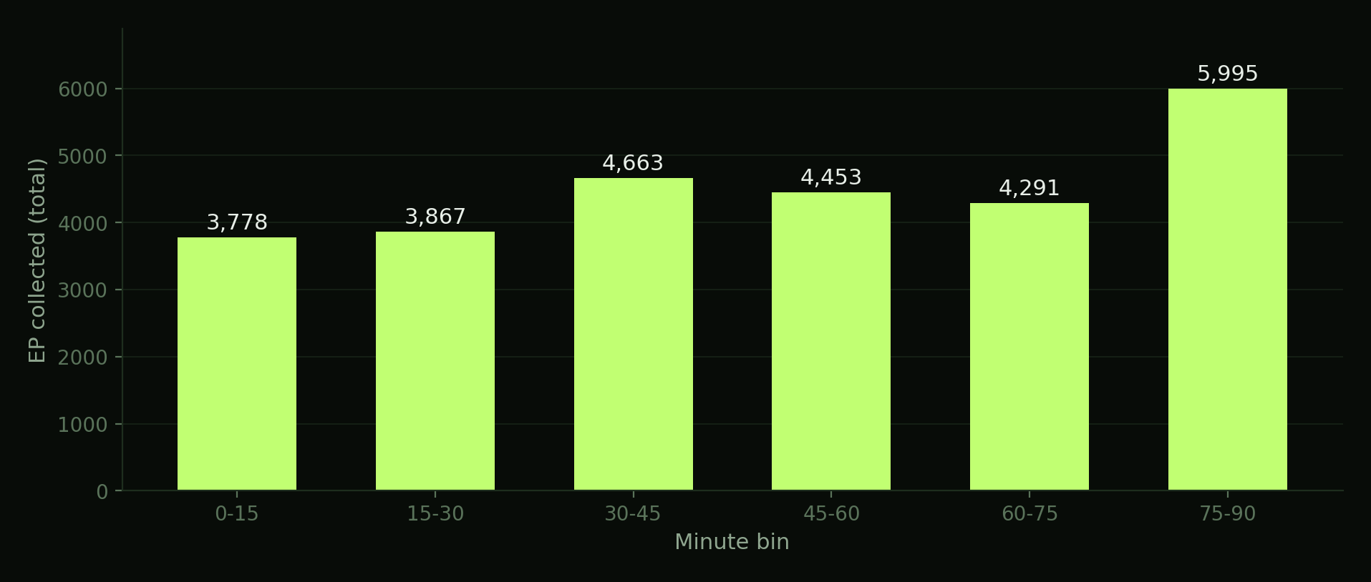
AGGREGATE
Where the expected points get cashed in
Sum of (ep_collected × n) across every transition, per minute bin. The last 15 minutes deliver ~1.6× the value of the first.
renball
07 / 13

Slide 8
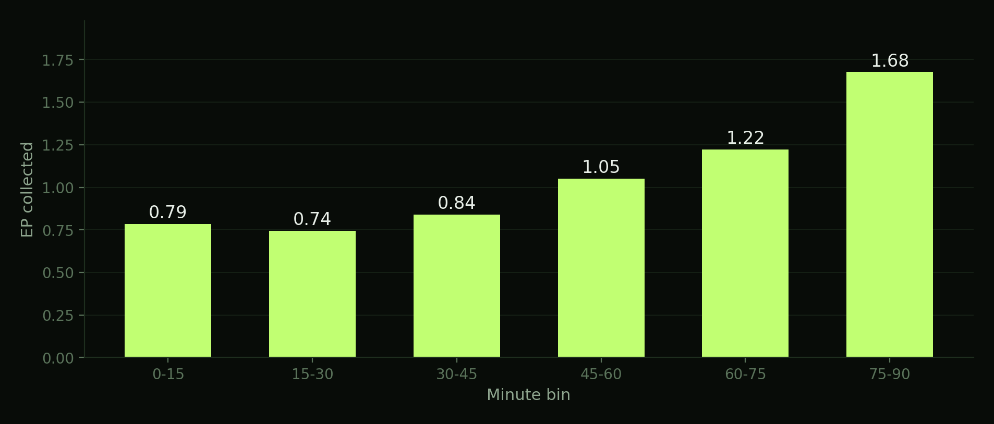
0 → 1
The opener: worth more the longer it took to arrive
EP collected from a 0→1 goal by minute bin. Late opener (1.68 EP) is 2.1× the early one (0.79 EP).
renball
08 / 13

Slide 9
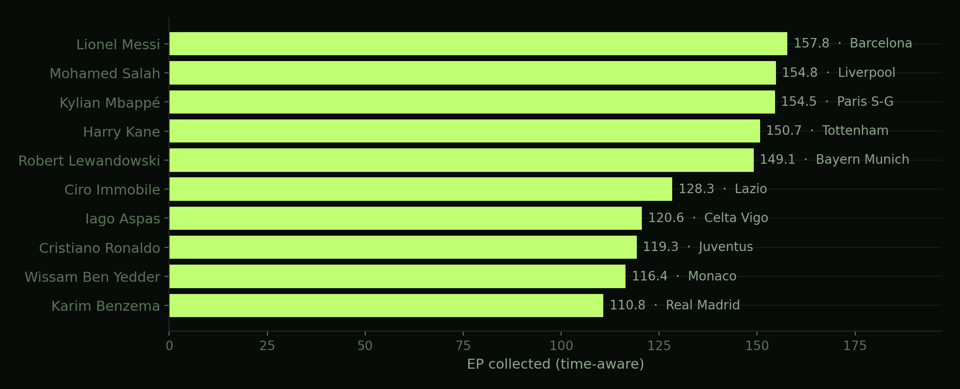
LEADERBOARD
Top 10 EP collectors · Goals + Assists
All leagues, all seasons pooled. Goals + assists combined; players pooled across team transfers (primary team labelled).
renball
09 / 13

Slide 10
SPOTLIGHT
The biggest time-aware upgrade
BIGGEST GAINER
TOP 5 UPGRADES
Mário Rui
1
Mário Rui
+3.43
Napoli · 28 G+A pooled
2
Evann Guessand
+3.34
3
Cristian Tello
+2.82
+3.43
4
Adama Traoré
+2.69
5
Youssoufa Moukoko
+2.58
Δ EP FROM TIME-AWARE RE-RATING
(24.11 timed − 20.68 untimed)
A walking late-equaliser: ~30 career goals in scope, almost entirely in score-tied late minutes.
renball
10 / 13

Slide 11
IMPLICATIONS
What this changes
—
Goals are not a unit — they are a function of state and time. EP-weighted rankings expose contribution patterns raw counts can't see.
—
Recruitment with leverage in mind: a player whose 12 goals are mostly late equalisers is materially different from one whose 12 are 4–0 cushions.
—
Squad-management: knowing which minute bins your forwards harvest from informs substitution timing and game-state-conditional roles.
—
Coaching: late-minute defending decisions get a clean valuation — the equaliser you concede in the 88th minute is worth ~1.7× the one in the 18th.
renball
11 / 13

Slide 12
LIMITATIONS
What this isn't
—
Not xG-weighted. A tap-in and a 30-yard volley count the same.
—
Penalties and own goals are not separated from open play (next iteration).
—
Assist credit caps at SCA1 — build-up beyond the first shot-creating action isn't captured.
—
Observational, not causal: it values the gap between states, not the goal's incremental effect on the final outcome.
—
Pooled value function across leagues — per-league calibration available in the dashboard.
Full discussion: methodology.html · §5
renball
12 / 13

Slide 13
Want every cell, every league, every season?
Full methodology, source code and data:
renball.com
/PROJECTS/02-POINTS-BY-GAMESTATE/
→ analysis.html editorial write-up with five Chart.js + D3 visuals
→ dashboard.html full interactive Tabulator dashboard, six datasets, drill-down
→ methodology.html formal write-up — state-value math, attribution, eight limitations
→ code/build.py Python pipeline from raw pickles to JSON
renball

