Slide 1
RESEARCH · 03
The True Contributors.
WHO ACTUALLY MOVES THE TABLE? · A THREE-LAYER EXPECTED-POINTS ATTRIBUTION
2026·06
renball

Slide 2
TL;DR
TL;DR — three sentences
—
We take project 02's time-aware expected-points (EP) value function and credit a THIRD touchpoint per goal — the pre-assist (SCA2) — alongside the scorer and the assister.
—
Across 39,381 goals in six leagues and seven seasons, the per-90 board still leads with the consensus elite (Lionel Messi, 1.14 EP/90) — the framework clears the eye test before it surfaces surprises.
—
The marquee finding: Julian Brandt collects 40.93 EP from pre-assists alone — second in Europe only to Messi (51.69) — and 39% of his total value comes from that single layer.
renball
02 / 15

Slide 3
THE QUESTION
Three touchpoints, two counted
Every goal is built by a chain of contributions. The scoreboard credits the end of the chain and forgets the rest.
SCORER
Puts the ball in the net. Always credited — the goal goes on his record.
ASSIST · SCA1
The final pass. Sometimes credited, when the box score bothers to log it.
PRE-ASSIST · SCA2
The pass before the pass. Almost never credited — it disappears into the squad page.
→ Credit all three. Then ask who the model elevates that the box score does not.
renball
03 / 15

Slide 4
DATA & METHOD
What the framework runs on
39,381
6
7
6,516
GOAL EVENTS
LEAGUES
SEASONS
PLAYERS W/ META
three_layer credit = scorer + SCA1 + SCA2 (each role = 1 credit · EP summed)
Inherits project 02's value function verbatim — a goal is priced by the swing in expected league points it produces, conditioned on game-state and minute.
Per-90 = (EP / minutes) × 90. Minutes come from FBref summary tables — Top-5 leagues only, so every per-90 board excludes Eredivisie.
Absolute-EP boards keep all six leagues; per-90 boards are Top-5 only.
renball
04 / 15

Slide 5
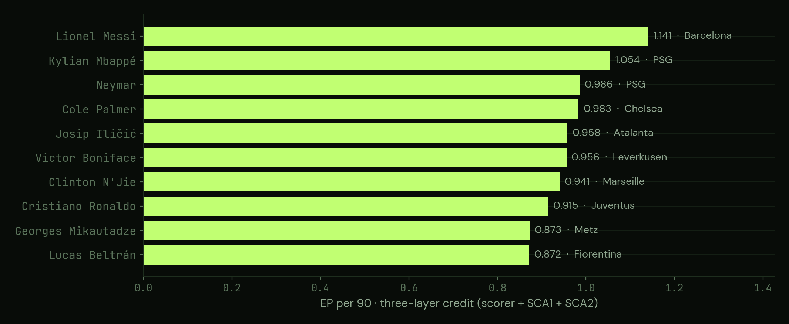
Q1A · FULL-CREDIT LEADERBOARD
The model clears the eye test
Top 10 by EP/90, ≥ 1,000 minutes, Top-5 leagues. The consensus elite leads — which is the point. Recover what everyone knows before surfacing surprises.
renball
05 / 15

Slide 6
Q1B · ROBUSTNESS
Does weighting the credits change the answer?
—
Re-run the same board with credits weighted 0.40 / 0.35 / 0.25 (scorer / SCA1 / SCA2) — EP only, the minutes threshold is unchanged.
—
The top eight is essentially identical. The biggest movers are pure scorers gaining a little under the heavier scoring weight: Lewandowski +6, Dovbyk +7.
—
Creator-heavy names slip a few places: Jallow −9, Ljajić −9.
—
That the tuned weights reproduce the simple 1/1/1 board IS the result — the ranking is not an artefact of the credit split.
Full rank-shift table on the dashboard · Q1 Rank Shift (A vs B)
renball
06 / 15

Slide 7
Q2 · PER-SEASON MVPS
The model's MVPs, season by season
LA LIGA · 2022-23
5 LEAGUES COMBINED · 2020-21
Nicolas Jackson
Luis Muriel
Villarreal · 1.211 EP/90 over 1,598 minutes (26 credits).
La Liga's top per-90 pick the season before he joined Chelsea.
Atalanta · 1.605 EP/90 (43 credits).
The model's Ballon d'Or pick that season — not what the trophy cabinet recorded.
Model's top EP/90 pick per (league × season) vs the real award winner — matched in 11 of 40 cells (28%). The model prices leverage, not reputation. Top-5 only.
renball
07 / 15

Slide 8
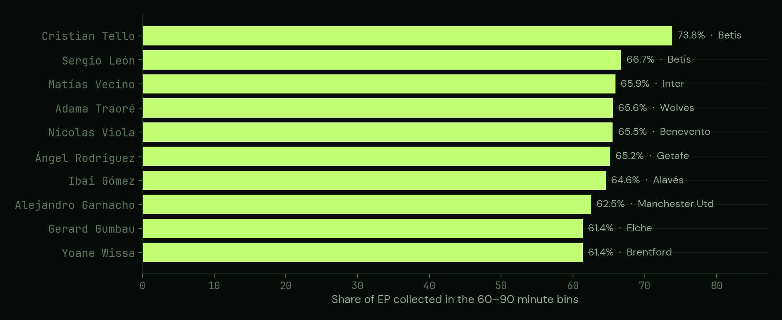
Q3 · LATE-GAME SPECIALISTS
The late-game substantives
Top 10 by late share, ≥ 30 three-layer credits (super-subs filtered out). Includes all six leagues. Tello takes 73.8% of his value after the 60th minute.
renball
08 / 15

Slide 9
Q5 · POSITION-ADJUSTED
Position-adjusted · outfield only
POSITION
#1 PICK
EP/90
MINUTES
CREDITS
Defender
Samuel Iling-Junior
0.785
1,128
11
Midfielder
Adem Ljajić
0.845
2,185
26
Forward
Lionel Messi
1.141
16,516
356
Top EP/90 per modal position, ≥ 1,000 minutes. GK excluded — a structural blind spot of the framework (top GK ~0.1 EP/90 vs ~1.1 for forwards). De Bruyne is the most-sampled elite pick anywhere here: 14,674 minutes, 206 credits.
renball
09 / 15

Slide 10
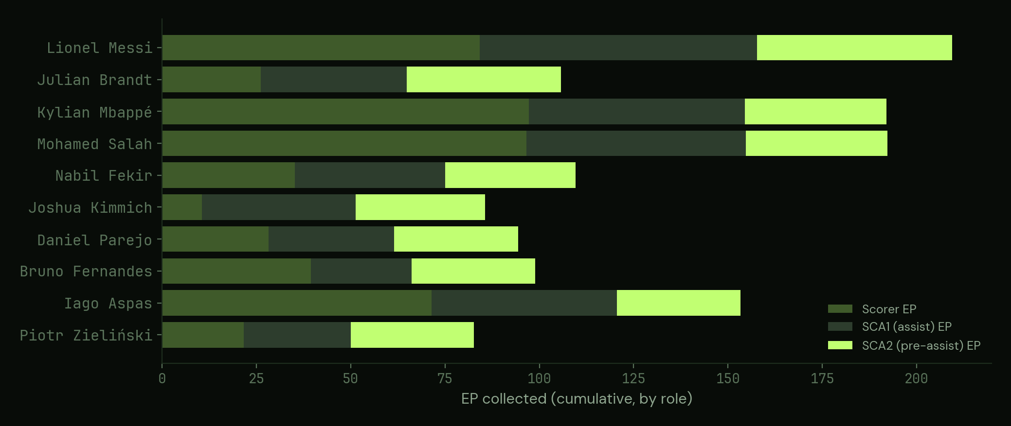
Q6 · MARQUEE FINDING
The Hidden Architects
Top 10 SCA2 EP collectors, stacked by contribution role. Bright accent = the pre-assist layer. One player is structurally different from everyone else.
renball
10 / 15

Slide 11
SPOTLIGHT
What the model exists to find
PRE-ASSIST ARCHITECT
SCA2 SHARE OF TOTAL EP
Julian Brandt
Julian Brandt
38.7%
Borussia Dortmund · MF
Nabil Fekir
31.6%
40.93
Lionel Messi
24.7%
Kylian Mbappé
19.6%
EP COLLECTED FROM SCA2 ALONE
Mohamed Salah
19.5%
Second in Europe only to Messi (51.69). The pre-assist is his single largest contribution layer.
Brandt's profile — 25% scorer / 37% SCA1 / 39% SCA2 — is shared by no pure goalscorer.
renball
11 / 15

Slide 12
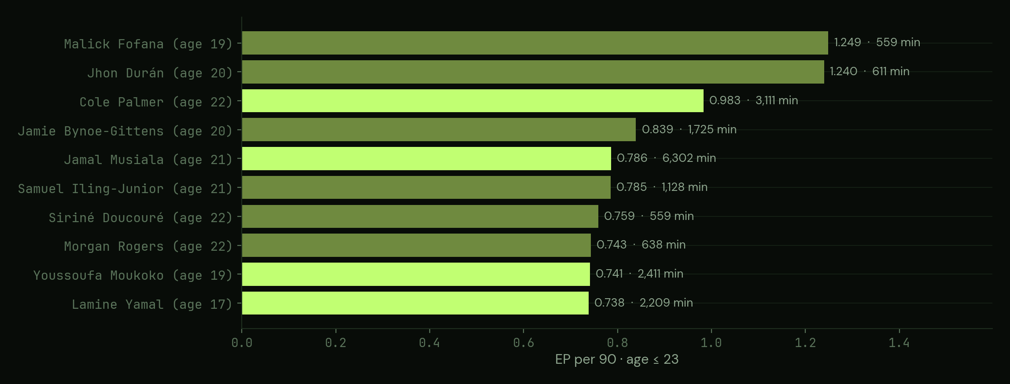
Q7 · UNDER-23 WATCHLIST
Young players to watch
Top 10 EP/90, age ≤ 23, ≥ 500 minutes. Dim bars = under 2,000 minutes (low sample). Yamal sits #10 on 2,209 minutes at age 16.9 — real volume, not a cameo.
renball
12 / 15

Slide 13
IMPLICATIONS
What this changes
—
Contribution is a chain, not a tally. Pricing the pre-assist surfaces value the goal-and-assist box score structurally cannot see.
—
Recruitment: a player like Brandt — whose largest layer is the pass before the pass — is materially mis-valued by conventional output metrics.
—
The ranking is stable. Re-weighting the three layers barely moves the board, so the discoveries beneath the elite are not an artefact of the credit split.
—
The dashboard exposes all seven boards with per-league and per-season drill-down, so any analyst can apply their own thresholds.
renball
13 / 15

Slide 14
LIMITATIONS
What this isn't
—
Not xG-weighted; penalties not separated; own goals missing from the shot data (inherited from project 02).
—
Credit caps at SCA2 — build-up beyond the pre-assist isn't captured.
—
Per-90 boards exclude Eredivisie: the minutes source covers the top five leagues only.
—
No opinion on goalkeepers — the three credited touchpoints are ones GKs rarely occupy.
—
Observational, not causal: EP is the gap between states a goal connects, not its counterfactual effect.
Full discussion: methodology.html · §5
renball
14 / 15

Slide 15
Every player, every league, every season.
Full methodology, source code and data:
renball.com
/PROJECTS/03-TRUE-CONTRIBUTORS/
→ analysis.html editorial write-up · Chart.js + custom SVG visuals
→ dashboard.html interactive Tabulator dashboard · 7 datasets · drill-down
→ methodology.html three-layer attribution · seven questions · nine limitations
→ code/build.py Python pipeline — project 02 framework + SCA2 enrichment
renball

