Slide 1
CS301 - Algorithms
Hüsnü Yenigün

Slide 2
About the course: People
Instructor
  Hüsnü Yenigün
  FENS 2054
  Lectures
    Tuesday 14.40-17.30 – FMAN G060
    Thursday 08.40-11.30 – FENS L063
TAs :
  Atakan Saraçyakupoğlu
  Emine Ayşe Sunar

Slide 3
About the course: Office Hours
Hüsnü Yenigün
  Tuesday 09.40-11.30 Online
Atakan Saraçyakupoğlu
  Monday 13.40-15.30 Online
Emine Ayşe Sunar
  Wednesday 09.40-11.30 Online

Slide 4
About the course: Recitations
Recitations:
  mostly homework / problem solving
  occasionally some new topics are covered
  may not be regular
  will be announced in advance for the weeks we will skip
  (assume that there is a recitation unless it is announced)
Two recitation sections (but, …)
  CS301R-A: Thursday 14.40-16.30 FASS 1102
  CS301R-B: Friday 14.40-16.30 FASS 1102

Slide 5
About the course: Grading
Exams:
  1 Midterm (40%)
    Date: August 03, 2023 (Thursday) @ 08.40-11.30
  1 Final (40%) – MUST SCORE AT LEAST 30
    Date: TBA [ during the finals’ weeks ]
  1 Make-up
    Date: TBA [ after the final exam ]
    Make-up policy
      If you miss exactly one of Midterm or Final, you can take the make-up
      (please send me a copy of your report, official excuse letter)
      If you miss both Midterm and Final, you fail the course
      Make-up grade is considered as the grade of your missing exam
Homeworks ~ 3 (10%)
Project (10%) [ group based, needs analysis, implementation, reporting, etc.]
No end-of-term requests are granted

Slide 6
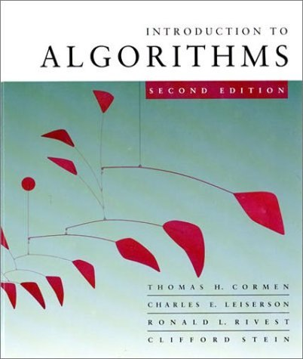
About the course: Textbook
Course material
  Textbook (CLRS)
    Thomas H. Cormen,
    Charles E. Leiserson,
    Ronald L. Rivest,
    Clifford Stein:
    Introduction to Algorithms.
    MIT Press 2009,
    ISBN 978-0-262-03384-8, pp. I-XIX, 1-1292
  Lecture slides (available on SUCourse)

Slide 7
About the course: Motivation
Very basic and intellectually enlightening course
Get to know some common computational problems and their existing solutions
Get familiar with algorithm design techniques
(that will help you come up with algorithms on your own)
Get familiar with algorithm analysis techniques
(that will help you analyze algorithms to pick the most suitable algorithm)
Computers are not infinitely fast and memory is finite
Get familiar with typical problems and learn the bounds of power of algorithms (undecidability and NP-completeness)

Slide 8
About the course: Tentative Outline
Introduction
Asymptotic Notation
Divide and Conquer Paradigm
Recurrences
Solving Recurrences
Quicksort
Sorting in linear time
Medians and order statistics
Binary search trees
Red-Black trees
Augmenting data structures
Dynamic programming
Greedy algorithms
Amortized Analysis
Graph algorithms
Sorting Networks
Computational Geometry
Undecidability
NP-Completeness
Practical Evaluation of Algorithms

