Slide 1
CS301 - Algorithms
Hüsnü Yenigün

Slide 2
RANDOMIZED ALGORITHMS

Slide 3
Recall “The Selection Problem”
Definition: Given a set of n numbers,
i^{th} (1 ≤ i ≤ n) order statistics of the set of numbers
is the i^{th} smallest number in the set.
The selection problem:
Given n numbers and another number i (1 ≤ i ≤ n), find the i^{th} order statistics.

Slide 4
Pseudo code for Partition
It was based on the “Partition” algorithm:
Partition(A,p,r) {
z=A[r]; // picks the last element as the pivot (could be smthg else)
i=p-1; // the index of the last number seen which is ≤z
for (j=p; j <r; j++) { // go over every element (except pivot itself)
if (A[j] ≤z) { // whenever we see a number ≤z
i++; // update i and
swap(A[i],A[j]); // move the number to the front
}
}
swap(A[i+1],A[r]); // move to the pivot right next to the last seen
return(i+1); // smaller number, and return the index of the
} // pivot

Slide 5
Pseudo code for Selection algorithm
Select (A, first, last, i) {
// find i^{th} order statistics between first and last indices given
if (first == last)
return A[first]; // i=1 in this case
mid = Partition(A, first, last);
mid_and_less = mid – first + 1;
if (mid_and_less == i) // we may be lucky
return A[mid];
if (i < mid_and_less) // it is in the left subarray
return (Select(A, first, mid-1, i));
// it is in the right subarray
return (Select(A, mid+1, last, i-mid_and_less));
}
≤ x
x ≤
x
first
mid
last

Slide 6
Running time for the algorithm Select
The running time for Partition is O(n)
In the worst case, Partition step will always generate:
Hence, T(n)=T(n-1)+O(n)=O(n²)
< x
x <
x
or
x
mid
mid

Slide 7
Randomized Select
Shuffle the elements of the input, the last element (which we use as pivot for partitioning) is a random element.
However, this is equivalent to picking a random element as the pivot.
random shuffling:
a random index

Slide 8
Pseudo code for Randomized Select
RandomizedSelect (A, first, last, i) {
if (first == last)
return A[first]; // i=1 in this case
random_index = random(first, last); // returns a number first ≤ … ≤ last
swap(A[random_index], A[last]);
mid = Partition(A, first, last );
mid_and_less = mid – first + 1;
if (mid_and_less == i) // we may be lucky
return A[mid];
if (i < mid_and_less) // it is in the left subarray
return (Select(A, first, mid-1, i));
return (Select(A, mid+1, last, i-mid_and_less));
}

Slide 9
Analysis of Randomized Select
Note that we can still be extremely unlucky, and partition around the largest or smallest element in the subarray.
Hence, there is no change in the worst case behavior. It is still O(n²)
However, let’s have a look at the expected running time.
We have the following cases as the outcome of the partitioning step:

Slide 10
Analysis of Randomized Select
Suppose that, we always get unlucky, and recurse into the subarray that has greater number of elements.
The expected running time can be calculated as:

Slide 11
Analysis of Randomized Select
Consider the elements in the summation:
Hence the summation is equivalent to:
=
=
each term appears twice

Slide 12
Analysis of Randomized Select
Let us solve the recurrence by substitution:
Guess: T(n)=O(n)
Verify: Show that T(n) ≤ cn
pick c big enough
to dominate const
factors in O(n)

Slide 13
Analysis of Randomized Select
Therefore, Randomized Select has linear expected time.

Slide 14
A “Randomized Algorithm”
RandomizedSelect (A, first, last, i) {
if (first == last)
return A[first]; // i=1 in this case
random_index = random(first, last); // returns a number first ≤ … ≤ last
swap(A[random_index], A[last]);
mid = Partition(A, first, last );
mid_and_less = mid – first + 1;
if (mid_and_less == i) // we may be lucky
return A[mid];
if (i < mid_and_less) // it is in the left subarray
return (Select(A, first, mid-1, i));
return (Select(A, mid+1, last, i-mid_and_less));
}
makes a random choice

Slide 15
“Deterministic” vs. “Randomized” Algorithms
Deterministic Algorithms
input
ALGORITHM
output
Randomized Algorithms
input
ALGORITHM
output
The behavior of the algorithm
is based on the random data.
random data

Slide 16
“Correct” Randomized Algorithms
RandomizedSelect (A, first, last, i) {
if (first == last)
return A[first]; // i=1 in this case
random_index = random(first, last); // returns a number first ≤ … ≤ last
swap(A[random_index], A[last]);
mid = Partition(A, first, last );
mid_and_less = mid – first + 1;
if (mid_and_less == i) // we may be lucky
return A[mid];
if (i < mid_and_less) // it is in the left subarray
return (Select(A, first, mid-1, i));
return (Select(A, mid+1, last, i-mid_and_less));
}
RandomizedSelect is a
“correct” algorithm.
It always finds
the correct result.
Randomness affects its
expected running time.

Slide 17
“Incorrect” Randomized Algorithms
Consider the following problem:
Given an unsorted array of numbers A[1..n], find an element x in A such that
n/10 ≤ rank(x) ≤ 9n/10
RandomizedApproximateMiddle (A) {
pick an element x of A uniformly at random;
return x;
}
- Runs in constant time
- Finds a correct answer with probability 8/10

Slide 18
“Incorrect” Randomized Algorithms
Consider the following problem:
Given an unsorted array of numbers A[1..n], find an element x in A such that
n/100 ≤ rank(x) ≤ 99n/100
RandomizedApproximateMiddle (A) {
pick an element x of A uniformly at random;
return x;
}
- Runs in constant time
- Finds a correct answer with probability 98/100

Slide 19
Monte Carlo & Las Vegas Algorithms
Monte Carlo Algorithms: Randomized algorithms that run fast and find the correct answer with high probability. (e.g. RandomizedApproximateMiddle algorithm) However, with small probability, they may fail to find the correct answer, or not compute any answer at all.
Las Vegas Algorithms: Randomized algorithms that always find the correct answer and have low expected running time. (e.g. RandomizedSelect algorithm)
Note that, expected running time is an average over all possible sequences of random choices (not over all possible inputs).

Slide 20
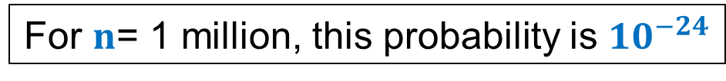

Motivation for Randomized Algorithms
Randomized algorithm for a problem is usually simpler and more efficient than its deterministic counterpart.
Sorting Problem Deterministic Algorithms: Heap sort, Merge Sort
Randomized Las Vegas algorithm: Randomized Quick sort
Randomized Quick sort almost always outperforms heap sort and merge sort.
P[running time of quick sort exceeds twice its expected time] < $n^{−loglog n}$
For $n$= 1 million, this probability is ${10}^{−24}$

Slide 21
Motivation for Randomized Algorithms
Randomized algorithm for a problem is usually simpler and more efficient than its deterministic counterpart.
Smallest Enclosing Circle: Given n points in a plane, compute the smallest radius circle that encloses all n point.
Best deterministic algorithm :
O(n) time complexity, too complex, uses advanced geometry
Randomized Las Vegas algorithm:
Expected O(n) time complexity, very simple, uses elementary geometry

Slide 22

Motivation for Randomized Algorithms
Randomized algorithm for a problem is usually simpler and more efficient than its deterministic counterpart.
Min Cut: Given a connected graph G=(V,E) on n vertices and m edges, compute the smallest set of edges that will make G disconnected.
Best deterministic algorithm :
O(n²m lg (n²/m)) time complexity.
Randomized Monte Carlo algorithm:
O(m log³ n) time complexity.
Error probability: $n^{−c}$ for any $c$ that we desire

Slide 23
Min Cut Problem
Min Cut: Given a connected graph G=(V,E) on n vertices and m edges, compute the smallest set of edges that will make G disconnected.

Slide 24
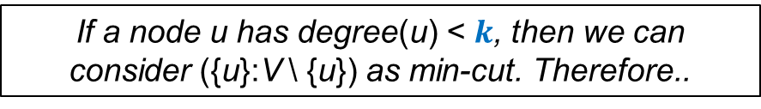
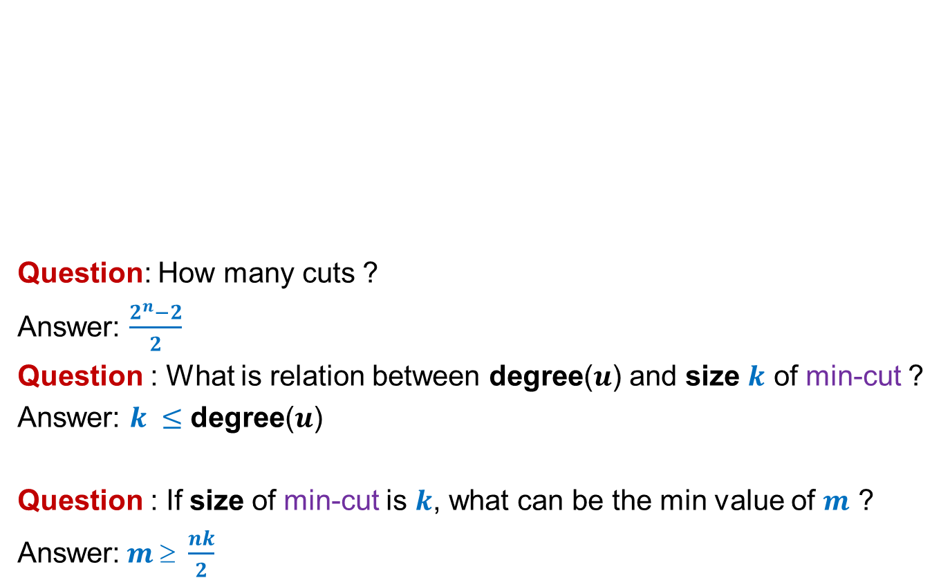
Cuts
Question: How many cuts ?
Answer: $\frac{2^{n}−2}{2}$
Question : What is relation between degree($u$) and size $k$ of min-cut ?
Answer: $k ≤$ degree($u$)
Question : If size of min-cut is $k$, what can be the min value of $m$ ?
Answer:$m \text{≥} \frac{nk}{2}$
A cut is (C : V \ C). Consider every possible non-empty subset C (but once, not twice)
If a node u has degree(u) < $k$, then we can consider ({u}:V \ {u}) as min-cut. Therefore..
Every node u must have degree(u) ≥ k (count every edge once, not twice)

Slide 25









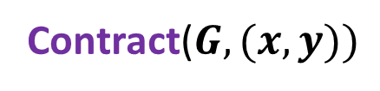









Contracting an edge
Contract($G,e$)
$$u$$
$$x$$
$$a$$
$$l$$
$$v$$
$$y$$
$$b$$
$$h$$
$$w$$
Contract($G,(x,y))$
$$u$$
$$a$$
$$l$$
$$v$$
$$xy$$
$$w$$
$$b$$
$$h$$

Slide 26
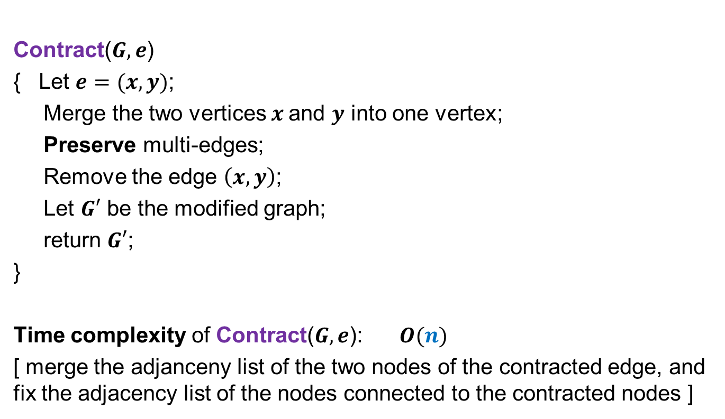

Contracting an edge
Contract($G,e$)
Contract($G,e$)
{ Let $e=(x,y)$;
Merge the two vertices $x$and $y$ into one vertex;
Preserve multi-edges;
Remove the edge $\left(x,y\right)$;
Let $G′$ be the modified graph;
return $G′$;
}
Time complexity of Contract($G,e$): $O(n)$
[ merge the adjanceny list of the two nodes of the contracted edge, and fix the adjacency list of the nodes connected to the contracted nodes ]

Slide 27



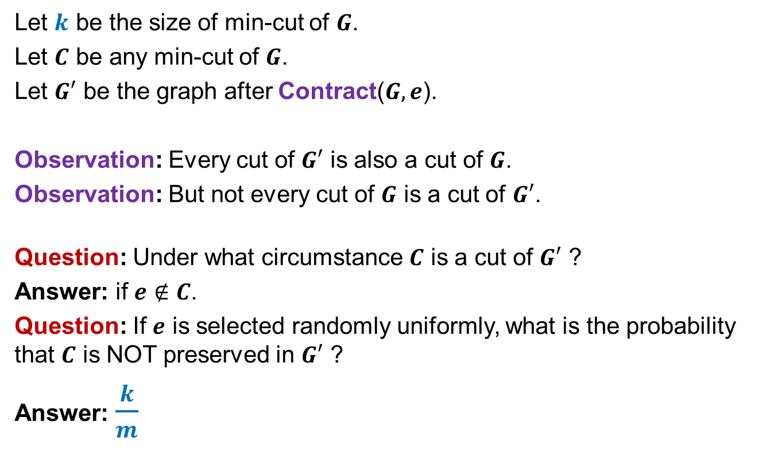





Contracting an edge
$$G:$$
$$x$$
Let $k$ be the size of min-cut of $G$.
Let $C$ be any min-cut of $G$.
Let $G′$ be the graph after Contract($G,e$).
Observation: Every cut of $G′$ is also a cut of $G$.
Observation: But not every cut of $G$ is a cut of $G′$.
Question: Under what circumstance $C$ is a cut of $G′$ ?
Answer: if $e∉C$.
Question: If $e$ is selected randomly uniformly, what is the probability that $C$ is NOT preserved in $G′$ ?
Answer: $\frac{k}{m}$
$$y$$
$$G^{′}:$$
$$xy$$
$$m \text{≥}\frac{nk}{2}$$
$$≤\frac{k}{nk/2}$$
$$=\frac{2}{n}$$
There are m edges in G and there are k edges in C.

Slide 28
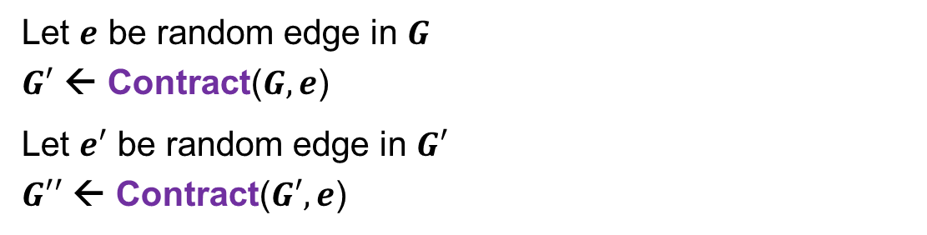
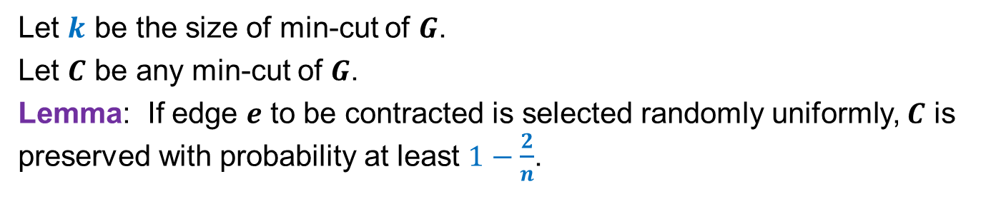
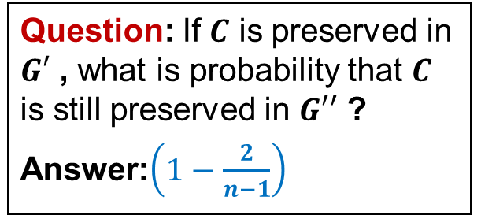
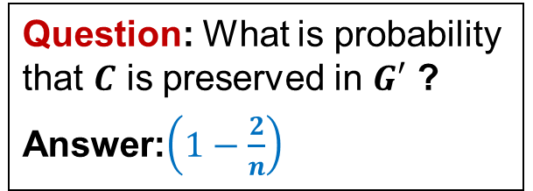
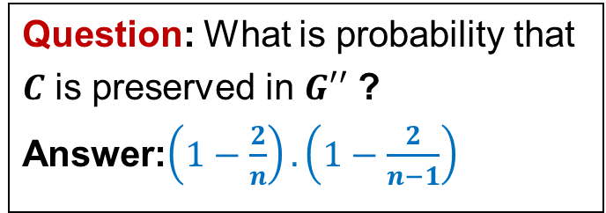
Contracting an edge
Let $k$ be the size of min-cut of $G$.
Let $C$ be any min-cut of $G$.
Lemma: If edge $e$ to be contracted is selected randomly uniformly, $C$ is preserved with probability at least $1−\frac{2}{n}$.
Question: What is probability that $C$ is preserved in $G′$ ?
Answer:$\left(1−\frac{2}{n}\right)$
Let $e$ be random edge in $G$
$G′$ ← Contract($G,e$)
Let $e′$ be random edge in $G′$
$G′′$ ← Contract($G′,e$)
Question: If $C$ is preserved in $G′$ , what is probability that $C$ is still preserved in $G′′$ ?
Answer:$\left(1−\frac{2}{n−1}\right)$
Question: What is probability that
$C$ is preserved in $G′′$ ?
Answer:$\left(1−\frac{2}{n}\right).\left(1−\frac{2}{n−1}\right)$

Slide 29

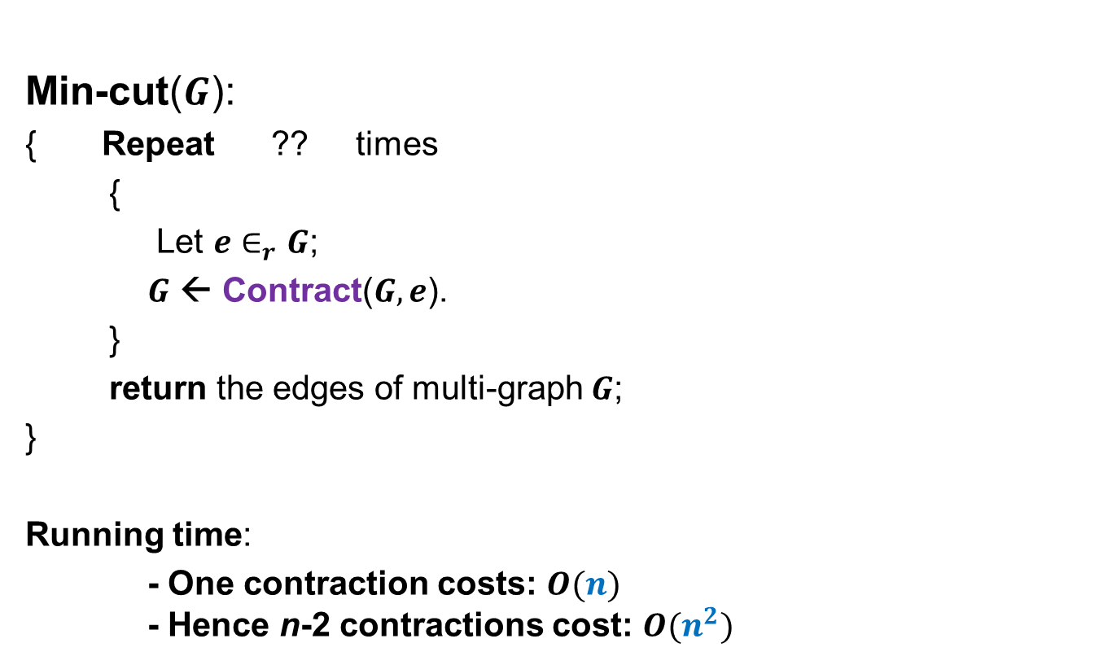
Algorithm for min-cut
The problem is very easy if we have only two vertices.
Min-cut($G$):
{ Repeat ?? times
{
Let $e∈_{r}G$;
$G$ ← Contract($G,e$).
}
return the edges of multi-graph $G$;
}
Running time:
- One contraction costs: $O(n)$ - Hence n-2 contractions cost: $O(n^{2})$
$$n−2$$
So, why not keep contracting the graph until we have only two vertices left.

Slide 30
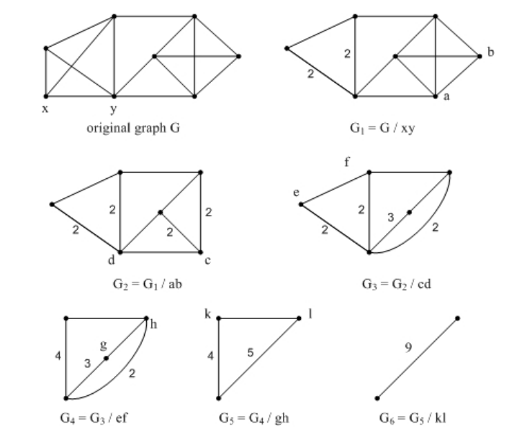
An Example Run

Slide 31
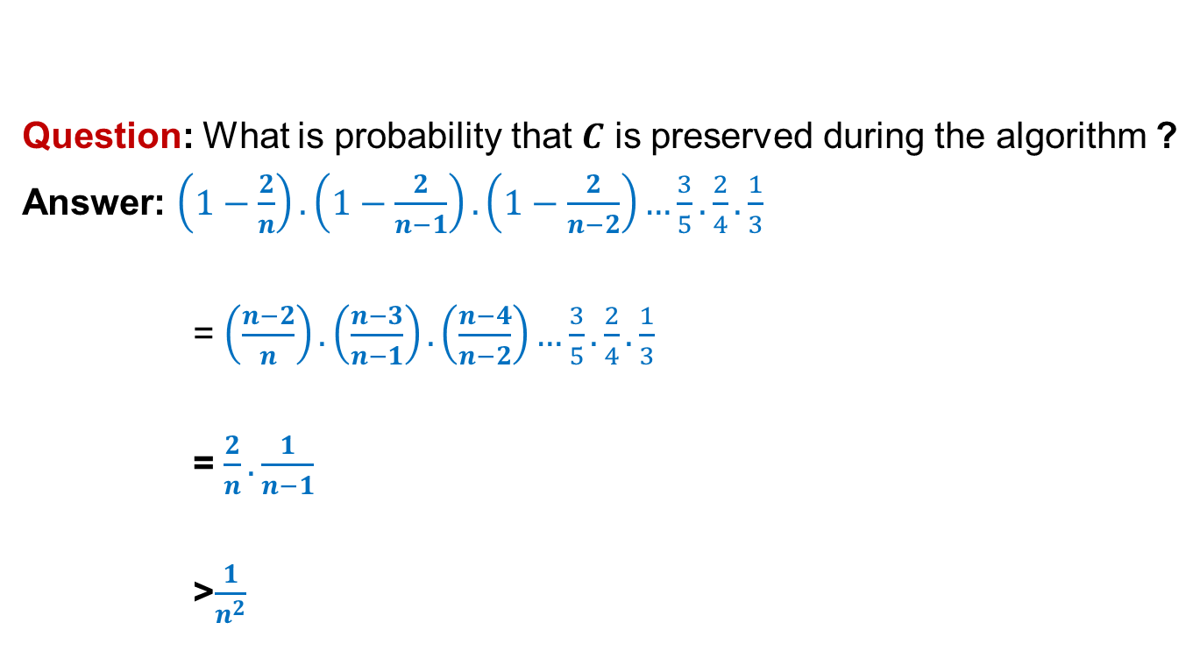
Algorithm for min-cut
Question: What is probability that $C$ is preserved during the algorithm ?
Answer: $\left(1−\frac{2}{n}\right).\left(1−\frac{2}{n−1}\right).\left(1−\frac{2}{n−2}\right)…\frac{3}{5}.\frac{2}{4}.\frac{1}{3}$
= $\left(\frac{n−2}{n}\right).\left(\frac{n−3}{n−1}\right).\left(\frac{n−4}{n−2}\right)…\frac{3}{5}.\frac{2}{4}.\frac{1}{3}$
= $\frac{2}{n}.\frac{1}{n−1}$
>$\frac{1}{n^{2}}$

Slide 32
Algorithm for min-cut
Result:
- Min-Cut(G) finds the min-cut of G with probability 1/n².
- Equivalently, Min-Cut(G) fails to find the min-cut of G with probability 1 – (1/n²).
Hmm:
- If we have a graph with 1000 nodes, Min-Cut(G) finds the min-cut with probability 1/1.000.000 !!!
- Equivalently, if we have a graph with 1000 nodes, Min-Cut(G) fails to find the min-cut with probability 999.999/1.000.000 !!!
Not impressive at all….
But, wait. We can play the trick of
“PROBABILITY AMPLIFICATION”

Slide 33
Amplification for min-cut
A wrapper algorithm for Min-Cut(G):
Min-Cut-High-Probability(G) {
- Run Min-Cut(G) M times.
- Output the smallest cut found in these M runs.
} Note that, all runs are independent.
Pr[all M runs of Min-Cut(G) fails] =
Pr[1st run of Min-Cut(G) fails] ×
Pr[2nd run of Min-Cut(G) fails] ×
…
Pr[Mth run of Min-Cut(G) fails]
Failure probability in 1 run: 1 – (1/n²) Failure probability in M runs: (1 – (1/n²))^{M} ≤ e^{– (M/(n×n))}
(1+x) ≤ e^{x}

Slide 34
Amplification for min-cut
Min-Cut-High-Probability(G) fails to find min-cut with probability
e^{– (M/(n×n))}
For M = cn² ln n ➔ e^{– (M/(n×n))} = e^{– (c × n × n × ln n/(n×n))} = e^{– (c × ln n)} = 1/n^{c}
Note that, we can pick c as we wish, and therefore make the probability of failing as small as we wish.

