Slide 1
Real Estate Price Class Estimation
Machine Learning In Finance – Group 1
Alexander Beck | Joel Blank | Pascal Müntener | Arthur Pavlics | Kenan Öztürk
16.04.2023

Slide 2
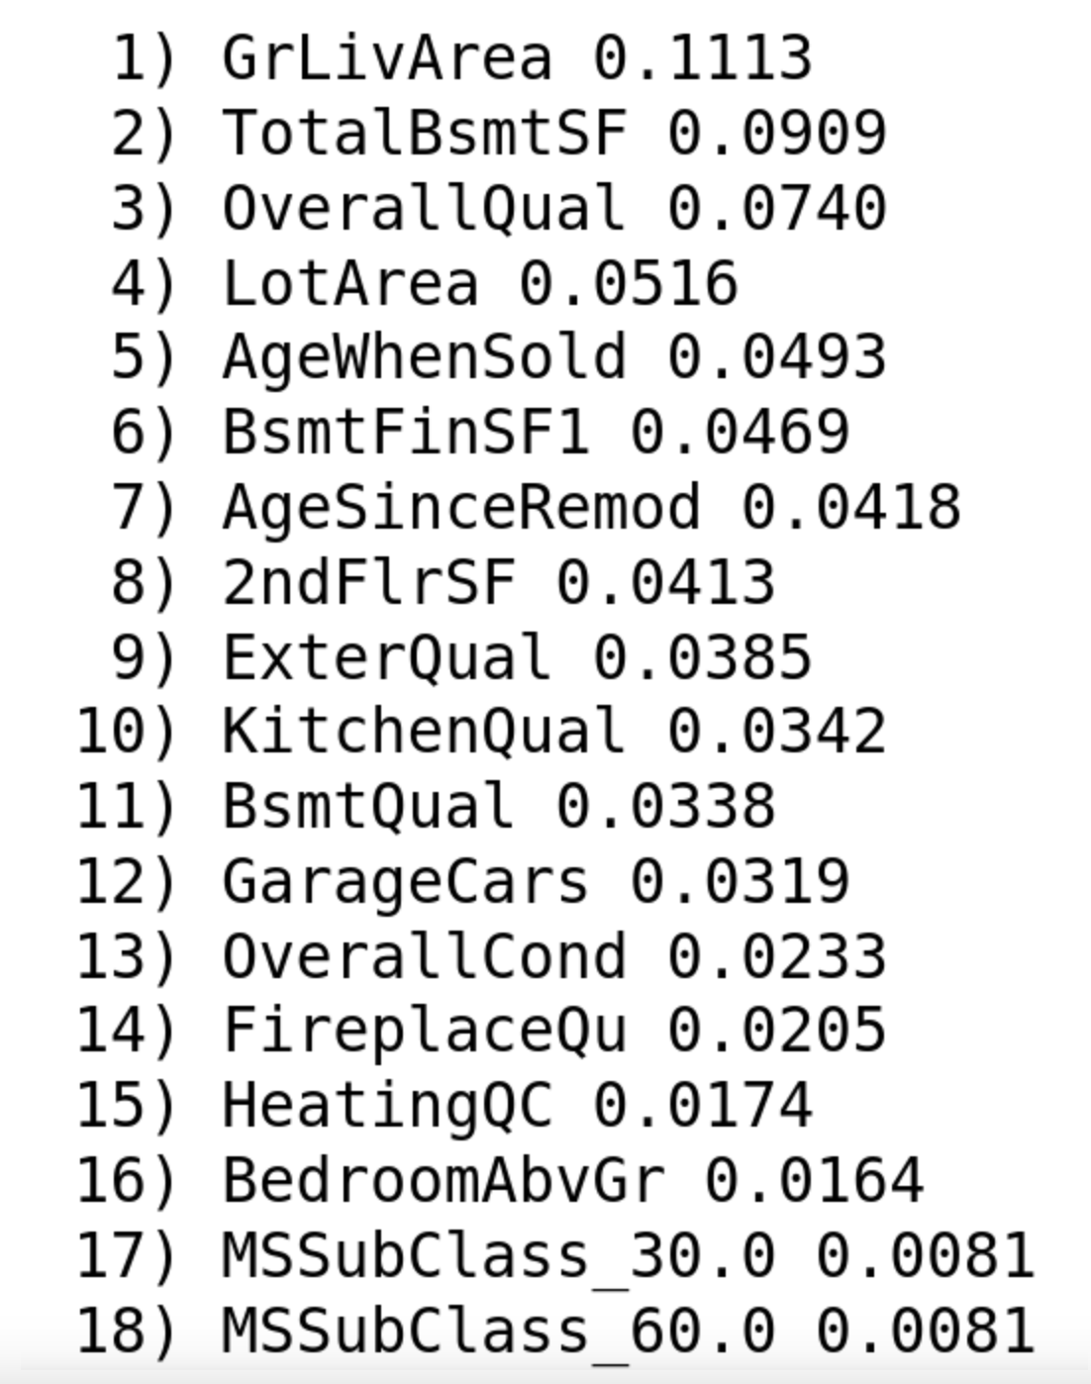
Handling
The Data
Features
Feature selection
Make composite features
Dummies categorical features
Scale all numericals
Convert strings to numbers
NAN Values
No «real» NaN values
16.04.2023
Image 1

Slide 3
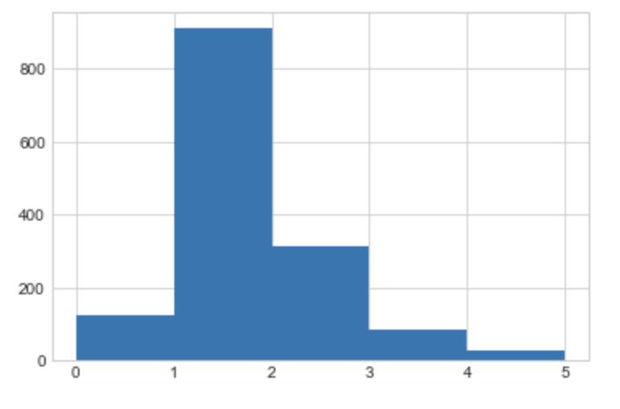
Wirtschaftswissenschaftliche Fakultät der Universität Zürich
Data Imbalance
Problem
Big imbalance
Solution
Fuse class 4 and 5
Upsampling
Downsampling
Tomek Links
Image 2
16.04.2023

Slide 4
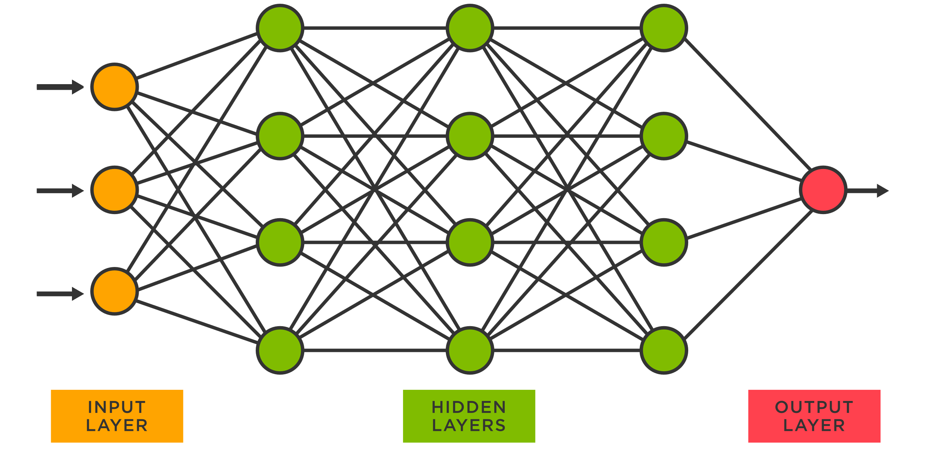
Neural Net
Powerful tool, but not enough data
Accuracy: 78.2%
16.04.2023
Image 3

Slide 5
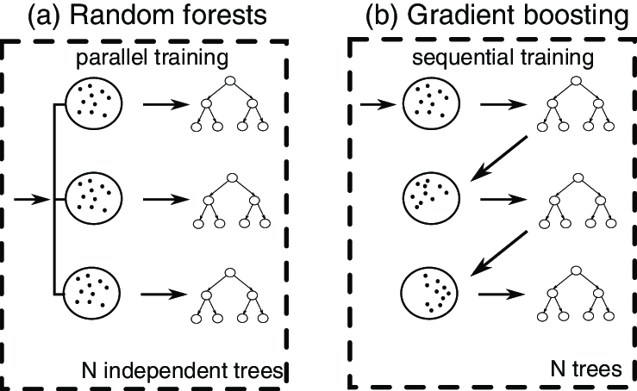
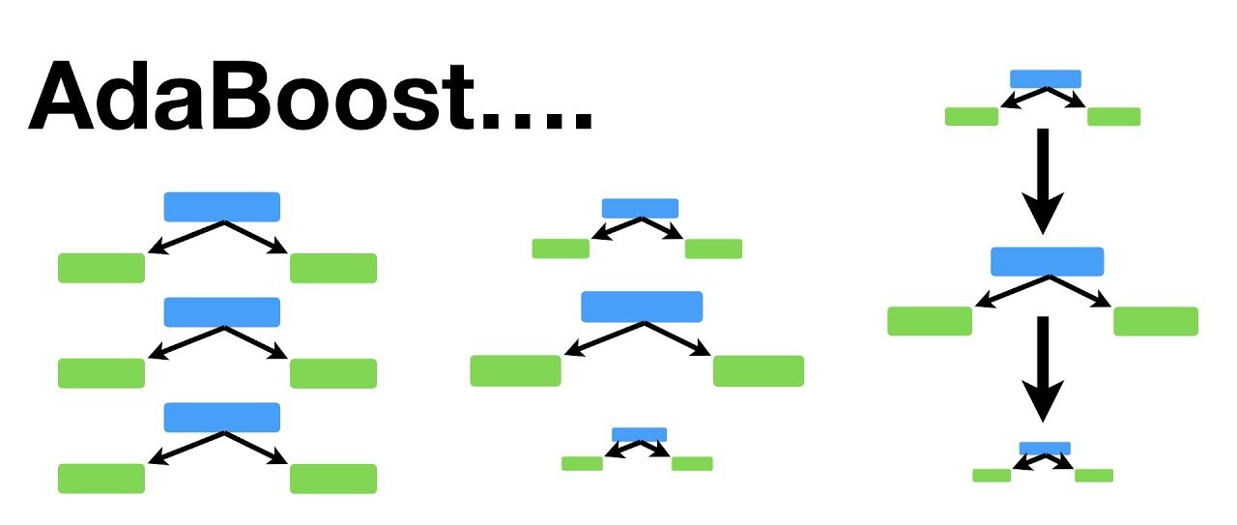
Boosted Random Forest
Best performing
Accuracy AdaBoost: 86%
Accuracy Gradient Boost: 88.7%
16.04.2023
Image: 4, 5

Slide 6
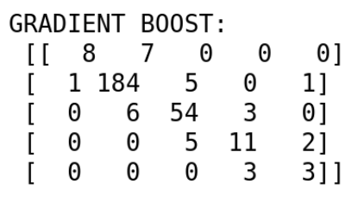
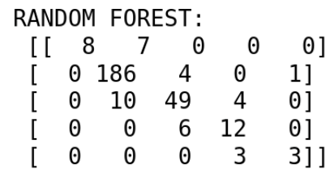
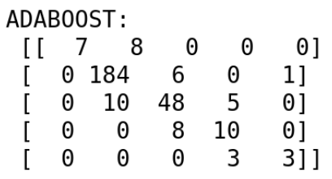
Model Comparison
01
Wirtschaftswissenschaftliche Fakultät der Universität Zürich
02
03
Gradient Boost
Random Forest
AdaBoost
Accuracy: 88.7%
F1 Score: 0.88
Accuracy: 88.1%
F1 Score: 0.88
Accuracy: 86%
F1 Score: 0.85
Images 6,7,8

Slide 7
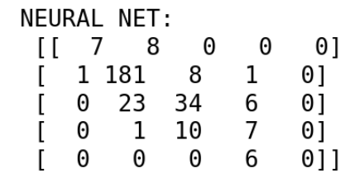
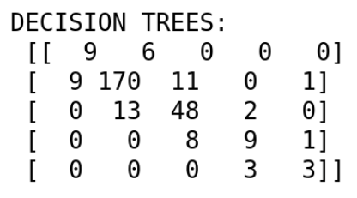
Model Comparison
01
Wirtschaftswissenschaftliche Fakultät der Universität Zürich
02
03
Decision Trees
Neural Net
Minimal Working Example
Accuracy: 81.6%
F1 Score: 0.82
Accuracy: 78.2%
F1 Score: 0.77
Accuracy Rand. Forest
82%
Images 9, 10

Slide 8
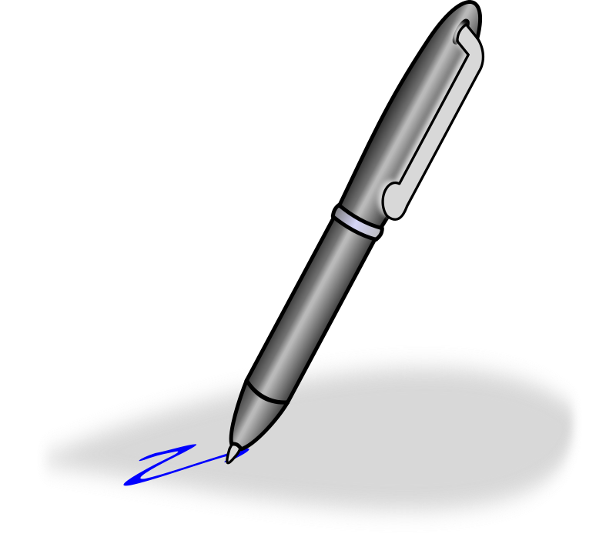
Conclusion
Wirtschaftswissenschaftliche Fakultät der Universität Zürich
Baseline to beat: 62.33% (always guess most common class)
All models beat this comfortably
NNs may not be the best tool for this specific task
-> Hyperparameteroptimization
16.04.2023
Image 11

Slide 9
BIBLIOGRAPHICAL REFERENCES
References
Beck, A., Blank, J., Müntener, P., Pavlics, A. & Öztürk, K. (2023)
Jupyter Notebooks – ML GROUP PROJECT.
Schmitt, T. (2019). house_prices [Datensatz]. OpenML.
https://www.openml.org/search?type=data&sort=runs&id=42165&status=active
Zimmermann, B. (2023). Jupyter Notebooks – Group Project:
Minimal Working Expamle.
16.04.2023

Slide 10
Images
Image 1,6,7,8,9,10: Beck, A., Blank, J., Müntener, P., Pavlics, A. & Öztürk, K. (2023) Jupyter
Notebooks – ML GROUP PROJECT.
Image 2: Zimmermann, B. (2023). Jupyter Notebooks – Group Project: Minimal Working
Expamle.
Image 3: TIBCO Software. (o. J.). What is a Neural Network?. Abgerufen am 14. April 2023
von https://www.tibco.com/reference-center/what-is-a-neural-network
Image 4: ResearchGate. (o.J.). FIG. 1. Comparison between (a) random forest and (b)
gradient boosting.... Abgerufen am 14. April 2023 von
Image 5: StatQuest with Josh Starmer. (2019). AdaBoost, Clearly Explained. Abgerufen am
14. April 2023 von https://www.youtube.com/watch?v=LsK-xG1cLYA
Image 11: Clipartix. (o. J.). Ballpoint pen clipart free clipart images. Abgerufen am 14. April
2023 von https://clipartix.com/pen-clipart-image-22207/
Slides: Slidesgo. (o. J.). The Evolution of Invention in Canada Thesis. Abgerufen am 14.
April 2023 von https://slidesgo.com/theme/the-evolution-of-invention-in-canada-thesis#search-tech&position-34&results-354&rs=search
16.04.2023

