Slide 1
HealthConnect Clinic
Data Analytics — Final Report & Decision Support
AnalystLab Africa Experience Lab | Weeks 4–8 | #AnalystLabAfrica
Improving Patient Appointment Attendance Using Data and AI

Slide 2
The Problem
HealthConnect Clinic loses nearly half its scheduled appointments to no-shows — wasting capacity, disrupting care, and increasing administrative burden.
48.46%
Central project question:
“How can HealthConnect Clinic use data and AI to reduce missed appointments and improve the patient support experience?”
of all 5,000 appointments
end in a No-Show
1,696 unique patients • 18 variables • Jan 2025 – Jun 2026

Slide 3
Our Approach: Weeks 4–7
4
5
6
7
Problem Understanding
Analysis & KPIs
Validation & Integration
Testing & Refinement
Reviewed the dataset & data dictionary; defined 5 business questions and 5 candidate KPIs.
Cleaned the data, ran full EDA, calculated all KPIs, built an initial dashboard.
Chi-square tested top findings, found a compounding risk segment, exported validated features to Data Science.
Re-tested every Week 6 claim, caught and corrected a real error, validated the cross-track export with a live model comparison.

Slide 4
Key Finding: Booking Lead Time
The single strongest, statistically validated driver of no-shows (Cramer's V = 0.184, p < 0.001)
What this means
No-show rate more than doubles as booking lead time grows — from 28% (booked within a week) to over 60% (booked 31-60 days out).
Recommendation: add a mid-point reminder — not just a day-before one — for any appointment booked more than 14 days in advance.

Slide 5
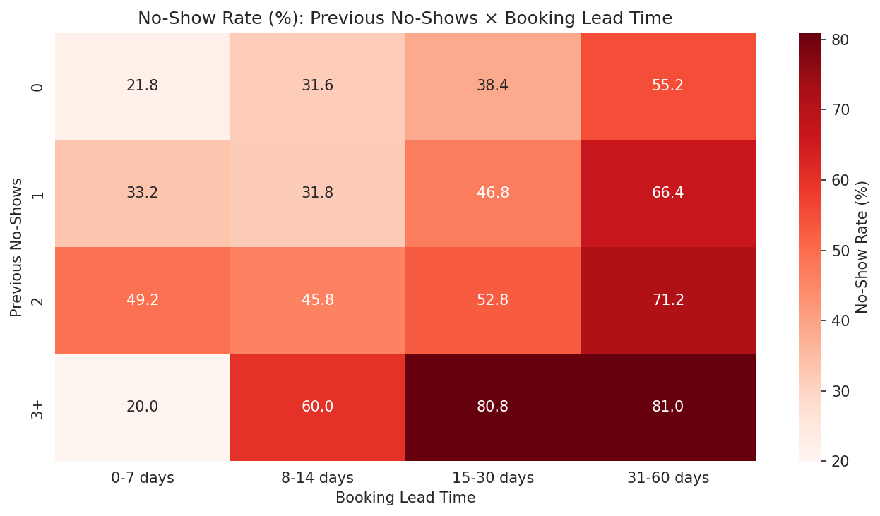
Key Finding: Prior No-Shows Compound With Lead Time
Patients with a history of no-shows AND a long lead time show the highest risk in the dataset
New in Week 6: the compounding effect wasn't visible when either factor was studied alone.

Slide 6
Testing Is Part of the Deliverable
Week 7 didn't just repeat Week 6 — it re-tested every claim, and found a real error
✓
✗
✓
Claimed (Week 6)
Tested (Week 7)
Corrected & Re-exported
“All four tested variables are statistically significant.”
Re-ran the chi-square test on appointment_type: p = 0.104 — not significant.
Claim fixed, dashboard rebuilt, and a corrected feature file re-issued to Data Science.

Slide 7
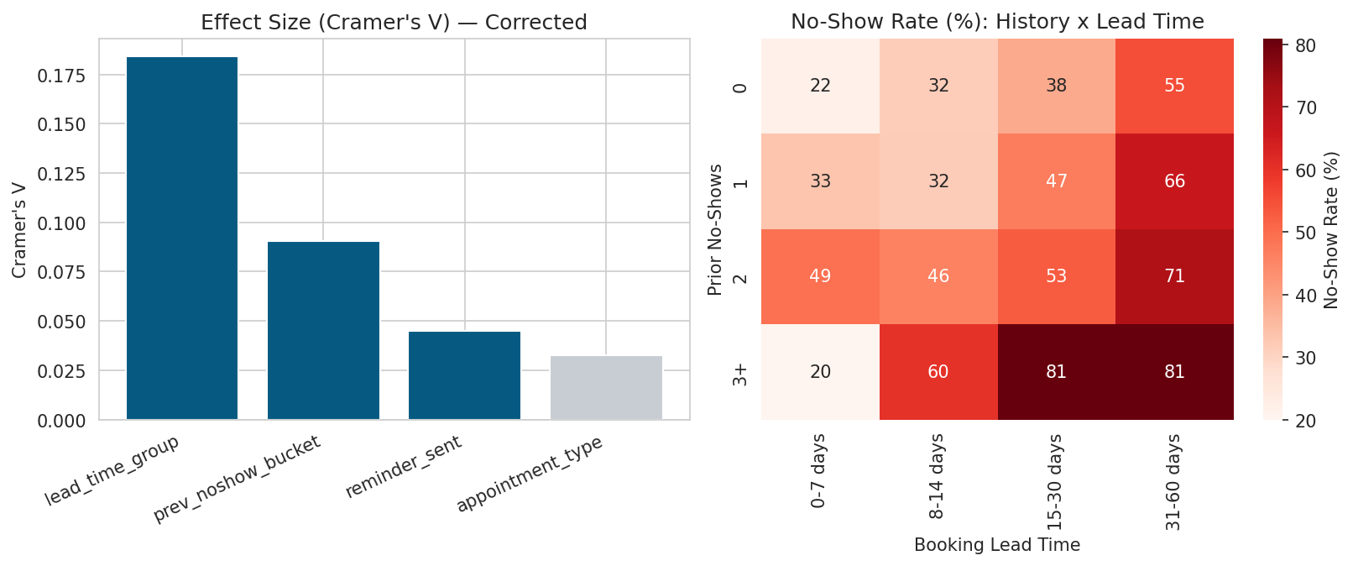
Final Validated Dashboard
Corrected for the Week 7 appointment_type finding — grey bars are not statistically significant

Slide 8
Recommendations for HealthConnect
1
Lead-time-aware reminders
2
Flag the double-risk segment
Add a mid-point reminder for appointments booked 14+ days out — targets the single largest validated driver.
Patients with 3+ prior no-shows AND long lead times should get phone confirmation, not SMS.
3
Close the reminder gap
4
Deprioritise waiting time
Only 72.7% of appointments get a reminder at all — fixing this is low-cost and immediate.
Confirmed twice (Week 5 & 7) as not a meaningful driver — don't spend resources here.

Slide 9
Cross-Track Contribution: Data Science
PROVIDED
TESTED
VALIDATED
A statistically validated, ranked feature list — chi-square tests, effect sizes, and logistic regression coefficients for every candidate feature.
Trained a top-3-feature model vs. a full 5-feature model on an identical train/test split to check if the ranking actually holds predictive value.
ROC-AUC: 0.662 (top-3) vs 0.662 (all 5)
A leaner model loses zero predictive power.

Slide 10
Business Value & Limitations
Business Value
Limitations
• Two concrete, low-cost interventions ready to pilot immediately
• All findings are associational, not yet causal
• A validated, evidence-backed feature set ready for predictive modelling
• Smallest interaction segment (n=15) needs more data
• A repeatable testing framework other tracks can reuse
• Fictional dataset — needs validation on real clinic data
Thank you
HealthConnect Clinic Experience Lab | Data Analytics Track | AnalystLab Africa | #AnalystLabAfrica

