Slide 1
Senior Project Review
Brandon Essary, Sunya Chay, William Flores

Slide 2
Roles and responsibilities
Responsibilities
All members are responsible to commutate with each other. The best teams will fail if there is poor or no commutation.
When presenting a roadblock team members should present options to get past the problem or be open to solicitation form other teammates.
Any team member should be ready to fill the role of another if that person is unavailable .
Roles
Brandon Essary (Team lead) Brandon is responsible for contact with the customer and setting up meetings. Research and coding.
Sunya Chay (Team member) Research, coding and web design.
William Flores (Team member) Research, ADA requirements, coding.

Slide 3
Introductions
Team Introductions
Project name: kofc-wa.org website update
Project client: Dr. Olwell- Knights of Columbus Washington state council

Slide 4
Purpose of the project
The purpose of this project is to update the current Knights of Columbus Washington website to provide the client and end user a secure website that is sleek and easy to use. With this project we will provide a website that is easy to navigate for both the end user and the website administrator. The end state for this project is for the elected members to be able to communicate in mass with current and future members about past, current and future events in real time.

Slide 5
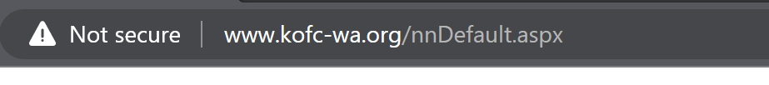
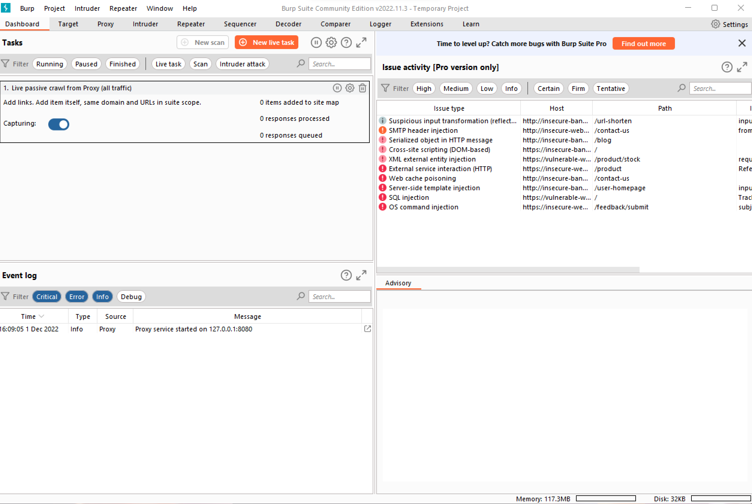
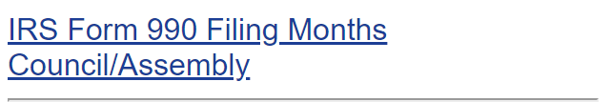
Current state of http://www.kofc-wa.org/
The current site is not secure.
The site is does have personal identifiable information leaks in more than one location.
The site is not used to pass information, not updated or used to full potential.
The current site is prime to hackers via SQL injection (Burp Suite) or other means.

Slide 6
Current Schedule
Date | Event | Notes
February 17th, 2023 | Poster 1 Due
February 20th, 2023 | Front end completed | Homepage with links to other pages
February 27th, 2023 | Login pages completed | Encrypt login pages to ensure security
March 13th, 2023 | Static Pages Complete | Get static pages encrypted
March 16th, 2023 | Security completed | Making sure that the website is secure. Following OWASP.org “Top 10 Security Risks”
March 20th, 2023 | Meeting with Members to approve the website | Ensuring that the client approves of the website and other feedback from the board
March 27th, 2023 | Finalize prototype and set up in host system | Placing prototype into server like AWS or Azure
March 30th , 2023 | Launch Prototype and Finish and Record Presentation | Make sure that Client likes the prototype and hand it over to them
April 6th, 2023 | Submit Presentation and All Links
Post-Schedule
After EAB Presentation
Date | Event | Notes
April 26th, 2023 | Final meeting with Dr. Olwell | Make sure that everything looks good so we can hand it off to the next group
April 28th 2023 | Meeting with Tim | Get access to database from original website builder
May 2nd 2023 | Start writing documentation for handoff
May 2nd 2023 | Final presentation to the class
May 5th 2023 | Finish documentation for handoff | Tie up any loose ends, ensure that we have all of the documentation ready for handoff

Slide 7
Technical/qualitative project constraints
Access to data restricted to members only.
ADA requirements for websites. Our goal for the new website is to be compliant to the checklist level AA at the time of development.
Having to learn webhost control panel to maximize website for the end user.
If decided not to start with a webhost, ensuring that current prototype can be passed to and from team members so as the project is moving forward.
Meeting with the board: With meeting with the board, there was one vision for the new site and what we currently have as our prototype.
Fully working navigation bar: some features are not working.

Slide 8
Risk
Cost: Website hosting is currently covered by overall budget. There is no risk with running over budget.
Schedule: Currently the team is on schedule, with a few exception as outlined in the schedule the team has met with Knights of Columbus state board only once. With only meeting with the board, it was difficult to get the information that we needed for items like the database or how the website was hosted before we started the project.
Compliances: Using best practices for securing the website will come from coding the website and encrypting the database based on OWASP.org principles on securing a website. At the prototype phase the site will follow ADA requirements level AA.
Site performance: The current site is hosted on good webhost site however our goal is to move to webhost that will provide overall better performance and security. We have decided to go with AWSLightsail.
Additional requirements: As the project moves forward, add functions will slow production. Cutting functions based on level of priority for the website.
Current AWS server is not fast enough. This means that the budget for the website could change if the current server is not fast enough.

Slide 9
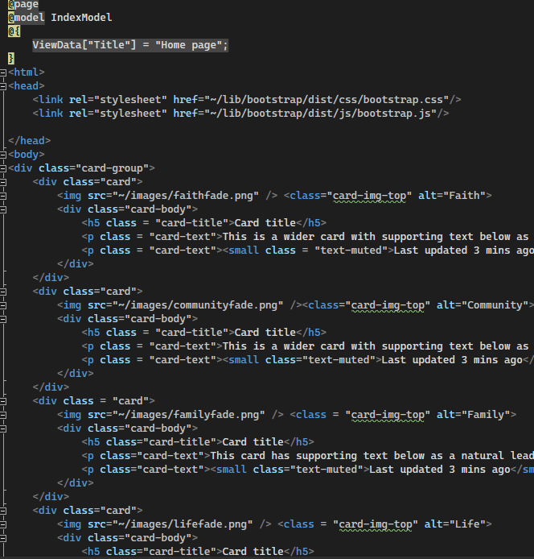
Implementation
Using both Visual Studio and Visual Studio Code to create the prototype of the website.
Having to work with bootstrap5 for the website.
Using ASP.Net MVC to code our website.
Using languages such as JavaScript, HTML, and css.

Slide 10
Security
Ensuring the website is encrypted.
Using OWASP.org “Top 10 Web Application Security Risks” to make sure that we are following all of the security protocols for the website.
Encrypting the database.
Our webhost, AWSLightsail has its own built-in security certificate.

Slide 11
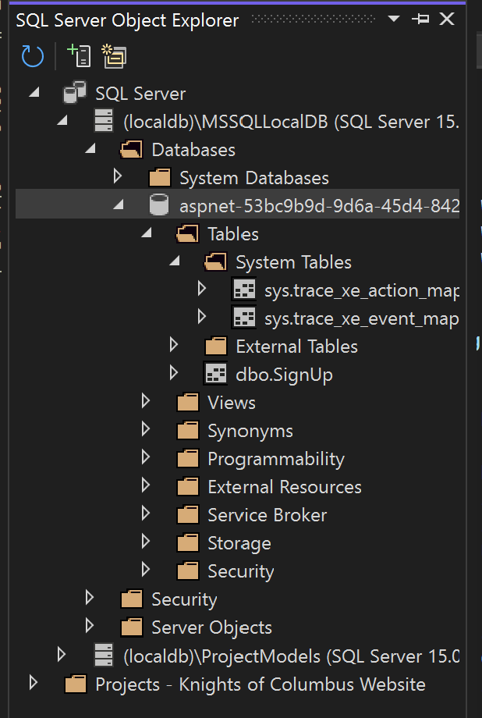
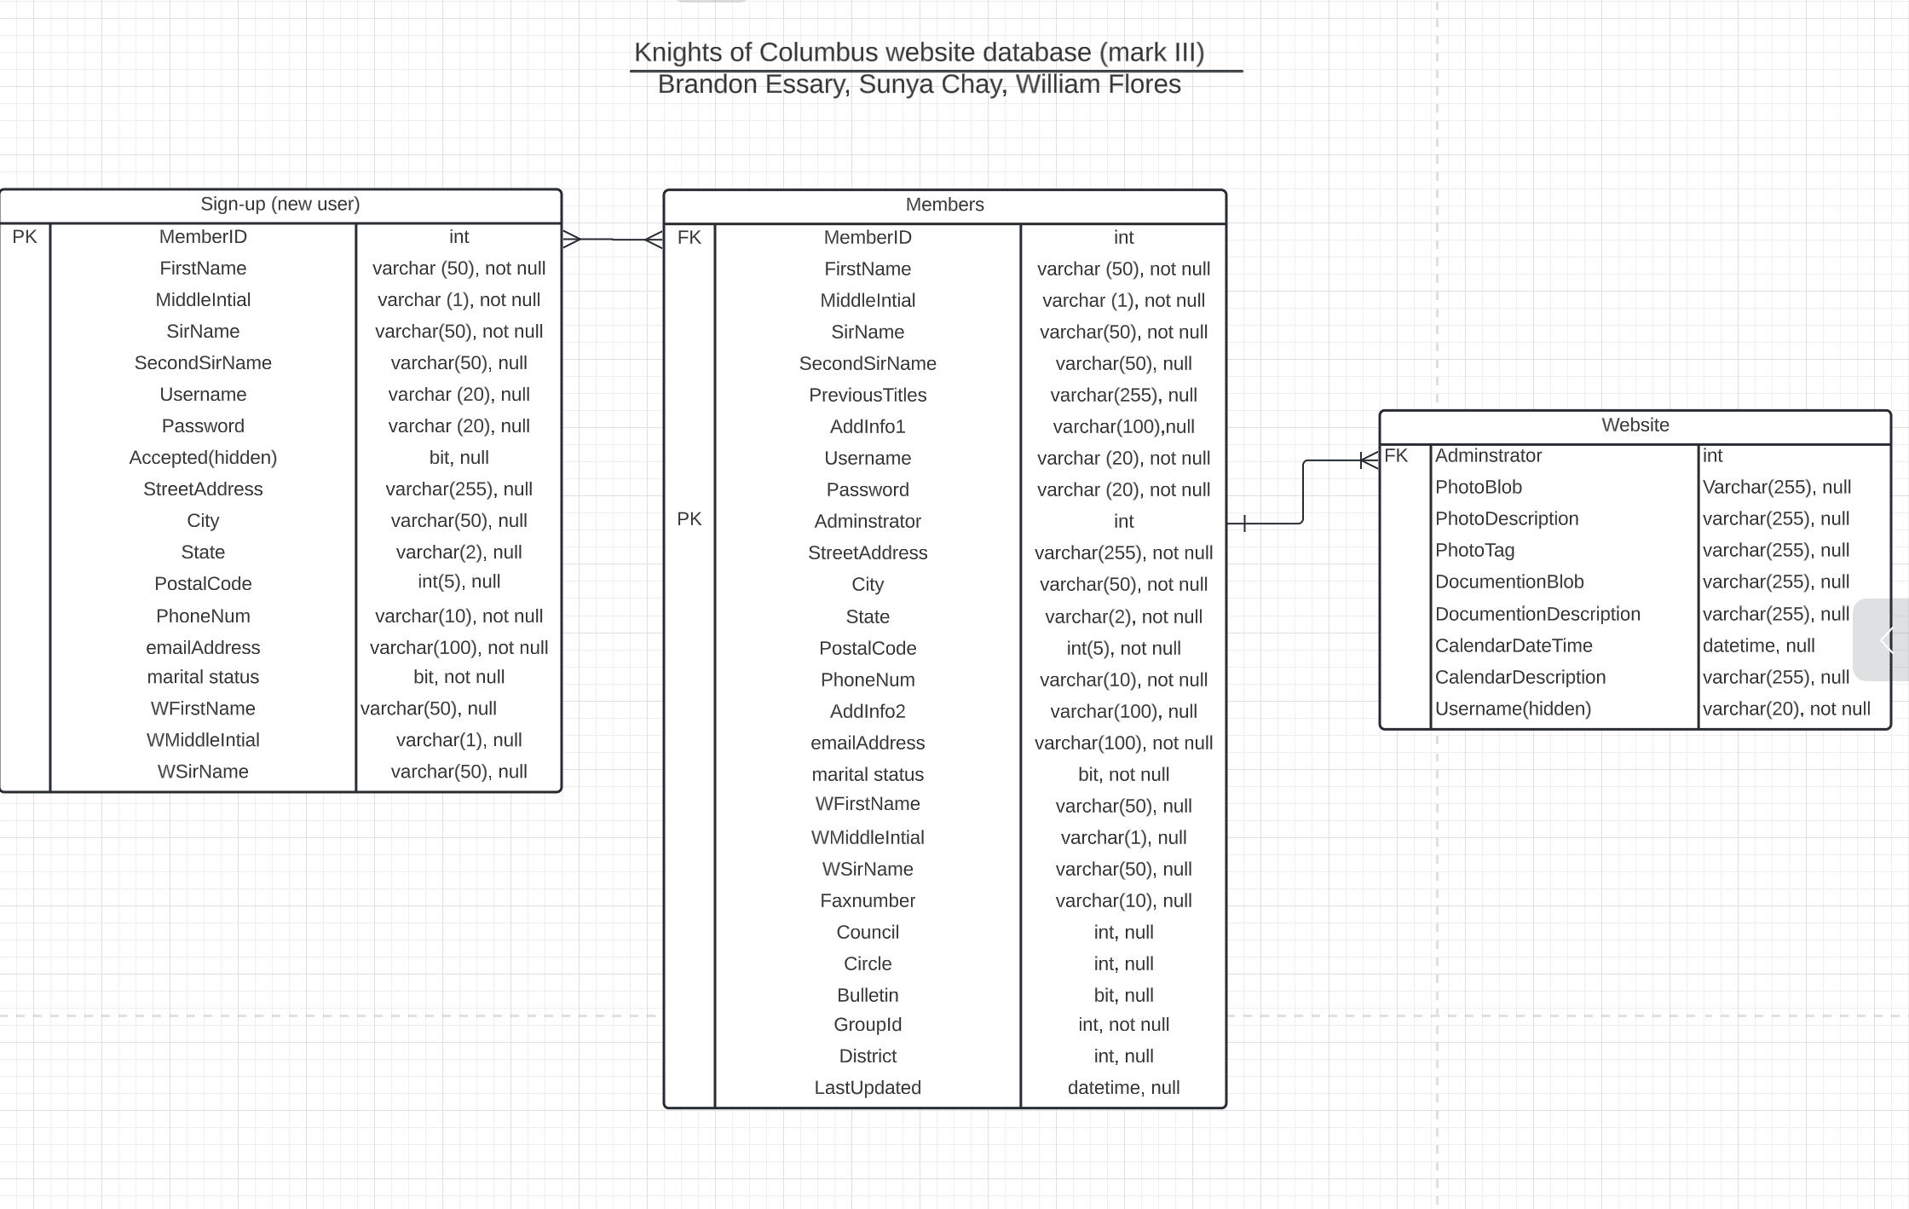
Database
We created our database using SQL Server.
Our database will be encrypted, as well as a simpler version compared to the older one.
Our current database manager is Marcus. However, once we hand it off to the client, it will be the Web Master to maintain the database.
Calendar database appears on the website, working on ensuring that the dates can be filterable and viewable

Slide 12
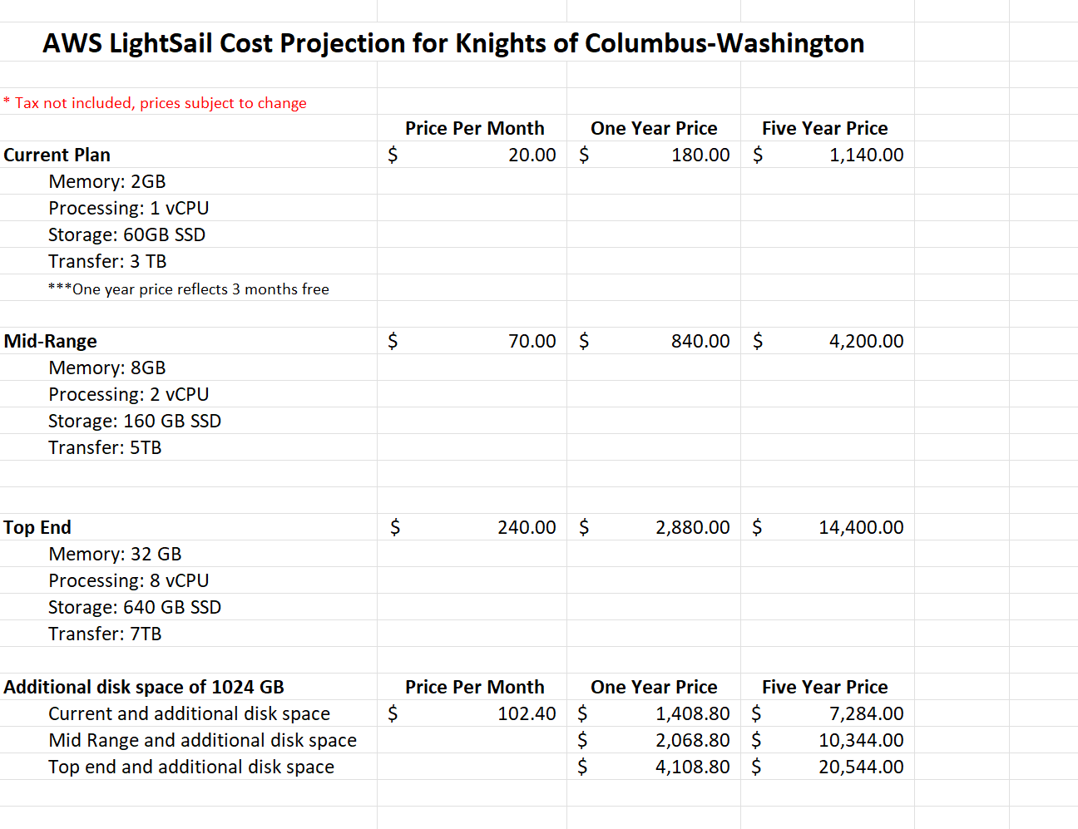
Current Budget
We are currently in budget.
Our biggest cost is the host website. The client wishes to use AWSLightsail.
Client is looking to see if they want to go with 1TB of storage or stick with the current plan of 2GB. Both of which are different price points.
Compared to the other hosting sites that we were looking at, AWS was the better deal than the others.

Slide 13
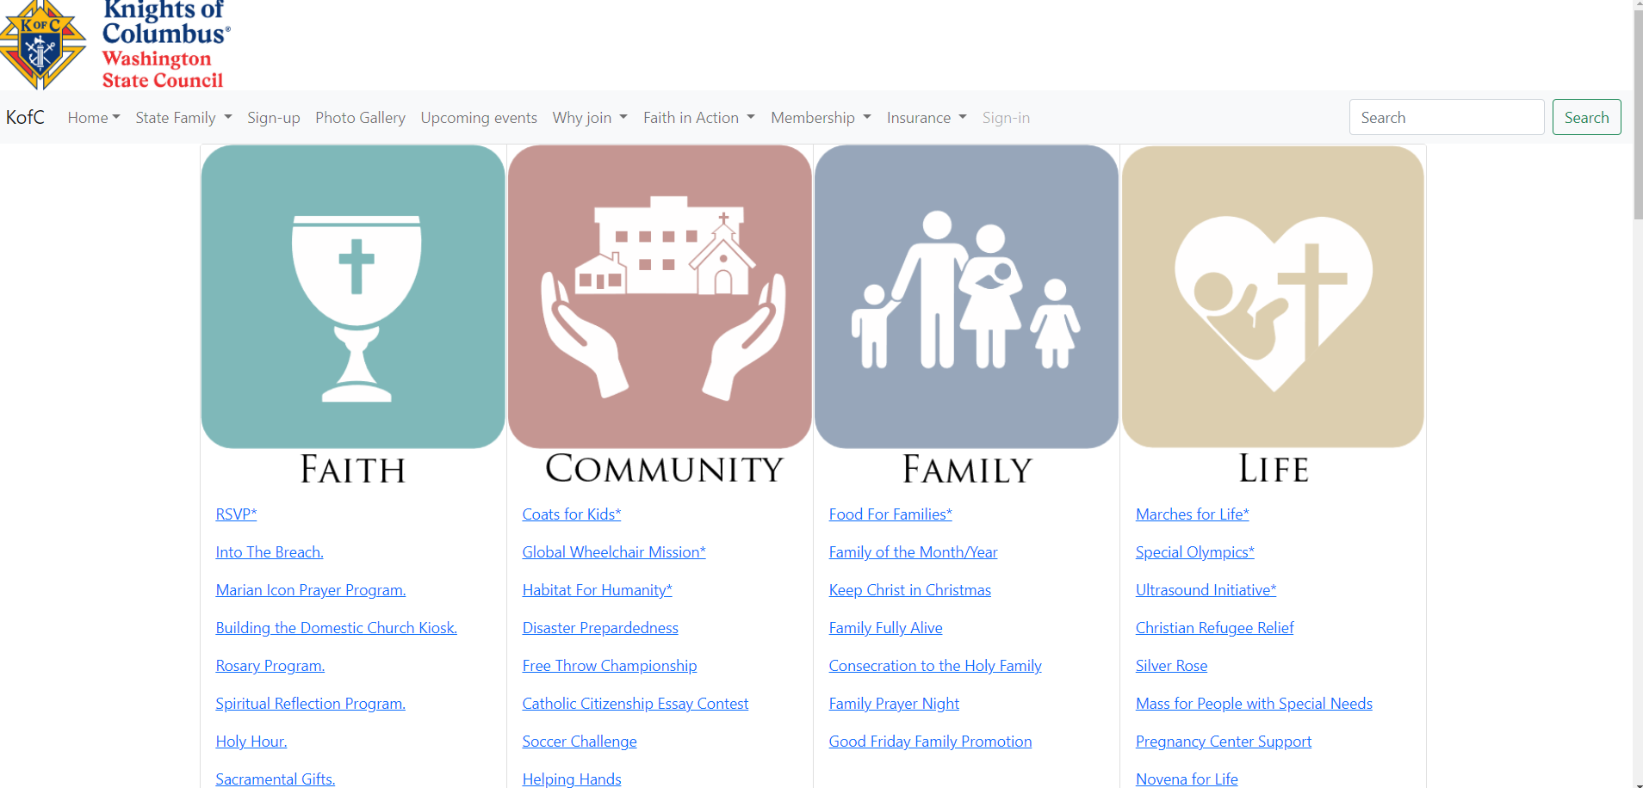
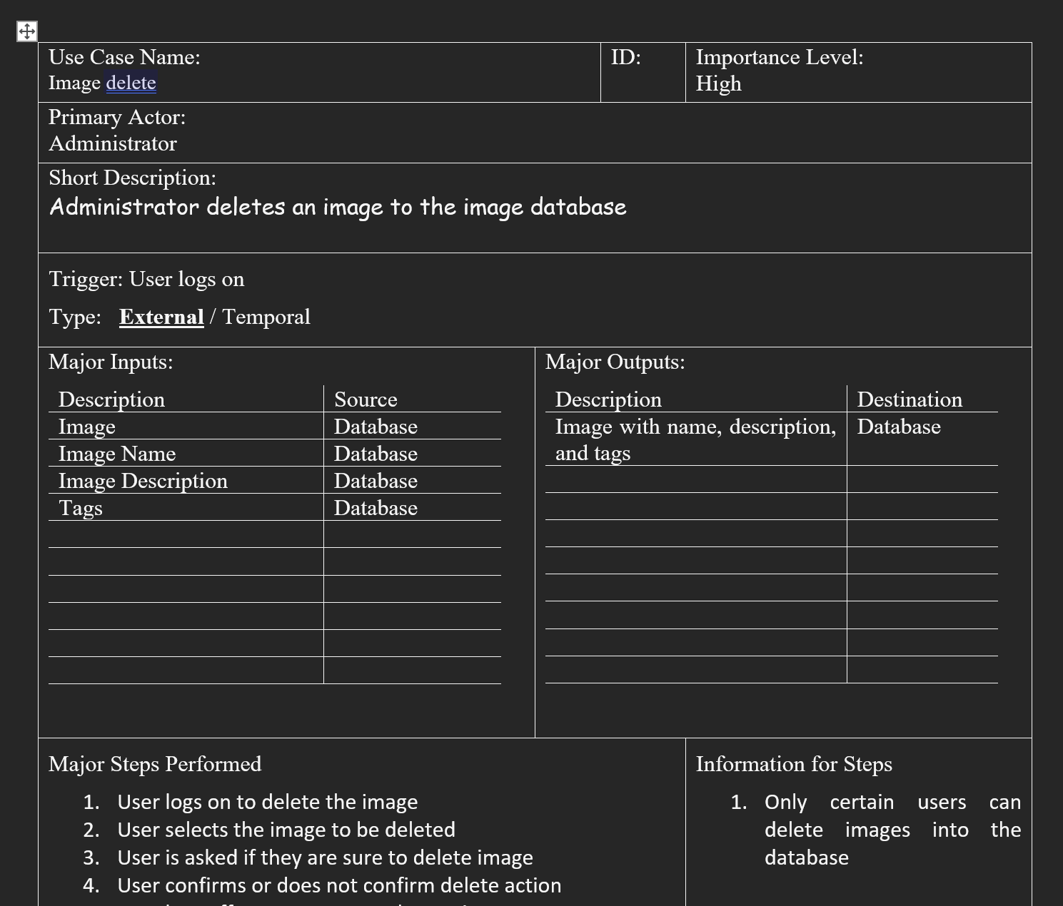
Progress
Use cases for document repository, calendar of events, and photo gallery (search, upload, and delete).
Homepage, and other pages are nearing completion.
Database being connected to the website.
Creating a working calendar database that is filterable

Slide 14
Next Steps
Project is nearing completion. The client will want to use the website when it is finished. Projected finish date: June 2023
As we did not finish the project, we will either hand it off to the next group; we will continue to work on it in the summer as needed.
If our project isn’t complete, the client may also look at another solution to complete the website.
Creating a user manual to give to the Web Master when we hand off the project.
Handing over the project to the Knights of Columbus. Making sure that there is proper documentation to ensure that someone else can maintain and work on what we have already done.
Creating a timeline when the project will go live with the board.

