Slide 1

October 17, 2026
Will these ideas make Stories money?
We tested each one 20,000 times with a simulation
EECE 490 · Stories Coffee Hackathon
Notes:
This deck covers one thing: the simulation we used to test our ideas, what it found, and what we recommend.

Slide 2

EECE 490 · Stories Coffee Hackathon
ⓒ All rights reserved. American University of Beirut 2026.
We don’t know the exact numbers
Every idea depends on things nobody can measure in advance
?
?
?
How many staff work the early hour?
If we open later, do those customers come back?
What will electricity cost next month?
We only know: Somewhere between 1 and 2
We only know: Probably 20–60% of them
We only know: Between $0.45 and $0.59 per kWh
So we don’t guess once. We guess 20,000 times.
Notes:
These are the kinds of unknowns behind every idea. We know a sensible range for each, but not the exact value.

Slide 3
EECE 490 · Stories Coffee Hackathon
ⓒ All rights reserved. American University of Beirut 2026.
How the simulation works
Like rolling dice, over and over
1
2
3
4
Roll the dice
Do the math
Write it down
Repeat 20,000 times
Pick one value for each unknown from its range
In that version of the future, did the idea make or lose money?
Keep the answer
Every roll is a different, believable future
Then count. If 15,000 of the 20,000 rolls made money, we say “75% chance it pays”, just like a weather forecast says “75% chance of rain”.
Notes:
The computer does this 20,000 times in about a second. The result is not one guess but a picture of all the believable outcomes.

Slide 4
EECE 490 · Stories Coffee Hackathon
ⓒ All rights reserved. American University of Beirut 2026.
One roll, step by step
Example: open Uptown at 8:00 instead of 7:00
+$5.00
saved each hour in wages and power
The dice say…
2 staff work that hour
−$2.60
profit lost each hour from the 60% who don’t come back
= +$2.40
better off, every hour we stay closed
40% of those customers come back later
Electricity costs $0.50 per kWh
About +$430 over six months. Write it down, then roll again with new dice.
Notes:
Wages: 2 staff × $2.60 an hour × 70% of the hour actually removed from the roster = $3.64. Power: 3 kWh, mostly from the generator at $0.50 = $1.36. Uptown earns $4.37 of profit in that hour; 60% of it is lost = $2.62. $2.38 a day over 182 days is about $430.

Slide 5
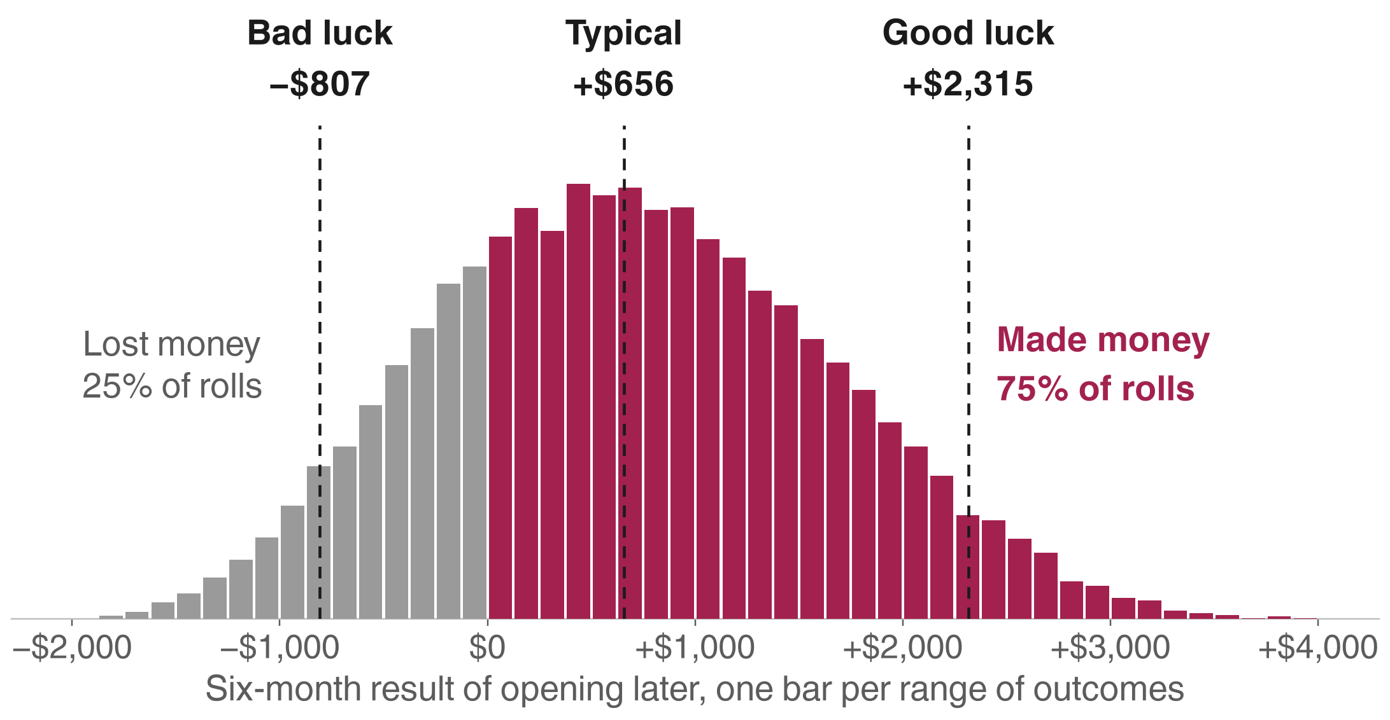
EECE 490 · Stories Coffee Hackathon
ⓒ All rights reserved. American University of Beirut 2026.
20,000 rolls later
Opening Uptown and Garden later in the morning: every outcome at once
75%
of the rolls made money
+$656
typical result over six months, across the three early hours
Notes:
Each bar counts how many of the 20,000 rolls landed at that amount. Bad luck (1 roll in 20) loses −$807; good luck (1 in 20) gains $2,315.

Slide 6
EECE 490 · Stories Coffee Hackathon
ⓒ All rights reserved. American University of Beirut 2026.
What the simulation found
Five ideas, tested the same way
Open Uptown and Garden later in the morning
75%
chance it pays
Probably worth it, if two people really work that early hour
Raise all prices 5%
$7,300
typical, per six months
Very likely to pay, unless customers are more price-sensitive than we think. Test first
Raise prices but keep coffee the same
88%
of rolls it does worse
Our earlier idea. Raising everything does better
Lock in a fixed matcha price
$1,200
what it’s worth, per six months
Pay a supplier less than that to guarantee price and supply
Harbour: round prices down to $X.95 or up to $X.25?
61% vs 39%
down vs up
Basically a coin flip, so test both
Notes:
All money figures are gross profit over six months, typical (middle) result of 20,000 rolls.

Slide 7
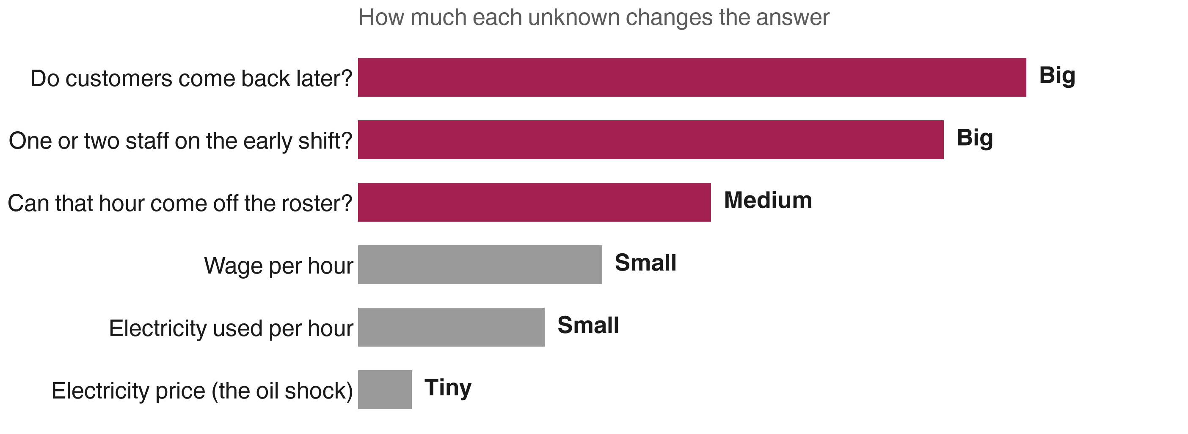
EECE 490 · Stories Coffee Hackathon
ⓒ All rights reserved. American University of Beirut 2026.
What matters most
For opening later: people, not power
Check first
Is the early shift really two people, and can that hour come off the roster?
Don’t worry about
The oil shock. The electricity price barely changes the answer.
Notes:
The simulation also tells us which unknown moves the answer most, so we know what to check before acting.

Slide 8
EECE 490 · Stories Coffee Hackathon
ⓒ All rights reserved. American University of Beirut 2026.
What we recommend
Small tests first, then roll out what works
Typical value, 6 months
1
Open Uptown at 9:00 and Garden at 8:00 for four weeks, after checking the early-shift roster
$656
2
Raise all prices 5% at one branch for four weeks; stop if sales fall more than 8%
$7,300
3
Include coffee in the rise. Don’t freeze it
avoids losing $1,200
4
Lock a 6–12-month matcha price if the extra cost is under $1,200 per six months
$1,200
5
At Harbour, try $X.95 and $X.25 prices in alternating weeks for 8 weeks; keep the winner
$418–$585
Notes:
Each recommendation starts as a small test so real results, not our guesses, decide whether to roll it out.

Slide 9
EECE 490 · Stories Coffee Hackathon
ⓒ All rights reserved. American University of Beirut 2026.
What it can and can’t do
Honest limits of the simulation
It can
It can’t
Show how much our uncertainty matters
Prove our ranges are right
Tell us which unknown to check first
Predict exactly what will happen
Rank ideas by how likely they are to pay
Replace a real test in a branch
That’s why every recommendation starts as a four-week test at one branch.
Notes:
If one of our ranges is wrong, the answer can be wrong. The simulation shows where that matters; the tests settle it.

Slide 10

Thank you
Notes:
Questions. Full detail: reports/monte_carlo.md and the full deck, Stories_Outside_In_Deck.pptx.

