Slide 1

October 17, 2026
What the till can’t tell you
Stories Coffee, H1 2026: five outside-in causal chains, stress-tested with a 20,000-draw Monte Carlo
EECE 490 · Stories Coffee Hackathon
Notes:
We read the transaction file against what actually happened in Lebanon between January and June 2026: a war, an oil shock, 20% inflation and a matcha shortage. Five chains of cause come out of that, and we stress-tested each decision with a Monte Carlo.

Slide 2

EECE 490 · Stories Coffee Hackathon
ⓒ All rights reserved. American University of Beirut 2026.
The short version
Five chains of cause, each ending in a decision
+4%
75%
$6.4k
+80%
11 items
The war is missing
Early hours
Frozen costs
Rationed matcha
Price endings
The till shows no break at 2 March; the restaurant sector fell 85%. Reconcile the till before trusting its +57% growth.
Chance that opening Uptown at 09:00 and Garden at 08:00 pays. Staffing decides it more than energy does.
Median GP overstated in Mar–Jun because no unit cost moved in 181 days. Refresh costs monthly; test +5%.
Matcha leaf at auction, against −16% for arabica. Lock matcha supply; run the attachment pilot on coffee.
Harbour’s × 1.05 formula puts them a few cents past a dollar. Test $N.95 against $N.25.
Chains 2–5 hold even if the file is simulated: they rest on the menu, the recorded costs and Lebanon’s real 2026 prices, not on the demand figures.
Notes:
One message per chain. The first is about trust in the data; the other four are about money and survive whatever the answer to the first turns out to be.

Slide 3
EECE 490 · Stories Coffee Hackathon
ⓒ All rights reserved. American University of Beirut 2026.
How we built it
Every link in every chain says where it comes from
1
2
3
4
5
Transaction file
44 sourced facts
5 causal chains
Monte Carlo
Field tests
51,177 lines, 33,887 baskets, Jan–Jun 2026, three branches
War timeline, oil, generator tariffs, CPI, commodity prices, a survey of Lebanese firms
Ten links each, every link tagged D, R, I or A
20,000 draws over every assumption; P(pays) and P5–P95
Each action ships with a test design and a stop rule
How to read the chains
D
R
I
A
Measured in the data
Sourced outside fact
Our inference
Assumption
Reproducible: scripts/outside_in_chains.py and scripts/monte_carlo.py rebuild every number from the CSV and data/external/outside_research_2026.csv. 44 automated tests pass.
Notes:
D means we measured it in the file. R means an external, sourced fact. I is our inference, A is an assumption you can change. The Monte Carlo then varies every A at once.

Slide 4
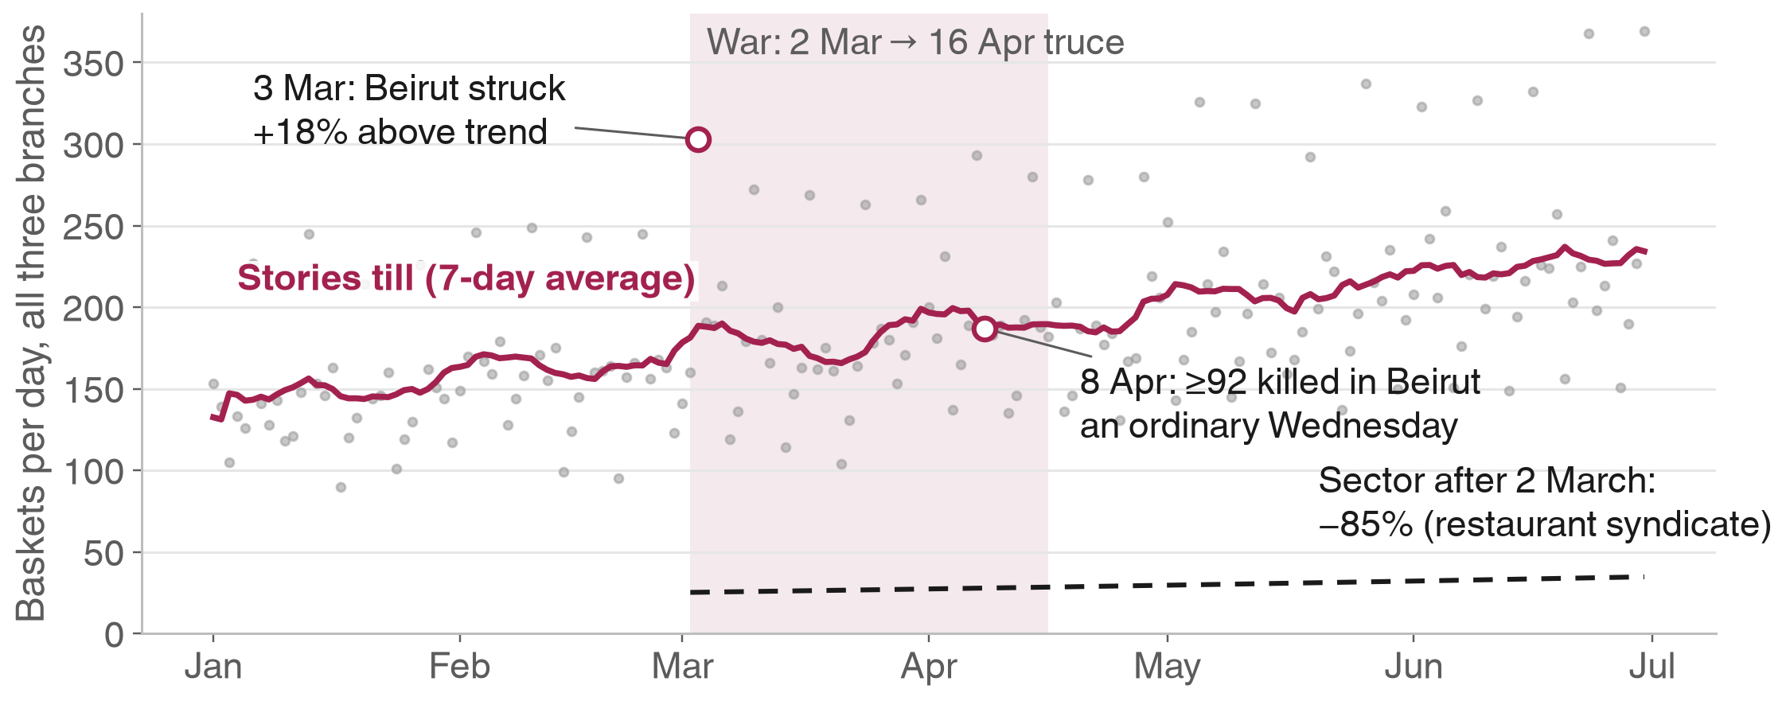
EECE 490 · Stories Coffee Hackathon
ⓒ All rights reserved. American University of Beirut 2026.
The war the till never heard
Lebanon’s restaurant sector fell 85% after 2 March. Stories’ till kept climbing.
R
R
R
R
D
D
D
D
D
I
1. US–Israel strike Iran, 28 Feb
2. War resumes 2 Mar
3. Beirut struck, 1.2M displaced
4. Sector −85%, nightlife “died”
5. Till: +4% step
6. Strike days look normal
7. Evening share flat
8. No burst of new customers
9. Formula fingerprints
10. Growth unusable as is
+4.0%
Step in baskets/day at 2 March (95% CI −2.7% to +11.2%)
−85%
Restaurant sector after 2 March (syndicate, Tony Ramy)
44.5% → 44.5%
Evening share before vs during the war, while “the nightlife sector completely died”
Sources: Wikipedia, Timeline of the 2026 Lebanon war; World Bank Lebanon Economic Monitor (Aug 2026); InfoPro / Leaders Club survey (Jul 2026). Data: stories_transactions.csv.
Notes:
Beirut was struck on 3 March. That day the till ran 18% above its trend. On 8 April, when at least 92 people were killed in Beirut, it recorded an ordinary Wednesday. Either the extract is not a faithful record of H1 2026, or Stories had an extraordinary half that needs explaining before anyone extrapolates it.

Slide 5
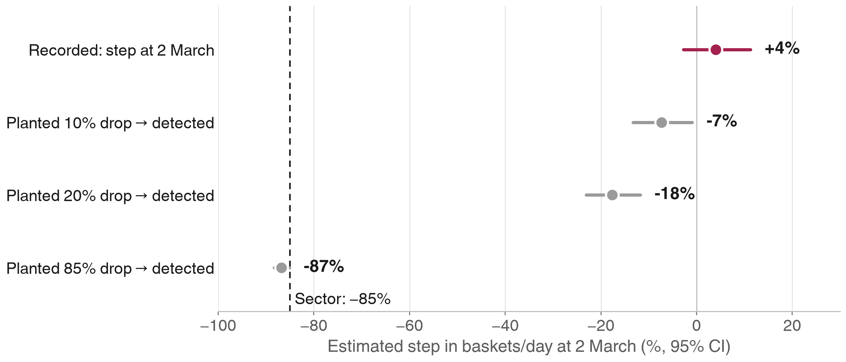
EECE 490 · Stories Coffee Hackathon
ⓒ All rights reserved. American University of Beirut 2026.
The test would have seen a war
Planting even a 10% drop is detected. The file also carries formula fingerprints.
100%
100%
Harbour prices = Garden × 1.05, exactly
Garden costs = Harbour × 1.43, exactly
0
1.55×
Price or unit-cost changes in 181 days
Every Tuesday vs its neighbours (25 of 25)
Decision Reconcile the till with card settlements, cash deposits and cup invoices for 25 Feb – 15 Apr before using the growth. If the till is right, takeaway cups rose 47 → 77 per day.
Method: log baskets per branch-day on branch × weekday effects and branch trends, week-clustered errors; placebo breaks on every date 1 Feb – 31 May.
Notes:
We deleted random post-war baskets and re-ran the same test: a 10% drop shows up as −7% with a confidence interval that excludes zero; the sector’s 85% shows up as −87%. So the absence of a war step is not a power problem.

Slide 6
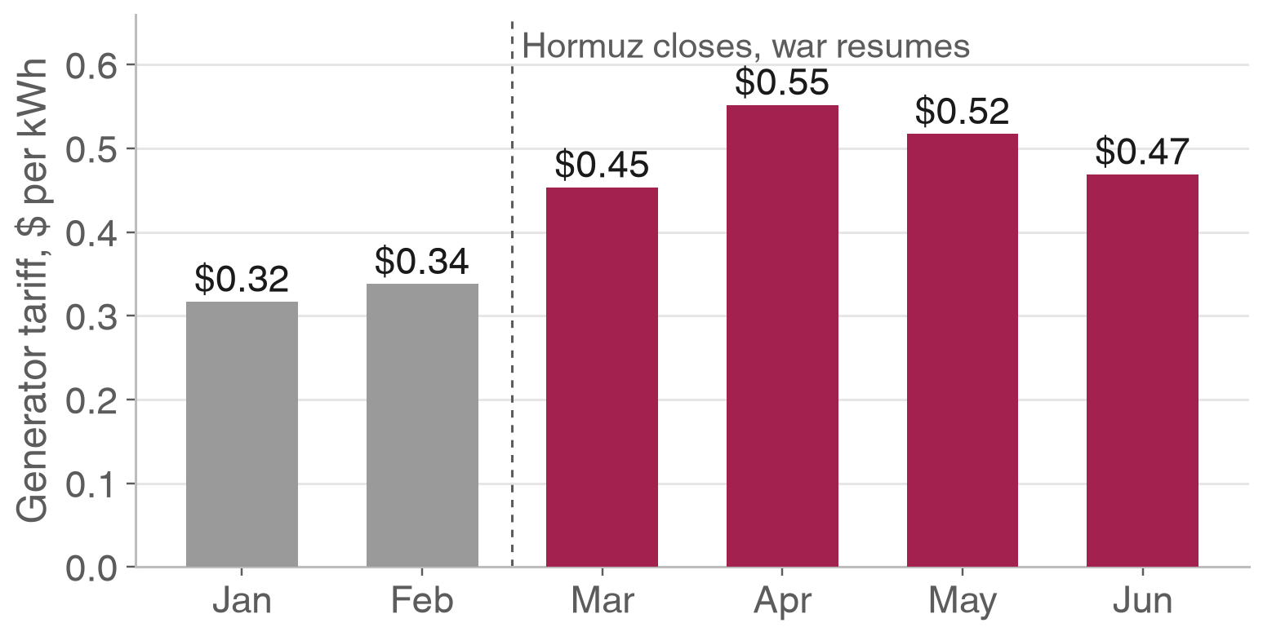
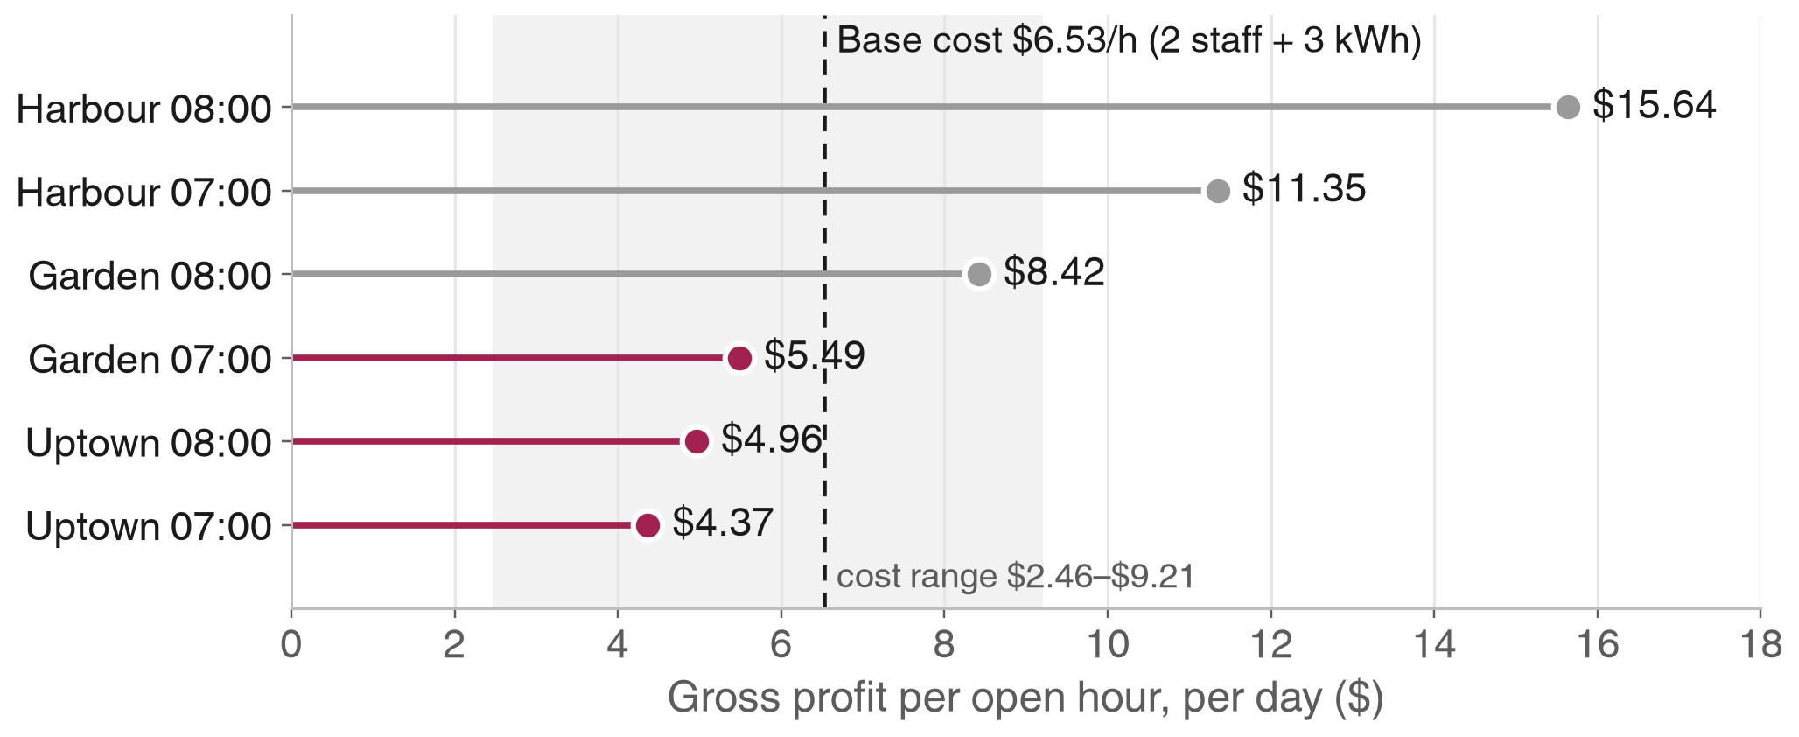
EECE 490 · Stories Coffee Hackathon
ⓒ All rights reserved. American University of Beirut 2026.
Oil shock → generator bill → early hours
Three early branch-hours earn less gross profit than they cost to open
R
R
R
R
R
D
A
D
A
I
1. Hormuz closed 28 Feb
2. Brent +65% in March
3. Diesel +77%
4. Grid 7–9 h → 4 h a day
5. Generator $0.32 → $0.55
6. Early hour: $4–5 GP
7. Cost ≈ $6.5 an hour
8. 3 hours below cost
9. 75% chance it pays
10. Open later + monthly rule
Decision Open Uptown at 09:00 and Garden at 08:00 for four weeks; then close any branch-hour whose GP is below staff + kWh × that month’s tariff.
Sources: EIA, World Bank (Brent); Ministry of Energy tariffs via L’Orient Today and SmartioLeb; EDL hours via Libnanews; Dalla Corte (espresso standby 0.33 kWh/h).
Notes:
The energy shock is real: the generator tariff rose 74% from January to April. But the Monte Carlo shows that the tariff barely moves the answer; staffing and whether customers come back later decide it.

Slide 7
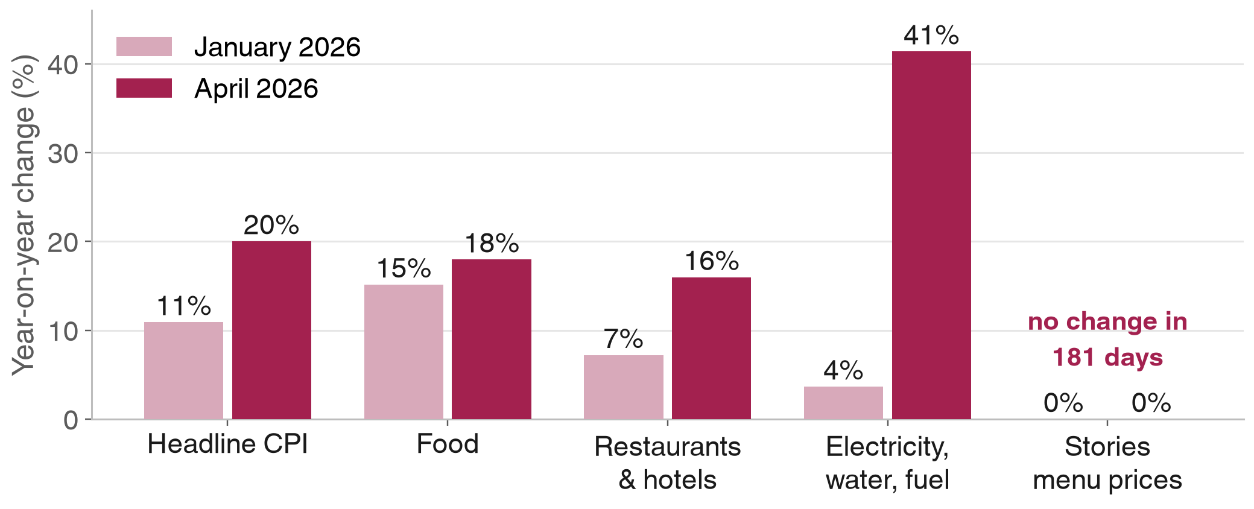
EECE 490 · Stories Coffee Hackathon
ⓒ All rights reserved. American University of Beirut 2026.
A frozen menu in a 20% inflation year
Prices and unit costs never moved while Lebanese prices jumped
R
R
R
R
D
I
A
I
D
I
1. Oil shock + war
2. CPI 11% → 20% y/y
3. Restaurants +16% y/y
4. Food +18% y/y
5. Stories: zero changes
6. Cost = standard, not landed
7. GP overstated $6.4k
8. Relative price fell
9. +5% breaks even at 7.9% lost volume
10. Refresh costs, test +5%
$6.4k
Median GP overstated Mar–Jun by frozen costs (Monte Carlo, P5 $2.7k to P95 $11.0k)
−1.68
Break-even elasticity for a 5% rise: demand must be more elastic than this before it loses money
Decision Refresh unit costs monthly from invoices, starting with the 10 highest-volume items, and test a uniform +5% at one branch for four weeks.
Sources: Central Administration of Statistics CPI via Credit Libanais (Jan, Apr 2026); InfoPro / Leaders Club survey (60% of firms raised prices).
Notes:
Recorded margin is 58.7%, but it is the margin at the cost master’s prices, not today’s. Each 5% of unrecorded cost inflation since March is about $4,600 of overstated GP.

Slide 8
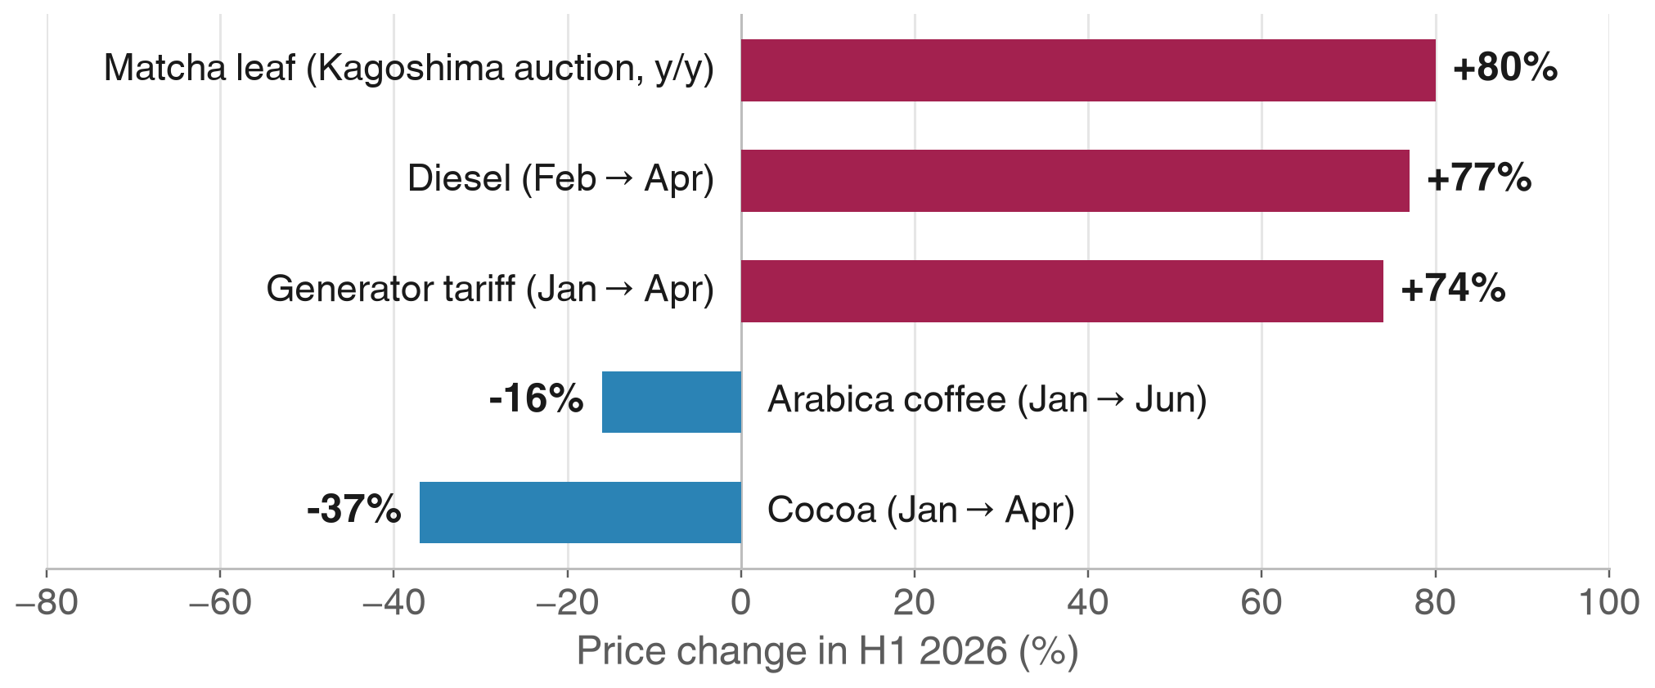
EECE 490 · Stories Coffee Hackathon
ⓒ All rights reserved. American University of Beirut 2026.
The evening runs on rationed matcha
The menu’s fastest-rising input sits in its most valuable daypart
R
R
R
R
D
D
A
A
R
I
1. Kyoto heat cuts tencha
2. Ippodo rations, 2025
3. Tencha auction +80%
4. Freight up 33%
5. Evening: 13% matcha
6. Recorded cost never moves
7. +$0.18 per drink
8. Stockout: $0.9–1.8k
9. Arabica −16%
10. Pilot on coffee, lock matcha
13.1%
Of evening units are matcha drinks, against 8.1% in the morning
$1.2k
Six-month value of a fixed-price matcha contract before its premium (median; P5 $513, P95 $2.6k)
Decision Lock a 6–12-month matcha price or dual-source culinary grade; run the no-discount attachment pilot on cold coffee + bakery first.
Sources: Ippodo notice (Aug 2025); tencha auction trackers (Kagoshima, 14 May 2026); ICE arabica via CropGPT; IMF cocoa via FRED; CPI transport via Credit Libanais.
Notes:
Bakery + matcha is the stronger pairing in the existing null model (1.76×), but bakery + cold coffee also replicates in both periods (1.18×, 1.23×), carries a higher recorded margin and runs on a falling input cost.

Slide 9
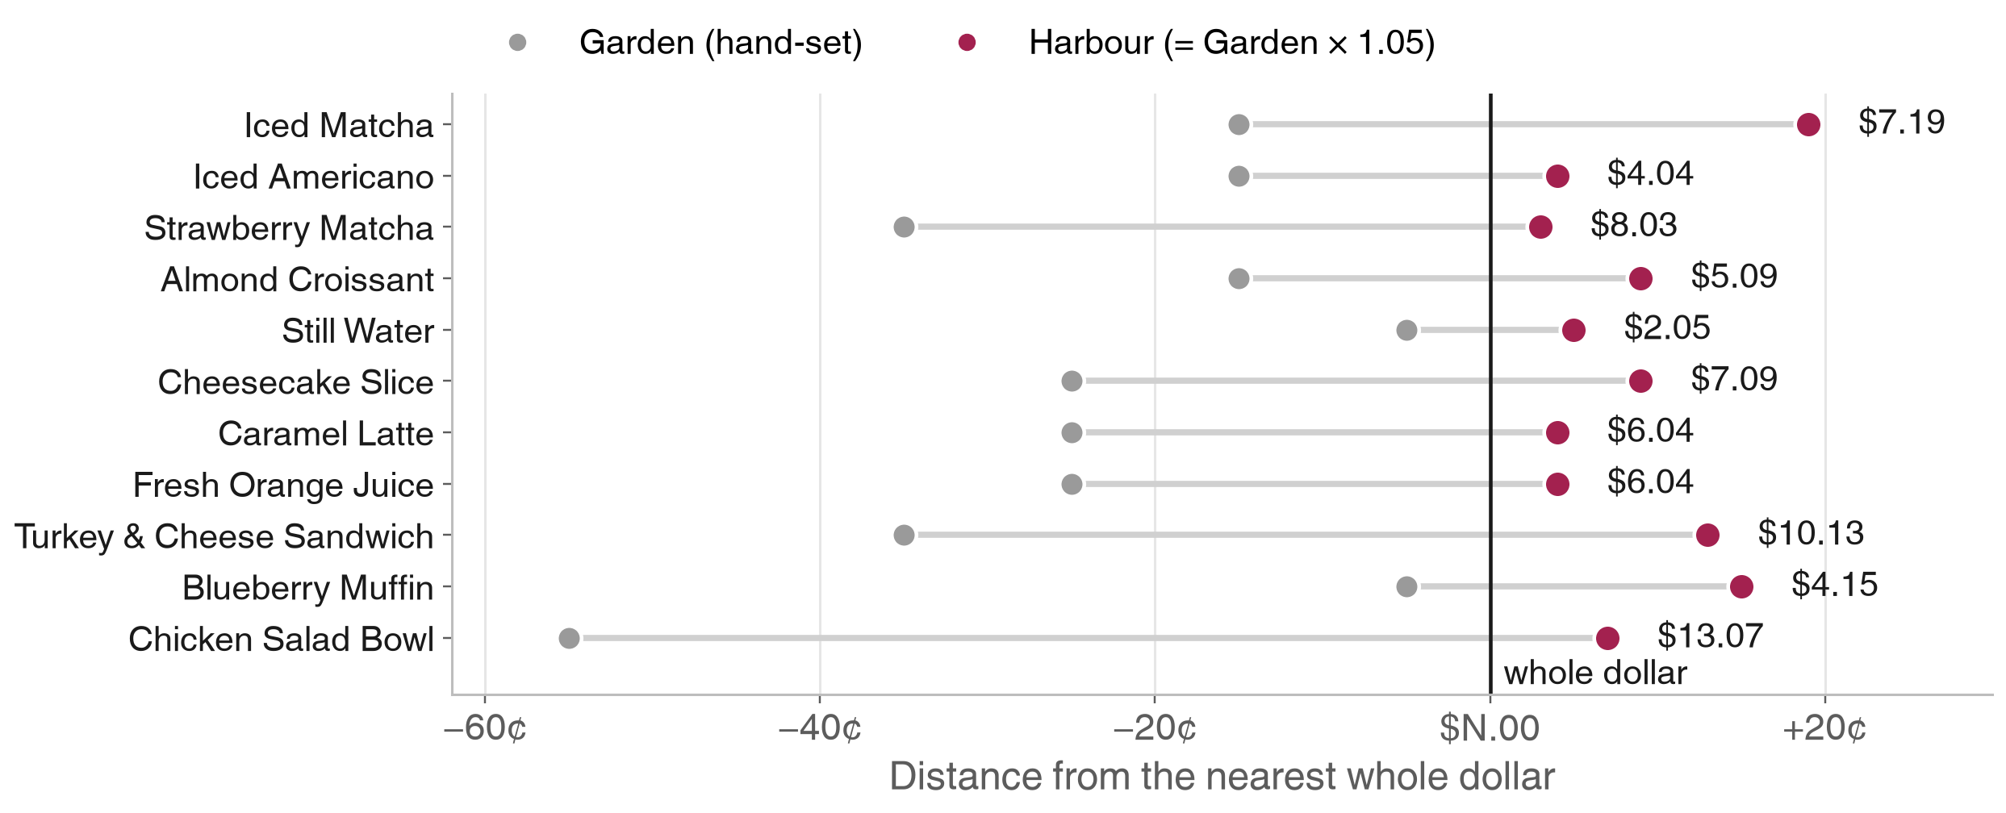
EECE 490 · Stories Coffee Hackathon
ⓒ All rights reserved. American University of Beirut 2026.
Formula prices sit just past the dollar
Harbour = Garden × 1.05 pushes 11 items a few cents over a whole dollar
R
D
D
R
D
D
D
A
A
I
1. Cash economy 46% of GDP
2. Garden prices hand-set
3. Harbour = Garden × 1.05
4. Left-digit bias θ ≈ 0.22
5. 11 items just past $
6. 6,570 units
7. $918 to fix
8. Elasticity decides
9. $N.95 wins 61%
10. Three-arm price test
100% vs 11%
Of prices ending in 0 or 5 cents: Garden vs Harbour
20¢+
How a 1¢ move across a dollar feels to shoppers (Strulov-Shlain, Review of Economic Studies, 2023)
Decision Reprint the Harbour menu with a price ladder (Garden + fixed premium) and test today, $N.95 and $N.25 in alternating weeks.
Sources: World Bank Lebanon Economic Monitor (May 2023); Strulov-Shlain (2023), More Than a Penny’s Worth: Left-Digit Bias and Firm Pricing.
Notes:
Garden’s prices end in 5 cents every time; Harbour and Uptown are computed. The paper finds retailers forgo 1–4% of gross profit by under-using price endings.

Slide 10
October 17, 2026
Monte Carlo: 20,000 futures
Every assumption drawn from a stated distribution and replayed against the till
Part 2 · How sure are the decisions?
Notes:
Part two: instead of low, base and high cases, we vary every assumption at once and ask how often each action pays.

Slide 11
EECE 490 · Stories Coffee Hackathon
ⓒ All rights reserved. American University of Beirut 2026.
What we let vary
Twenty inputs, each with a distribution and a basis; ten that matter most below
Input | Distribution | Basis
Staff on the early shift | 1 (40%) or 2 (60%) | Assumption
Customers who come back later | Beta(2,3), mean 40% | Assumption
Generator tariff, next 6 months | Uniform $0.45–$0.59/kWh | Ministry tariffs Mar–Sep 2026
Coffee cost drift since cost master | Triangular −4% / +1% / +7% | Arabica −16% × bean share, plus dairy and packaging
Other food cost drift | Triangular 0% / +7% / +18% | Food CPI +15% → +18% y/y
Matcha landed price rise | Triangular +$15 / +$60 / +$120 per kg | Tencha auctions +22% to +80% y/y
Category price elasticity | Triangular −1.5 / −0.8 / −0.25 | Food away from home −0.7 to −0.8; coffee −0.26
Coffee elasticity multiplier | Uniform 1.0–1.5× | Coffee is the most price-compared item (assumption)
Left-digit bias θ | Beta(0.66, 2.09): mean 0.24, IQR 0.06–0.37 | Strulov-Shlain (2023) product estimates
Item elasticity multiplier | Uniform 1.0–2.0× category elasticity | Items substitute within the menu
All twenty inputs: reports/tables/mc_inputs.csv · seed 490 · hourly GP bootstrapped over the 181 trading days
Notes:
Wherever we had a published number we used it to centre the distribution; where we did not, the range is wide on purpose and labelled as an assumption.

Slide 12
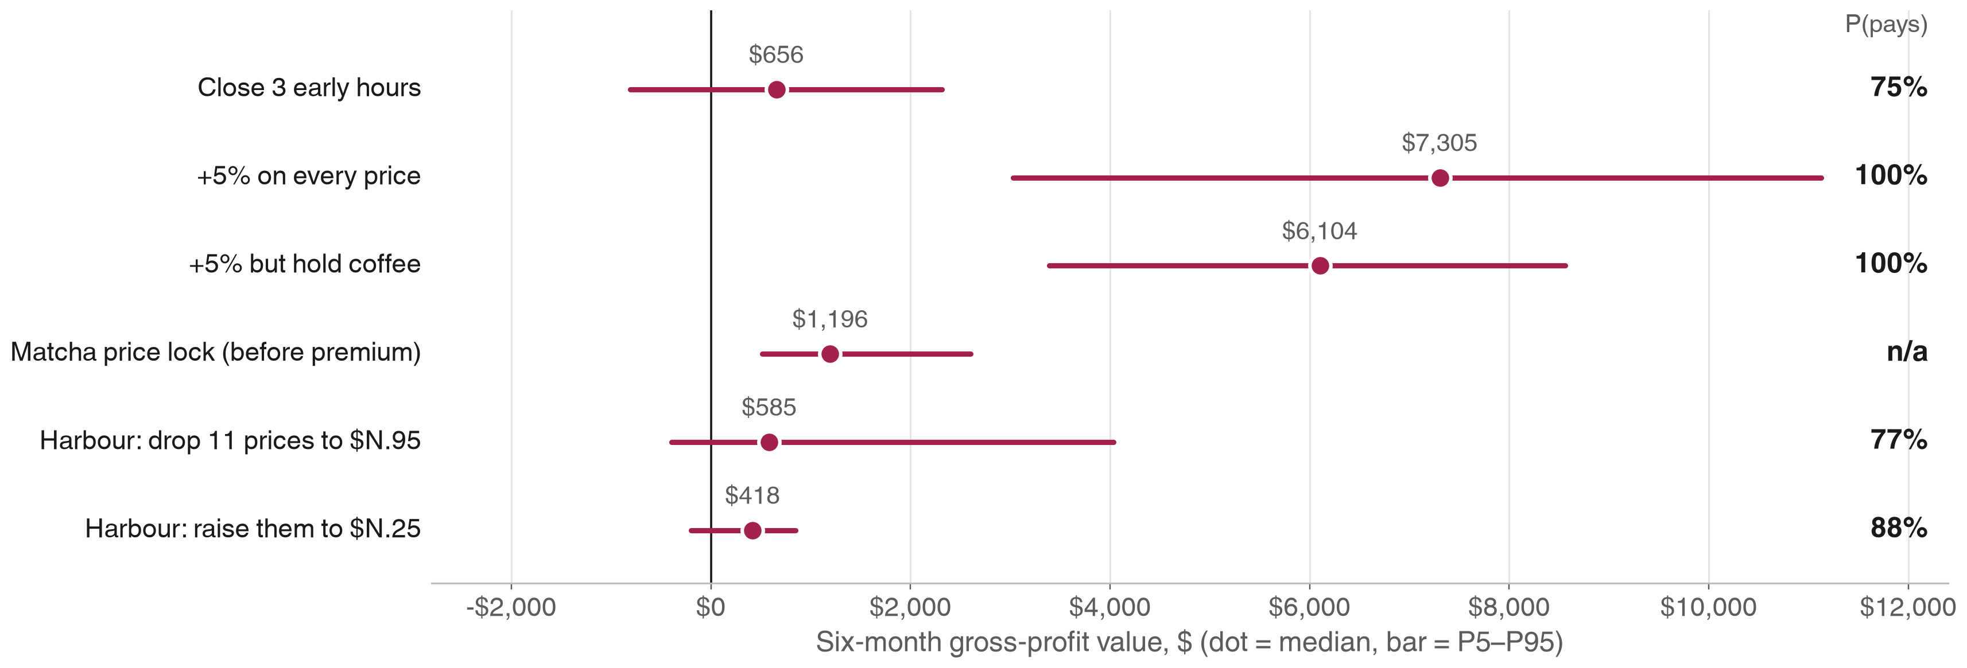
EECE 490 · Stories Coffee Hackathon
ⓒ All rights reserved. American University of Beirut 2026.
How sure are we?
Six-month value of each action: median dot, 90% range bar, and the chance it pays
The 100% for price rises reflects the elasticity prior: the break-even elasticity (−1.68) lies beyond the whole range we drew. The field test settles it.
Notes:
Everything is in six-month gross profit. The matcha contract shows its value before the premium, so it has no “chance it pays” until the supplier quotes a premium.

Slide 13
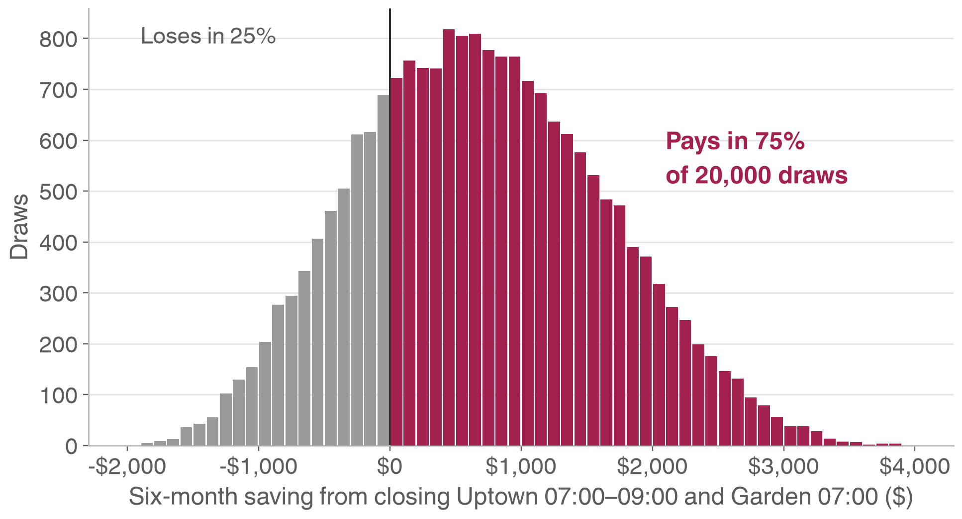
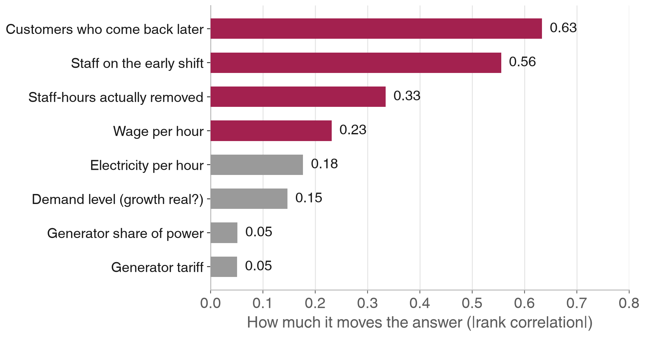
EECE 490 · Stories Coffee Hackathon
ⓒ All rights reserved. American University of Beirut 2026.
Early hours: staffing decides, not oil
The tariff barely moves the answer; who is on shift and who comes back do
Decision Before switching, confirm the early shift really has two people and that the hour comes off the roster. Median value $656 per six months; P5 −$807, P95 $2.3k.
Notes:
Rank correlations: customers who come back 0.63, staff 0.56, tariff 0.05. The Hormuz link is true but minor for this decision.

Slide 14
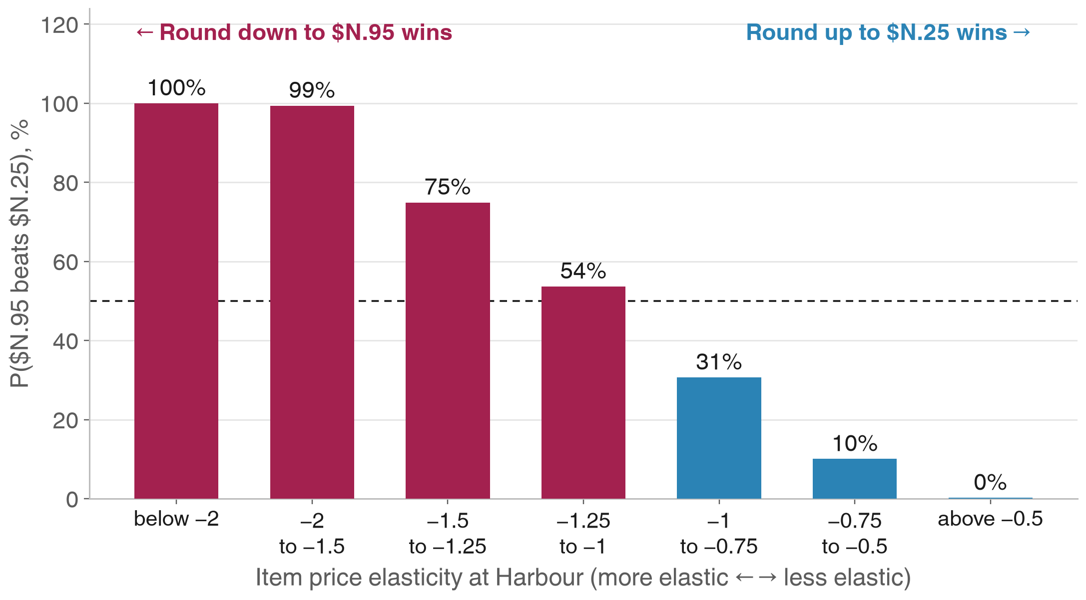
EECE 490 · Stories Coffee Hackathon
ⓒ All rights reserved. American University of Beirut 2026.
Raise prices; test the rounding
Uniform +5% beats holding coffee back; rounding direction turns on elasticity
88%
Of draws where a uniform +5% beats “+5% but hold coffee” (median gap $1.2k)
$7.3k
Median six-month GP from a uniform +5% (P5 $3.0k, P95 $11.1k)
61%
Of draws where $N.95 beats $N.25 at Harbour: too close to call without a test
Notes:
Holding coffee only wins if coffee demand is far more elastic than the rest of the menu. The Harbour rounding question flips at an item elasticity of about −1.25, which is why the test has three arms.

Slide 15
EECE 490 · Stories Coffee Hackathon
ⓒ All rights reserved. American University of Beirut 2026.
What the simulation changed
Three recommendations we revised after stress-testing them
Before
After 20,000 draws
Energy prices make early hours unprofitable
Staffing and returning customers decide it (tariff ρ = 0.05). Confirm the roster first.
Before
After 20,000 draws
Raise prices but hold coffee, since arabica fell
A uniform +5% wins in 88% of draws. Hold coffee only if a test shows it is unusually elastic.
Before
After 20,000 draws
Round Harbour’s prices down to $N.95
Round-down wins in only 61% of draws. Test three arms: today, $N.95 and $N.25.
Notes:
This is the point of the simulation: it overturned part of our own story. The chains still hold; the actions got sharper.

Slide 16
EECE 490 · Stories Coffee Hackathon
ⓒ All rights reserved. American University of Beirut 2026.
Decisions and the tests behind them
Each action ships as a field test with a stop rule
Action | Test | Stop if | Six-month value
Reconcile the till | POS vs card settlements, cash deposits, cup invoices, 25 Feb – 15 Apr | Totals disagree | Protects every forecast
Open later at Uptown and Garden | Four-week switch; difference-in-differences against Harbour | Branch GP falls more than the saving | $656
Cost refresh + uniform +5% | One branch for four weeks against the other two | Units fall more than 7.9% | $7.3k
Lock matcha supply | 6–12-month fixed price or dual source | Premium above $1.2k | $1.2k before premium
Harbour price ladder | Today, $N.95, $N.25 in alternating weeks for 8 weeks | Arm GP below today | $585 / $418
Attachment pilot on cold coffee | Randomised no-discount bakery prompt | Whole-basket GP does not rise | Test first
Notes:
Values are medians from the Monte Carlo. None is a forecast; each is what the decision is worth if our ranges are right, and the test is how we find out.

Slide 17
EECE 490 · Stories Coffee Hackathon
ⓒ All rights reserved. American University of Beirut 2026.
What could make us wrong
The limits we know about, and which findings survive them
The file may be simulated or re-dated
Constant-elasticity demand
Then chain 1 stands and the growth trend goes. Chains 2–5 rest on the menu, the costs and Lebanon’s real 2026 prices, so they survive.
It ignores customers lost to competitors for good, the real risk of any price rise. The one-branch test measures it.
External figures are approximate
Branches are anonymised
News, industry and vendor sources; matcha prices especially. Every figure and URL is in outside_research_2026.csv.
We cannot map Harbour, Garden and Uptown to streets, so a branch on EDL or its own generator pays a different rate.
Notes:
We would rather show where we could be wrong than have a grader find it.

Slide 18

Thank you
Notes:
Questions. Code, tables and sources are in the repository: reports/outside_in_chains.md and reports/monte_carlo.md.

