Slide 1
CS5260 – Artificial Intelligence Project Part I
By: Kevin Offemaria
Spring 2023
Vanderbilt University
MS. in Computer Science

Slide 2
Project Goal
The goal of the project is to implement an AI Search Agent capable of performing an anytime, forward-searching, depth-bounded, utility-driven search.
Other parts of the project include:
Defining a State Quality
Establishing an initial State
Perform various tests

Slide 3
State Quality
The heart of the AI Agent.
My state quality is measured by the amount of Electronic resources a country currently owns at a given time/state.
Having the necessary raw materials to potentially produce Electronics is also weighed heavily, albeit at a discount.
Finally, some electronics can be recycled (up to ~17%, source)! So not all E-Waste has a negative consequence.
WIP - An excessive amount of Electronics becomes a negative asset as supply exceeds demand, similar to the real world.

Slide 4
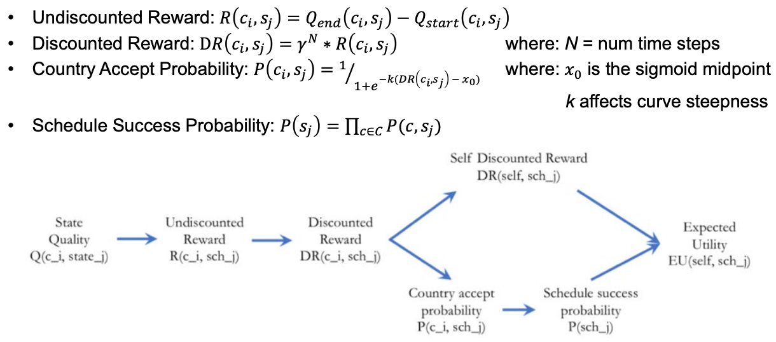
State Quality Function
Considered the driver of the State Quality.
Contains:
Undiscounted Reward
Discounted Reward
Country Accept Probability
Schedule Accept Probability
https://files.realpython.com/media/sockets-tcp-flow.1da426797e37.jpg

Slide 5
Search Function
Brains of the program
Conducts a Breadth-First Search
Import PriorityQueue class from Python library queue class
Used to store tuples of EU score and custom Node class
Generates children Nodes containing the initial state and resources
Attempt to generate Action Templates for TRANSFORM/TRANSFER
Calculate and evaluates Expected Utility scores
Ends when a maximum depth or frontier size has exceeded

Slide 6
Initial State
Inspired by the video game, Fallout 2
Post-apocalyptic setting where resources are scarce and bartering for goods are commonplace.
In the game, various countries/cities have their own unique characteristics, which my initial state references.
NewCaliforniaRepublic – highly efficient police state (adequate resources/waste, high Electronics to start)
NewReno – gambling capital (moderate resources/waste)
Arroyo – primitive village (high resources, 0 waste)
SanFrancisco – center of trade (high raw materials, population)
Gecko – small town ravaged by a nearby nuclear power plant (high waste, low resource)

Slide 7
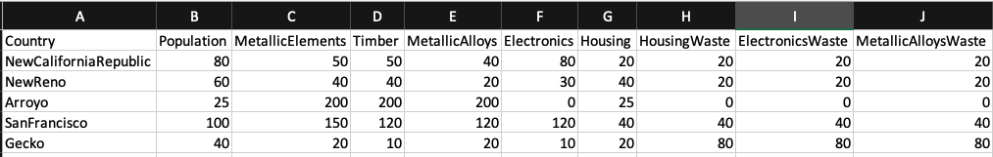
Initial State Screenshot

Slide 8
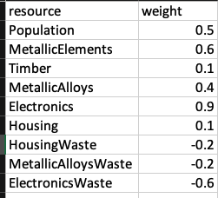
Resource Weights
I weighed the resources heavily based on Electronics.
Additionally, the raw materials needed to produce Electronics are higher the most.
MetallicAlloys
MetallicElements
Consequently, it also make sense to have a higher negative value for E-Waste.

Slide 9
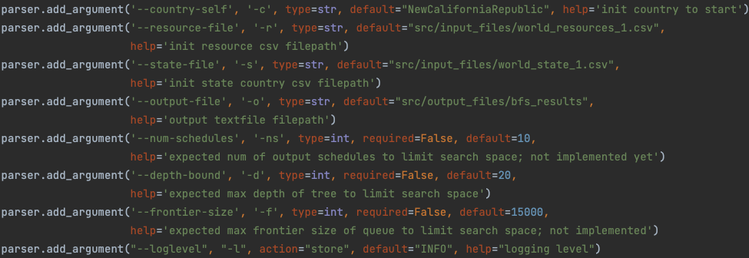
Test Case 1
Main goal is to test capability of my BFS function given the initial state settings.
country_schedule() parameters:

Slide 10
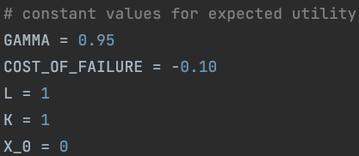
Test Case 1 continued...
Expected Utility constants
Using low cost of failure, this kept the Node depth deep as my search algorithm traversed.

Slide 11
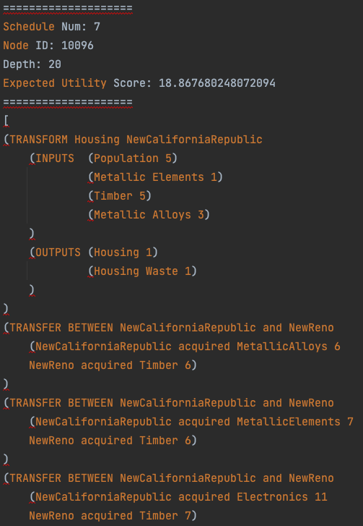
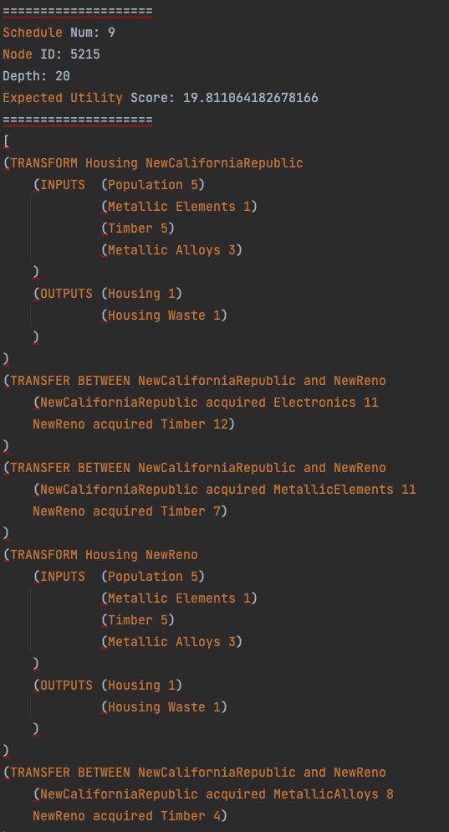
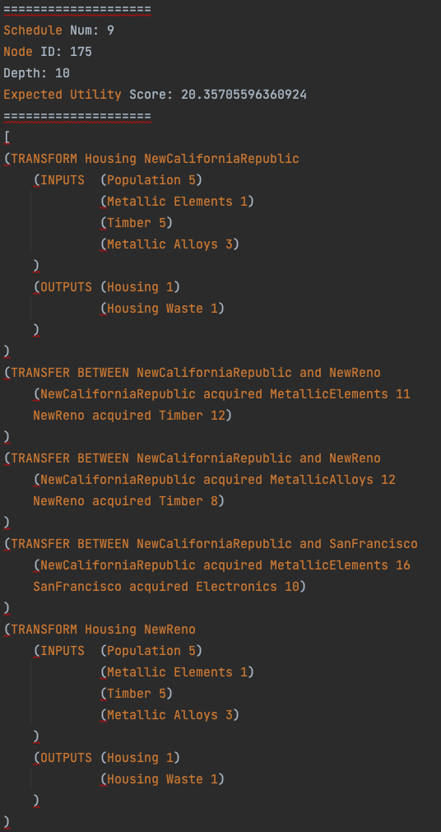
Test 1 Results

Slide 12
Test 1 Analysis
Highly variable values:
Depths reached; some finished at 10 some at max setting of 20.
Node counts; some reaching up to 10k counts, others in the 100's.
Generally, more TRANSFER's than TRANSFORM's were accepted.
Best EU scores hovered in the mid-teens, I suspect due to the low negative Cost Of Failure constant.

Slide 13
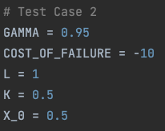
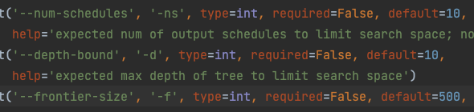
Adjustments
Kept initial state and resource weights the same
Significantly reduced the frontier size and depth bound parameters
Constants
Significantly increase COF
Give halves for K and X_0
K = steepness of curve
X_0 = sigmoid midpoint

Slide 14
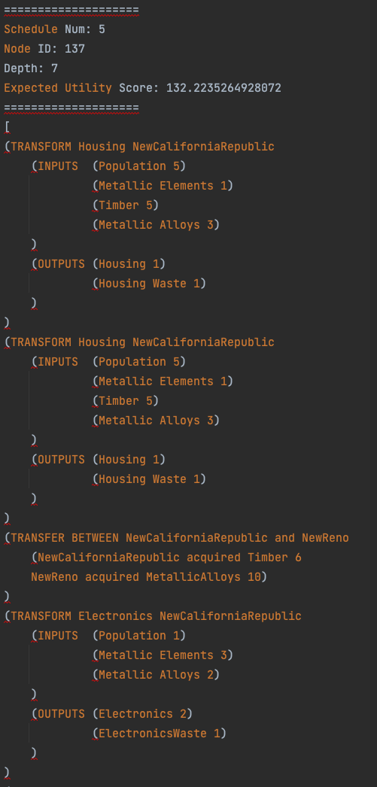
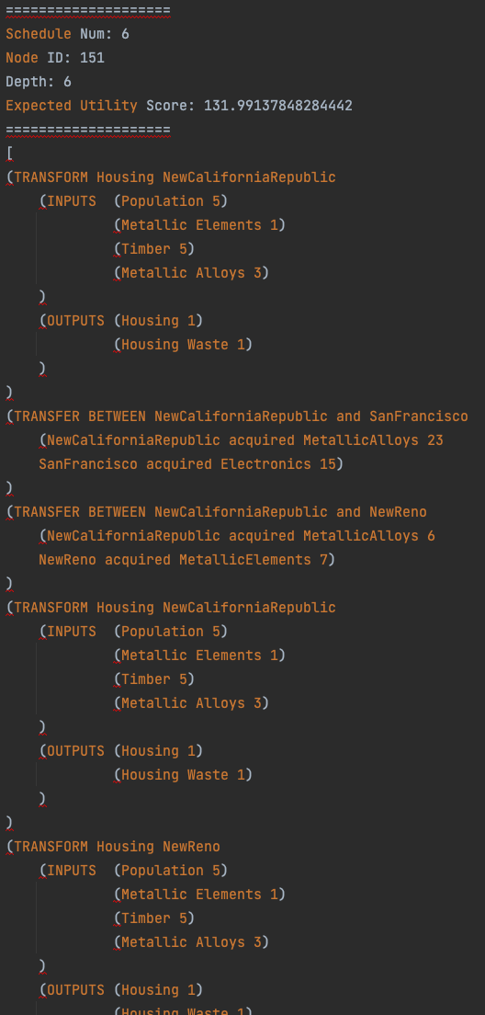
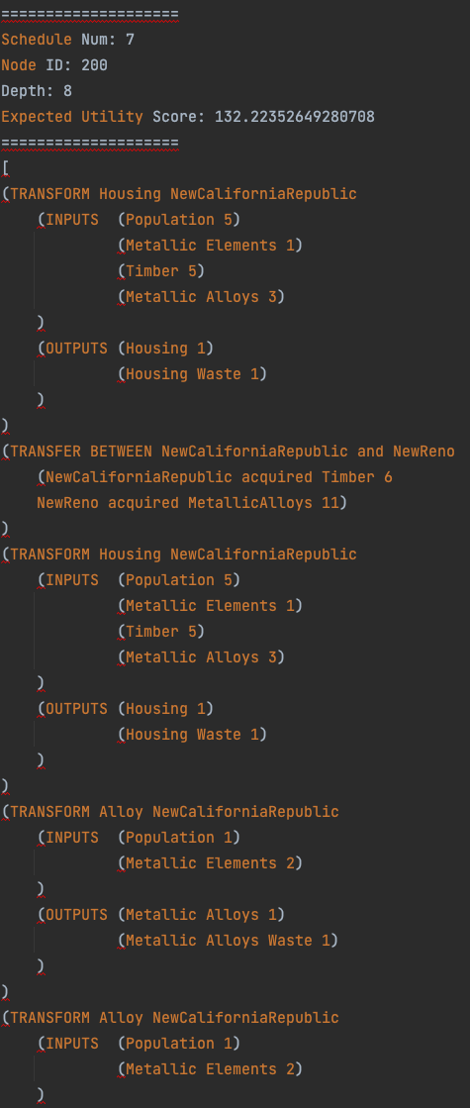
Test Case 2 Results

Slide 15
Test 2 Analysis
More consistent values:
Depths reached; around halfway (5-7) of the set depth max (10).
Node counts; less than half (< 200) of the set frontier size (500)
Generally, less TRANSFER's than TRANSFORM's were accepted.
Best EU scores hit over 100.

Slide 16
Graphs and Plots
Unfortunately, I ran out of time to properly submit graphs :(

Slide 17
Demo

Slide 18
Thank you Kevin Offemaria
"War. War never changes. The end of the world occurred pretty much as we had predicted. Too many humans, not enough space or resources to go around"
-Opening narration, Fallout 2

Slide 19
Citations
E-waste recycling in the real world.
https://www.genevaenvironmentnetwork.org/resources/updates/the-growing-environmental-risks-of-e-waste/
Python Priority Queues
https://www.linode.com/docs/guides/python-priority-queue/#the-python-priority-queue-class
https://stackoverflow.com/questions/15124097/priority-queue-with-higher-priority-first-in-python/15124115#15124115
Deep Copy
https://stackoverflow.com/questions/17246693/what-is-the-difference-between-shallow-copy-deepcopy-and-normal-assignment-oper

