Slide 1
CS 5260 - Artificial Intelligence Project Part II
By: Kevin Offemaria
Spring 2023
Vanderbilt University
MS. in Computer Science

Slide 2
Project Goal
The goal of the project is to implement an AI Search Agent capable of performing an anytime, forward-searching, depth-bounded, utility-driven search.
Country Scheduler game
Agenda:
Part 1 recap
Code base improvements
Architecture
State Quality
Initial State and Resources
Test Cases
Summary

Slide 3
Recap: Part 1
From feedback:
Simplistic state quality definition
Incorrect frontier storage type
Human intuition on resource weights
No graphs/plots
What was done well:
Class architecture, clean code
State quality function
Generating appropriate templates and correct modification of resources

Slide 4
Codebase: Fixes
Embrace Greedy Best First Search using PriorityQueue()
Inverting EU values is necessary to get the highest EU score and follow this for GBFS
Found bug on the function: create_child_nodes()
The Transform template was doing unnecessary looping for all countries, but we only care about Transforms of the country we are playing (self.country)
Randomize EU evaluation of templates
Add 4 more test cases and subsequent graphs/plots
Remove human intuition application on AI Agent by redefining State Quality definition

Slide 5
Codebase: New Features
Two new search strategies – HDFS, BFS
Increase State Quality complexity
Add country population cap on production of Electronics and its raw resources
Add housing requirement for population
Add uncertainty on templated actions
Chance for random encounters during Transfers which could have positive/negative effects
Chance to recycle waste during Transforms which converts the waste to a raw resource
Resource Decay – using node count as time steps

Slide 6
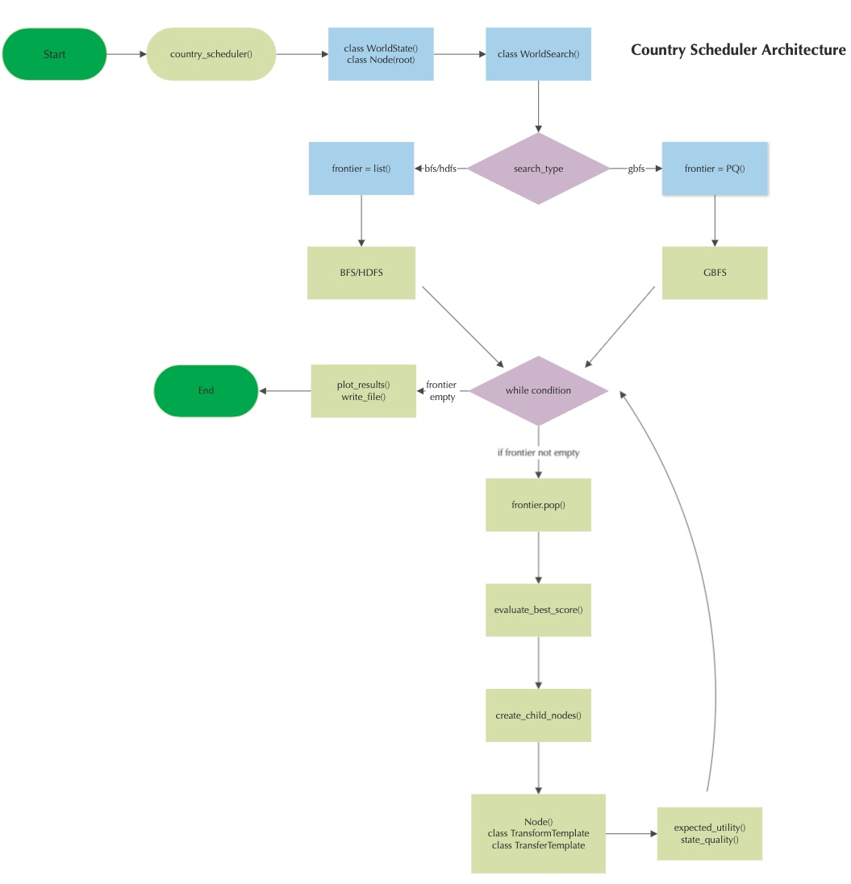
Architecture
Class based architecture leveraging Python's Object Oriented Programming features such as inheritance and polymorphism.
Key classes:
WorldState
Node
WorldSearch
TransformTemplate
TransferTemplate
Driver is country_scheduler.py module

Slide 7
Search Functions
General common search algorithm
Used to store tuples of EU score and custom Node class, eg. (eu_score, node_class)
Generates children Nodes containing the initial state and resources
Attempt to generate Action Templates for TRANSFORM/TRANSFER
Calculate and evaluates Expected Utility scores
Ends when a maximum depth or frontier size has exceeded or the frontier is empty
Greedy Best First Search
Import PriorityQueue class from Python library queue class
Heuristic Depth First Search and Breadth First Search
Python built-in list()

Slide 8
State Quality
State quality is measured by the amount of Electronic resources a country currently owns at a given time/state.
There is a cap where an excessive amount of Electronics becomes a negative asset as supply exceeds demand of the population (2:1).
Having the necessary raw materials to potentially produce Electronics as a means to continue production also has higher positive impact on EU, albeit at a discount.
Some electronics can be recycled (up to ~17%, source)! So not all E-Waste has a negative consequence.
Housing for a country's population affects the happiness of all. However, there is a cap on the ratio of population to housing (4:1).

Slide 9
Initial State
Inspired by the video game, Fallout 2
Post-apocalyptic setting where resources are scarce and bartering for goods are commonplace.
In the game, various countries/cities have their own unique characteristics, which my initial state references.
NewCaliforniaRepublic – highly efficient police state (adequate resources/waste, high Electronics to start)
NewReno – gambling capital (moderate resources/waste)
Arroyo – primitive village (high resources, 0 waste)
SanFrancisco – center of trade (high raw materials, population)
Gecko – small town ravaged by a nearby nuclear power plant (high waste, low resource)

Slide 10
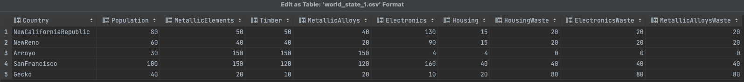
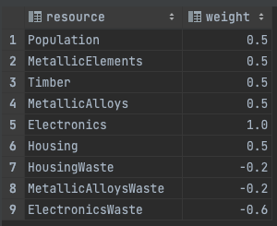
Initial State and Resource Weights

Slide 11
Part 2 Test Cases

Slide 12
Test Cases Overview
6 Test cases
Search Strategy:
Greedy Best First Search
Heuristic Depth First Search
Breadth First Search
Play as:
New California Republic
Moderate raw resources
High Electronics/Housing to Population ratio
Arroyo
High raw resources
Low Electronics/Housing to Population ratio
Expected Utility constants:
GAMMA = 0.95
COST_OF_FAILURE = -10
L = 1
K = 0.001
X_0 = 5

Slide 13

Test Case 1: GBFS
Search Strategy: Greedy Best First Search
Play as New California Republic
Moderate raw resources
High Electronics/Housing to Population ratio
country_schedule() parameters:
country = "NewCaliforniaRepublic"
search_type = "gbfs"
num_schedules = 20
depth_bound = 20
frontier_size = 10000
Expected Utility constants:
GAMMA = 0.95 COST_OF_FAILURE = -10 L = 1 K = 0.001 X_0 = 5

Slide 14
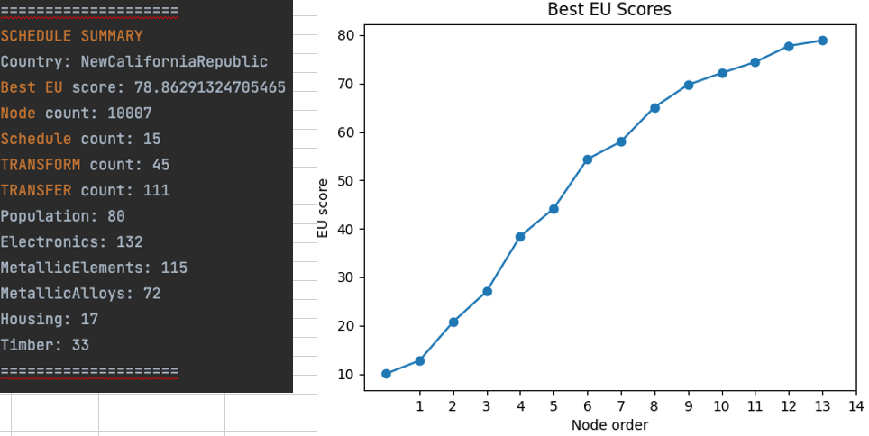
Test Case 1: Results

Slide 15
Test Case 1: Analysis
Search Strategy: Greedy Best First Search
Play as New California Republic
Moderate raw resources
High Electronics/Housing to Population ratio
Observations:
Generally more TRANSFERs than TRANSFORMs
Higher schedule count, between 15-18
Avg EU score between 70 to 80

Slide 16

Test Case 2: GBFS
Search Strategy: Greedy Best First Search
Play as Arroyo
High raw resources
Low Electronics/Housing to Population ratio
country_schedule() parameters:
country = "Arroyo"
search_type = "gbfs"
num_schedules = 20
depth_bound = 20
frontier_size = 10000
Expected Utility constants:
GAMMA = 0.95 COST_OF_FAILURE = -10 L = 1 K = 0.001 X_0 = 5

Slide 17
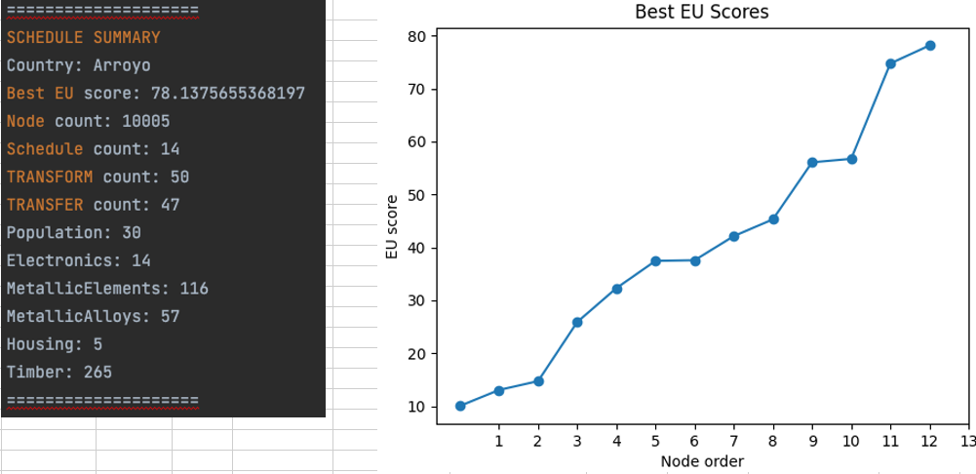
Test Case 2: Results

Slide 18
Test Case 2: Analysis
Search Strategy: Greedy Best First Search
Play as New California Republic
Moderate raw resources
High Electronics/Housing to Population ratio
Observations:
Generally more TRANSFORMs than TRANSFERs
Lower schedule count, between 10 to 14
Avg EU score between 70 to 90, higher variance than test case 1
Due to its high amount of raw resources and the randomness of transfer trade percentage (10-20%), a relatively large transfer occurs which results in a spike in EU score.

Slide 19
Test Case 3: HDFS
Search Strategy: Heuristic Depth First Search
Play as New California Republic
Moderate raw resources
High Electronics/Housing to Population ratio
country_schedule() parameters:
country = "NewCaliforniaRepublic"
search_type = "hdfs"
num_schedules = 20
depth_bound = 5
frontier_size = 20000
Expected Utility constants:
GAMMA = 0.95 COST_OF_FAILURE = -10 L = 1 K = 0.001 X_0 = 5

Slide 20
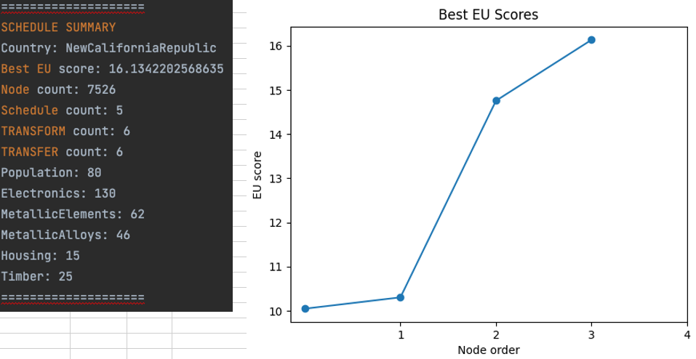
Test Case 3: Results

Slide 21
Test Case 3: Analysis
Search Strategy: Heuristic Depth First Search
Play as New California Republic
Moderate raw resources
High Electronics/Housing to Population ratio
Observations:
Slightly more TRANSFERs than TRANSFORMs, almost even
Very low schedule count, between 3-5
Very low EU scores, lowest scores among all search types, as low as in the teens
Due to the nature of HDFS, it will almost always have limited best EU scores because the algorithm goes down the leftmost node and may never recover from a low EU score.

Slide 22
Test Case 4: HDFS
Search Strategy: Heuristic Depth First Search
Play as Arroyo
High raw resources
Low Electronics/Housing to Population ratio
country_schedule() parameters:
country = "Arroyo"
search_type = "hdfs"
num_schedules = 20
depth_bound = 5
frontier_size = 20000
Expected Utility constants:
GAMMA = 0.95 COST_OF_FAILURE = -10 L = 1 K = 0.001 X_0 = 5

Slide 23
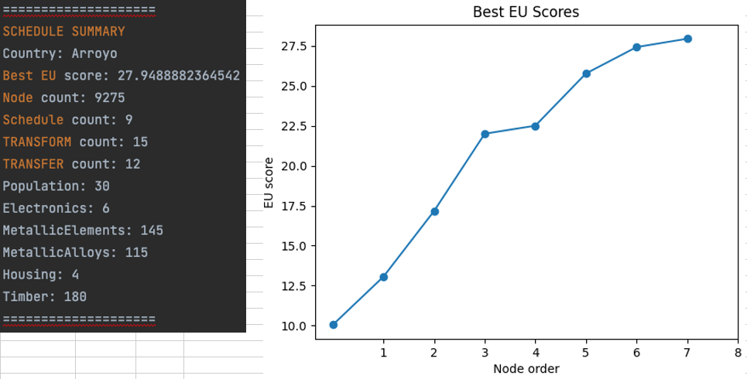
Test Case 4: Results

Slide 24
Test Case 4: Analysis
Search Strategy: Heuristic Depth First Search
Play as Arroyo
High raw resources
Low Electronics/Housing to Population ratio
Observations:
Slightly more TRANSFORMs than TRANSFERs, almost even
Low schedule count, between 7 to 9
Low EU scores, between 22 to 27
Limited by nature of search type.

Slide 25
Test Case 5: BFS
Search Strategy: Breadth First Search
Play as New California Republic
Moderate raw resources
High Electronics/Housing to Population ratio
country_schedule() parameters:
country = "NewCaliforniaRepublic"
search_type = "bfs"
num_schedules = 20
depth_bound = 10
frontier_size = 50000
Expected Utility constants:
GAMMA = 0.95 COST_OF_FAILURE = -10 L = 1 K = 0.001 X_0 = 5

Slide 26
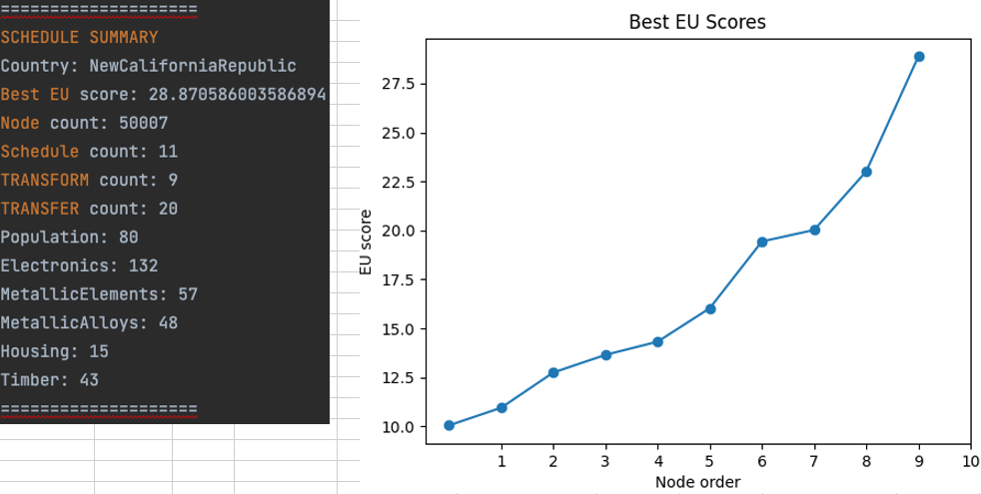
Test Case 5: Results

Slide 27
Test Case 5: Analysis
Search Strategy: Breadth First Search
Play as New California Republic
Moderate raw resources
High Electronics/Housing to Population ratio
Observations:
Generally more TRANSFERs than TRANSFORMs
Moderate schedule count, between 8 to 11
Lower EU score, between 25 to 28
Never goes deep enough to explore potentially more optimal schedules.

Slide 28
Test Case 6: BFS
Search Strategy: Breadth First Search
Play as Arroyo
High raw resources
Low Electronics/Housing to Population ratio
country_schedule() parameters:
country = "Arroyo"
search_type = "bfs"
num_schedules = 20
depth_bound = 10
frontier_size = 50000
Expected Utility constants:
GAMMA = 0.95 COST_OF_FAILURE = -10 L = 1 K = 0.001 X_0 = 5

Slide 29
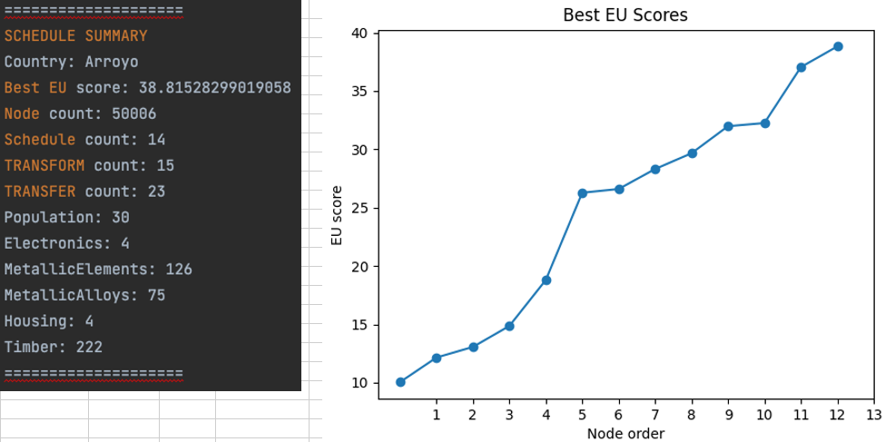
Test Case 6: Results

Slide 30
Test Case 6: Analysis
Search Strategy: Breadth First Search
Play as Arroyo
High raw resources
Low Electronics/Housing to Population ratio
Observations:
Generally more TRANSFERs than TRANSFORMs
Moderate schedule count, between 8 to 13
Moderate EU score, between 30 to 40
Slightly higher EU due to resource weights on raw materials.

Slide 31
Test Cases Summary
Randomness of applied uncertainty on the respective action templates generates higher variance of EU scores due to potential positive/negative effects.
Higher resources scored a higher potential due to its given value on the means to production.
Effects of Resource Decay
Since Housing is given some priority, there are more transformations to reflect this.

Slide 32
Search Strategy Observations
Of the 3 search types, GBFS is the most efficient at finding the best schedule.
GBFS relies on accuracy of heuristics (EU) to guide the search.
HDFS and BFS are very limited when used with a large or infinite search space.
If HDFS goes on a low scoring node, it may never recover and will not find high EU scores.
It is almost impossible to find the best schedule for BFS on an infinite search space.
Since we have no explicit "goal" state, we are not able to accurately estimate the distance to the goal.
Fine line when introducing alpha-beta pruning because it is technically injecting human intuition to the agent.

Slide 33
Demo

Slide 34
Thank you Kevin Offemaria
"War. War never changes. The end of the world occurred pretty much as we had predicted. Too many humans, not enough space or resources to go around"
-Opening narration, Fallout 2

Slide 35
Citations
Class community citations:
John Ford – Concept of Resource decay
Karely Rodriguez – Proper implementation of HDFS, alpha-beta pruning
Online citations:
E-waste recycling
Fallout Random Encounters
Greedy Best First Search
Depth First Search
Breadth First Search
Metals deterioration
Timber decay

