Slide 1
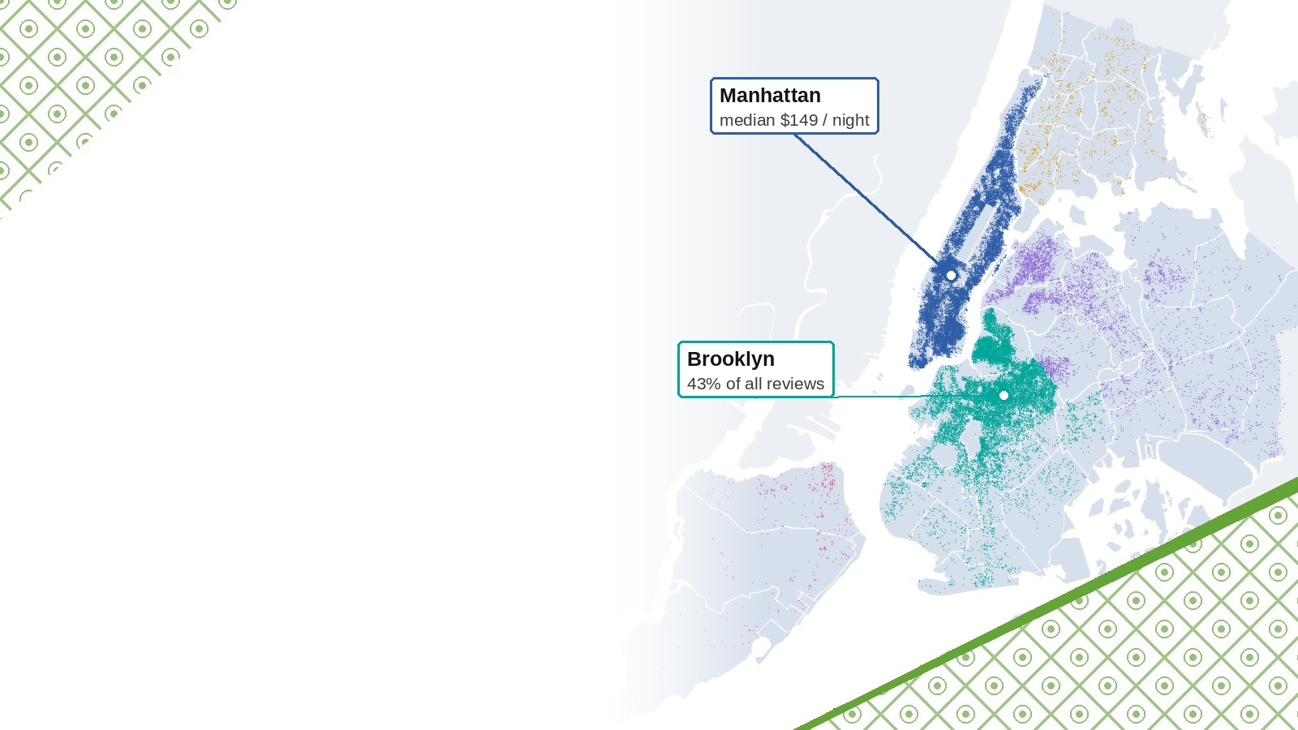
NYC AIRBNB MARKET
Where, what and at which price? Listing types, areas, prices, demand and hosts of New York City, 2019.
Task 12 | 48,645 listings | 5 boroughs | 221 neighbourhoods
KOUAME Koffi Fidèle
Data Analysis Internship | Final project | October 2026
Map and listings: the dataset supplied for the project (New York City, 2019), coloured by borough.

Slide 2
Roadmap: one dataset, seven questions
01
02
03
04
Data and cleaning
Questions 1 to 4
Questions 5 to 7
Dashboard and actions
48,895 listings, 16 columns; audit and 10 logged steps
Listing types, active areas, prices by area, price and reviews
Price factors, best performers, patterns and hosts
Seven-page Power BI dashboard, insights, recommendations
From the raw file to a dashboard and recommendations, every number reproducible.
OUTLINE
Data Analysis Internship | Task 12 | NYC Airbnb
2

Slide 3
The brief: seven business questions
 | Question | Measured with
Q1 | Which listing types are the most common? | listings by room type
Q2 | Which areas have the most activity? | listings (supply) and reviews (demand)
Q3 | How do prices differ across areas? | median price by borough and neighbourhood
Q4 | Is there a relationship between price, ratings and reviews? | rank correlation; no rating in the file
Q5 | Which factors seem to affect price? | multiple regression of the log price
Q6 | Which areas or listings perform best? | reviews per month, a proxy of stays
Q7 | Are there noticeable patterns or trends? | recency, availability, host size
Audience: hosts, Airbnb and the city. Only the supplied dataset is used.
OVERVIEW
Data Analysis Internship | Task 12 | NYC Airbnb
3

Slide 4
The dataset in one table
Group | Columns
Identifiers | listing id, host id
Location | borough, neighbourhood (221), latitude, longitude
Offer | room type, price per night, minimum nights
Demand | number of reviews, reviews per month, last review
Host and calendar | listings of the host, days available in the year
Text | listing name, host first name
48,895 listings
16 columns | the supplied dataset only
Not in the file
No rating: Q4 uses reviews.
No booking or revenue: prices are asked prices.
No size or amenities.
One snapshot of July 2019: it shows the offer and the demand, not satisfaction or revenue.
DATA
Data Analysis Internship | Task 12 | NYC Airbnb
4

Slide 5
Cleaning: ten logged steps
Issue | Rows | Treatment
Never reviewed: no date, no rate | 10,052 | rate = 0, flag
Names missing / extra spaces | 16 / 254 | filled / trimmed
Host name missing | 21 | column dropped
Price = $0 | 11 | removed
Price above $1,000 | 239 | removed
Minimum stay above 365 nights | 14 | capped at 365
Duplicates | 0 | none found
48,895 → 48,645
listings, 99.49 % kept
16 → 29
columns: 1 dropped, 14 derived (bands, host size, recency)
$106 → $105
median price before and after
250 listings removed (0.5 %): the median price only moves from $106 to $105.
CLEANING
Data Analysis Internship | Task 12 | NYC Airbnb
5

Slide 6
Key figures of the market
48,645
37,283
$105
listings in 221 neighbourhoods
hosts
median price per night (mean $141)
1.14 M
59.8 %
33.9 %
reviews in total
listings active in the last 12 months
listings of multi-listing hosts
A typical night costs $105; 60 % of the listings were reviewed in the last 12 months.
KPIS
Data Analysis Internship | Task 12 | NYC Airbnb
6

Slide 7
Question 1: listing types
51.8 %
entire homes, median $160 a night
45.8 %
private rooms, median $70 a night
2.4 %
shared rooms, median $45 a night
Two products: an entire home (median $160) and a private room ($70).
QUESTION 1
Data Analysis Internship | Task 12 | NYC Airbnb
7

Slide 8
Question 2: the most active areas
Reviews per listing
Staten Island
31.1
Queens
27.7
Bronx
26.0
Brooklyn
24.2
Manhattan
21.1
Brooklyn has fewer listings than Manhattan but receives more reviews.
QUESTION 2
Data Analysis Internship | Task 12 | NYC Airbnb
8

Slide 9
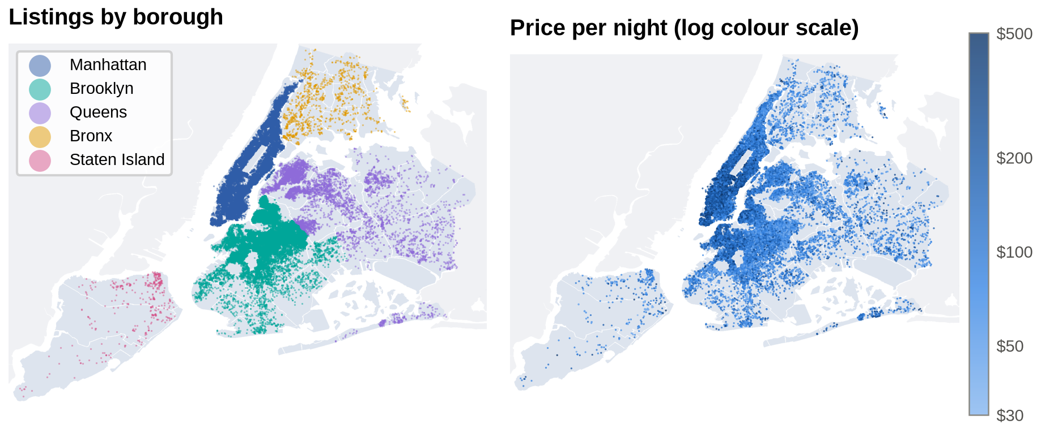
Where the listings are
Ten neighbourhoods hold 48 % of the listings; prices peak in Lower and Midtown Manhattan.
QUESTION 2
Data Analysis Internship | Task 12 | NYC Airbnb
9

Slide 10
Question 3: prices by area
$149 / $65
median, Manhattan / Bronx
$305
Tribeca, entire home (30+ listings)
$88
Midwood, entire home: 3.5 times less
Prices fall with the distance from Manhattan; an entire home costs about twice a room.
QUESTION 3
Data Analysis Internship | Task 12 | NYC Airbnb
10

Slide 11
Question 4: price, ratings and reviews
Listings never reviewed, by price band per night
ρ = -0.05
price and number of reviews: almost no link
0.46
median reviews a month at $50-99, the highest
37 %
of listings above $500 never reviewed
No rating in the file: reviews measure demand, and demand goes to affordable listings.
QUESTION 4
Data Analysis Internship | Task 12 | NYC Airbnb
11

Slide 12
Question 5: what moves the price
Difference in price, other factors held constant (%)
52 %
of the price variation explained (59 % with the 221 neighbourhoods)
41 %
explained by the room type alone
The rest needs data the file does not have: size, quality, amenities.
Room type and location set the price; the host's size does not.
QUESTION 5
Data Analysis Internship | Task 12 | NYC Airbnb
12

Slide 13
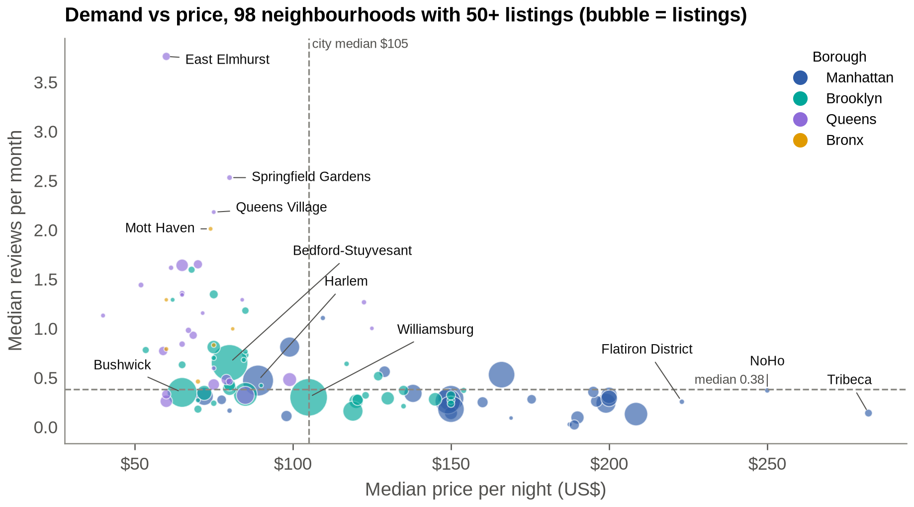
Question 6: where demand is strongest
3.76
reviews a month in East Elmhurst, next to LaGuardia
2.53
in Springfield Gardens, next to JFK, at $60-80
63 / 100
busiest listings in Queens; 64 are private rooms
Cheap rooms near the airports are the busiest listings of the city.
QUESTION 6
Data Analysis Internship | Task 12 | NYC Airbnb
13

Slide 14
Question 7: patterns in hosts and activity
59.8 %
35.9 %
reviewed in the last 12 months
closed calendar (0 days available)
343
310
hosts with 6+ listings run 4,755 listings
days open a year (median) for those hosts
40 % of the listings look inactive; 0.9 % of the hosts run 10 % of the offer.
QUESTION 7
Data Analysis Internship | Task 12 | NYC Airbnb
14

Slide 15
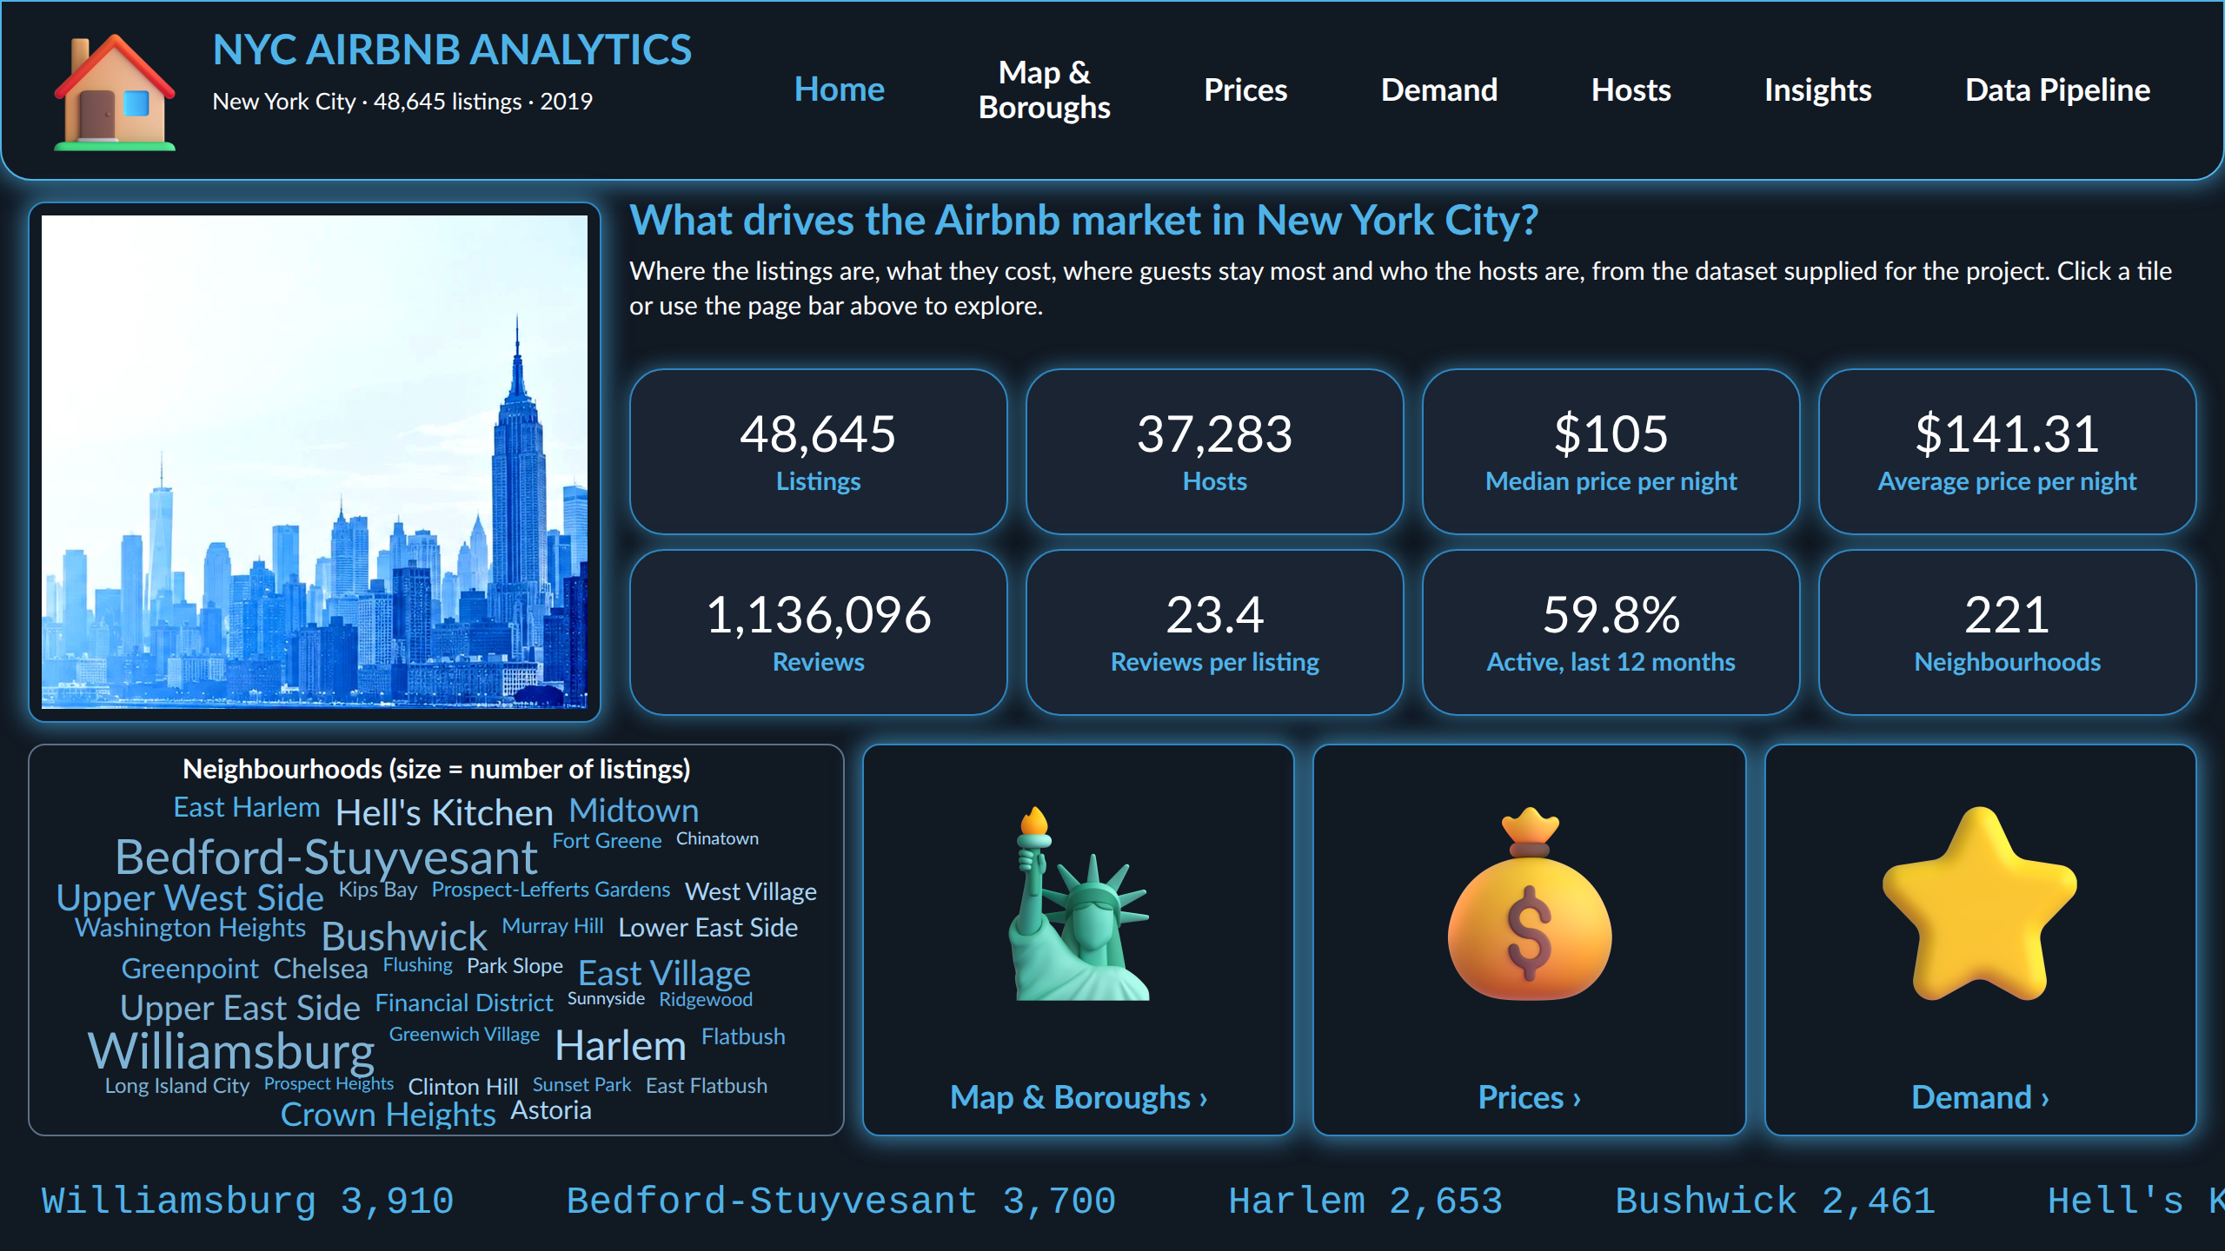
The Power BI dashboard
7 pages
Home, Map & Boroughs, Prices, Demand, Hosts, Insights, Data Pipeline
44 DAX measures
KPI cards, gauge against the city median
5 synchronised filters
borough, neighbourhood, room type, price, minimum stay
Map of 48,645 listings
on the map supplied with the data
Navigation
page navigator, picture tiles; cross-filtering on every chart
Every number of the dashboard is the number of the notebook (same cleaned tables).
DASHBOARD
Data Analysis Internship | Task 12 | NYC Airbnb
15

Slide 16
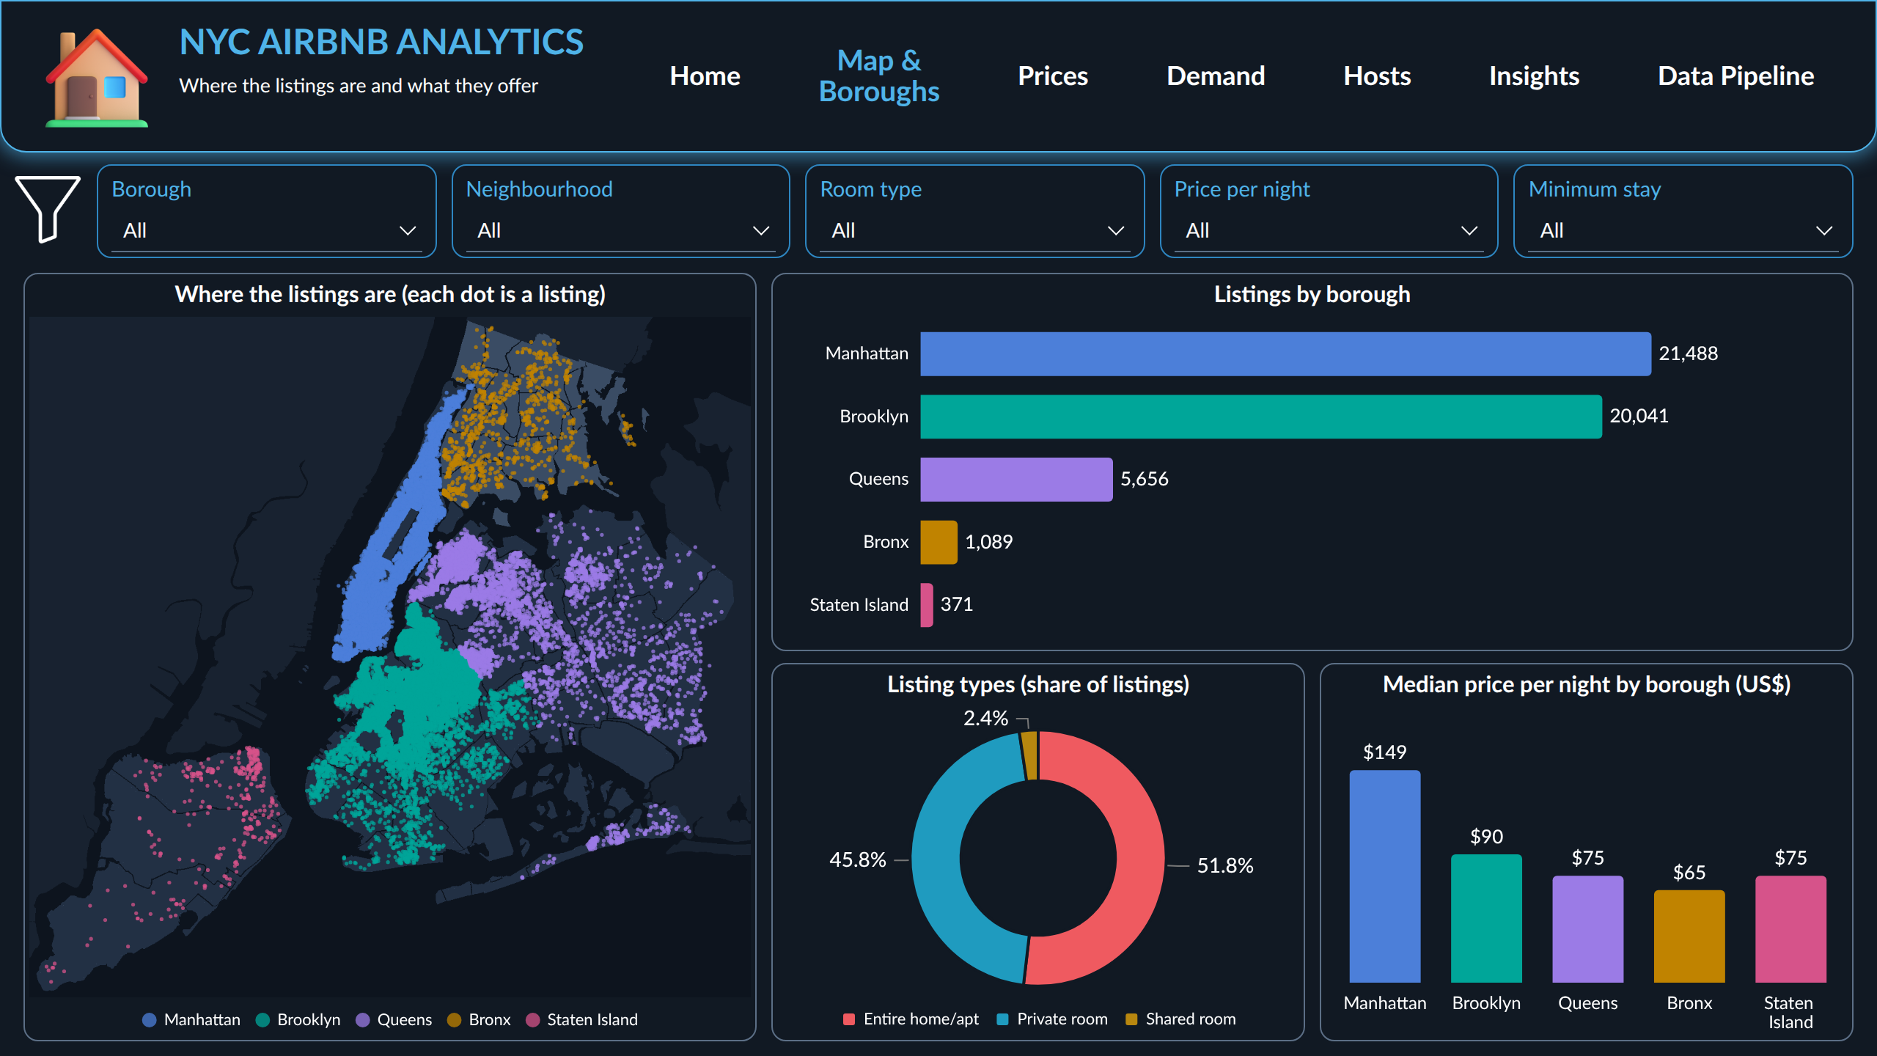
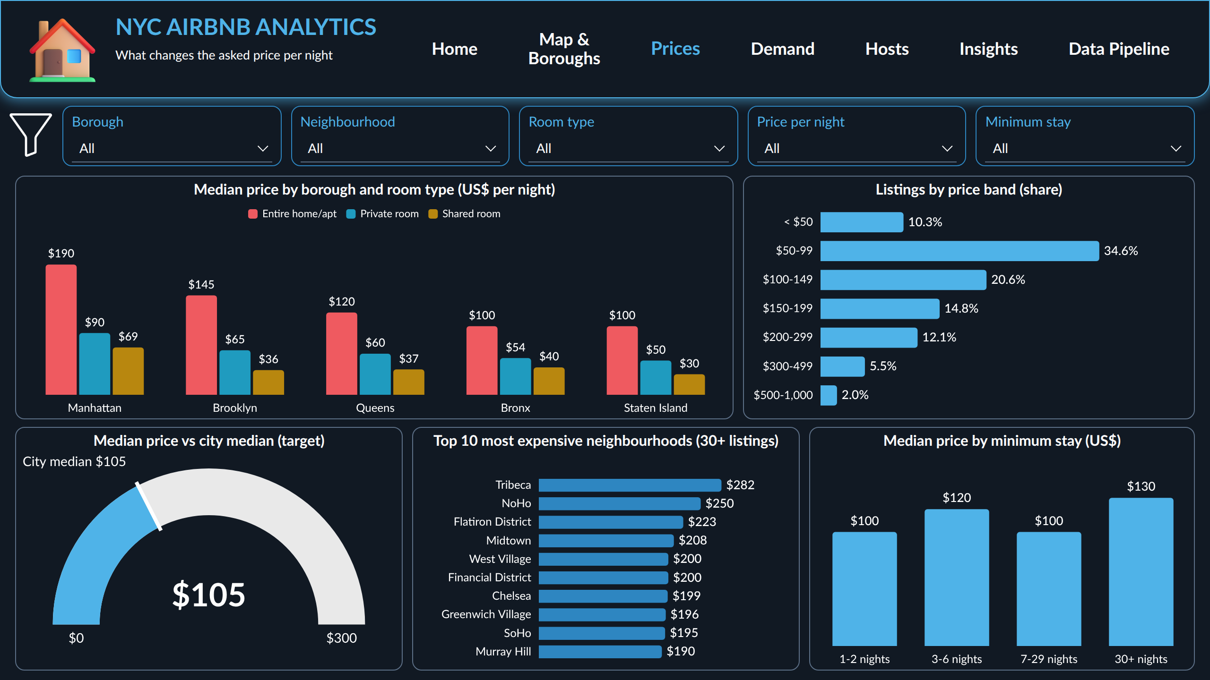
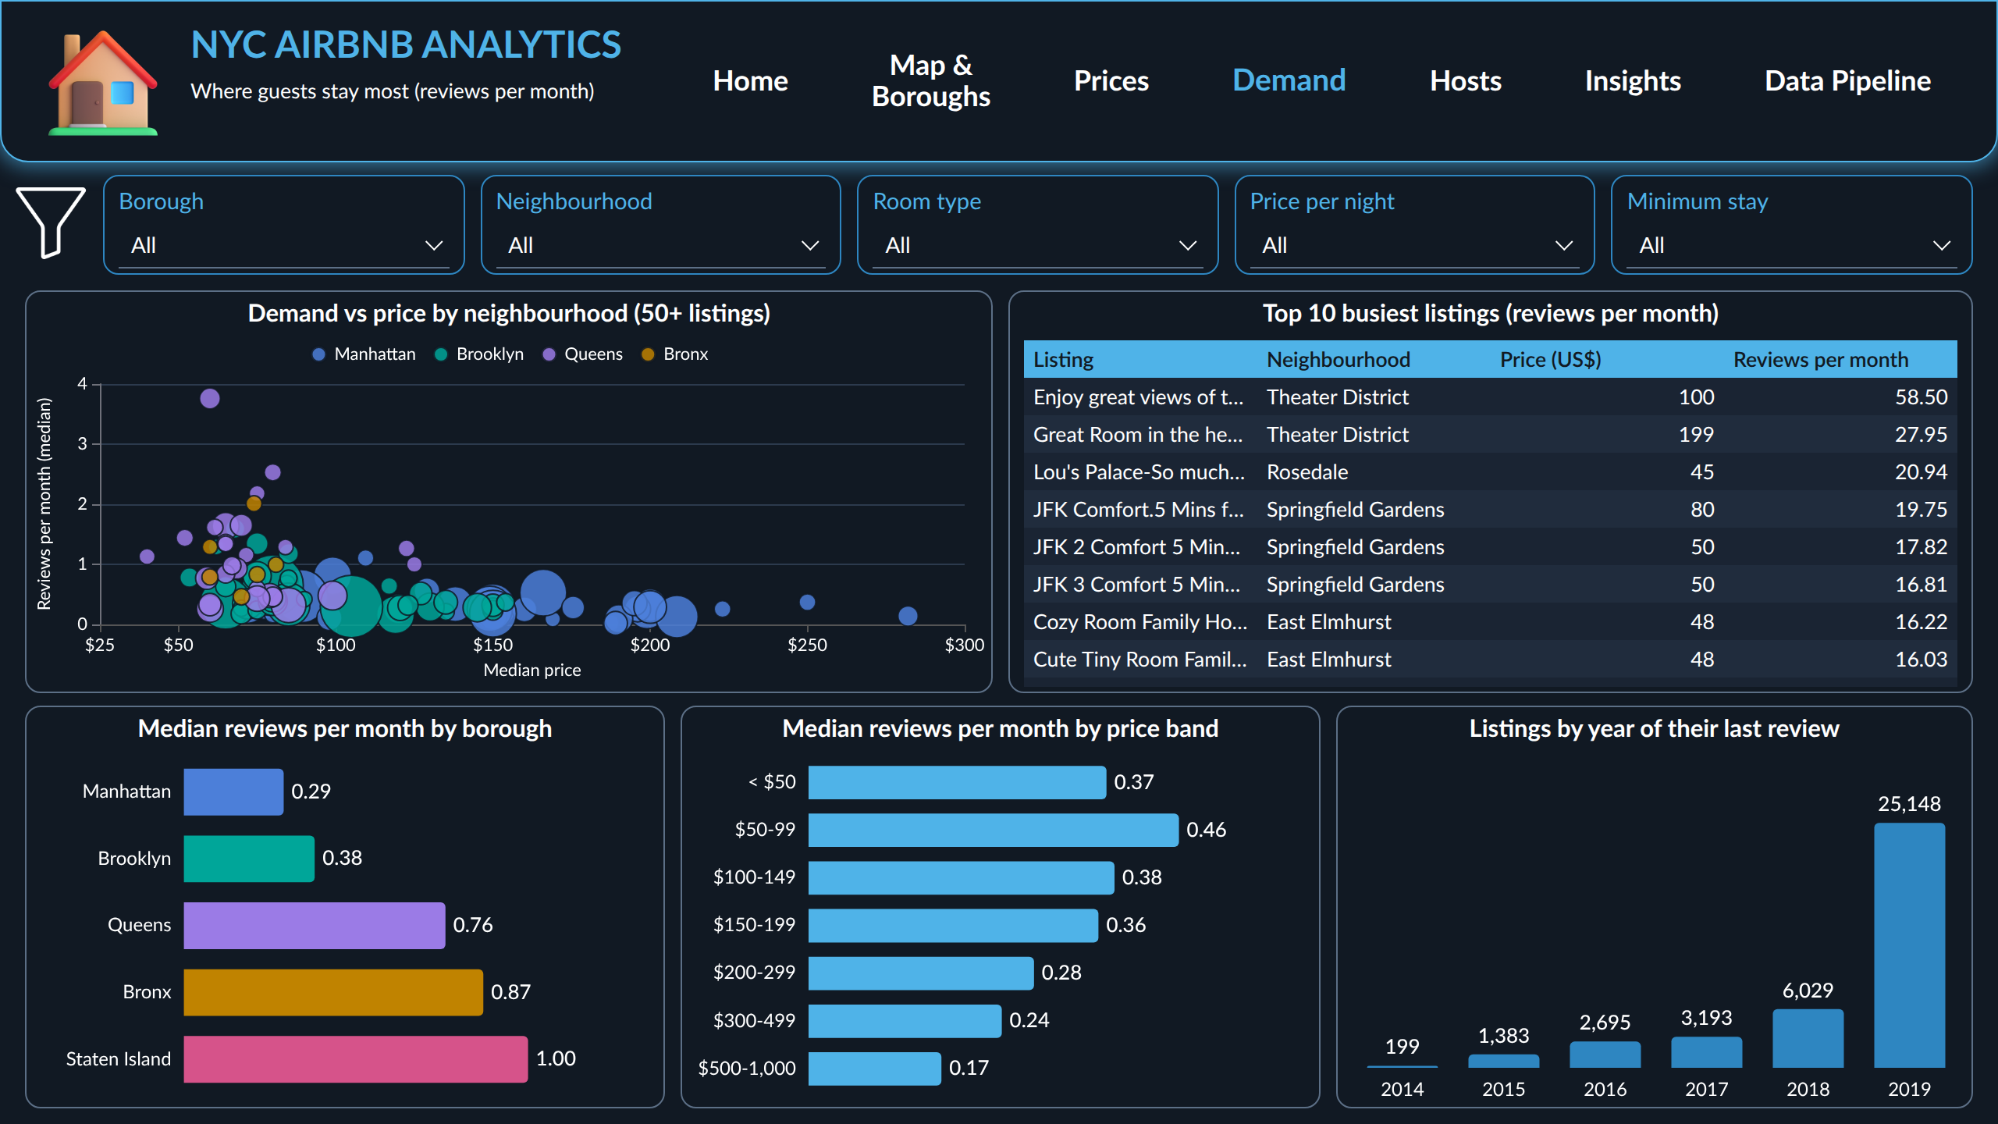
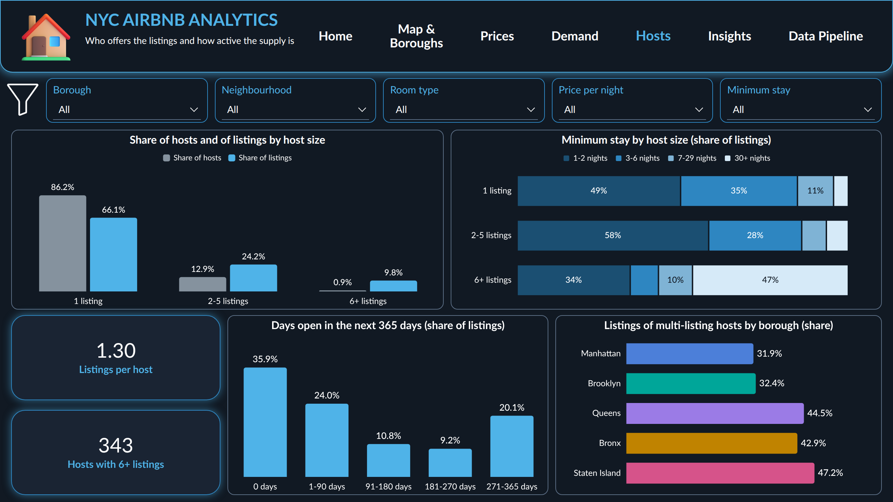
Dashboard pages
Map & Boroughs (Q1, Q2)
Prices (Q3, Q5)
Demand (Q2, Q4, Q6)
Hosts (Q7)
One page per group of questions, with the same filters on every analysis page.
DASHBOARD
Data Analysis Internship | Task 12 | NYC Airbnb
16

Slide 17
Business insights
What we found | What it means | Why it matters
52 % entire homes ($160), 46 % rooms ($70) | two products, two kinds of guests | compare prices within a room type
Brooklyn: fewer listings, more reviews | demand has moved beyond Manhattan | Brooklyn matters as much for growth
More reviews per listing outside Manhattan | supply is short where demand is high | less competition for new hosts
Price falls with distance from Manhattan | location sets the price level | a city-wide average misleads
Price and reviews unrelated (ρ = -0.05) | reviews follow affordability | a high price does not bring stays
40 % of listings inactive in 12 months | counts over-state the active supply | search results and market size inflated
0.9 % of hosts run 10 % of listings | a professional segment | targeted checks for the city
What we found, what it means, and why it matters for the decisions.
INSIGHTS
Data Analysis Internship | Task 12 | NYC Airbnb
17

Slide 18
Recommendations
Hosts
Airbnb
City
Next analysis
• Price against the median of the same room type in the same neighbourhood.
• Consider Queens and the airport areas.
• Open the calendar, shorten the minimum stay.
• Activate dormant listings: 20 % never reviewed, 36 % closed.
• Recruit hosts where demand per listing is high.
• Segment: short trips, families, monthly stays.
• Follow the 343 hosts with 6+ listings (4,755 listings).
• Check short-term rental rules there, not on home sharers.
• Add ratings, bookings and property size.
• Repeat on several snapshots for trends.
Price against the right benchmark, grow where demand is, activate the dormant supply.
RECOMMENDATIONS
Data Analysis Internship | Task 12 | NYC Airbnb
18

Slide 19
Conclusion
2
85 %
+119 %
40 %
products: entire homes and private rooms
of listings in Manhattan and Brooklyn
for an entire home, other things equal
of the listed supply looks inactive
The New York Airbnb market of 2019 is two products concentrated in Manhattan and Brooklyn, where the room type and the location set the price. Demand does not follow the price: it is strongest for affordable rooms in the outer boroughs and near the airports.
Thank you
Questions and discussion
CONCLUSION
Data Analysis Internship | Task 12 | NYC Airbnb
19

Slide 20
References
Data Analysis Internship, Task 12. AB_NYC_2019.csv and New_York_City_.png, dataset supplied for the final project.
Gebru, T. et al. (2021). Datasheets for Datasets. Communications of the ACM, 64(12), 86-92.
Kruskal, W. H., & Wallis, W. A. (1952). Use of ranks in one-criterion variance analysis. JASA, 47(260), 583-621.
Seabold, S., & Perktold, J. (2010). statsmodels: Econometric and statistical modeling with Python. Proc. 9th Python in Science Conf.
Microsoft. Power BI documentation. https://learn.microsoft.com/power-bi/
Microsoft. Fluent Emoji 3D (icons of the dashboard), MIT License. github.com/microsoft/fluentui-emoji
Project: github.com/koffifidelek59-collab/nyc-airbnb-analytics | koffifidelek59@gmail.com
REFERENCES
Data Analysis Internship | Task 12 | NYC Airbnb
20

