Slide 1
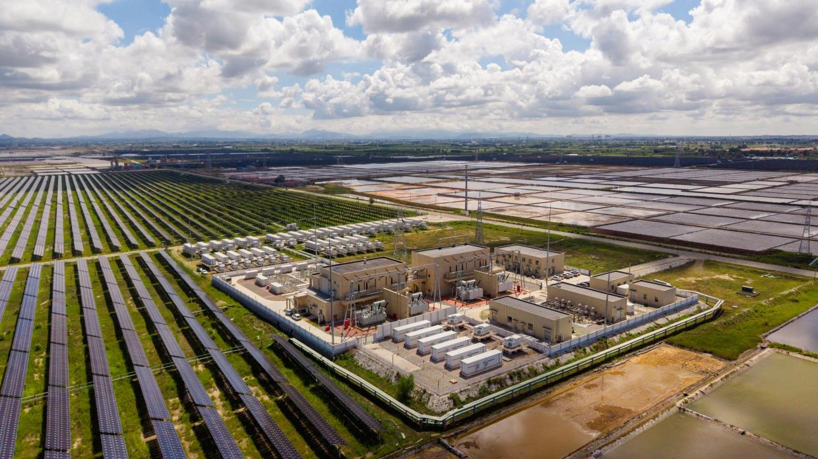
POWER SYSTEM CASE STUDIES WITH PYPSA
LOAD FLOW, OPERATING LIMITS AND RENEWABLE INTEGRATION | KOUAME KOFFI FIDÈLE, IMP-EGH
Notes:
Exercise 5 and the practical work on load flow, solved with PyPSA, plus two real cases on 2023 weather for Niger.

Slide 2
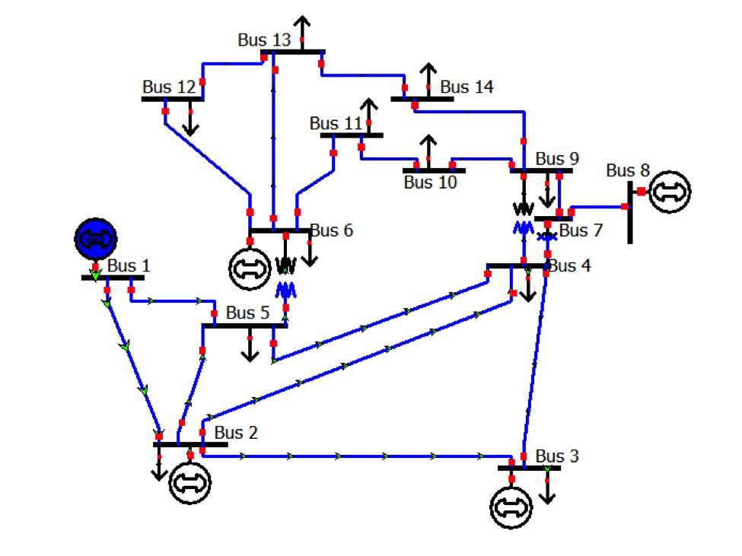
CASE STUDIES
Topics
Exercise 5: Newton's method and the Newton-Raphson load flow
TP case 1: power sharing (3 buses)
TP case 2: undervoltage (5 buses)
TP case 3: congestion and N-1 security (IEEE 9-bus)
TP case 4: demand growth (IEEE 14-bus)
TP case 5: solar, reverse power flow and storage (IEEE 14-bus)
Real case A: Niamey, solar and storage, every hour of 2023
Real case B: Agadez off-grid mini-grid
Notes:
Each case isolates one type of problem and follows the same scientific approach.

Slide 3
SCIENTIFIC APPROACH
The eight steps applied to every case
1
Statement and question
5
Implementation in PyPSA
2
Data and hypotheses
6
Results
3
Physical model (equations)
7
Verification
4
Solution method (algorithm)
8
Interpretation and recommendation
Notes:
Statement with the original diagram; data and hypotheses; model; method; PyPSA code; results; independent verification; interpretation.

Slide 4
PYPSA IN PRACTICE
Build the network, solve it, read the results
import pypsa
n = pypsa.Network()
n.add("Bus", "1", v_nom=110, v_mag_pu_set=1.00)
n.add("Line", "L1-2", bus0="1", bus1="2",
x=15.125, b=8.26e-4) # ohm, siemens
n.add("Generator", "G1", bus="1",
control="Slack", p_set=0)
n.add("Load", "D3", bus="3", p_set=250, q_set=100)
n.pf() # AC load flow
n.buses_t.v_mag_pu # voltages (p.u.)
n.optimize() # optimal power flow
Units: MW, MVAr, kV, ohm, siemens
Per-unit data: Z_B = kV²/MVA, then x = x_pu · Z_B
Bus types: Slack, PV (P and |V|), PQ (P and Q)
n.pf(): Newton-Raphson AC load flow
n.optimize(): dispatch and investment (HiGHS)
Check: PyPSA = own Newton-Raphson to 4e-15
Notes:
Five objects are enough: Network, Bus, Line, Generator, Load. Per-unit data are converted with the base impedance of the zone, as in the per-unit method sheet.

Slide 5
EXERCISE 5: NEWTON'S METHOD
Assignment 1: f(x) = 10x² − 2x³ = 0, f'(x) = 20x − 6x²
k | x_k (x0 = 1) | Δx | x_k (x0 = 4) | Δx
0 | 1.00000 | -0.57143 | 4.00000 | 2.00000
1 | 0.42857 | -0.22482 | 6.00000 | -0.75000
2 | 0.20375 | -0.10408 | 5.25000 | -0.22826
3 | 0.09966 | -0.05034 | 5.02174 | -0.02155
4 | 0.04932 | -0.02478 | 5.00019 | -0.00019
5 | 0.02454 |  | 5.00000001
From x0 = 1: double root 0, linear convergence (error halved each step)
From x0 = 4: overshoot to 6, then quadratic convergence to 5 (8 exact digits)
At x0 = 10/3, f'(x) = 0: no step possible
Load flow = vector Newton: the Jacobian replaces f'(x)
Notes:
Five iterations from each start. The double root slows Newton down; a simple root gives quadratic convergence.

Slide 6
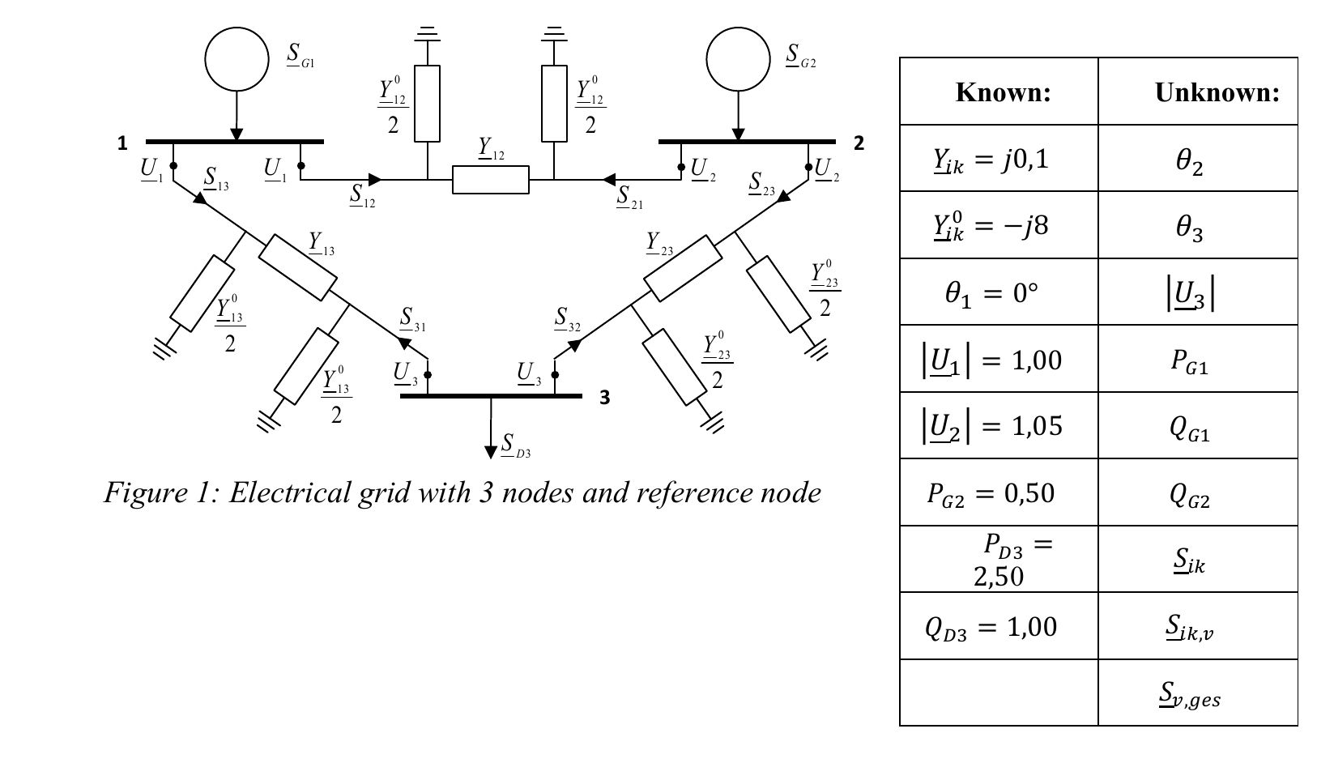
EXERCISE 5: LOAD-FLOW PROBLEM
Assignment 2: three buses, slack (1), PV (2), PQ (3)
Find Y, solve with Newton-Raphson, give flows and losses
Data check: the table values are swapped
Series admittance −j8 (X = 0.125 p.u.)
Total line charging +j0.1 (j0.05 per end)
Literal reading: no solution exists
Unknowns: θ2, θ3, |U3|
Notes:
The literal values give a capacitive series element and an 8 p.u. reactor; the problem has no solution. Swapping the values gives a normal line.

Slide 7
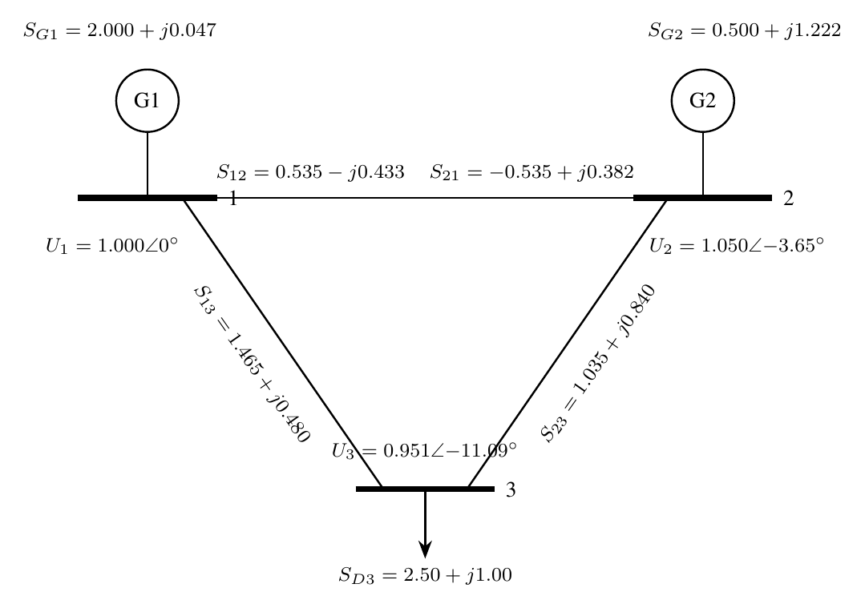
EXERCISE 5: SOLUTION
Admittance matrix, Newton-Raphson iterations, flows and losses
Y = [ −j15.9 j8 j8 ; j8 −j15.9 j8 ; j8 j8 −j15.9 ]
It. | max |ΔF| | θ2 (°) | θ3 (°) | |U3|
0 | 2.5e+0 | 0.000 | 0.000 | 1.0000
1 | 2.1e-1 | -3.578 | -10.567 | 0.9675
2 | 4.1e-3 | -3.652 | -11.083 | 0.9518
3 | 1.9e-6 | -3.653 | -11.095 | 0.9515
4 | 3.9e-13 | -3.653 | -11.095 | 0.9515
|U3| = 0.951 p.u., θ3 = -11.09°, 4 iterations
P_G1 = 2.000, Q_G1 = 0.047, Q_G2 = 1.222 p.u.
Losses: 0 + j0.269 p.u. (lossless lines)
Notes:
Quadratic convergence: 2.5, 0.21, 4e-3, 2e-6, 4e-13. Active balance exact, reactive losses 0.269 p.u.; PyPSA identical.

Slide 8
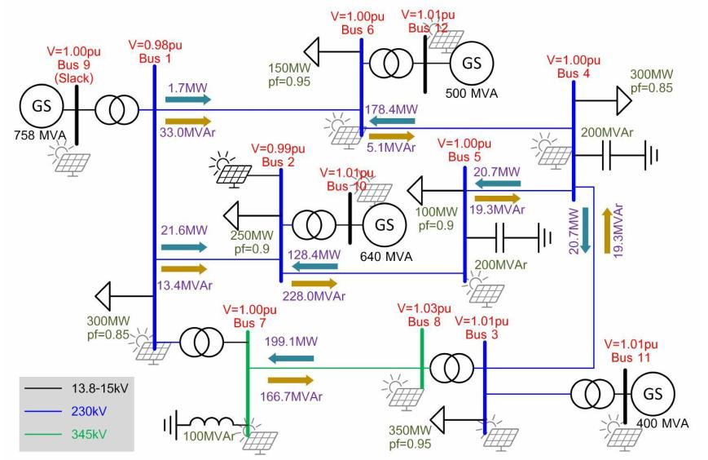
PRACTICAL WORK: LOAD FLOW ON A REAL NETWORK
Common thread: a solar plant in a grid supplying Niamey (educational data)
Build the network: buses, lines, generators, loads
Set parameters: R, X, ratings, P, Q
Set bus types: slack, PV, PQ
Run the AC load flow
Change the scenario: demand, solar, battery
Compare, interpret, recommend
Indicators: V, θ, P, Q, loading, losses
Notes:
Same protocol for every network size: 3, 5, 9 and 14 buses.

Slide 9
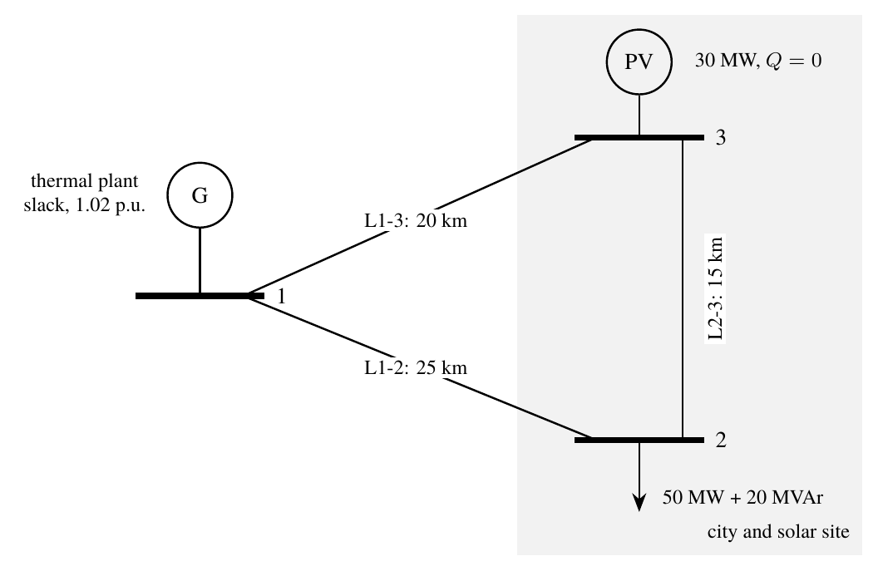
TP CASE 1: POWER SHARING (3 BUSES)
Thermal plant (slack), city 50 MW + 20 MVAr, solar plant 30 MW
Variant | |V2| | P thermal | Q thermal | Q PV | Losses
No PV | 1.009 | 50.3 | 17.8 | 0.0 | 0.28
PV, unity PF | 1.011 | 20.2 | 17.5 | 0.0 | 0.19
PV, voltage control | 1.013 | 20.2 | 5.7 | 11.7 | 0.18
Thermal output 50.3 → 20.2 MW (estimate 50 − 30 = 20)
Voltages 1.009-1.017 p.u.: close to nominal
Max loading 33 %; losses 0.28 → 0.19 MW
Voltage control: inverters give 11.7 MVAr (< 13.7 MVAr)
Notes:
Answers to questions 1 to 5 of the statement.

Slide 10
TP CASE 1: A REAL DAY
4 May 2023 (annual demand peak), real solar profile from NASA POWER
PV gives at most 20 MW and 15 % of the energy
Peak at 19:00, after sunset
Thermal must still cover 50 MW
Steep thermal ramp 16:00-19:00
Solar saves fuel, not capacity, without storage
Notes:
24 AC load flows with the measured solar profile; energy balance 837 + 147 = 980 + 4 MWh.

Slide 11
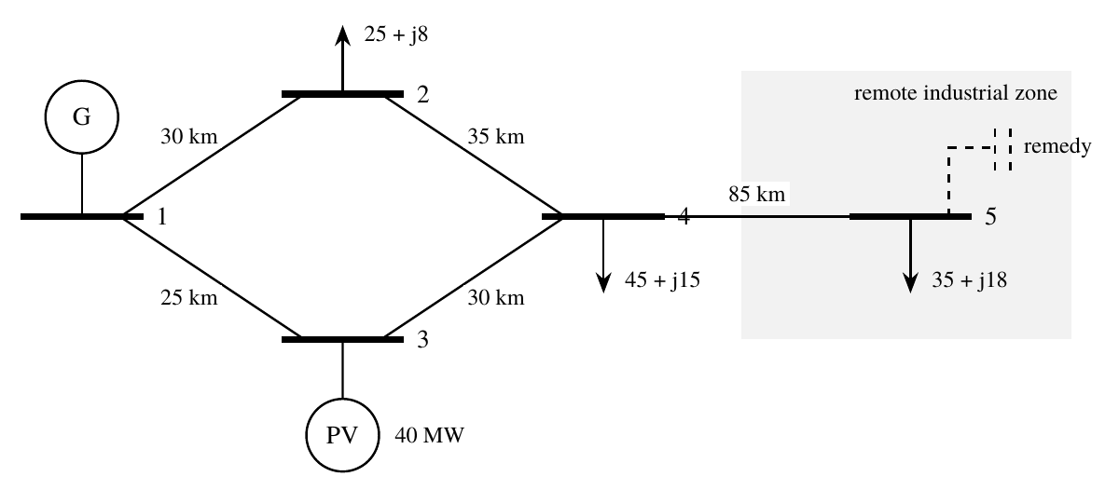
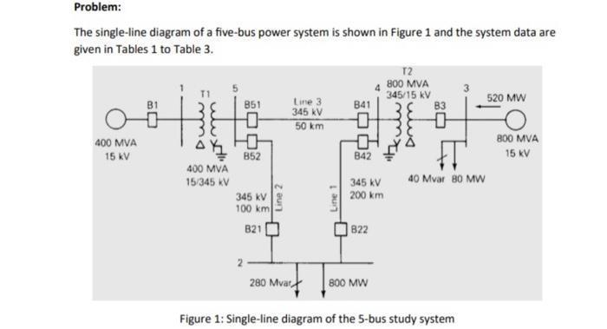
TP CASE 2: UNDERVOLTAGE (5 BUSES)
Remote industrial zone at the end of an 85 km line
V5 = 0.919 p.u. at the evening peak
Below 0.95 p.u. 24 hours a day
Cause: X ≈ 3R and a reactive load (35 + j18 MW)
Notes:
Only bus 5 violates the limit; the worst case is the evening peak without sun.

Slide 12
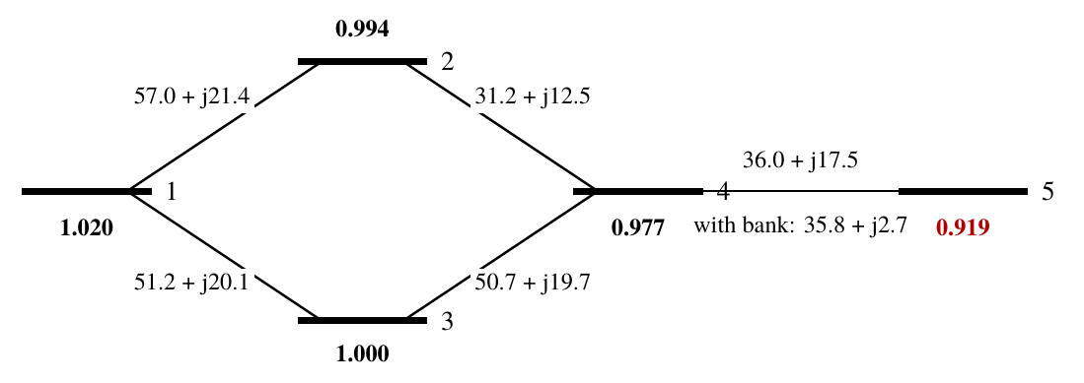
TP CASE 2: REMEDIES
Compared at the evening peak; 3.1 points of voltage needed
Recommendation: 15 MVAr capacitor bank (3 × 5 MVAr)
V5 0.919 → 0.959 p.u.; Q on line 4-5: 17.5 → 2.7 MVAr
Losses −14 % at the peak, −16 % over the day
PV inverters would need 68 MVAr (> 44 MVA)
Notes:
Smallest bank 11.8 MVAr by bisection; 15 MVAr chosen in three steps. Second circuit kept as long-term option.

Slide 13
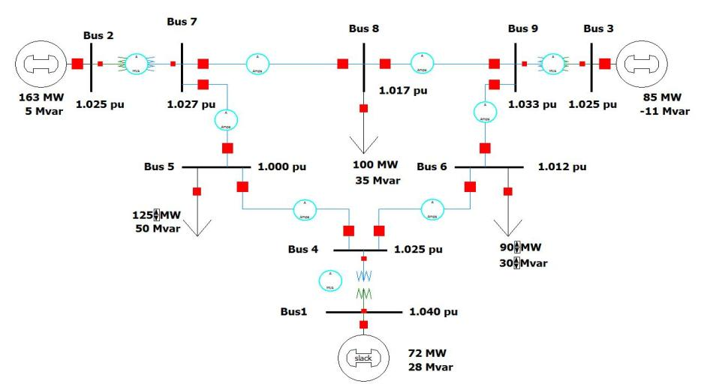
TP CASE 3: CONGESTION AND N-1 (IEEE 9-BUS)
Hot season (ratings −15 %) and evening peak (+15 %)
Loss of 8-9 overloads 5-6: 113 %
Security-constrained OPF: 99 %
AC check: loss of 9-4 → bus 9 at 0.75 p.u.
Notes:
The 115 % of the statement is reproduced by physics: hot-season derating and evening peak, then N-1.

Slide 14
TP CASE 3: DECISION
Redispatch first, reactive support where the AC check says so
Preventive redispatch
Nodal prices
Reactive support at bus 9
+54 $/h
25.5-31.3
62 MVAr
0.8 % of cost; 18 MW moved to G1
$/MWh instead of one price: value of the corridor
after the loss of 9-4: voltage 0.75 → 0.95 p.u.
Uprating line 5-6 fixes flows (97 %) but not the voltage at bus 9
Redispatch ≈ 32 k$ per year (600 critical hours): reinforce only if congestion becomes frequent
A DC optimisation must always be re-checked with the AC load flow
Notes:
Three levers, from the cheapest; the price spread tells planners when to reinforce.

Slide 15
TP CASE 4: DEMAND GROWTH (IEEE 14-BUS)
S0 to S5 (+0 to +50 %), generator reactive limits enforced
Up to +30 %: voltages fine, but all reactive reserve used
+50 %: nine buses below 0.95 p.u.; losses 13.4 → 35.2 MW
Maximum loadability +77 % (not +145 % as without limits)
Notes:
The first warning is the loss of reactive reserve, not a low voltage.

Slide 16
TP CASE 5: SOLAR, REVERSE FLOW AND STORAGE
PV plant at bus 14 of the IEEE 14-bus system, real profile of 16 March 2023
Scenario | max V14 | overvolt. h | reverse h | export MW
S0 no PV | 1.057 | 15 | 0 | 0
S1 PV 50 MW | 1.073 | 20 | 9 | 25
S2 PV 100 MW | 1.098 | 20 | 10 | 62
S3 PV 100 + battery | 1.080 | 24 | 14 | 38
S4 S3 + PF 0.95 | 1.046 | 0 | 14 | 37
Flow reverses when PV > local load (≈ 14 MW): 60 − 40 = 20 MW logic
Voltage rise is the limit, not line capacity
Battery cuts peak voltage and export but must be voltage-aware
Notes:
S4 = battery + PF 0.95 + set points lowered: no overvoltage hour.

Slide 17
REAL CASE A: NIAMEY, EVERY HOUR OF 2023
Least-cost solar and storage, with and without imports
Real weather: NASA POWER 2023, 1 710 kWh/kWp
Demand 726 GWh, peak 105 MW (model)
Fuel 180 $/MWh, imports 70 $/MWh
PV 800 $/kW, battery 4 h 1 150 $/kW
Islanded: 20 MW thermal must-run
Linear OPF + investment, 8 760 hours
Notes:
Islanded, the cost is 180 $/MWh; solar plus storage brings it to 140; with imports, solar still lowers 78 to 68.

Slide 18
REAL CASE A: RESULTS
Storage, not the grid, unlocks solar
333 MW
solar with a 196 MW / 783 MWh battery
72 %
of the yearly demand from the sun
−68 %
fuel, and −22 % yearly cost
Without storage: 154 MW PV, 20 % curtailed
Lines ≤ 67 %; AC check 0.968-1.02 p.u.
Notes:
The battery at the solar site also smooths the line flows. Thermal stays for monsoon weeks.

Slide 19
REAL CASE B: AGADEZ MINI-GRID
Solar + battery + diesel back-up, real weather 2023
 | Diesel only | Optimal hybrid
PV / battery | - | 7.5 MW / 18 MWh
Renewable share | 0 % | 94 %
Diesel per year | 3.48 M litres | 0.22 M litres
CO2 per year | 9209 t | 570 t
Cost of electricity | 0.30 $/kWh | 0.16 $/kWh
Hybrid halves the cost and cuts diesel by 94 %
Cheaper at every fuel price tested
Genset kept as back-up for monsoon days
Notes:
Fuel-price risk is replaced by a predictable investment.

Slide 20
RECOMMENDATIONS
For grid managers and decision-makers
Fix voltage cheaply first: capacitor banks at remote substations, review voltage set points
Monitor the reactive reserve, not only the voltage; plan compensation before demand grows 30 %
Operate N-1 secure in the hot season: preventive redispatch and AC contingency checks
Grid code for solar: reactive capability (PF 0.95) and voltage-aware storage
Invest in solar + storage: security for Niamey, hybrid mini-grids for northern towns
Key numbers
0.919 → 0.959 p.u. (capacitor)
113 % → 99 % for 54 $/h
Loadability +77 %
Hosting 3 → 129 MW
Niamey: −22 % cost, −68 % fuel
Agadez: 0.30 → 0.16 $/kWh
Notes:
Cheap operational measures first; storage is what lets the grid absorb solar.

Slide 21
NEXT STEPS AND DISCUSSION
From educational models to real decisions
Replace educational grids with real network and load data
Renewables.ninja and multi-year weather (2015-2023)
N-1 checks on every hour of the solar and storage plan
Feasibility of capacitor banks and a first solar + storage block
Financing and grid-code update for inverters
THANK YOU - QUESTIONS
Notes:
Code, datasets, notebooks and the workbook are in pypsa-case-studies/.

