Slide 1

What'sUpWithAI
An ETL Data Pipeline for Real-Time AI News Updates
Kofi Adom
https://github.com/kofiadom/AI_News_ETL_Pipeline

Slide 2
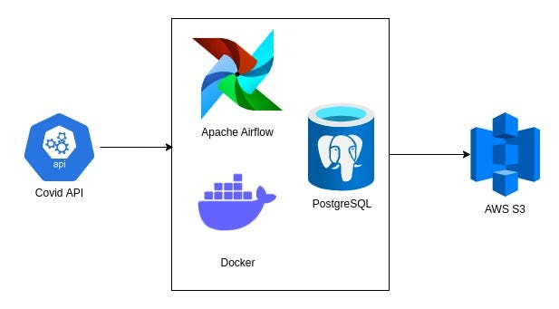

Project Overview
Goal: To develop an ETL data pipeline for extracting, transforming, and loading news articles related to Artificial Intelligence (AI) into data lake.
Focus: Utilize Docker, Airflow, and Python to extract data from NewsAPI, transform it, and ingest it into PostgreSQL and AWS S3 for seamless access to insights into the latest AI trends and developments.

Slide 3
My Role: Project Lead and Data Engineer
Responsibilities included:
Designing the overall architecture of the data pipeline.
Implementing Docker to host Airflow.
Writing Python scripts to extract and transform data from NewsAPI.
Setting up PostgreSQL and AWS S3 for data storage.
Ensuring data integrity and pipeline efficiency.

Slide 4
Technical Challenges
Integrating Docker with Airflow for seamless orchestration.
Handling real-time data extraction from NewsAPI.
Transforming raw data to meet specific requirements.
Ensuring data consistency and handling potential data discrepancies.
Managing and optimizing storage solutions in PostgreSQL and AWS S3.

Slide 5
Solutions Approach
Docker and Airflow: Used Docker to containerize Airflow, enabling easy deployment and management of the data pipeline.
Python packages: Developed custom Python scripts leveraging packages (eg: event registry) to extract data from NewsAPI and perform necessary transformations.
PostgreSQL and AWS S3: Utilized PostgreSQL for structured data storage and queries, and AWS S3 for scalable and durable storage.
Data Validation: Implemented validation checks to ensure data quality and consistency.

Slide 6
Results and Impact
Established a robust and scalable data pipeline for continuous monitoring of AI-related news.
Enabled data-driven insights and decision-making for businesses and organizations operating in the AI domain.
Facilitated the identification of emerging trends, potential opportunities, and areas for further research and development.

Slide 7
Lessons Learned
Importance of containerization for scalable and manageable deployment.
Challenges of real-time data extraction and the need for efficient handling.
Best practices in data transformation and validation to ensure data integrity.
Effective use of cloud storage solutions like AWS S3.
Continuous learning and adaptation to new tools and technologies.

Slide 8
Adaptability
Demonstrated ability to adapt to evolving data sources and project requirements.
Flexibility in integrating new tools and technologies to enhance project outcomes.
Capability to troubleshoot and resolve unforeseen technical challenges.
Commitment to continuous improvement and learning in the field of data engineering.

Slide 9
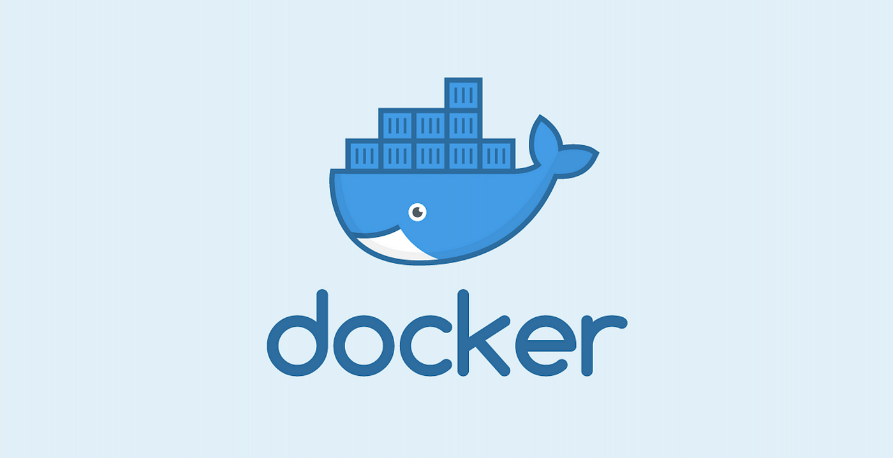
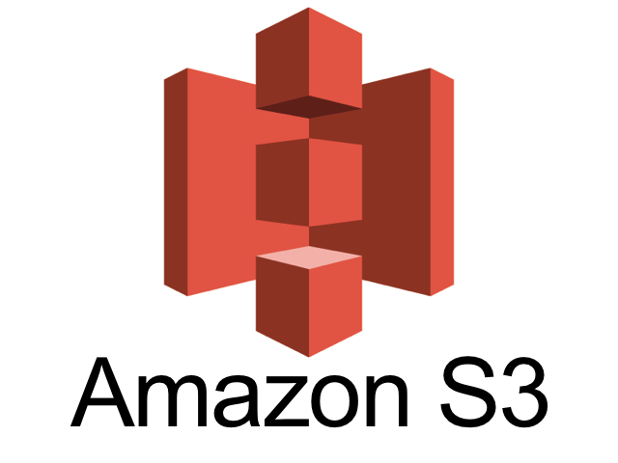



Technical Tools & Technologies

Slide 10
Closing Statement
This project showcases my ability to handle complex data engineering challenges.
Demonstrated expertise in using Docker, Airflow, Python, PostgreSQL, and AWS S3.
Proven track record of delivering efficient and scalable data solutions.
Strong collaborative skills and commitment to continuous learning and improvement.

