Slide 1
IMDB MOVIE REVIEWS
Sentiment Analysis: Trends & Model Results
50,000 reviews · TF-IDF features · Logistic Regression, Naive Bayes, Random Forest & LDA topic modeling
50,000
reviews analyzed
88.4%
best model accuracy
7
latent topics discovered
3,000
TF-IDF vocabulary terms

Slide 2
The Dataset
A perfectly balanced benchmark for binary sentiment classification
PROCESSING PIPELINE
25,000
25,000
1
Lowercase & strip HTML tags
2
Remove non-alphabetic characters
POSITIVE REVIEWS
NEGATIVE REVIEWS
3
Tokenize & remove stopwords
50% of dataset
50% of dataset
4
TF-IDF vectorize (3,000 terms)
5
80 / 20 train-test split
Source: IMDB Dataset of 50K Movie Reviews (Kaggle)

Slide 3
Model Performance
Four classification approaches, evaluated on a held-out 20% test set (10,000 reviews)
BEST MODEL
Logistic Regression
88.4% accuracy · 0.954 ROC-AUC
ROC-AUC BY MODEL
Logistic Regression
0.954
Naive Bayes
0.926
Random Forest
0.920
The ensemble slightly trades peak accuracy for more balanced, robust predictions across models.

Slide 4
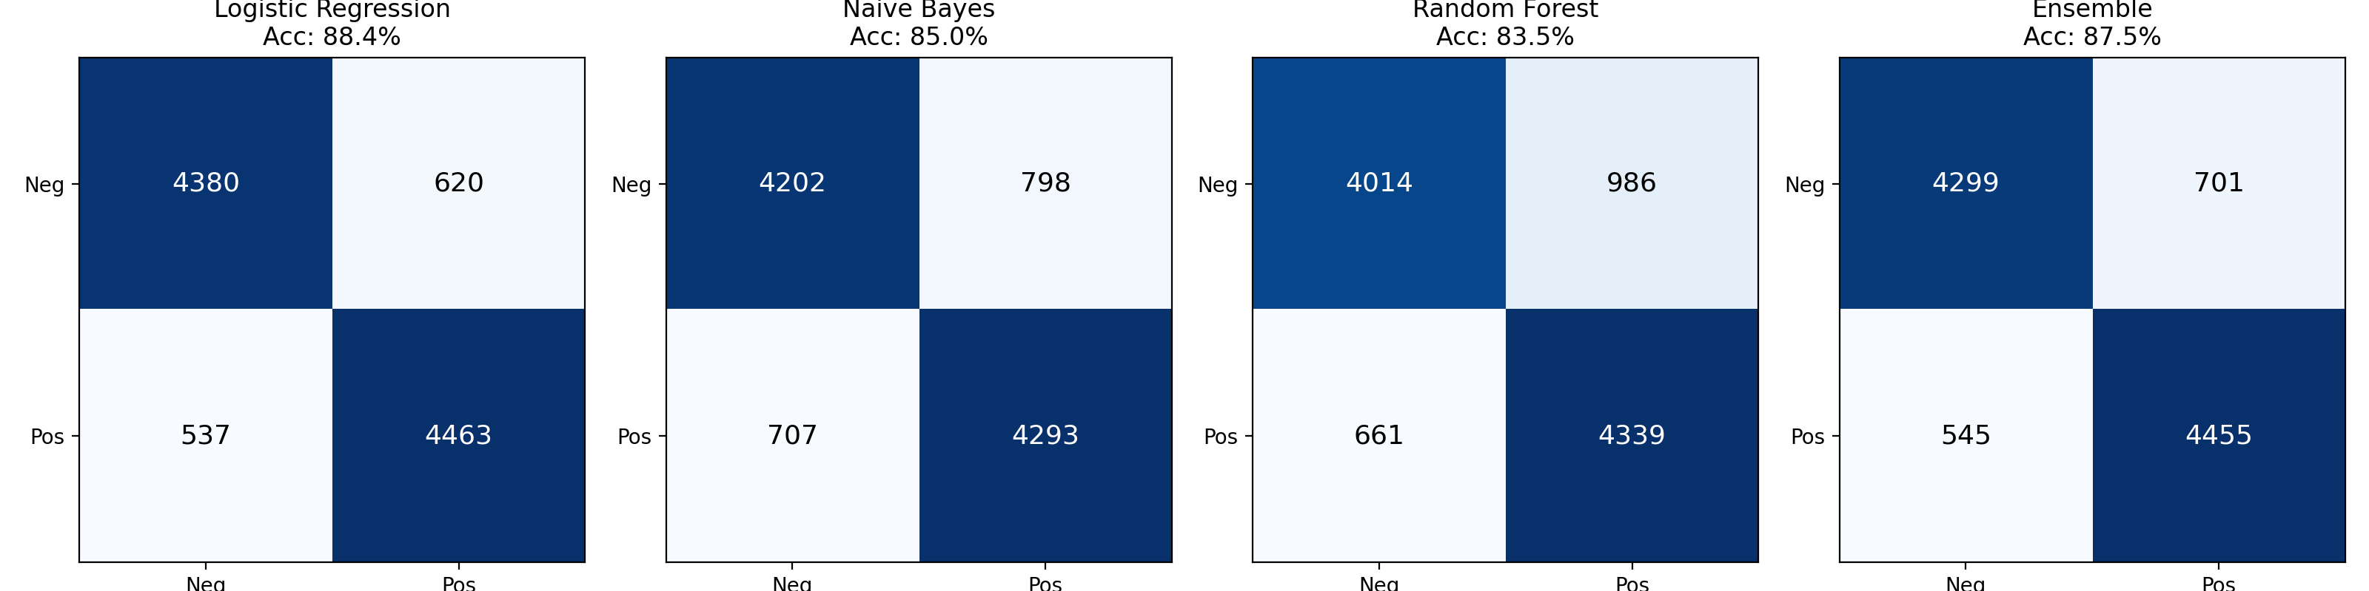
Where Each Model Gets Confused
Confusion matrices on the 10,000-review test set (rows = actual, columns = predicted)
Logistic Regression has the fewest total errors (1,157 of 10,000) and the most balanced error split between false positives and false negatives.
Random Forest shows the largest asymmetry — it misses more true positives (986 false negatives) than it does true negatives, suggesting a mild bias toward predicting “positive.”
Naive Bayes sits between the two, trading some accuracy for its much faster training time — a classic speed/accuracy tradeoff for this feature space.

Slide 5
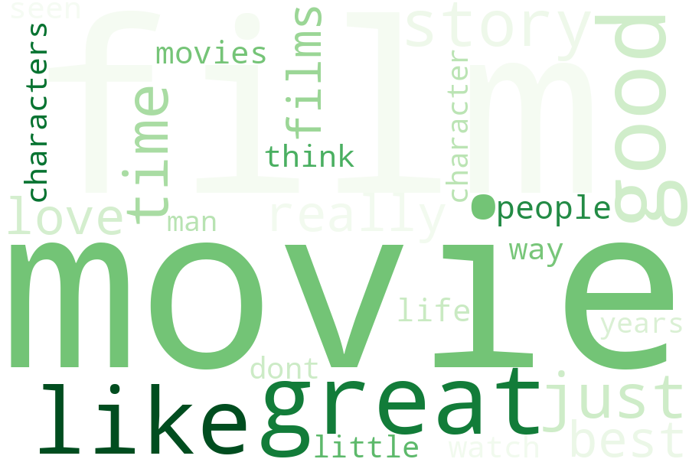
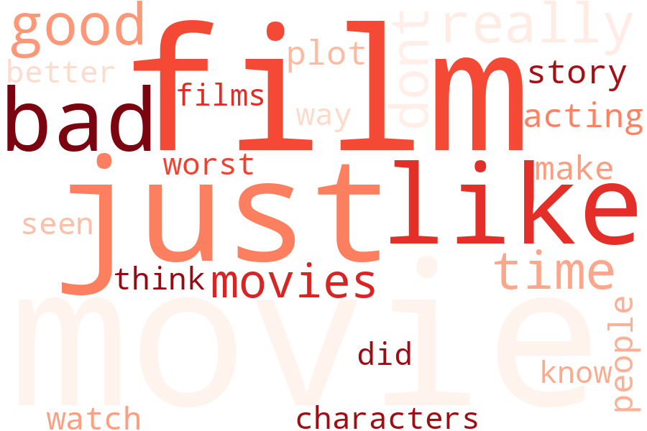
The Words That Drive Sentiment
Highest cumulative TF-IDF weight, split by review sentiment
POSITIVE REVIEWS
NEGATIVE REVIEWS
Top positive drivers: great, excellent, perfect, amazing, best · Top negative drivers: worst, waste, awful, bad, boring

Slide 6
Strongest Sentiment Signals
Logistic Regression coefficients — how strongly each term pushes a prediction toward positive or negative

Slide 7
What Reviewers Actually Talk About
7 latent topics from LDA topic modeling, colored by how positively each topic skews
1
Storytelling & characters
2
Star performances & genre
3
Casual / mixed reactions
4
Enthusiastic praise
film, story, life, films, book, people, time
film, films, best, john, star, role, game
movie, just, like, really, little, girl, good
great, movie, good, series, love, best, story
78% positive · n=5,641
73% positive · n=2,115
49% positive · n=5,417
85% positive · n=6,418
5
War & family drama
6
Horror & plot criticism
7
Casual negative takes
man, war, life, wife, world, woman, young
film, plot, films, good, just, horror, acting
movie, like, just, bad, movies, dont, really
66% positive · n=4,666
27% positive · n=10,544
33% positive · n=15,199

Slide 8
Key Takeaways
01
02
Simple models win here
Sentiment words are highly distinctive
Logistic Regression on TF-IDF features (88.4% accuracy, 0.954 AUC) outperformed both Naive Bayes and a 200-tree Random Forest — sentiment in this dataset is largely linearly separable.
"Worst," "waste," and "awful" carry more predictive weight than any positive term, meaning negative reviews are somewhat easier to detect confidently than positive ones.
03
04
Horror & casual reviews skew negative
An ensemble adds robustness, not accuracy
Topics dominated by "horror / plot / acting" and casual "just / like / bad" language have the lowest positive rates (27–33%), while enthusiastic "great / love / best" language topics run 85%+ positive.
Majority voting across all three models (87.5%) landed between Logistic Regression and Naive Bayes — useful for stability, but it doesn't beat the best single model here.

