Slide 1
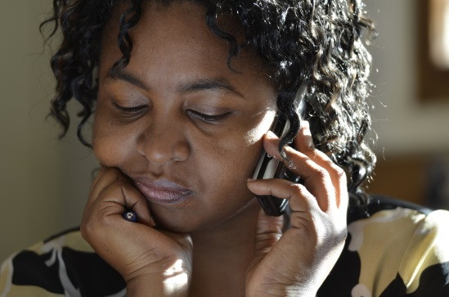
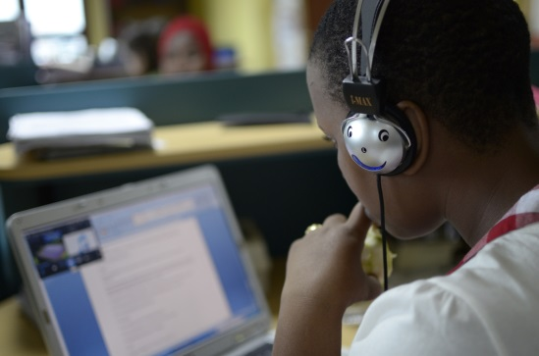
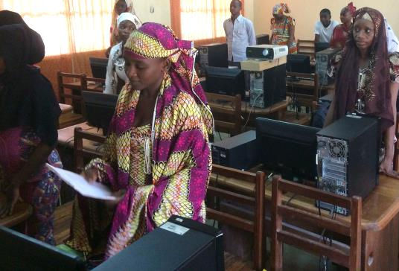
#Hackathon
#eServices
#PRADEC-UN
#nodigitaldivide
Notes:
jjjjjjj
<number>

Slide 2
Agenda
Presentation ICT Component GIZ-PRADEC The TCP project in Cameroon Connectivity approach Idea of the platform Résultats attendus

Slide 3
i. ICT Component GIZ-PRADEC
The Support Programme for Municipal Development (PROMUD) , under the authority of the Ministry of Decentralization and Local Development (MINDDEVEL), support municipalities on: Local finances Public Infrastructure Management Local Development Service Capacity building of Multipurpose Community Telecentres (TCP) to provide demand-driven digital services (ICT component)

Slide 4
i. ICT Component GIZ-PRADEC
The ICT component is part of the "Digital Africa" initiative of the German Federal Ministry for Economic Cooperation and Development, which aims to improve Internet access in the regions of intervention and to provide digital services based on needs. The main areas of the component are ... Support Internet access for the community via telecentres Develop different management models for telecentres Design and implement innovative digital services based on needs municipal services (municipalities), education and health, etc.
Notes:
<number>

Slide 5
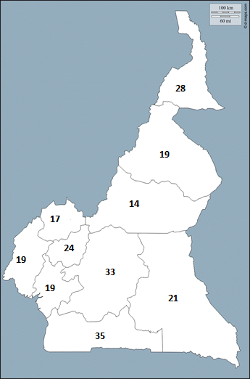
ii. The TCP project in Cameroon
The project was launched by the Ministry of Posts and Telecommunications (MINPOSTEL) in the early 2000s with the aim of bridging the digital divide and supporting the development of rural areas by facilitating access to ICT tools and services at affordable prices . So far, 231 multipurpose community telecentres have been established throughout the country, mainly in rural areas.
2.11.2018

Slide 6
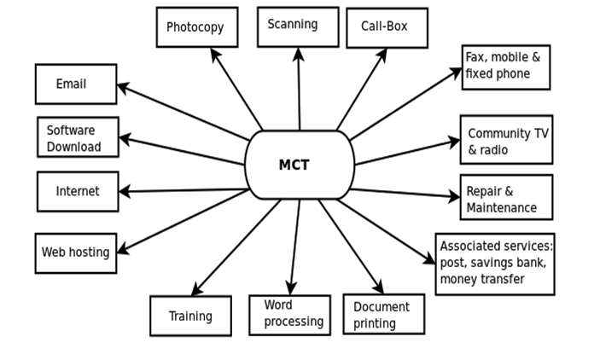
ii. The TCP project in Cameroon
MINPOSTEL strategic plan on digital development: transforming telecentres into important social interaction points providing access to the Internet and information as well as digital services / literacy
But faced with many organizational, structural and infrastructural difficulties among which: Limited capacity (VSAT, PC, ...) Lack of relevant content (What on Internet?) High cost (for the low-income population) Need to go to the telecentre …
Telecentres in a building vs telecentres as community network management centers
2.11.2018
Notes:
<number>

Slide 7
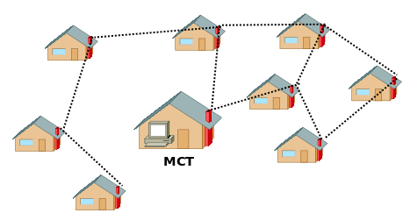
iii. Connectivity Approach
Services administratifs
Marché
Ecoles
?
Autres
Mairie
Hôpital
ONG

Slide 8
iv. Platform Idea
The network without the services will be useless.
The network provides access to resources and services and eventually to the Internet.
The platform is the point of entry into the network: the portal.
Three categories of users:
Category 1: User with access to local services and resources only
Category 2: Category 1 + access to certain online services only
Category 3: Category 2 + access to the Internet

Slide 9
iv. Idée de la plateforme
Catégorie 3
Catégorie 2
Catégorie 1
En local
Partiellement en ligne
En ligne
Ressource
Service
Ressource
Service
Internet complet
Ressource
Service
Service
Plateforme de services
Réseau Communautaire sans fil

Slide 10
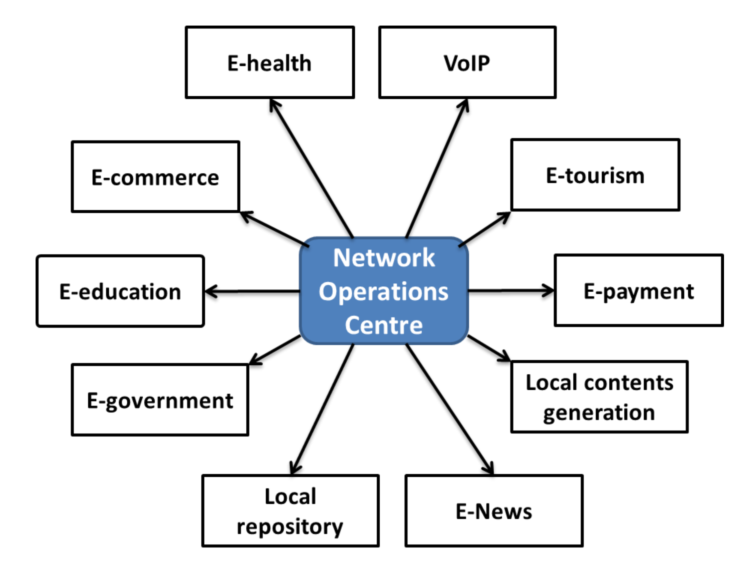
iv. Idée de la plateforme
Juste pour vous inspirer!!!

Slide 11
v. Expectations of the platform
Frontend
Content Presentation (Simple and responsive interface)
Easy navigation
User dashboard
Color harmonization
Organization (bundling) of content
Feedback Mechanism
Help User
Default settings

Slide 12
vi. Attentes de la plateforme
Backend
Ease of deployment of the platform on the network (Technologies)
Easy deployment of new services on the platform
Dashboard of Services for the Administrator
User Management
Integration of metrics
History Management
Easy maintainability of deployed services
Help User

Slide 13
vii. Functional Requirements
La plateforme des Télécentres Communautaires doit être capable de:
View meeting reports and municipalities newsletters
Host the entire wikipedia database accessible offline
Access the various IT training opportunities provided by the Telecentre
Measure the traffic of the connections, of the most visited pages
disseminate the news of the locality
bring together people living in the community through forums, blogs and even instant discussions
Any other useful features for the community (demonstrate creativity)

Slide 14

If Question then
please_ask
Else
Thank you;
End
goto code;
#PRADEC-UN
#eServices
#HackathonGIZ-UN
#nodigitaldivide
Notes:
<number>

