Slide 1
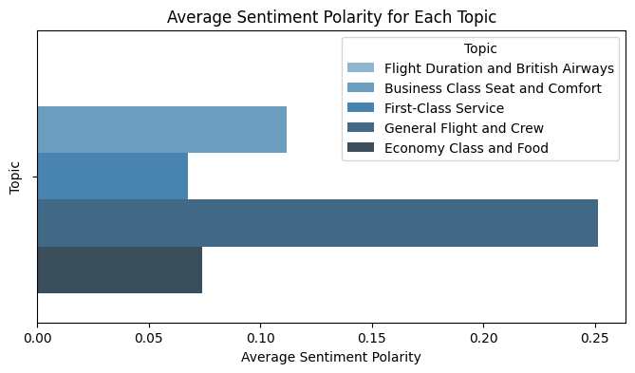
Sentiment Analysis and Topic Modeling Insights on British Airways Reviews
Key Insights:
Key Insights:
1. General Flight and Crew: 0.251 (Highest sentiment)
2. Business Class Seat and Comfort: 0.112
3. First-Class Service: 0.068
4. Economy Class and Food: 0.074
5. Flight Duration and British Airways: 0.000

