Slide 1










全体構成
Internet
AWS Cloud
File system
(Amazon EFS)
Amazon CloudFront
Bucket for MediaFile
Virtual private cloud (VPC)
Availability Zone
Application Load Balancer
Availability Zone
Auto Scaling group
Instance
Instance
Amazon Aurora
Amazon Aurora

Slide 2




ネットワークトポロジー
AWS Cloud
Virtual private cloud (VPC)
172.16.0.0/16
Availability Zone
Availability Zone
Public subnet
Internet gateway
Public subnet
172.16.10.0/24
172.16.20.0/24
NAT gateway
NAT gateway
Bastion Instance
Private subnet
172.16.40.0/24
172.16.30.0/24
Private subnet
Instance
Amazon Aurora
Instance
Amazon Aurora

Slide 3




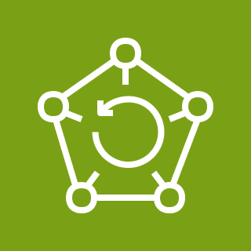
運用監視図
Email
AWS Cloud
AWS Backup
Amazon CloudWatch
Alarm
Amazon SNS
Virtual private cloud (VPC)
Availability Zone
Availability Zone
Auto Scaling group
Instance
Instance
Amazon Aurora
Amazon Aurora

Slide 4




セキュリティ構成
Internet
HTTPs Connection
AWS Cloud
SSH Connection
Virtual private cloud (VPC)
SSL Certificate
HTTPs Connection
Availability Zone
Application Load Balancer
Availability Zone
Amazon CloudFront
ACM
Public subnet
HTTP Connection
Agent
AWS WAF
Bastion Instance
SSH PortForward
Private subnet
Auto Scaling group
Amazon Inspector
Agent
Agent
Instance
Instance

Slide 5
ファイアウォール構成(Ingress)
AWS Cloud
Virtual private cloud (VPC)
Port 443
CloudFront Prefix List Only
Security group(LB)
Security group(Bastion)
Port 22
Limited IP Address Only
Amazon CloudFront
Internet
Security group(Instance)
Port 80
Security group(LB)
Port 22
Security group(Bastion)
Security group(database)
Port 3306
Security group(EFS)
Port 2049
Security group(Instance)
Any
Security group(NAT Gateway)

Slide 6


ログフロー
AWS Cloud
Amazon CloudFront
Log Bucket
Virtual private cloud (VPC)
Availability Zone
Application Load Balancer
Availability Zone
Auto Scaling group
Bastion Instance
Instance
Instance
Operating System Log
Amazon CloudWatch
Performance Log
Amazon Aurora
Amazon Aurora
Logs

