Slide 1
Ethical Hacking 101
October 2019
By: AJ Savino

Slide 2
The difference between “Hacking” and “Ethical Hacking” is permission.

Slide 3
EC-Council Certified Ethical Hacker v9 curriculum
Footprinting and Reconnaissance
Scanning Networks
Enumeration
System Hacking
Malware Threats
Sniffing
Social Engineering
Denial of Service
Session Hijacking
Hacking Web servers
Hacking Web Applications
SQL Injection
Hacking Wireless Networks
Hacking Mobile Platforms
Evading IDS, Firewalls, and Honeypot
Cloud Computing
Cryptography

Slide 4
Phases
Reconnaissance
Scanning / Enumeration
Gaining access
Maintaining access
Clearing tracks
Document everything!

Slide 5
Passive Reconnaissance
Don’t interact with target
Public information and News
Social networks (LinkedIn, Facebook)
Job postings
Whois records
Google Hacking Database

Slide 6
Active Reconnaissance
Interact with target
Social engineering (call reception, contact employees)
Visit company sites
Determine network range
Identify hosts
Find open ports

Slide 7
Scanning / Enumeration
Scan network
Identify hosts / OS
Identify open ports
Identify services
Map network
Scan for vulnerabilities
Identify users and groups

Slide 8
Scanning / Enumeration tools
Nmap
Hping3
Netcraft
Shodan
Nessus
Acunetix
Arachni
NetBIOS Enumerator
SNMP Scanner
LDAP search

Slide 9
Gain access
Gain access to machine, application, network
Use specific exploit
Default credentials
Buffer overflow
Session hijacking
Social engineering
Password cracking
Privilege escalation (horizontal or vertical)

Slide 10
Maintain access
Patch the vulnerability to maintain control
Change credentials
Change configurations
Insert a backdoor
Pivot from compromised system to launch further attacks

Slide 11
Clearing tracks
Delete or modify logs
Encrypt communications
Utilize steganography to hide data

Slide 12
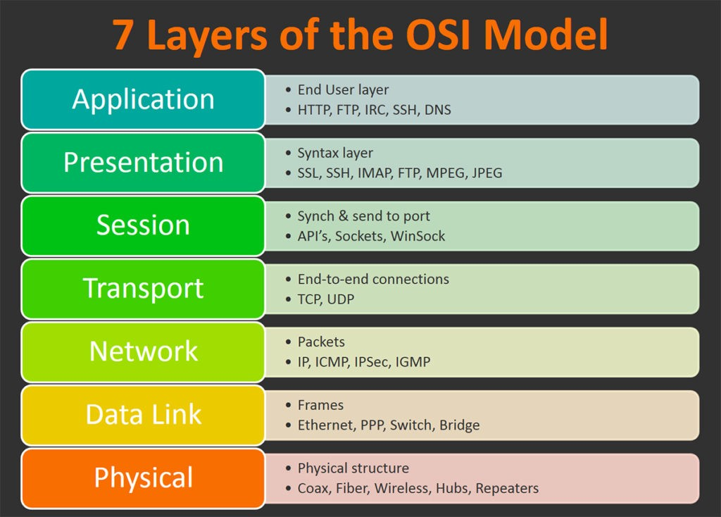
Networking

Slide 13
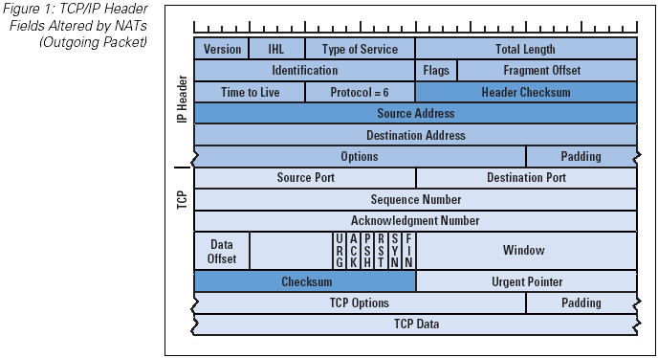

Slide 14
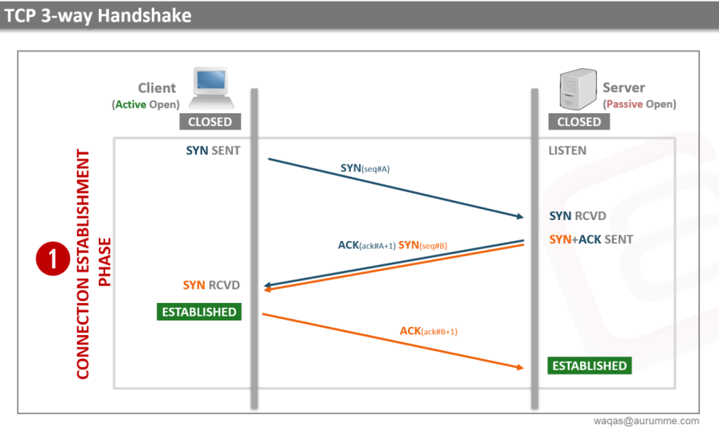

Slide 15
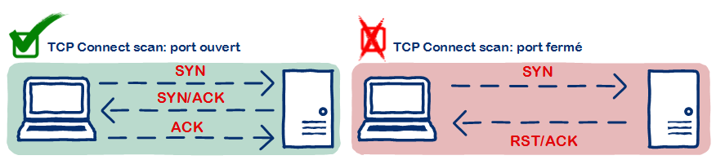
Full open scan
Establishes a full connection via the three-way handshake
Port is open if connection is established
Port is closed if server sends rst/ack

Slide 16
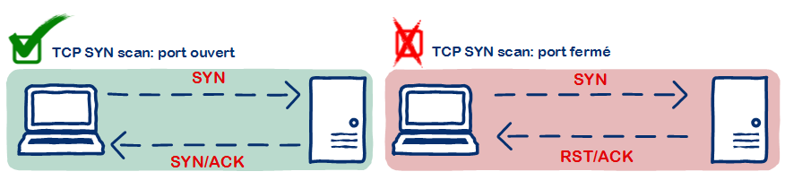
SYN (stealth) scan
Establishes a half-open connection via the three-way handshake
Port is open if connection server sends SYN/ACK
Port is closed if server sends RST/ACK

Slide 17
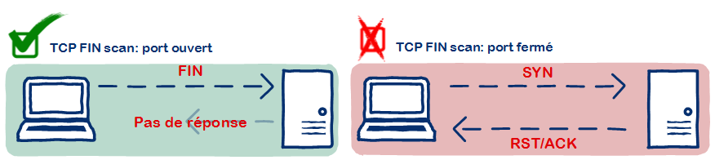
Inverse TCP flag scan / NULL scan
Send FIN/ACK/URG/PSH or send nothing
Port might be open if server does not respond
Port is closed if server sends RST/ACK

Slide 18
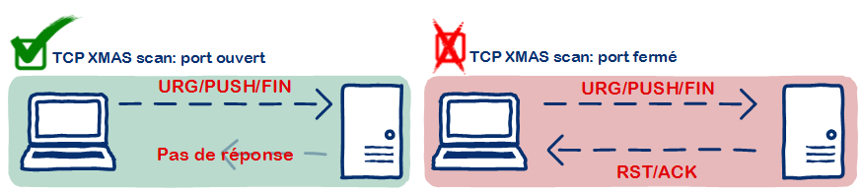
Xmas scan
Send FIN + URG + PSH
Port might be open if server does not respond
Port is closed if server sends RST
Doesn’t work with Windows / Cisco because they don’t implement RFC 793 correctly

Slide 19
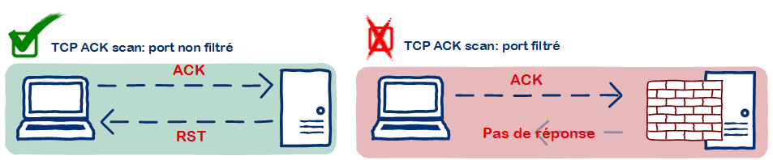
ACK flag probe scan
Send ACK
Port is open if TTL of RST packet is less than 64
Port is open if WINDOW of RST packet is non-zero
No response could indicate presence of firewall

Slide 20
IDLE / Zombie scan
Send SYN/ACK to zombie computer (should be idle)
Zombie responds with RST – make note of the IPID
Send SYN packet to target spoofing IP of zombie
If port is open target will send SYN/ACK to zombie which will reply with RST
If port is closed target will send RST to zombie but zombie will not reply
Send SYN/ACK to zombie again and see if the IPID has incremented by 2 instead of 1. If so port is open

Slide 21
Web Application vulnerabilities
#1 cause for vulnerabilities is lack of input validation!
Validate all values received from client
Reject rather than correct bad data
Example: “../” > “./” = “…/” > “../”
Learn regex if you don’t know it

Slide 22
OWASP top 10
Injection
Broken Authentication
Sensitive data exposure
XML External Entities (XXE)
Broken Access control
Security misconfigurations
Cross Site Scripting (XSS)
Insecure Deserialization
Using Components with known vulnerabilities
Insufficient logging and monitoring

Slide 23
XSS - Cross-Site Scripting
Client trusts server
Inject <script> via webform, url parameters
Attackers can read cookies, steal session, log user activity
Persistant – XSS is stored on server such as DB
Reflective – XSS is stored in URL
XSS example: login to demo site, post message with script tag. The script will be executed for other users who view the message.
<script>alert(‘xss’)</script>

Slide 24
XSS - Mitigation
Input validation – If data isn’t exactly what you expect throw it out
Don’t echo client originated data to the page (ex. 404 page)
Encode output and use XSS-safe methods
jQuery innerText is safe vs innerHTML
PHP htmlspecialchars() method
React default binding vs dangerouslySetInnerHtml
Razor default binding vs Html.Raw()
IIS / .NET has some built in XSS protection

Slide 25
CSRF – Cross-Site Request Forgery
Server trusts client
Attacker creates a malicious page that submits to legit server
Attackers can perform server actions on behalf of the user
CSRF example: login to demo site, save message form, open saved html. Note that you can submit from this saved page (or another domain)

Slide 26
CSRF – Mitigation
Use CSRF tokens
Stateful method is store unique value in user session, write same value to webform. Server verifies that values match.
Stateless method is cookie double-submit:
Webform has a hidden field containing a unique value, user has cookie containing the same value. Server verifies that the values match. An attacker can not modify the site cookies from a separate domain.
Use a library to handle automatic CSRF insertion and validation
Use a RNG library to generate the tokens

Slide 27
Session Fixation
Allows attacker to steal user session
Attacker sends user a link with a pre-defined session id
User logs in
Attacker knows the session id and is now logged in as the user
Session Fixation example: Set the session id in the URL “sid=abc”. Log in using this session. Open another browser and go to messages.php?sid=abc and notice that you are logged in

Slide 28
Session Fixation – Mitigation
Don’t store session id in URL!
Don’t store session id in hidden form field
Store session id in cookies marked same-site
Mitigate XSS which could be used to steal session id

Slide 29
SQLi – SQL Injection
Modify SQL statements client-side to retrieve restricted data or perform unintended operations
Test with ‘
SELECT * FROM USERS WHERE UNAME=‘${INPUT}’ AND PASS=‘${PASS}’
SELECT * FROM USERS WHERE UNAME=‘AJ’ AND PASS=‘123’
SELECT * FROM USERS WHERE UNAME=‘AJ’ AND PASS=‘’ UNION SELECT * FROM USERS #’
SQLi example: go to search page on demo site and execute the following query: ' union select username,password,3 from users #

Slide 30
bSQLi – Blind SQL Injection
Used to safely test SQLi without exposing sensitive data
Rather than dumping data it uses Booleans to determine vulnerability
Try to trigger different responses, if you are able to trigger different application behavior then SQLi worked
` OR 1=1 --
‘ OR 1=2 --
Time based – WAIT FOR DELAY ‘30’ – if response takes 30 seconds then SQLi worked

Slide 31
SQLi – Mitigation
Validate input
Use parameterized queries
Use parameterized stored procedures
Use an ORM framework such as Entity, nHibernate, Mongoose
Don’t echo errors to the client

Slide 32
Password Cracking
Passwords are stored as hashes, you need to crack the hash
Common methods:
Brute-Force
Dictionary
Precomputed hash table
Rainbow tables
Keyspace
“a-z” = 26
“a-zA-Z0-9” = 52
“Big-O notation” for cracking password is length^keyspace

Slide 33
Password cracking tools
John the Ripper / Johnny
Hydra
Rainbow Crack
Pyrit
Related tools:
hash-identifier
pass sniper (by me :)

Slide 34
Password Cracking - Mitigation
Don’t use plaintext!
Don’t “encrypt” passwords (encryption = 2 way, hash = 1 way)
Don’t use MD5 or SHA-1 – these are busted (collisions found)
Use a slow hashing algorithm such as bcrypt or scrypt
Salt your passwords to prevent precomputed and rainbow attacks
Use robust password requirements: length and complexity

Slide 35
Website defacement
Spread your hacktivist message
Change source code to capture user data
Replace legitimate files / email addresses with malicious ones
Need access to server (FTP/SSH/CMS)
Mitigation: Lock your shit down!

Slide 36
Grab SSL/TLS private key
Attacker can use it to make fake sites seem legitimate
Decrypt traffic MITM
Key can be obtained via server access
Can also be obtained via memory dump exploits (heartbleed)
Example: Test server has FTP directory traversal. Traverse to /etc/ssl and download the file

Slide 37
Grab SSL/TLS private key - Mitigation
Mitigation: Lock your shit down!
When someone who has access to private keys (tech-ops) leaves the keys should be changed
Example: Test server has FTP directory traversal. Enable chroot (change root) jail for FTP to prevent directory traversal

Slide 38
Root access
Attacker can do anything on the server!
Steal customer records
Use the server in botnet
Use the server as backdoor into network
Pivot from server to gain further access
Example: Test server has vsftpd 2.3.4 vulnerability. Exploit with metasploit or manually
Mitigation: Keep servers patched

Slide 39
Other issues – server headers
HTTPS not enforced and HTTP traffic can be sniffed – to fix:
RewriteCond %{HTTPS} off
RewriteRule ^ https://%{HTTP_HOST}%{REQUEST_URI}
Header always set Content-Security-Policy "upgrade-insecure-requests; default-src https:"
Header always set Strict-Transport-Security "max-age=31536000; includeSubDomains; preload" env=HTTPS
Clickjacking permitted by default – to fix:
Header always set x-frame-options "SAMEORIGIN“
“Server” header and “X-Powered-By” details server information – to fix:
ServerSignature Off
Header always unset "Server"
Header unset "Server"
Header always unset "X-Powered-By"
Header unset "X-Powered-By"

Slide 40
Other issues – verbose logging
Search.php shows SQL error messages
500s write error to page (log level)
Phpinfo.php shows detailed server information

