Slide 1
Ethical Hacking 101
October 2019
By: AJ Savino

Slide 2
The difference between “Hacking” and “Ethical Hacking” is permission.

Slide 3
Phases
Reconnaissance
Scanning / Enumeration
Gaining access
Maintaining access
Clearing tracks
Document everything!

Slide 4
Passive Reconnaissance
Don’t interact with target
Public information and News
Social networks (LinkedIn, Facebook)
Job postings
Whois records
Google Hacking Database

Slide 5
Active Reconnaissance
Interact with target
Social engineering (call reception, contact employees)
Visit company sites
Determine network range
Identify hosts
Find open ports

Slide 6
Scanning / Enumeration
Scan network
Identify hosts / OS
Identify open ports
Identify services
Map network
Scan for vulnerabilities
Identify users and groups

Slide 7
Scanning / Enumeration tools
Nmap
Hping3
Netcraft
Shodan
Nessus
Acunetix
Arachni
NetBIOS Enumerator
SNMP Scanner
LDAP search

Slide 8
Gain access
Gain access to machine, application, network
Specific exploit
Default credentials
Buffer overflow
Session hijacking
Social engineering
Password cracking
Privilege escalation (horizontal or vertical)

Slide 9
Maintain access
Patch the vulnerability to maintain control
Change credentials
Change configurations
Insert a backdoor
Use compromised system to launch further attacks

Slide 10
Clearing tracks
Delete or modify logs
Encrypt communications
Utilize steganography to hide data

Slide 11
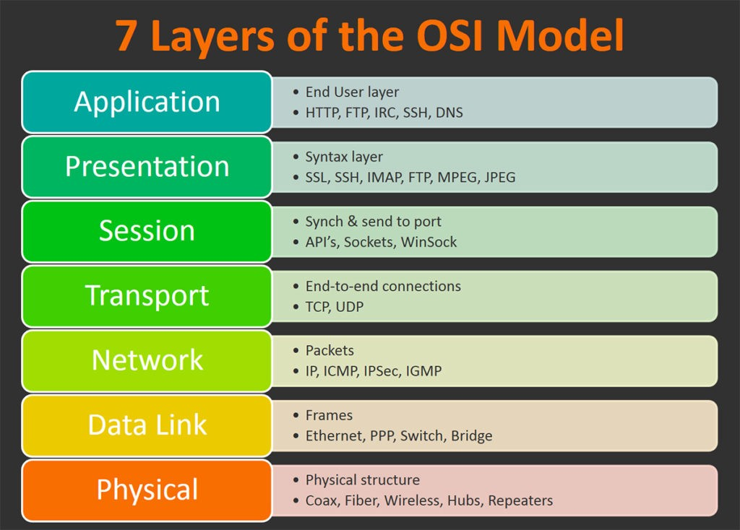
Networking

Slide 12
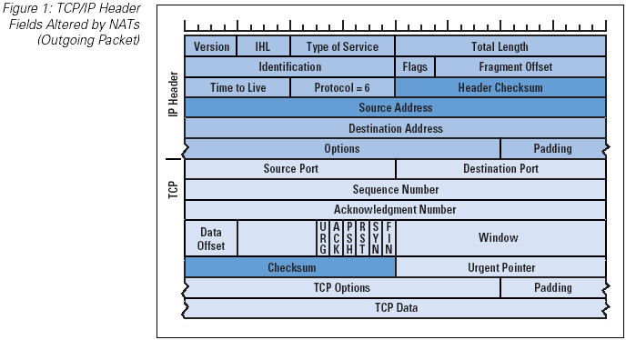

Slide 13
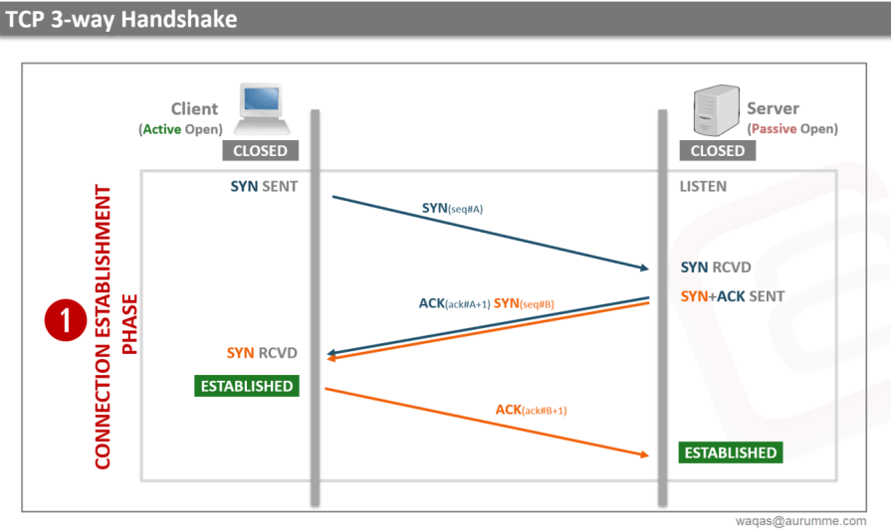

Slide 14
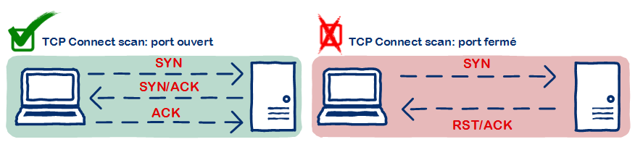
Full open scan
Establishes a full connection via the three-way handshake
Port is open if connection is established
Port is closed if server sends rst/ack

Slide 15
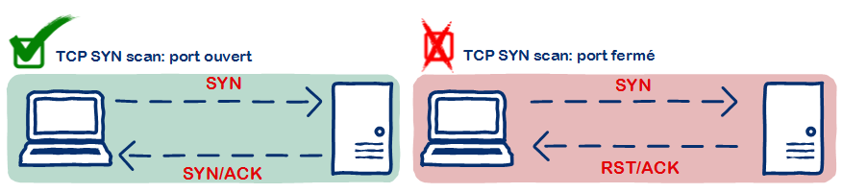
SYN (stealth) scan
Establishes a half-open connection via the three-way handshake
Port is open if connection server sends SYN/ACK
Port is closed if server sends RST/ACK

Slide 16
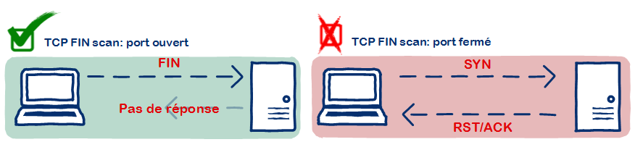
Inverse TCP flag scan / NULL scan
Send FIN/ACK/URG/PSH or send nothing
Port might be open if server does not respond
Port is closed if server sends RST/ACK

Slide 17
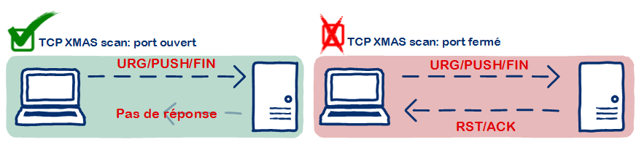
Xmas scan
Send FIN + URG + PSH
Port might be open if server does not respond
Port is closed if server sends RST
Doesn’t work with Windows / Cisco because they don’t implement RFC 793 correctly

Slide 18
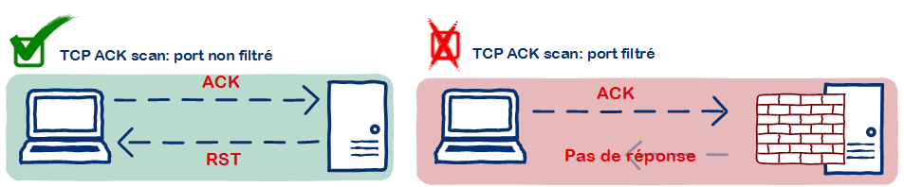
ACK flag probe scan
Send ACK
Port is open if TTL of RST packet is less than 64
Port is open if WINDOW of RST packet is non-zero
No response could indicate presence of firewall

Slide 19
IDLE / Zombie scan
Send SYN/ACK to zombie computer (should be idle)
Zombie responds with RST – make note of the IPID
Send SYN packet to target spoofing IP of zombie
If port is open target will send SYN/ACK to zombie which will reply with RST
If port is closed target will send RST to zombie but zombie will not reply
Send SYN/ACK to zombie again and see if the IPID has incremented by 2 instead of 1. If so port is open

Slide 20
Web Application vulnerabilities
#1 cause for vulnerabilities is lack of input validation!
Validate all values received from client
Reject rather than correct bad data
Example: “../” > “./” = “…/” > “../”
Learn regex if you don’t know it

Slide 21
OWASP top 10
Injection
Broken Authentication
Sensitive data exposure
XML External Entities (XXE)
Broken Access control
Security misconfigurations
Cross Site Scripting (XSS)
Insecure Deserialization
Using Components with known vulnerabilities
Insufficient logging and monitoring

Slide 22
XSS - Cross-Site Scripting
Client trusts server
Inject <script> via webform, user-generated content, url parameters
Attackers can read cookies, steal session, log user activity, phish
Persistant – XSS is stored on server such as DB
Reflective – XSS is stored in URL
XSS example: login to demo site, post message with script tag. The script will be executed for other users who view the message.
<script>alert(‘xss’)</script>

Slide 23
XSS - Mitigation
Input validation – If data isn’t exactly what you expect throw it out
Don’t echo client originated data to the page (404 page)
Encode output and use XSS-safe methods
jQuery innerText is safe vs innerHTML
PHP htmlspecialchars() method
React default binding vs dangerouslySetInnerHtml
Razor default binding vs Html.Raw()
IIS / .NET has some built in XSS protection

Slide 24
CSRF – Cross-Site Request Forgery
Server trusts client
Attacker creates a malicious page that submits to legit server
Attackers can perform server actions on behalf of the user
CSRF example: login to demo site, save message form, open saved html. Note that you can submit from this saved page (or another domain)

Slide 25
CSRF – Mitigation
Use CSRF tokens
Stateful method is store unique value in user session, write same value to webform. Server verifies that values match.
Stateless method is cookie double-submit:
Webform has a hidden field containing a unique value, user has cookie containing the same value. Server verifies that the values match. An attacker can not modify the site cookies from a separate domain.
Use a library to handle automatic CSRF insertion and validation

Slide 26
SQLi – SQL Injection
Modify SQL statements client-side to retrieve restricted data or perform unintended operations
Test with ‘
SELECT * FROM USERS WHERE UNAME=‘${INPUT}’ AND PASS=‘${PASS}’
SELECT * FROM USERS WHERE UNAME=‘AJ’ AND PASS=‘123’
SELECT * FROM USERS WHERE UNAME=‘AJ’ AND PASS=‘’ UNION SELECT * FROM USERS #’
SQLi example: go to search page on demo site and execute the following query: ' union select username,password,3 from users #

Slide 27
bSQLi – Blind SQL Injection
Used to safely test SQLi without exposing sensitive data
Rather than dumping data it uses Booleans to determine vulnerability
Try to trigger different responses, if you are able to trigger different application behavior then SQLi worked
` OR 1=1 --
‘ OR 1=2 --
Time based – WAIT FOR DELAY ‘30’ – if response takes 30 seconds then SQLi worked

Slide 28
SQLi – Mitigation
Validate input
Use parameterized queries
Use parameterized stored procedures
Use an ORM framework such as Entity, nHibernate, Mongoose
Don’t echo errors to the client

