Slide 1
Assignment 1
Machine Learning

Slide 2
Assignment 0
The difficulty of learning depends on the number of questions to be asked to decide. So the question is how time consuming the training of the decision tree is. If the training data is noisy the training of the true model is more difficult since there a false-true values and vice versa.
MONK-1: Decision possible after 2 boolean questions.
MONK-2: Decision possible after 6 boolean questions.
MONK-3: Decision possible after 4 boolean questions.

Slide 3
Assignment 1
Data set | Entropy
Monk1 | 1.0
Monk2 | 0.9571
Monk3 | 0.9998

Slide 4
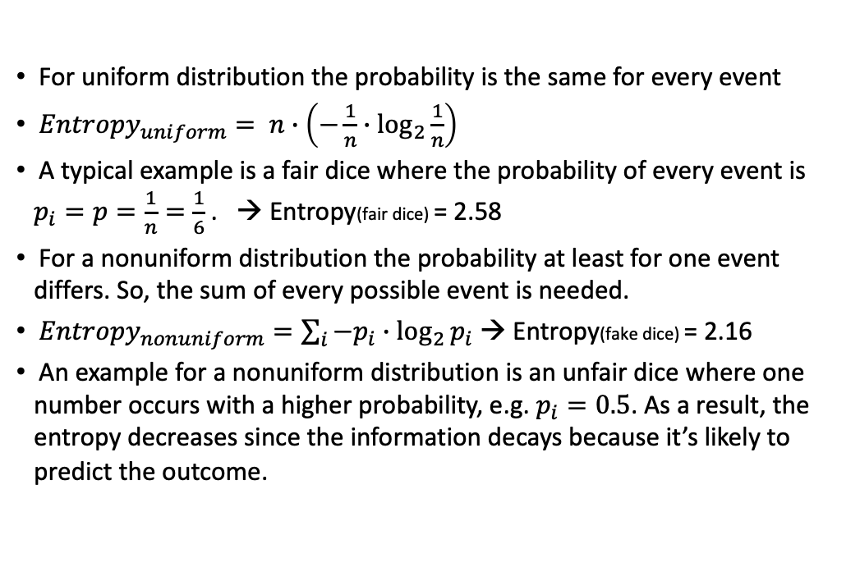
Assignment 2
For uniform distribution the probability is the same for every event
$Entropy_{uniform}= n∙\left(−\frac{1}{n}∙\log_{2}{\frac{1}{n}}\right)$
A typical example is a fair dice where the probability of every event is $p_{i}=p=\frac{1}{n}=\frac{1}{6}$ . → Entropy(fair dice) = 2.58
For a nonuniform distribution the probability at least for one event differs. So, the sum of every possible event is needed.
$Entropy_{nonuniform}=\sum_{i}{−p_{i}∙\log_{2}{p_{i}}}$ → Entropy(fake dice) = 2.16
An example for a nonuniform distribution is an unfair dice where one number occurs with a higher probability, e.g. $p_{i}=0.5$. As a result, the entropy decreases since the information decays because it’s likely to predict the outcome.

Slide 5
Assignment 3
Dataset | Attribute A1 | Attribute A2 | Attribute A3 | Attribute A4 | Attribute A5 | Attribute A6
Monk1 | 0.0752 | 0.0058 | 0.0047 | 0.0263 | 0.2870 | 0.0007
Monk2 | 0.0037 | 0.0024 | 0.0010 | 0.0156 | 0.0172 | 0.0062
Monk3 | 0.0071 | 0.2937 | 0.0008 | 0.0028 | 0.2559 | 0.0070
Attribute with the highest information gain is chosen at the root node (bold).

Slide 6

Assignment 4
For the attribute $A$ of the highest information gain $Gain(S,A)$ the $Entropy(S)$ is reduced the most. So, this subset has the lowest weighted sum of entropies. So the most lowest uncertainty.

Slide 7
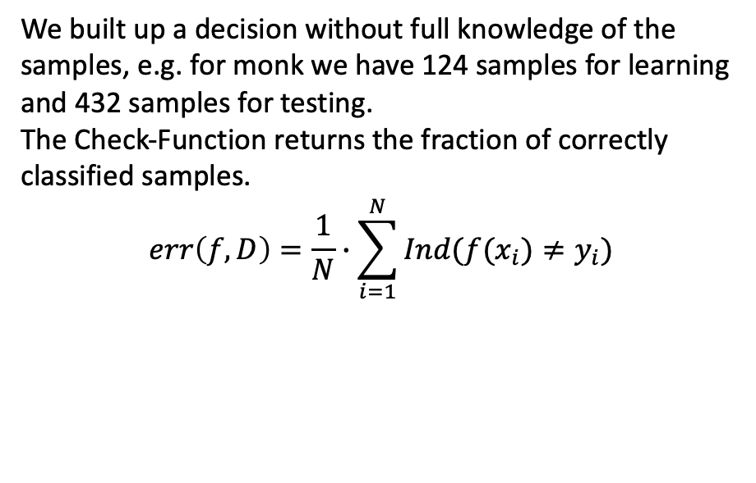
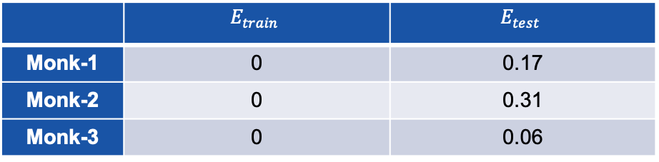
Assignment 5
We built up a decision without full knowledge of the samples, e.g. for monk we have 124 samples for learning and 432 samples for testing.
The Check-Function returns the fraction of correctly classified samples.
$$err\left(f,D\right)=\frac{1}{N}∙\sum_{i=1}^{N}{Ind(f(x_{i})≠y_{i})}$$
 | $$E_{train}$$ | $$E_{test}$$
Monk-1 | 0 | 0.17
Monk-2 | 0 | 0.31
Monk-3 | 0 | 0.06

Slide 8
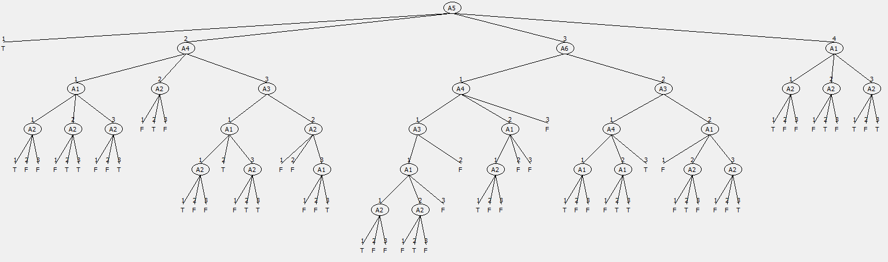
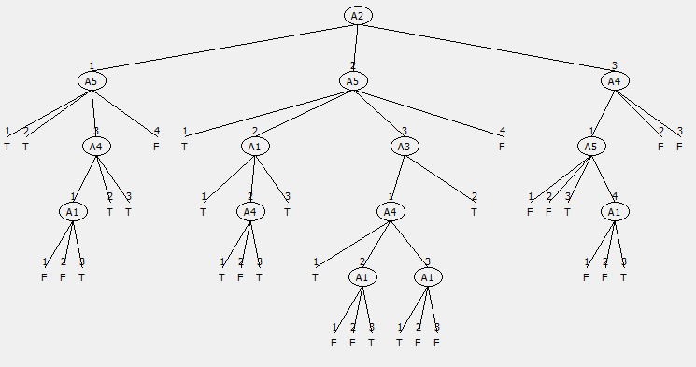
Assignment 6 (1)
Monk1
Monk3

Slide 9
Assignment 6 (2)
For pruning the tree every node is subject of an accuracy increase check. To prune compare the accuracy of the decision with and without the node. If the accuracy does not decrease by pruning, the node should be pruned since the simplest tree is desired. This simplest tree will have less edge cases. As a result, the decision is more generalized, which will decrease the variance of the decision because little deviation in the attributes will not lead to different results. By pruning the bias of the decision will increase since the decision is more general and may be taking with fewer attributes.

Slide 10
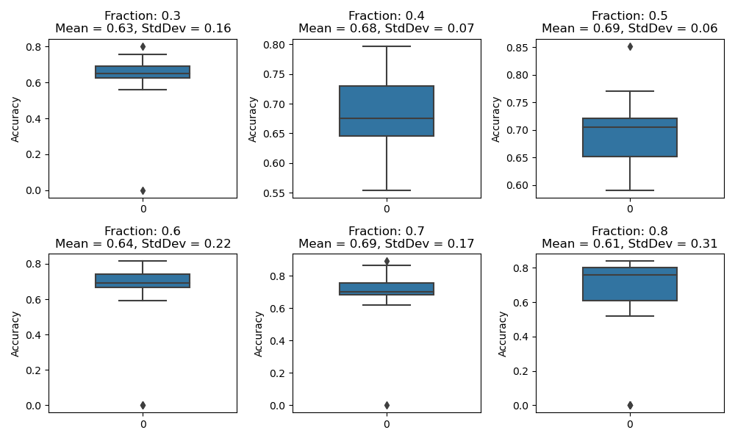
Assignment 7 (Monk1)

Slide 11
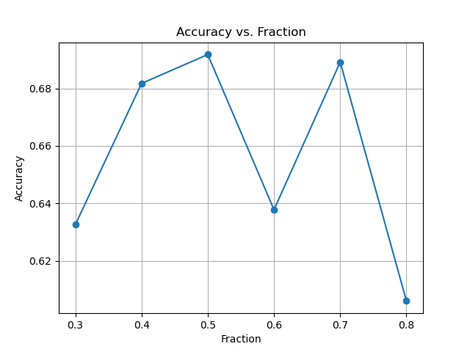
Assignment 7 (Monk1)

Slide 12
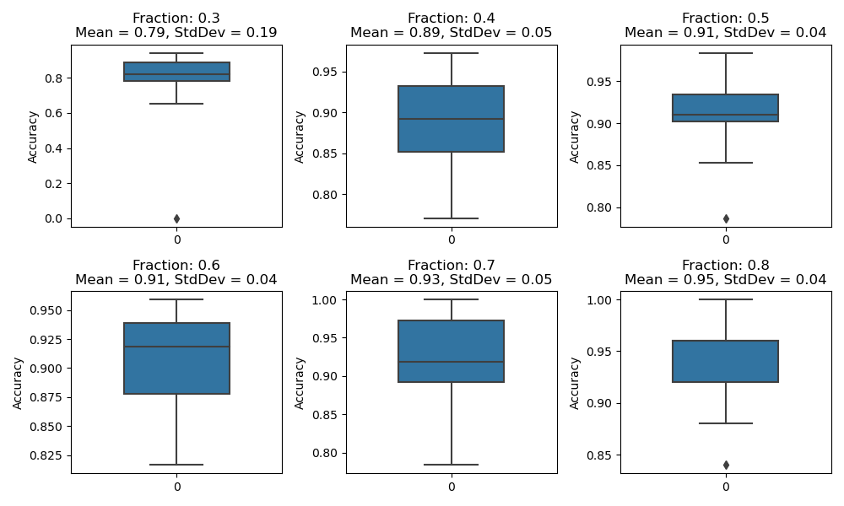
Assignment 7 (Monk3)

Slide 13
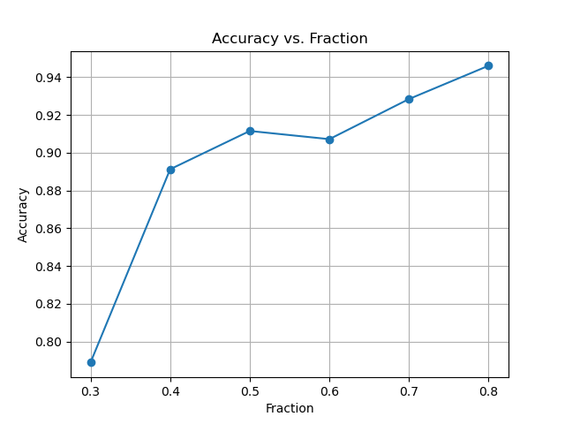
Assignment 7 (Monk3)

Slide 14
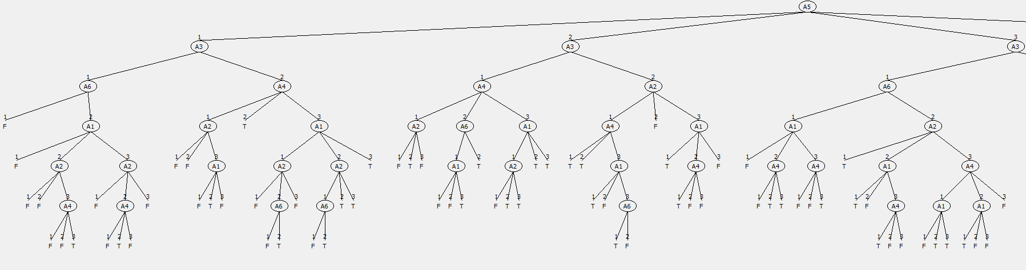
Assignment 6 (Backup)
Monk 2

Slide 15
Assignment 7 (Backup)
0 : 0.40541 for tree: +
1 : 0.75676 for tree: A2(+A5(+A1(+A4(--+)+)A3(A1(A4(+-+)-+)+)-)A1(--A5(--A3(+-)+)))
2 : 0.83784 for tree: A2(A5(+++-)A5(+A1(+A4(--+)+)A3(A1(A4(+-+)-+)+)-)A1(--A5(--A3(+-)+)))
3 : 0.81081 for tree: A2(A5(++A1(-++)-)A5(+A1(+A4(--+)+)A3(A1(A4(+-+)-+)+)-)A1(--A5(--A3(+-)+)))
4 : 0.75676 for tree: A2(A5(++A1(A3(-+)++)-)+A1(--A5(--A3(+-)+)))
5 : 0.86486 for tree: A2(A5(++A1(A3(-+)++)-)A5(++A3(A1(A4(+-+)-+)+)-)A1(--A5(--A3(+-)+)))
6 : 0.83784 for tree: A2(A5(++A1(A3(-+)++)-)A5(+A1(+-+)A3(A1(A4(+-+)-+)+)-)A1(--A5(--A3(+-)+)))
7 : 0.83784 for tree: A2(A5(++A1(A3(-+)++)-)A5(+A1(+A4(--+)+)+-)A1(--A5(--A3(+-)+)))
8 : 0.83784 for tree: A2(A5(++A1(A3(-+)++)-)A5(+A1(+A4(--+)+)A3(++)-)A1(--A5(--A3(+-)+)))
9 : 0.83784 for tree: A2(A5(++A1(A3(-+)++)-)A5(+A1(+A4(--+)+)A3(A1(+-+)+)-)A1(--A5(--A3(+-)+)))
10 : 0.91892 for tree: A2(A5(++A1(A3(-+)++)-)A5(+A1(+A4(--+)+)A3(A1(A4(+-+)-+)+)-)-)
11 : 0.91892 for tree: A2(A5(++A1(A3(-+)++)-)A5(+A1(+A4(--+)+)A3(A1(A4(+-+)-+)+)-)A1(---))
12 : 0.83784 for tree: A2(A5(++A1(A3(-+)++)-)A5(+A1(+A4(--+)+)A3(A1(A4(+-+)-+)+)-)A1(--A5(---+)))
Best subset is 10 with an accuracy of 0.91892
A2(A5(++A1(A3(-+)++)-)A5(+A1(+A4(--+)+)A3(A1(A4(+-+)-+)+)-)-)
0 : 0.40541 for tree: +
1 : 0.83784 for tree: A2(+A5(+A1(+A4(--+)+)A3(A1(A4(+-+)-+)+)-)-)
2 : 0.91892 for tree: A2(A5(+++-)A5(+A1(+A4(--+)+)A3(A1(A4(+-+)-+)+)-)-)
3 : 0.89189 for tree: A2(A5(++A1(-++)-)A5(+A1(+A4(--+)+)A3(A1(A4(+-+)-+)+)-)-)
4 : 0.83784 for tree: A2(A5(++A1(A3(-+)++)-)+-)
5 : 0.94595 for tree: A2(A5(++A1(A3(-+)++)-)A5(++A3(A1(A4(+-+)-+)+)-)-)
6 : 0.91892 for tree: A2(A5(++A1(A3(-+)++)-)A5(+A1(+-+)A3(A1(A4(+-+)-+)+)-)-)
7 : 0.91892 for tree: A2(A5(++A1(A3(-+)++)-)A5(+A1(+A4(--+)+)+-)-)
8 : 0.91892 for tree: A2(A5(++A1(A3(-+)++)-)A5(+A1(+A4(--+)+)A3(++)-)-)
9 : 0.91892 for tree: A2(A5(++A1(A3(-+)++)-)A5(+A1(+A4(--+)+)A3(A1(+-+)+)-)-)
Best subset is 5 with an accuracy of 0.94595
A2(A5(++A1(A3(-+)++)-)A5(++A3(A1(A4(+-+)-+)+)-)-)

Slide 16
Assignment 7 (Backup)
Monk1

