Slide 1
Comparison of Machine Learning Algorithms for NDT in Aerospace
Frank Duckhorn, Constanze Tschöpe, Matthias Wolff

Slide 2
Comparison of Machine Learning Algorithms for NDT in Aerospace
Outline
Background
Test Objects and Database
Analysis and Classification Algorithms
Results and Interpretation

Slide 3
Background
Aim: Automatic damage detection in airplane materials with machine learning algorithms
Two materials: Aluminum & carbon fiber reinforced plastic (CFRP)
Signal acquisition based on ultrasonic guided waves
Network of many sensors
Introduction of artificial structural damages
Compare different machine learning algorithms for defect detection
Try to use only signals without damage for training

Slide 4
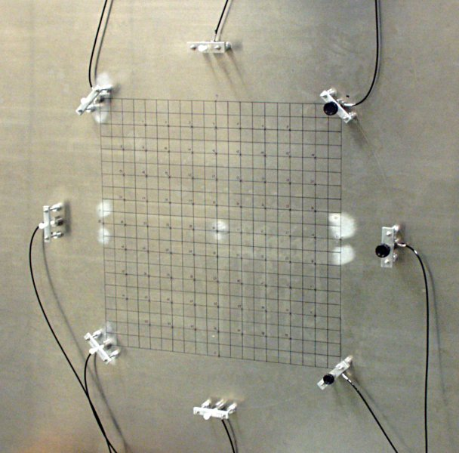
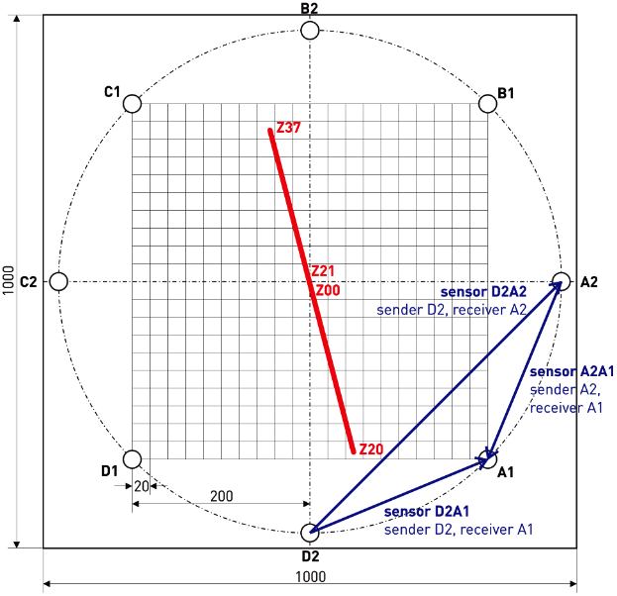
1. Test Object – Aluminum Plate
Aluminum plate 1000 x 1000 x 2.5 mm
8 ultrasound transducers (A1…D2) in circular arrangement (Ø 570 mm)
States:
Z00: intact
Z01-Z37: introduced fissure with length 1 to 37 mm
Test signal:
Ricker wavelet 250 kHz
Each transducer sends test signal, all others record the response
56 sensor signals (A1A2…D1D2)
Source: C. Tschöpe et. al. : „Experiments in acoustic structural health monitoring of airplane parts“, ICASSP 2008, USA

Slide 5
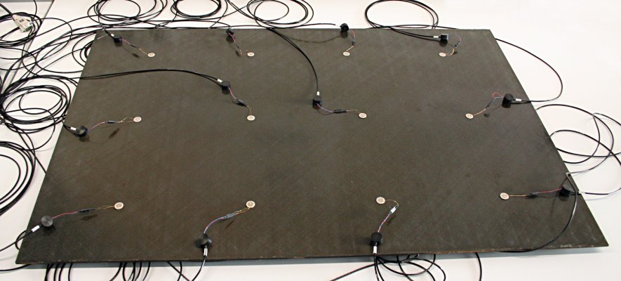
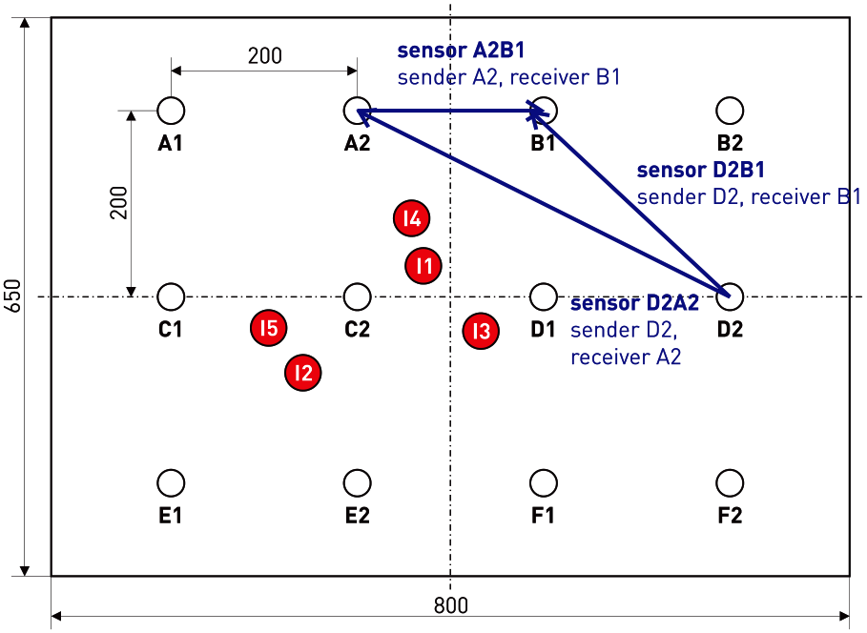
2. Test Object – CFRP Plate
CFRP plate 860 x 600 x 5 mm
12 ultrasound transducers (A1…F2) in grid arrangement (dist. 200 mm)
States:
Z00-Z02: intact
Z03-Z07: with impacts I1 - I5
Test signals:
Ricker wavelet 100 kHz (R100)
Ricker wavelet 350 kHz (R350)
Sinc 600 kHz (S600)
Each transducer sends test signal, all others record the response
132 sensor signals (A1A2…F1F2)
Id | Energy | Back
I1 | 15 J | supported
I2 | 25 J | supported
I3 | 45 J | supported
I4 | 25 J | free
I5 | 25 J | free
Source: C. Tschöpe et. al. : „Experiments in acoustic structural health monitoring of airplane parts“, ICASSP 2008, USA

Slide 6
Database
State | Repetitions | Signals
Z00 | 2 000 | 112 000
Z01 | 2 000 | 112 000
Z02-Z05 | 100 | 5 600
Z06 | 2 000 | 112 000
Z07-Z37 | 100 | 5 600
Sum | 9 500 | 532 000
Aluminum plate
100 repetitions for all fissure lengths
2000 repetitions for length 0, 1 and 6 mm
56 signals per repetition
CFRP plate
Z01+Z02 only for R350
132 signals per repetition
Test signal | State | Repetitions | Signals
R100 | Z00,Z03-7 | 1 000 | 792 000
R350 | Z00-Z07 | 1 000 | 1 056 000
S600 | Z00,Z03-7 | 1 000 | 792 000
Sum |  | 20 000 | 2 640 000

Slide 7
Analysis Algorithms
Comparison of different feature types:
Signals (SIG)
Use raw signals, no processing ALU: Srate = 6.25 MS, Len = 400 us CFRP: Srate = 4.16 MS, Len = 1000 us
Primary feature analysis (PFA)
Short-time Fourier transform (crate = 32, wlen = 1024)
Spectral averaging
Spectral limiting
Feature dim ALU: 47 x 24, CFRP: 105 x 32
Secondary feature analysis (SFA)
Normalization (Average and variance)
Principle component analysis
Feature dim ALU: 47 x 16, CFRP: 105 x 16

Slide 8
Detection Modes
Multiclass classification (MC)
Only for CFRP data
Use 70% of the signals of all states for training (also defect ones) => One class per state
Estimate the state of the test object
Train one model for every sensor => Sensor fusion: Average all classification model outputs
Verify model against remaining 30% of signals
Calculate error rate (ER)
If no misclassification: calculate safety margin for worst state pair

Slide 9
Detection Modes
Regression (REG)
Only for ALU data
Use 70% of the signals of all state for training (also defect ones) => Fissure length is objective criterion
Estimate length of fissure
Train one model for every sensor => Sensor fusion by meta classification with linear regression on sensor model outputs
Verify model against remaining 30% of signals
Calculate equal error rate (EER) for separation of good (Z00) and defect state (Z01-Z37)

Slide 10
Detection Modes
Oneclass detector (OD)
For both test objects
Use 70% of the signals only for state Z00 (intact) – realistic scenario
Mismatched training:
- “Good” model: Z00 data of designated sensor - “Bad” model: Universal background model with signals of state Z00 of all other sensors
Train one model for every sensor => Sensor fusion: Average all classification model outputs
Verify model against remaining 30% of signals of Z00 and all signals of other states
Calculate equal error rate (EER)
If no misclassification: calculate safety margin

Slide 11
Classifications Methods
Convolutional neuronal network (CNN)
1-2 convolution layers with pooling
2-3 full connected layers with ReLu
Deep neuronal network (DNN)
2 full connected layers
ReLu activation layer
Support vector machine (SVM)
Linear of RBF kernel
Hidden Markov Model (HMM)
3 emitting states
Full covariance matrices
Features: all
Detection: MC, REG
Features: PFA
Detection: MC, REG
Features: all
Detection: all
Features: PFA, SFA
Detection: all

Slide 12
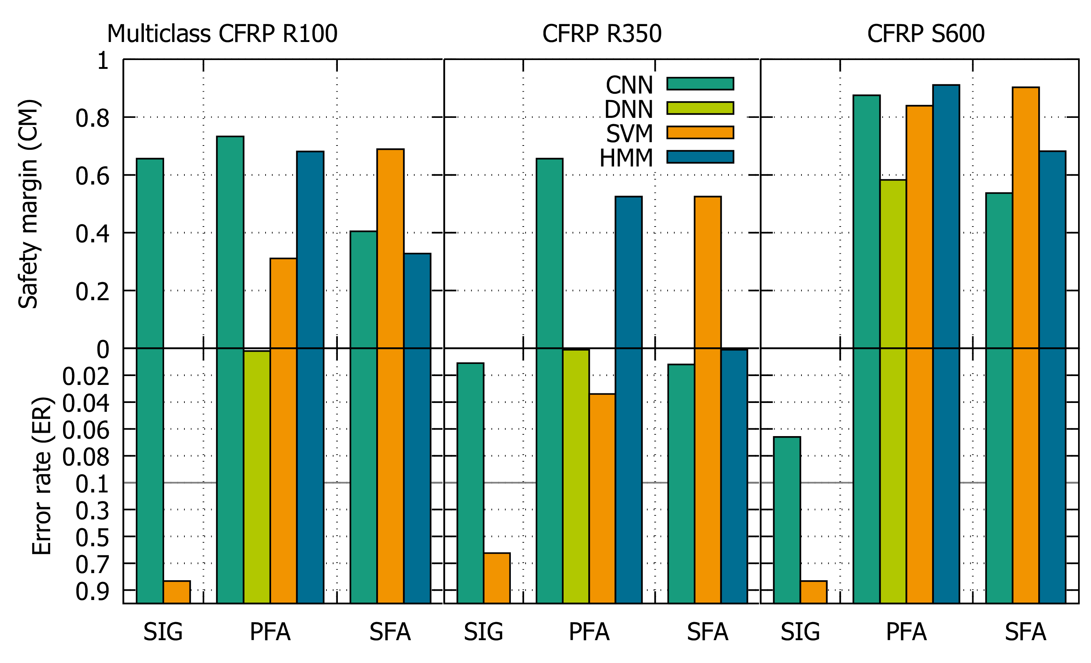
Multiclass Classification Results
Notes:
ER<2% for all except SVM on SIG
SIG: only CNN + R100 successful
SVM bis auf SIG sehr gut
PFA+SFA for S600: all successful
PFA for Rxxx: CNN best
SFA for Rxxx: SVM best

Slide 13
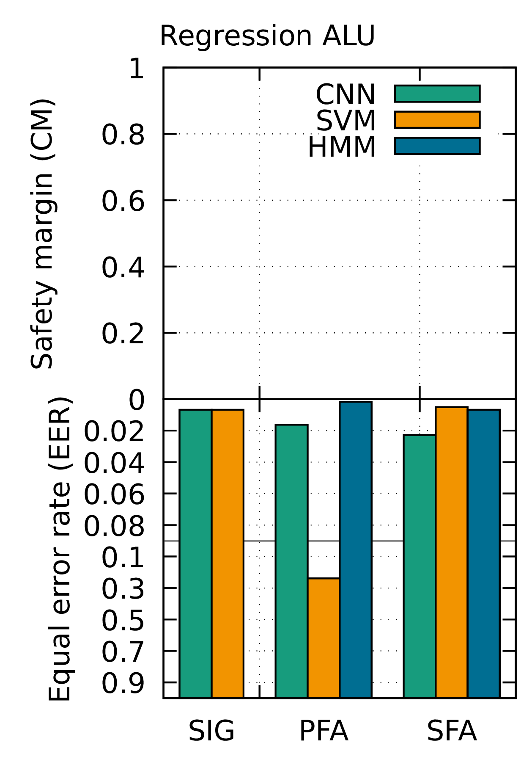
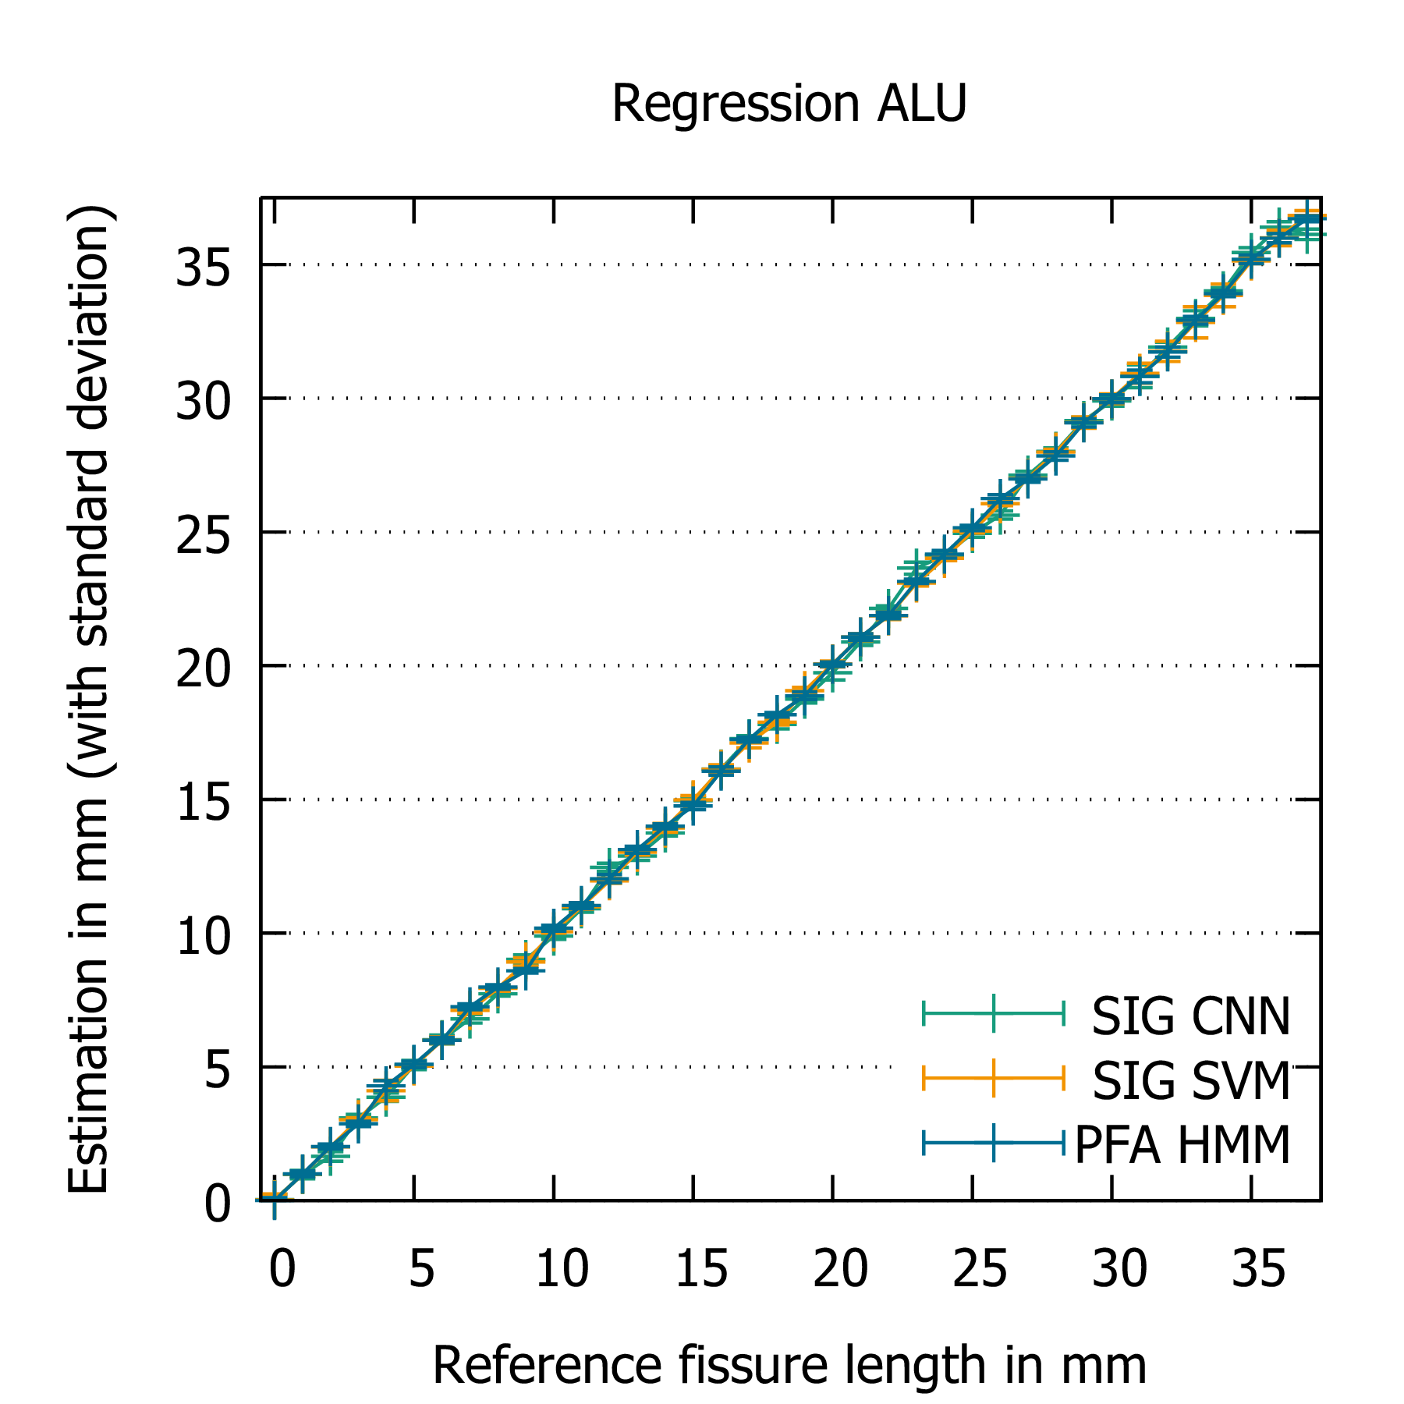
Regression Results

Slide 14
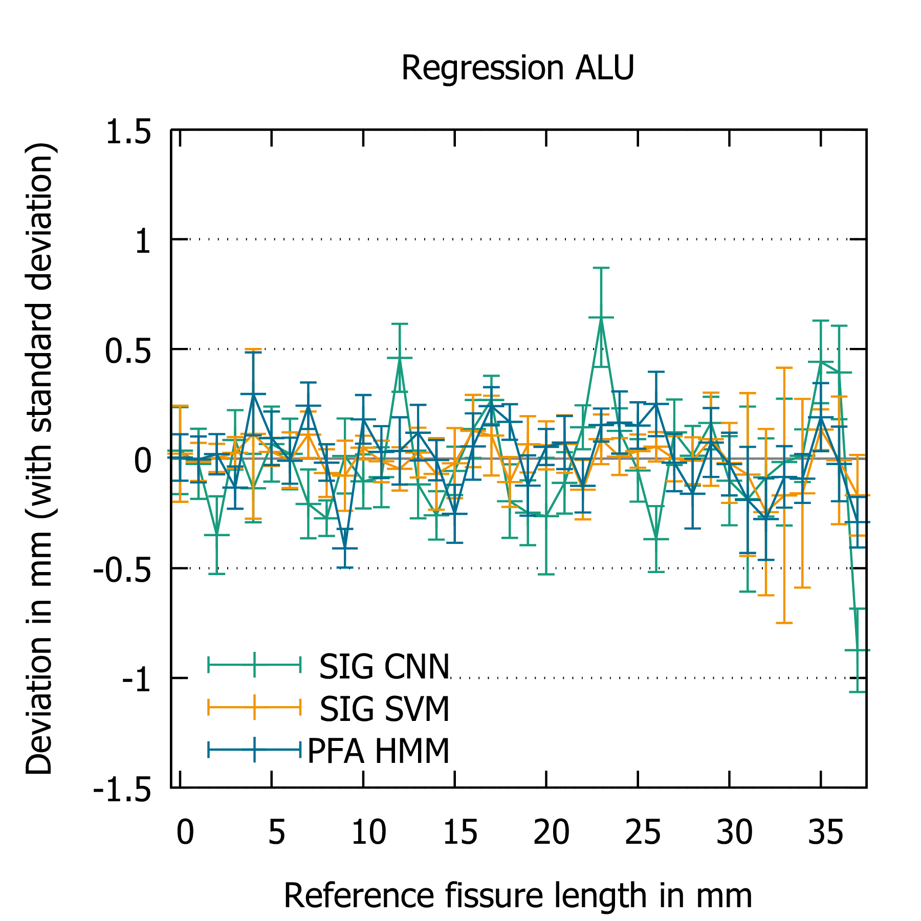
Regression Results

Slide 15
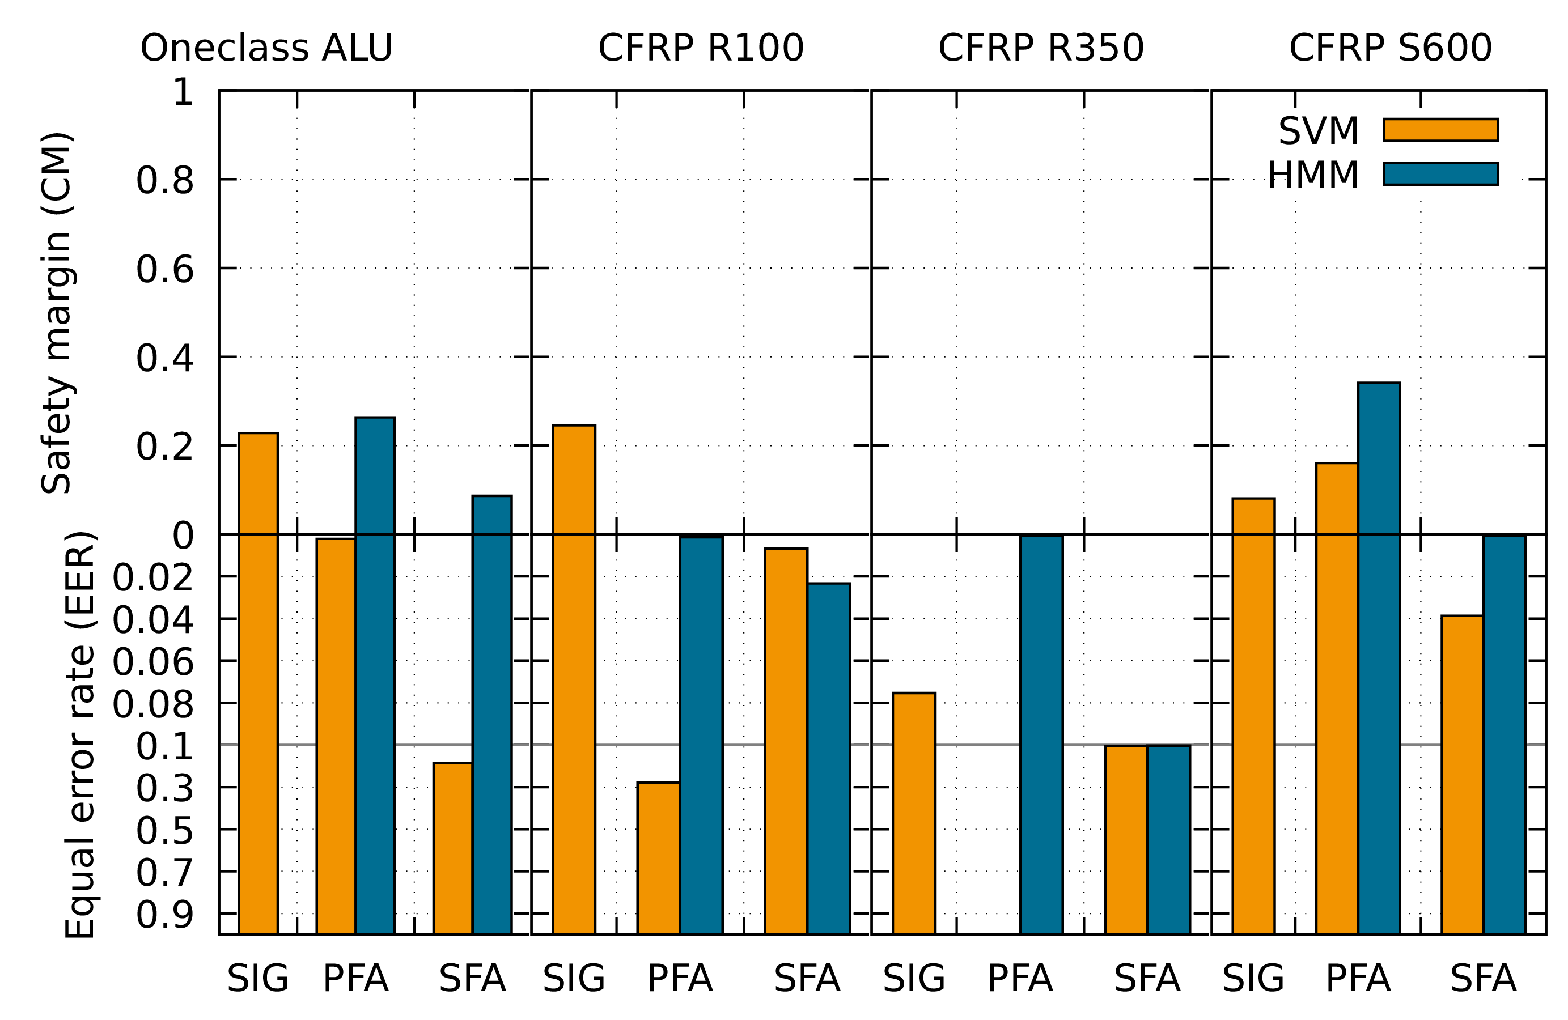
Oneclass Detector Results
Notes:
Much more difficult than multiclass
NN convergates not at all
HMM more stable results (except R350,SFA)
SVM works on SIG really good

Slide 16
Summary
Detection modes
Multiclass classification is very successful
Regression and oneclass classification more difficult, but useful
Oneclass classification is the realistic scenario
Features
With all features are good results possible depending on the classification method
Classification methods
CNN: Very good and robust results even on raw signals
DNN: Good results, but worse compared to other methods
SVM & HMM: Very good results on specific Feature/Mode combinations, but less robust than CNN

Slide 17
Comparison of Machine Learning Algorithms for NDT in Aerospace
Thank you!

