Slide 1
Comparison of Machine Learning Algorithms for NDT in Aerospace
Frank Duckhorn, Constanze Tschöpe, Matthias Wolff

Slide 2
Background
Aim: Automatic damage detection in airplane materials with machine learning algorithms
Two materials: Aluminum & carbon fiber reinforced plastic (CFRP)
Signal acquisition based on ultrasonic guided waves
Network of many sensors
Introduction of artificial structural damages
Compare different machine learning algorithms for defect detection
Try to use only signals without damage for training

Slide 3
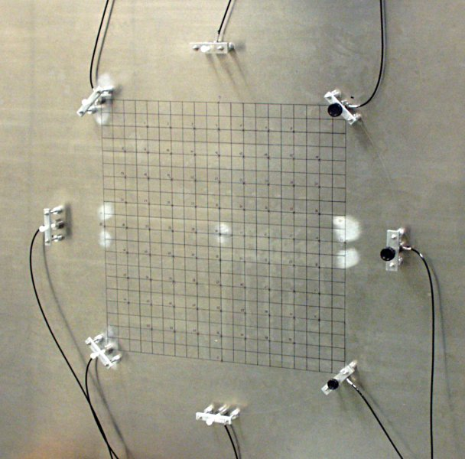
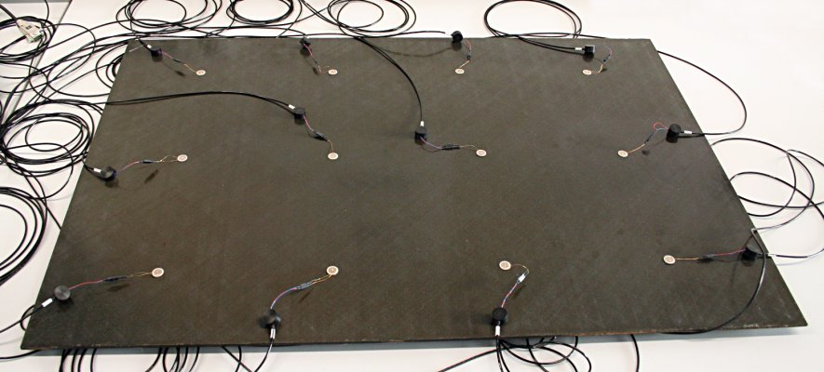
Test Objects
Aluminum plate 1000 x 1000 x 2.5 mm
8 ultrasound transducers (A1…D2) in circular arrangement (Ø 570 mm)
States:
Z00: intact
Z01-Z37: introduced fissure with length 1 to 37 mm
CFRP plate 860 x 600 x 5 mm
12 ultrasound transducers (A1…F2) in grid arrangement (dist. 200 mm)
States:
Z00-Z02: intact
Z03-Z07: with different introduced impacts

Slide 4
Analysis & Classification Algorithms
Comparison of different feature types:
Signals (SIG) - raw signals, no processing
Primary feature analysis (PFA) - Short-time Fourier transform
Secondary feature analysis (SFA) - Normalization & Principle component analysis
Comparison of different classification algorithms:
Convolutional neuronal network (CNN)
Deep neuronal network (DNN)
Support vector machine (SVM)
Hidden Markov Model (HMM)

Slide 5
Detection Modes
Investigate different detection modes:
Multiclass classification
Use all states for training (also defect ones) => One class per state
Estimate the state of the test object
Regression
Use all states for training (also defect ones) => Fissure length is objective criterion
Estimate length of fissure
Oneclass classification
Use only state Z00 data for training (intact) – realistic scenario
“Good” class: Z00 data of designated sensor
“Bad” class: Universal background model with signals of state Z00 of all other sensors

Slide 6
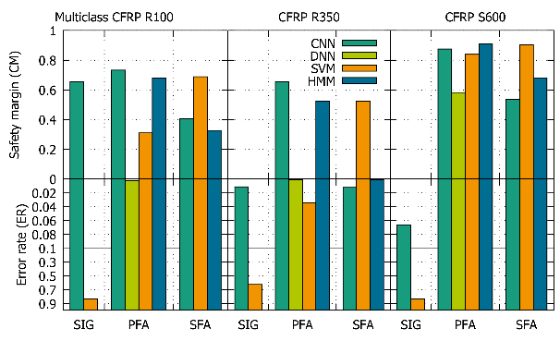
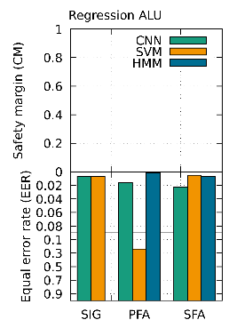
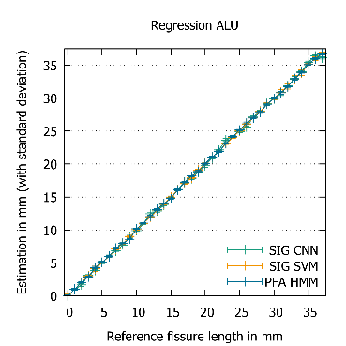
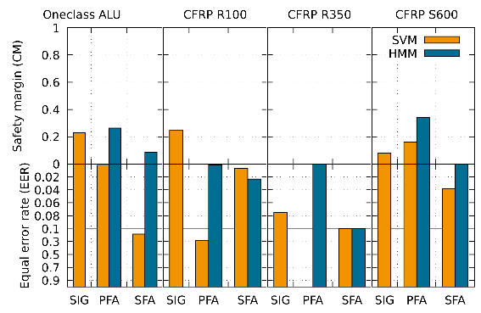
Comparison of Machine Learning Algorithms for NDT in Aerospace
Details on results in afternoon presentation We.A.6 Room Frauenkirche 1+2 16:30

