Slide 1
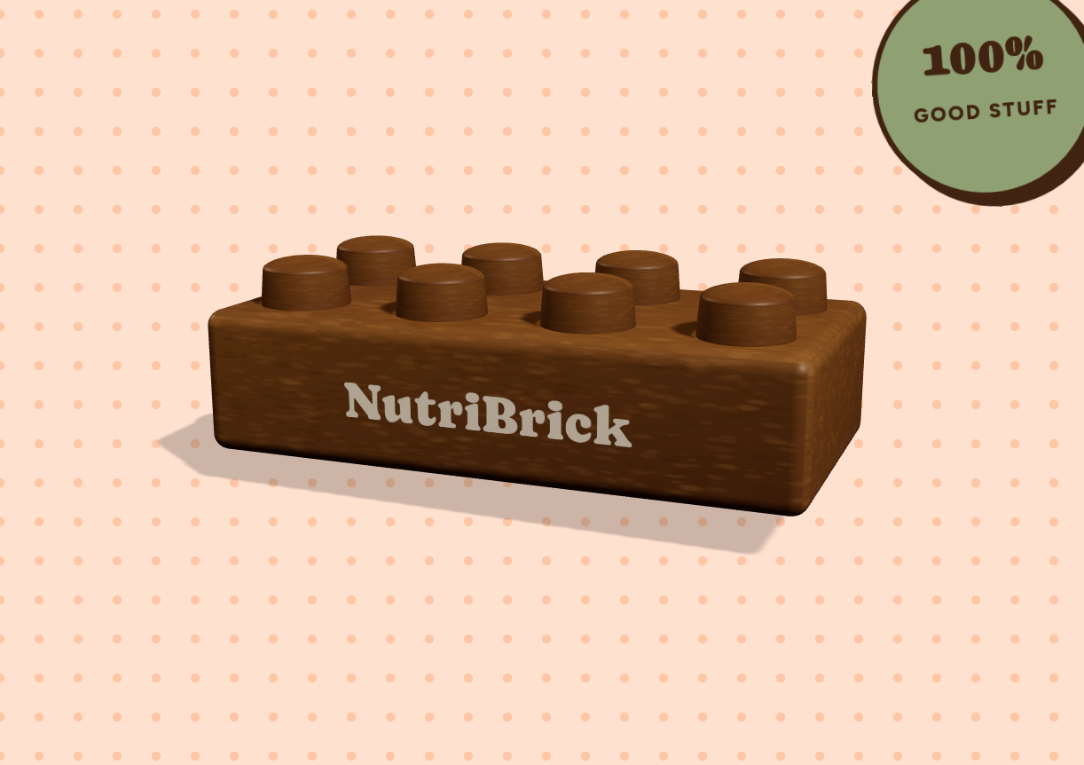
NUTRIBRICK
Food bites shaped
like building bricks.
Made to play with, built to nourish.
A YEAR 10 CONCEPT · NOT YET FOR SALE
kohan1.github.io/NutriBrick
Notes:
NutriBrick is a snack for primary school kids, shaped like a building brick that actually stacks. Then the AIHW numbers.

Slide 2
THE PROBLEM
The gap is real, and it is big.
1M+
95%
Parents already
know what is
healthy.
children in Australia
are unhealthy
are not meeting their daily
macronutrient targets
The problem is not
information.
Source: team problem statement — verify before presenting.
Notes:
According to the Australian Institute of Health and Welfare, over a million children in Australia are unhealthy and 95% are not hitting their macronutrient requirements daily. Have the source ready.

Slide 3
EVERY NIGHT
Dinner is a negotiation.
1
The snack goes in the bin, untouched.
Nagging
is not a
nutrition plan.
2
Something sweet gets negotiated in.
3
Nobody wins. Repeat tomorrow.
Notes:
Parents already know what is healthy. The hard part is getting a kid to eat it. Young kids decide by how it looks and feels, which is why explaining does not work.

Slide 4
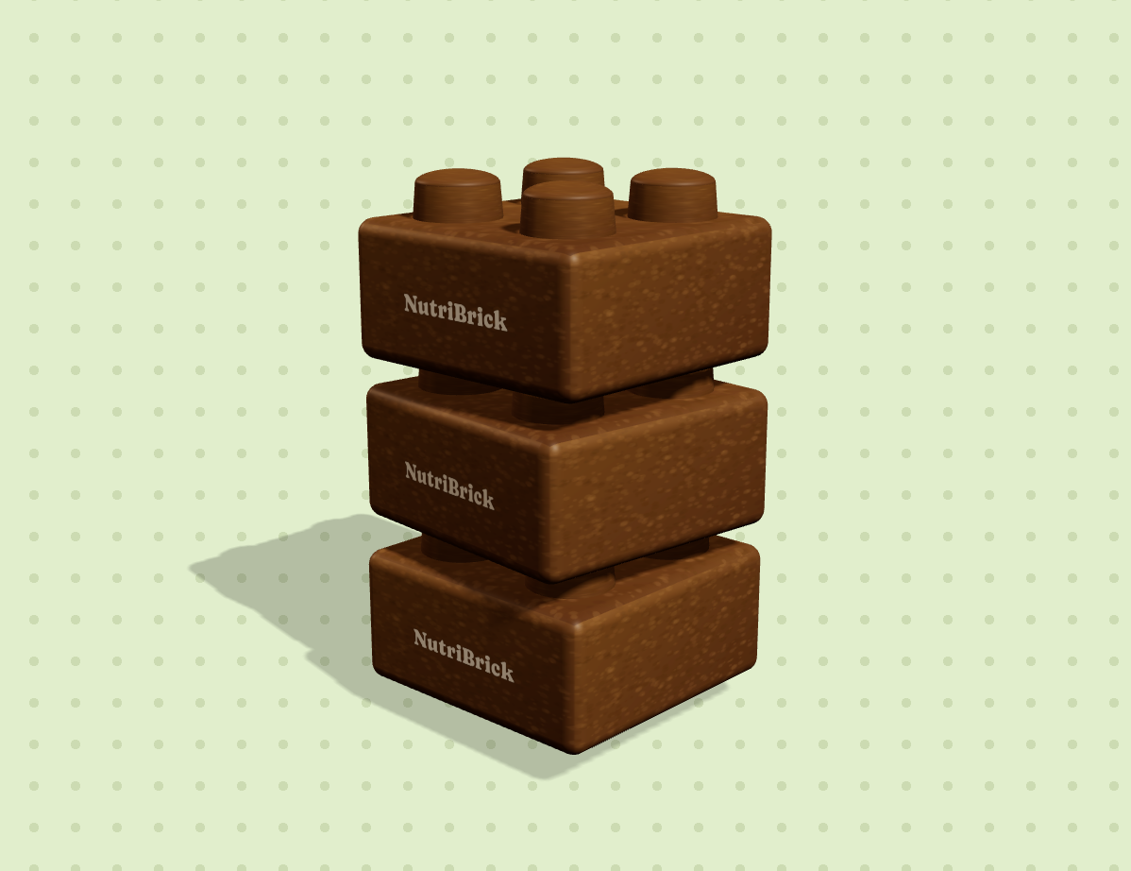
THE PRODUCT
Build it.
Stack it.
Eat it.
A food bite the size of a building brick, with studs that actually interlock. Kids stack a tower — then they eat the tower.
Nut-free
No gelatine
No junk bricks
Made to play with
Notes:
Let the tower finish loading before you talk. Size of a Duplo brick, studs interlock, every brick identical so the nutrition per brick is fixed.

Slide 5
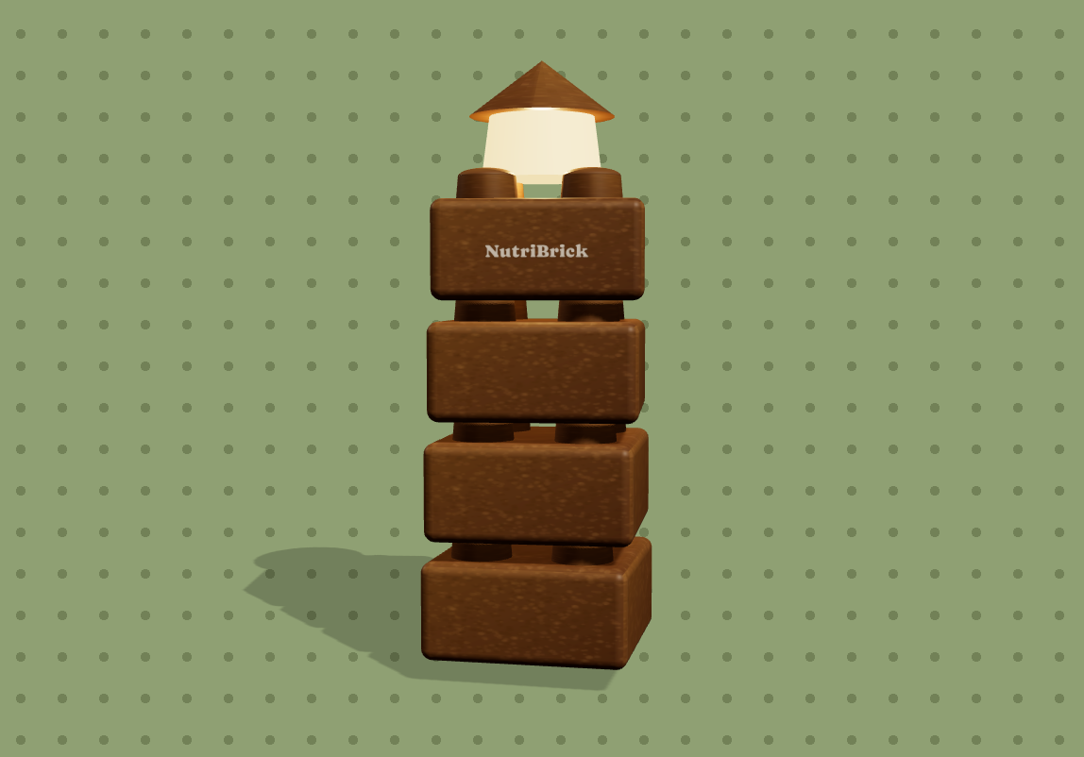
THE INSIGHT
“Don’t play
with your food.”
That rule exists because playing with food usually means wasting it.
Here, playing with it is how it gets eaten.
Same instinct, opposite outcome.
Notes:
Slow down here. State the rule first, then explain why it does not apply: the building is what gets it eaten, so the food is not wasted.

Slide 6
THE SNACK AISLE
Honestly compared.
✕
✕
✕
✓
KIDFRESH
LITTLE SPOON
GUMMY BUILDING BLOCKS
NUTRIBRICK
Frozen premade meals in supermarkets. Long ingredient lists, and not sold in Australia.
Fresh organic meals, but subscription only and priced for higher income parents.
They stack, but they are sugar and sold as a party novelty.
Play and nutrition in the same bite. In store, and no subscription.
Notes:
Name them: Kidfresh is frozen, long ingredient lists, not sold in Australia. Little Spoon is fresh but subscription only and priced for higher income parents. Gummy blocks stack but are sugar. Be ready to say what each does well.

Slide 7
NUTRITION, MADE VISIBLE
One brick. 45g. Here is all of it.
203
13g
4g
100%
KCAL
PROTEIN
FIBRE
VIT C, A & D
Seven ingredients, in plain words
Figures are formulation targets for the concept, not tested label values.
Rolled oats — slow-release energy and fibre
Sunflower seed butter — the bind, and nut-free
Milk protein — the 13g of protein
Dates — sweetness instead of refined sugar
Chia and flaxseed — omega-3 and fibre
Cocoa and cinnamon — the flavour kids ask for
Added vitamins C, A and D — the only part we fortify
Nut-free · No gelatine
No refined sugar
No artificial colours
Notes:
45 grams, 203 calories, 13g protein, 4g fibre, full day of vitamin C, A and D. Seven ingredients. Nut free because the bind is sunflower seed butter. Say the numbers clearly, do not rush the list.

Slide 8
PRICING
$2.00
ONE BRICK A DAY, PACK OF SEVEN
PER BRICK
Planned as packs of seven — a week of snacks for $14.00. No subscription, no freezer space, no leftovers to scrape.
MON
TUE
WED
THU
FRI
SAT
SUN
Every pack also comes with plans for a new build
A different design each time — so seven bricks are never just seven snacks.
Plus plans for one new build
Notes:
$2 a brick, packs of seven, $14 a week. In store, not a subscription, which is where Little Spoon prices itself out. Build plans are the repeat purchase hook.

Slide 9
WHAT WE ARE ASKING FOR
$100,000 to get it off paper.
NutriBrick is a concept and the nutrition figures are recipe targets. This is what changes that.
1
2
3
Food scientist
& nutritionist
Food grade
moulds
A small
production run
Turn the recipe into a real formulation, and verify the macros, shelf life and allergen safety.
The studs have to interlock and survive a six year old. Tooling is the main upfront cost.
Put real bricks in front of real families and test whether kids build before they eat.
Notes:
Say the $100,000 clearly, then the three things it buys. Do not rush it or apologise for it. This is the part judges are waiting for.

Slide 10
NUTRIBRICK
Kids decide with their
eyes and their hands
before anything else.
Almost every healthy snack asks them to ignore that. Ours is built on it.
A Year 10 team working through Future Anything. Still a concept.
A FUTURE ANYTHING STUDENT VENTURE
Notes:
Year 10 team through Future Anything. Close on the reasoning: kids decide with their eyes and hands first, and almost every healthy snack ignores that.

