Slide 1
Java Generics

Slide 2
Motivation
In any nontrivial software project, bugs are simply a fact of life. Careful planning, programming, and testing can help reduce their pervasiveness, but somehow, somewhere, they'll always find a way to creep into your code. This becomes especially apparent as new features are introduced and your code base grows in size and complexity.
Compile-time bugs can be detected early on, you can use the compiler's error messages to figure out what the problem is and fix it, right then and there.
Generics add stability to your code by making more of your bugs detectable at compile time.

Slide 3


Why Use Generics?
Code that uses generics has many benefits over non-generic code:
Stronger type checks at compile time.
A Java compiler applies strong type checking to generic code and issues errors if the code violates type safety. Fixing compile-time errors is easier than fixing runtime errors, which can be difficult to find.
Elimination of casts.
The following code snippet without generics requires casting and re-written to use generics, the code does not require casting:

Slide 4
Generic Types & Naming Convention
A generic class is defined with the following format:
class Name<T1, T2, ..., Tn> { /* ... */ }
The most commonly used type parameter names are:
  E - Element (used extensively by the Java Collections Framework)
  K - Key
  N - Number
  T - Type
  V - Value
  S,U,V etc. - 2nd, 3rd, 4th types
  Example_1

Slide 5
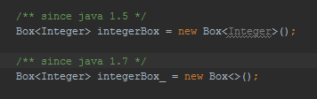
The Diamond
Example_2
Raw Types
A raw type is the name of a generic class or interface without any type arguments.
However, a non-generic class or interface type is not a raw type.
Example_3

Slide 6
Generic Methods
Generic methods are methods that introduce their own type parameters. This is similar to declaring a generic type, but the type parameter's scope is limited to the method where it is declared. Static and non-static generic methods are allowed, as well as generic class constructors.
The syntax for a generic method includes a type parameter, inside angle brackets, and appears before the method's return type. For static generic methods, the type parameter section must appear before the method's return type.
Example_4

Slide 7
Bounded Type Parameters
There may be times when you want to restrict the types that can be used as type arguments in a parameterized type. For example, a method that operates on numbers might only want to accept instances of Number or its subclasses. This is what bounded type parameters are for.
To declare a bounded type parameter, list the type parameter's name, followed by the extends keyword, followed by its upper bound, which in this example is Number. Note that, in this context, extends is used in a general sense to mean either "extends" (as in classes) or "implements" (as in interfaces).
Example_5

Slide 8
Multiple Bounds
The preceding example illustrates the use of a type parameter with a single bound, but a type parameter can have multiple bounds:
<T extends B1 & B2 & B3>
A type variable with multiple bounds is a subtype of all the types listed in the bound. If one of the bounds is a class, it must be specified first. For example:
Class A { /* ... */ }
interface B { /* ... */ }
interface C { /* ... */ }
class D <T extends A & B & C> { /* ... */ }
If bound A is not specified first, you get a compile-time error:
class D <T extends B & A & C> { /* ... */ } // compile-time error
Example_6

Slide 9
Generics, Inheritance, and Subtypes
As you already know, it is possible to assign an object of one type to an object of another type provided that the types are compatible. For example, you can assign an Integer to an Object, since Object is one of Integer's supertypes:
Now consider the following method:
public void boxTest(Box<Number> n) { /* ... */ }
What type of argument does it accept? By looking at its signature, you can see that it accepts a single argument whose type is Box<Number>. But what does that mean? Are you allowed to pass in Box<Integer> or Box<Double>, as you might expect? The answer is "no", because Box<Integer> and Box<Double> are not subtypes of Box<Number>.
This is a common misunderstanding when it comes to programming with generics, but it is an important concept to learn.

Slide 10
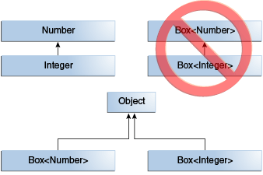
Example_7

Slide 11
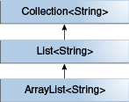
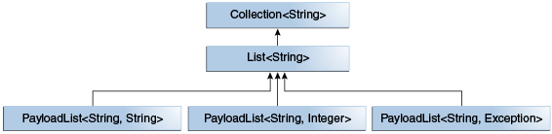
Generic Classes and Subtyping
Example_8

Slide 12
Type Inference
Type inference is a Java compiler's ability to look at each method invocation and corresponding declaration to determine the type argument (or arguments) that make the invocation applicable. The inference algorithm determines the types of the arguments and, if available, the type that the result is being assigned, or returned. Finally, the inference algorithm tries to find the most specific type that works with all of the arguments.
Example_9

Slide 13
Wildcards
In generic code, the question mark (?), called the wildcard, represents an unknown type. The wildcard can be used in a variety of situations: as the type of a parameter, field, or local variable; sometimes as a return type (though it is better programming practice to be more specific). The wildcard is never used as a type argument for a generic method invocation, a generic class instance creation, or a supertype.

Slide 14
Upper Bounded Wildcards
You can use an upper bounded wildcard to relax the restrictions on a variable. For example, say you want to write a method that works on List<Integer>, List<Double>, and List<Number>; you can achieve this by using an upper bounded wildcard.
To declare an upper-bounded wildcard, use the wildcard character ('?'), followed by the extends keyword, followed by its upper bound. Note that, in this context, extends is used in a general sense to mean either "extends" (as in classes) or "implements" (as in interfaces).
To write the method that works on lists of Number and the subtypes of Number, such as Integer, Double, and Float, you would specify List<? extends Number>. The term List<Number> is more restrictive than List<? extends Number> because the former matches a list of type Number only, whereas the latter matches a list of type Number or any of its subclasses.
Example_10

Slide 15
Unbounded Wildcards
The unbounded wildcard type is specified using the wildcard character (?), for example, List<?>. This is called a list of unknown type. There are two scenarios where an unbounded wildcard is a useful approach:
If you are writing a method that can be implemented using functionality provided in the Object class.
When the code is using methods in the generic class that don't depend on the type parameter. For example, List.size or List.clear. In fact, Class<?> is so often used because most of the methods in Class<T> do not depend on T.
It's important to note that List<Object> and List<?> are not the same. You can insert an Object, or any subtype of Object, into a List<Object>. But you can only insert null into a List<?>.
Example_11

Slide 16
Lower Bounded Wildcards
An upper bounded wildcard restricts the unknown type to be a specific type or a subtype of that type and is represented using the extends keyword. In a similar way, a lower bounded wildcard restricts the unknown type to be a specific type or a super type of that type.
A lower bounded wildcard is expressed using the wildcard character ('?'), following by the super keyword, followed by its lower bound: <? super A>.
Example_12

Slide 17
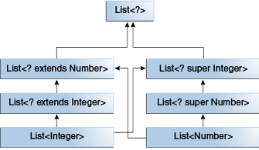
Wildcards and Subtyping

Slide 18
Guidelines for Wildcard Use
One of the more confusing aspects when learning to program with generics is determining when to use an upper bounded wildcard and when to use a lower bounded wildcard. This page provides some guidelines to follow when designing your code.
For purposes of this discussion, it is helpful to think of variables as providing one of two functions:
An "In" Variable
An "in" variable serves up data to the code. Imagine a copy method with two arguments: copy(src, dest). The src argument provides the data to be copied, so it is the "in" parameter.
An "Out" Variable
An "out" variable holds data for use elsewhere. In the copy example,
copy(src, dest), the dest argument accepts data, so it is the "out" parameter.

Slide 19
Wildcard Guidelines:
An "in" variable is defined with an upper bounded wildcard, using the extends keyword.
An "out" variable is defined with a lower bounded wildcard, using the super keyword.
In the case where the "in" variable can be accessed using methods defined in the Object class, use an unbounded wildcard.
In the case where the code needs to access the variable as both an "in" and an "out" variable, do not use a wildcard.
These guidelines do not apply to a method's return type. Using a wildcard as a return type should be avoided because it forces programmers using the code to deal with wildcards.
Example_13

Slide 20
Type Erasure
Generics were introduced to the Java language to provide tighter type checks at compile time and to support generic programming. To implement generics, the Java compiler applies type erasure to:
Replace all type parameters in generic types with their bounds or Object if the type parameters are unbounded. The produced bytecode, therefore, contains only ordinary classes, interfaces, and methods.
Insert type casts if necessary to preserve type safety.
Generate bridge methods to preserve polymorphism in extended generic types.
Type erasure ensures that no new classes are created for parameterized types; consequently, generics incur no runtime overhead.
Example_14/_15

Slide 21
Restrictions on Generics
To use Java generics effectively, you must consider the following restrictions:
Cannot Instantiate Generic Types with Primitive Types
Cannot Create Instances of Type Parameters
Cannot Declare Static Fields Whose Types are Type Parameters
Cannot Use Casts or instanceof With Parameterized Types
Cannot Create Arrays of Parameterized Types
Cannot Create, Catch, or Throw Objects of Parameterized Types
Cannot Overload a Method Where the Formal Parameter Types of Each Overload Erase to the Same Raw Type

