Slide 1
Rinstat

Slide 2
Arsitektur
Frontend
Backend
RIN
Connect through Token Api Dataverse
Connect through Token Api Dataverse
nextjs
nodejs
dataverse,docker, java
DB-RIN
docker, postgresql

Slide 3
Docker Database
db:
container_name: db
ports:
- 5432:5432
image: postgres:latest
environment:
- POSTGRES_DB=db_dataverse
- POSTGRES_PASSWORD=dvnsecret
- POSTGRES_USER=dataverse
- TZ=Asia/Jakarta
volumes:
- ./docker-dev-volumes/pg_data:/var/lib/postgresql/data # Persist PostgreSQL data

Slide 4
Docker dataverse
- "GIT_BRANCH=v5.0-cvm-autocomplete"
- "LANG=en"
- "cvManager=http://"
- "BUNDLEPROPERTIES=Bundle.properties"
- "ADMIN_EMAIL=admin@localhost"
- "MAIL_SERVER=mailrelay"
- "POSTGRES_SERVER=db"
- "POSTGRES_PORT=5432"
- "POSTGRES_DATABASE=db_dataverse"
- "POSTGRES_USER=dataverse"
- "PGPASSWORD=dvnsecret"
# - "POSTGRES_PASSWORD=dv"
- "SOLR_LOCATION=solr:8983"
- "TWORAVENS_LOCATION=NOT INSTALLED"
- "RSERVE_HOST=localhost"
- "RSERVE_PORT=6311"
- "RSERVE_USER=rserve"
- "RSERVE_PASSWORD=rserve"
- "JVM_OPTS='-Xmx1g -Xms1g -XX:MaxPermSize=2g -XX:PermSize=2g'"
depends_on:
- db
- solr
volumes:
- dataverse-data:/usr/local/payara5/glassfish/domains/domain1/autodeploy
labels:
- "traefik.enable=true"
- "traefik.http.services.dataverse.loadbalancer.server.port=8080"
dataverse:
image: coronawhy/dataverse:5.2.2-cv
container_name: dataverse
privileged: true
ports:
- "443:443"
- "4848:4848"
- "8085:8080"
environment:
- "CVM_SERVER_NAME=CESSDA" #Optional
- "CVM_SERVER_URL=https://vocabularies-dev.cessda.eu/v2/search/vocabularies"
- "CVM_TSV_SOURCE=https://github.com/IQSS/dataverse-docker/releases/download/5.2-cv/citation.tsv"
- "1GIT_CVM_TEMPLATES=https://github.com/Dans-labs/semantic-gateway"
- "WAR_FILE=https://github.com/IQSS/dataverse-docker/releases/download/5.2-cv/dataverse-5.2-cv.war"
- "GIT_BRANCH=v5.2-cvm"
- "CVM_SQL=https://github.com/IQSS/dataverse-docker/releases/download/5.2-cv/cv-update.sql"
- "CVM_CONFIG=https://github.com/IQSS/dataverse-docker/releases/download/5.2-cv/cv-cessda-keywords.json"
- "GIT_SOURCE=https://github.com/ekoi/dataverse"

Slide 5
Docker app_be
app_be:
tty: true
build:
context: .
dockerfile: Dockerfile-dev-app_be
ports:
- 82:3000
command: "yarn dev"
volumes:
- ./app_be:/app
- /app/node_modules
environment:
- NODE_ENV=production
# Use the official Node.js image as the base image
FROM node:alpine
# Set the working directory in the container
WORKDIR /app
COPY app_be/package.json .
RUN yarn install
# Expose the port that the app will run on
EXPOSE 3000

Slide 6
Docker app_fe
app_fe:
tty: true
build:
context: .
dockerfile: Dockerfile-dev-app_fe
ports:
- 83:3000
command: "yarn dev"
volumes:
- ./app_fe:/app
- /app/node_modules
# Use the official Node.js image as the base image
FROM node:alpine
# Set the working directory in the container
WORKDIR /app
COPY app_fe/package.json .
RUN yarn install

Slide 7
Functional Requirements
Show Users & Roles
Count All Downloads
Show New User Affiliation
Show New Dataset
Show New Dataverse
Show New Files
Show Dataset Cumulative

Slide 8
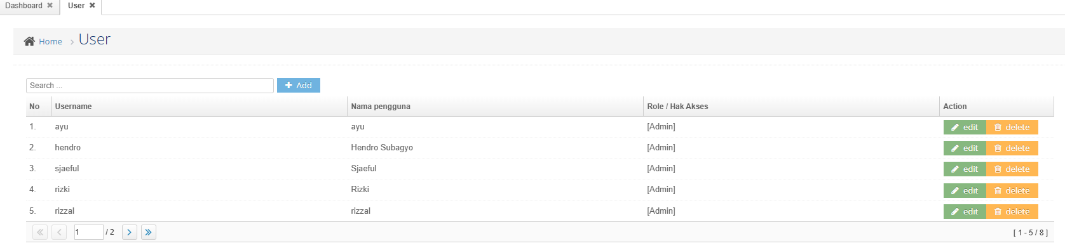
FR 1 : Show Users & Roles

Slide 9
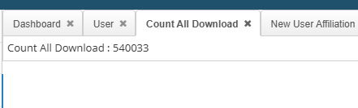
FR 2 : Count All Downloads

Slide 10
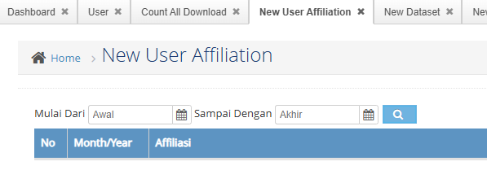
FR 3 : Show New User Affiliation

Slide 11
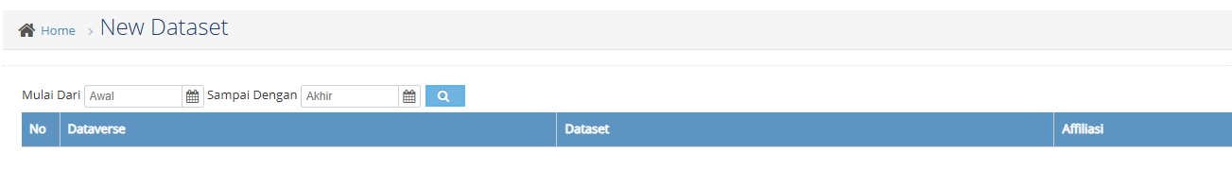
FR 4 : Show New Dataset

Slide 12
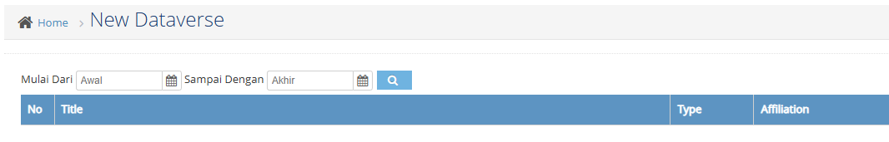
FR 5 : Show New Dataverse

Slide 13
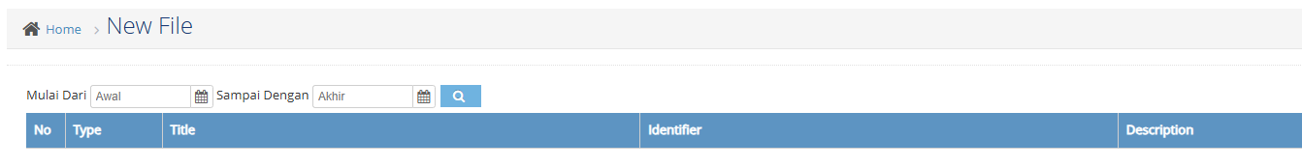
FR 6 : Show New Files

Slide 14
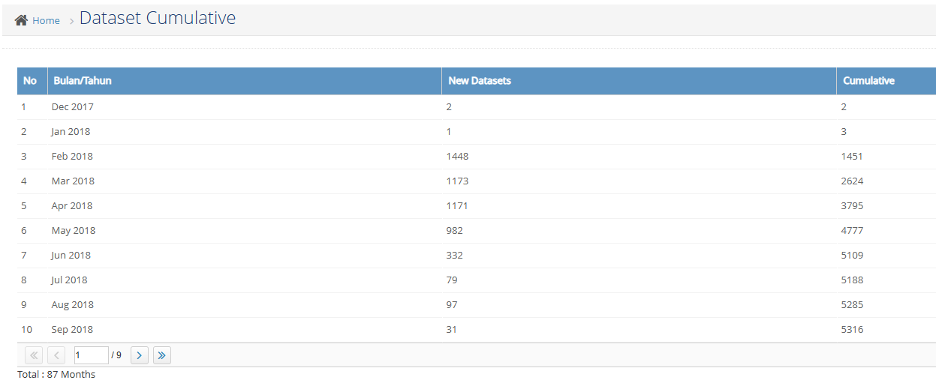
FR 7 : Show Dataset Cumulative

