Slide 1
SSO

Slide 2
SSO lama
Codeigniter based
oldPHP 5.6
Less features
Not yet dockerized app

Slide 3
SSO Baru (Keycloak)
Best Practise (BKN, Kemenkeu, dll)
More features (2FA, MFA)
Dockerized App : quay.io/keycloak/keycloak

Slide 4
Keycloak Arsitektur

Slide 5
Install keycloak development docker (done)
keycloak:
build:
context: keycloak-image
dockerfile: Dockerfile
environment:
- KC_DB=postgres
- KC_DB_URL=jdbc:postgresql://db:5432/db_keycloak
- KC_DB_USERNAME=postgres
- KC_DB_PASSWORD=postgres
- KC_HOSTNAME=host.docker.internal
- KEYCLOAK_ADMIN=admin
- KEYCLOAK_ADMIN_PASSWORD=admin
- TZ=Asia/Jakarta
ports:
- "8080:8080" # Port Host:Port Container
depends_on:
- db
command: start-dev --http-enabled=true --hostname-strict=false --hostname host.docker.internal

Slide 6
Install keycloak https docker via revproxy (done)
keycloak:
build:
context: keycloak-image
dockerfile: Dockerfile
environment:
- KC_DB=postgres
- KC_DB_URL=jdbc:postgresql://db:5432/db_keycloak
- KC_DB_USERNAME=postgres
- KC_DB_PASSWORD=postgres
- KC_HOSTNAME=host.docker.internal
- KEYCLOAK_ADMIN=admin
- KEYCLOAK_ADMIN_PASSWORD=admin
- TZ=Asia/Jakarta
- KC_PROXY=edge # Wajib untuk reverse proxy
ports:
- "8080:8080" # Port Host:Port Container
depends_on:
- db
command: start-dev --http-enabled=true --hostname-strict=false --hostname host.docker.internal
nginx:
image: nginx:latest
container_name: nginx
volumes:
- ./nginx-reverse-proxy/nginx.conf:/etc/nginx/nginx.conf:ro
- ./certs/cert.pem:/etc/nginx/cert.pem:ro
- ./certs/key.pem:/etc/nginx/key.pem:ro
ports:
- "443:443"
depends_on:
- keycloak
restart: always
FROM quay.io/keycloak/keycloak:23.0.5 AS builder
# Enable health and metrics support
ENV KC_HEALTH_ENABLED=true
ENV KC_METRICS_ENABLED=true
WORKDIR /opt/keycloak
FROM quay.io/keycloak/keycloak:23.0.5
COPY --from=builder /opt/keycloak/ /opt/keycloak/
Harus 23.0.5 -> versi ke atas wajib https

Slide 7
Install keycloak https docker (done)
keycloak-https:
tty: true
build:
context: keycloak-image-https
dockerfile: Dockerfile
environment:
- KC_DB=postgres
- KC_DB_URL=jdbc:postgresql://db:5432/db_keycloak_https
- KC_DB_USERNAME=postgres
- KC_DB_PASSWORD=postgres
- KC_HOSTNAME=host.docker.internal
- KEYCLOAK_ADMIN=admin
- KEYCLOAK_ADMIN_PASSWORD=admin
- KC_LOG_LEVEL=DEBUG
- TZ=Asia/Jakarta
ports:
- "8443:8443" # Port Host:Port Container
depends_on:
- db
FROM quay.io/keycloak/keycloak:latest
COPY ./certs/ /opt/keycloak/certs
# Mengubah ke root user untuk mengubah kepemilikan
USER root
# Mengubah kepemilikan folder certs
RUN chown -R keycloak:keycloak /opt/keycloak/certs
# Kembali ke user keycloak setelah mengubah kepemilikan
USER keycloak
# Menjalankan Keycloak dengan sertifikat HTTPS
ENTRYPOINT [ "/opt/keycloak/bin/kc.sh", "start", "--https-certificate-file=/opt/keycloak/certs/cert.pem", "--https-certificate-key-file=/opt/keycloak/certs/key.pem", "--http-enabled=false" ]

Slide 8
Install keycloak prod from source
keycloak-src:
tty: true
image: openjdk:21-slim
ports:
- 90:8080
- 93:8443
volumes:
- ./keycloak-src:/opt/keycloak-src
- ./keycloak-dist:/opt/keycloak-dist
- ./certs:/opt/localhost/certs
Masuk ke container dan cd ke folder /opt/keycloak-src
Jalankan perintah
./mvnw -pl quarkus/deployment,quarkus/dist -am -DskipTests clean install
Jalankan aplikasi
java -jar quarkus/server/target/lib/quarkus-run.jar start-dev

Slide 9
Install keycloak prod from dist (done)
keycloak-src:
tty: true
image: openjdk:21-slim
ports:
- 90:8080
- 93:8443
volumes:
- ./keycloak-src:/opt/keycloak-src
- ./keycloak-dist:/opt/keycloak-dist
- ./certs:/opt/localhost/certs
Masuk ke container
docker exec -it sso-brin-compose-keycloak-src-1 /bin/bash
Masuk ke folder
cd /opt/keycloak-dist/
Jalankan skrip bootstrap admin (untuk buat user)
./bin/kc.sh bootstrap-admin user
Jalankan skrip
./bin/kc.sh start --hostname=host.docker.internal --https-certificate-file=/opt/localhost/certs/cert.pem --https-certificate-key-file=/opt/localhost/certs/key.pem

Slide 10
Instalasi Keycloak di Client (Laravel)
Masuk ke container
docker exec -it sso-brin-compose-keycloak_client_laravel-1 /bin/bash

Slide 11
Instalasi Keycloak di Client (Laravel) : 2
composer require laravel/socialite
composer require socialiteproviders/manager
composer require socialiteproviders/keycloak
https://medium.com/@possibleolayode5344/laravel-socialite-keycloak-integration-98d512a63460

Slide 12
Instalasi Keycloak di Client (Laravel) : 3
Configure Keycloak Provider: Open the config/services.php file and add the following configuration for Keycloak:
'keycloak' => [
'client_id' => env('KEYCLOAK_CLIENT_ID'),
'client_secret' => env('KEYCLOAK_CLIENT_SECRET'),
'redirect' => env('KEYCLOAK_REDIRECT_URI'),
'base_url' => env('KEYCLOAK_BASE_URL'),
]
https://medium.com/@possibleolayode5344/laravel-socialite-keycloak-integration-98d512a63460

Slide 13
Instalasi Keycloak di Client (Laravel) : 4
Configure Keycloak Provider: Open the config/services.php file and add the following configuration for Keycloak:
'keycloak' => [
'client_id' => env('KEYCLOAK_CLIENT_ID'),
'client_secret' => env('KEYCLOAK_CLIENT_SECRET'),
'redirect' => env('KEYCLOAK_REDIRECT_URI'),
'base_url' => env('KEYCLOAK_BASE_URL'),
]
https://medium.com/@possibleolayode5344/laravel-socialite-keycloak-integration-98d512a63460

Slide 14
1. Aplikasi SSO Berjalan
DONE

Slide 15
2. Memastikan user lama bisa login

Slide 16
3. Memastikan client bisa grant authorized code
DONE

Slide 17
4. Memastikan client bisa grant password
DONE

Slide 18
5. Memastikan internet.brin bisa jalan

Slide 19
6. Membuat sample kit untuk php native, laravel, next,
Konsep
User klik login -> redirect authorize ke keycloak
User login di halaman keycloak
Keycloak redirect callback dengan mengirim code
Aplikasi request token dengan authorization_code dengan code dari kiriman dari keycloak
Aplikasi dapat token

Slide 20
6. Membuat sample kit untuk php native,
$params = [
"client_id"=>'demo83',
"redirect_uri"=>'http://host.docker.internal:83/callback.php',
"scope"=>"openid",
"response_type"=>"code",
"state"=>uniqid("x")
];
$url = "http://host.docker.internal:8080/realms/master/protocol/openid-connect/auth?".http_build_query($params);
$data = [
'grant_type' => 'authorization_code', // Menggunakan Client Credentials Flow
'client_id' => $clientId,
'client_secret' => $clientSecret,
'redirect_uri' => 'http://host.docker.internal:83/callback.php',
'code' => $_GET['code']
];
// Inisialisasi cURL
$ch = curl_init();

Slide 21
6. Membuat sample kit untuk laravel
Installed Laravel (11)
Install dep Libs
"laravel/socialite": "^5.18",
"socialiteproviders/keycloak": "^5.3",
"socialiteproviders/manager": "^4.8“
Add services
'keycloak' => [
'client_id' => env('KEYCLOAK_CLIENT_ID'),
'client_secret' => env('KEYCLOAK_CLIENT_SECRET'),
'redirect' => env('KEYCLOAK_REDIRECT_URI'),
'base_url' => env('KEYCLOAK_BASE_URL'),
'realms' => env('KEYCLOAK_REALM')
]
Add .env
KEYCLOAK_CLIENT_ID=demo
KEYCLOAK_CLIENT_SECRET=MaUM3TxEnKvvDj7gSdblKQDldDIh3HVt
KEYCLOAK_REDIRECT_URI=http://host.docker.internal:82/login/keycloak/callback
KEYCLOAK_BASE_URL=http://host.docker.internal:8080
KEYCLOAK_REALM=master
Add Route .web
Route::get('login/keycloak', [LoginController::class, "redirectToKeycloak"])->name('login.keycloak');
Route::get('login/keycloak/callback', [LoginController::class, "handleKeycloakCallback"]);
Add Providers
Event::listen(function (\SocialiteProviders\Manager\SocialiteWasCalled $event) {
$event->extendSocialite('keycloak', KeycloakService::class);
});
<?php
namespace App\Http\Controllers\Auth;
use Illuminate\Http\Request;
use Laravel\Socialite\Facades\Socialite;
use App\Http\Controllers\Controller;
use App\Models\User;
use Illuminate\Support\Facades\Auth;
class LoginController extends Controller
{
public function redirectToKeycloak()
{
return Socialite::driver('keycloak')->redirect();
}
public function handleKeycloakCallback()
{
$user = Socialite::driver('keycloak')->user();
$existingUser = User::where('email', $user->email)->first();
return redirect()->intended('/whatever-your-route-look-like');
}
}

Slide 22
6. Membuat sample kit next
import { AuthOptions } from "next-auth"
import NextAuth from "next-auth"
import KeycloakProvider from "next-auth/providers/keycloak"
import axiosInstance from "../../../lib/axios" // Make sure to import the axiosInstance
export const authOptions: AuthOptions = {
providers: [
KeycloakProvider({
clientId: process.env.KEYCLOAK_CLIENT_ID as string,
clientSecret: process.env.KEYCLOAK_CLIENT_SECRET as string,
issuer: process.env.KEYCLOAK_ISSUER as string,
}),
],
}
const handler = NextAuth(authOptions)
export { handler as GET, handler as POST }
Masuk ke container
Installed Next latest (11)
npx create-next-app@latest .
yarn add next-auth, yarn install
mkdir -p "src/app/api/auth/[...nextauth]" && touch "src/app/api/auth/[...nextauth]/route.ts“
Create .env
openssl rand -base64 32
command: "npm run dev --experimental-https"
keycloak_client_next:
tty: true
build:
context: .
dockerfile: Dockerfile-keycloak_client_next
ports:
- 84:3000
volumes:
- ./keycloak_client_next:/app
command: "npm run dev --experimental-https"
KEYCLOAK_CLIENT_ID=demonext
KEYCLOAK_CLIENT_SECRET= P5gMaGRNFCnX7qIuQZB1OyXkFhBLJ7m0
KEYCLOAK_ISSUER="https://host.docker.internal/realms/master"
NEXTAUTH_URL="http://host.docker.internal:84"
NEXTAUTH_SECRET=xavwln4Ph/x4w5W2dU0Hd0iWkXeoFh2nzYa8L4DbA+E=

Slide 23
6. Membuat sample kit next custom
Masuk ke container
Installed Next latest (11)
npx create-next-app@latest .
yarn add next-auth, yarn install
mkdir -p "src/app/api/auth/[...nextauth]" && touch "src/app/api/auth/[...nextauth]/route.ts“
Create .env
openssl rand -base64 32
https://github.com/koharudin/keycloak_client_next.git
121ca80442313ad104e5e5225eadb4630c597ded
KEYCLOAK_CLIENT_ID=demonext
KEYCLOAK_CLIENT_SECRET=P5gMaGRNFCnX7qIuQZB1OyXkFhBLJ7m0
KEYCLOAK_CLIENT_ID_CUSTOM=demonext_custom
KEYCLOAK_CLIENT_SECRET_CUSTOM=FslzQUHXv5w8QsdAXMZCtB4WweGHxtdK
KEYCLOAK_REDIRECT_URI_CUSTOM="http://host.docker.internal:84/api/auth/callback/custom-oauth"
KEYCLOAK_ISSUER="https://host.docker.internal/realms/master"
KEYCLOAK_REDIRECT_URI="http://host.docker.internal:84/api/auth/callback/keycloak"
NEXTAUTH_URL="http://host.docker.internal:84"
NEXTAUTH_SECRET=xavwln4Ph/x4w5W2dU0Hd0iWkXeoFh2nzYa8L4DbA+E=
KEYCLOAK_CLIENT_ID_NATIVE=demonext_native
KEYCLOAK_CLIENT_SECRET_NATIVE=UTWJx50x8GyT4GAUjUy7ssFm1Pg0mb9P
KEYCLOAK_REDIRECT_URI_NATIVE="http://host.docker.internal:84/api/native/auth/callback"
NODE_TLS_REJECT_UNAUTHORIZED="0"

Slide 24
6. Membuat sample kit next - nolib
Masuk ke container
Installed Next latest (11)
npx create-next-app@latest .
create login route
import { NextResponse } from 'next/server';
export default async function handler(req) {
const url = new URL(req.url); // req.url contains the full URL, including query params
const params = new URLSearchParams({
response_type: "code", // We're using authorization code flow
client_id: process.env.KEYCLOAK_CLIENT_ID_NATIVE, // Your client ID
redirect_uri: process.env.KEYCLOAK_REDIRECT_URI_NATIVE, // Redirect URI after authorization
scope: "openid", // Scopes (you can modify based on your needs)
state: generateState(), // Typically a random value to protect against CSRF
});
const redirectUrl = new URL(`${process.env.KEYCLOAK_ISSUER}/protocol/openid-connect/auth`);
redirectUrl.search = params.toString();
return NextResponse.redirect(redirectUrl);
}
export { handler as GET, handler as POST };
function generateState() {
return Math.random().toString(36).substring(2, 15);
}
http://host.docker.internal:84/api/native/auth/login
http://host.docker.internal:84/api/native/auth/callback
KEYCLOAK_ISSUER="https://host.docker.internal/realms/master"
NEXTAUTH_URL="http://host.docker.internal:84"
NEXTAUTH_SECRET=xavwln4Ph/x4w5W2dU0Hd0iWkXeoFh2nzYa8L4DbA+E=
KEYCLOAK_CLIENT_ID_NATIVE=demonext_native
KEYCLOAK_CLIENT_SECRET_NATIVE=UTWJx50x8GyT4GAUjUy7ssFm1Pg0mb9P
KEYCLOAK_REDIRECT_URI_NATIVE="http://host.docker.internal:84/api/native/auth/callback"
NODE_TLS_REJECT_UNAUTHORIZED="0"

Slide 25
6. Membuat sample kit next - nolib
Create callback route
import { NextResponse } from 'next/server';
import fetch from 'node-fetch'; // You might need to install this if you're using Node.js
export default async function handler(req) {
// Extract the authorization code from the query parameters
const url = new URL(req.url);
const authorizationCode = url.searchParams.get('code');
const state = url.searchParams.get('state'); // Validate this state parameter
// If the authorization code is not present, return an error
if (!authorizationCode) {
return new NextResponse('Authorization code not found', { status: 400 });
}
// Prepare the request body to exchange the code for an access token
const body = new URLSearchParams({
grant_type: 'authorization_code', // This specifies the authorization code flow
client_id: process.env.KEYCLOAK_CLIENT_ID_NATIVE, // Your Keycloak client ID
client_secret: process.env.KEYCLOAK_CLIENT_SECRET_NATIVE, // Your Keycloak client secret
code: authorizationCode, // The code received from the authorization request
redirect_uri: process.env.KEYCLOAK_REDIRECT_URI_NATIVE, // The same redirect URI used in the initial request
});
// Token endpoint for Keycloak
const tokenUrl = `${process.env.KEYCLOAK_ISSUER}/protocol/openid-connect/token`;
try {
// Send a POST request to Keycloak's token endpoint
const response = await fetch(tokenUrl, {
method: 'POST',
headers: {
'Content-Type': 'application/x-www-form-urlencoded',
},
body: body.toString(),
});
// Parse the JSON response from Keycloak
const data = await response.json();
// If there's an error, return it
if (!response.ok) {
return new NextResponse(`Error: ${data.error_description}`, { status: 400 });
}
console.log(data);
// Extract the access token from the response
const accessToken = data.access_token;
// You can now use the access token to make authenticated requests
return NextResponse.json({ access_token: accessToken });
} catch (error) {
console.log(error);
// Catch any other errors (e.g., network issues)
return new NextResponse('An error occurred while fetching the access token.', { status: 500 });
}
}
export { handler as GET, handler as POST };

Slide 26
7. Integrasi HTTPS
Install nginx
Install keycloack as port 8080
Konfigurasi ada di docker compose
Keycloak di tambah .env (gunakan versi 23.0.5)
- KC_PROXY=edge
Konfigurasi cert (self-signed) di nginx (ada di docker compose)

Slide 27
8. Integrasi dengan LDAP
openldap:
image: osixia/openldap:latest
container_name: openldap
environment:
LDAP_ORGANISATION: "My Organization"
LDAP_DOMAIN: "example.com"
LDAP_ADMIN_PASSWORD: "admin"
ports:
- "389:389" # Port LDAP
- "636:636" # Port LDAPS (SSL)
restart: always
phpldapadmin:
image: osixia/phpldapadmin:latest
container_name: phpldapadmin
environment:
PHPLDAPADMIN_LDAP_HOSTS: host.docker.internal
PHPLDAPADMIN_HTTPS: "false" # Non-SSL mode
ports:
- "8081:80"
restart: always
Integrasi ada di docker compose
LDAP Admin :
user : cn=admin,dc=example,dc=com
Password: admin
url : http://localhost:8081

Slide 28
Spint 5
Nginx
Keycloak, v23.0.5
CLIENT
browser,postman,etc…
reverseProxy
https://host.docker.internal
http://host.docker.internal:8080

Slide 29
Docker composer service keycloak
keycloak:
build:
context: keycloak-image
dockerfile: Dockerfile
deploy:
replicas: 1 # Number of replicas
environment:
- KC_DB=postgres
- KC_DB_URL=jdbc:postgresql://db:5432/db_keycloak
- KC_DB_USERNAME=postgres
- KC_DB_PASSWORD=postgres
- KC_HOSTNAME=host.docker.internal
- KEYCLOAK_ADMIN=admin
- KEYCLOAK_ADMIN_PASSWORD=admin
- TZ=Asia/Jakarta
- KC_PROXY=edge # Wajib untuk reverse proxy
- PROXY_ADDRESS_FORWARDING=true
ports:
- "8080:8080"
depends_on:
- db
command: start --http-enabled=true --hostname-strict=false --hostname host.docker.internal

Slide 30
Dockerfile service keycloak
FROM quay.io/keycloak/keycloak:23.0.5 AS builder
# Enable health and metrics support
ENV KC_HEALTH_ENABLED=true
ENV KC_METRICS_ENABLED=true
WORKDIR /opt/keycloak
FROM quay.io/keycloak/keycloak:23.0.5
COPY --from=builder /opt/keycloak/ /opt/keycloak/

Slide 31
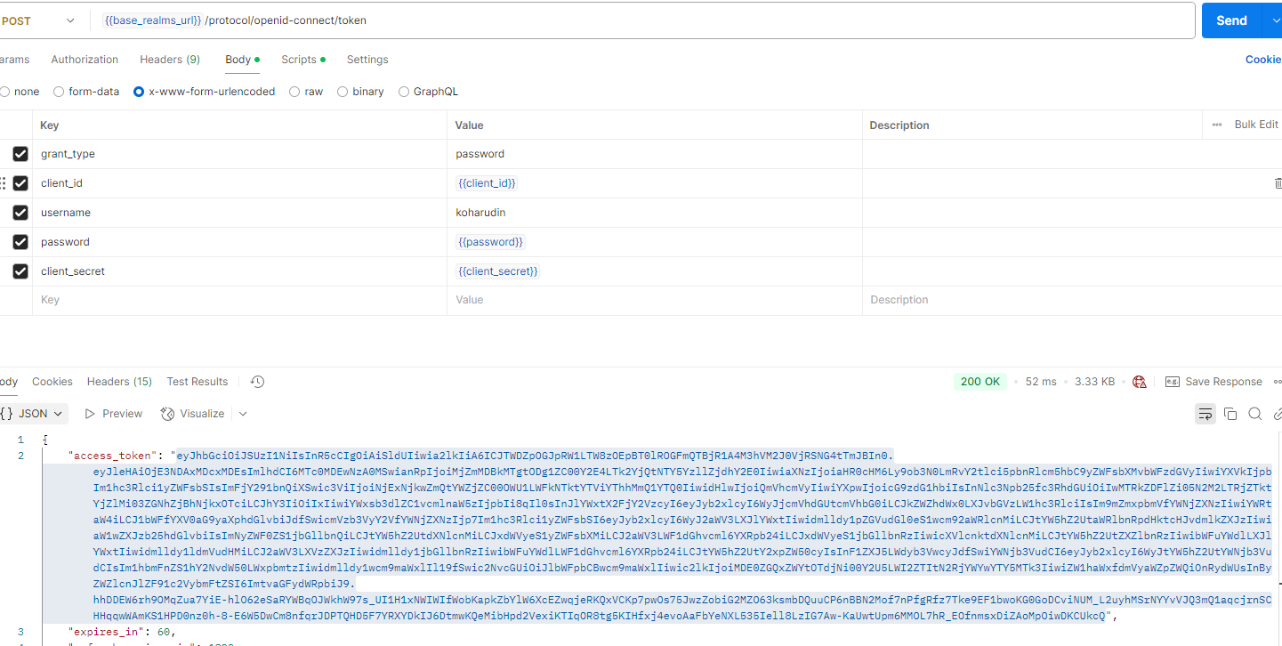
Req Access Token

Slide 32
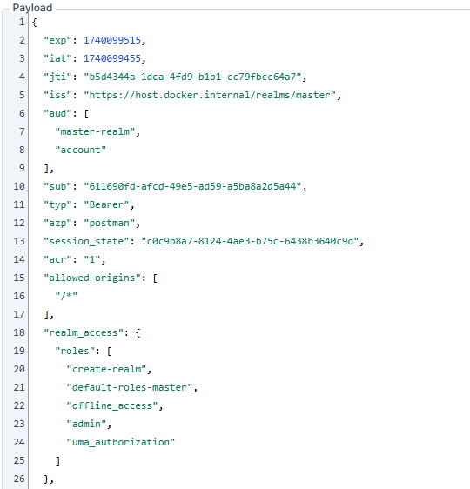
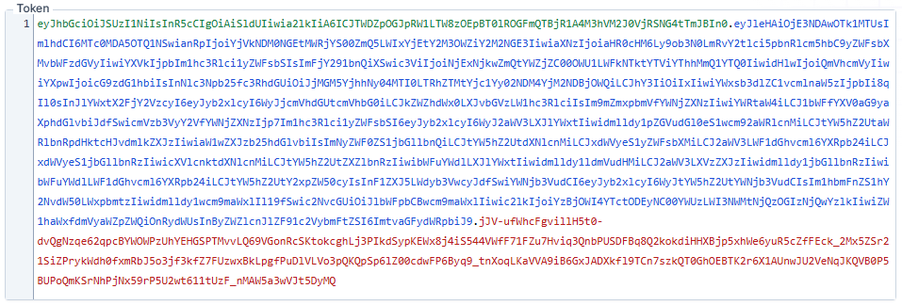
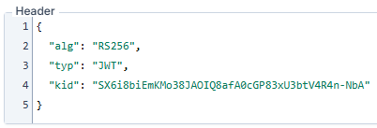
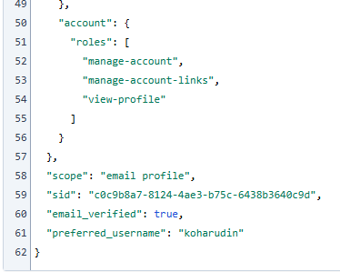
JWT Decrypt

Slide 33
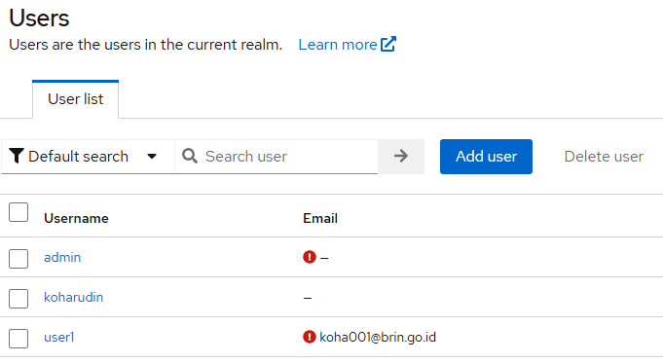
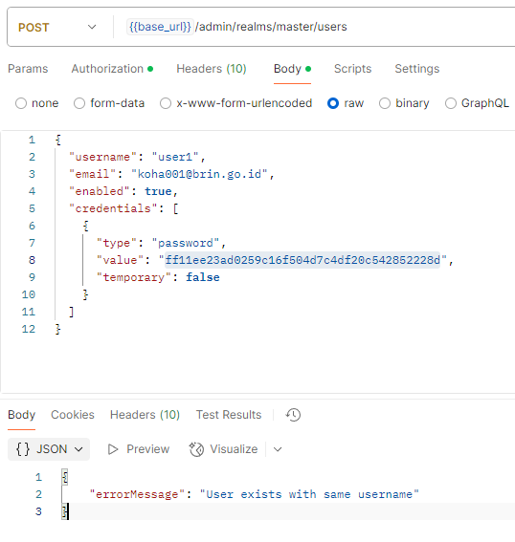
Create user over RestAPI
ff11ee….it’s SHA-1 hashed password, but keycloak recognizes it as raw password
If you're migrating from a system that uses SHA1 for password hashes, it’s better to implement a password migration strategy, where users are forced to change their passwords on first login, and then Keycloak can rehash them using a more secure algorithm.
https://www.keycloak.org/docs-api/latest/rest-api/openapi.json

Slide 34
Mig Strategy password (opt1) (add column password_bcrypt)
As-is SSO
user
Hash rawPassword using bcrypt
Login SSO

Slide 35
Mig Strategy password (opt2) (blast email)
Ext System
blast email
As-is SSO
user
Open update password link
Hash rawPassword using bcrypt

Slide 36
Mig Strategy password (opt2) (forgot password)
SSO Keycloak
Click forgot password
Send email link
user
Open forgot password, update password

Slide 37
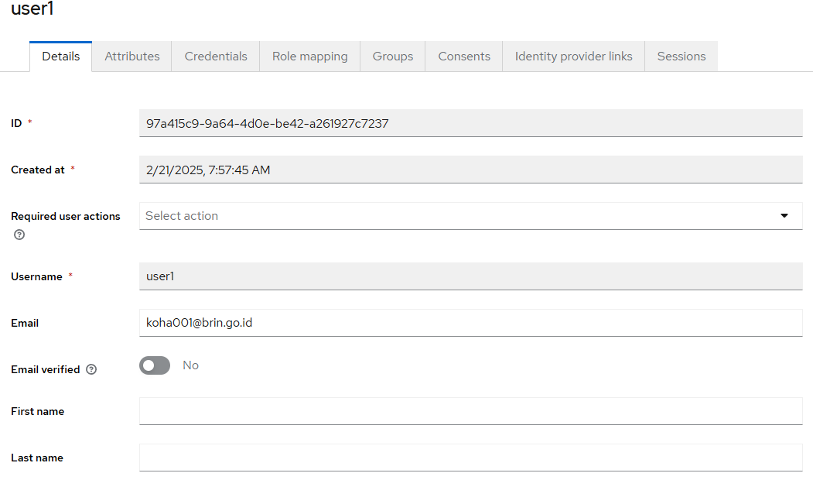
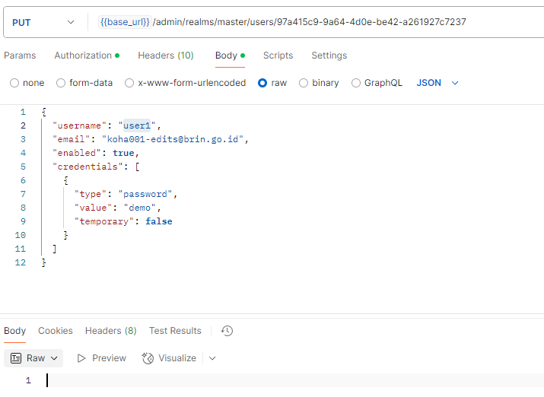
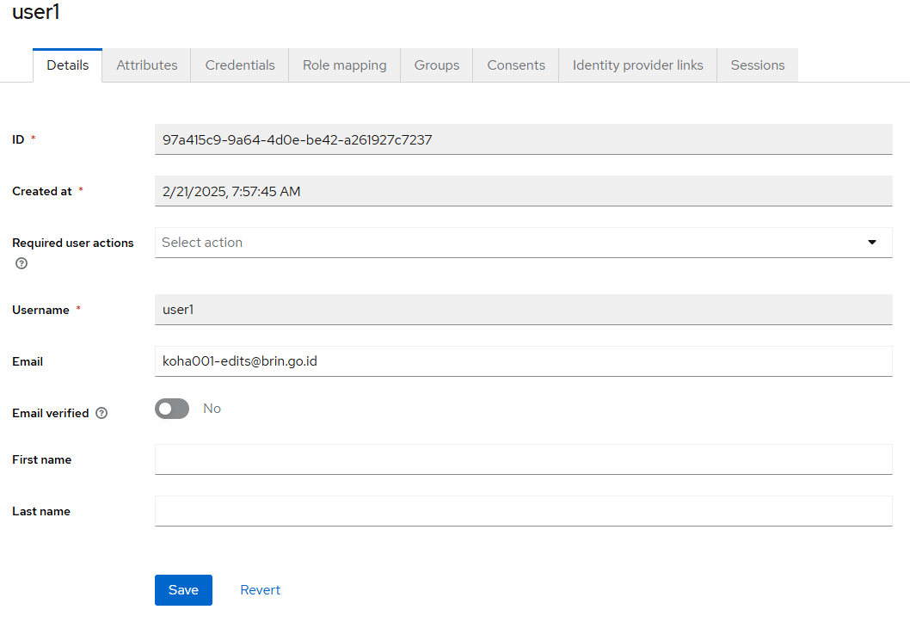
update user over RestAPI

Slide 38
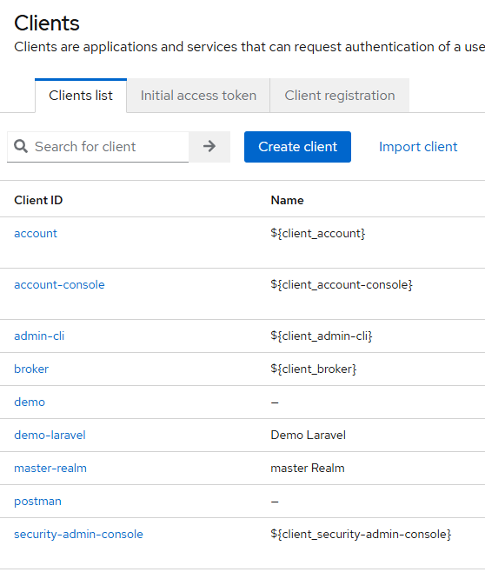
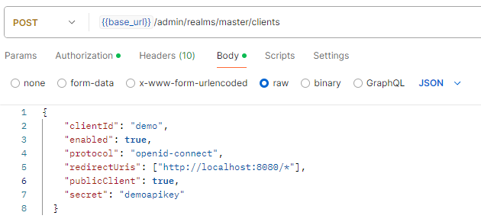
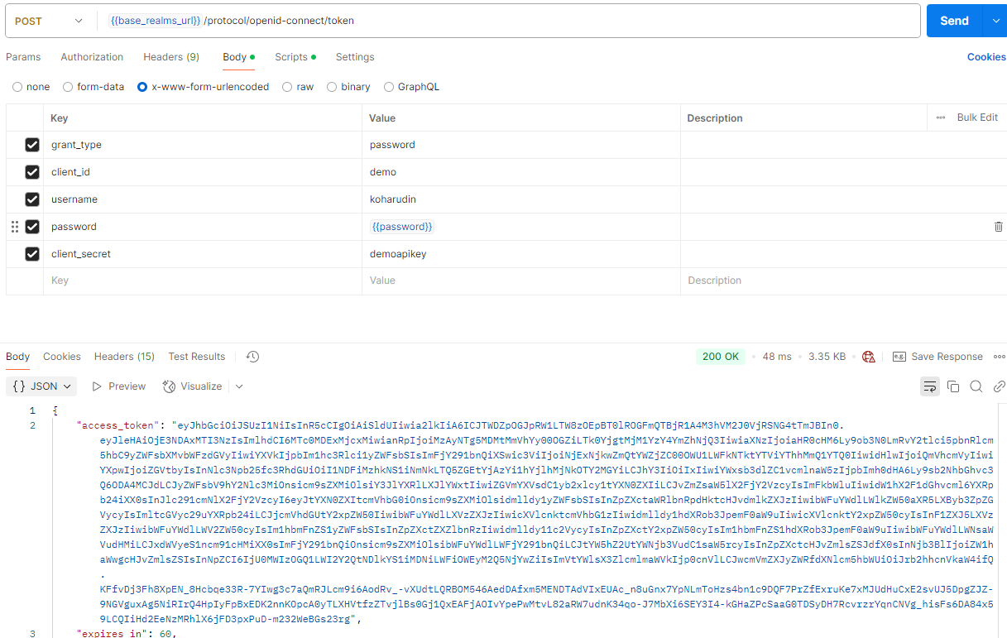
Create client

Slide 39
Integrasi keycloak dengan LDAP
LDAP (Lightweight Directory Access Protocol) : protocol
AD vs OpenLDAP? Perangkat lunak yang mendukung LDAP
LDAP adalah protokol yang menentukan bagaimana pengguna, perangkat, dan klien dapat berkomunikasi dengan direktori server.
AD berbasis windows, ada gui dan lisensi
OpenLDAP berbasis linux dan opensource

Slide 40
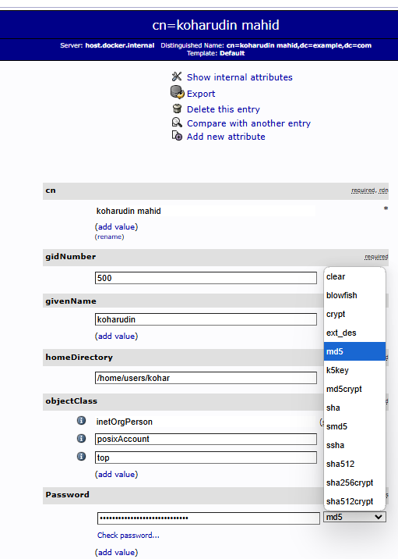
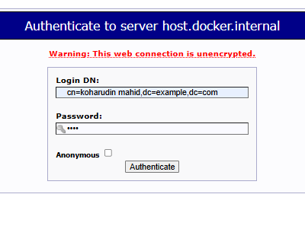
Add User (LDAP)
User :
koharudin.mail07@gmail.com
pass :
demo

Slide 41
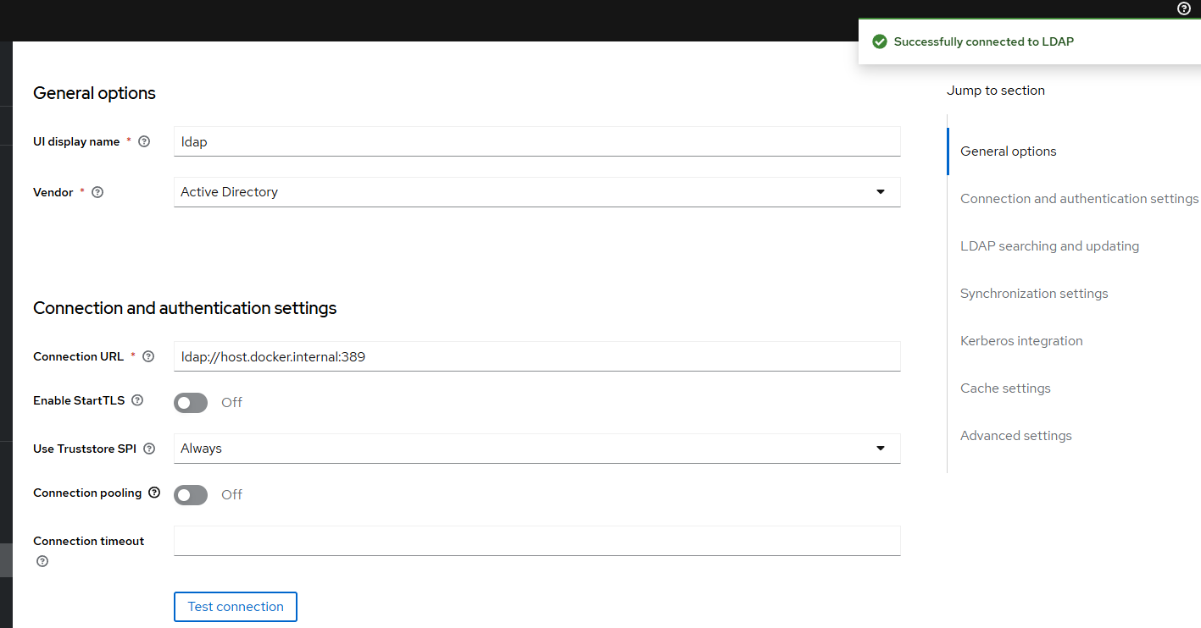
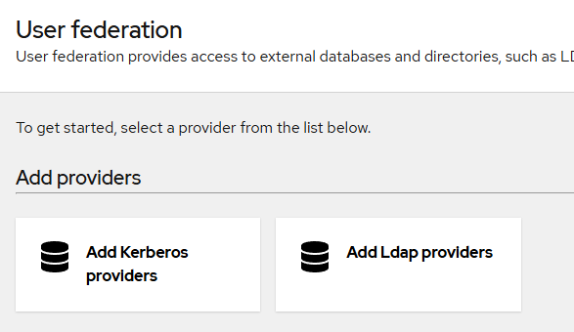
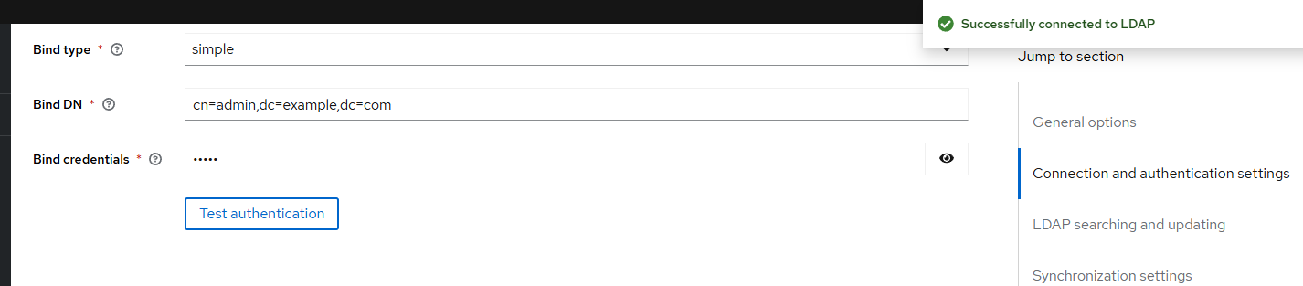
Keycloak ldap user federation

Slide 42
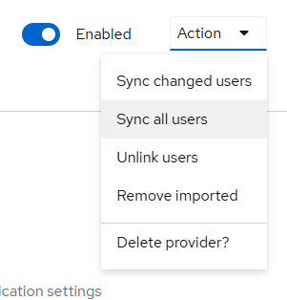
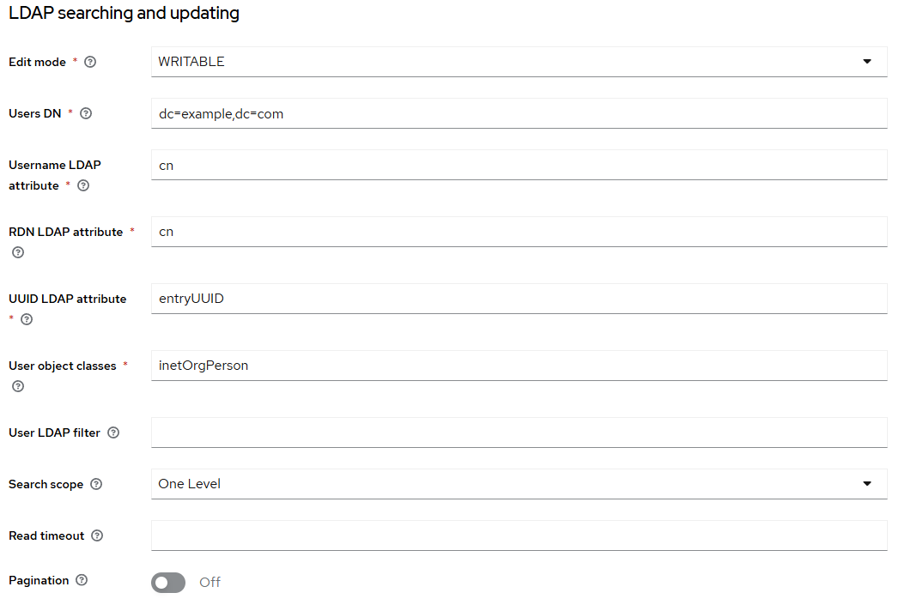

Keycloak ldap user federation

Slide 43
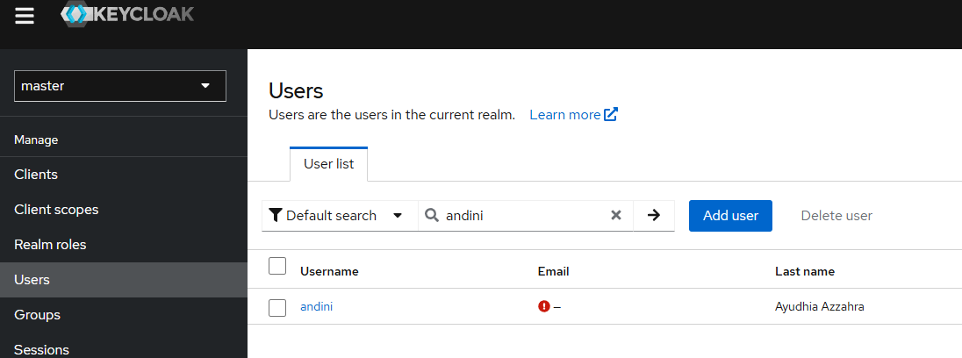
Keycloak ldap user federation

Slide 44
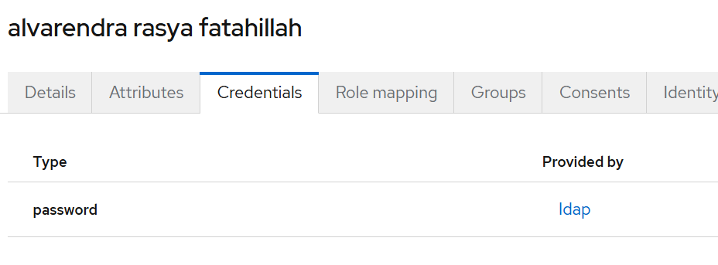
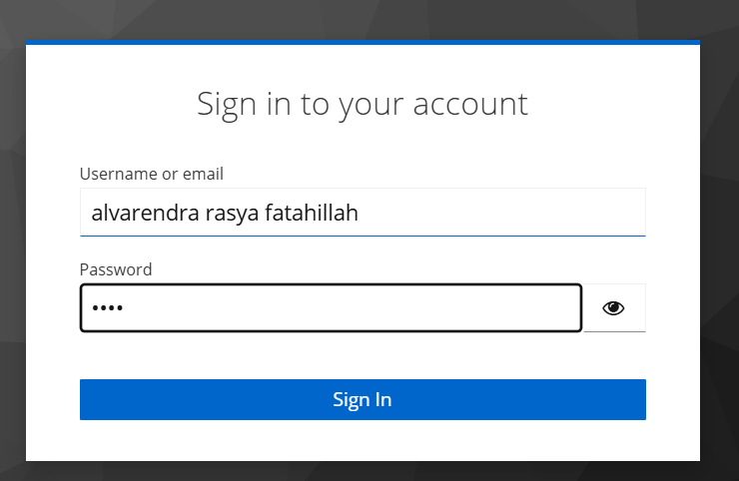
Login user LDAP di keycloak admin panel

Slide 45
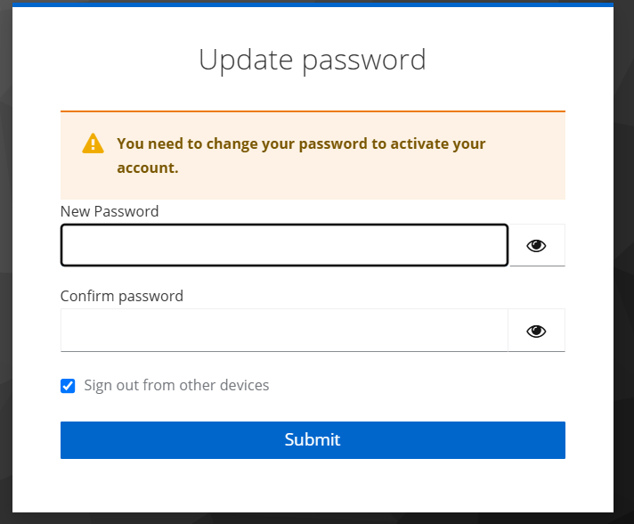
Must Update Password

Slide 46
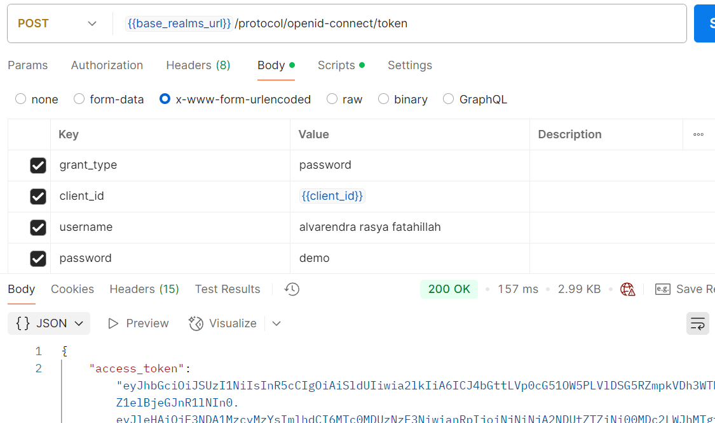
Test LDAP-Keycloak via Postman

Slide 47
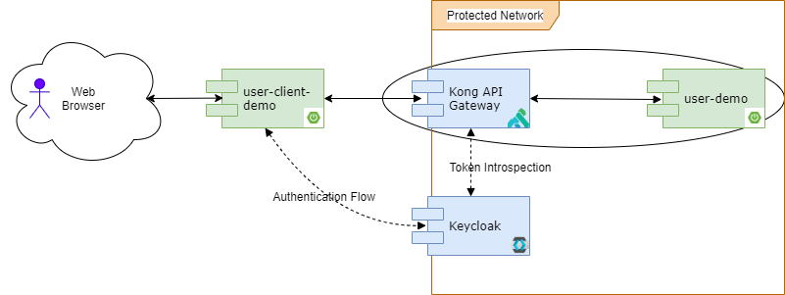
What’s kong?
a lightweight, fast, and flexible cloud-native API gateway.
kong:
image: kong/kong-gateway:3.9.0.1
environment:
- KONG_DATABASE=postgres
- KONG_PG_HOST=host.docker.internal
- KONG_PG_USER=postgres
- KONG_PG_PASSWORD=postgres
- KONG_PG_DATABASE=db_kong
- KONG_PROXY_ACCESS_LOG=/dev/stdout
- KONG_ADMIN_ACCESS_LOG=/dev/stdout
- KONG_PROXY_ERROR_LOG=/dev/stderr
- KONG_ADMIN_ERROR_LOG=/dev/stderr
- KONG_ADMIN_LISTEN=0.0.0.0:8001
- KONG_ADMIN_GUI_URL=http://localhost:8002
depends_on:
- db
ports:
- "8000:8000" # Proxy port
- "8001:8001" # Admin API port
- "8002:8002" # Admin GUI port
- "8003:8003" # Portal GUI port
kong-migrations:
image: kong:3.0
command: "kong migrations bootstrap"
environment:
KONG_DATABASE: postgres
KONG_PG_HOST: host.docker.internal
KONG_PG_USER: postgres
KONG_PG_PASSWORD: postgres
KONG_PG_DATABASE: db_kong
depends_on:
- db
restart: "no"
docker-compose run kong kong migrations up

