Slide 1
Model Checking
Chuan Hock KOH (Ah Fu)
Limsoon WONG

Slide 2
Aldridge et al. (2006)
Building a mathematical model
  Construction
    Drawing the network of the model
  Verification
    Ensure that the drawn network is reasonable
  Calibration
    Parameter values are estimated
  Validation
    Satisfy given constraints or properties
Notes:
In general, there are four main step in building a model
Manual modeling – manually write a list of differential equations. Graphical modeling – draw a network diagram (manually). Draw the involved species and their connections.
Model Verification checks that the drawn network makes sense. Conservation of species. Structure is logical.
Estimate parameter values to model such that it fits experimental data. However, most biological pathway models remain poorly calibrated due to poor quality data such as low sampling rate and noisy data. Furthermore, this inverse problem are known to be ill-conditioned and multimodal. i.e. Multiple local minimum.
To ensure that the built model can satisfy constraints or properties which the system is known to exhibit.

Slide 3
Model Validation
Final step in building a model
Ensures that the model behavior adhere to certain constraints
  Exhibit or does not exhibit certain behaviors
A powerful computer science technique can be used to automate this process
  Model checking

Slide 4
Model Checking
An automated process to formally verify a system’s behavior with respect to a set of properties
Widely used for validating circuit designs
Properties need to be first written in temporal logic
  Linear Temporal Logic

Slide 5
Linear Temporal Logic (LTL)
Name | Operator | Explanation
Next | X ϕ | ϕ must be true at the next time point
Global | G ϕ | ϕ must always be true
Finally | F ϕ | ϕ must be true at least once
Until | ϕ₁ U ϕ₂ | ϕ₁ must be true until ϕ₂ becomes true; ϕ₂ must become true eventually
Release | ϕ₁ R ϕ₂ | ϕ₂ must be true until and including the time point ϕ₁ becomes true; if ϕ₂ never become true, ϕ₁ must always be true

Slide 6
Categories
Generally, properties of pathway models can be sorted into five categories (Barnet et al. 2009)
  Reachability properties
    F(B > 2 && B < 3)
  Time-ordering of events
    A < 2 U (A >= 2 && A <= 5) U A >= 5
  Variables correlations
    A < 2 U (A >= 2 && A <= 5) U A >= 5 ->
    (B > 10 U (B <= 10 && B >= 5) U B < 5)
  (Multi)stability properties
    A > 0 -> F( G (A < 2) )
  Oscillation properties
    ( G[ (A < 3) -> F(A >=3) ] ) && ( G[ (A >=3) -> F(A < 3) ] )

Slide 7
Approaches of Model Checking
Exact or Approximative
  Exact explores all possible reachable states
  Approximative does sampling
Biological systems are robust and random in nature
  Will have infinite possible reachable states
  Approximative is more suitable

Slide 8
Approximative Model Checking
How many samples are sufficient?
  Donaldson and Gilbert (2008)
    Just sample a fix number that is assumed to be large enough (10,000)
  Clarke et al. (2008)
    Based on statistics and sample until enough to make a decision using a procedure developed by Younes and Simmons (2002)

Slide 9
Younes and Simmons (2002)
Relaxed the standard hypothesis testing from
  H₀: p ≥ θ vs. H₁: p < θ to
  H₀: p ≥ θ + δ vs. H₁: p ≤ θ - δ
    (θ - δ, θ + δ) is known as the indifference region
Together with Wald’s sequential probability ratio test (Wald, 1945)
One can determine after each sample, whether another sample is required or decision on which hypothesis to accept can be made

Slide 10
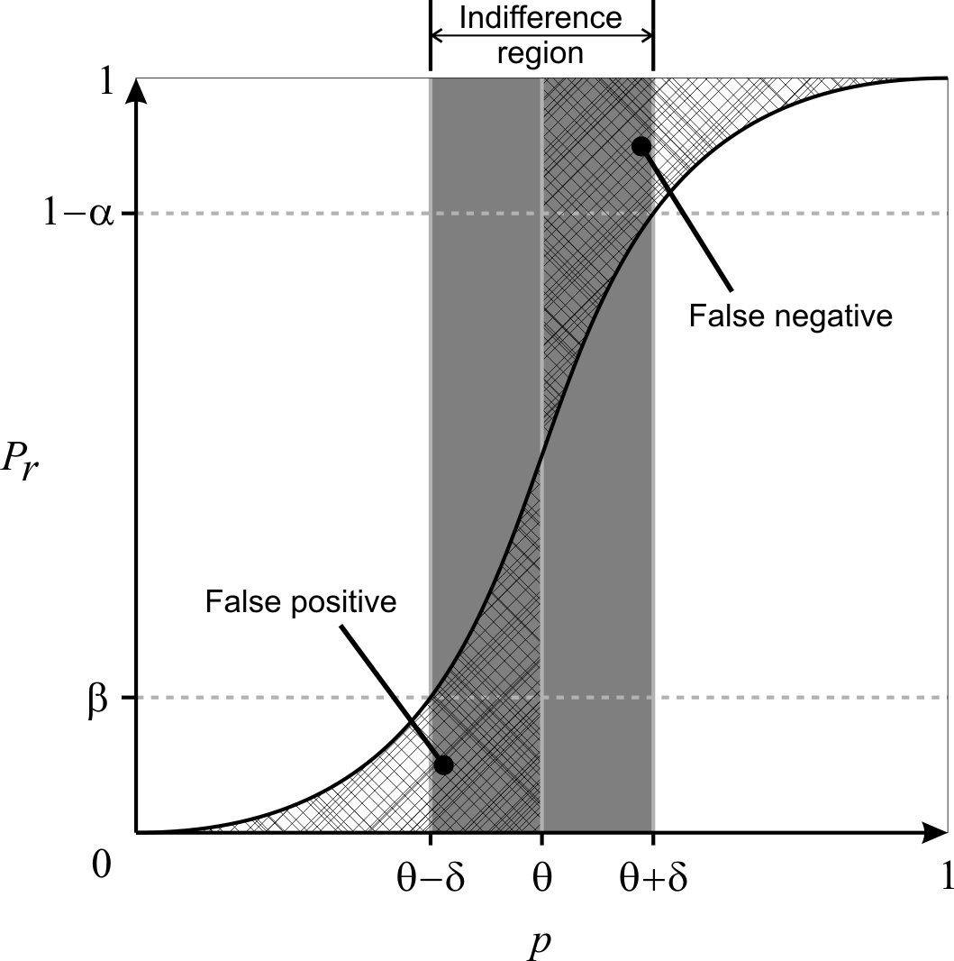
Younes and Simmons (2002) II
Plus points
  type-I error rate and type-II error rate can be bounded independently
  Min samples to make a decision are used
Pitfall
  Error rates are only bounded if p is outside indifference region
  Choice of δ is critical
    Too small, “min samples” increases significantly
    Too large, higher chance for p to be inside indifference region

Slide 11
Younes (2006)
Younes is aware of the problems
Improve the procedure such that whenever a definite result is given, the error rate is bounded
Uses two acceptance tests
  H₀: p > θ vs. H₁: p ≤ θ – δ with <α, γ>
  H'₀: p > θ + δ vs. H'₁: p ≤ θ with <γ, β>.
    γ controls the probability of an undecided result
  P_{>Θ} is accepted as true iff H₀ and H'₀
  P_{>Θ} is accepted as false iff H₁ and H’₁
  Undecided if (H₀ and H’₁) or (H₁ and H’₀)

Slide 12
Younes (2006) II
Plus points
  Error rates are guaranteed to be bounded if a definite result is given
Problems
  Choice of δ is still crucial
    Influence “min samples” required
    Together with γ, influence number of undecided results
  Undecided results are normally undesirable
    Especially after using up computation resources

Slide 13
Our proposed algorithm (MIRA A)
Dynamically selects an indifference region
Improve on Younes (2006) procedure
  Set δ to 1.0 as default
  Whenever an undecided result is returned, half δ
  Stop when a definite result is returned
Plus points
  Predetermined δ is not required from user
  Required sample size adjust accordingly to difficulty of problem
  Error rate is always bounded
  Always returns a definite result
Problem
  If p is very close to θ, sample size required will be exorbitant and in the extreme case where p is equal to θ, sample size required is infinite

Slide 14
Our proposed algorithm II (MIRA B)
Add an additional stopping condition
  Maximum sample size
  If maximum sample size has reached, stop and compute the p-value for both (H₀: p > θ vs. H₁: p ≤ θ ) and accept the one with lower p-value
Our algorithm
  Always return a definite result
  Gives confidence measure (either error rate is bounded or p-value)
  No need for user to input indifference region

Slide 15
Experiment
Validate P_{>=θ}
  p is fixed at 0.5 and θ varies from 0.01 to 0.99 inclusive with increment of 0.01 except 0.5
Each sample is a uniformly randomly generated value in the range [0,1]
Repeat the experiment 1,000 times
Type-I error rate and Type-II error rate fixed at 0.01
Further limit the sample size of our proposed algorithm to 3,000
δ is set to 0.05 for Younes A and Younes B

Slide 16
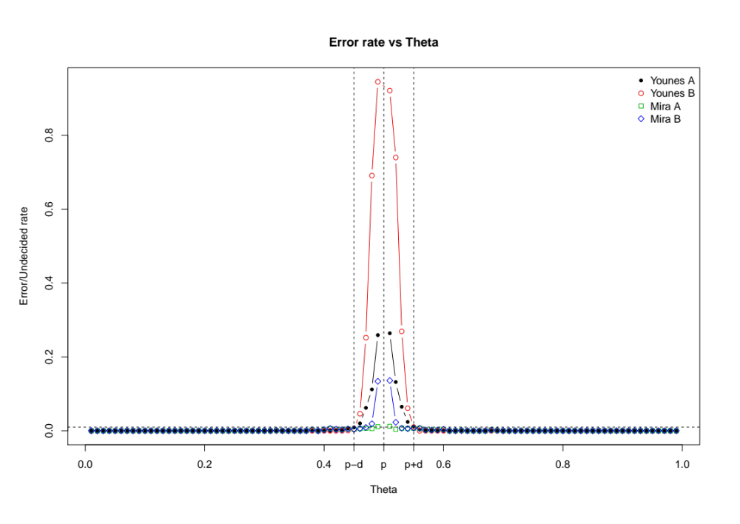

Slide 17
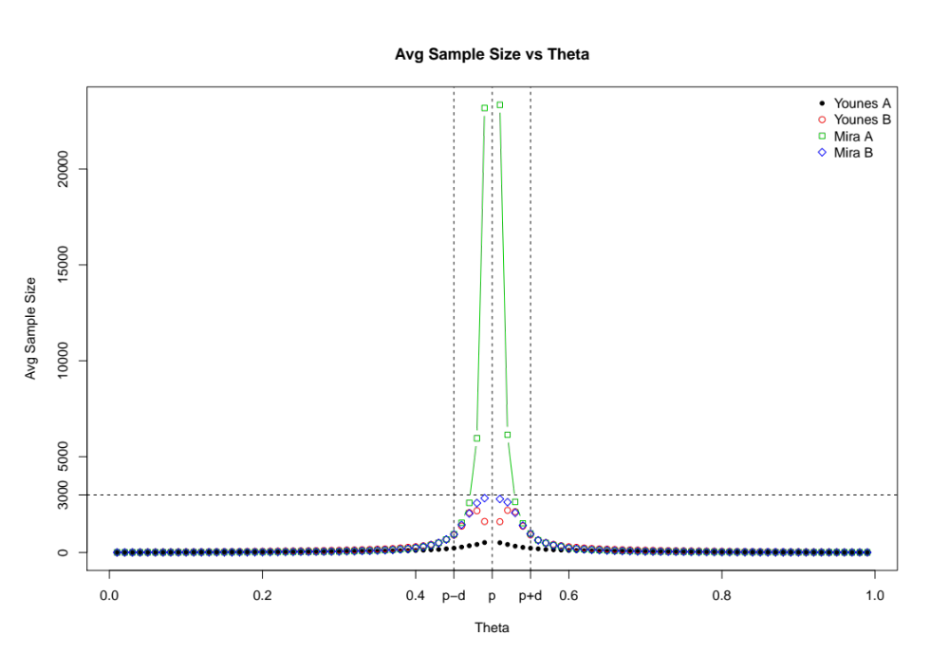

Slide 18
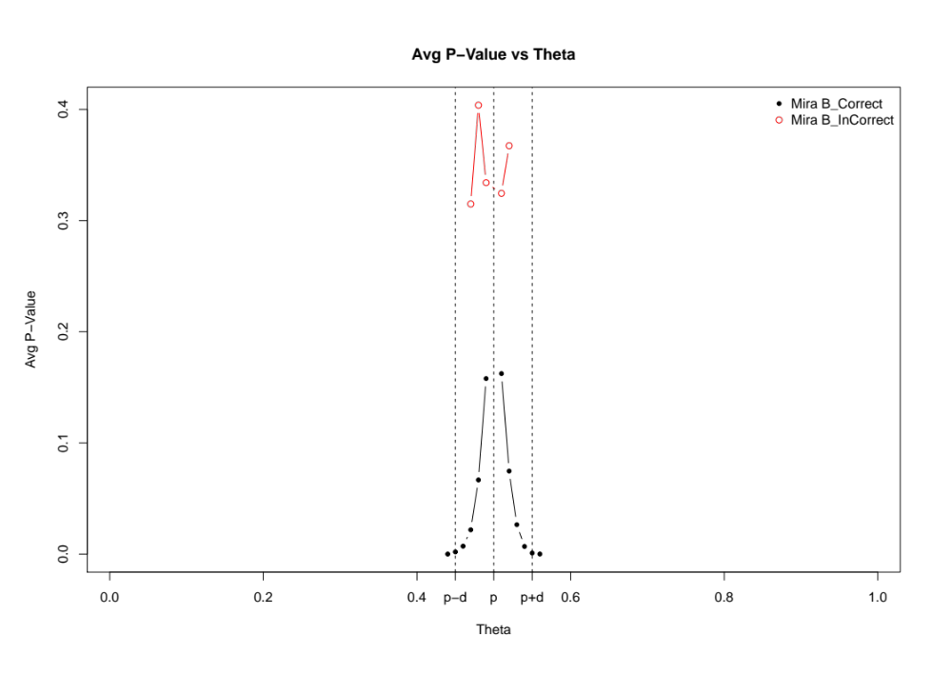

Slide 19
Conclusion
MIRA A
  Controls Error Rate well
  But potentially needs large amount of samples
  For resource-rich users
MIRA B
  Controls sample size needed
  Despite giving errors but could easily differentiate them based on p-values
  In fact, we could estimate the distance to true threshold based on p-values
  For resource-limited users

