Slide 1

SARSA Policy and Its Explanation in Trading
National Conference on Artificial Intelligence 2026 (FJCAI) - Can Tho, 27-28/3/2026
Nguyen Hoang Dac ∗, Lam Quang Khoi † , Nguyen Quoc Huy†
*Dept. of Information Technology, Tay Do College, Can Tho City, VietNam
†Dept. of Information Technology, Sai Gon University, Ho Chi Minh City, Viet Nam
Presenter: Lam Quang Khoi
March 27st, 2026

Slide 2
Agenda
Introduction
Related Works
Proposed Methods
Experiments and Discussion
Conclusion

Slide 3
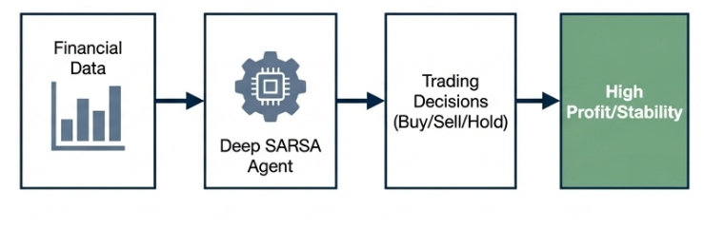
1. Introduction – Motivation
Automated Trading status: Among RL methods, Deep SARSA is an on-policy approach with high stability, making it suitable for noisy financial data.
→ Leading to various model agent used in trading to compared but lack of explanations
Figure 1: The standard automated trading process using RL.
Problem: Explain the automated trading behaviour of SARSA model

Slide 4
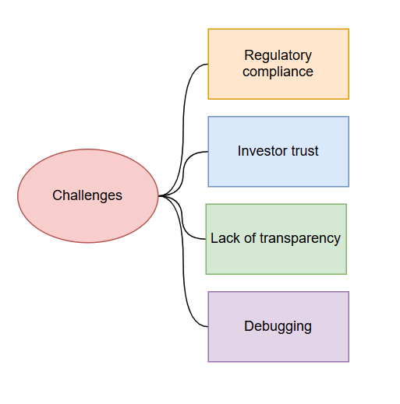
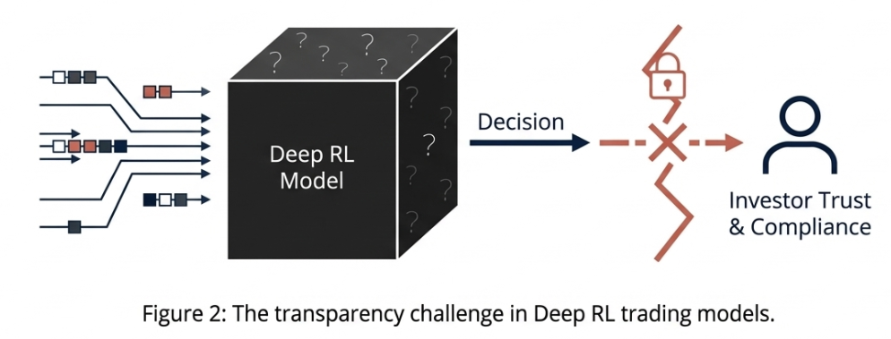
1. Introduction - Challenges
Deep RL models fundamentally act as opaque “Black-Box”

Slide 5
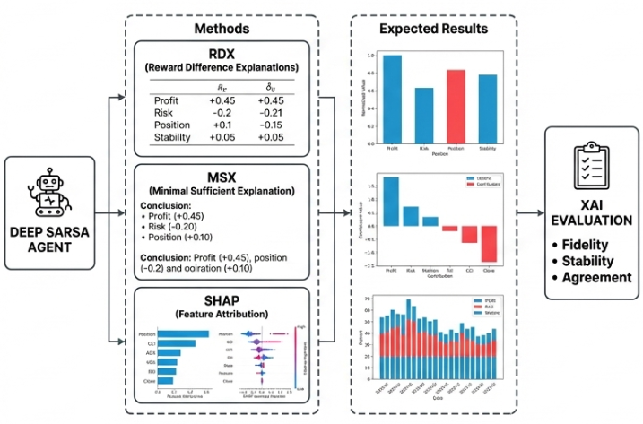
1. Introduction – Research Approach
Proposed Approach:
An Explainable Reinforcement Learning (XRL) framework designed for Deep SARSA.
Goal:
Clarify decision-making at both the reward structure level and the input feature level.
Figure 3: Proposal of the method

Slide 6
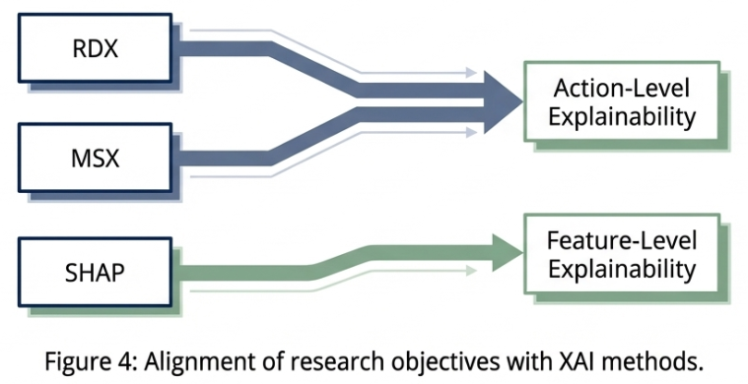
1. Introduction – Research Question
Research question
Question 1: How to identify the minimal sufficient reasons justifying a decision?
Question 2: How do technical indicators impact Q-values in the VNStock market?

Slide 7
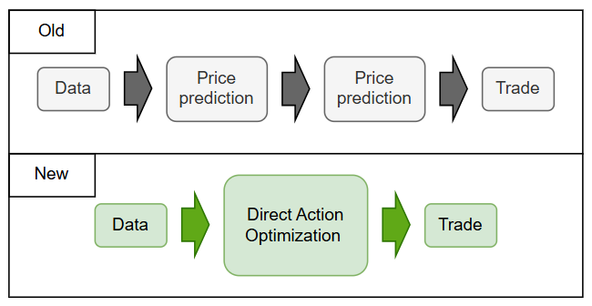
2. Related works
Direct RL in Trading[1]
Traditional methods attempt to forecasting the price.
Direct RL optimizes actions directly for performance (e.g. Sharpe ratio).
Deep SARSA leverages this direct action – value mapping.
→ Learning to trade optimized but lack of transparency
Figure 5: Forecasting vs Direct RL.
[1] J. Moody and M. Saffell, "Learning to trade via direct reinforcement," IEEE Transactions on Neural Networks, vol. 12, no. 4, pp. 875-889, July 2001.

Slide 8
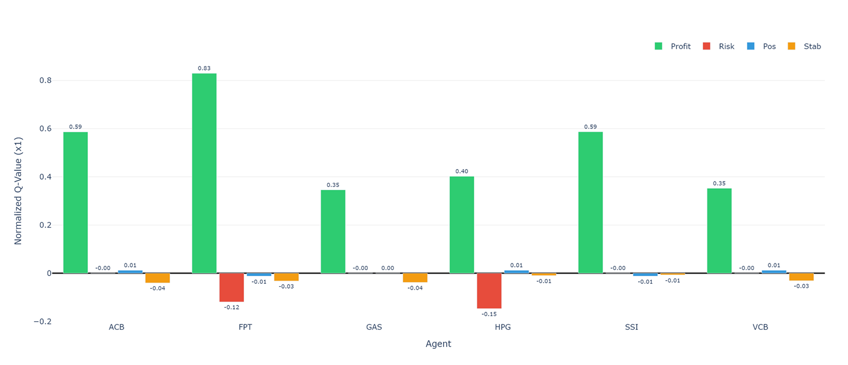
2. Related works
Explainable RL via Reward Decompose[2]
RDX and MSX split scalar rewards into distinct, meaningful channels.
Explain why an agent prefers one action over another.
→ Lack of explain of the agent in the VietNam market index
Figure 6: Example graph demonstrate reward decompose method.
[2] Z. Juozapaitis, A. Koul, A. Fern, M. Erwig, and F. Doshi-Velez, "Explainable reinforcement learning via reward decomposition," in IJCAI/ECAI Workshop on Explainable Artificial Intelligence, 2019, pp. 47-53.

Slide 9
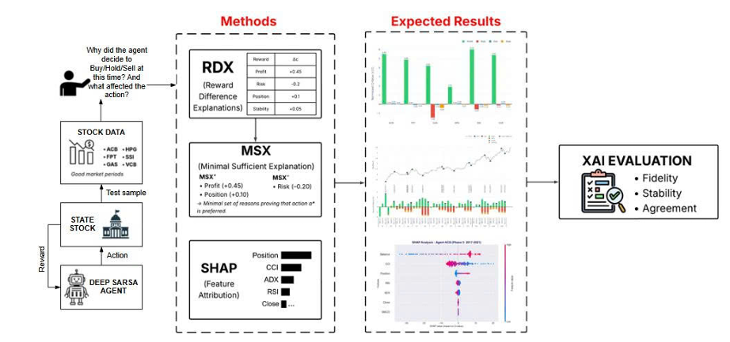
3. Proposed method
Figure 7: Original framework of the paper
Overall XRL framework
The Agent learns optimal policies via Q-function updates in historical data.
The XAI model executes post-hoc analysis on the trained “black-box”

Slide 10
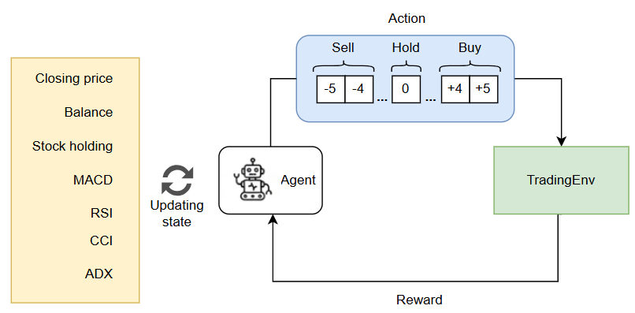
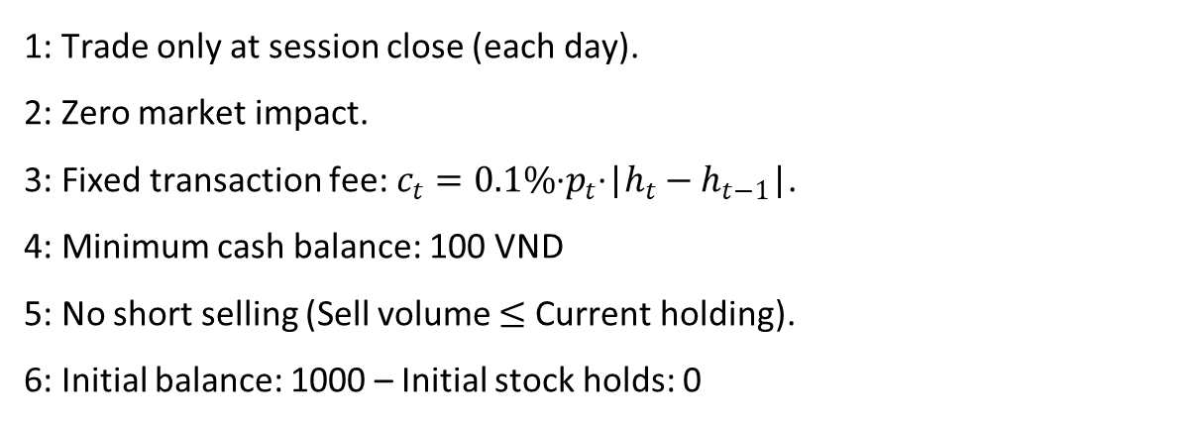
3. Proposed method
1: Trade only at session close (each day).
2: Zero market impact.
3: Fixed transaction fee: $c_{t}=0.1\%\text{·}p_{t}\text{·}\text{|}h_{t}−h_{t−1}\text{|}$.
4: Minimum cash balance: 100 VND
5: No short selling (Sell volume $≤$ Current holding).
6: Initial balance: 1000 – Initial stock holds: 0
Figure 8: Training agent method

Slide 11
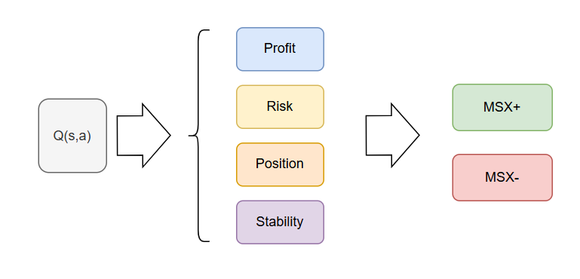
3. Proposed method
Reward-level Explanation
RDX: Decomposes total reward into 4 components to compute the different between actions
MSX: Condenses RDX output into the absolute minimal set of reasons required to certify an action’s optimality
Answer: “Why was Action A preferred over Action B?
Figure 9: RDX + MSX method to compare each action

Slide 12
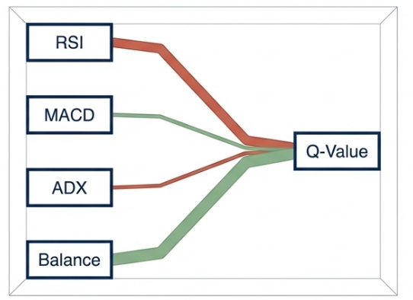
3. Proposed method
Feature-level Explanation
Applies Game Theory (Shapley values) to quantify feature contributions to Q-values
Answer: How does current capital or a specific market signal trigger a action?
Figure 10: Feature attributiton mechanism using SHAP for Q-value estimation.

Slide 13
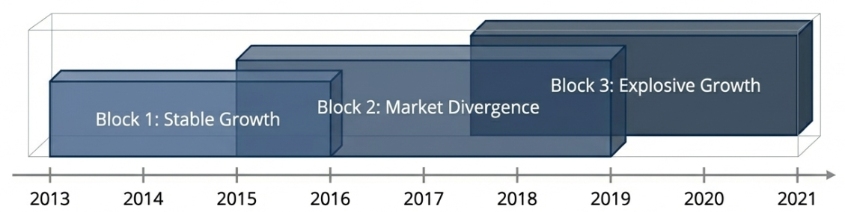
4. Experiment and Discussion
Dataset & Setup
Dataset: 6 high liquidity VNStock blue-chips (ACB, FPT, GAS, HPG, SSI, VCB).
Phases: Tested across three overlapping market environments to evaluate robustness.
Algorithm: Deep SARSA (ε-greedy, two fully connected hidden layers).
Figure 11: Experimental blocks and evaluation timeline on the VNStock dataset

Slide 14
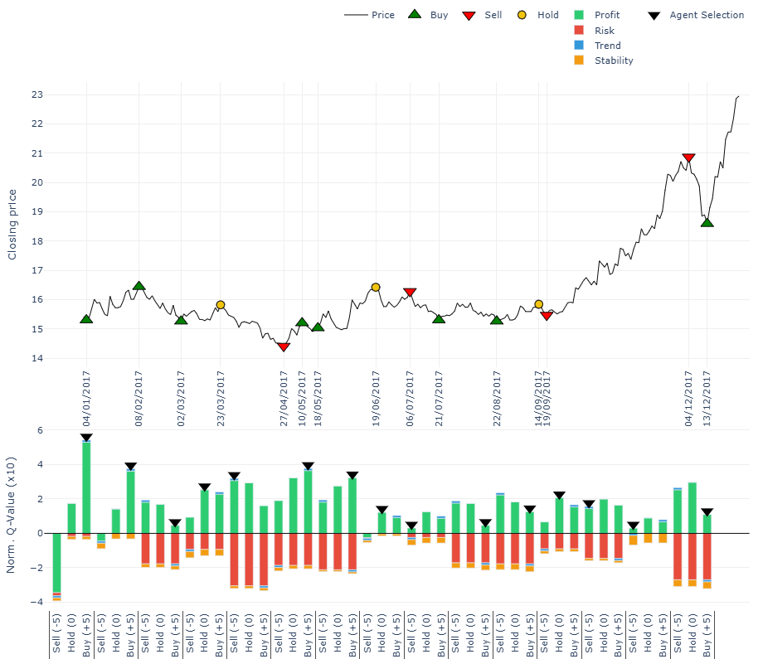
4. Experiment and Discussion
Example RDX + MSX result
The Good execution: It successfully executes “buy the dip” strategies during the sideways market (Jan–Oct).
The Bad execution: It struggles with major market shifts.
The Anomaly detection: The agent almost entirely ignores "Trend" and "Stability" rewards.
Figure 12: Top 15 critical points and action comparison at each point

Slide 15
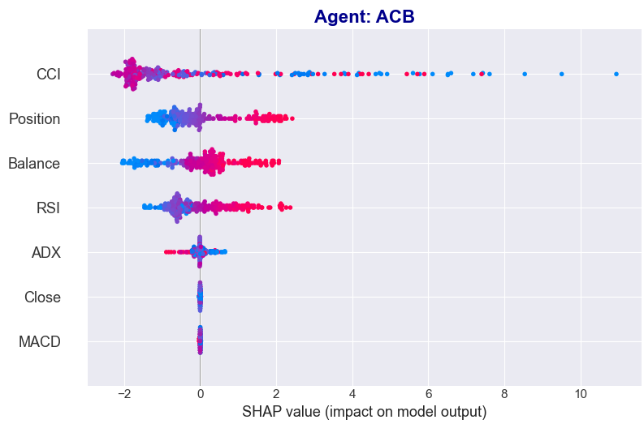
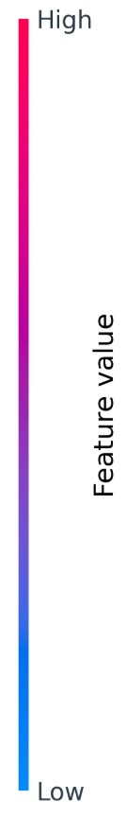
4. Experiment and Discussion
Over-reliance on the 'Close' price.
Poor Indicator Adaptation: Fails to dynamically adjust MACD and RSI
Zero Risk Management: 'Balance' has the lowest SHAP importance
Figure 13: Bee-hive graph present the contribution of each feature to the agent’s action

Slide 16
5. Conclusion
Policy Behavior Illumination: Successfully identifies behavioral patterns within the agent's policy
Limitation & Improve: Post-hoc explanation can only analyze decisions after the agent has completely traversed the test samples.
Future work: Upgrade from SARSA to advanced Deep RL models (e.g., DQN/PPO) and evaluate the agent across diverse, volatile, and downtrend markets.

Slide 17


THANK YOU FOR LISTENING

