Slide 1



A PREDICTIVE ANALYSIS FOR CUSTOMER RETENTION AND REVENUE OPTIMIZATION AT POWERCO
A BDM CAPSTONE PROJECT BY
KOHIL SHARMA
22F3001103
1

Slide 2

CONTENT
01
ABOUT ORGANIZATION AND THE PROBLEMS
02
DATA COLLECTION AND OBSERVATIONS
03
GRAPHICAL ANALYSIS
04
RESULTS AND FINDINGS
05
RECOMMENDATIONS
2

Slide 3

ABOUT ORGANIZATION
AND THE PROBLEMS
PowerCo is a New Zealand utility provider offering gas and electricity services to residential customers, small and medium enterprises (SMEs), and corporations. Serving both B2C and B2B markets, it is a prominent player in the energy sector.
They are facing two major challenges:
Customer churn among small and medium enterprises (SMEs) due to strong competition in the open energy market.
Revenue instability caused by seasonal energy demand.
3

Slide 4

DATA COLLECTION
AND OBSERVATIONS
Customer Data: Information on customer demographics, industry type, contract length, energy consumption history, and tenure with PowerCo.
Pricing Data: Historical pricing data, capturing any fluctuations in energy costs that customers may have experienced over time, to assess its impact on churn.
75% of customers have no gas consumption.
High skewness, with a few customers consuming significantly more electricity than the majority.
Most customers have been with the company for 4–6 years, indicating loyalty.
4

Slide 5
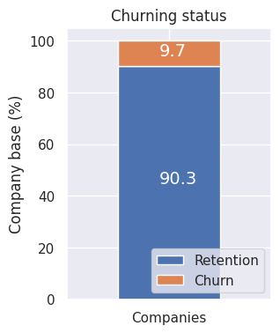

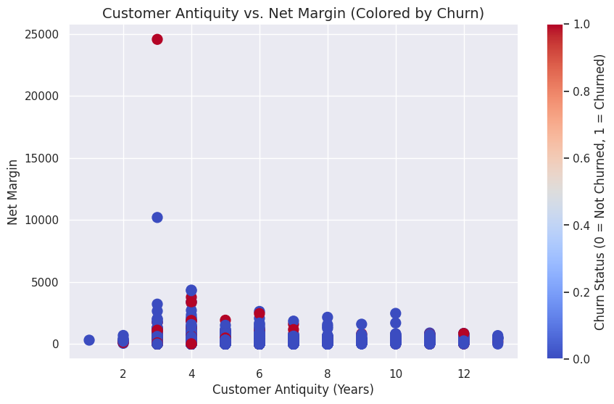

GRAPHICAL ANALYSIS
Most customers are retained, but the 10% churned group needs targeted retention strategies.
While the churn rate appears low, this percentage could represent a significant revenue impact, especially if high-margin customers are included in this group.
Churn (represented by red dots) is concentrated among customers with lower antiquity (1–4 years).
Few high-margin customers are present, and churn is rare among this group, except for an outlier.
5

Slide 6
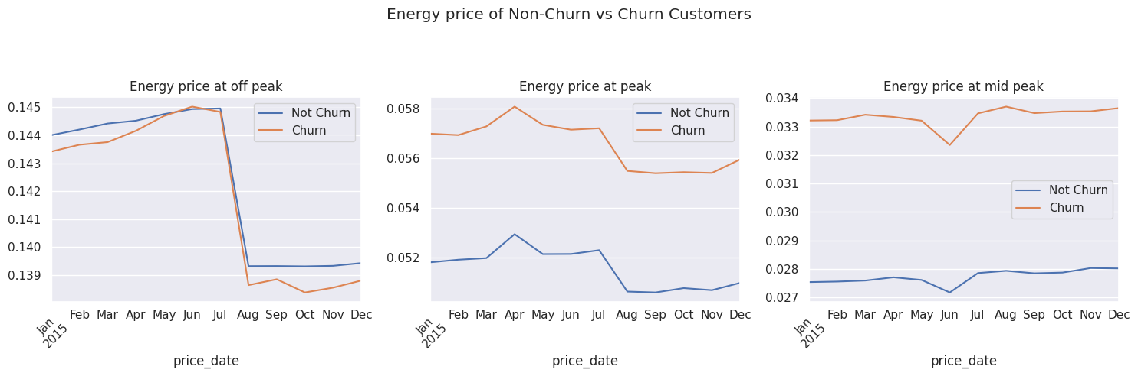
GRAPHICAL ANALYSIS
Churned customers consistently faced higher peak, off-peak and mid-peak energy prices than retained customers.
Churned customers experienced a steeper decline in off-peak, which could indicate dissatisfaction with prior price hikes.
6

Slide 7
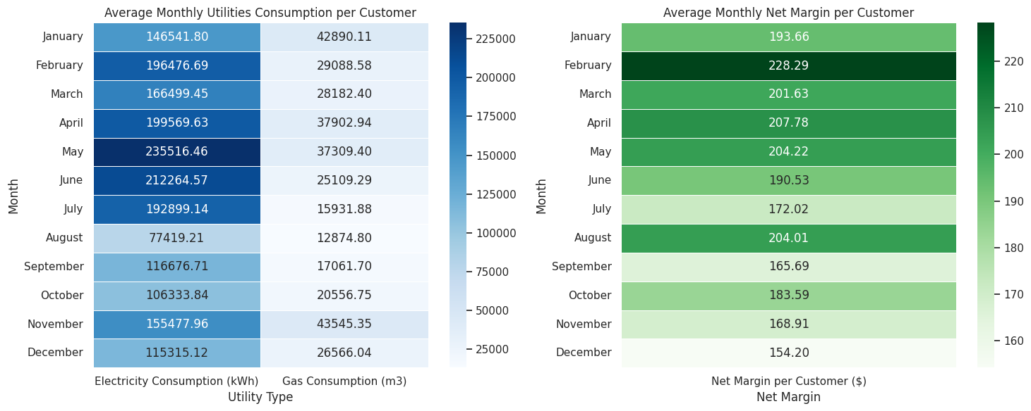
GRAPHICAL ANALYSIS
May (~235,516 kWh) has the highest electricity consumption, likely driven by increased cooling needs in warmer months.
November (~43,545 m³) reflects the highest gas consumption, aligning with heating demands during colder months.
December (~$154.20 per customer) has the lowest margins, likely due to increased costs during the holiday season or pricing inefficiencies.
7

Slide 8
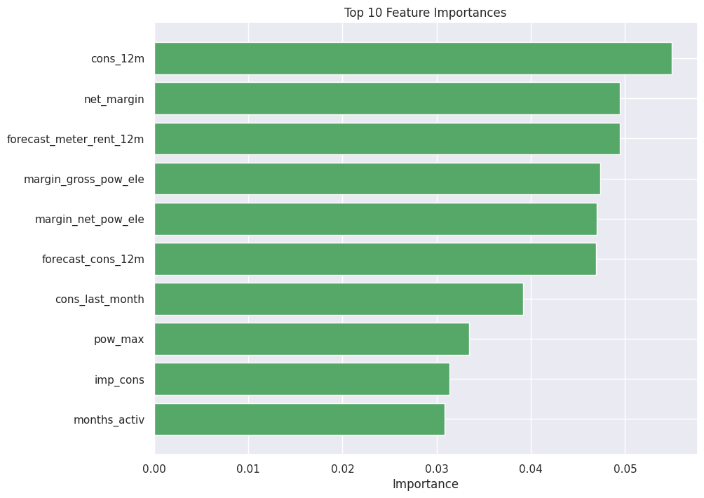
GRAPHICAL ANALYSIS
cons_12m: Annual electricity consumption is the strongest predictor of churn, highlighting long-term usage patterns as critical.
net_margin: Low net margins strongly correlate with churn, emphasizing the importance of profitability.
8

Slide 9
RESULTS AND FINDINGS
Churn Rate: 9.7% of customers churned, with high churn observed among newer customers (1–4 years of tenure).
Sales Channels: Specific channels, like "foosdfpfkusacimwkcsosbicdxkicaua", exhibit the highest churn rate (12.14%), indicating service or engagement issues.
Higher Prices for Churned Customers: Churned customers faced consistently higher and more volatile energy prices, particularly during peak and mid-peak periods.
Retained customers tend to have longer tenures (5+ years) and higher net margins.
Churn is more prevalent among customers with lower net margins (~$0–$500).
Feature importance analysis revealed that net margin, electricity consumption over 12 months, and time-related variables (e.g., tenure, months to contract renewal) were the strongest churn predictors.
Pricing sensitivity, while contributing to churn, was not a primary driver.
9

Slide 10

RECOMMENDATIONS
Stabilize pricing and offer tailored discounts to price-sensitive customers, particularly during critical periods of usage spikes.
Capitalize on summer peaks with dynamic pricing strategies and promotional campaigns to drive engagement and retention.
Bundle gas and electricity plans during complementary seasons to smooth revenue fluctuations and increase cross-utility sales.
Investigate underperforming channels, replicate strategies from successful ones, and standardize engagement practices across all channels.
Use the top predictors to refine customer segmentation, focusing retention efforts on high-risk, high-value customers.
10

