Slide 1
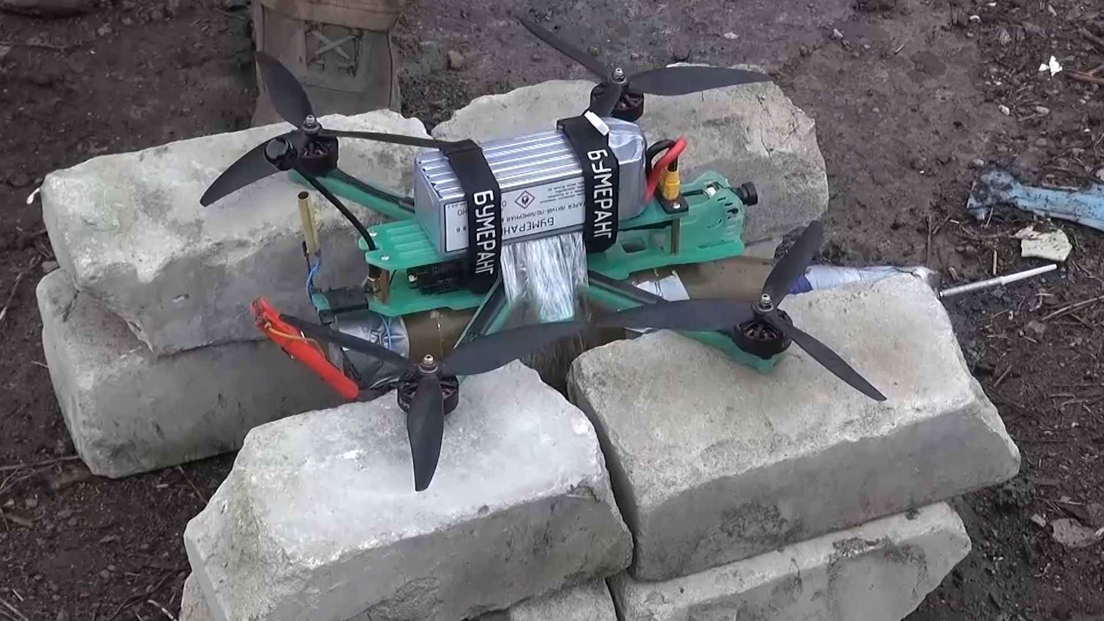
Drone detection

Slide 2
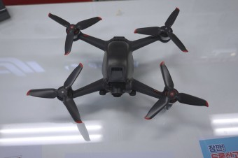
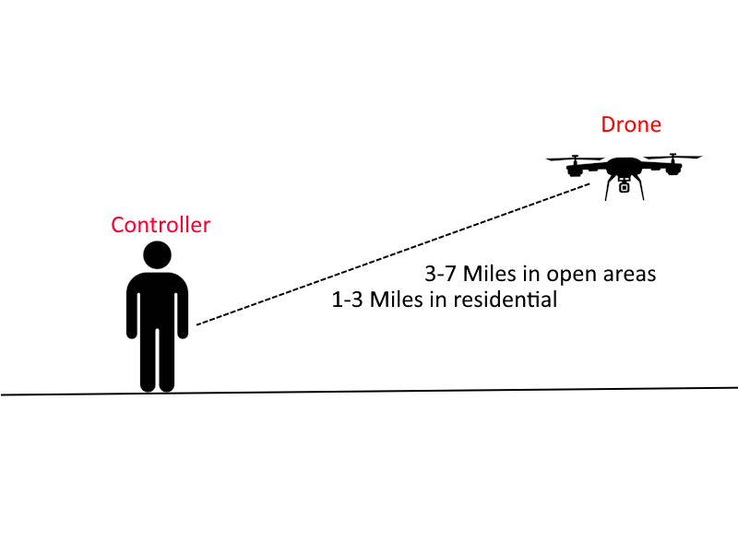
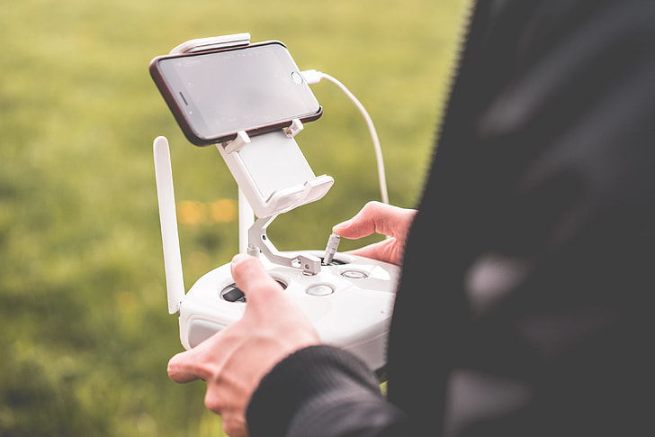
What are drones?
Notes:
Drones are flyable devices capable of travelling great distances from their controller wirelessly. These drones have cameras and other sensors so the controller can control them even when they may not be able to see them.
Modern mid-tier drones can be controlled remotely or wirelessly from between 3 to 7 miles in open areas, or 1-3 Miles in residential areas.

Slide 3
The problem
Notes:
These drones can be equipped to carry explosive devices, such as artillery shells, mortar rounds, or even hand grenades.

Slide 4
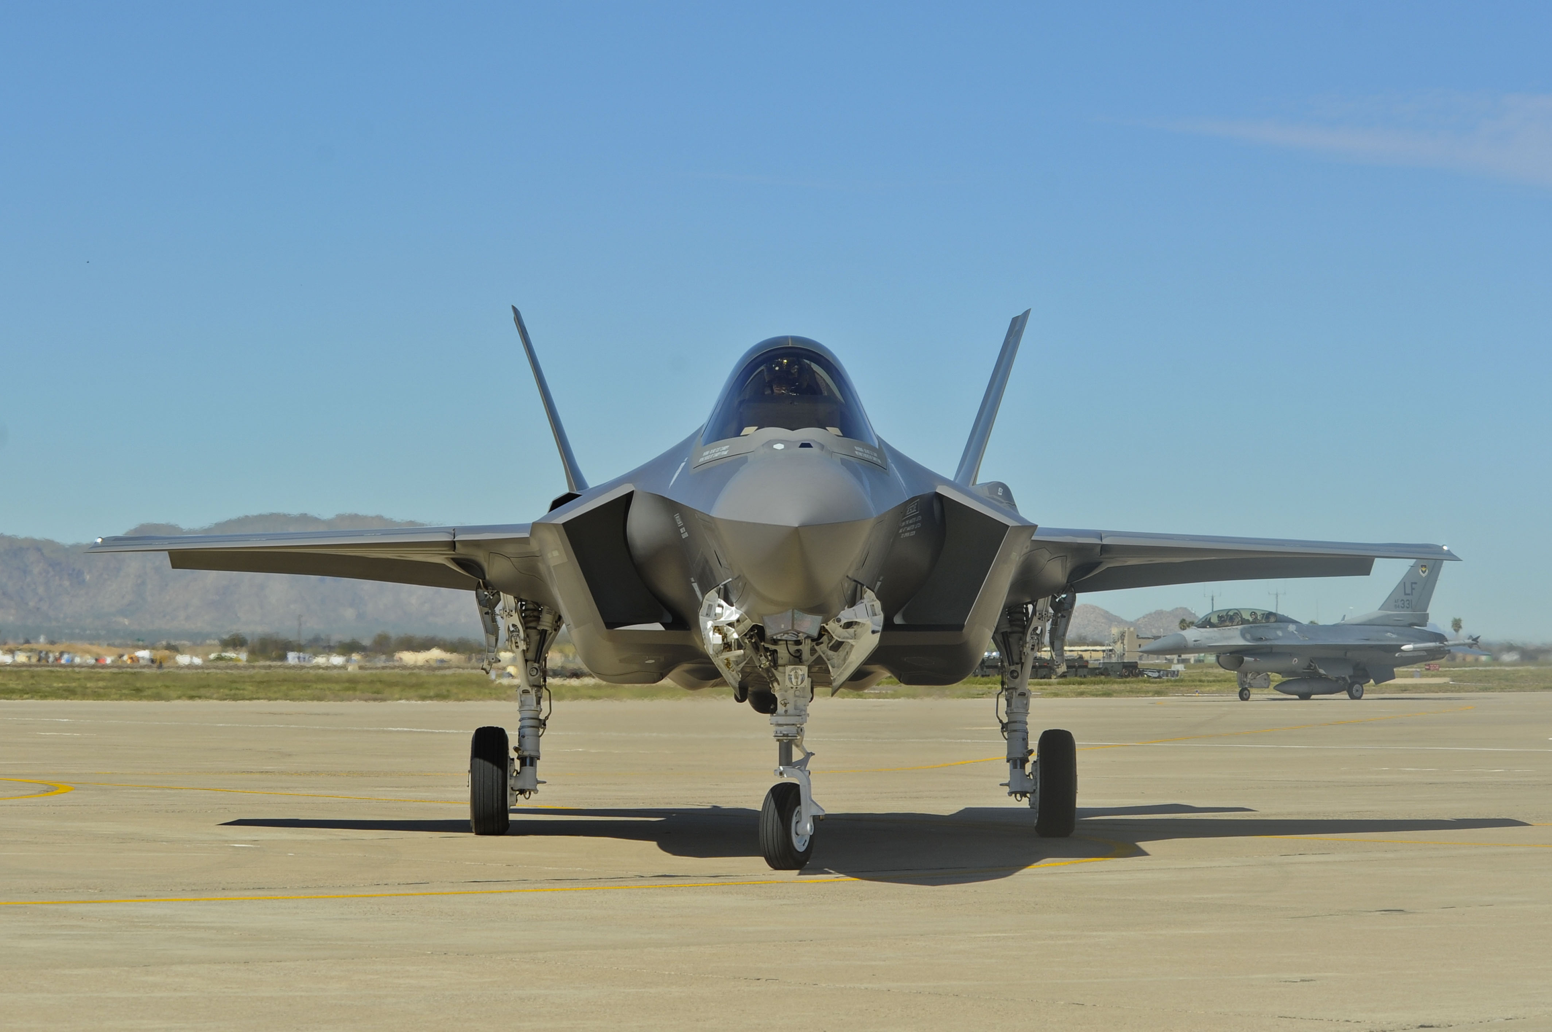
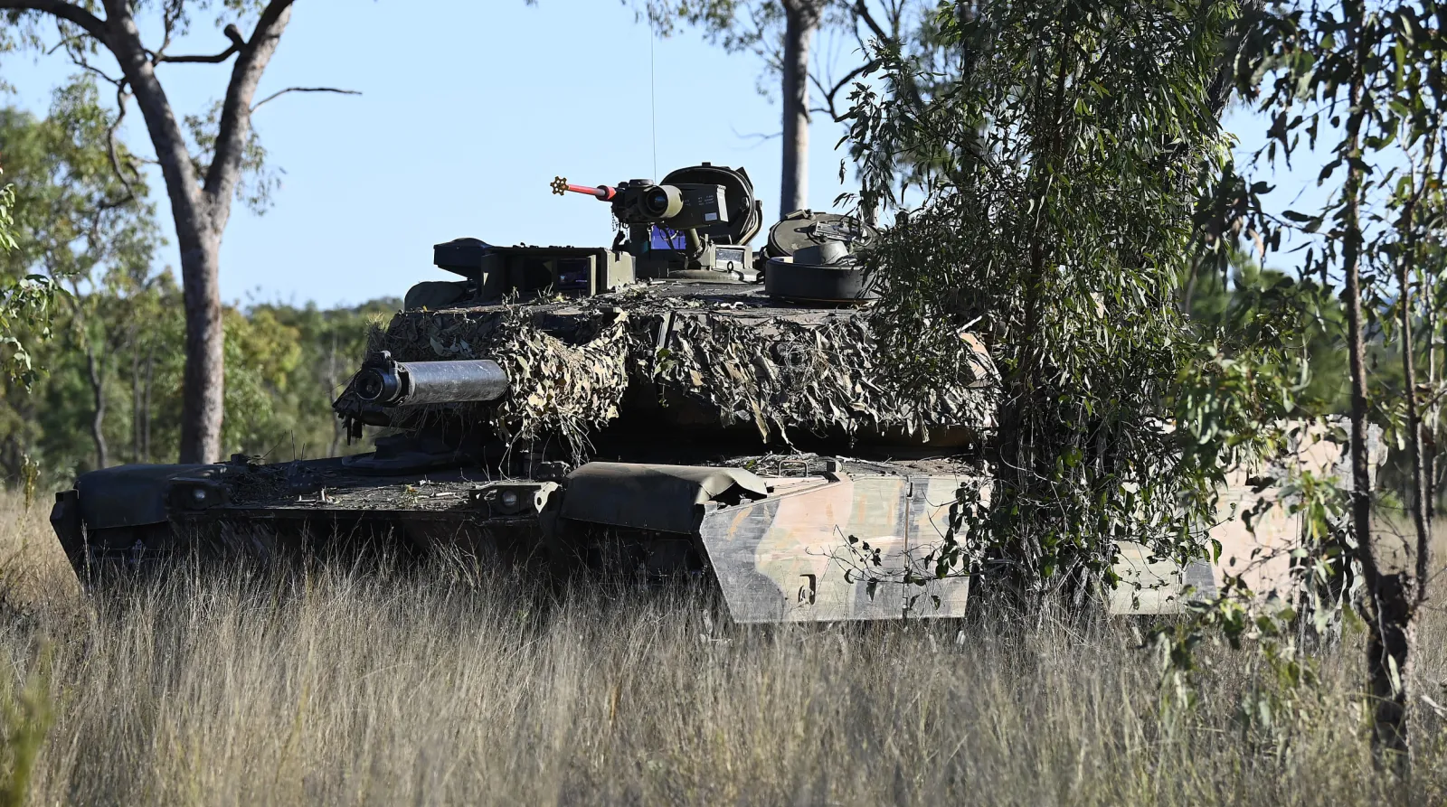
Usually $350-$500
F-35: $90-$100 million
M1 Abrams: $8-$10 Million
Notes:
Those explosives can easily disable or destroy million or even billion dollar equipment when the drone itself costs less than 500 dollars. When many of your tanks are being taken out by low cost drones, sustaining a war becomes financially impossible.

Slide 5
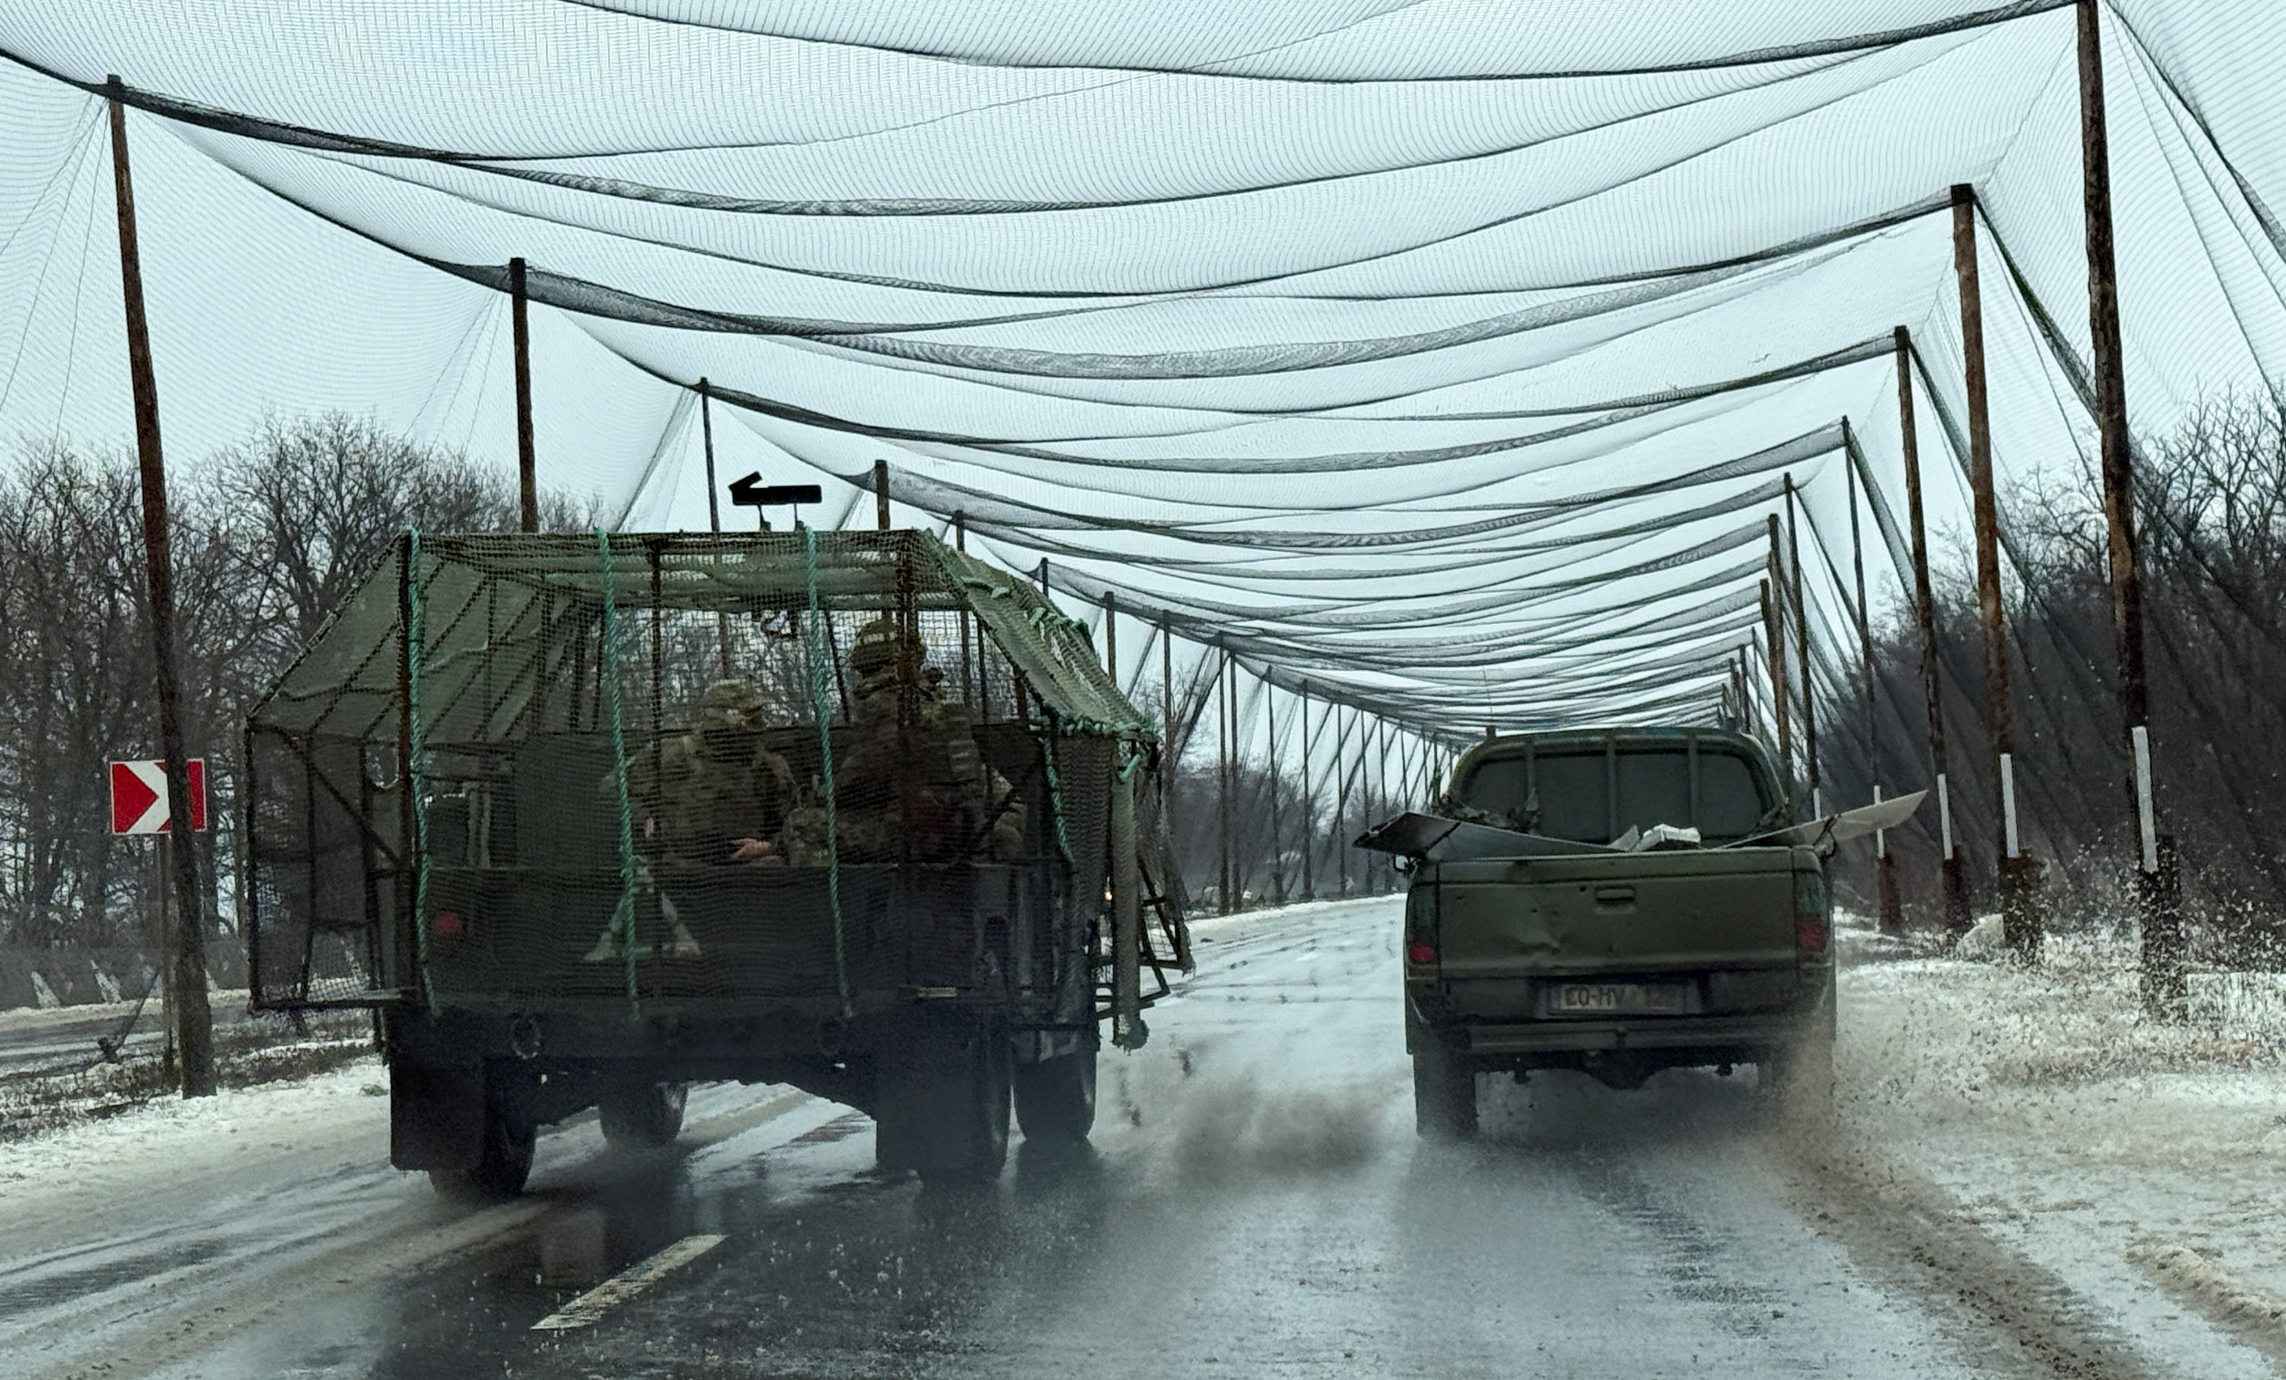
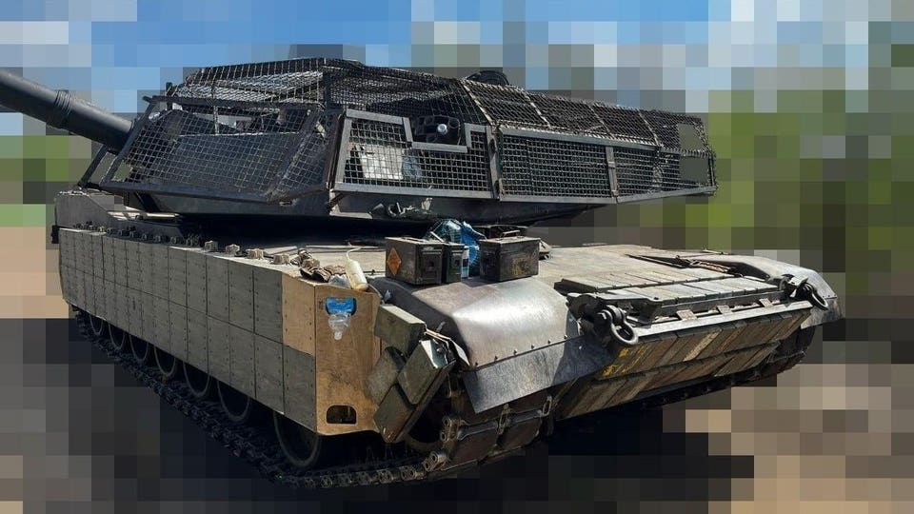
On the battlefield in Ukraine
Notes:
In the Ukraine War, ground forces have opted to surround their equipment with nets as a countermeasure to drones.

Slide 6
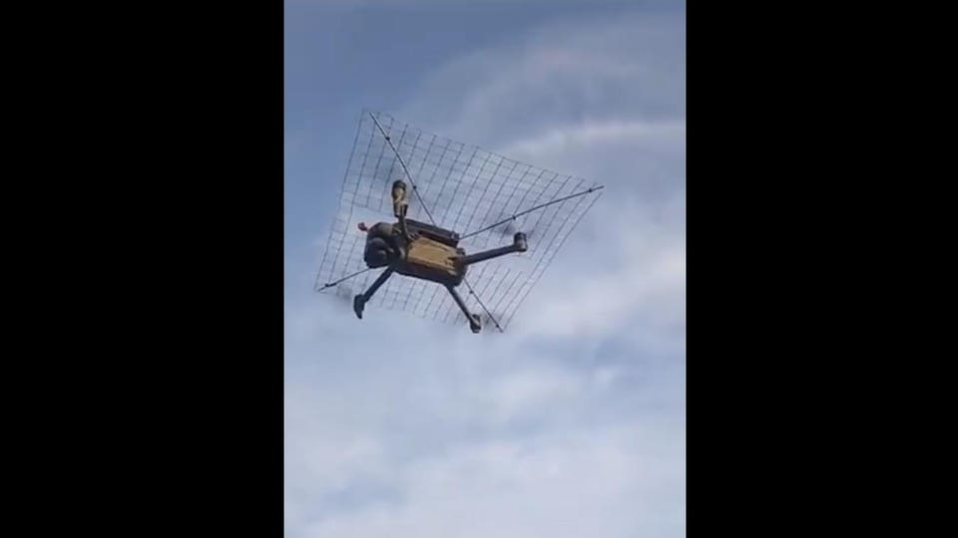
Even the drones get cages!
Notes:
They’ve even tried adding cages to drones as drones are being used against other drones.

Slide 7
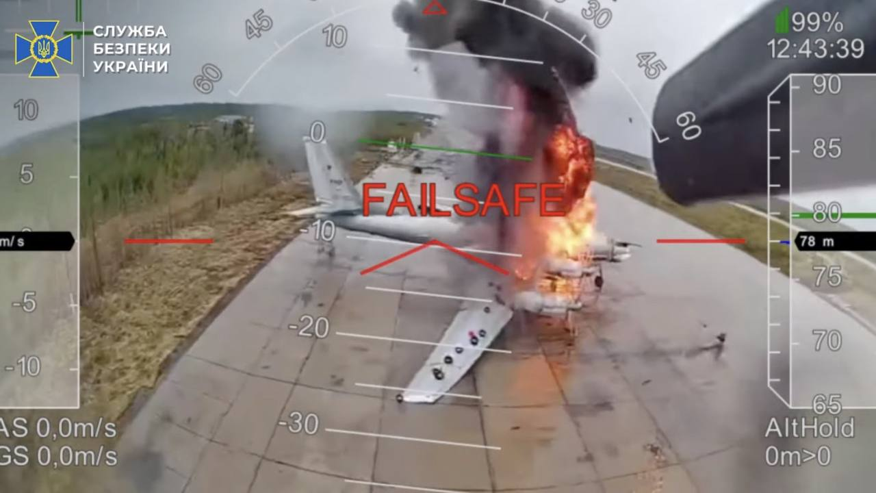
Operation Spiderweb
Notes:
Operation spiderweb was an operation launched by Ukraine against Russian airbases in June of 2025.

Slide 8
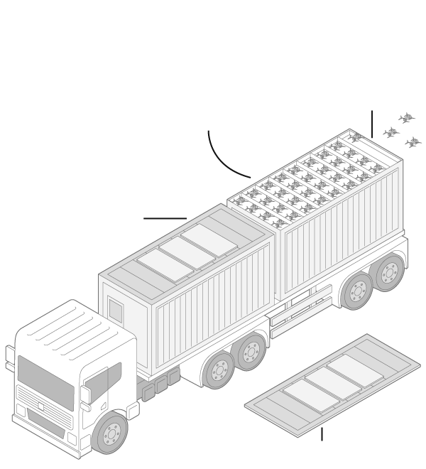
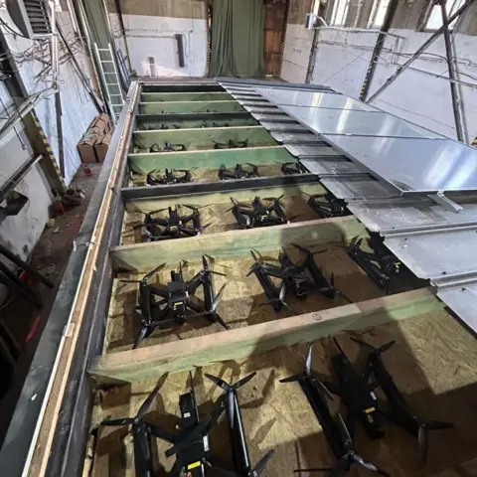
Operation Spiderweb
Notes:
This operation involved drones being covertly transported near many Russian airbases to then be remotely launched towards parked bombers and jets.

Slide 9
Operation Spiderweb
Roughly 20 aircraft hit
More than $700 million in lost equipment
Ukraine’s cost: <$1 Million
Only $2,000 per drone used
Notes:
Operation spiderweb revealed a massive weakness in modern warfare, as multi million-dollar aircraft are easily taken out by low-cost drones.

Slide 10
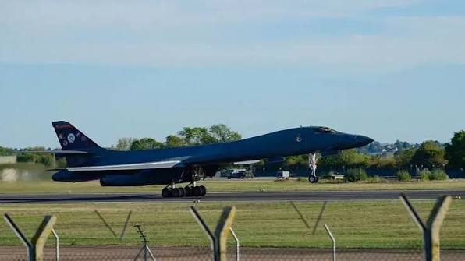
Notes:
If you follow the news, the United States just recently recalled several of its own bombers from the United Kingdom after they feared an operation spiderweb style attack might occur.

Slide 11
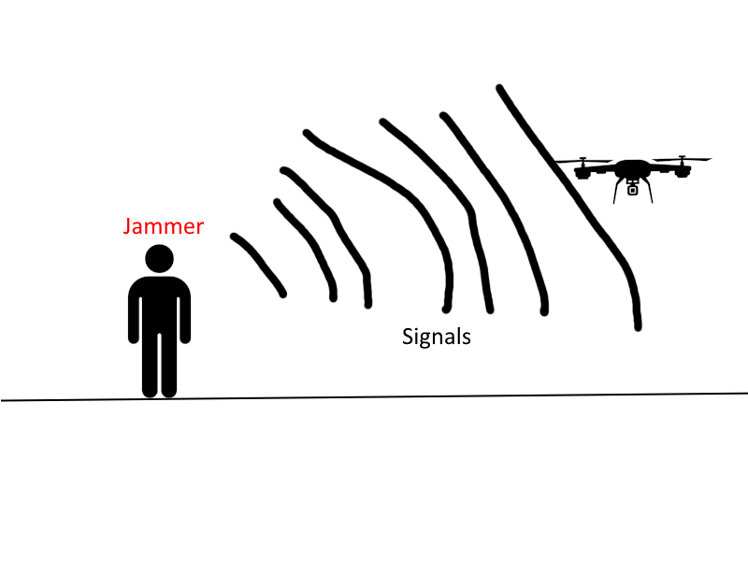
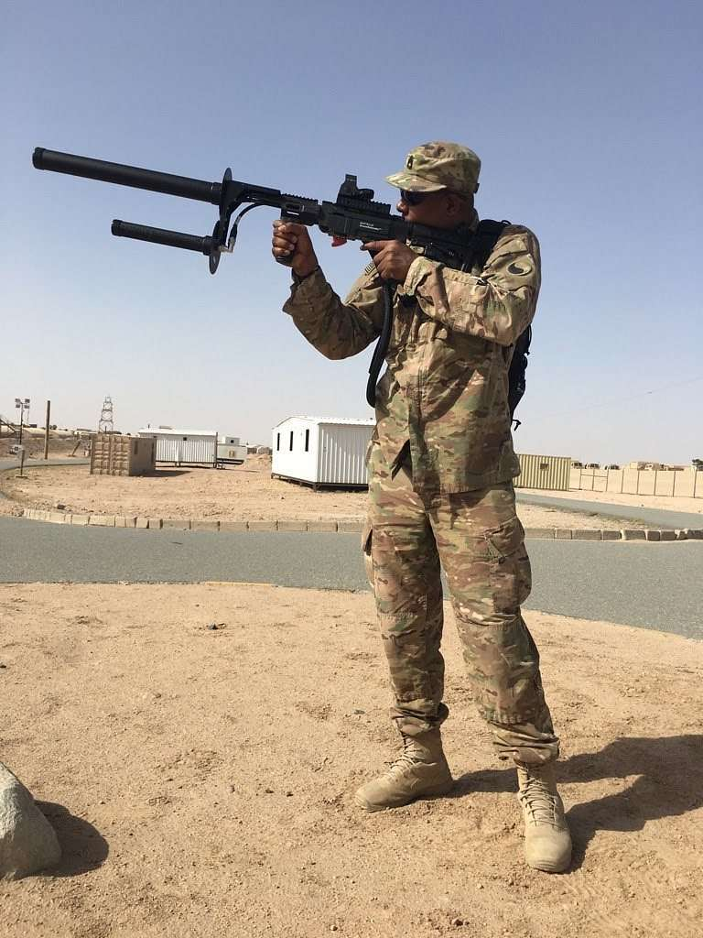
Drone defenses
Notes:
Wireless drones can be easily jammed by overloading the Drone with noise to effectively block incoming and outgoing signals.

Slide 12
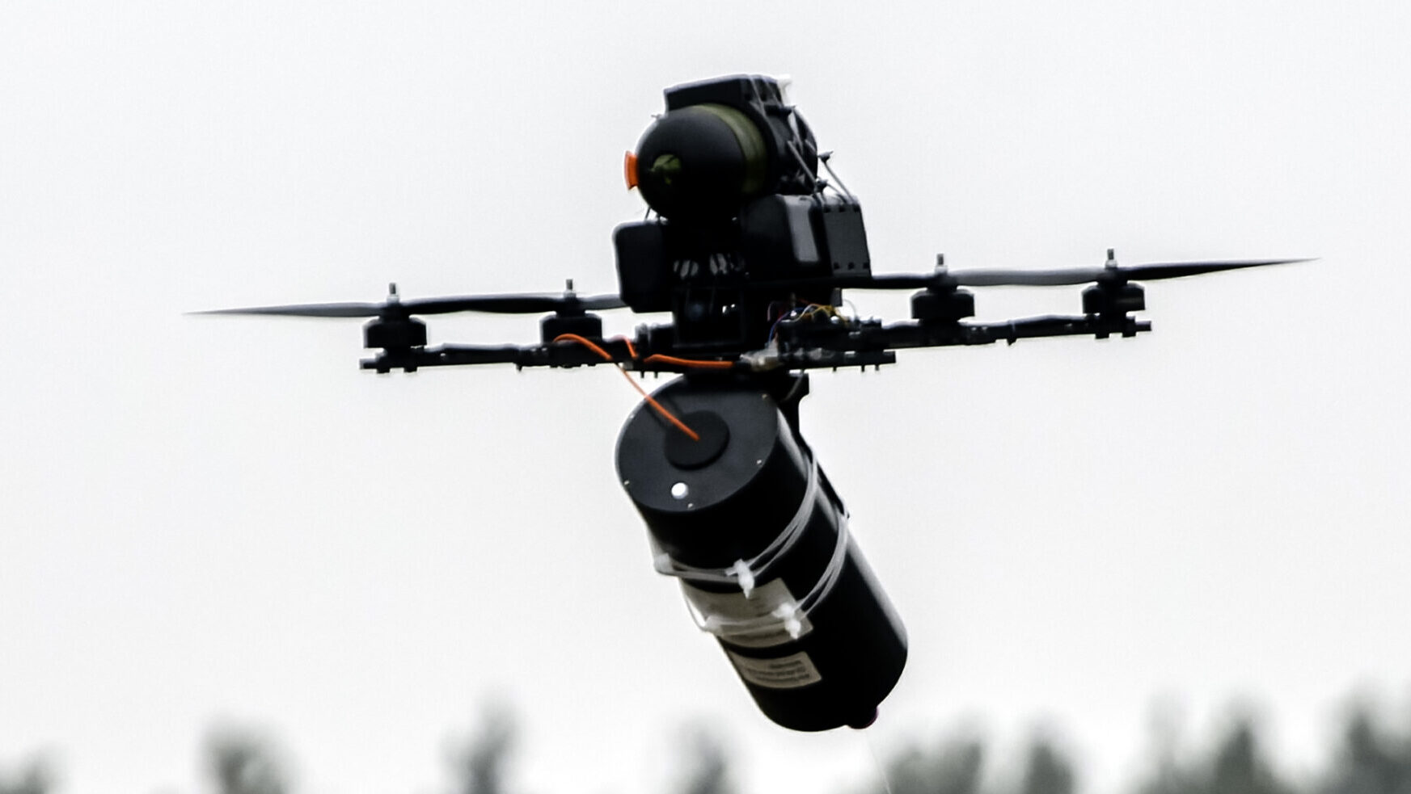
War innovation
Notes:
Their solution to drone jamming, is to use drones equipped with a fiber optic cable instead of relying on wireless signals. These drones can travel upwards of 40 miles to their target, with no way of being jammed. Basically, there needs to be a solution in taking these drones down without purely relying on signal jamming.
Fiber Optic drones require a more kinetic solution to disable them.

Slide 13
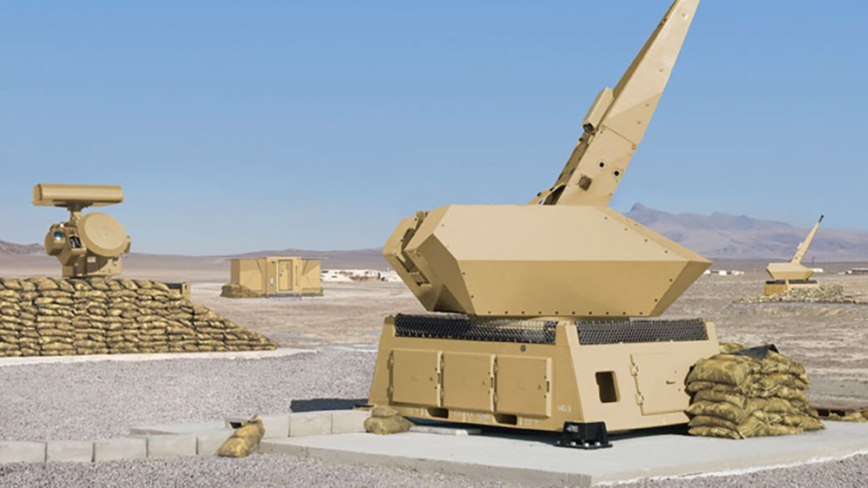
Air defense
Need to “see” the target
Notes:
Anti air systems are capable of defending against small targets, but they first need to be able to ‘see’ the target.

Slide 14
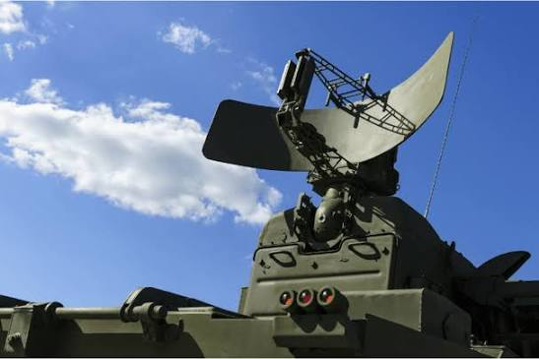
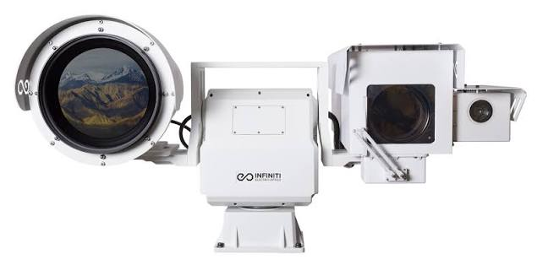
Radar
Cameras
Notes:
Air defense systems “see” targets primarily by using Radar and Cameras. A radar can give a rough position for the target, but a camera can give a much more accurate position to actually track the target. We aim to mimic visual based systems to visually track drones or other aerial targets.

Slide 15
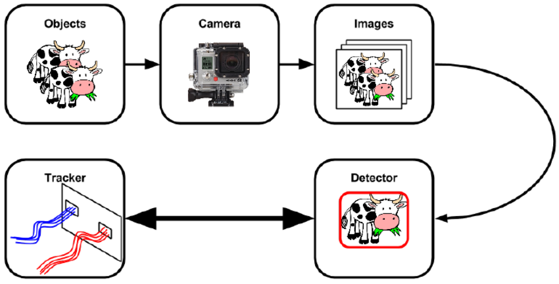
How do cameras “see” targets?
Notes:
Cameras can see targets by recording visual data which is then sent to a Convolutional Neural Network. The camera records the objects, then the images from that footage is extracted and sent to a neural network to detect and classify objects.

Slide 16
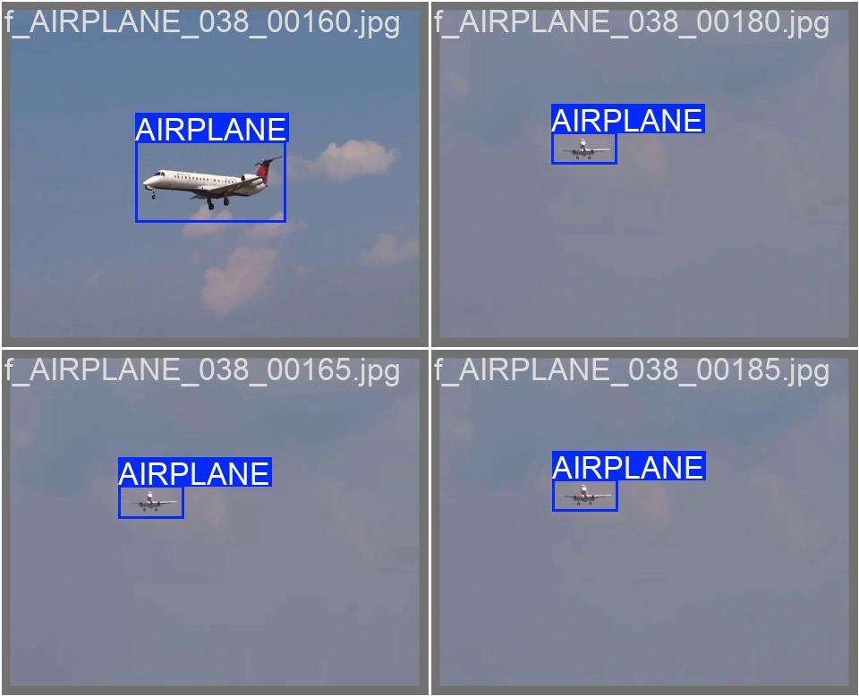
Approach
70% train
15% validation
15% test
Svanström F. (2020). Drone Detection and Classification using Machine Learning and Sensor Fusion.
Notes:
Our approach uses a publicly available dataset By Svanstrom which consists of a few hundred videos of different aerial objects. Drones, Helicopters, Airplanes, and birds were filmed from the ground in both visual and Infrared. It also consists of data forming bounding boxes around the object in each image to give a more precise classification. Due to time constraints however, we opted to only use visual data instead of the Infrared data.
You can see that 3 of those images look remarkably similar to each other. This is because when extracting images from the videos, we only extract every 5th frame, which leads to duplicates in the dataset.
The dataset was split between 70% training data, 15% validation data and 15% test data.

Slide 17
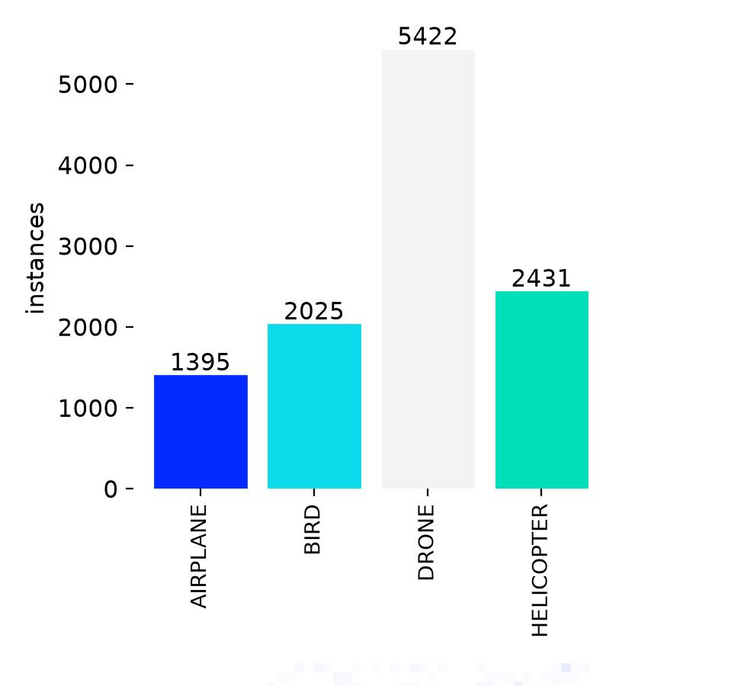
Notes:
Here is the distribution of data In the dataset. As we can see there is a lot more Drone data than any other class.

Slide 18
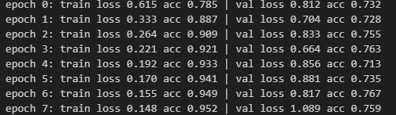
CNN results
Eval on the test set: 0.28 loss, 0.927 accuracy
Notes:
We trained the model on both a normal CNN model and another model.
The CNN was trained a total of 15 epochs, but the best run was epoch 3. After about 3 epochs I saw that the model rapidly began to overfit.
I’m thinking this is due to the model learning the entire image as the object rather than using the bounding boxes to crop an area surrounding the object to give a more precise classification.

Slide 19
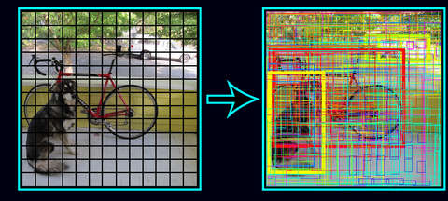
YOLO (You Only Look Once)
Notes:
YOLO or You Only Look Once is a pre-trained CNN model developed in 2015. Originally, CNN classifiers had to propose a few thousand regions that may or may not contain something In them. It then ran a classifier on each part of that region to detect whether something is there. This process works but is incredibly slow.

Slide 20
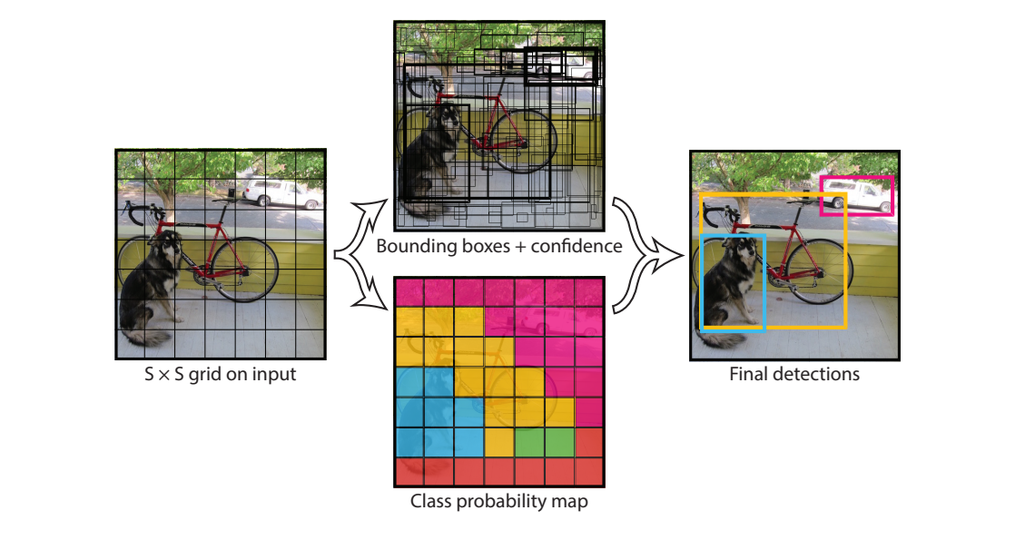
YOLO (You Only Look Once)
Notes:
Yolo solves the speed problem by treating those thousands of regions as one regression problem. One pass of the network outputs every box and its class all at once.

Slide 21
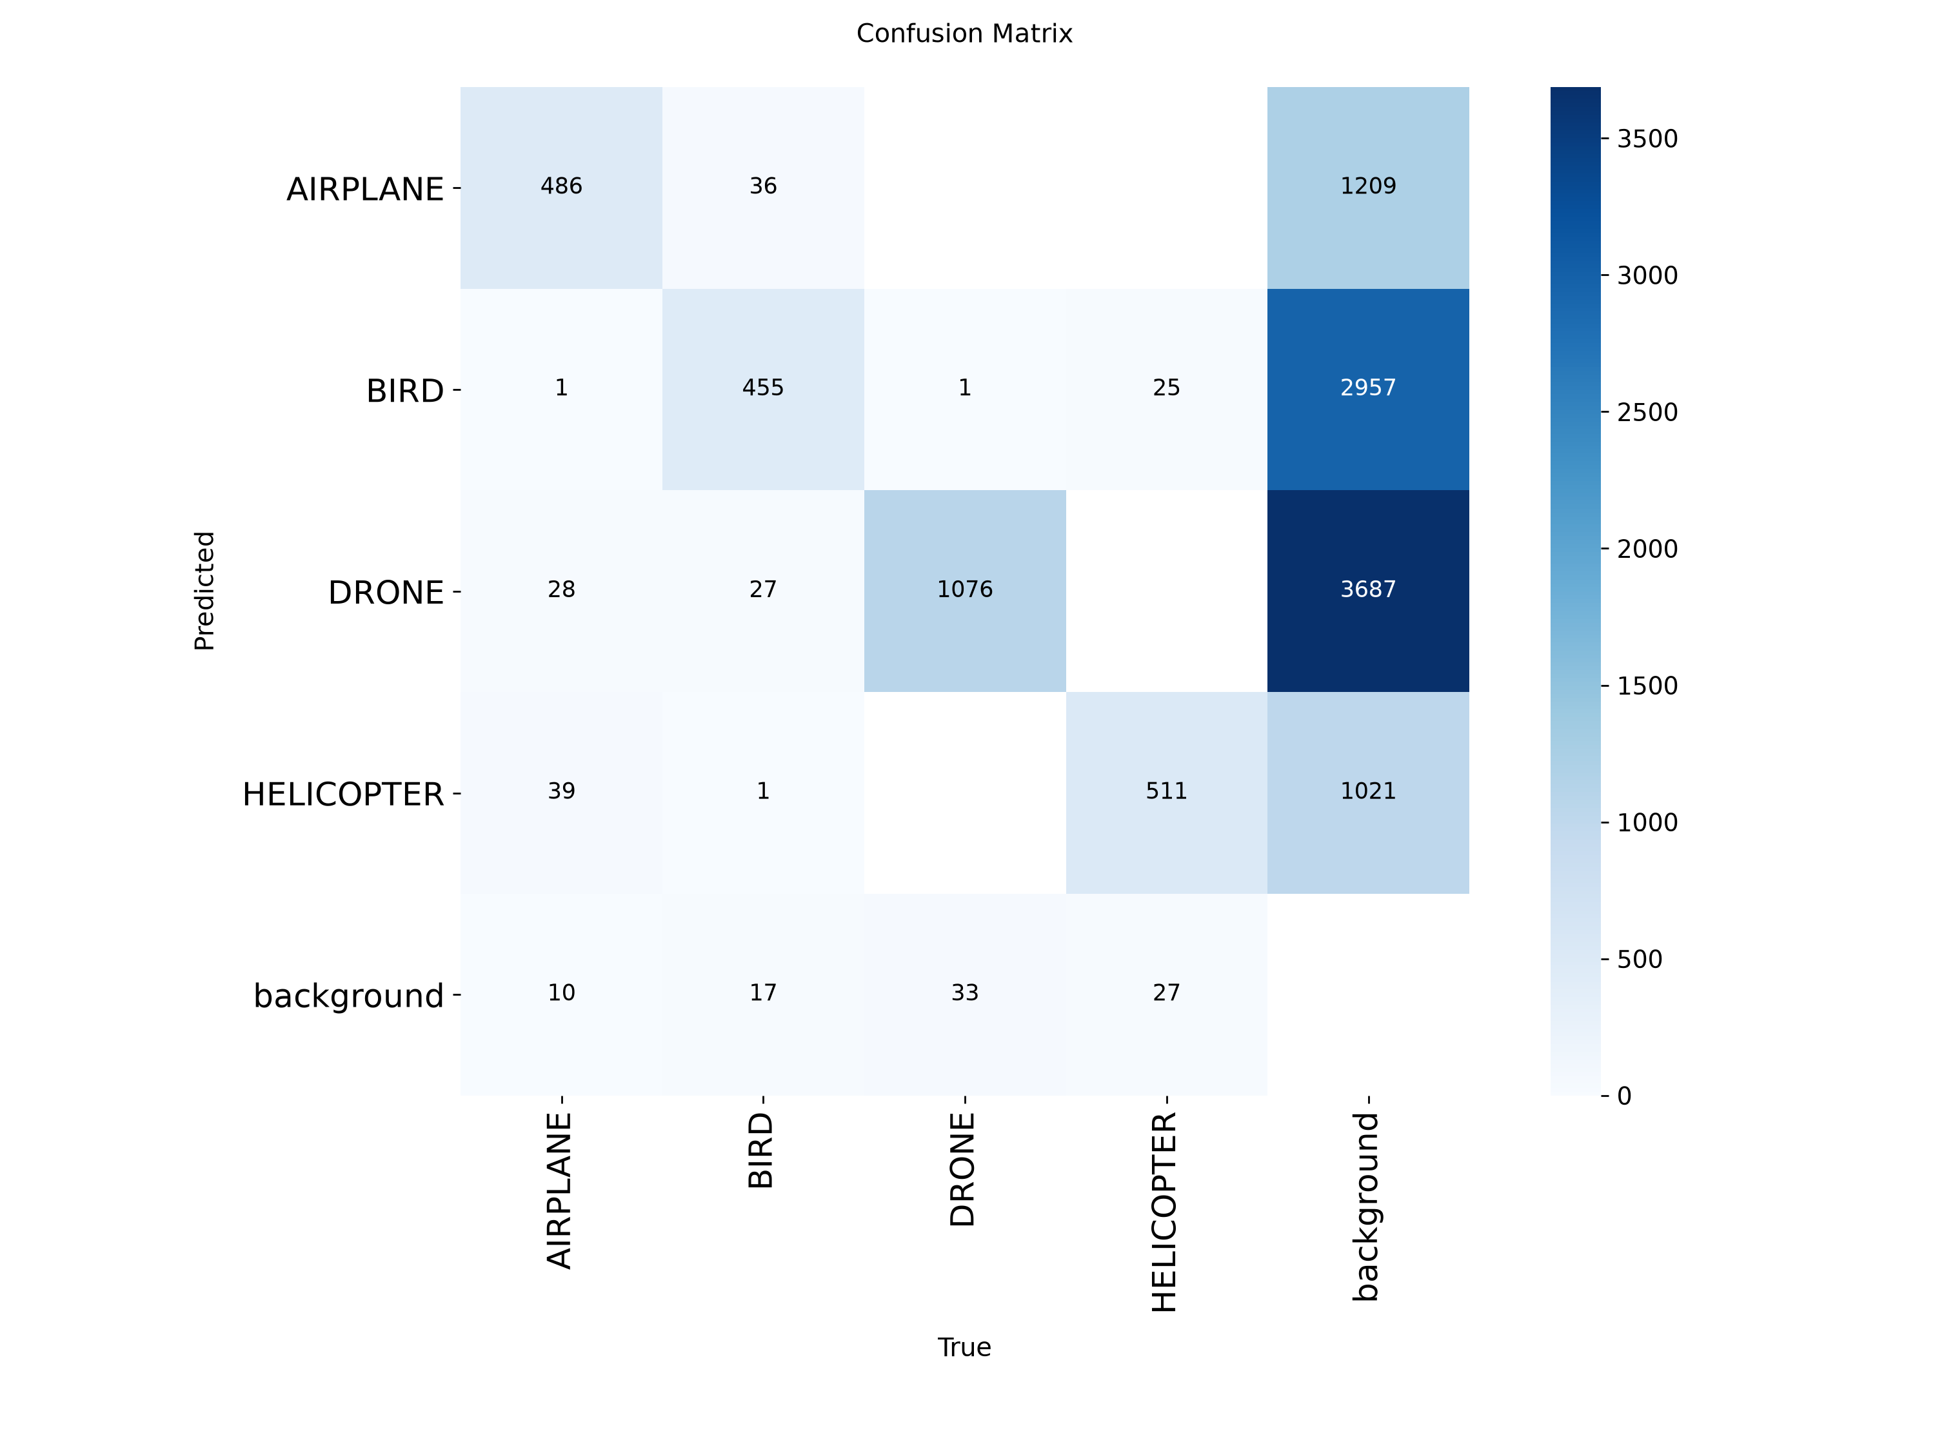
Results (initial)
Notes:
Here’s the confusion matrix for the initial YOLO run. Note that the “Background” row means that the model couldn’t find any of the 4 classes in the image and treated it as empty.
Initially, we used zero data cleaning in our model training. This, which turned out to be a mistake, led to the model learning the background as the object. Some of the videos recorded airplanes from the ground at their cruising altitude, which is roughly 35,000 ft.

Slide 22
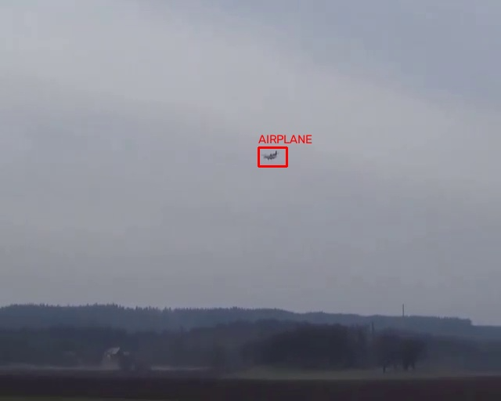
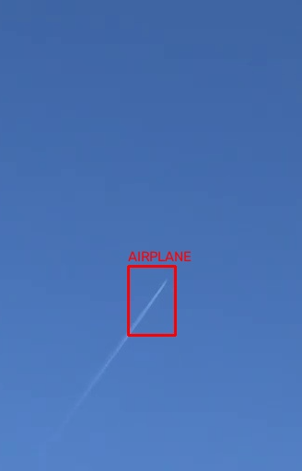
Data
Notes:
An example of good data on the left and bad data on the right. Notice that in the left one, you can somewhat easily make out what object is in the image, especially if its in a video. In the right one, you can’t even see the object, only the trail behind it.
These were both classified as AIRPLANE in the dataset, which I believe is what caused the model to learn the background so heavily.

Slide 23
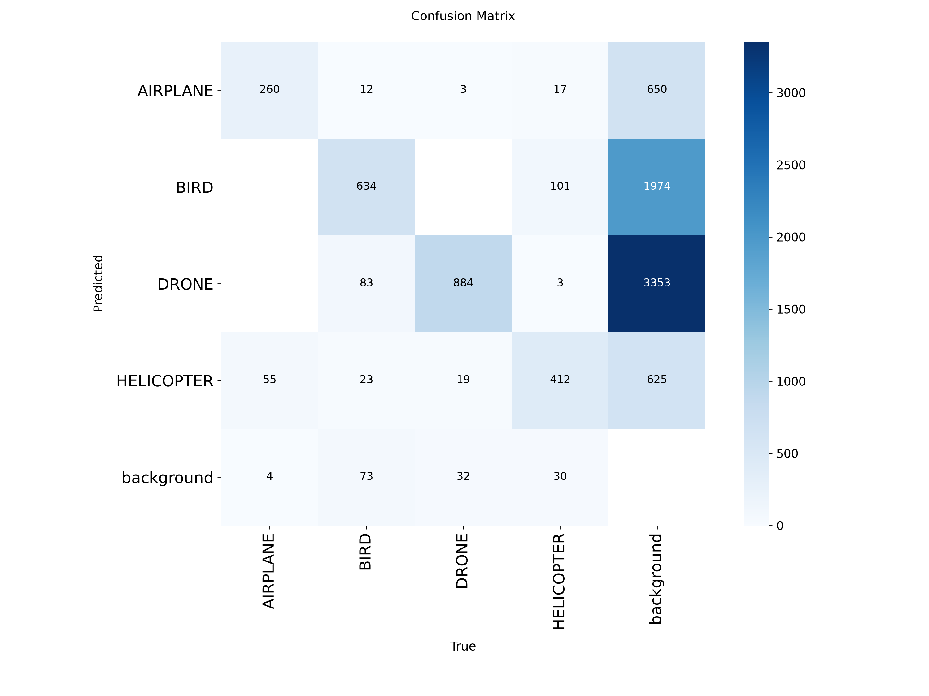
Results (after)
Notes:
After removing those distant files from the dataset, we saw a small decrease in the number of background-classified images. It wasn’t as big of a decrease as I hoped for though, and so I’ll need to go through the dataset once again to find a complete reason why it might be the case.

Slide 24
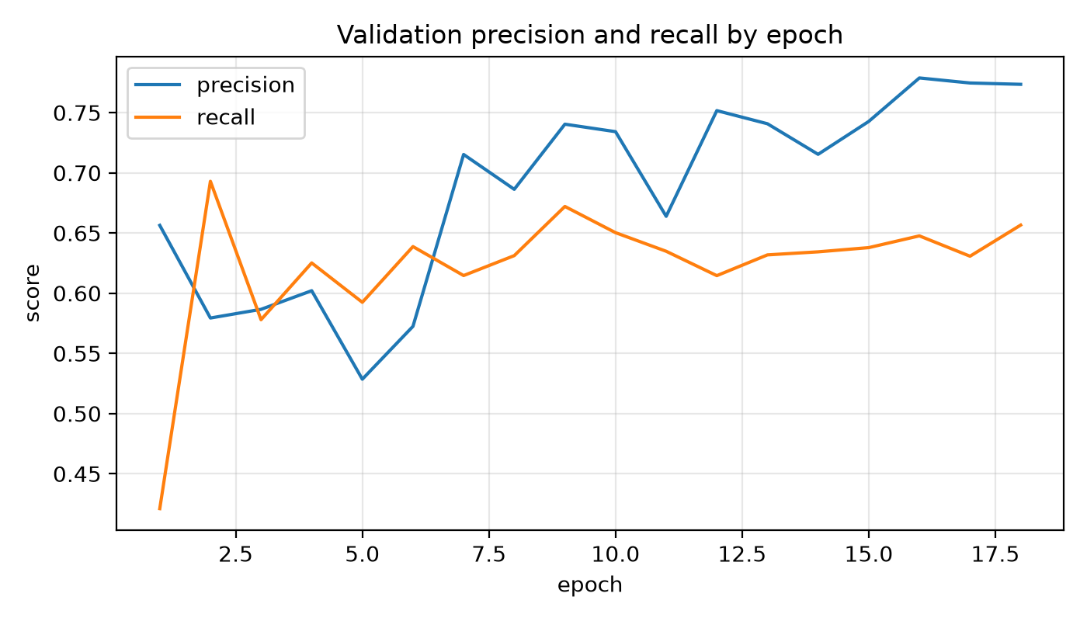

Slide 25
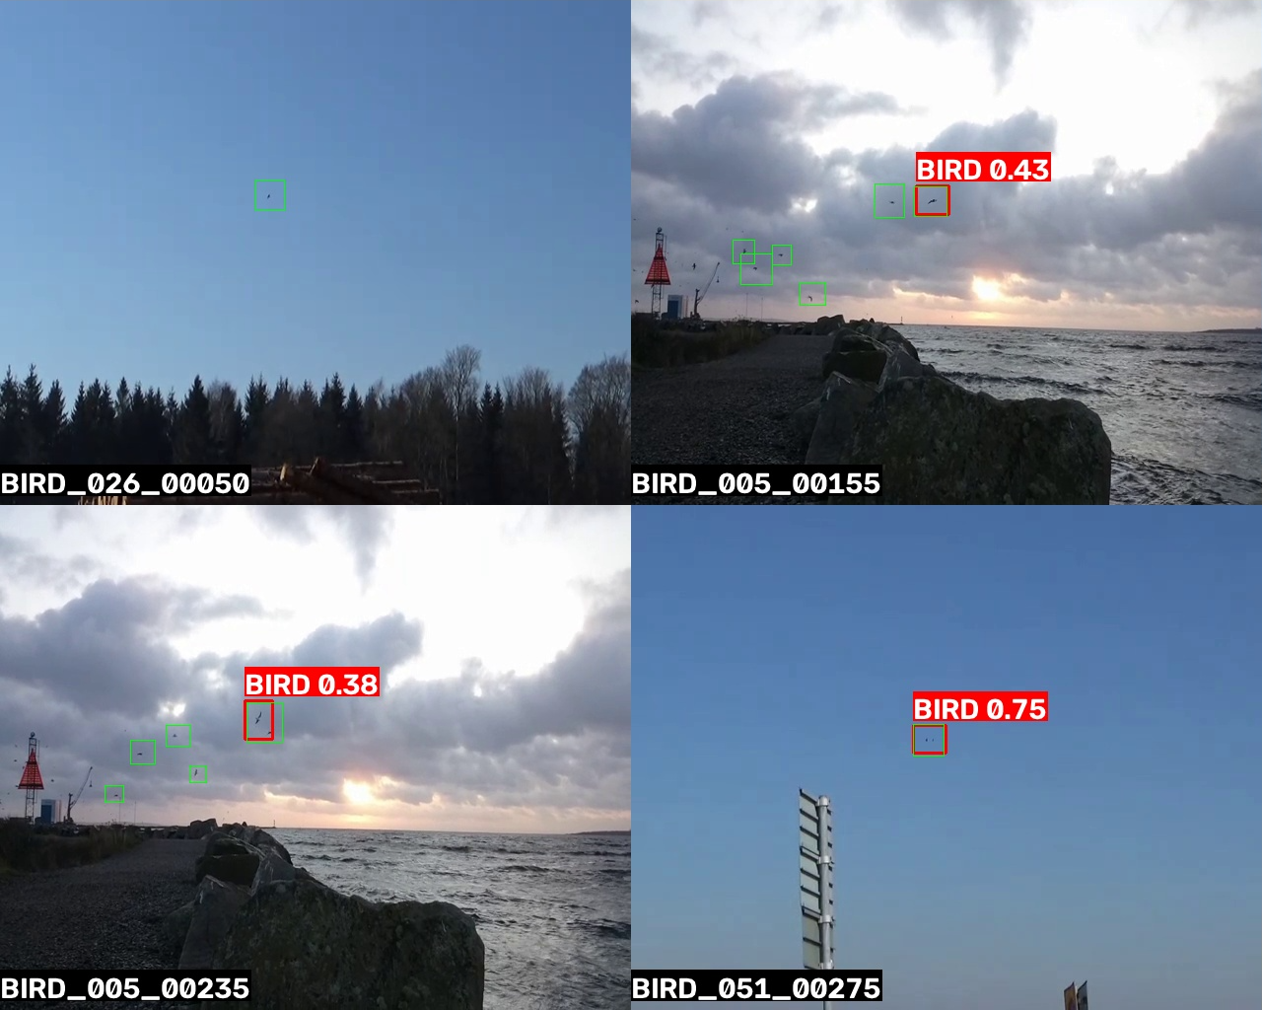

Slide 26
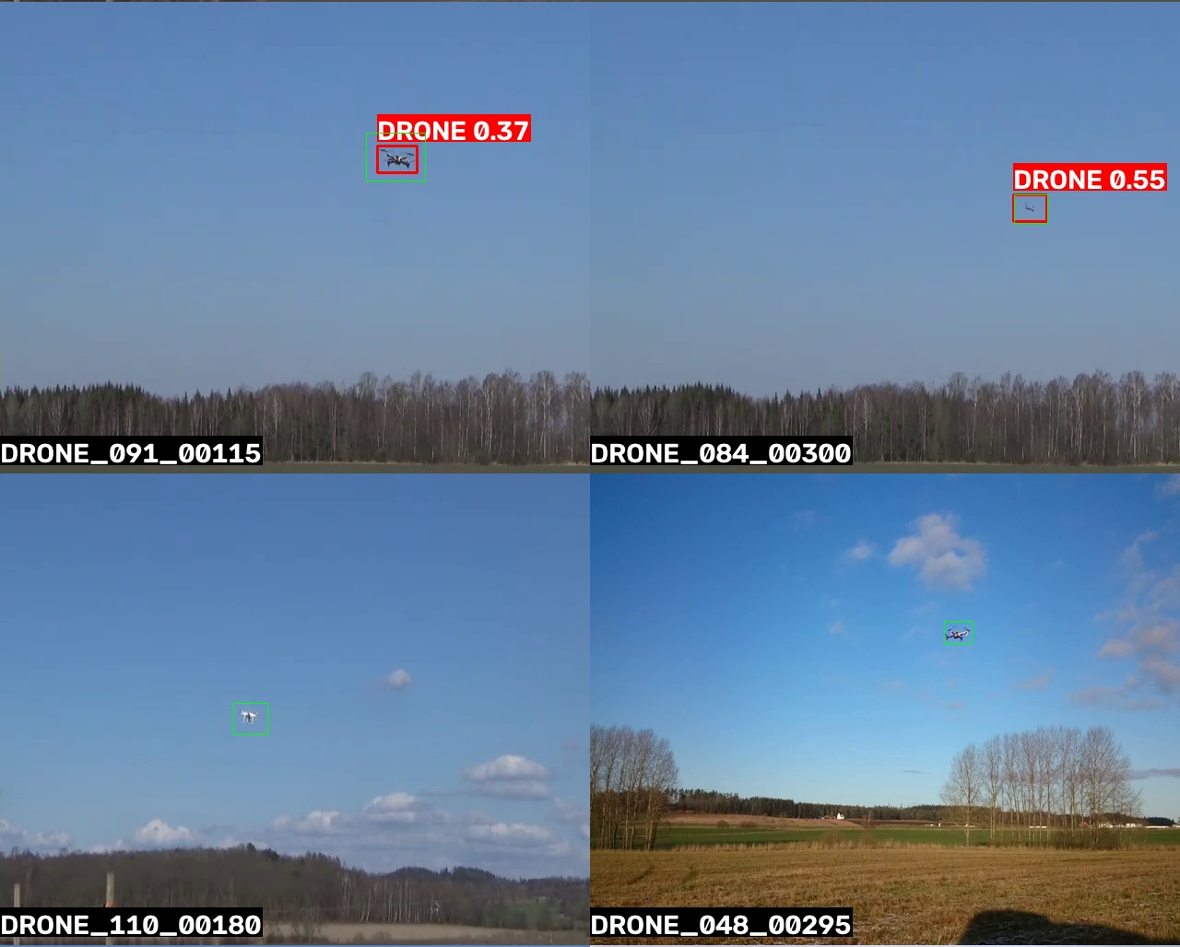
Notes:
The green bounding boxes are the ‘true’ labels supplied by the dataset, and when there isn’t a red label, it means the model missed the classification.

Slide 27
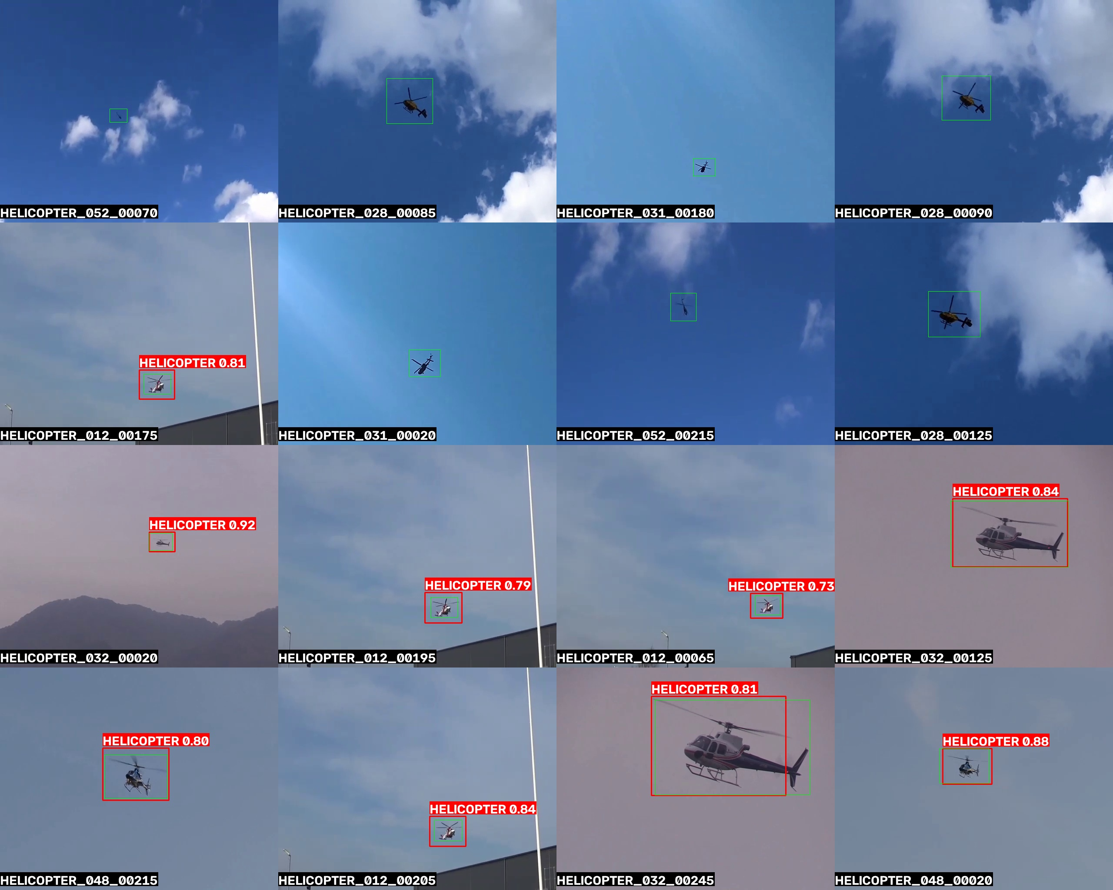
Notes:
We can see that the model misses items quite frequently.
Final thoughts:
1) Automated systems can fail, even with a 100% accurate detection algorithm.

Slide 28


