Slide 1

Introduction to Ansible
BY KRISHNA PRASAD KALAKODIMI

Slide 2
Introduction to Ansible
Ansible is an IT automation tool. It can configure systems, deploy software, and orchestrate more advanced IT tasks such as continuous deployments or zero downtime rolling updates.
It support configuration management with examples as below.
Configuration of servers
Application deployment
Continuous testing of already install application
Provisioning
Orchestration
Automation of tasks

Slide 3
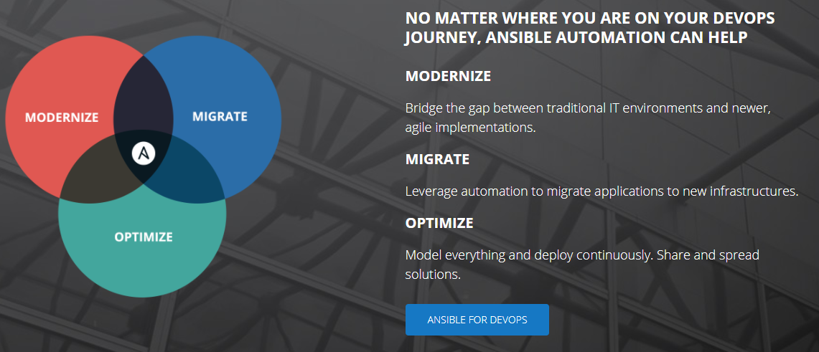
Why Automation?
Working in IT, you're likely doing the same tasks over and over. What if you could solve problems once and then automate your solutions going forward? Ansible is here to help.

Slide 4
WHEN YOU AUTOMATE, YOU ACCELERATE
Team impact
Save time and be more productive
Eliminate repetitive tasks
Fewer mistakes and errors
Improve collaboration job satisfaction
Enterprise impact
Over come complexity
More resources for innovation
Increase accountability and compliance

Slide 5
Ansible is
Simple
Human readable automation
No special coding skills needed
Tasks executed in order
Get productive quickly
Powerful
App deployment
Configuration management
Workflow orchestration
Orchestrate the app lifecycle

Slide 6
Ansible is
AGENTLESS
Agentless architecture
Uses OpenSSH and WinRM
No agents to exploit or update
Predictable, reliable and secure

Slide 7
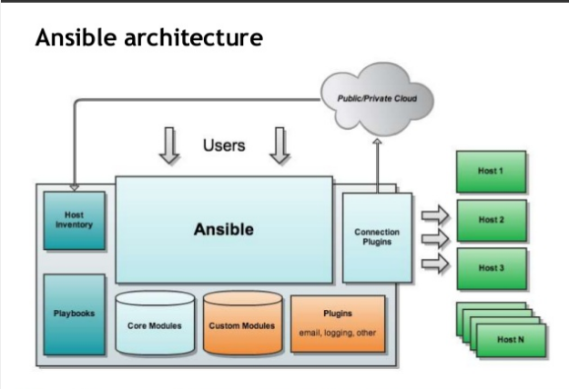
Ansible Architecture

Slide 8
Installation Requirements
Control Machine
Currently Ansible can be run from any machine with Python 2 (versions 2.6 or 2.7) or Python 3 (versions 3.5 and higher) installed
This includes Red Hat, Debian, CentOS and soon.
Windows isn’t supported for the control machine
Remote Machine
Python 2.6

Slide 9
Installation of Ansible
Install packages below on the control Machine
Red Hat
$ sudo yum install –y ansible
Make rpm from source
$ git clone https://github.com/ansible/ansible.git
$ cd ./ansible
$ make rpm
$ sudo rpm -Uvh ./rpm-build/ansible-*.noarch.rpm
Ubuntu
$ sudo apt-get update
$ sudo apt-get install software-properties-common
$ sudo apt-add-repository ppa:ansible/ansible
$ sudo apt-get update
$ sudo apt-get install ansible

Slide 10
Installation of Ansible
Install packages below on the control Machine
Debian
Add the following line to /etc/apt/sources list:
deb http://ppa.launchpad.net/ansible/ansible/ubuntu trusty main
Then run these commands:
$ sudo apt-key adv --keyserver keyserver.ubuntu.com --recv-keys 93C4A3FD7BB9C367
$ sudo apt-get update
$ sudo apt-get install ansible
pip
$ sudo easy_install pip
$ sudo pip install ansible

Slide 11
Installation of Ansible
Install packages below on the remote Machine
Red Hat
$ sudo yum install –y python
Ubuntu
$ sudo apt-get install python
Debian
$ sudo apt-get install python

Slide 12
Configuration of Ansible
Do the following on the control machine
Create the list of client machines you wish to access via this control machine
vi /etc/ansible/hosts ( And enter the following lines and save file)
[Servers]
192.168.85.135
192.168.85.136
Run the ping command below to see if indeed you are reaching both client nodes
ansible -m ping all

Slide 13
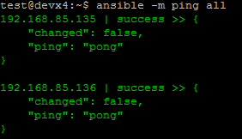
Examples of Ansible Commands
The output show ping result success as shown below

Slide 14
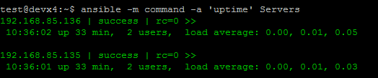
Examples of Ansible Commands (cnt)
How to run commands to fetch hard drives utilization
ansible -m command -a 'df -h' Servers
How to run commands to fetch system uptime
ansible -m command -a ‘uptime' Servers

Slide 15
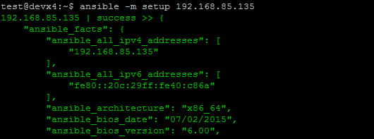
Examples of Ansible Commands (cnt)
The full configuration environment inventory of a particular client machine can be obtain using the command below.
ansible -m setup 192.168.85.135 ( output as shown below)

Slide 16
Inventory File
Define how ansible interact with remote machine
Define logical groups of managed nodes
Define location : /etc/ansible/host
The inventory file can be in one of many formats, depending on the inventory plugins you have.
eg: /etc/ansible/hosts is an INI-like
Hosts and groups
sample.example.com
[webservers]
web1.example.com
web2.example.com
[dbservers]
db1.example.com
db2.example.com
db3.example.com

Slide 17
Inventory File
Host Variables
[webserver]
host1 http_port=80 maxRequestsPerChild=808
host2 http_port=303 maxRequestsPerChild=909
Group variables
[webserver]
host1
host2
[webserver:vars]
Ansible_ssh_user=ansible
Ansible_ssh_pass=‘ansible’

Slide 18
Inventory File
Groups of Groups and Group Variables
[webserver]
host1
host2
[dbserver]
host2
Host3
[totalgroups:children]
webserver
dbserver
[totalgroups:vars]
Ansible_ssh_user=ansible
Ansible_ssh_pass=‘ansible’

Slide 19
Ad-Hoc commands
An ad-hoc command is something that you might type in to do something really quick, but don’t want to save for later
Ensure a service is started on all webservers:
$ ansible webservers -m service -a "name=httpd state=started"
Alternatively, restart a service on all webservers:
$ ansible webservers -m service -a "name=httpd state=restarted"
Ensure a service is stopped:
$ ansible webservers -m service -a "name=httpd state=stopped“
File transfer
Ansible webserver -m copy -a "src=/etc/hosts dest=/tmp/hosts"

Slide 20
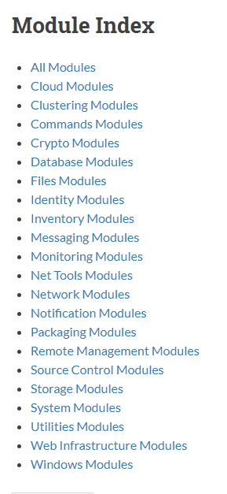
Modules
Ansible ships with a number of modules that can
be executed directly on remote hosts or through
playbooks
Users can write their own modules .
These modules can control system resources like
services , packages, files , inventory etc..

Slide 21
Playbook
Playbook’s are used to manage ,configuration and deployment to remote machine
Playbook’s are designed to be human-readable and are deployment in a basic text language
Expressed in YAML format (Yet Another Mark-up Language).
Composed one or more play in a list.
Allowing multi- machine deployments orchestration.
Ansible-playbook [options] playbook.yml [playbook2.yml … … … …]

Slide 22
Creating a Ansible Playbook Template
# Sampleplaybook.yml
---
- hosts: web
become: yes
tasks
- name: installing web server on remote machine
apt: name = apache2 state =present
- name: installing a git server
apt: name =git state=installed

Slide 23
Understanding Ansible Playbook Configurations
In order to use ansible with SSH passwords you will need to install the program below
$ sudo apt-get install sshpass
Ansible-playbook command can be executed to run the sampleplaybook.yml file
$ ansible-playbook -k –K sampleplaybook.yml
The –k –K switches allow you to be able to use your ssh key and passwordless sudo.
Every playbook configuration begins with triple dash ( ----)
The hosts, tasks, name, action are various instructions commands to help automate
your web server and git installation process.

Slide 24
Playbook- Task
Each playbook contains a list of tasks .
Tasks are executed in order one at a time, aganist all machine matched by the host pattern.
Every task should have a NAME: which is included in the output from running playbook
Tasks are declared using legacy action:
E.g.:
Tasks:
- name: installing a web server
apt: name=apache2 state=installed

Slide 25
Playbook –Handlers
Notifications may be triggered at the end of each block of task whenever a changes has been made on the remote system.
Handlers are referenced by name
Tasks:
-name: template configuration file
template: src=template.j2 dest=/etc.foo.conf
notify:
- restart: apache
Handlers:
- name: restart apache
service: name=apache state=restarted

Slide 26
Playbook – Roles
Roles are ways of automatically loading certain vars files, tasks, and handlers based on a known file structure. Grouping content by roles also allows easy sharing of roles with other users.
Creating a role:
$ ansible-galaxy install bennojoy.ngix
$ ansible-galaxy init <role name> → initializing a role .
$ ls → check role is created or not.
$ cd <role name> → change to created role galaxy
Execution
Sampleplaybook1.yml
---
- host: web
become: yes
roles:
- role: <role name>
Execute a role : $ ansible-playbook sampleplaybook1.yaml

Slide 27
Important Links
Ansible is simple automation tool : https://www.ansible.com/
Ansible Documentation : http://docs.ansible.com/ansible/latest/intro.html
Ansible module index: http://docs.ansible.com/ansible/latest/modules_by_category.html
Ansible playbooks : http://docs.ansible.com/ansible/latest/playbooks.html
Ansible galaxy: http://docs.ansible.com/ansible/latest/playbooks.html
Ansible command line tools: http://docs.ansible.com/ansible/latest/command_line_tools.html

Slide 28


Slide 29


