Slide 1
IBS – Integrated Banking Services
IBS is an Indian banking and financial services company headquartered in Mumbai, Maharashtra, it is India’s largest private sector lender by assets. It is the largest bank in India by market capitalisation as of February 2016.
Loan Management Services
Team:
Chetan Kohli
Devyansh Goyal
Divyam Batta
Shreya Sinha
Yuvraj Kalra

Slide 2
Requirements
Customer Level Operation:
Apply for loan (Personal/Vehicle/Education/Home)
Pay loan EMI
View Loan Details
Request loan pre-closure.
Band Admin Level Operations:
Approve or decline loan request
Approve or decline pre-closure

Slide 3
In-Scope
User can decide the type of loan, amount of loan required (Loan limit is defined by the bank based on the credit scores) and duration of loan.
EMI calculator to define loan repayment details.
Customer has to upload relevant documents defined by bank on the basis of type of loan required by the customer.
Verification of documents and loan approval/denial by the bank representative.
User has the option for pre-closure, which will be approved/denied by the bank representative on the basis of defined bank’s policy.

Slide 4
Assumptions
Customer is already logged in (console application)
We assume that all the following user details are present in the database:
Name of Customer
Gender
Address
Bank Account Number
Email ID
Phone Number
Mother/Father Name
DOB
Loan limit is defined by the bank
Interest rates are fixed based upon the bank’s policy
EMI cycle is assumed to be monthly
Pre closure amount and interest rates to be defined by the bank

Slide 5


Customer Functionalities
Apply Loan
Pay EMI
Apply Pre-closure
View Details

Slide 6

Admin Functionalities
Approve Loan
Approve Pre-Closure

Slide 7


Apply Loan
Applicant Details
Pulls details for approval
Oracle
View Loan Details
Loan Approved
Customer
Interface
Admin
Interface

Slide 8
Pay EMI
Loan Number
EMI Details
Pays EMI
Updated Loan History
Customer
Interface
Oracle

Slide 9
Apply Pre-closure
Applies pre-closure
Pulls details for approval
(Loan Number)
Oracle
Updated Loan Details
Pre-closure Approved
Customer-UI
Admin-UI

Slide 10
View Loan History
User ID
All loans corresponding to User ID
Customer
Interface
Oracle

Slide 11
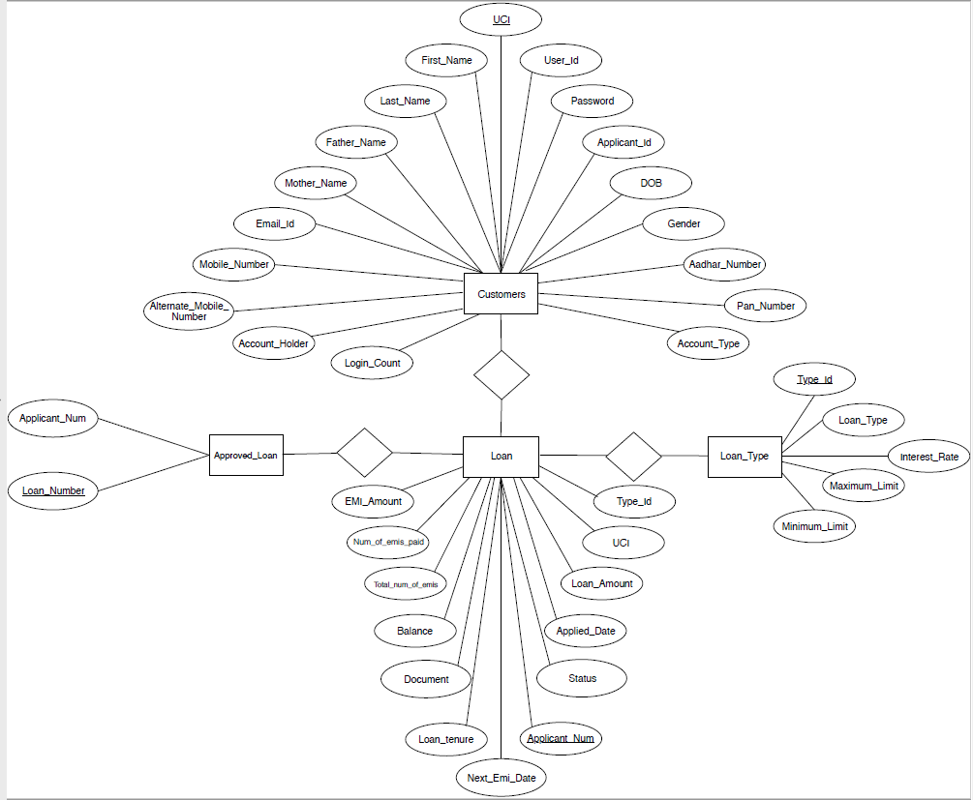
ER Diagram

