Slide 1
Identifying fronts from Saildrones

Slide 2
Identifying fronts
Run Identify-Abrupt-Fronts.py
Stretch data (by lat and lon) to equally spaced vector of distances
Calculate temperature gradient
Identify where dT/dx > 1C /km
Remove duplicate detections
Filter noise based on 5 km before and after temp means
Restrict to 0-10N

Slide 3
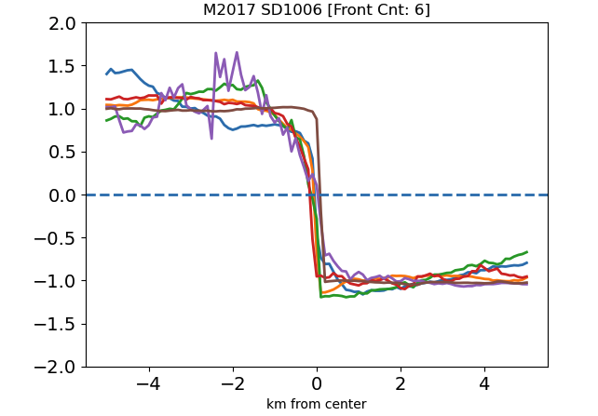
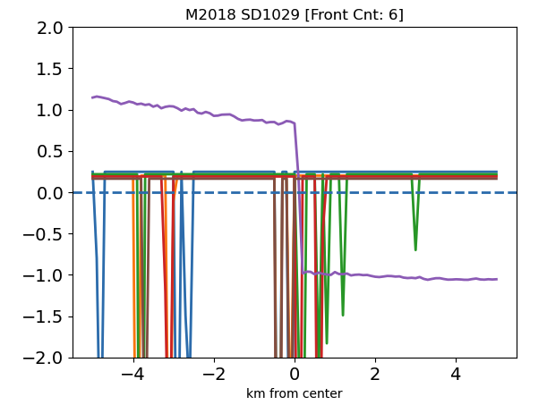
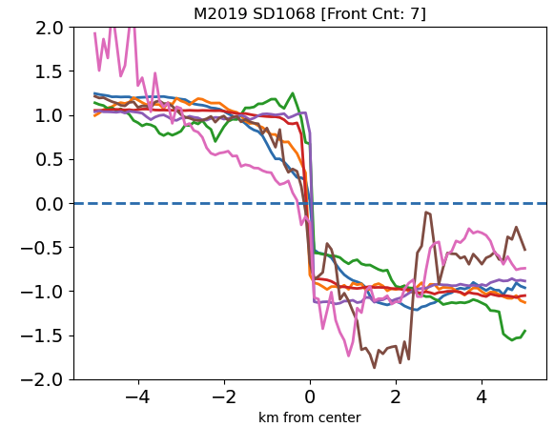
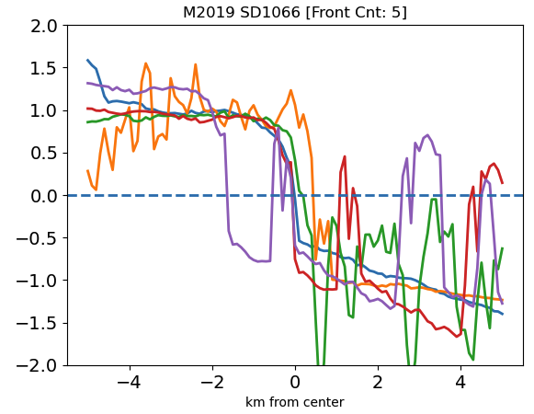
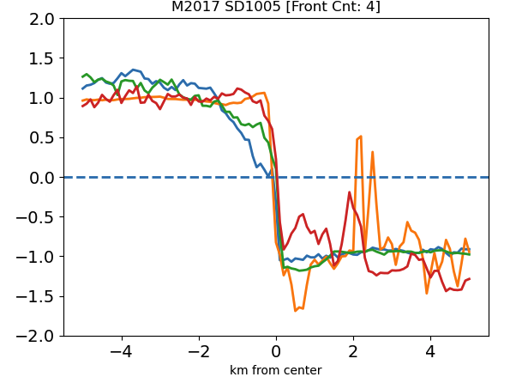
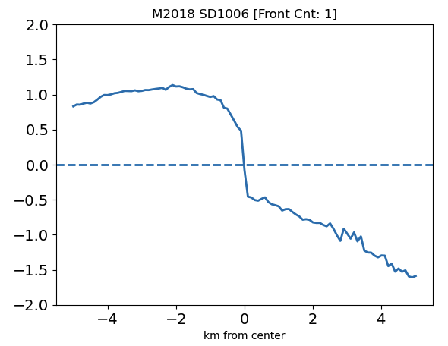
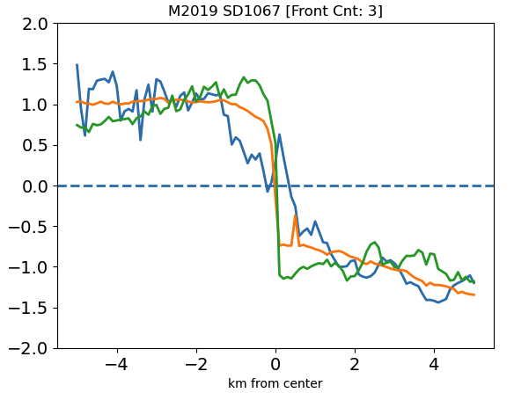
Results of Identify-Abrupt-Fronts.py
2017
2018
2019

Slide 4
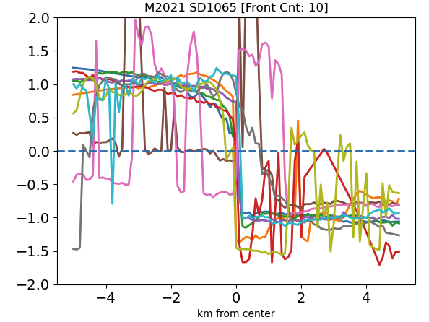
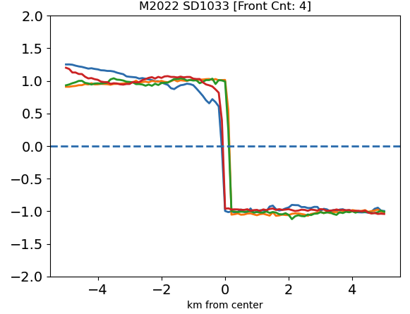
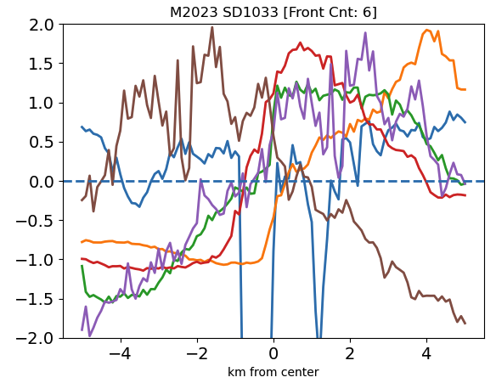
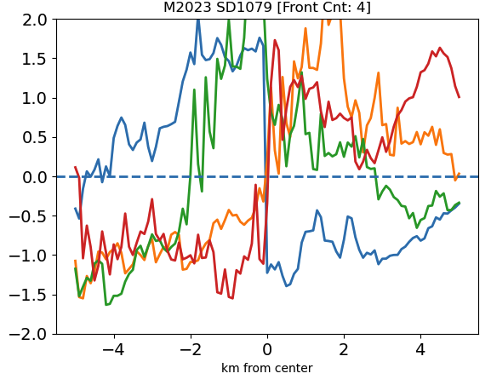
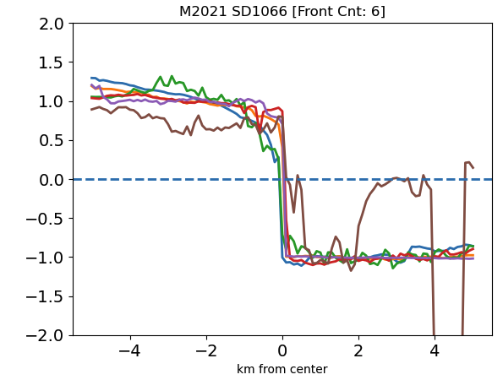
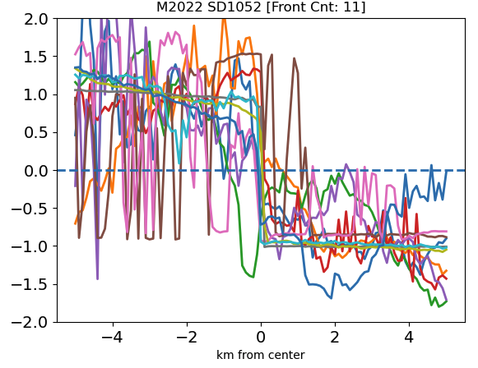
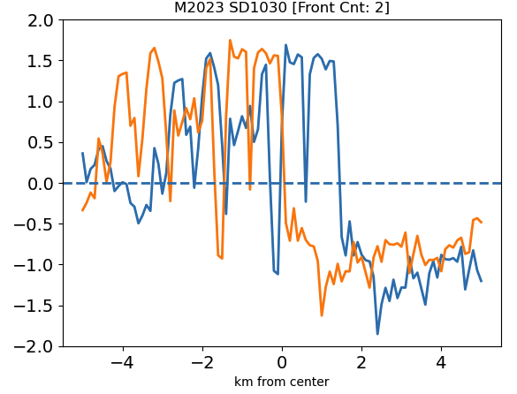
Results of Identify-Abrupt-Fronts.py
2021
2022
2023

Slide 5
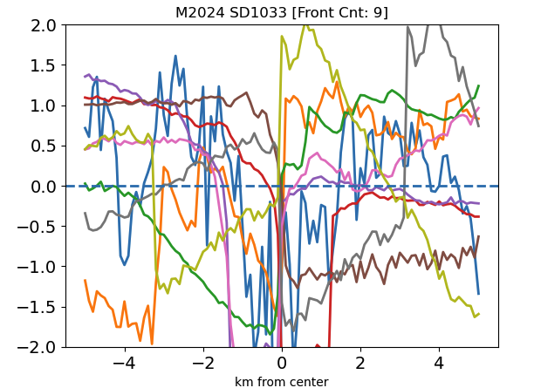
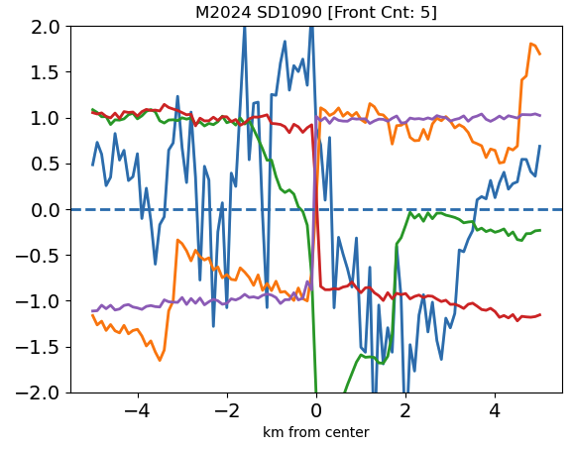
Results of Identify-Abrupt-Fronts.py
2024
Messy! Needs manual check.

Slide 6
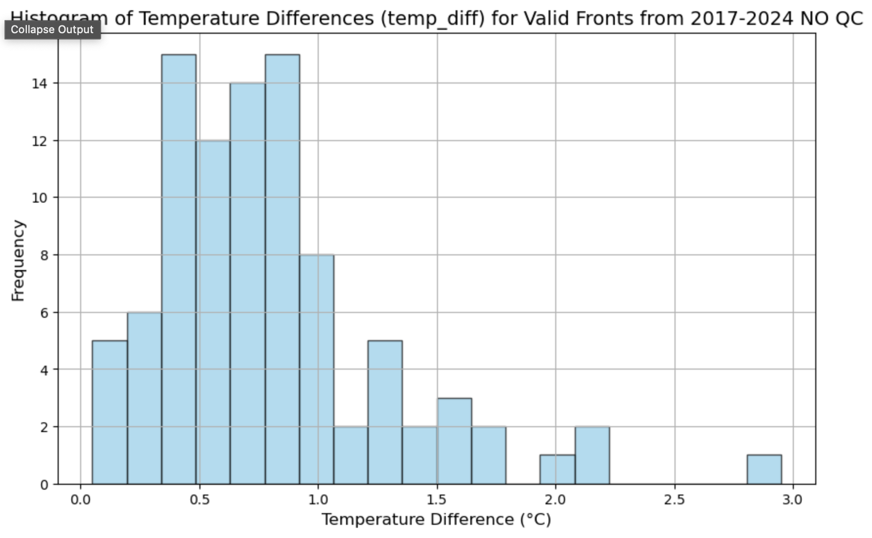
Different temp changes (no QC)

Slide 7
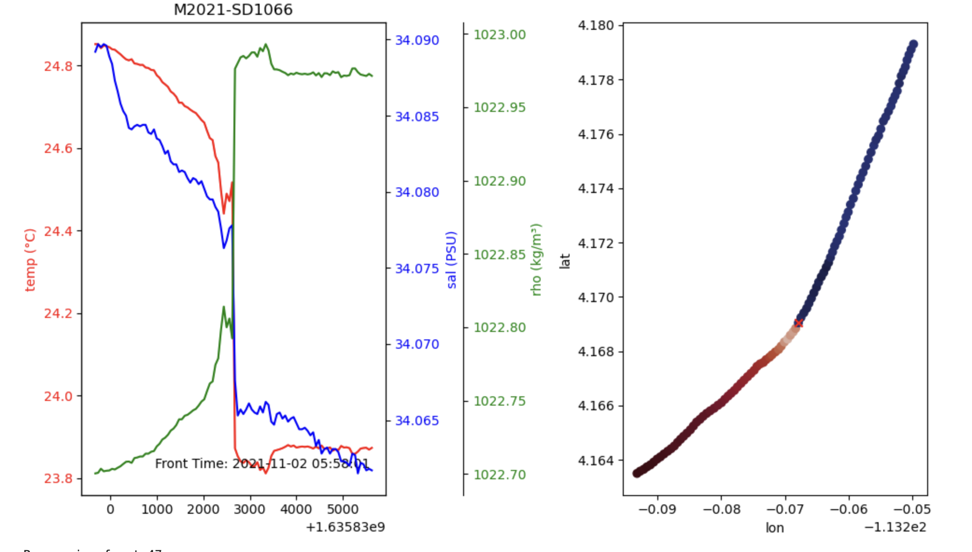
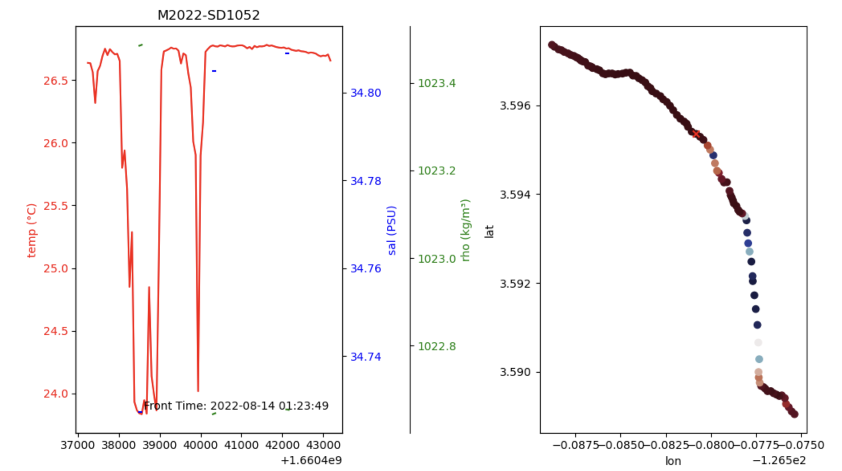
Manual QC
Look at the scatter SST and temp difference (min and max 50 data points on either side of the front)
QC = 0 : good
QC = 1 : bad / not a front (i.e., temp spike)
QC = 2 : need revision (possible bad data)

Slide 8
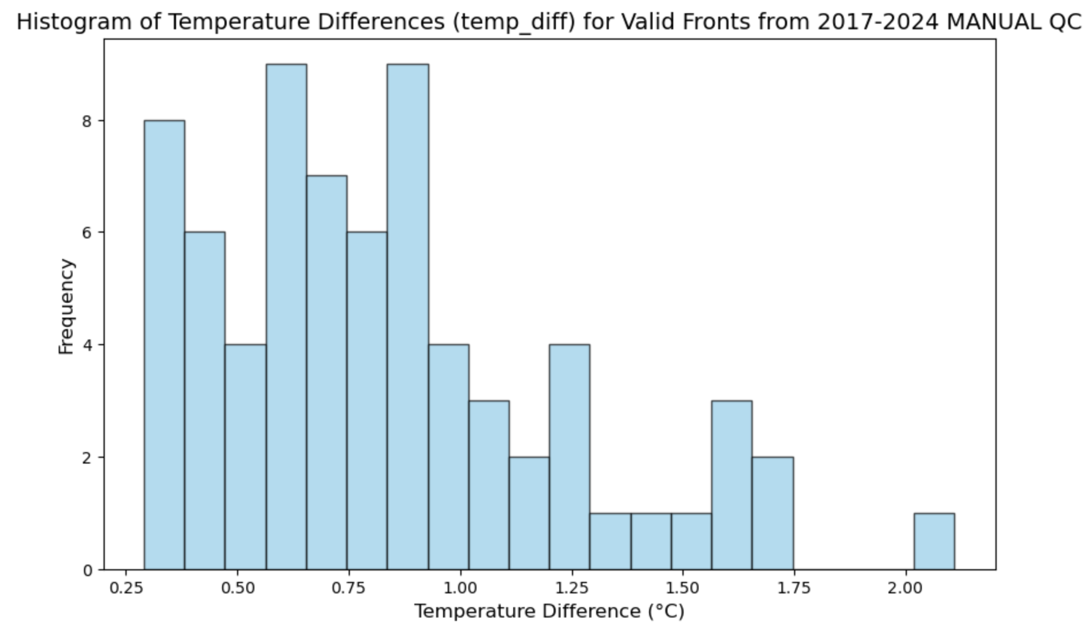
Different temp changes (no QC)
*Needs verified*
Number of valid fronts (manual_QC == 0): 71
Number of valid fronts (temp_diff >= 1 AND manual_QC == 0): 18

Slide 9
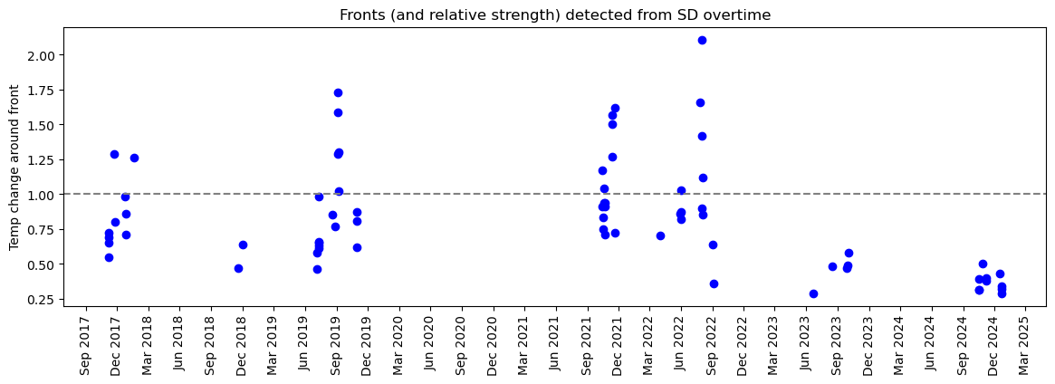
Fronts over time in (SD missions)

Slide 10
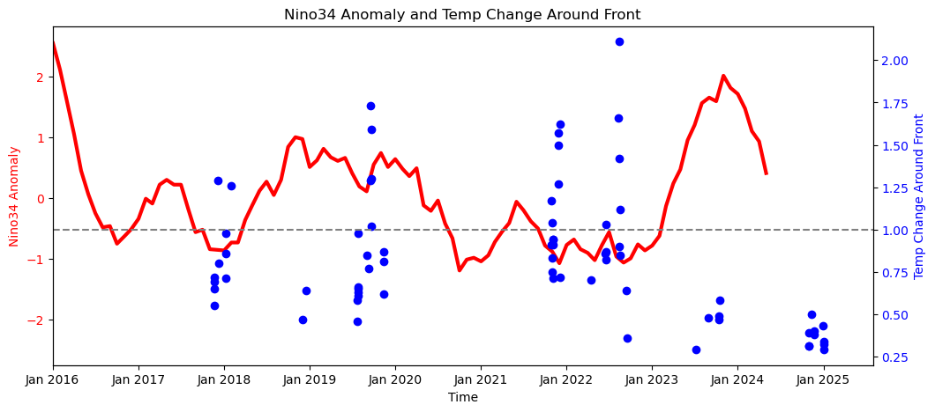
Fronts over time in (SD missions) w/ NINO3.4

Slide 11
Things to do/think about
How does frontal identification differ in using foundation temperature vs. bulk temperature?
Can compute COARE foundational temp
Use 2023 mission SBE56s
Maybe adjust sensitivity of temperature gradients detected (i.e., 0.5/km, 0.75/km, 1/km)
How to classify as a cool/warm front?
Are they density fronts as well?

Slide 12
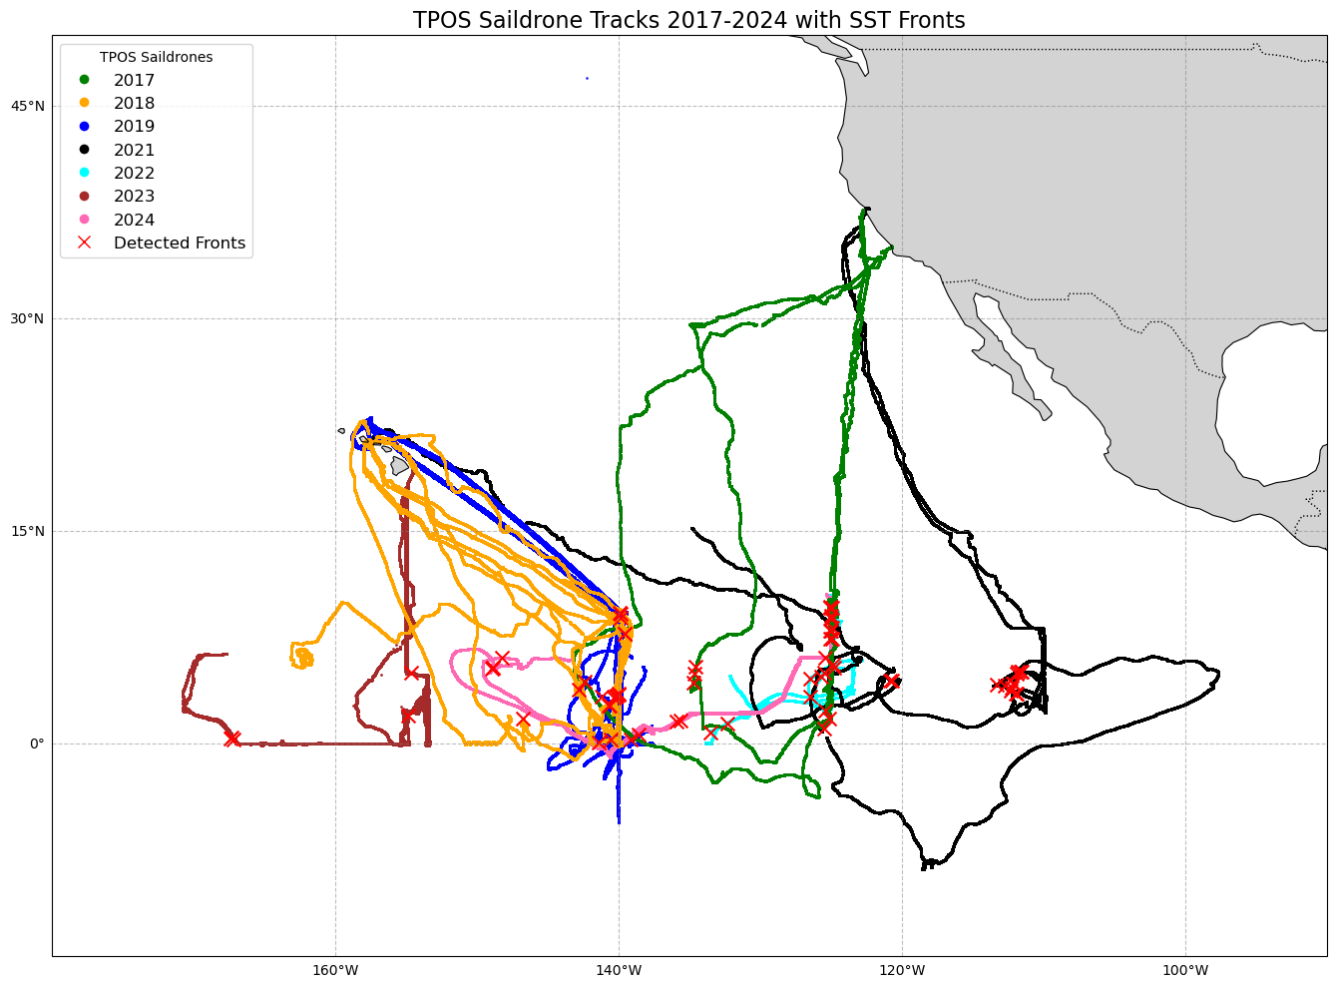

Slide 13
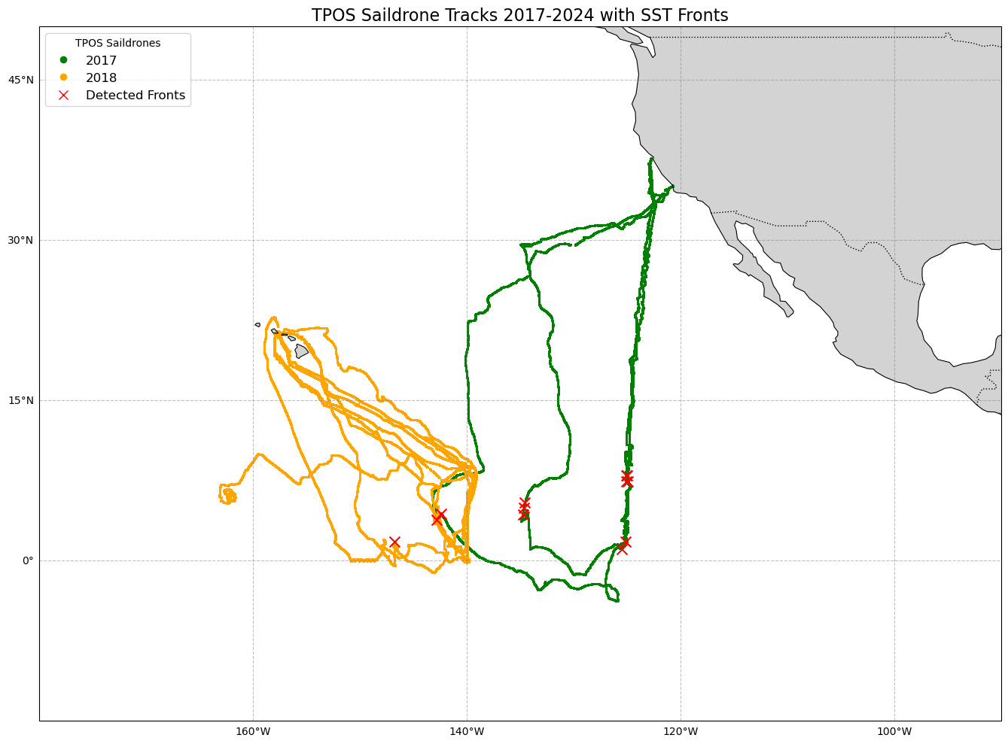

Slide 14
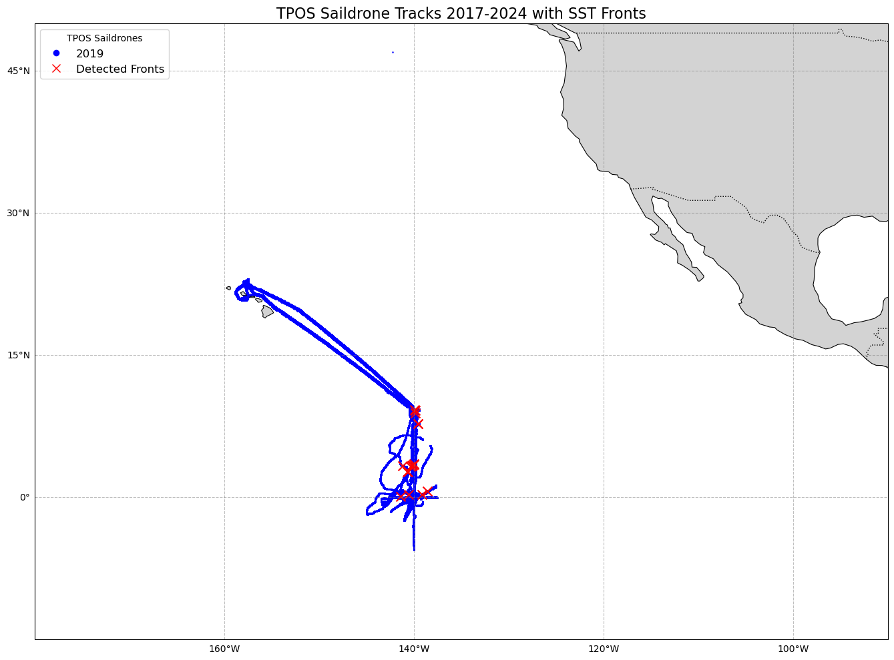

Slide 15
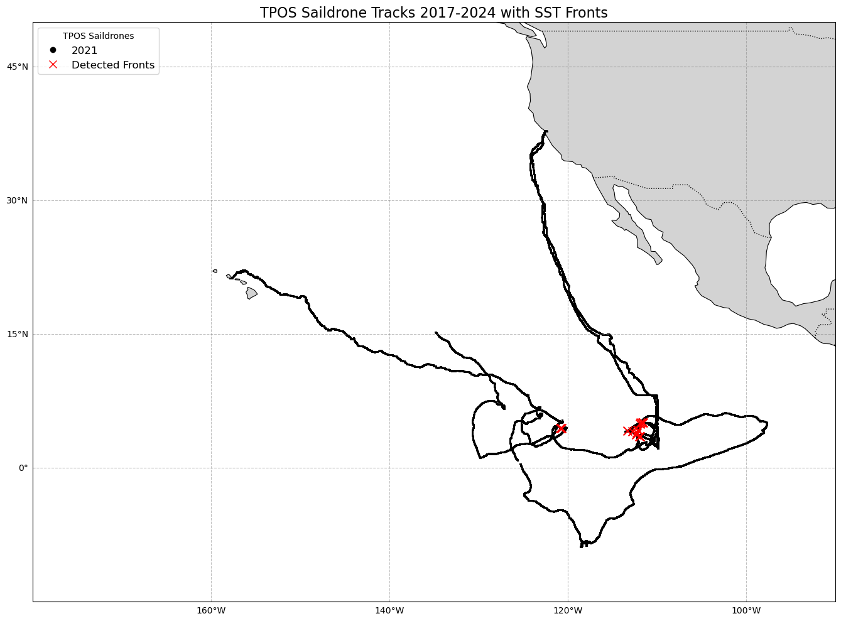

Slide 16
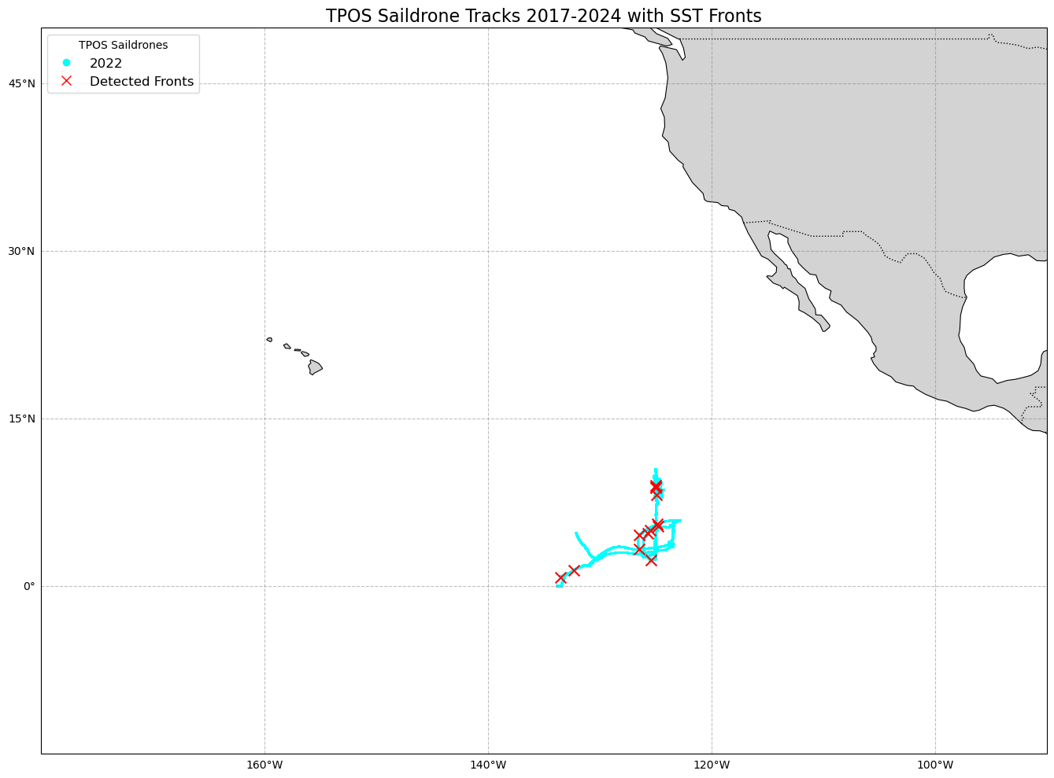

Slide 17
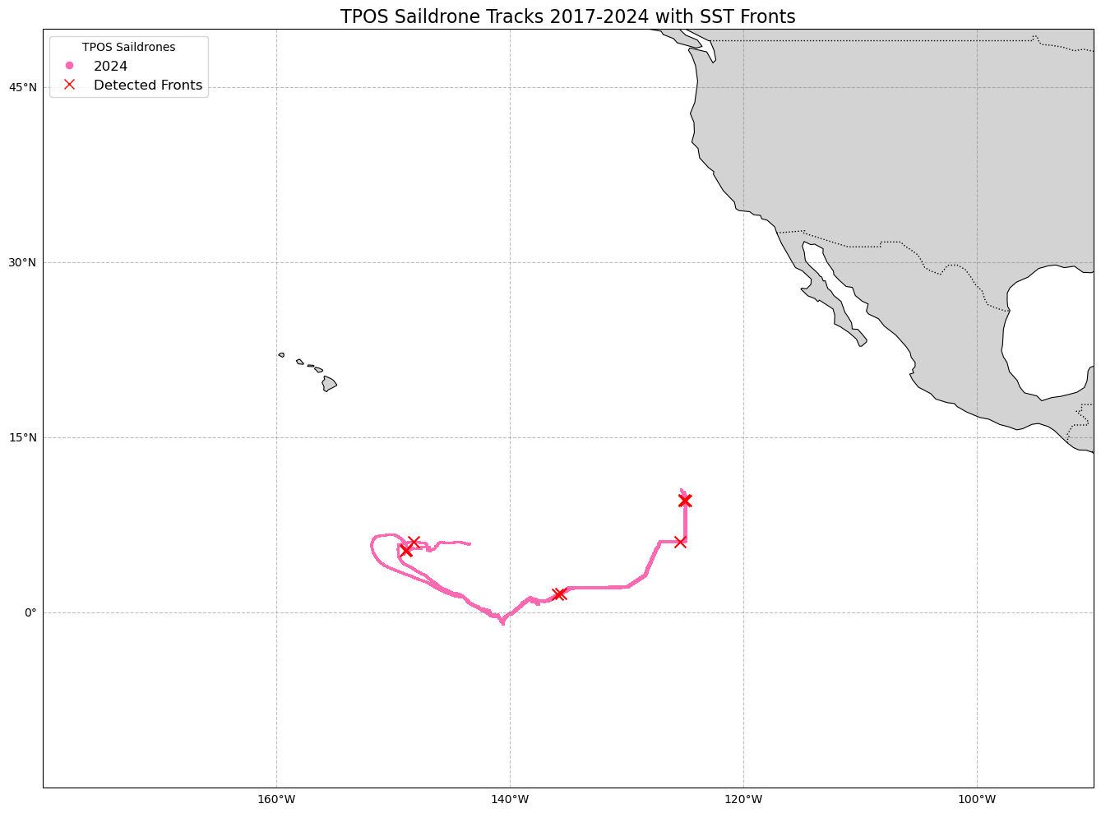

Slide 18
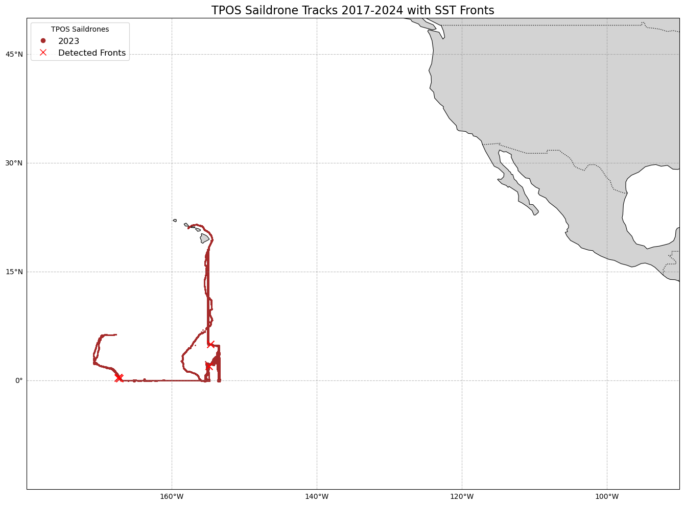

Slide 19
Strong fronts only (1C)

Slide 20


Slide 21
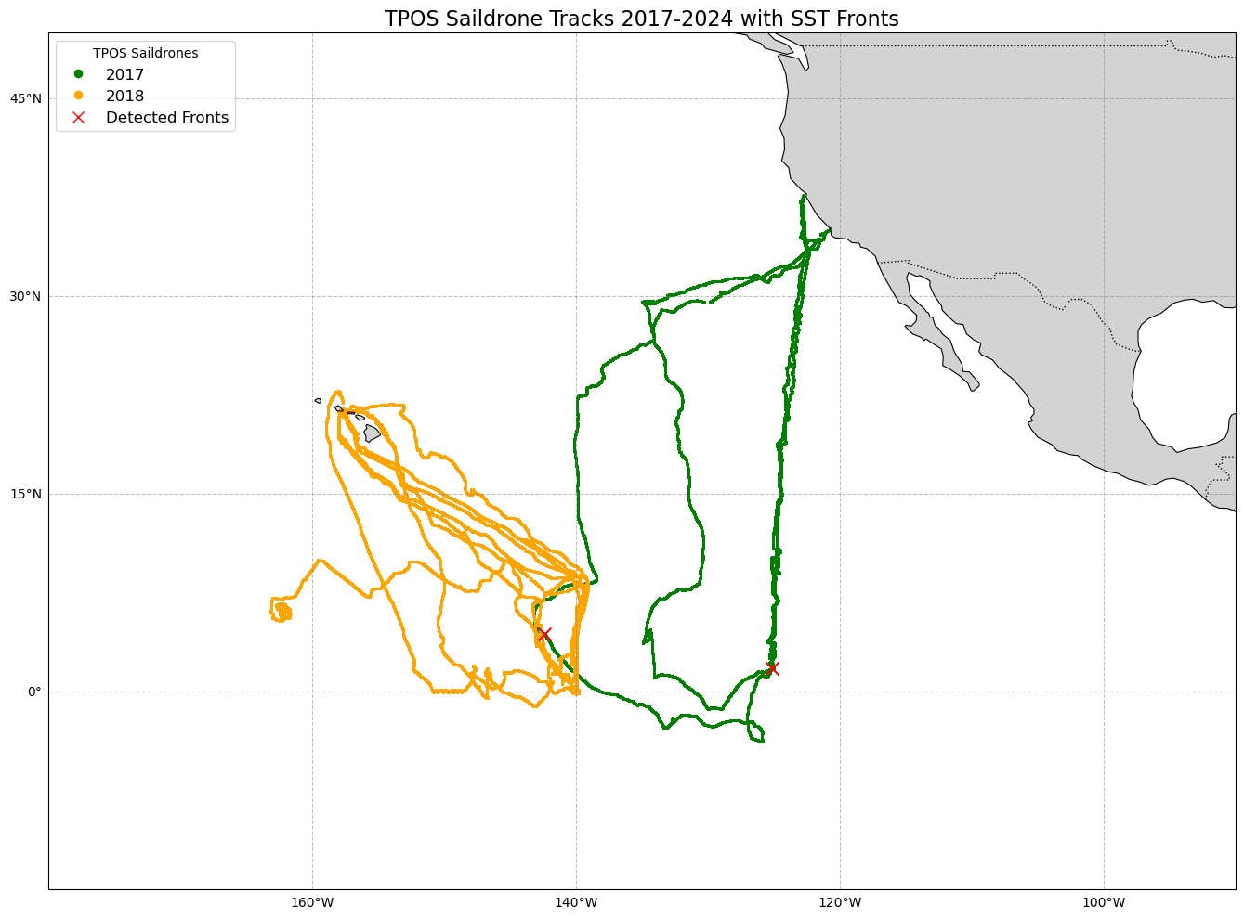

Slide 22
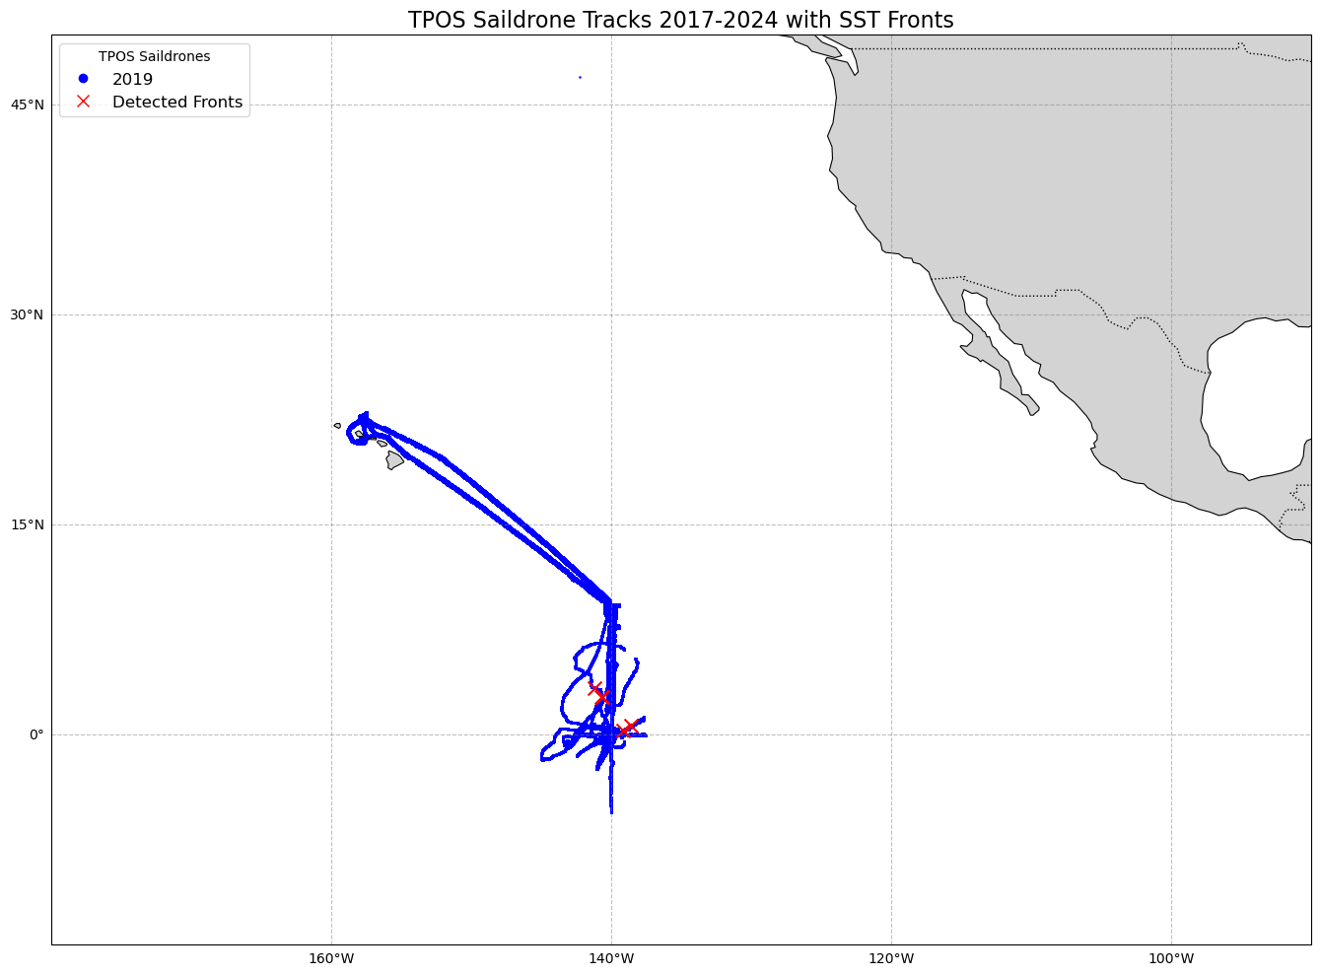

Slide 23
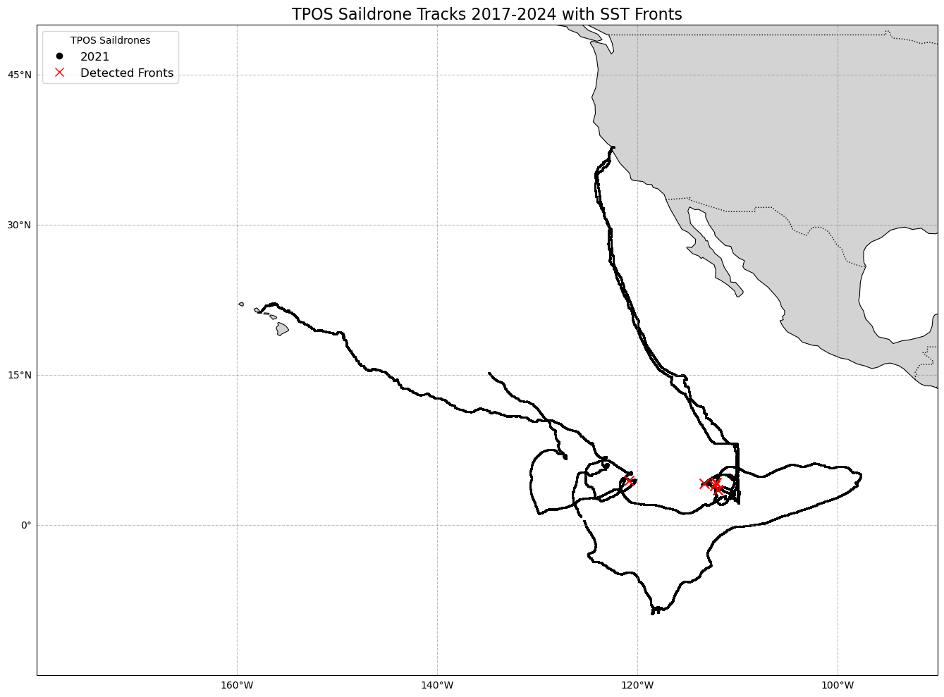

Slide 24
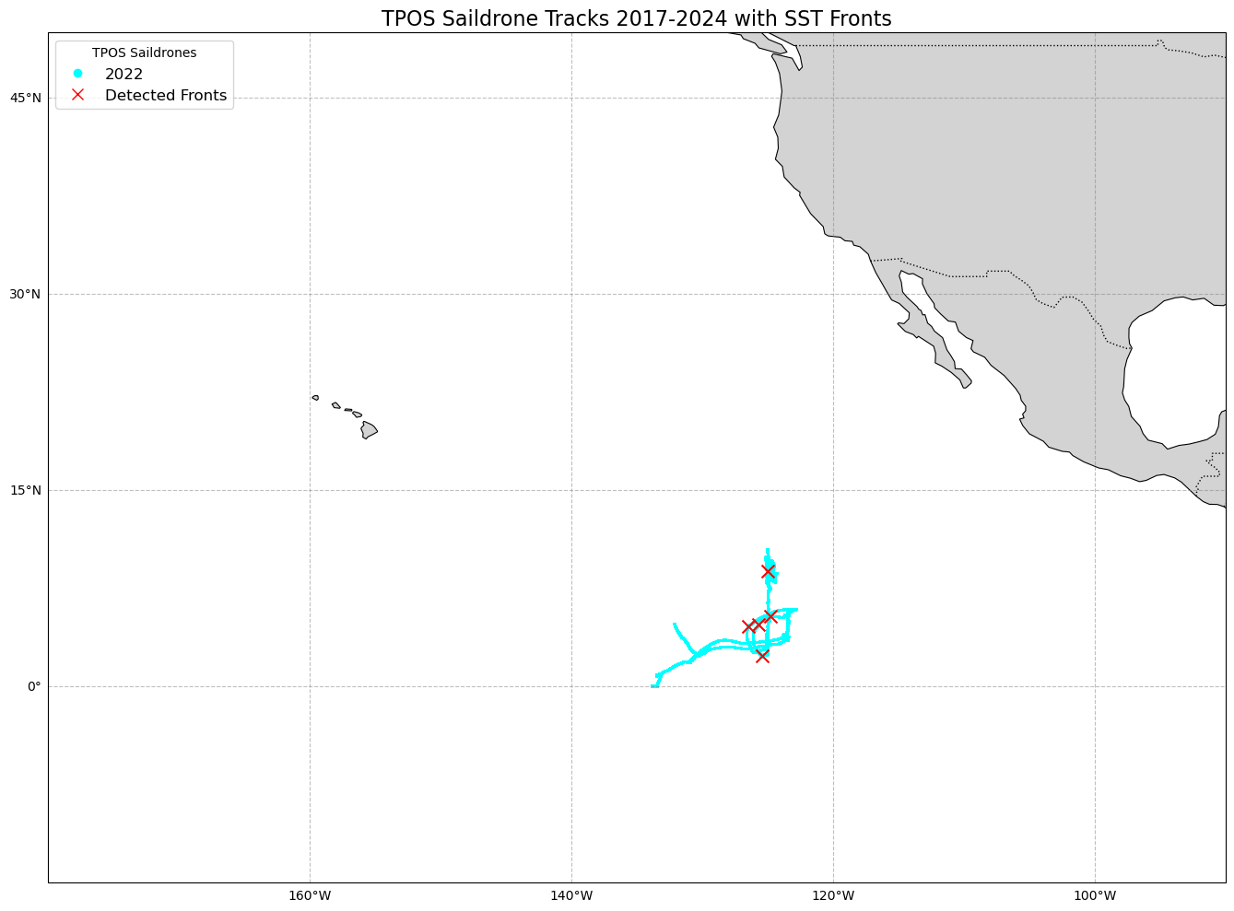

Slide 25


Slide 26
