Slide 1
Identifying fronts from TAO moorings

Slide 2
Followed Warner et al. 2019
Warner et al. 2019 TAO frontal criteria:
Fronts were identified from the temperature time series using the following three criteria:
Change of T by at least 0.2°C between consecutive data points separated by 10 min; alternatively, |Tt(t0)| ≥ 3.33 × 10−4 K s−1, where subscript t represents a time derivative, and t0 is the time that the front occurred. This criterion ensures that we identify features with magnitudes and propagation speeds similar to or greater than our two observed SSFs. For instance, when the 2008 fronts crossed the TAO mooring at 0°, 140°W, T increased by 0.27°C between consecutive measurements, which is the largest value of Tt at that location over a 3-week period (Fig. 14).
The 48-h-averaged temperature following the front is at least 0.3°C warmer (or cooler) than the 48-h-averaged temperature before the front (gray lines show daily averages in Fig. 14). These criteria ensure that the change in temperature was long lasting and not related to the diurnal temperature cycle.
We required that there were no decreases (or increases) in T with magnitudes greater than 30% of −Tt(t0) within 1 h before or after the observed front. This criterion was necessary to remove instances where temperature spiked and then quickly returned to its original value one or two data points later.

Slide 3
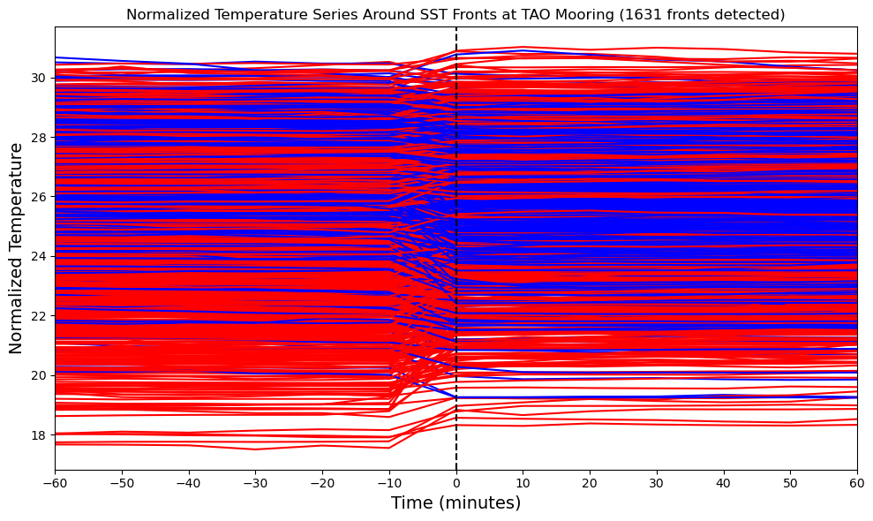

Slide 4
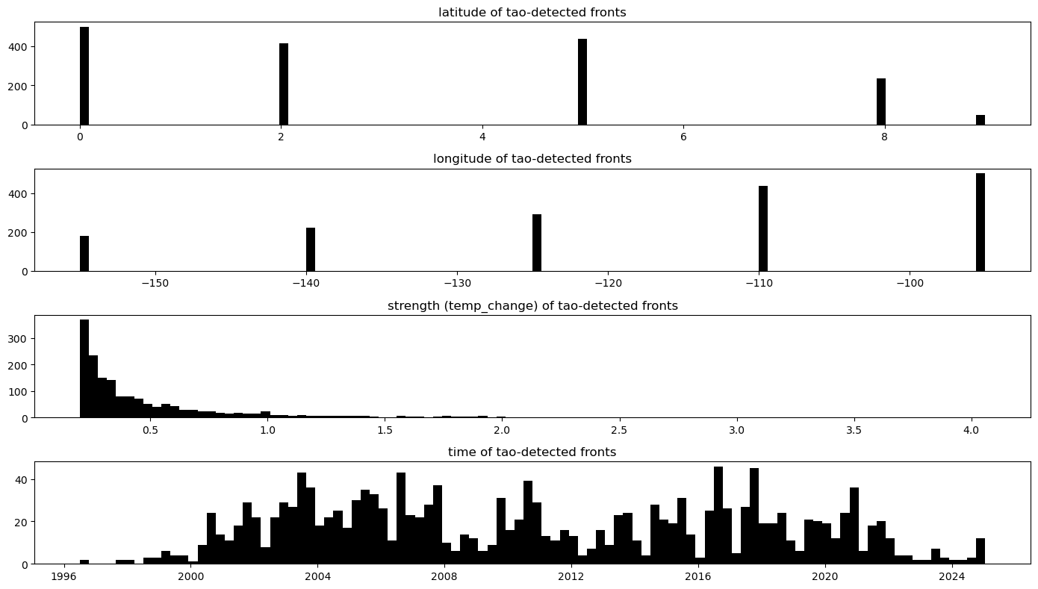
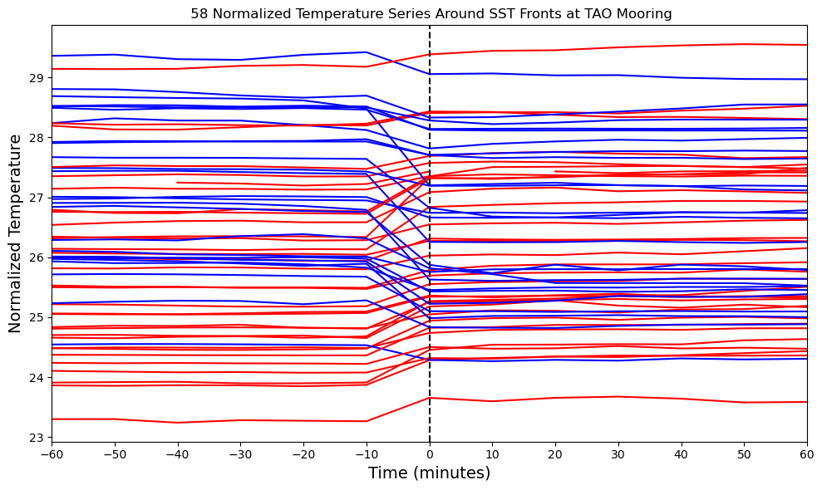
140W mooring

Slide 5
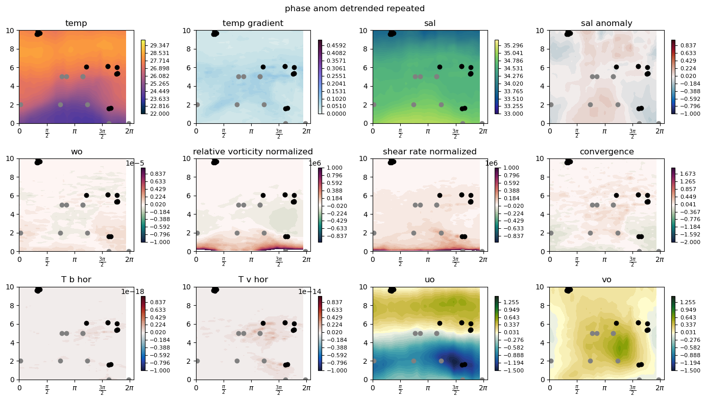
2024/25 season:

