Slide 1
Temp vs. sal contributions

Slide 2
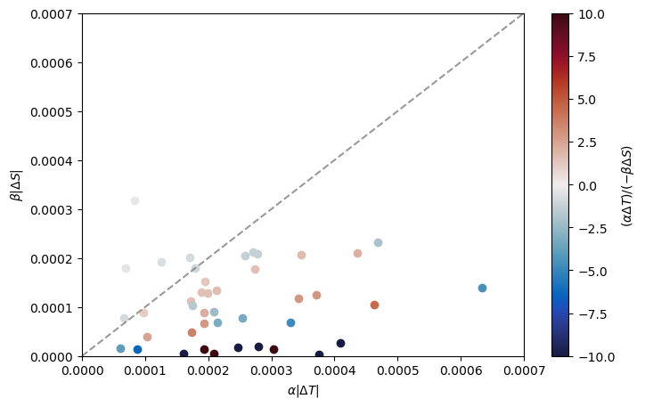
Working against each other for contributions of density

Slide 3
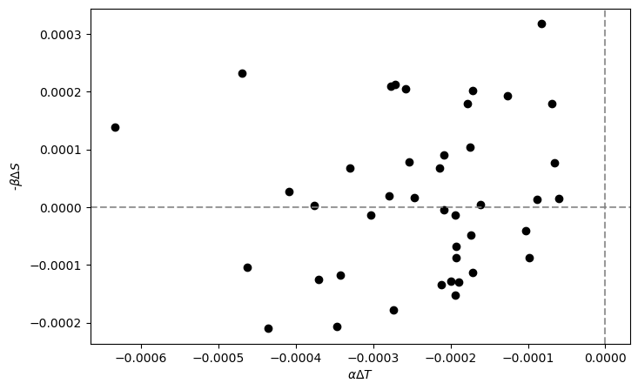
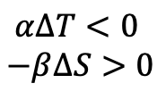
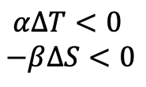
$$α∆T<0$$
$$−β∆S>0$$
Temp & Sal fronts
Reinforce each other
$$α∆T<0$$
$$−β∆S<0$$
Temperature fronts
Cooling and freshening counteract

Slide 4
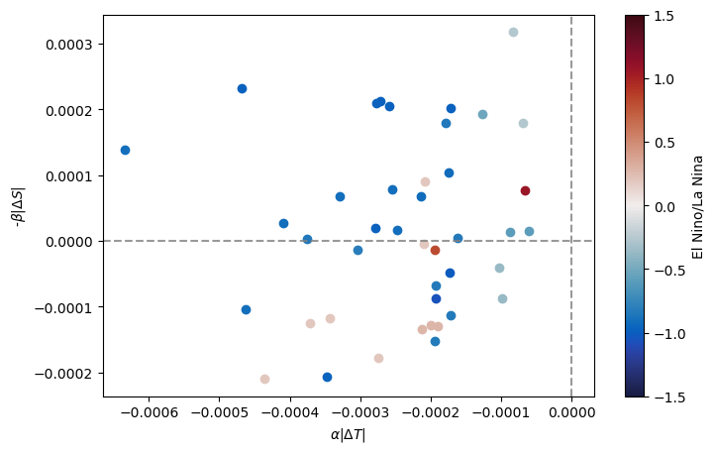

Slide 5
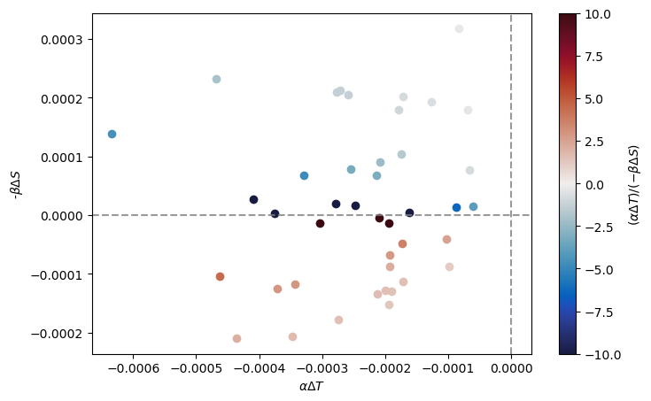

Slide 6
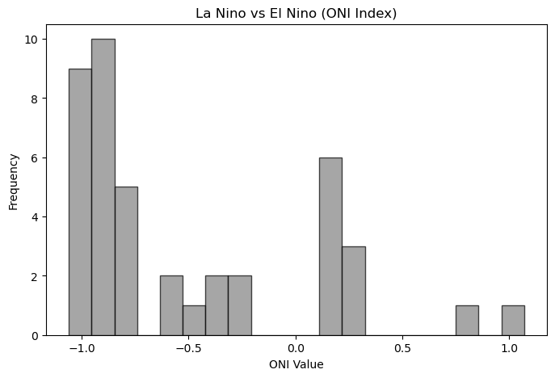

Slide 7
Find if temp or sal are working with ech other or not

