Slide 1

OPTOMETRY DA TRAINING | WEEK OF 25 AUGUST 2026
CRM tracker review, group-wide SOP findings, clinic-specific issues and good practice
CTE D5 · NGT · CTE D7 · LA · Song Han
Prepared for DA training and review · Internal use only

Slide 2
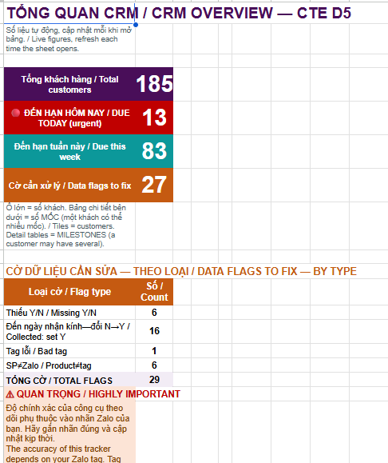
SETTING THE BASELINE
CRM Overview: Know What Is Due Today
WHAT TO LOOK AT
What the CRM Overview shows
1
Number of follow-ups due today
The urgent red tile — start here every morning.
▪ How many customer follow-ups are due today
▪ How many due each week
▪ How many data flags to fix
▪ Quantity of each data flags
2
Different cadence categories
Due today vs. due this week vs. flags to fix.
Tracker coverage
Live now: NGT and CTE D5
Coming live soon: CTE D7 and LA
Check the CRM Overview daily to see how many due each day and data flags to fix
CRM Overview — CTE D5 (live view)
Mắt Sài Gòn | Optometry DA Training
2

Slide 3
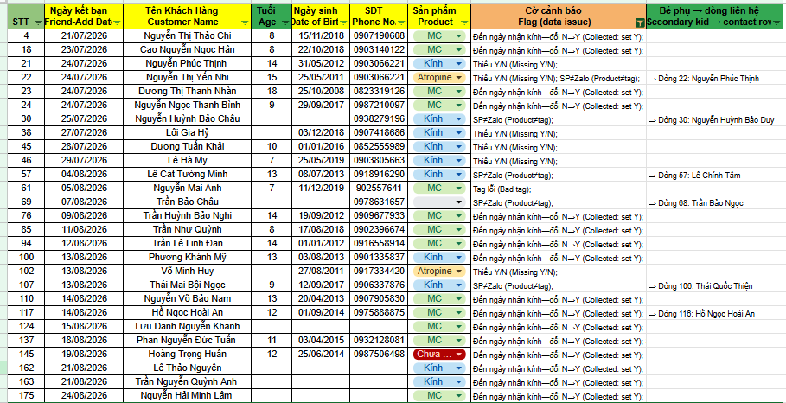
1. GROUP-WIDE ISSUES | FIX DATA FLAGS
Fix Data Flags before they affect your tracker, SOP result and bonus
Why Data Flags matter
▪ They affect the accuracy of the tracker
▪ They may affect which SOP cadence is assigned
▪ They affect recorded SOP performance
▪ They may ultimately affect your bonus
Many flags can be resolved in around 10 minutes
What you should do
▪ Check Data Flags regularly
▪ Correct missing or inaccurate information promptly
▪ Make sure customer details are properly recorded
▪ Raise the issue in the Zalo group if you cannot resolve it
Data flags — flagged customer records requiring correction
HOW TO WORK THROUGH IT
1
Check why the record is flagged — Read the flag column — it names the exact issue.
2
Correct the missing or inaccurate information — Fill in Y/N, dates, phone, product and tag fields.
Do not let something that can be fixed in
10 minutes affect your bonus.
3
Ask for help if you cannot resolve it — Post it in the Zalo group rather than leaving it open.
Mắt Sài Gòn | Optometry DA Training
3

Slide 4
1. GROUP-WIDE ISSUES | FOLLOW THE SOP CRITERIA
SOP Compliance is still lacking
CTE D5
NGT
COMBINED
0/22
1/21
1/43
Pass/Sample
Pass/Sample
Pass/Sample
CTE D7, LA and SH are not yet quantitatively tracked. Their trackers will come live soon.
Group-wide issues
What SOP compliance means
▪ Some individual D7 follow-ups were observed
▪ However, the full required cadence was generally not completed
▪ Membership benefits were sent more consistently than customer-care follow-ups
▪ Communication remains largely reactive rather than DA-initiated
▪ Customers often initiate the conversation
▪ Follow-up must happen at the correct cadence and cover the correct content
Many conversations stopped after the DA introduction and membership-benefit message, without enough subsequent customer care or recheck engagement.
A compliant follow-up must:
✓ Happen at the required cadence
✓ Cover the correct content
✓ Be proactive where required
✓ Address the purpose of that specific touchpoint
Follow up at the right cadence and cover the right content.
Mắt Sài Gòn | Optometry DA Training
4

Slide 5
2. CLINIC-SPECIFIC ISSUES | CLINIC-SPECIFIC ISSUES
Clinic-Specific Issues
CTE D5
Result: 0/22 complied
NGT
Result: 1/21 complied
Main issues
▪ CD3–5, CD7, CD14 and D30 were not consistently completed
▪ Communication was mainly limited to membership benefits
▪ DA interaction remained largely reactive
▪ Limited communication around customisation, collection, warranty, rechecks and referrals
Some D7-type follow-up was observed, but the overall number of follow-ups remained low.
Main issues
▪ D30 follow-up was largely not completed
▪ A small number of D7 follow-ups were observed
▪ Other proactive customer engagement remained limited
▪ Customer relationships were not being consistently maintained after collection
Focus: Move beyond membership-benefit messages and complete the full required follow-up sequence.
Focus: Use glasses usage, warranty and rechecks as natural reasons to initiate communication.
CTE D7
Qualitative review only
LA
Qualitative review only
Main issues
▪ Execution varied significantly between customers
▪ Some customers received parts of the required journey, while others missed several steps
▪ Common gaps: customisation updates, collection communication, D7 follow-up, referral benefits, correct customer information
The audit showed both more complete cases and cases where only one or two touchpoints were completed.
Main issues
▪ Some good D7 and collection communication was observed
▪ Other cases missed customisation, collection-day evening follow-up, Ortho-K Day 2, D7 and D30, educational content and referrals
▪ Marketing and membership messages were sometimes sent without first building customer engagement
CZ noted DAs should communicate from the perspective of caring about the child's glasses usage and eyesight.
Focus: Apply the same complete customer journey consistently across every customer.
Focus: Strengthen care-oriented follow-up before relying on marketing or referral messages.
Good practices exist, but they are not yet being applied consistently across every customer.
Mắt Sài Gòn | Optometry DA Training
5

Slide 6

2. CLINIC-SPECIFIC ISSUES | SONG HAN: GET THE BASICS RIGHT FIRST
Every optometry customer should be added on Zalo and tagged correctly
1. Capture every customer
2. Apply correct MC tagging
3. Communicate before collection
4. Follow up after collection
1
Capture Every Customer
What good MC tagging should look like
▪ Not all optometry customers are currently being added on Zalo
▪ This is despite relatively low patient volume
▪ Customers not added cannot enter the membership or follow-up workflow
▪ This is the most fundamental issue
2
Apply the Correct MC Tagging
▪ Customer names and remarks are sometimes missing or incorrect
▪ Incorrect tagging makes identification and future follow-up difficult
▪ Follow the same MC tagging format shown in the screenshot
▪ Correct inaccurate customer information as soon as it is identified
WHY THIS IS CORRECT
Communicate Before Collection
1
Correct MC tag — Starts with the MC prefix and date.
3
▪ Production or customisation updates
▪ Expected collection timing and collection arrangements
▪ Clear collection information
2
Customer clearly identified — Parent/child name written out in full.
4
Follow Up After Collection
3
Consistent naming format — Same structure used for every customer.
▪ Check how the child is adapting to the glasses
▪ Answer questions proactively and share useful eye-care information
▪ Continue the relationship after collection
4
Easy to find for future follow-up — Searchable when the next cadence is due.
Add every customer and follow the correct MC tagging format. Without this,
the customer cannot be tracked or followed up properly.
Mắt Sài Gòn | Optometry DA Training
6

Slide 7
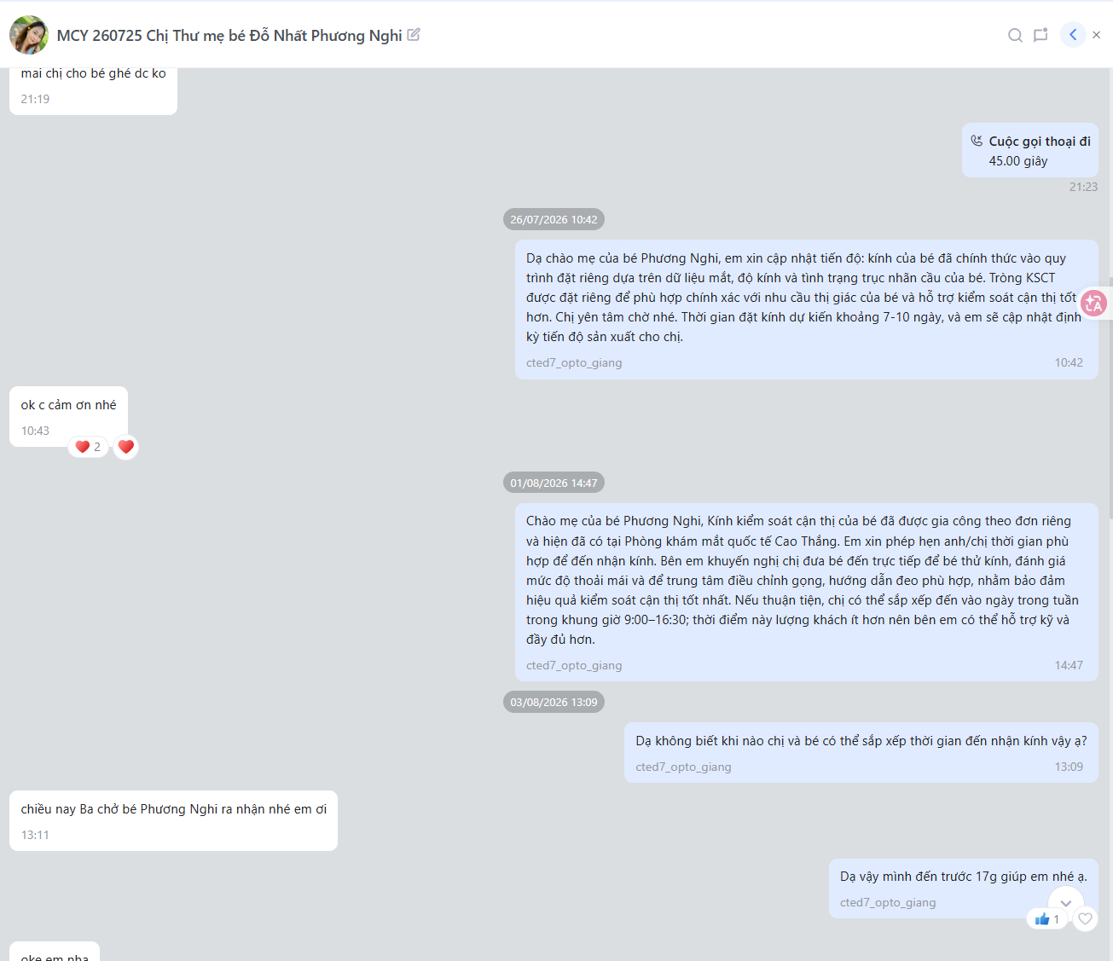
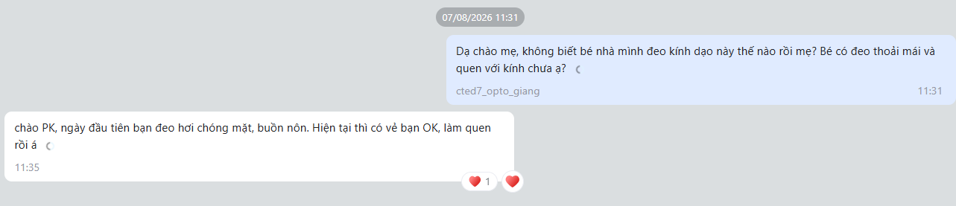
3. GOOD EXAMPLE | GOOD EXAMPLE: PROACTIVE CUSTOMER JOURNEY MANAGEMENT
Good Example: Proactive Customer Journey Management
Customer: MCY 260725 Chị Thư mẹ bé Đỗ Nhất Phương Nghi
THE THREE STAGES SHOWN
Why this is good
1
1
Customisation information
proactively communicated to the parent
▪ The DA keeps the customer informed without waiting for the customer to ask
▪ The customer knows what is happening at each stage
▪ The DA appears organised, attentive and professional
▪ The parent gains confidence that the child's case is being properly managed
▪ Consistent communication helps build trust in the DA
2
Collection information
clearly shared, with timing options
2
3
Post-collection check-in
on how the child is adapting to the glasses
Proactive communication makes the DA look professional and helps build customer trust.
Trainer message
The DA should manage the customer journey from customisation through collection and after-care, rather than waiting for the customer to ask for updates.
Customisation update (26/07) and
collection communication (01–03/08)
3
Post-collection
check-in (07/08)
Manage the journey end to end —
do not wait to be asked.
Mắt Sài Gòn | Optometry DA Training
7

Slide 8
4. KEY TAKEAWAYS | KEY TAKEAWAYS
Key Takeaways
1
Fix Data Flags
2
Follow the SOP Criteria
3
Ask Anything
▪ Data flags affect the tracker
▪ They affect SOP tracking
▪ They may affect your bonus
▪ Many issues can be fixed in around 10 minutes
▪ Do not leave easily corrected issues unresolved
▪ Ask for help if you cannot resolve a flag
▪ Follow up at the required cadences
▪ Cover the correct content for each touchpoint
▪ Sending any message does not automatically mean the SOP has been completed
▪ The SOP gives you regular touchpoints to build relationships
▪ When you follow up well, customers become familiar with and trust you
▪ Stronger relationships support engagement, rechecks and referrals
▪ We are all still learning the new process
▪ It is okay not to know something
▪ However, we do not know what you do not know
▪ Raise questions in the Zalo group
▪ CZ and Khoa will answer and clarify them
▪ We are here to support you
Do not let something that can be fixed in 10 minutes affect your bonus.
Use every SOP touchpoint to build the customer relationship, not simply to complete a task.
It is okay not to know. Ask early so that we can solve the issue together.
Fix the data. Follow the SOP. Ask whenever you are unsure.
Mắt Sài Gòn | Optometry DA Training
8

