Slide 1
3 September 2026
Optometry Doctor’s Assistant Training
NGT · CTE D5 · CTE D7 · LA · SH (Song Han)
Prepared for DA training and review · Internal use only

Slide 2
1. ZALO FEEDBACK | CLINIC SPECIFIC
Zalo Performance and Feedback for each clinic
Read these numbers with slide 8 in mind: some Zalo tag dates are wrong, so follow-up that was sent can appear as missed.
NGT
Total 11/26
CTE D5
Total 5/14
CTE D7
Total 3/6
D6-7
CD
CD+3-5
CD+14
CD+30
D6-7
CD
CD+3-5
CD+7
CD+14
CD+30
D6-7
CD
CD+3-5
CD+14
CD+30
2/3
2/3
0/4
2/3
5/13
—
—
0/2
0/2
0/4
5/6
—
2/2
1/2
0/1
0/1
What went well
What went well
What went well
✓ Some customers received the CD30 follow-up, but not all of them
✓ Referrals were asked for, but not often enough
✓ CD30 follow-ups were made
✓ Collection notifications were sent, and some customers were helped with courier delivery
✓ The QR code on the counter card has increased the number of customers added
✓ Some customers were told how long the glasses would take
✓ Customer enquiries were followed up promptly
What to change
What to change
▪ Send more follow-ups on time — usage instructions (CD1), check on the child’s glasses (CD3–CD5), myopia-control information (CD14), usage check (CD30)
▪ Every customer must be followed up, not only some
▪ Meet every customer in person at collection, so they know who you are when you message
▪ Ask every customer for a referral. If you do not ask, they will not refer
▪ Customer numbers are low, so there is time to message first and send every CD follow-up on time
▪ Send usage instructions (CD1), check on the child’s glasses (CD3–CD7), myopia-control information (CD14) and a usage check (CD30)
▪ When the customer replies well — for example after you confirm courier delivery — ask them for a referral
What to change
▪ After payment, add the customer on Zalo and tell them how long the glasses will take
▪ After collection, send a CD+3-5 follow-up to ask how the glasses are being worn
▪ Ask for a referral once the customer has replied positively
▪ Use the CD14 follow-up to send educational content or discuss how the glasses are being used
Not yet in the tracked numbers
SH (Song Han) · Access to Zalo disconnected & CRM Form not updated – as of 2/9/26
Pending update of the CRM form. There is no channel to send follow-up on, so nothing can be sent or measured. This needs to be fixed by IT, not by the DA.
LA · Pending tracker go-live
Not measured this week. Reviewed by reading the conversations. See slide 3.
Mắt Sài Gòn | Optometry DA Training
2

Slide 3
1. ZALO FEEDBACK | CLINIC SPECIFIC
LA — what worked, and what to change
LA · Pending tracker go-live. Not measured this week. Reviewed by reading the conversations.
What went well — other clinics should do the same
What to change
✓ Ortho-K day-one follow-up
1
Add remarks for older existing customers
Some Ortho-K customers were called on the child’s first day wearing the lenses. This is good. Do this for every Ortho-K customer, not only some.
For customers who bought before the tracker started, add a remark with the approximate collection date.
✓ Free recheck follow-up for MC customers
2
Combine free recheck and warranty notices with the CD follow-ups
MC customers were contacted about their free recheck. This is good. In the same conversation, ask the customer to refer someone.
Use the free-recheck and warranty messages to also cover the CD follow-ups — usage instructions (CD1), check on the child’s glasses (CD3–CD7), myopia-control information (CD14) and usage (CD30).
✓ Customer enquiries answered
3
Ask for referrals far more often
Almost all customer questions were answered. This is good. Keep learning about the products, because solving more problems builds trust.
Ask after you have solved a problem, sent a courier delivery, or the customer has thanked you. If you do not ask, they will not refer.
Related: LA’s point about collection-date remarks is the same problem as the Zalo tag date on slide 8. If the collection date is not recorded, the CRM cannot work out when follow-ups are due.
Mắt Sài Gòn | Optometry DA Training
3

Slide 4
2. RECOMMENDATIONS | GENERAL RECOMMENDATIONS
Five recommendations for all clinics
These are about order and consistency: the same work, done in the right order, for every customer.
1
Add the customer on Zalo on D1, right after the deposit
Do not wait until collection day. When the deposit is paid, add them on Zalo, give your name and role, and tell them how long the glasses will take.
2
Send usage instructions at collection. Send benefits after the customer replies
Send usage instructions on collection day. Send membership benefits only after the customer replies. Do not let the benefits message be the last message.
A benefits message sent with no reply looks like advertising. Benefits message flows more naturally and more likely to be read and considered by the member.
3
Speak to the customer in person at collection
Introduce yourself at the counter and explain the membership benefits in person, not only by message. This is a chance for you to build trust and rapport with parents.
4
If the customer does not reply, we should still send messages thoughtfully
No reply does not mean stop. We can ask them are the glasses fitting well, provide them with basic glasses-usage information, and myopia-control information.
5
Send follow-ups as often as the product requires
Every customer, at every point the product requires — not only some customers, and not only the easy ones.
Recommendation 5 depends on the product. Slide 5 shows what is required.
Mắt Sài Gòn | Optometry DA Training
4

Slide 5
3. REQUIRED FOLLOW-UP | REQUIRED FOLLOW-UP
Required follow-up for each product
Find the product column and read down. A dash means that follow-up does not apply to that product, so it was never due.
FOLLOW-UP
MC
Kính
Ortho-K
D1
Send introduction; tell the customer how long the glasses will take
Send introduction; tell the customer how long the glasses will take
Send introduction; tell the customer how long the lenses will take
deposit day
D6-7
If ready: tell the customer within 4 hours and give the collection date. If not ready: say the glasses are still being made, and you will update them
If ready: tell the customer within 4 hours and give the collection date. If not ready: say the glasses are still being made, and you will update them
If ready: tell the customer within 4 hours and give the collection date. If not ready: say the glasses are still being made, and you will update them
production check
CD
Send usage instructions; benefits after they reply; ask for a referral
Send usage instructions; benefits after they reply; ask for a referral
Send usage instructions; benefits after they reply; ask for a referral
collection day
CDN
— not applicable
— not applicable
Ask about the first Ortho-K wear; help adjust if it does not fit well
collection evening
CD+1
— not applicable
— not applicable
Check how the first night went; ask for a referral
next day
CD+3-5
Ask how the child is getting on; ask for a referral after they reply
Ask how the child is getting on; ask for a referral after they reply
Ask how the child is getting on; ask for a referral after they reply
care check
CD+7
— not applicable
Check usage; free frame adjustment; benefits; ask for a referral
Book the recheck appointment; benefits; ask for a referral
usage check
CD+14
Check usage; remind ≥ 12h wear per day; benefits; ask for a referral
— not applicable
— not applicable
myopia education
CD+30
Check usage; send education content; benefits; ask for a referral
Check usage; benefits; ask for a referral
Book recheck; remind ≥ 6 wears per week; benefits; ask for a referral
usage review
CD+90
Check usage; send education content; benefits; ask for a referral
Check usage; send education content; benefits; ask for a referral
Book recheck; remind ≥ 6 wears per week; benefits; ask for a referral
3-month recheck
CD+180
Invite recheck; benefits; ask for a referral
Invite recheck booking; benefits; ask for a referral
Book recheck; remind ≥ 6 wears per week; benefits; ask for a referral
6-month
CD+270
Check usage; send education content; benefits; ask for a referral
Check usage; benefits; ask for a referral
Book recheck; remind ≥ 6 wears per week; benefits; ask for a referral
9-month
CD+365
Invite recheck; benefits; ask for a referral
Invite recheck; membership renewal; lifetime free frame adjustment
Invite recheck; benefits; ask for a referral
12-month + renewal
Four rules that apply to every follow-up, for every product
1 Send benefits only after the customer replies. If there is no reply, send a care message the next day instead. 2 Do not end on a benefits message. The last message the parent receives should be about care.
3 Ask for the referral at the right time. After solving a problem, sending a courier delivery, or being thanked. If you do not ask, they will not refer. 4 Update the Zalo tag date on collection day. The CRM counts all CD follow-ups from that date. Wrong date, wrong schedule.
Mắt Sài Gòn | Optometry DA Training
5

Slide 6
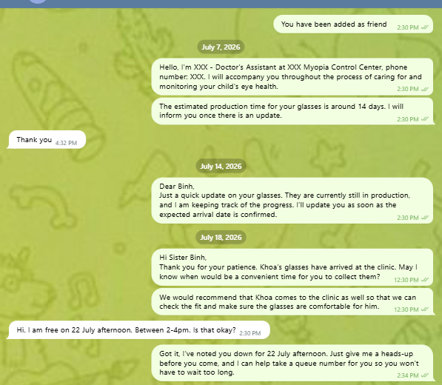
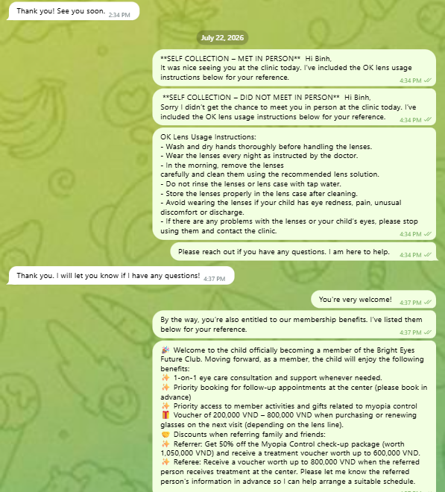
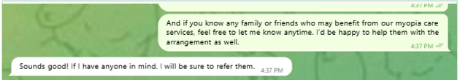
4. EXAMPLE TO FOLLOW | EXAMPLE TO FOLLOW
Example — D1 to collection day (OKY-260722)
OKY-260722 Chị Bình · Bé Khoa · Ortho-K · every follow-up was sent, in the right order, with the right content
D1 · deposit day and D6-7 · production check
CD · collection day
What this DA did
D1 · 7 Jul
Gave her name, role and phone number, and said the glasses would take about 14 days.
D6-7 · 14 Jul
Glasses not ready, so she said so: still being made, will update when the date is confirmed.
D6-7 · 18 Jul
Glasses ready. She told the parent and asked when they could collect, then suggested bringing the child in to check the fit.
Appointment
Confirmed the time and offered to take a queue number so they would not have to wait.
CD · 22 Jul
Complete lens instructions: wash hands, wear at night, use cleaning solution, do not use tap water, and when to stop and call.
CD · benefits
Membership benefits and referral ask sent only after the parent replied, with the voucher amounts and referral terms in full.
Mắt Sài Gòn | Optometry DA Training
6

Slide 7
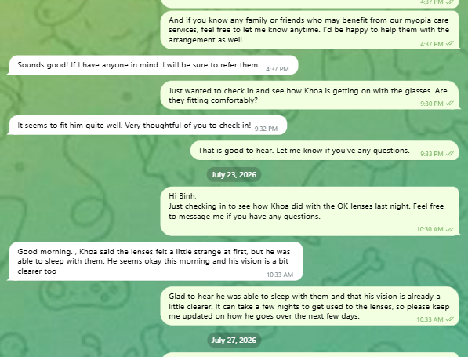
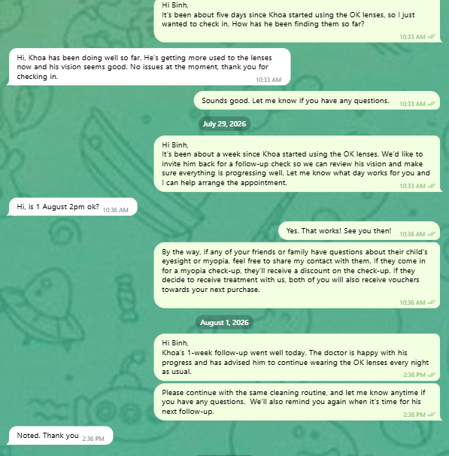
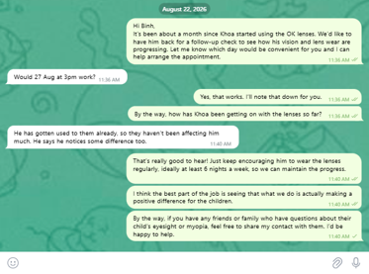
4. EXAMPLE TO FOLLOW | EXAMPLE TO FOLLOW
Example — collection evening to CD+30 (OKY-260722)
Continued. Six follow-ups after collection. The DA started every one; the parent never had to ask. The DA sent every follow-up first. She asked for a referral twice, both times after a reply.
CDN · CD+1
CD+3-5 CD+7
CD+30
What this DA did
CDN · 22 Jul, 9:30pm
Same evening as collection: asked whether the lenses were comfortable. This follow-up applies to Ortho-K only, and she did it that night.
CD+1 · 23 Jul
Next day, asked about the first night. The parent said the lenses felt strange but the child slept and could see better. The DA explained that a few nights of this is normal, and asked to be kept updated.
CD+3-5 · 27 Jul
Day five: checked the child was adapting and could see well.
CD+7 · 29 Jul
One week: invited them for a recheck, arranged the appointment, then asked for a referral — after the appointment was agreed, offered as a discount for family and friends.
CD+7 result · 1 Aug
Told the parent what the doctor said, repeated the cleaning steps, and said when she would message next.
CD+30 · 22 Aug
One month: arranged the recheck, reminded them to wear the lenses at least 6 nights a week, and asked for a referral again after the parent thanked her.
Mắt Sài Gòn | Optometry DA Training
7

Slide 8
5. DATA TO FIX | FIX DATA FLAGS
Two data problems in the tracker
These are not small errors. If the Zalo tag date is wrong, the CRM works out the wrong follow-up dates, and follow-up that was sent can be counted as missed.
PROBLEM 1 · Zalo tag date does not match the collection date
PROBLEM 2 · Second child not recorded
The Zalo tag still shows the original date, not the date the customer collected the glasses.
Why it matters: the CRM counts all follow-up dates from the tag date. If the tag date is wrong, every CD date is wrong, and follow-up you did send is counted on the wrong day or not counted at all.
Recurring at: NGT and CTE D7 — found in both in this week’s check.
When one parent has two or more children, only the first child has a row. The second child has no name and no tag.
Why it matters: the second child is never added to the follow-up list, so no follow-up is ever created for them.
Detected by: matching phone numbers — two children sharing one contact number raises the flag.
How big this is: NGT 33 of 39 data flags. CTE D5 26 of 31. This is the largest single cause of data flags at both clinics.
What this means for the numbers on slide 2
Some of the low CD3-5 and CD14 numbers may be a tagging problem, not a follow-up problem. If the tag date is wrong, the CRM never asked for those follow-ups on the right day.
These must be fixed before the tracker can be trusted. Until the dates are correct, we cannot tell the difference between a follow-up that was not sent and one that was sent but counted on the wrong date.
Fix the tag date first. Until then, the tracker is measuring the wrong days.
Mắt Sài Gòn | Optometry DA Training
8

Slide 9
5. DATA TO FIX | CORRECTING DATA FLAGS
Fix 1 — update the Zalo tag date on collection day
PROBLEM 1 · Zalo tag date does not match the collection date — found at NGT and CTE D7
✕ WRONG — tag still shows the original date
✓ RIGHT — tag updated to the collection date
The tag shows the date the order was placed. The CRM counts CD1, CD3-5, CD7, CD14 and CD30 from that date, so all of them fall on the wrong day.
The tag shows the date the customer collected the glasses. The CRM then creates the correct CD dates, and your follow-up is counted on the right day.
What to do
1
On the day the customer collects
Do it the same day — not later in the week.
2
Open the customer’s Zalo contact
Find the existing tag with the old date in it.
3
Change the date in the tag to the collection date
Keep the rest of the tag format exactly as it is.
4
Check the CRM shows the new follow-up dates
The CD dates should now count from collection day.
Note: if the tag date is not updated, the CRM shows the wrong follow-up dates, and work you did can look like a miss.
Update the tag on the same day the customer collects.
Mắt Sài Gòn | Optometry DA Training
9

Slide 10
5. DATA TO FIX | CORRECTING DATA FLAGS
Fix 2 — add a row for the second child
PROBLEM 2 · Two or more children under one parent — add one row per child, then link it to the Zalo contact
NGT 33 of 39 data flags. CTE D5 26 of 31 — the largest single cause of data flags at both clinics.
Step 1 — the same at every clinic
Add another row and enter the second child’s name and tag. Every child needs their own row. Without one, the second child is never added to the follow-up list and no follow-up is created for them.
STEP 2 — LINKING TO THE ZALO CONTACT WORKS DIFFERENTLY BY CLINIC
CTE D5 and CTE D7 · automatic
NGT · manual — you must do this yourself
Phone numbers are recorded, so the system matches them for you.
▪ Column S will display automatically for the secondary child
▪ It shows which row to refer to for the Zalo contact
▪ The match is made on the contact number — if two children share a number, it flags
Your job: check Column S is populated and points to the right row.
Phone numbers are not recorded, so the system has nothing to match on.
▪ Column S will not populate on its own
▪ You must manually key into Column S which row to refer to,
▪ or enter the Zalo tag of the contact directly
Root cause: this is why phone numbers must go into the name remark — it removes the manual step.
One row per child. CTE D5 and D7 match automatically by phone number. NGT must fill in Column S by hand.
Mắt Sài Gòn | Optometry DA Training
10

Slide 11
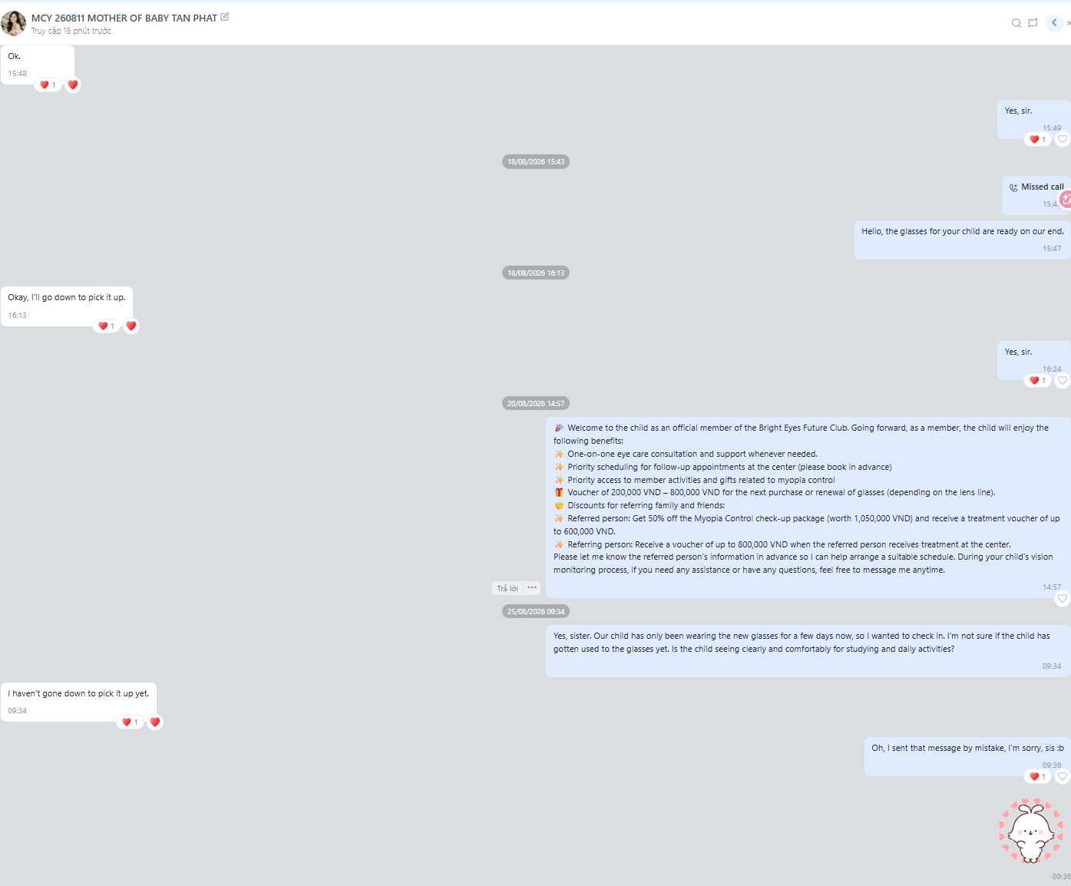
5. DATA TO FIX | WHY THE TAG DATE MATTERS
MCY 260811 — a wrong tag date caused a message that should not have been sent
MCY 260811 MẸ BÉ TẤN PHÁT · marked as collected on 11 August. The customer had not collected the glasses, and still had not collected them on 25 August.
What happened
11 Aug The tracker was marked as collected. The customer had not collected the glasses.
18 Aug The DA told the parent the glasses were ready. The parent said they would come and collect them.
20 Aug Membership benefits were sent, before the glasses had been collected.
25 Aug The tag said 11 August, so the CRM counted this day as CD+14. The DA sent the CD+14 usage check: has the child got used to the glasses?
25 Aug The parent replied: I have not gone down to pick it up yet. The DA had to apologise and say the message was sent by mistake.
What this shows
A wrong tag date does more than count wrongly. It makes the CRM ask for follow-up that is not due, and the DA sends it.
The customer sees the mistake. The parent was asked about glasses they did not have.
Mark as collected only on the day the customer collects. Not when the glasses are ready, and not when the customer says they will come.
Mark as collected only on the day the customer actually collects the glasses.
Mắt Sài Gòn | Optometry DA Training
11

Slide 12
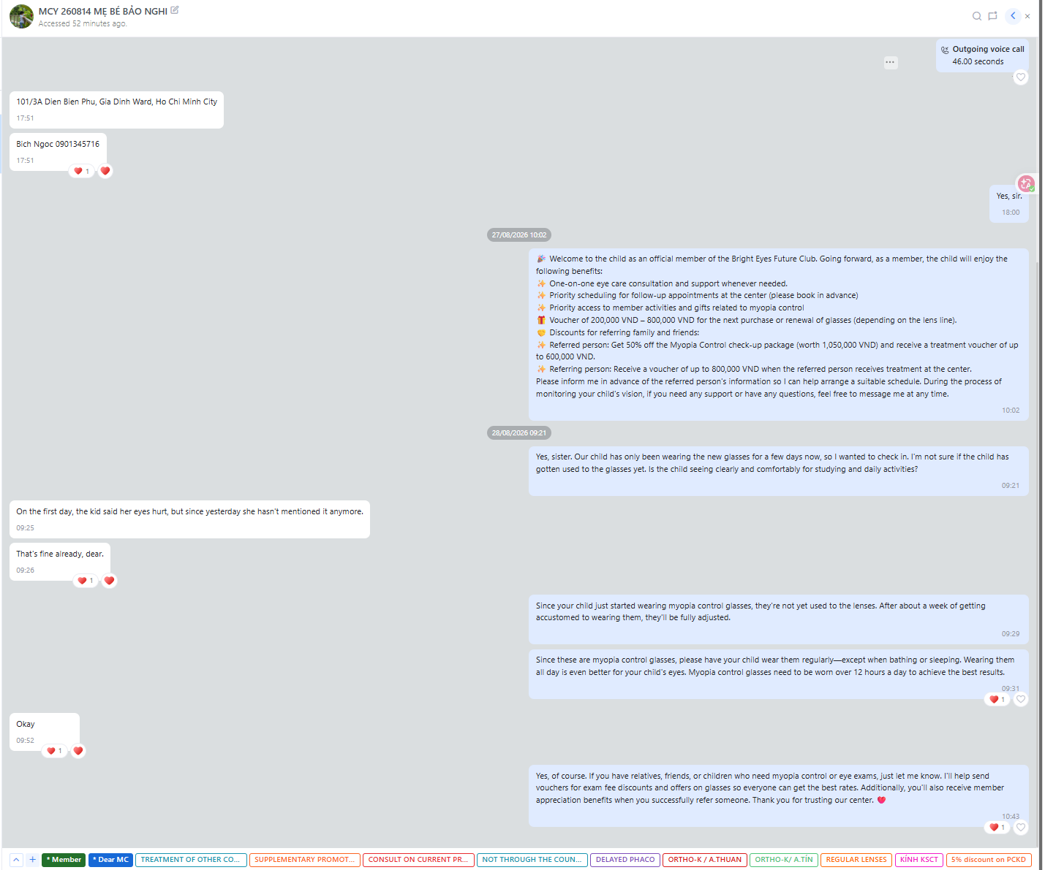
6. WHAT TO DO NEXT | A REAL EXAMPLE FROM THIS WEEK
A real example from this week — good follow-up, wrong tag date (MCY 260814)
Customer: MCY 260814 MẸ BÉ BẢO NGHI · MC · myopia-control glasses · 27–28 Aug 2026
What this DA did well
1
She asked a real question, not a standard message
She asked whether the child was seeing clearly and comfortably after a few days in the new glasses. The parent had not asked first.
2
She answered the concern properly
The parent said the child’s eyes hurt on the first day. The DA explained that about a week of adjustment is normal, then gave the wear rule: all day except bathing and sleeping, more than 12 hours for the best result.
3
She sent benefits, then asked for a referral after the reply
Membership benefits were sent with the voucher and referral terms in full. She asked for the referral only after the parent replied “Okay”, not before.
4
She ended with care, not an offer
The last message offered to arrange vouchers for family and friends, and thanked the parent for trusting the centre.
Message first. Answer properly.
Ask for the referral after they reply.
The only imperfection: the Zalo tag date is wrong.
The conversation was correct, but the tag date does not match the collection date, so the CRM counts the follow-up dates from the wrong day. See slides 8 and 9.
Mắt Sài Gòn | Optometry DA Training
12

Slide 13
6. WHAT TO DO NEXT | TRAINING PRIORITIES
This week’s three priorities
1
Follow-up frequency
and required content
2
Ask for referrals
whenever appropriate
3
More interaction
with members
▪ Send follow-ups as often as required, for every customer
▪ All customers, not only some
▪ Send the right content for each CD follow-up
▪ Each follow-up has its own purpose — check the product first
▪ CD+3-5 is the weakest follow-up at the moment
▪ Ask between payment and collection
▪ Ask again after the customer replies well
▪ For example after you confirm courier delivery
▪ All clinics are asking too rarely
▪ Ask consistently, not occasionally
▪ Have more contact with members
▪ Meet every customer in person at collection
▪ Customers then know who their DA is
▪ Customers who know you are more likely to reply
▪ If a customer does not reply, keep communicating
Every customer, on time, with the right content.
If you do not ask, they will not refer.
If they know you, they will reply.
Separate issue for Song Han: SH (Song Han) Zalo access is disconnected. No follow-up can be tracked until it is restored. Please also update the CRM Form.
Every customer. On time. With the right content.
Mắt Sài Gòn | Optometry DA Training
13

