Slide 1
24 September 2026
Optometry Doctor’s Assistant Training
NGT · CTE D5 · CTE D7 · LA · SH (Song Han)
Prepared for DA training and review · Content from the Optometry Weekly Review of 23 September 2026 · Internal use only

Slide 2
1. THIS WEEK | HOW THIS WEEK IS DIFFERENT
No score this week — qualitative feedback only
The tracker is not scored this week. The feedback below comes from reading the conversations at each site. Two things must change everywhere, and the cadence must hold for every customer.
01
Update the Zalo contact name to reflect the glasses collection date
The date in the contact name must be the date the customer actually collected. Every follow-up date the CRM works out is counted from it, so a wrong date puts CD+3-5, CD+7, CD+14 and CD+30 on the wrong day — and work you did send is counted as a miss.
02
Send membership benefits on the day of collection
Benefits belong on collection day, not days later. This week benefits were the one message that reliably arrived, but often late — at CTE D5 the contact name says 17 August and the benefits message went out on 20 August.
HOLD THE CADENCE Make sure these are adhered to, for every customer
CD+3-5
CD+7
CD+14
CD+30
care check
usage check
myopia education
usage review
Ask how the child is getting on, then ask for a referral once they reply
Check usage, offer the free frame adjustment, benefits, ask for a referral
Check usage, remind ≥ 12h wear per day, send educational content
Check usage, send educational content, benefits, ask for a referral
Before any of these: D1 — the introduction and how long the glasses will take. Day 6-7 — the production update, ready or not ready. CD — usage instructions, then benefits after the customer replies.
COMMON ISSUE, ALL SITES
CD+7 and CD+30 follow-ups, educational content and customer care follow-ups all need strengthening. Not one site sent the full post-collection cadence to every sampled customer this week.
THE DATE SELF-CHECK
Compare the date in the contact name with the day you sent the benefits message.
Same day → Correct. A week or more apart → Likely wrong. No date or no benefits → Uncertain.
Every customer. The full cadence. Benefits on the day of collection.
Mắt Sài Gòn | Optometry DA Training
2

Slide 3
2. ZALO FEEDBACK | CLINIC SPECIFIC · 1 OF 2
CTE D5, CTE D7 and NGT
CTE D7 handles preparation and collection well and CTE D5 does not. NGT writes the best messages of the three and records the wrong date on all of them.
CTE D5
POSITIVES
AREAS FOR IMPROVEMENT
Benefits only — the rest of the cadence is missing
✓ Customer name annotations are generally correct.
▪ D1 is only half done — the introduction is there, but the glasses were never mentioned.
▪ The sampled customers only received communication about membership benefits. This is far from sufficient.
▪ Communication about glasses preparation and collection was not done.
▪ CD+3-5, CD+7 and CD+30 follow-ups, educational content and customer care were not done.
Evidence
slide 6 · MCY-260817, three contacts between 5 and 20 August
CTE D7
POSITIVES
AREAS FOR IMPROVEMENT
Strong up to collection day, stops after it
✓ Communication about glasses preparation, collection, and membership benefits is generally in place.
▪ Post-collection CD+7 and CD+30 follow-ups need to be strengthened.
▪ Educational content and customer care need to be strengthened.
▪ Two children share one contact. Each child needs their own tracker row, or the second child never enters the follow-up list.
Evidence
slide 7 · MCY 260811, two children under one contact
NGT
POSITIVES
AREAS FOR IMPROVEMENT
Good writing, wrong dates, no post-collection care
✓ Membership benefits are consistently sent.
✓ The simplified referral script is occasionally used in customer conversations.
✓ She tailors her messages rather than sending a standard block of text.
▪ The date recorded in customers’ Zalo contact names is not the collection date.
▪ There is insufficient communication during glasses preparation.
▪ Within the first 30 days after collection, customers receive either no follow-up or only one. Two to three follow-ups and care messages are recommended.
Evidence
slide 8 · KTY 260815, the parent had to ask whether the glasses had arrived
CTE D7 shows what good preparation looks like. All three stop at the benefits message.
Mắt Sài Gòn | Optometry DA Training
3

Slide 4
2. ZALO FEEDBACK | CLINIC SPECIFIC · 2 OF 2
LA and SH (Song Han)
The two ends of the range. LA is the only site inviting rechecks on time; SH has almost no DA activity to review at all.
LA
POSITIVES
AREAS FOR IMPROVEMENT
The strongest of the five — the gap is consistency
✓ D1 is done properly: introduction, what the child ordered, and an estimated 3–10 days for the glasses. The best D1 of the five.
✓ The care message on 9 September asked a real question, and the parent replied the next morning. Benefits by image is accepted as it is.
✓ Follow-up examination invitations for MC glasses are timely and mention the warranty benefit. This is great, and no other site does it consistently.
▪ Add a check-in 3–5 days after collection. The 9 September care message is right, but it comes too late to be the first one.
▪ The referral was not asked for when the parent replied warmly. For members who are engaged in conversation, add the referral request.
▪ The collection date is not in the contact name. Confirm it and record it, so the CD dates the CRM builds are right.
Evidence
slide 5 · MCY 260814, the example to follow
SH
POSITIVES
AREAS FOR IMPROVEMENT
A new centre — set the standard now
— None noted this week.
▪ Very few customer contacts have been annotated.
▪ There is no content about membership benefits, and only a small amount of service information relating to collection and follow-up examinations.
▪ Follow-up and service for existing glasses customers are clearly insufficient.
▪ As this is a new centre with relatively few customers, strict standards for DA work should be enforced from the start.
Evidence
slide 9 · one appointment message is the whole conversation
WHAT THE OTHER FOUR SITES SHOULD TAKE FROM LA
Say what was ordered, and how long it will take
Ask a real question after collection
Invite the recheck on time, and name the benefit
LA’s D1 names the exam date, the product ordered and an estimated 3–10 days. The parent never has to ask, and never has to chase.
Her 9 September message asked whether the child had adapted and could see clearly. The parent replied the next morning. A standard line does not earn that.
LA’s MC recheck invitations arrive when due and mention the warranty benefit — a care message and a benefits message in one.
LA proves the cadence is possible. SH has the fewest customers and the most room to get it right from the start.
Mắt Sài Gòn | Optometry DA Training
4

Slide 5
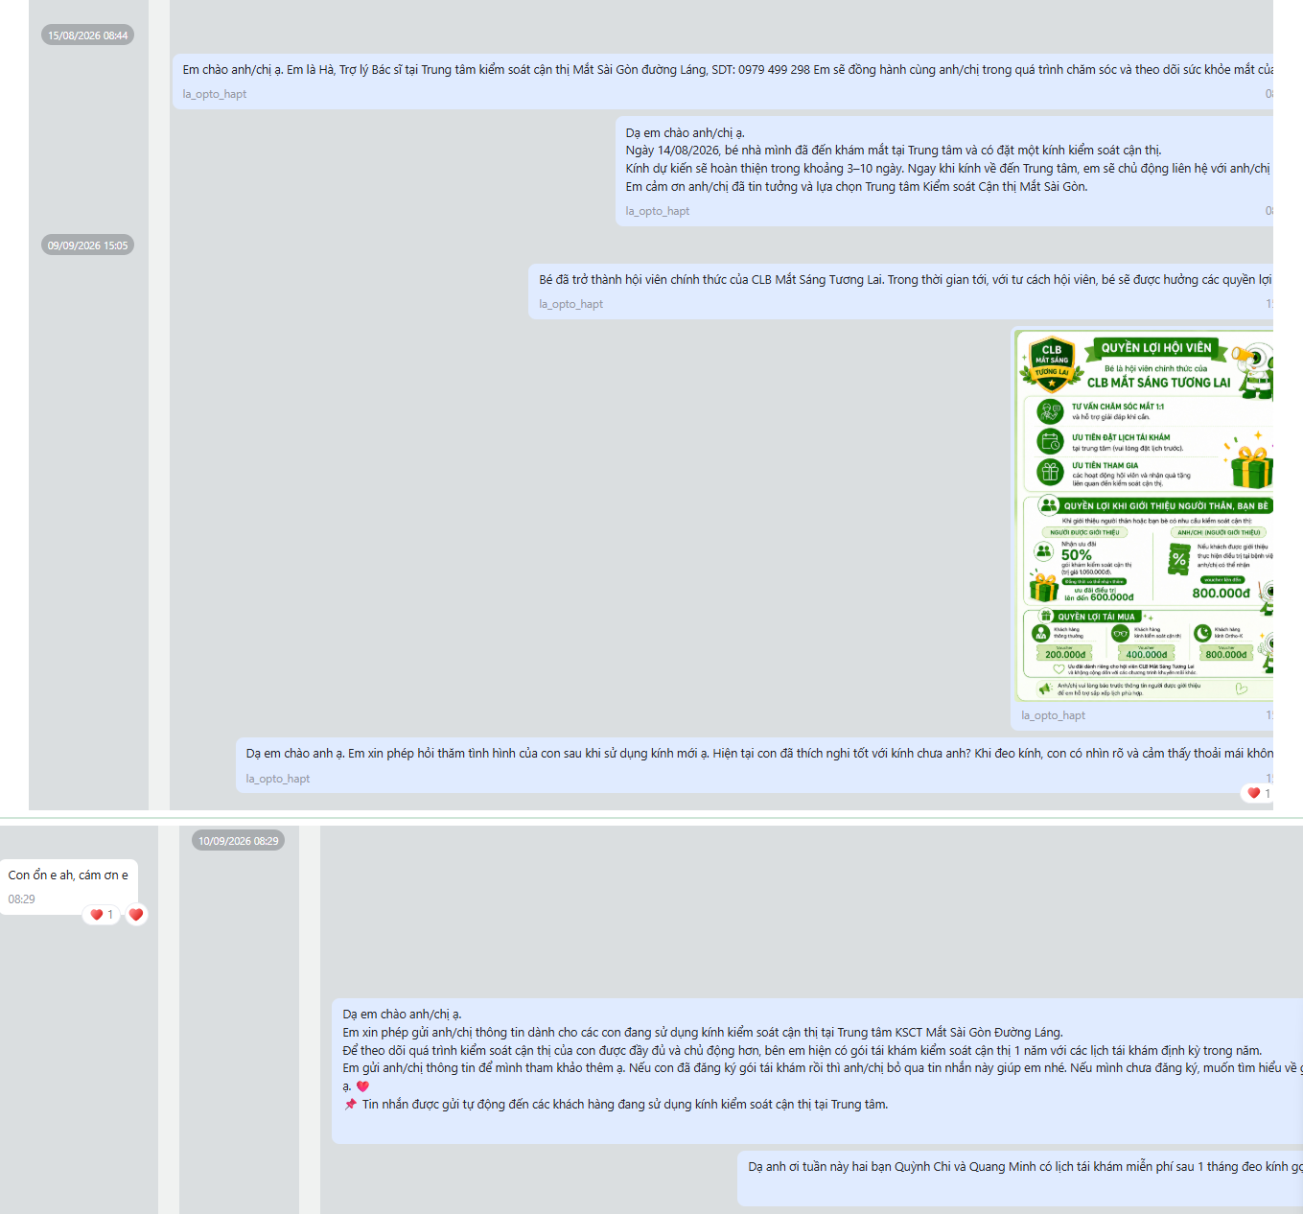
3. EXAMPLE TO FOLLOW | LA
LA — the best D1 of the five, and a real question that earned a reply
MCY 260814 Anh Toàn · PH Nguyễn Quỳnh Chi — and Quang Minh, who is not in the contact name · MC · myopia control · LA · 15 August → 10 September
What this DA did well — copy all of it except the gaps
15 Aug · D1 Introduction with her name, role, centre and phone number — then the child was examined on 14 August and ordered MC glasses, about 3–10 days, and she will make contact as soon as they arrive.
15 Aug → 9 Sep Nothing in the thread for twenty-five days — which is why the collection date cannot be read off Zalo.
9 Sep · benefits Benefits sent with the benefits card. The card is fine as it is.
9 Sep · care She did not end on benefits. She asked a real question: has the child adapted, does she see clearly and feel comfortable?
10 Sep · the reply “Con ổn e ah, cám ơn e” with two hearts. That is what a real question earns — and the moment to ask for a referral. She did not.
CD+30 · recheck Free recheck after one month of wearing the glasses, naming both children. No other site does this.
CADENCE CHECK what was due for MC
BEFORE COLLECTION
CD · COLLECTION DAY
AFTER COLLECTION
D1
D6-7
USAGE
BENEFITS
REFERRAL
CD+3-5
CD+7
CD+14
CD+30
✓
✕
✕
✓
✕
✕
n/a
✓
✓
The referral moment — she did not ask
✓ done ~ partly ✕ not done n/a not due for this product
BENEFITS DATE TEST is the date in the contact name the collection date?
DATE IN NAME
BENEFITS SENT
GAP
VERDICT
14 Aug
9 Sep
+26 days
Likely Wrong
Collection is somewhere between 14 Aug and 9 Sep. Confirm it and put that date in the Zalo tag.
Copy her D1, her care question and her recheck. Add a CD+3-5 check-in, ask for the referral, and confirm the collection date.
Mắt Sài Gòn | Optometry DA Training
5

Slide 6
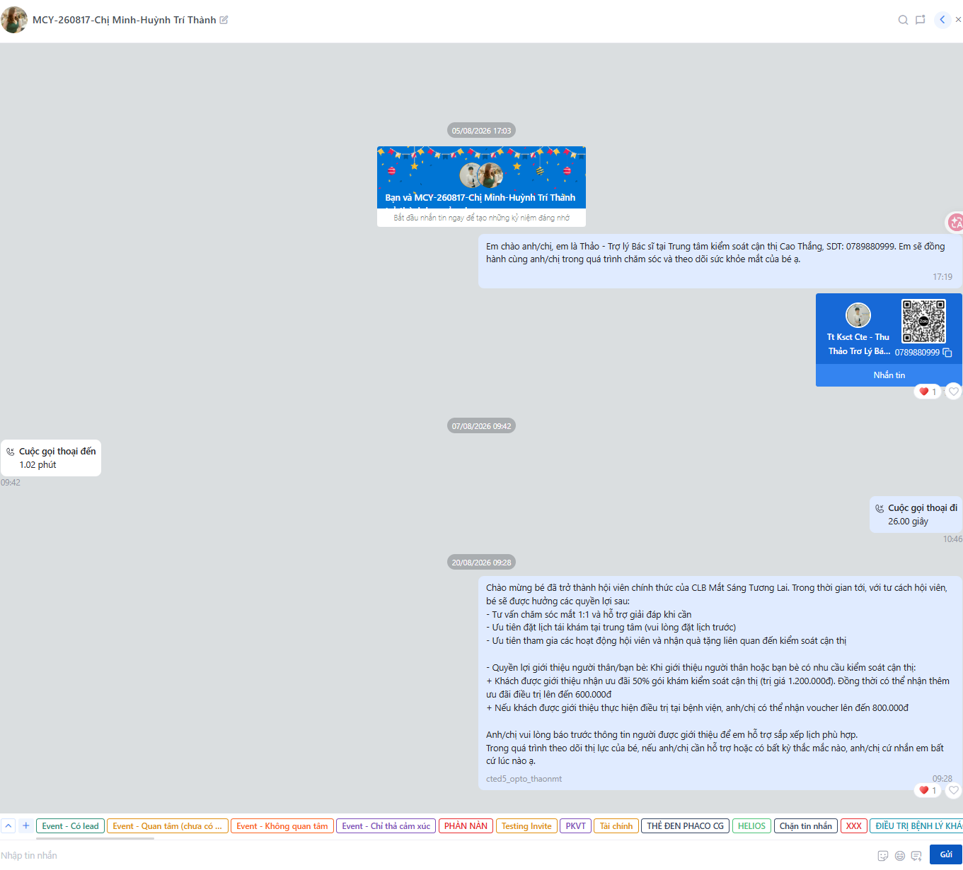
4. CASE REVIEW | CTE D5
CTE D5 — the benefits message arrived, and nothing else did
MCY-260817 Chị Minh · Huỳnh Trí Thành · MC · myopia control · CTE D5 · three contacts between 5 and 20 August
What was sent against what was due
13 days with no message — 7 August to 20 August
5 Aug · D1 Introduction sent: name, role and phone number, and the offer to accompany the child’s eye care. But nothing at all about the glasses — no estimate, no next step. Half of D1.
11–12 Aug · D6-7 Nothing. No production update, ready or not ready. Two phone calls on 7 August, nothing in writing the parent can read back.
20 Aug · CD Membership benefits, sent unprompted and with no usage instructions before them. Benefits belong on collection day, after the customer replies.
After 20 Aug Nothing. CD+3-5, CD+14 and CD+30 were never sent.
CADENCE CHECK what was due for MC
BEFORE COLLECTION
CD · COLLECTION DAY
AFTER COLLECTION
D1
D6-7
USAGE
BENEFITS
REFERRAL
CD+3-5
CD+7
CD+14
CD+30
~
✕
✕
✓
~
✕
n/a
✕
✕
✓ done ~ partly ✕ not done n/a not due for this product
BENEFITS DATE TEST is the date in the contact name the collection date?
DATE IN NAME
BENEFITS SENT
GAP
VERDICT
17 Aug
20 Aug
+3 days
Uncertain
Only three days apart. Check this one against the tracker before assuming the name date is right.
Finish D1 with how long the glasses will take. Then the day 6-7 update, usage instructions at collection, and the cadence after it.
Mắt Sài Gòn | Optometry DA Training
6

Slide 7
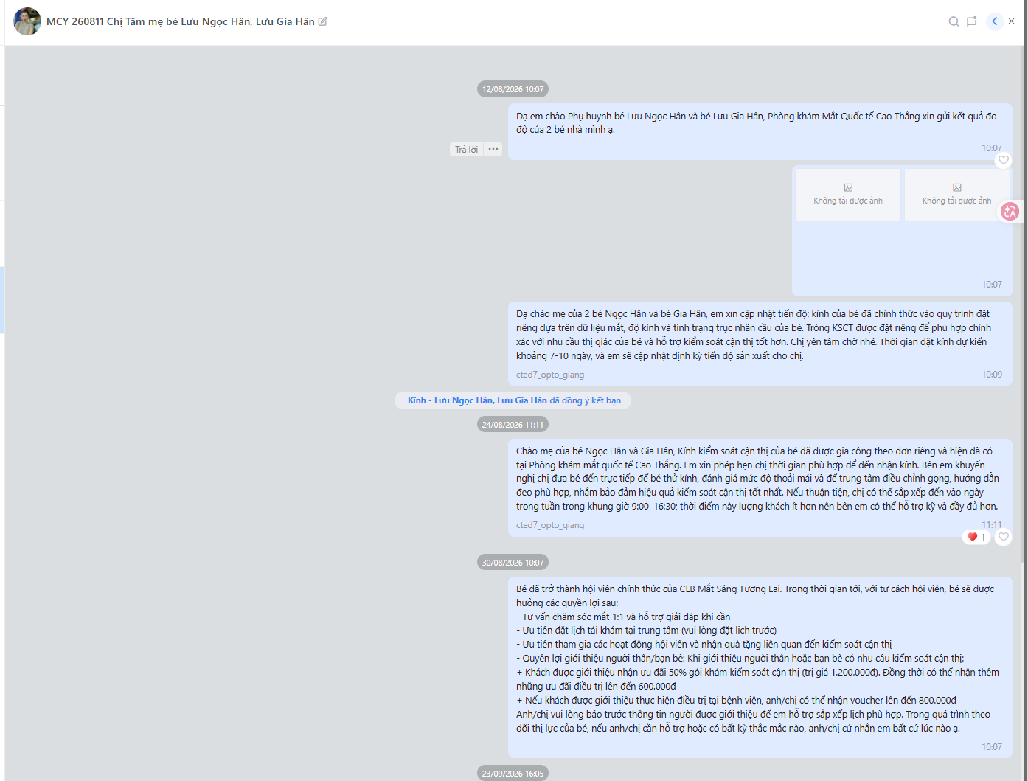
4. CASE REVIEW | CTE D7
CTE D7 — the best D1 and collection handling of the five, wrong date on it
MCY 260811 Chị Tâm · bé Lưu Ngọc Hân and bé Lưu Gia Hân · MC · myopia control · two children under one contact · CTE D7
What this DA did well — copy the first two
12 Aug · D1 Measurement results for both children, then the preparation explained: a custom order built on the child’s own measurements, about 7–10 days, with progress updates promised. Introduction and estimated time, both done.
18–19 Aug · D6-7 No update at day 6-7. The ready notice came on 24 August instead, twelve days after the order.
24 Aug · collection Glasses ready. She asked when would suit, recommended bringing the child in so the fit could be checked, and suggested a quiet weekday slot. Excellent.
30 Aug · benefits Membership benefits in full, with the referral terms.
CADENCE CHECK what was due for MC
BEFORE COLLECTION
CD · COLLECTION DAY
AFTER COLLECTION
D1
D6-7
USAGE
BENEFITS
REFERRAL
CD+3-5
CD+7
CD+14
CD+30
✓
~
✕
✓
~
✕
n/a
✕
✕
✓ done ~ partly ✕ not done n/a not due for this product
BENEFITS DATE TEST is the date in the contact name the collection date?
DATE IN NAME
BENEFITS SENT
GAP
VERDICT
11 Aug
30 Aug
+19 days
Likely Wrong
The glasses were only ready on 24 August, so 11 August cannot be the collection date.
Best D1 of the five. Fix the date in the name, then carry the care past the benefits message.
Mắt Sài Gòn | Optometry DA Training
7

Slide 8
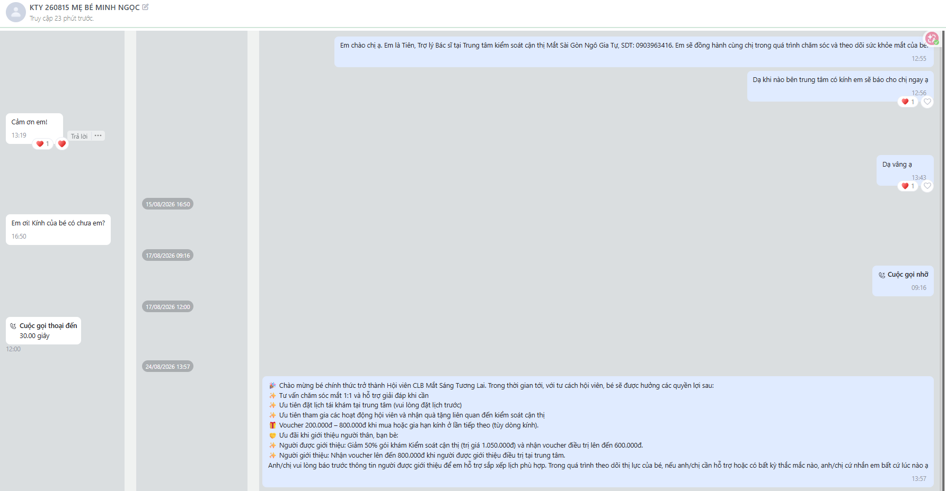
4. CASE REVIEW | NGT
NGT — written well, but the parent had to ask and the date is wrong
KTY 260815 MẸ BÉ MINH NGỌC · Kính · glasses · NGT · on 15 August the parent was still asking whether the glasses had arrived
What was sent against what was due
Before 15 Aug · D1 Introduction sent: name, role and phone number, then “I will let you know as soon as the centre has the glasses.” The parent thanked her and the reply was “Dạ vâng ạ”. No number of days, at either chance.
15 Aug · D6-7 “Em ơi! Kính của bé có chưa em?” The parent had to ask. The day 6-7 production update was never sent, so the promise was not kept.
17 Aug A missed call out, then a 30-second call in. Nothing in writing.
24 Aug · benefits Membership benefits in full, with the voucher and referral terms. Written well and tailored to the parent.
After 24 Aug Nothing. CD+3-5, CD+7 and CD+30 were never sent.
Parent had to ask — no update was sent
CADENCE CHECK what was due for Kính · glasses
BEFORE COLLECTION
CD · COLLECTION DAY
AFTER COLLECTION
D1
D6-7
USAGE
BENEFITS
REFERRAL
CD+3-5
CD+7
CD+14
CD+30
✓
✕
✕
✓
~
✕
✕
n/a
✕
✓ done ~ partly ✕ not done n/a not due for this product
BENEFITS DATE TEST is the date in the contact name the collection date?
DATE IN NAME
BENEFITS SENT
GAP
VERDICT
15 Aug
24 Aug
+9 days
Likely Wrong
On 15 August the parent was still asking where the glasses were — 15 August is the order date.
Change the date on collection day, and send the day 6-7 update so the parent never has to ask.
Mắt Sài Gòn | Optometry DA Training
8

Slide 9
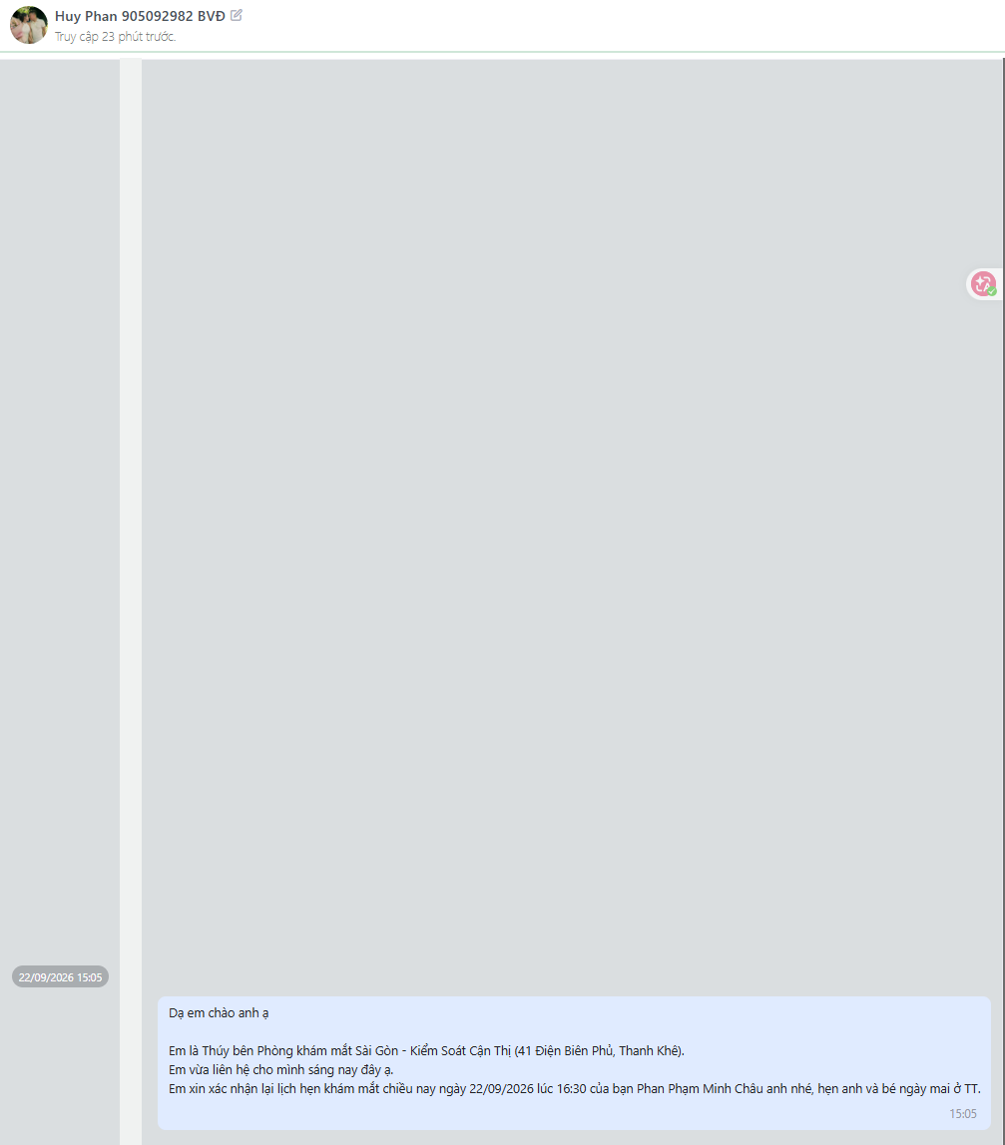
4. CASE REVIEW | SH (SONG HAN)
SH — the cadence has not started, and the name cannot tell us which one is due
Huy Phan 905092982 BVĐ · SH (Song Han) · no product code, no date, no child’s name · one message in the whole thread
What the whole conversation contains
Contact name: no product code, no date, no child’s name
The name “Huy Phan 905092982 BVĐ”. Without a product code there is no way to know whether MC, Kính or Ortho-K applies — so no cadence can be scheduled at all.
22 Sep One message: Thúy reconfirms the 16:30 eye examination for Phan Phạm Minh Châu. Polite and clear, but it sits before the purchase.
Everything else No D1 introduction, no production update, no usage instructions, no benefits, no care, no educational content.
No other messages in this conversation
CADENCE CHECK what was due for unknown — no product code
BEFORE COLLECTION
CD · COLLECTION DAY
AFTER COLLECTION
D1
D6-7
USAGE
BENEFITS
REFERRAL
CD+3-5
CD+7
CD+14
CD+30
✕
✕
✕
✕
✕
✕
✕
✕
✕
✓ done ~ partly ✕ not done n/a not due for this product
BENEFITS DATE TEST is the date in the contact name the collection date?
DATE IN NAME
BENEFITS SENT
GAP
VERDICT
none
none
—
Uncertain
No date and no benefits message, so the test cannot be run until the contact is annotated.
Annotate the contact first — product code, date, child’s name. Nothing can be scheduled or measured until then.
Mắt Sài Gòn | Optometry DA Training
9

Slide 10
5. WHAT TO DO NEXT | TRAINING PRIORITIES
Tomorrow’s two priorities
1
Get the dates right
including the old ones
2
Message on every due date
D1 through to CD+30
▪ The date in the contact name must be the date the customer collected
▪ Update it on the day of collection, not later in the week
▪ Go back through the existing contacts and correct the dates that are wrong
▪ Check yourself: the benefits message should carry the same date as the name
▪ Until the dates are right, nothing in the tracker can be trusted
▪ D1: the introduction and how long the glasses will take
▪ Day 6-7: the production update, ready or not ready
▪ CD: usage instructions, then benefits after they reply, then the referral ask
▪ Then CD+3-5, CD+7 or CD+14 by product, and CD+30
▪ Every customer who buys glasses, not only some
Right date, or nothing can be measured.
Benefits are part of CD, not a substitute for it.
Separate issue for SH (Song Han): almost no customer contacts are annotated and no membership benefits content has been sent. Start with the contact names — every other measurement depends on them.
Every customer. On time. With the right content.
Mắt Sài Gòn | Optometry DA Training
10

