Slide 1
October 2026
Optometry DA Training
CTE D5 · CTE D7 · NGT · SH · CMTT · LA
For DA training and review · Content from the CZ Zalo review · Internal use only

Slide 2
1. ALL CLINICS | COMMON TO EVERY CLINIC
CD3–5, CD7, CD14 and CD30 are still mostly not completed
CZ's one point against every clinic. The wording already exists in your own chats — let’s make sure we reach out to all members
CD3–5
CD7
CD14
CD30
Check in after collection
Glasses-use education
Has the child adapted
Ask about the child's vision
Ask how the first few days have gone, and whether anything is uncomfortable.
Teach the parent how the glasses are worn and looked after, before a bad habit forms.
Check the child has settled into the glasses and nothing is bothering them.
Move from comfort to result: what the child can actually see, at school and at home.
Reference Script
Reference Script
Reference Script
Reference Script
“Over the past few days, has the child been seeing clearly and comfortably — and has he got used to the new glasses?”
“Wear them continuously, except when sleeping or bathing.” / “Clean the lenses with the cloth provided — avoid clothing, which scratches them.”
No wording found at this touchpoint in the chats reviewed — the CD3–5 wording works here too.
“He’s back at school now — when studying, looking at the board or playing, can he see clearly and comfortably?”
Already in use: CMTT, MCY 261006 (9 Oct)
Already in use: CMTT, KTY 261013 · NGT, MCY 260825
This is the touchpoint missed most often.
Already in use: NGT, MCY 260825 (24 Sept)
We can consider adding these reference scripts to template to reduce Zalo workload
Important we follow up to build trust. Only with sufficient trust will members refer.
Mắt Sài Gòn | Optometry DA Training
2

Slide 3
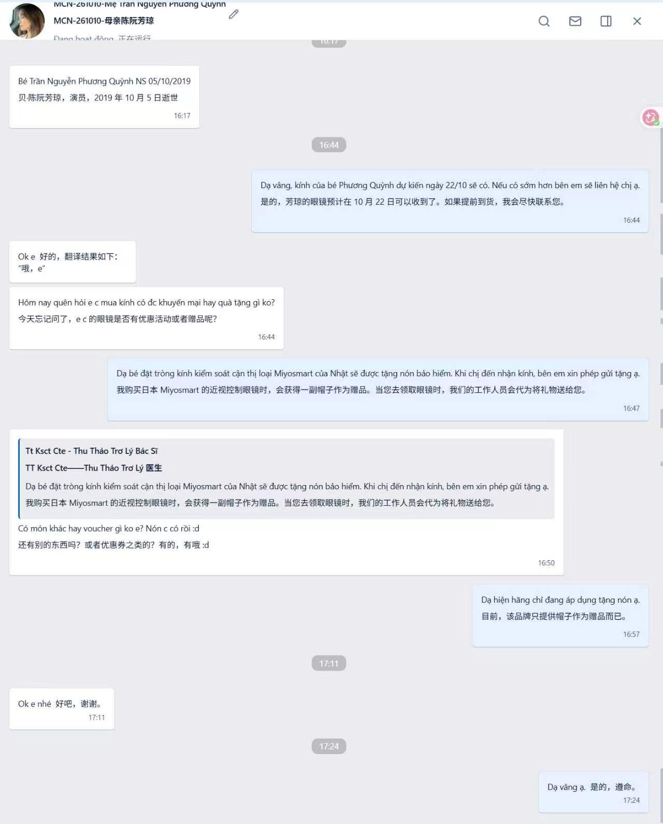
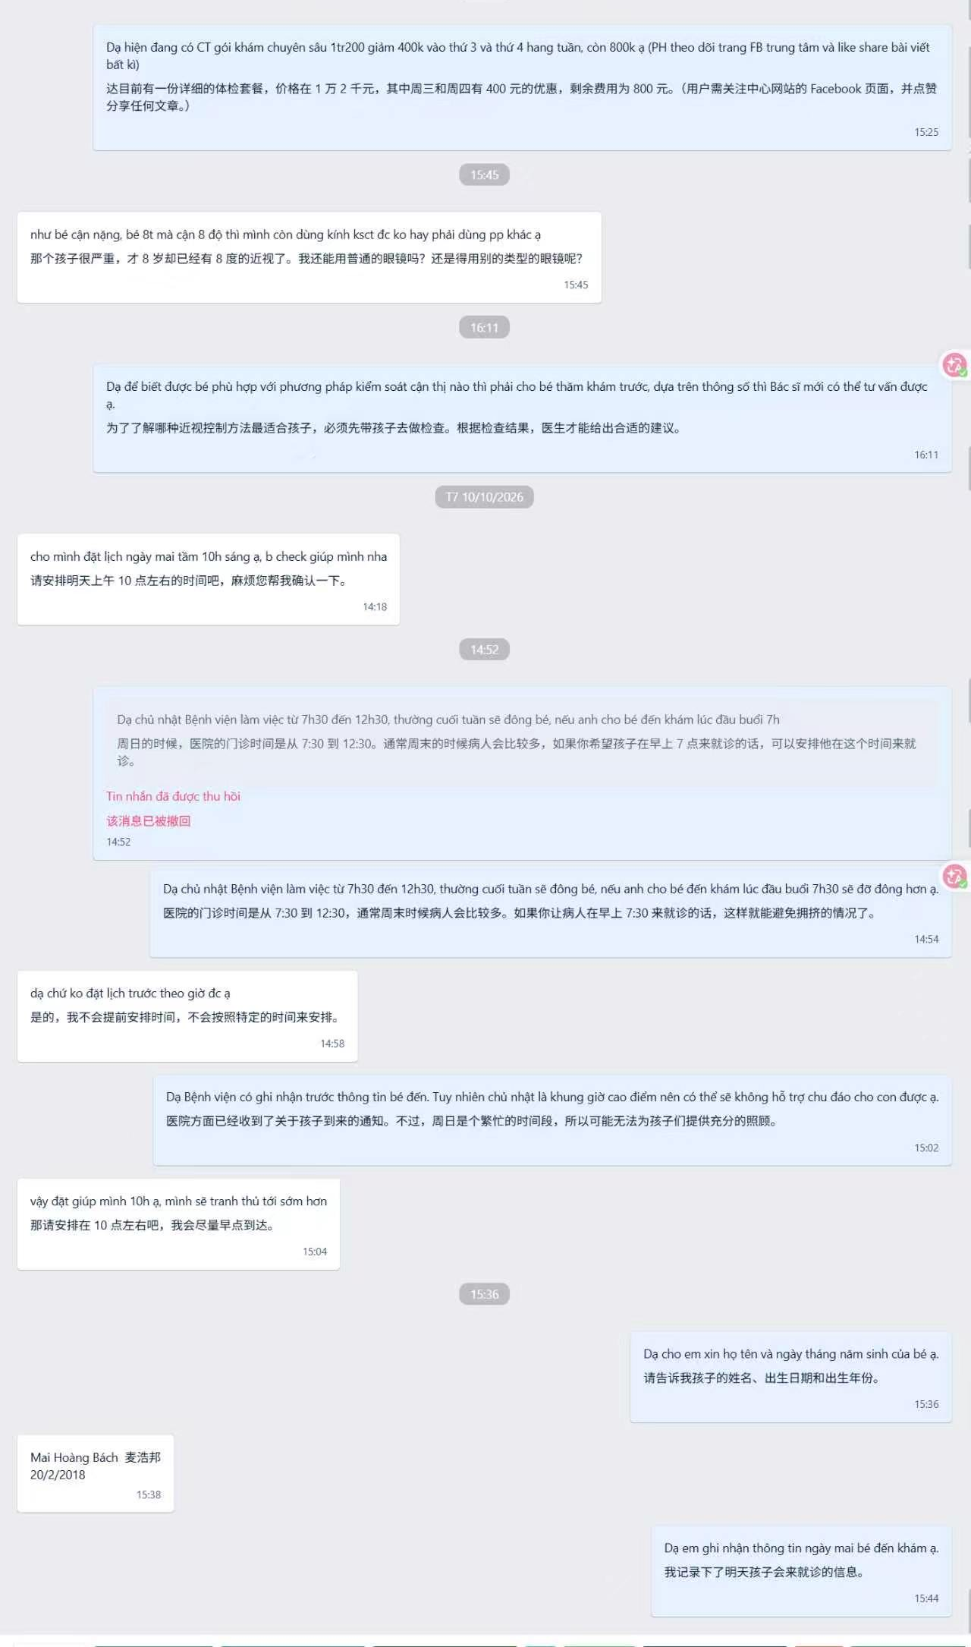
2. CLINIC REVIEW | CTE D5
CTE D5
CZ's verdict: still the same problems as before, no improvement. Both chats shown are CTE D5, DA Thảo.
MCN-261010 · asks twice about offers — answered with the gift only
Exam-261011 · consulted 27 Aug, still being nurtured 11 Oct
Strengths
– Zalo labels are accurate. The tags follow the code–date–parent format — MCN-261010 and Exam-261011.
Areas for improvement
▪ Benefits, then silence. Once the membership benefits are sent there is essentially no proactive communication and no follow-up, so the customer never comes to trust the DA.
▪ Low contact volume. Very few customers are being contacted Monday to Friday, and very few are being communicated with at all.
▪ Non-buyers dropped. Customers who consulted but did not buy glasses still need following up and guiding back toward a purchase.
▪ Product knowledge. Small questions — can Ortho-K lenses be rinsed with saline? — have to be answered confidently, because that is what earns trust.
What the Zalo chats show
▪ The gift question. The mother asks twice whether anything comes with the glasses. She is told about the free helmet. No member benefits, no voucher, no referral ask.
Fix the sequence first — benefits on collection day, then a CD3–5 care message. The silence after the benefits message is the whole problem.
Mắt Sài Gòn | Optometry DA Training
3

Slide 4
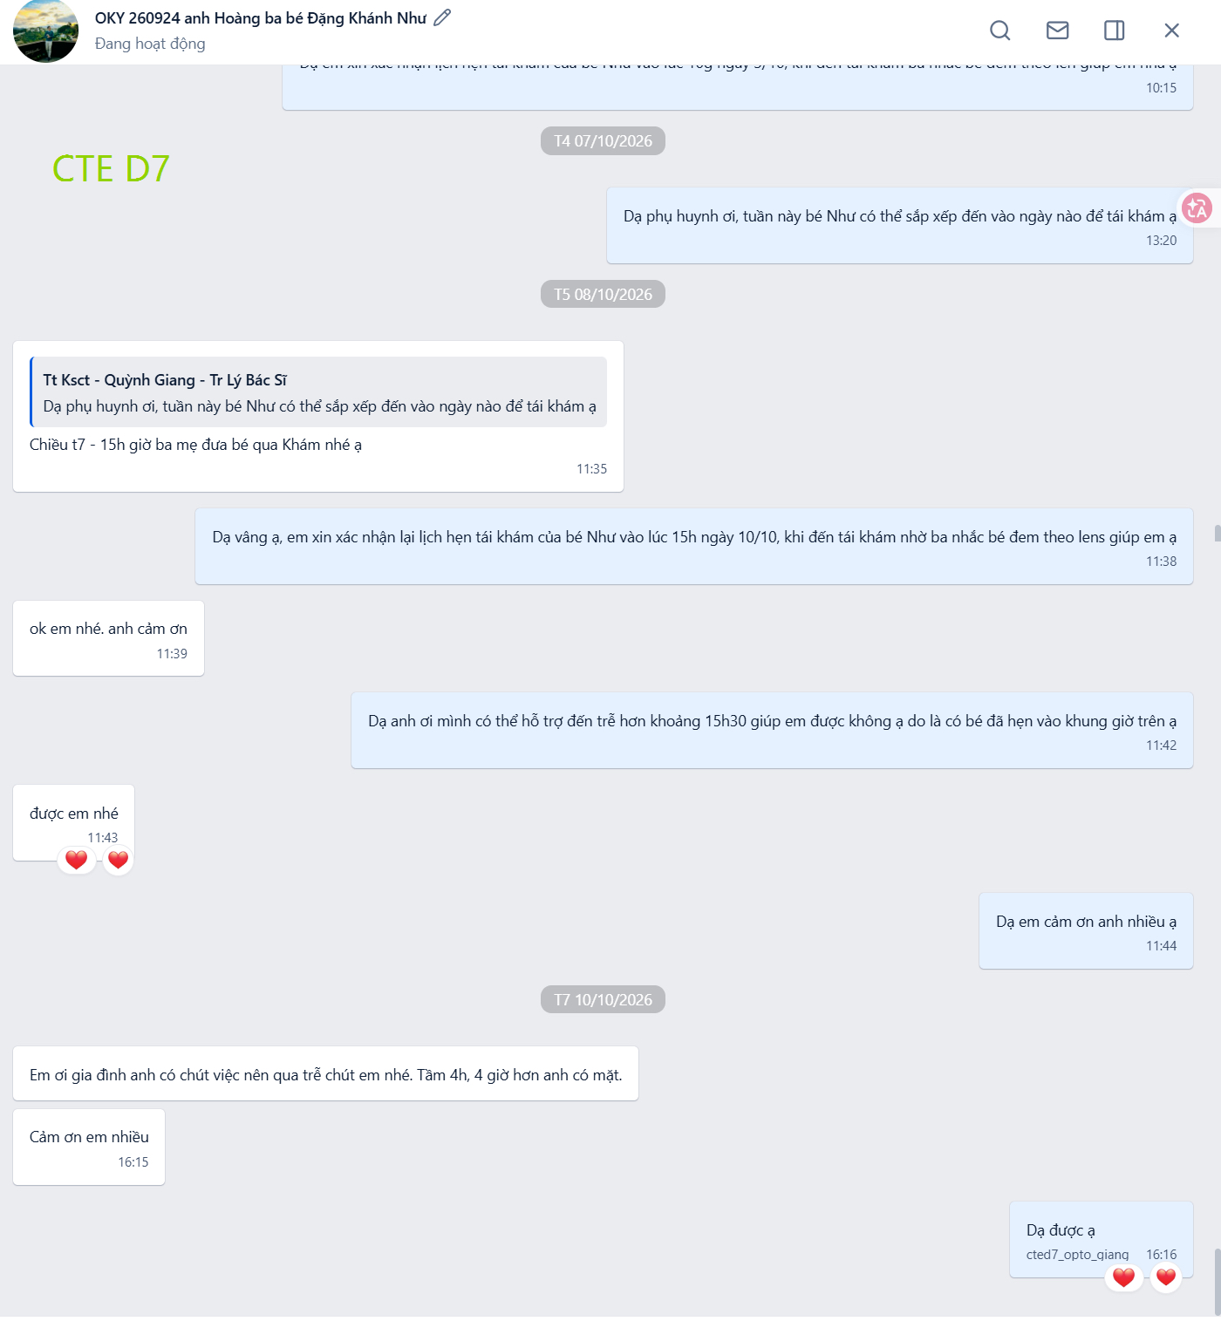
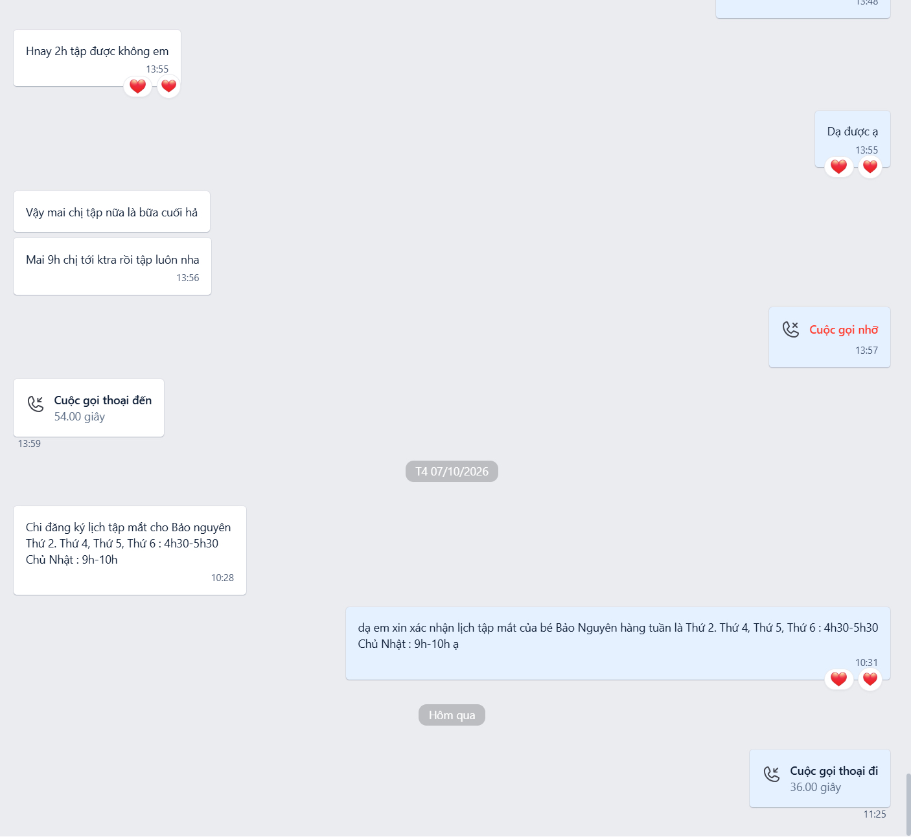
2. CLINIC REVIEW | CTE D7
CTE D7
One strength, one fix. CZ supplies the exact wording for the fix — see page 9.
OKY 260924 · Ortho-K recheck chased, confirmed, lens reminder
VT Bảo Nguyên · standing weekly schedule, calls — no referral ask
Strengths
– Follows the training. Name annotations and the messages being sent are both in line with the training content. Please keep this up.
Areas for improvement
▪ Ask for the referral. For member customers whose service is already complete, communicate with them more and prompt them to refer new customers, using the reference script.
What the Zalo chats show
▪ Trust is already there. The vision-therapy mother books her own standing weekly schedule and calls the DA directly. No referral ask anywhere in the chat.
▪ Ortho-K is handled well. The recheck is chased, confirmed, rescheduled around a clash, and the parent is reminded to bring the lens.
“Service complete” is the trigger: recheck booked, question answered, glasses delivered. That is the moment to ask.
Mắt Sài Gòn | Optometry DA Training
4

Slide 5
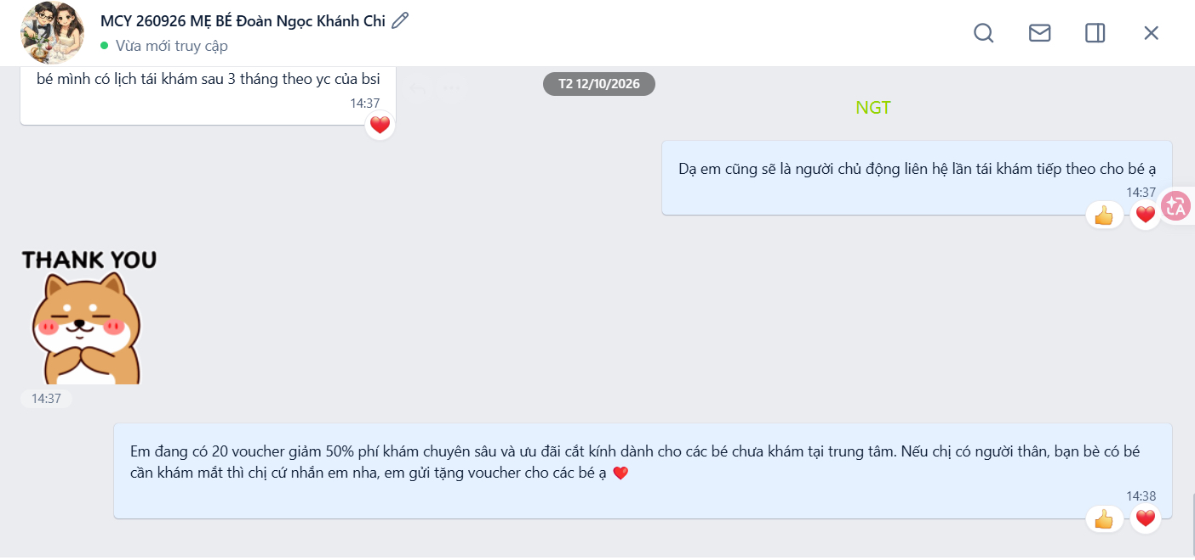
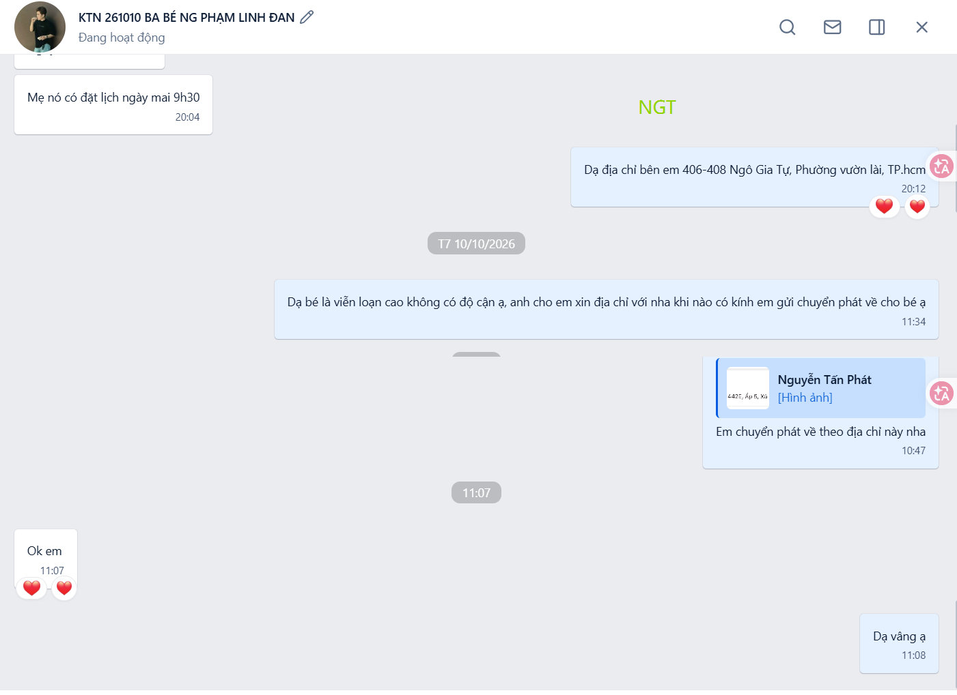
2. CLINIC REVIEW | NGT
NGT
CZ credits the voucher experiment. The gaps are in the collection and mailing steps.
MCY 260926 · 12 Oct — parent offered 20 referral vouchers to pass on
Strengths
Areas for improvement
– Her own initiative. She took the standard referral benefit and framed it as a limited promotion — 20 vouchers, 50% off the exam plus a discount on the glasses, for children new to the centre.
– Well timed. Sent a minute after she promised to own the next recheck.
▪ Collection builds the relationship. Many customers book a time to collect in person. While arranging it, add: if other relatives or friends have children who need myopia control, bring them along — 50% off the exam plus a discount on the glasses.
▪ Posted glasses. Where glasses are shipped instead of collected, send the membership benefits after they ship, and remind the customer to confirm with the DA as soon as they arrive.
KTN 261010 · glasses posted — chat ends at the address
What the Zalo chats show
▪ Exactly the mailing case. KTN 261010 is shipped to the parent's address. The chat ends at the shipping address — no benefits, no confirmation request, no care message.
Encourage this. Test the idea, keep it if it works, move on if it doesn't.
Mắt Sài Gòn | Optometry DA Training
5

Slide 6
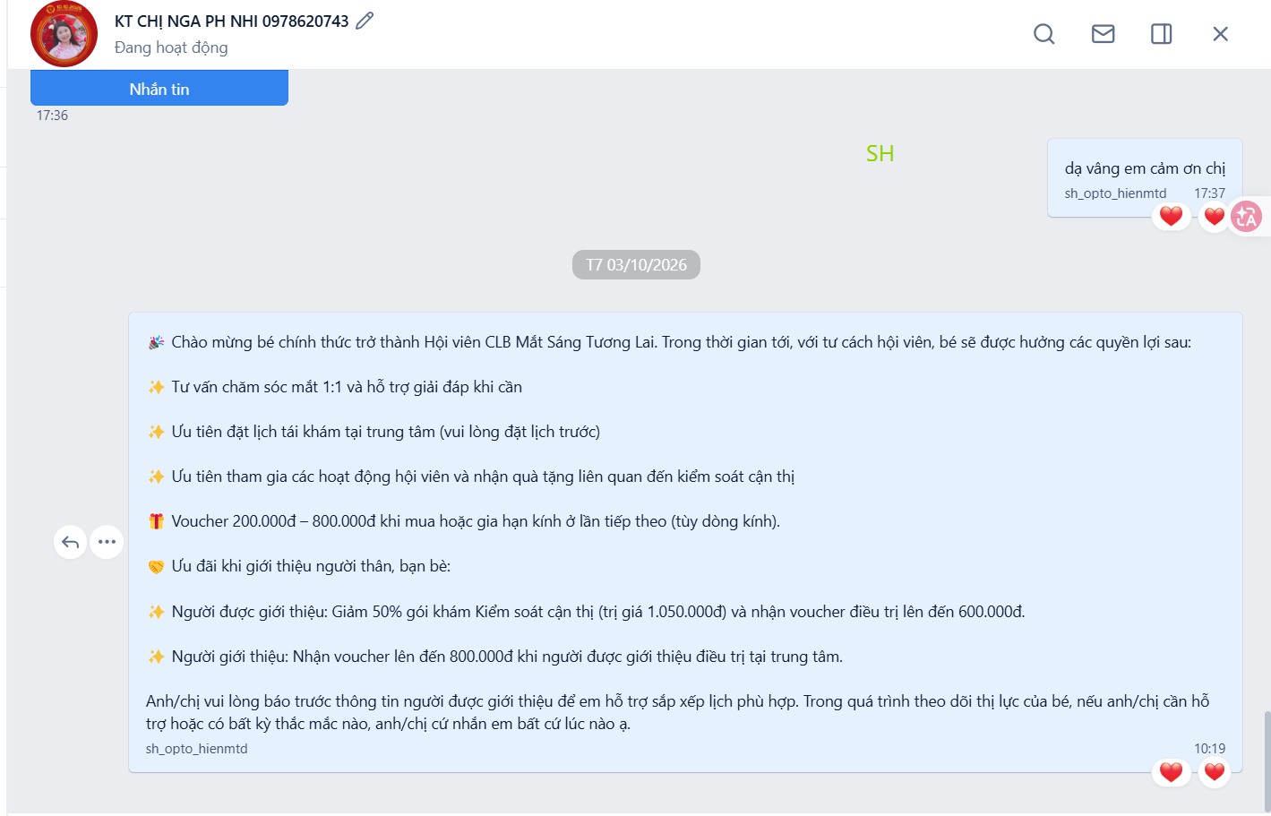
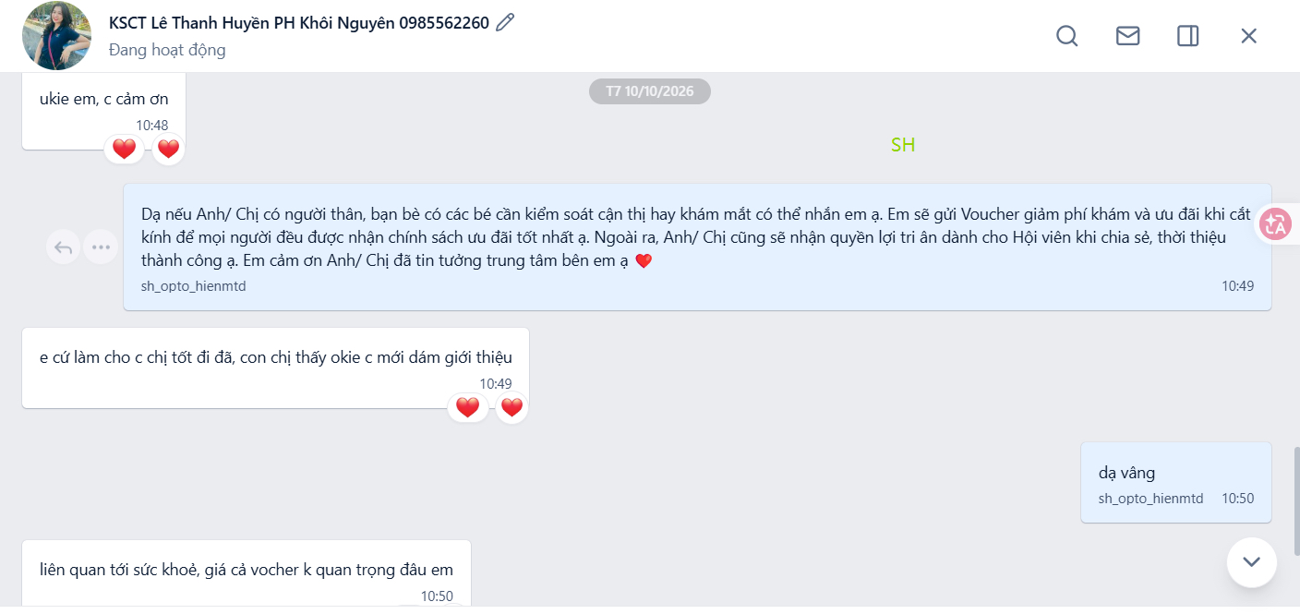
2. CLINIC REVIEW | SH
SH
CZ praises the script, then attaches a rule: it works once trust exists, not before.
KT chị Nga · full member benefits sent, 3 Oct
Strengths
Areas for improvement
– Reference script in use. Excellent — this is the wording CZ is asking the other clinics to adopt.
– But sequence matters. It works better once the member has collected and received the benefits, once you have answered their questions, or once you have booked their recheck — in other words, once some trust is earned.
▪ Benefits, then care. Send the membership benefits after collection, then a CD3–5 message asking how the child is getting on with the glasses, to build trust.
What the Zalo chats show
KSCT Khôi Nguyên · script sent 10 Oct — “prove it works first”
▪ The parent proves the rule. Sent the script on 10 Oct, she replied: do a good job for my child first — once I see she is okay, then I will feel comfortable referring. And: the voucher price does not matter, this is about health.
▪ Benefits template. KT chị Nga, 3 Oct — the full member benefits message, with both sides of the referral offer. The care message is what should follow it.
Her reply is the whole argument for CZ's sequencing rule — care first, referral second. Vouchers are not what persuades her.
Mắt Sài Gòn | Optometry DA Training
6

Slide 7
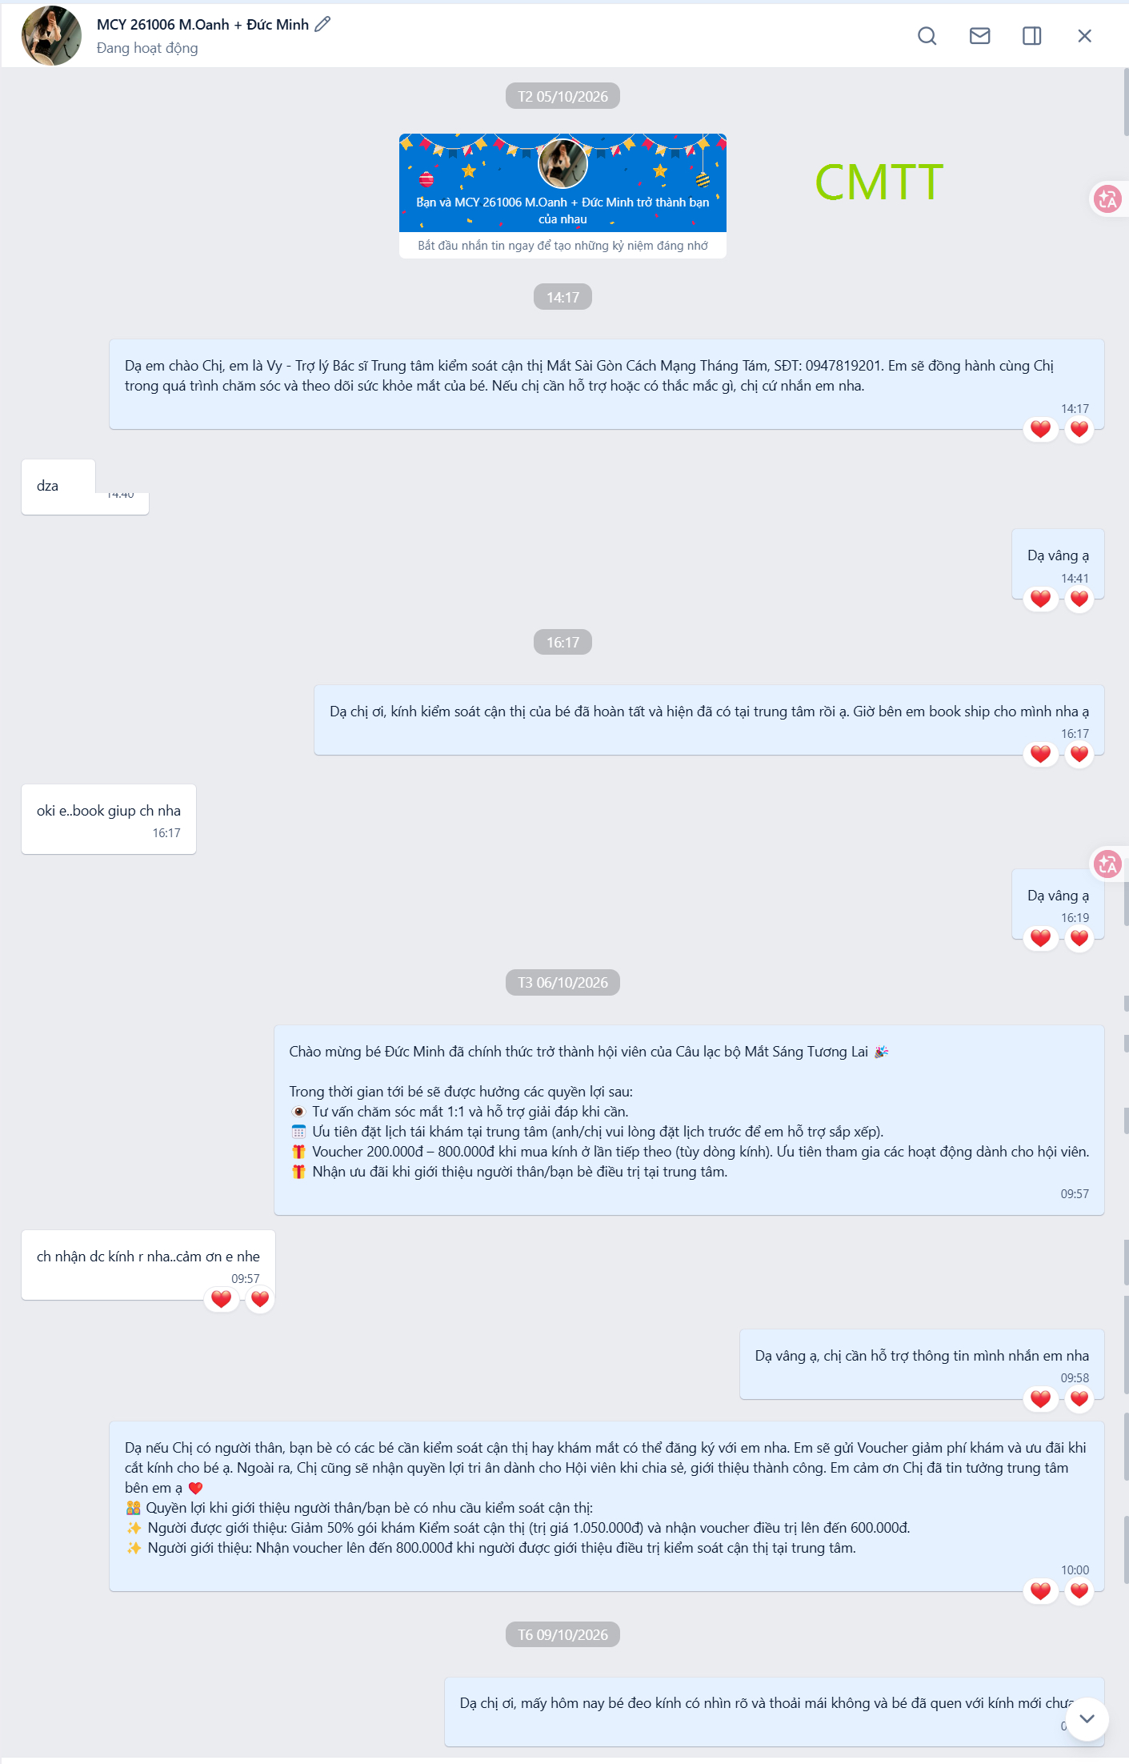
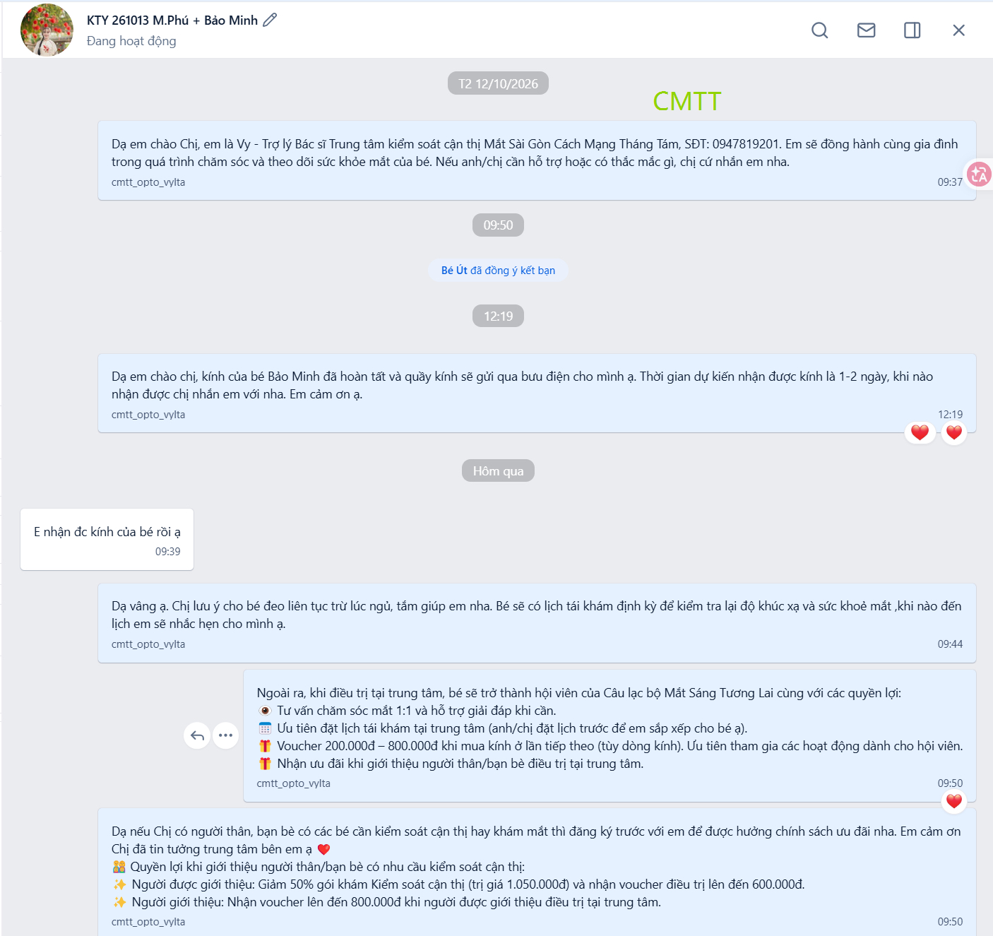
2. CLINIC REVIEW | CMTT
CMTT
Two strengths, no improvement points. The chats show the full sequence already running.
MCY 261006 · benefits, referral, then a CD3 check-in 9 Oct
KTY 261013 · posted, wear instructions, benefits, referral
Strengths
– Annotations are very good. Adding the customer's contact number to the annotation would make them better still.
– Proactive at customization. The membership program has only just started, and messaging customers at the glasses-customization stage without being asked is excellent.
Areas for improvement
▪ Only suggestion. Add contact numbers to the annotations — the one thing CZ would still change.
What the Zalo chats show
▪ Full sequence, unprompted. MCY 261006: introduction, customization notice, benefits, referral offer — then a CD3 check-in on 9 Oct asking whether the child can see clearly and comfortably.
▪ And again. KTY 261013: shipping notice, wear instructions (all day except sleeping and bathing), recheck promise, benefits, referral.
CMTT is the clinic to copy: customization notice, delivery, wear instructions, benefits, referral, then the CD3 check-in.
Mắt Sài Gòn | Optometry DA Training
7

Slide 8
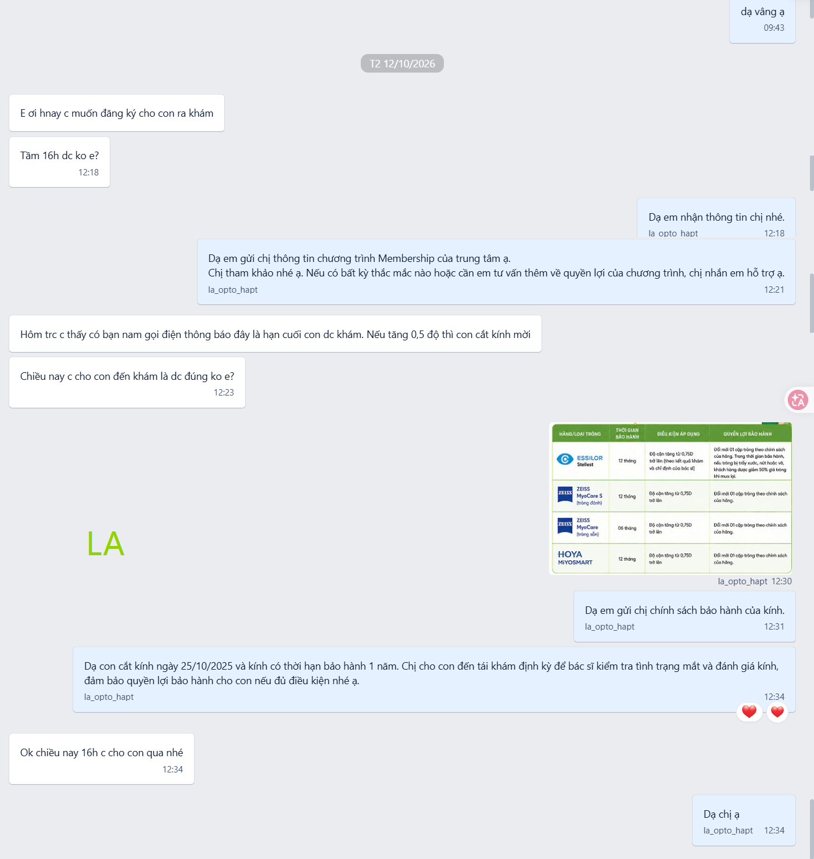
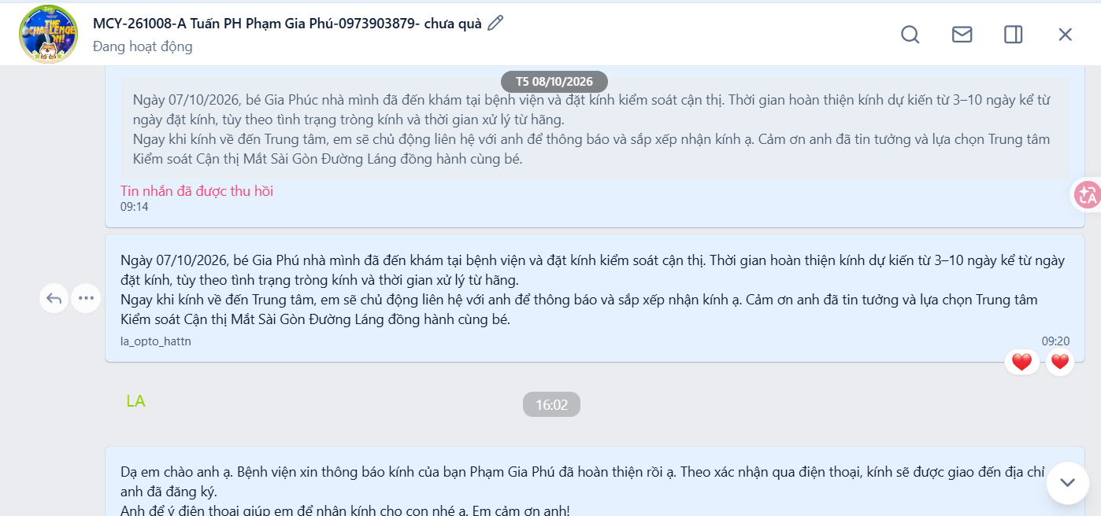
2. CLINIC REVIEW | LA
LA
Three strengths. Both fixes are about volume rather than quality.
MCY 251025 · 2025 customer, warranty used as the recall hook
Strengths
Areas for improvement
– Reactivating old customers. Has started following up with customers from 2025 and the first half of 2026 — excellent.
– Uses the training script. The “glasses customization” wording from the training is being used as written.
– Prompt replies. Most customer questions are answered quickly.
▪ Cover every member. Care check-ins, education and glasses-use questions can run continuously around your own schedule — but aim to cover every member who collects.
▪ Referrals are the KPI. Sales is the DA's main KPI, so use the referral script more often with customers who already trust or endorse you.
What the Zalo chats show
▪ Warranty as the recall hook. Dispensed 25/10/2025, one-year warranty, so the recheck has a deadline. The parent booked the same afternoon.
MCY-261008 · customization script, 3–10 day window
Best contact notes in the group: code, date, parent, child, phone, and a “gift not yet given” flag. Standardise on this format.
Mắt Sài Gòn | Optometry DA Training
8

Slide 9
3. REFERENCE SCRIPT | CZ STANDARD
The referral script, and when to send it
CZ cites this same wording three times — for CTE D7 to adopt, for SH for using it, and for LA to use more often.
REFERRAL SCRIPT · as issued by CZ — Vietnamese below is the text sent to customers, not a translation
có người thân bạn bè có các bé cần kiểm soát cận thị hay khám mắt có thể nhắn em ạ. Em sẽ gửi Voucher giảm phí khám và ưu đãi khi cắt kính để mọi người đều được nhận chính sách ưu đãi tốt nhất ạ. Ngoài ra, Anh/ Chị cũng sẽ nhận quyền lợi tri ân dành cho Hội viên khi chia sẻ, thời thiệu thành công ạ. Em cảm ơn Anh/ Chị đã tin tưởng trung tâm bên em ạ ❤️
“If you have relatives or friends with children who need myopia control or an eye exam, you can message me. I'll send a voucher reducing the exam fee plus an offer on the glasses, so everyone receives the best policy available. You will also receive the member appreciation benefit for a successful referral. Thank you for trusting our center.”
When to send it — after trust is earned
Fix before circulating
– After collection. The member has the glasses and the benefits message has gone out.
– After a question. You have answered something that mattered to them.
– After a booking. You have arranged their recheck.
– After shipping. You helped post the glasses and confirmed they arrived.
▪ Typo in the master. “thời thiệu” should be “giới thiệu”. It is a canned message, so every clinic that adopts it ships the error. Fix it at source.
▪ Not before any trust. Sent too early it reads as a sales push — the SH chat shows exactly that reaction.
Care first, referral second. The script only works where trust already exists.
Mắt Sài Gòn | Optometry DA Training
9

Slide 10
4. ACTIONS
What changes this week
The touchpoint standard for everyone, then one short list per clinic.
All clinics
– Reach out at CD3–5 and CD7, then CD14 and CD30 — at least three touchpoints per member.
CTE D5
– Send the membership benefits on collection day, then a CD3–5 care message.
– Re-contact the consulted-but-did-not-buy list, and lift weekday contact volume.
– Familiarise with product questions — for example Ortho-K care and saline.
CTE D7
– Casually ask for referrals when appropriate — after service has been provided.
NGT
– Keep testing ideas and customise the approach as needed.
– When booking a collection time, add the referral line — bring relatives or friends, 50% off the exam plus a discount on the glasses.
– When glasses are shipped, send the benefits after they ship and ask the parent to confirm arrival.
SH
– Move the referral script to after collection, after a question answered, or after a recheck booking.
– Add the CD3–5 care message once the benefits have gone out.
CMTT
– Keep up the good work — the sequence here is the model for the group.
– Add contact numbers to the Zalo tags.
– Stay close to the SOP, and raise any questions with the trainer.
LA
– Extend follow-up to every member who collects, not only the responsive ones.
– Use the referral script with customers who already trust or endorse you.
Keep the order: benefits first, then the care message, then the referral ask.
Mắt Sài Gòn | Optometry DA Training
10

