Slide 1
Automatic License Plate Recognition and Registration System
Group 35
Huihua Guan
Yi Luo

Slide 2
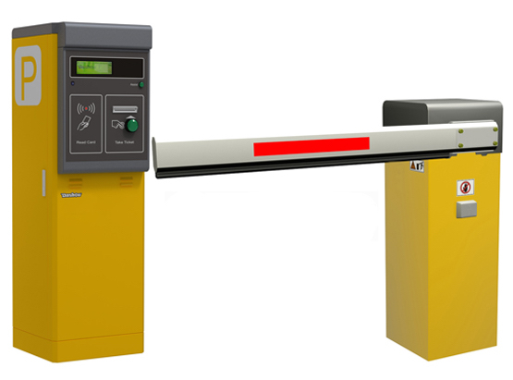

Have you ever seen this machine?
Press for ticket

Slide 3
Problem formulation
We would like to make the parking easier by abandoning the usage of physical ticket.
The ticket machine makes some problems. For example:
1. Dangerous because people need to be close to the machine
2. Inconvenient - you have to get off the vehicle to press the button
3. People lose the ticket
We commit ourselves to design a automatic license plate recognition and registration system.

Slide 4
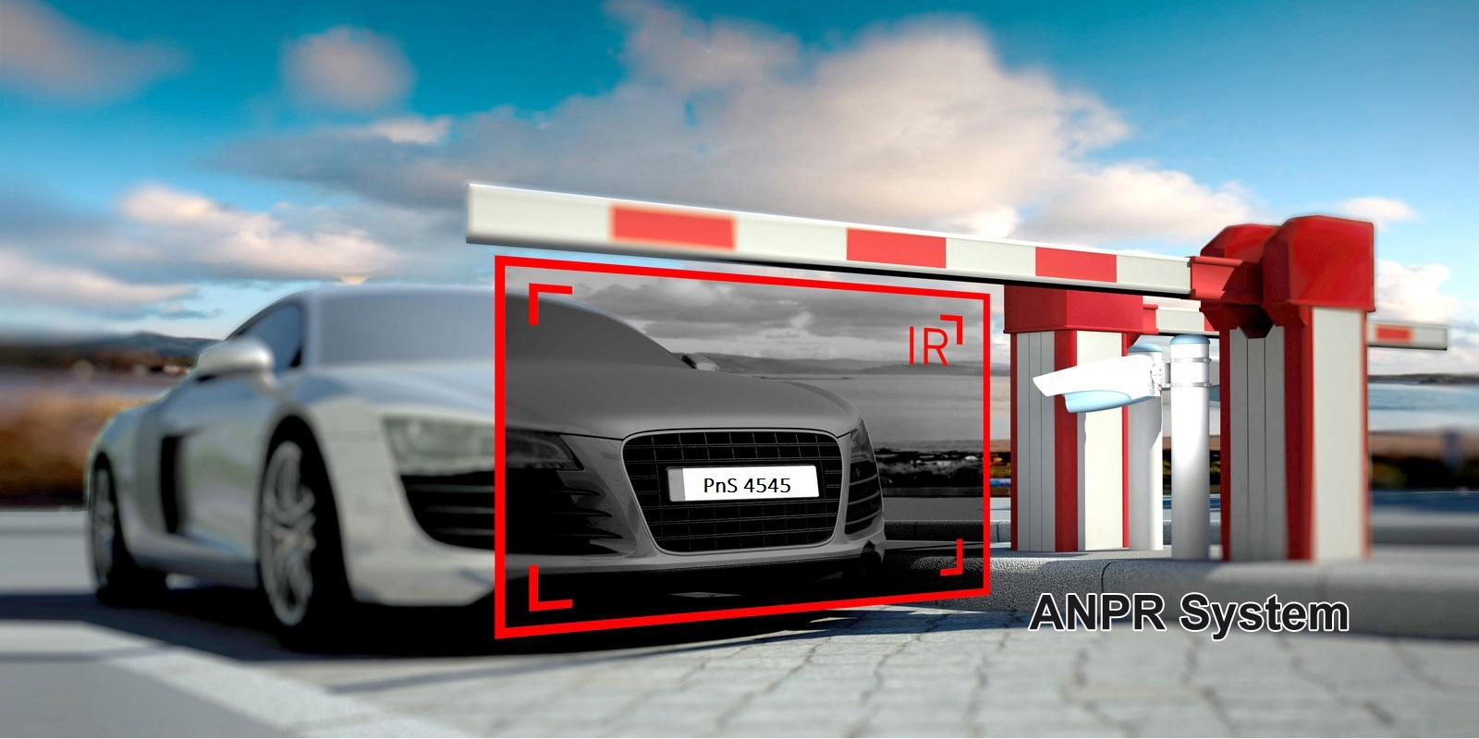
Something like this!
No more pressing button

Slide 5
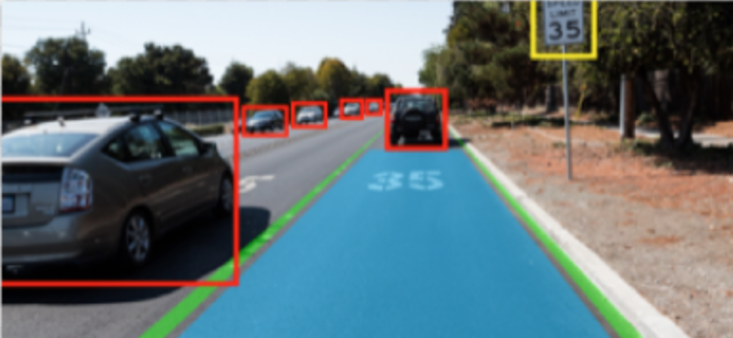
Review of previous techniques
Natural image recognition have been researched in the field of computer vision. Some examples include the autonomous car research. MATLAB has also conveniently built in these tools to use that can be found here:
https://www.mathworks.com/help/vision/examples/automatically-detect-and-recognize-text-in-natural-images.html

Slide 6
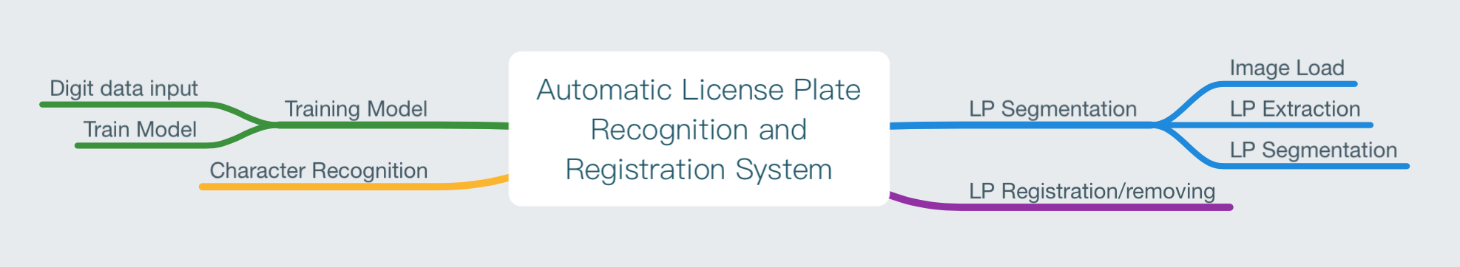
Technique overview
Basically, we divide the work into 4 parts:
Model training, LP segmentation, LP character recognition, registration/delist

Slide 7
Proposed solution overview
Recognizing the characters
Find dataset of 0-9, A-Z characters, except character I and O(similar to 1,0, will be fine)
Find license plate images
Create directory
Design appropriate models
Train and fit on images with SVC with K=10 folds
Try with CNN too
Localization of license plate
Identify in the given image where the plate is using connected region method
Extract characters separately
Identify the letters on the plate separately
Predict with the model then output results
Register the LP into a csv list

Slide 8
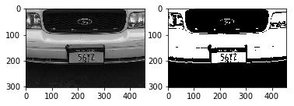
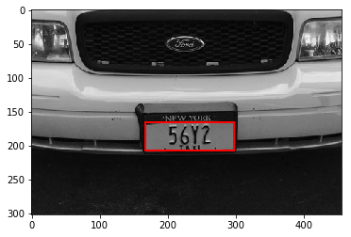
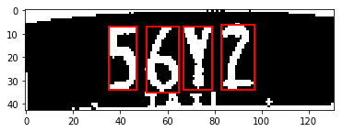
Proposed solution
56Y2
56Y2
Image Acquisition
LP Extraction
LP Segmentation
Character Recognition
Append to csv file

Slide 9
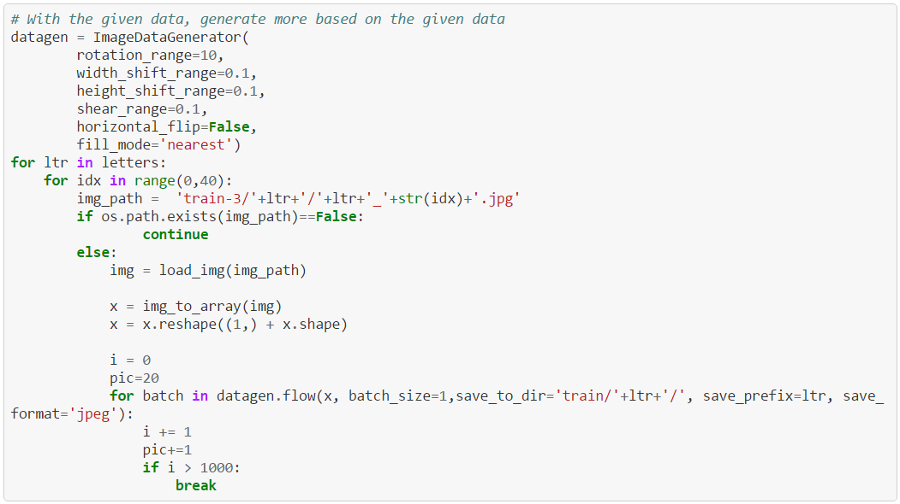
Creating the dataset
Considered CNN model
Require many, many samples
for high accuracy
Can use data generator
feature of Keras

Slide 10
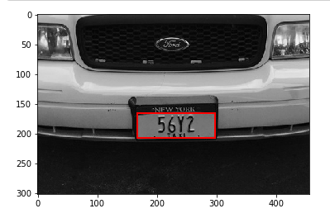
Locating the license plate
Find all connected regions
For most cases, a license plate
would be between 0.25 to 0.3 in
height of the entire image
It would be between 0.1 to 0.6 in width
General approximations
May change from different angles
and distance plate image was captured

Slide 11
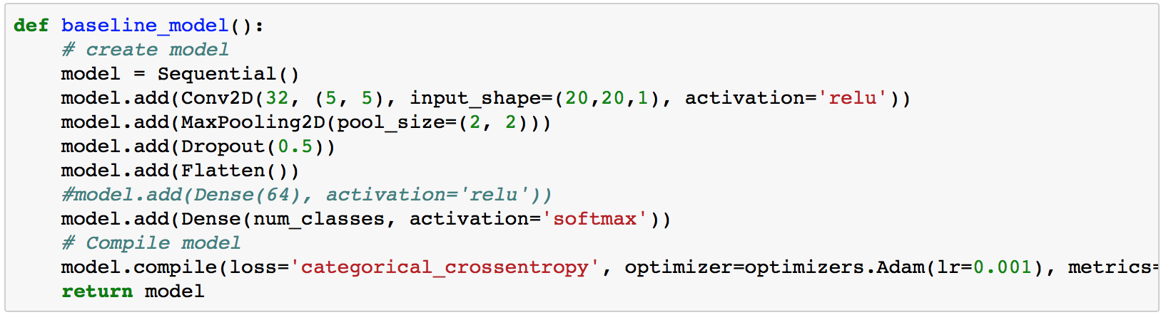
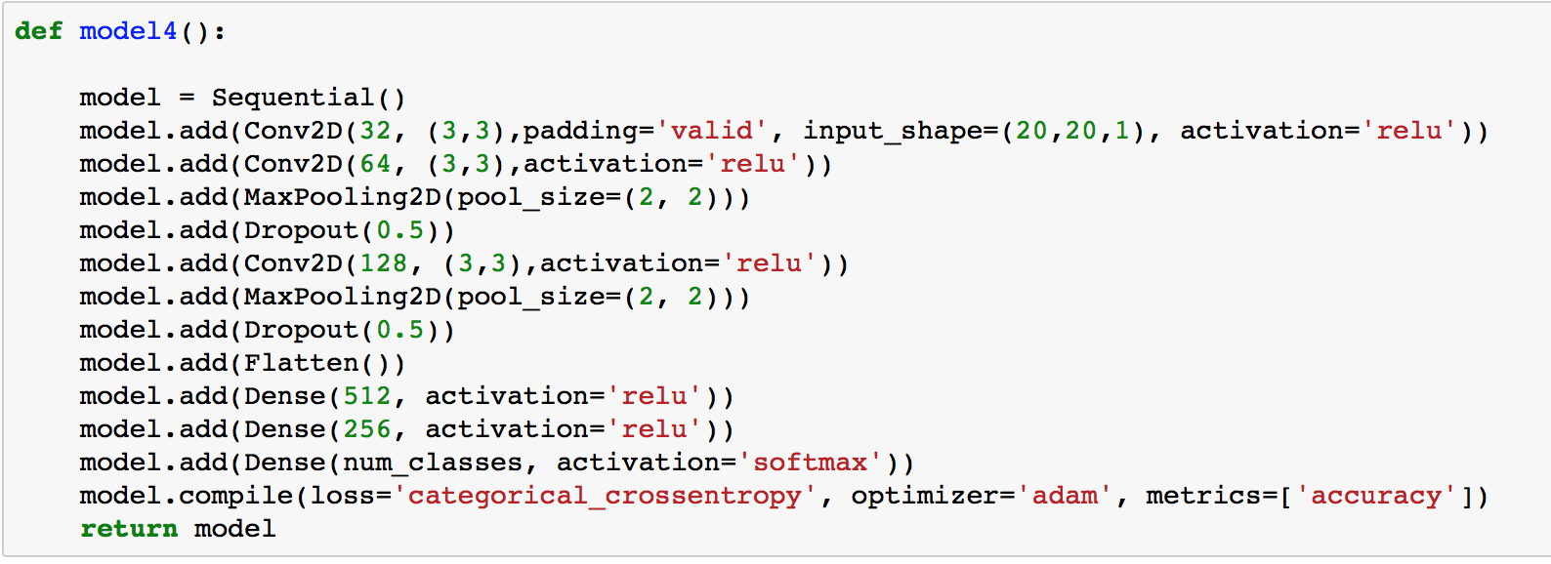
Convolutional Neural Network Models
We encountered some problems with the low accuracy using CNN so we use SVM model.

Slide 12
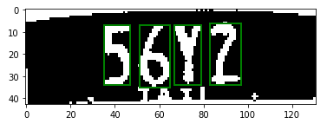
Locating characters on the license plate
Also find the connected regions
On a license plate, we estimate that
a ‘valid’ character would be at least 0.35
to 0.8 of the plate in height
Between 0.05 to 0.25 in width
Another generalization

Slide 13
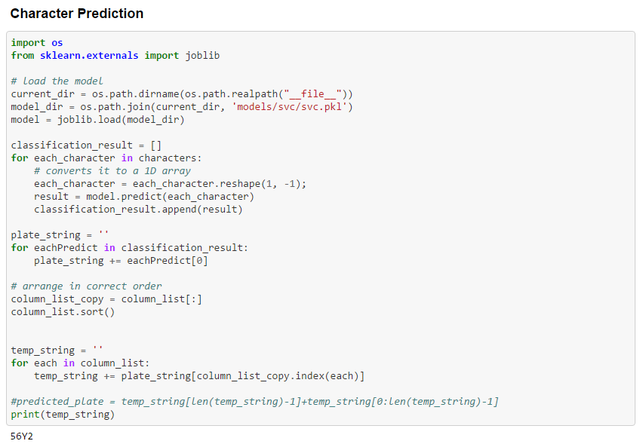
Perform recognition
Shown here is the results
from the SVC model

Slide 14
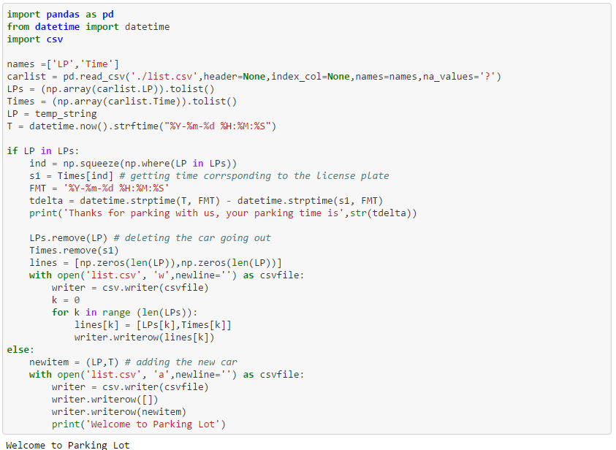
Add to parking lot list
Vehicle plate and check-in
time are added to cvs list
Check if the car's license plate has been on the list already
if yes, that means the car is going out, then we output the time it parked
if no, that means it is a new-coming car, we will register it into the list

Slide 15
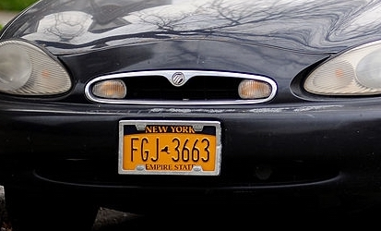
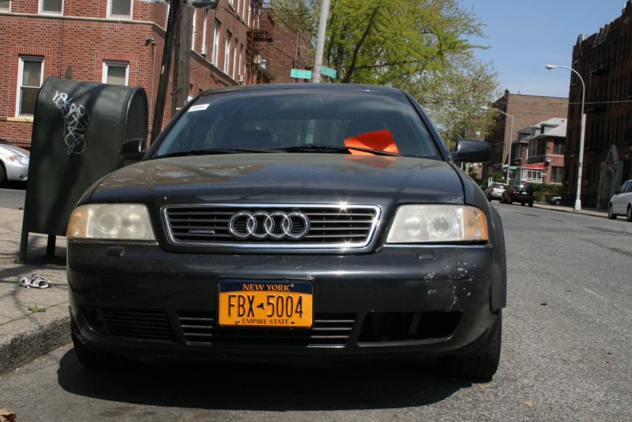
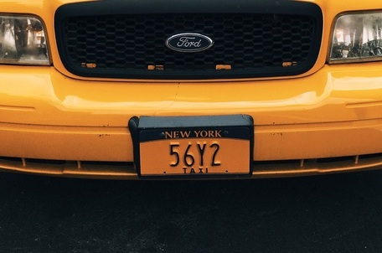
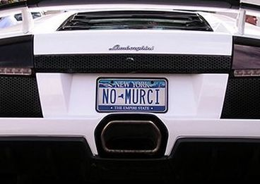
Evaluation
We find that the position of the license with respect to the taken image influenced the accuracy of the readings very much.
As a measure to solve this problem, we will assume that the image or video feed is like in the one in the 3rd image. With this assumption, the characters on the plate were all read correctly (images from our plate dataset) but orderings of the characters sometimes had a problem

Slide 16
Problems to consider
Consider deskewing an image to improve accuracy
Also consider add much more training data in different conditions to improve accuracy
Distance from the plate (we may see more of the vehicle or surrounding area than the actual plate)

Slide 17

Reference
https://matthewearl.github.io/2016/05/06/cnn-anpr/
https://blog.devcenter.co/developing-a-license-plate-recognition-system-with-machine-learning-in-python-787833569ccd
https://medium.com/@ageitgey/machine-learning-is-fun-part-3-deep-learning-and-convolutional-neural-networks-f40359318721
https://github.com/andela-foladeji/License-Plate-Recognition-Nigerian-vehicles

