Slide 1
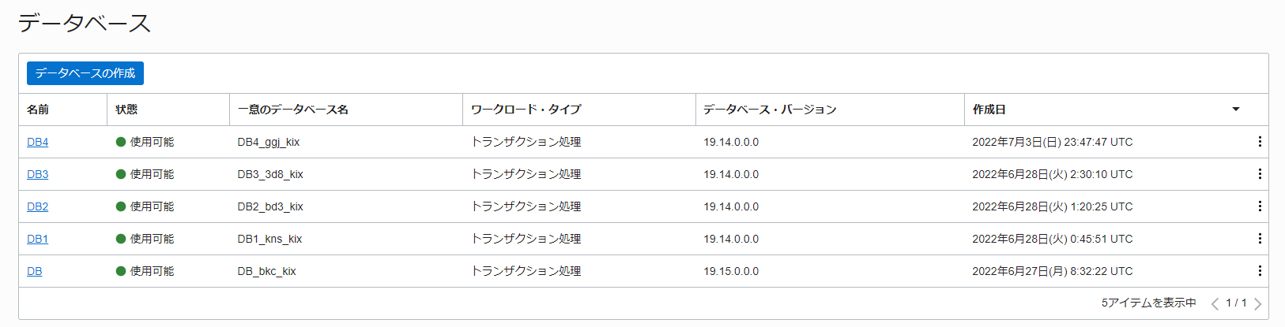

Slide 2
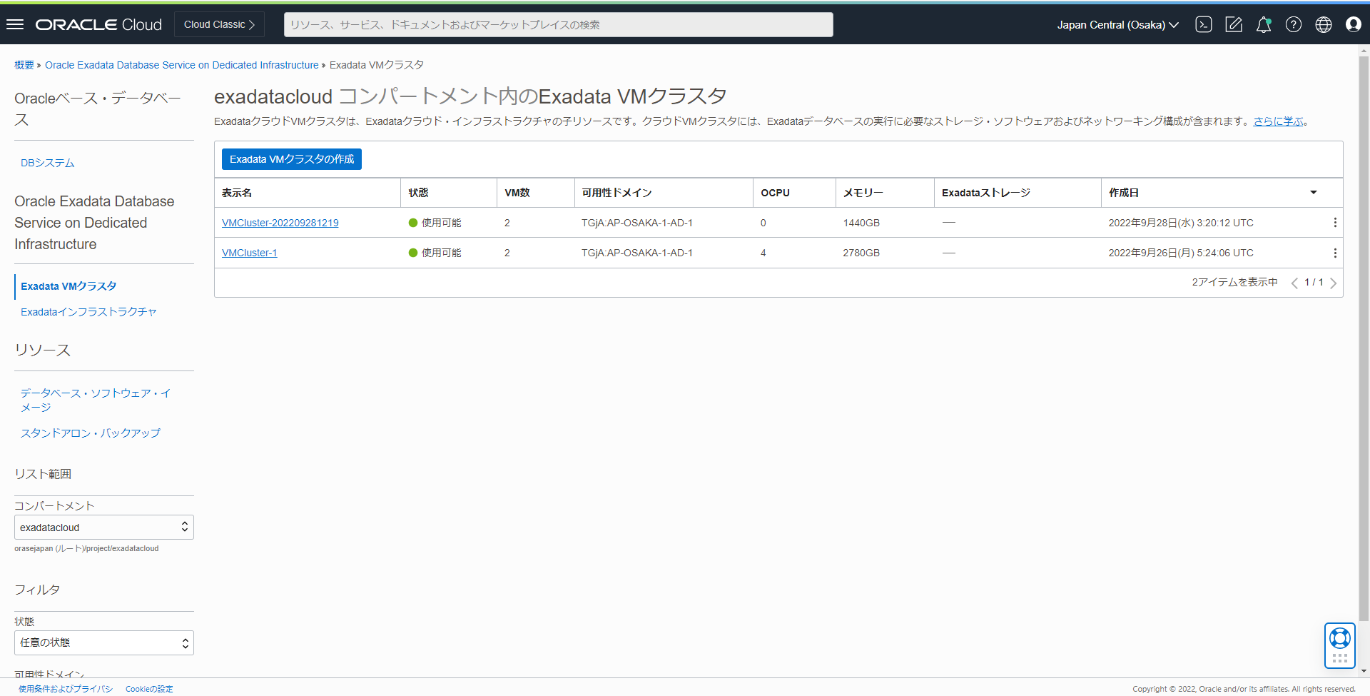

Slide 3
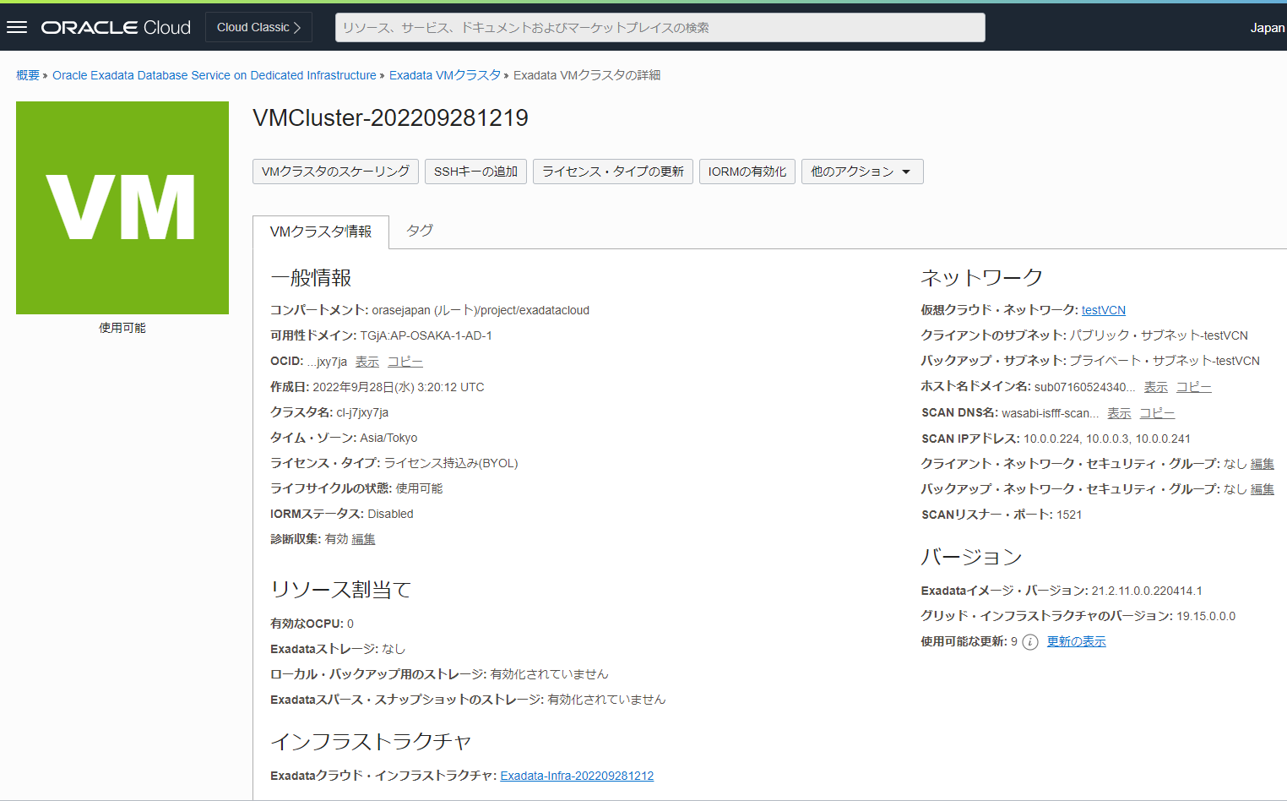

Slide 4
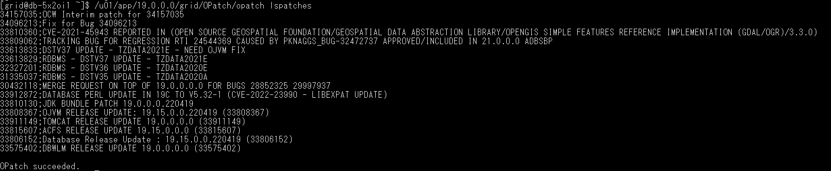
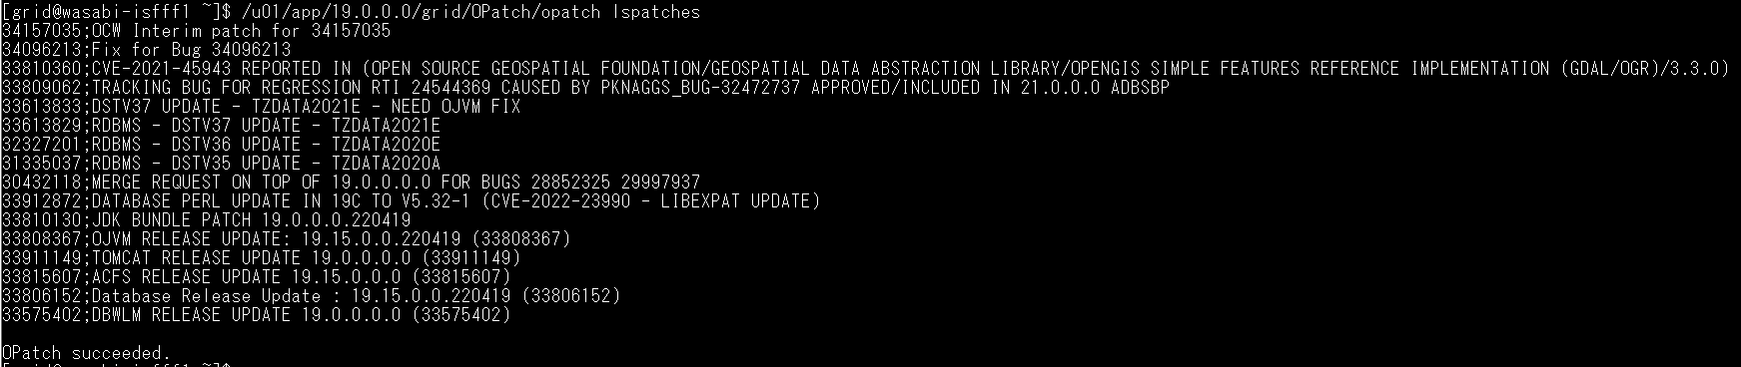
[grid@wasabi-isfff1 ~]$ /u01/app/19.0.0.0/grid/OPatch/opatch lspatches
34157035;OCW Interim patch for 34157035
34096213;Fix for Bug 34096213
33810360;CVE-2021-45943 REPORTED IN (OPEN SOURCE GEOSPATIAL FOUNDATION/GEOSPATIAL DATA ABSTRACTION LIBRARY/OPENGIS SIMPLE FEATURES REFERENCE IMPLEMENTATION (GDAL/OGR)/3.3.0)
33809062;TRACKING BUG FOR REGRESSION RTI 24544369 CAUSED BY PKNAGGS_BUG-32472737 APPROVED/INCLUDED IN 21.0.0.0 ADBSBP
33613833;DSTV37 UPDATE - TZDATA2021E - NEED OJVM FIX
33613829;RDBMS - DSTV37 UPDATE - TZDATA2021E
32327201;RDBMS - DSTV36 UPDATE - TZDATA2020E
31335037;RDBMS - DSTV35 UPDATE - TZDATA2020A
30432118;MERGE REQUEST ON TOP OF 19.0.0.0.0 FOR BUGS 28852325 29997937
33912872;DATABASE PERL UPDATE IN 19C TO V5.32-1 (CVE-2022-23990 - LIBEXPAT UPDATE)
33810130;JDK BUNDLE PATCH 19.0.0.0.220419
33808367;OJVM RELEASE UPDATE: 19.15.0.0.220419 (33808367)
33911149;TOMCAT RELEASE UPDATE 19.0.0.0.0 (33911149)
33815607;ACFS RELEASE UPDATE 19.15.0.0.0 (33815607)
33806152;Database Release Update : 19.15.0.0.220419 (33806152)
33575402;DBWLM RELEASE UPDATE 19.0.0.0.0 (33575402)
OPatch succeeded.

Slide 5
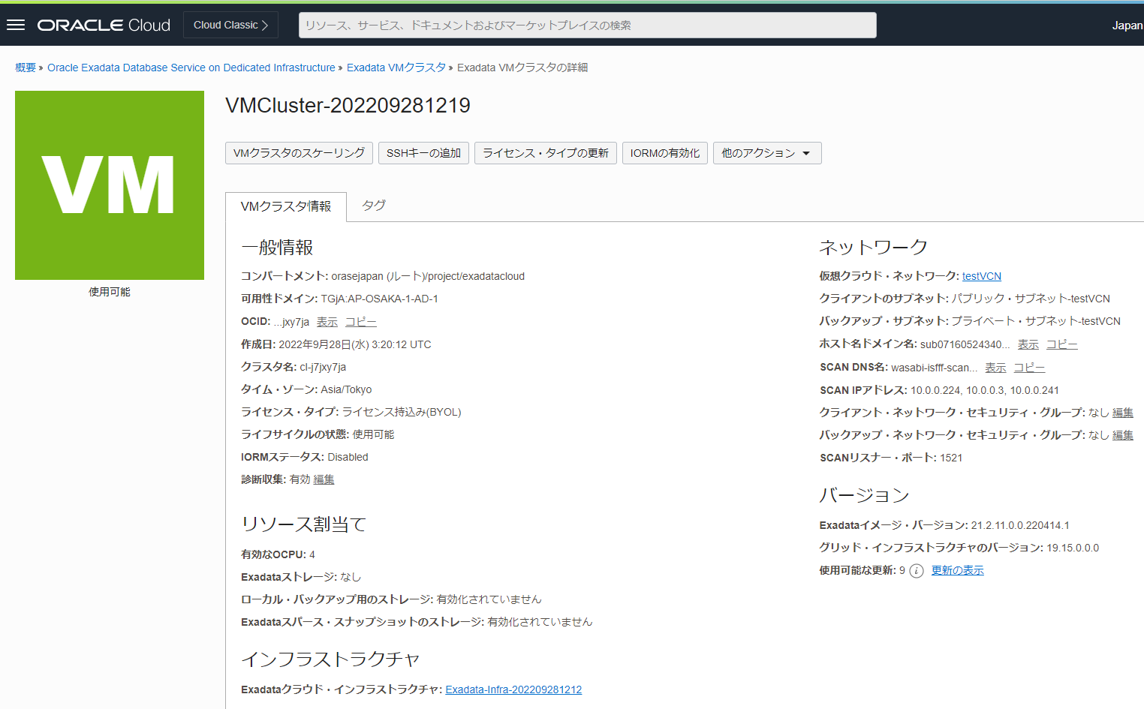

Slide 6
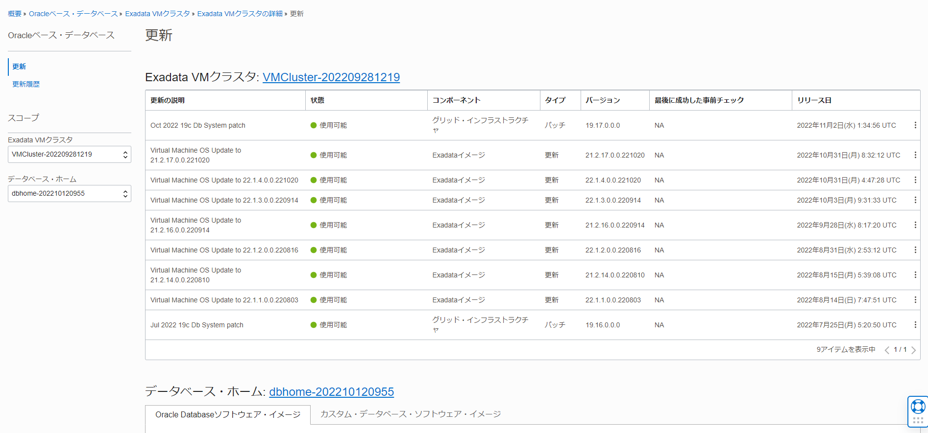

Slide 8
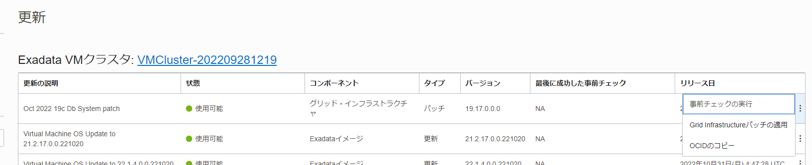

Slide 9
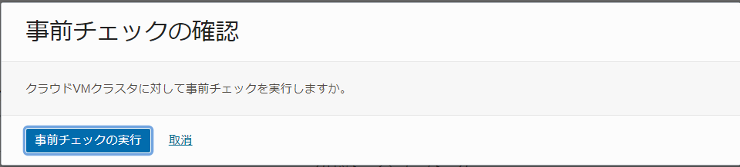

Slide 10
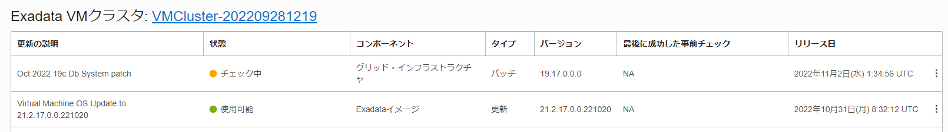

Slide 11
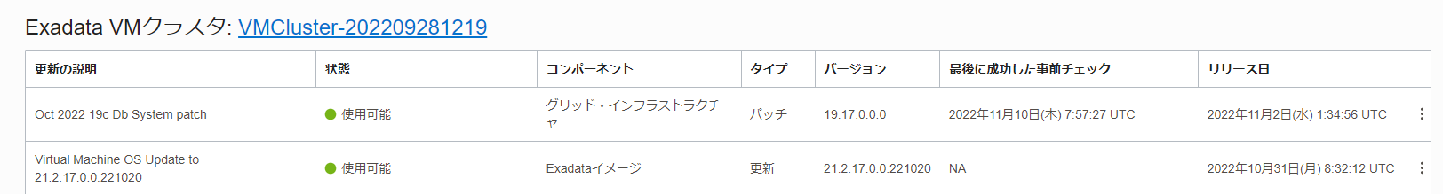

Slide 12
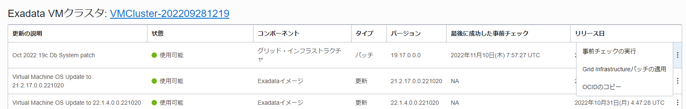

Slide 13
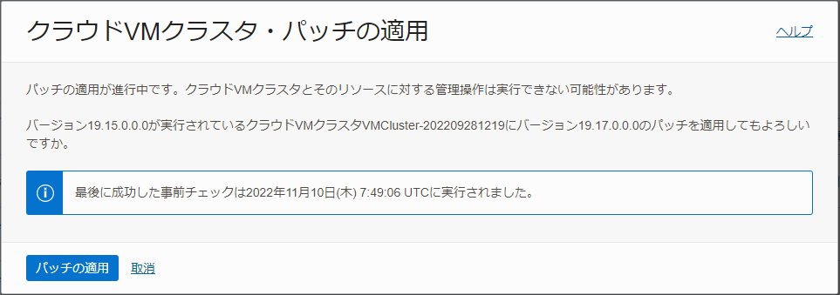

Slide 14
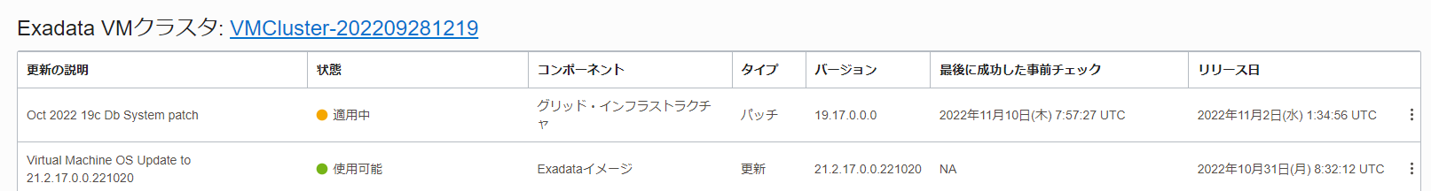

Slide 15
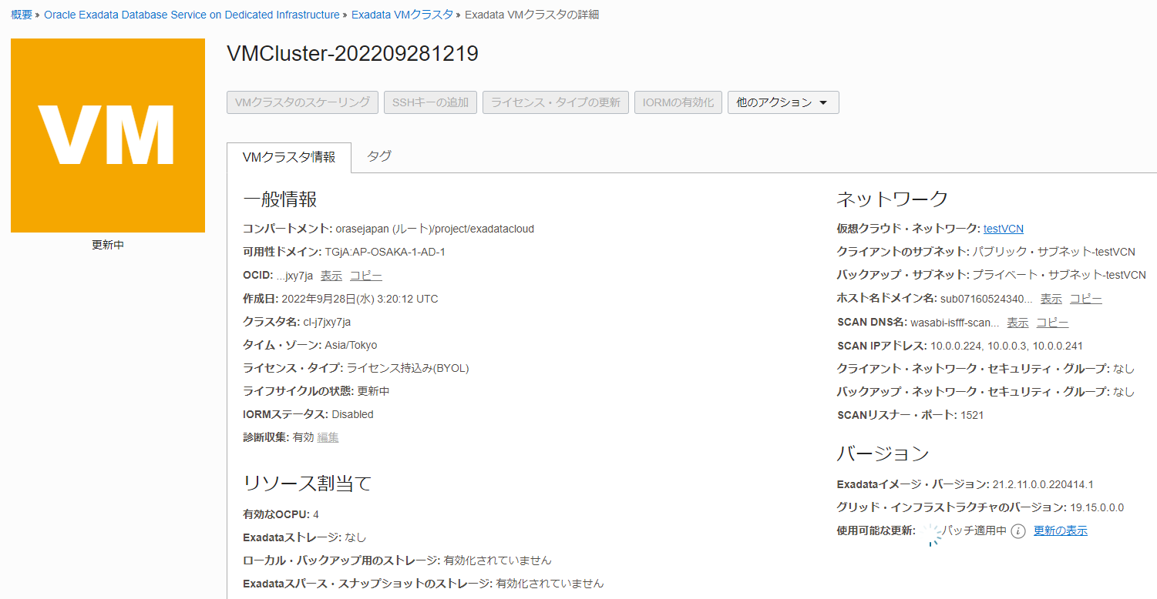

Slide 16
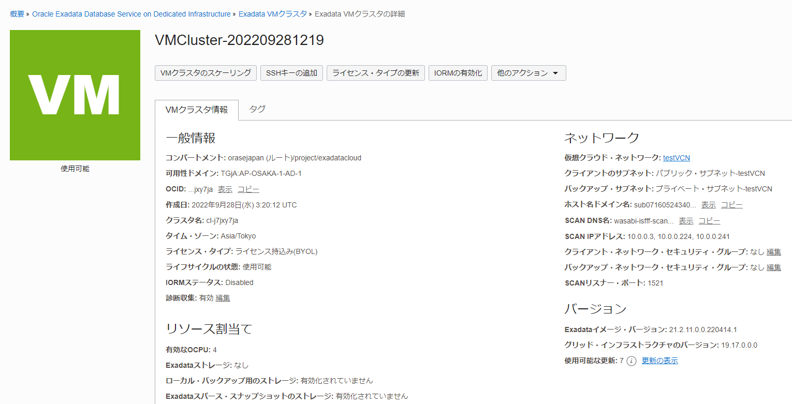

Slide 17
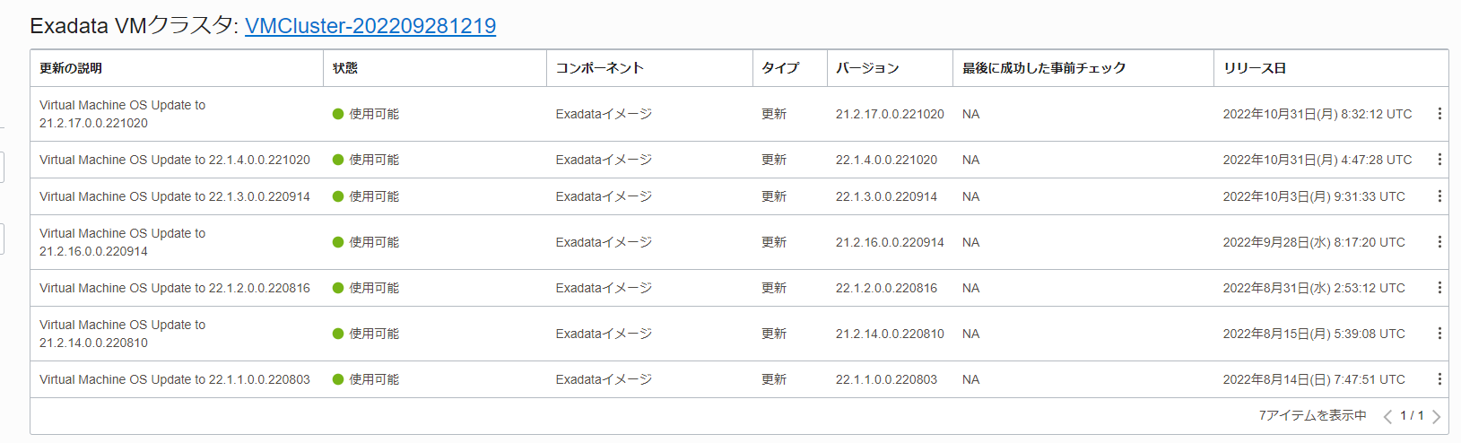

Slide 18
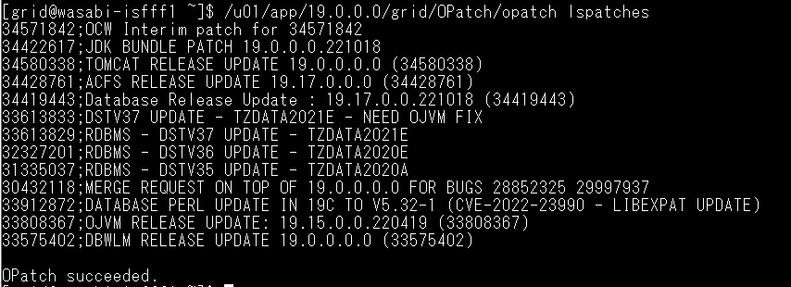
[grid@wasabi-isfff1 ~]$ /u01/app/19.0.0.0/grid/OPatch/opatch lspatches
34571842;OCW Interim patch for 34571842
34422617;JDK BUNDLE PATCH 19.0.0.0.221018
34580338;TOMCAT RELEASE UPDATE 19.0.0.0.0 (34580338)
34428761;ACFS RELEASE UPDATE 19.17.0.0.0 (34428761)
34419443;Database Release Update : 19.17.0.0.221018 (34419443)
33613833;DSTV37 UPDATE - TZDATA2021E - NEED OJVM FIX
33613829;RDBMS - DSTV37 UPDATE - TZDATA2021E
32327201;RDBMS - DSTV36 UPDATE - TZDATA2020E
31335037;RDBMS - DSTV35 UPDATE - TZDATA2020A
30432118;MERGE REQUEST ON TOP OF 19.0.0.0.0 FOR BUGS 28852325 29997937
33912872;DATABASE PERL UPDATE IN 19C TO V5.32-1 (CVE-2022-23990 - LIBEXPAT UPDATE)
33808367;OJVM RELEASE UPDATE: 19.15.0.0.220419 (33808367)
33575402;DBWLM RELEASE UPDATE 19.0.0.0.0 (33575402)
OPatch succeeded.

Slide 20
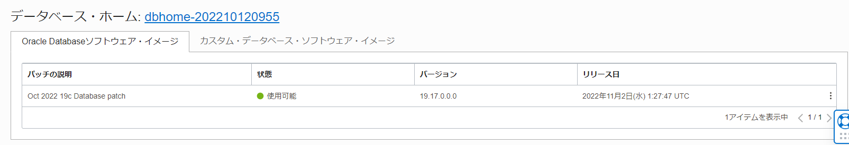

Slide 21
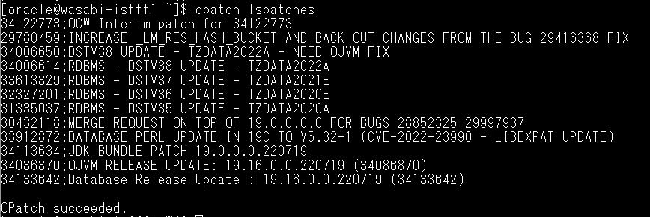
[oracle@wasabi-isfff1 ~]$ opatch lspatches
34122773;OCW Interim patch for 34122773
29780459;INCREASE _LM_RES_HASH_BUCKET AND BACK OUT CHANGES FROM THE BUG 29416368 FIX
34006650;DSTV38 UPDATE - TZDATA2022A - NEED OJVM FIX
34006614;RDBMS - DSTV38 UPDATE - TZDATA2022A
33613829;RDBMS - DSTV37 UPDATE - TZDATA2021E
32327201;RDBMS - DSTV36 UPDATE - TZDATA2020E
31335037;RDBMS - DSTV35 UPDATE - TZDATA2020A
30432118;MERGE REQUEST ON TOP OF 19.0.0.0.0 FOR BUGS 28852325 29997937
33912872;DATABASE PERL UPDATE IN 19C TO V5.32-1 (CVE-2022-23990 - LIBEXPAT UPDATE)
34113634;JDK BUNDLE PATCH 19.0.0.0.220719
34086870;OJVM RELEASE UPDATE: 19.16.0.0.220719 (34086870)
34133642;Database Release Update : 19.16.0.0.220719 (34133642)
OPatch succeeded.

Slide 22
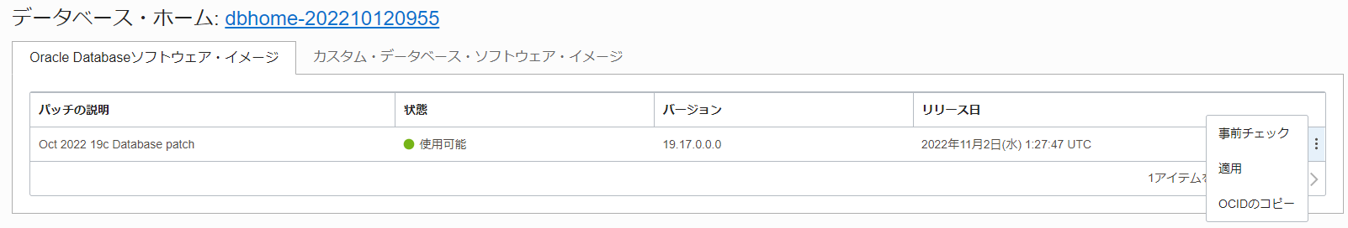

Slide 23
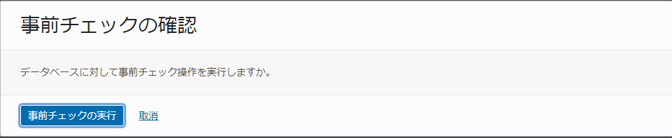

Slide 24
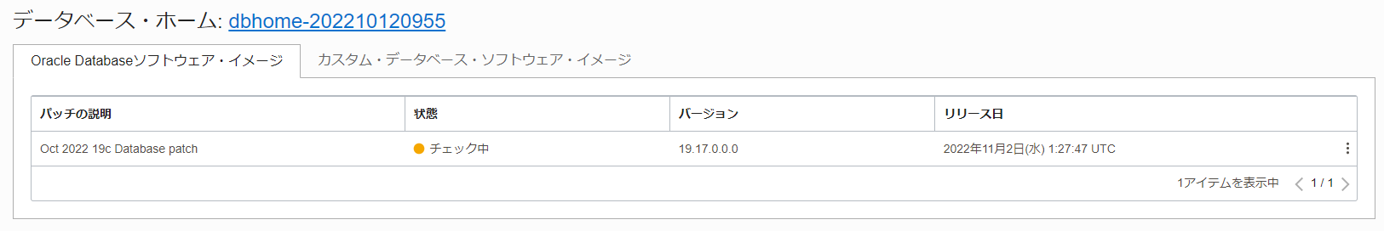

Slide 25
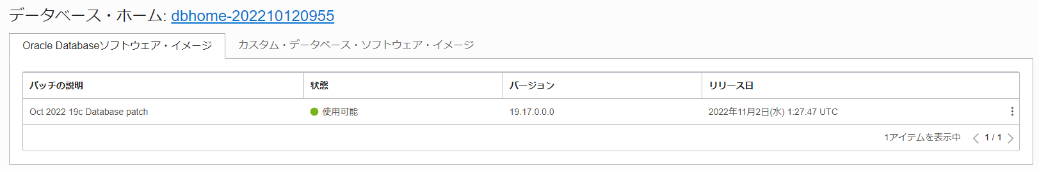

Slide 27
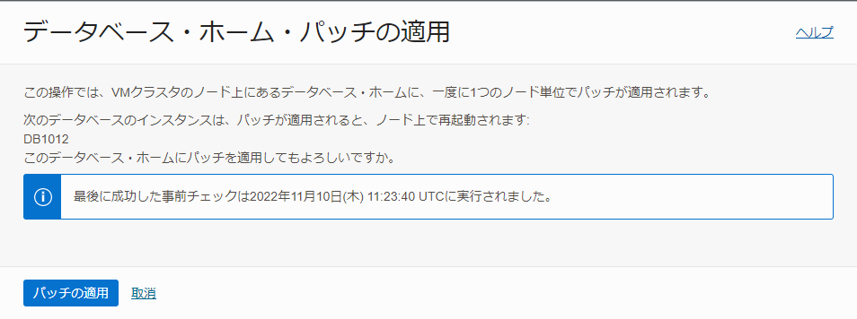

Slide 28
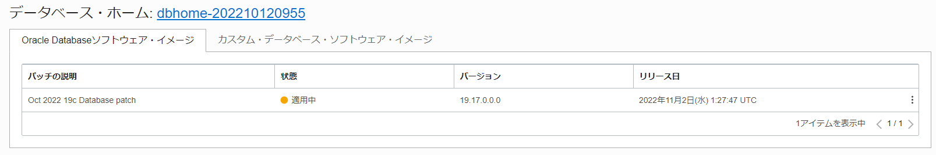

Slide 29
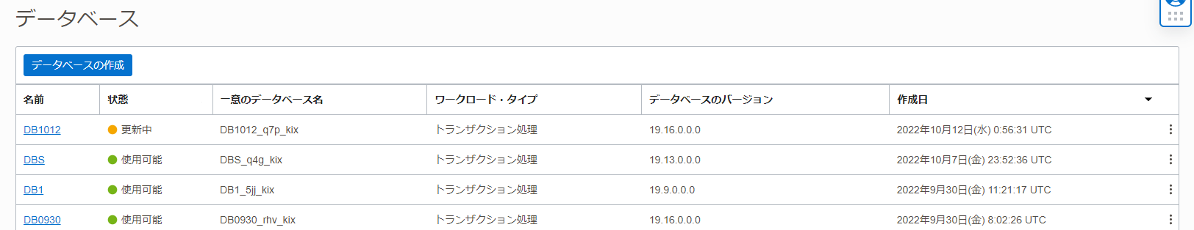

Slide 30
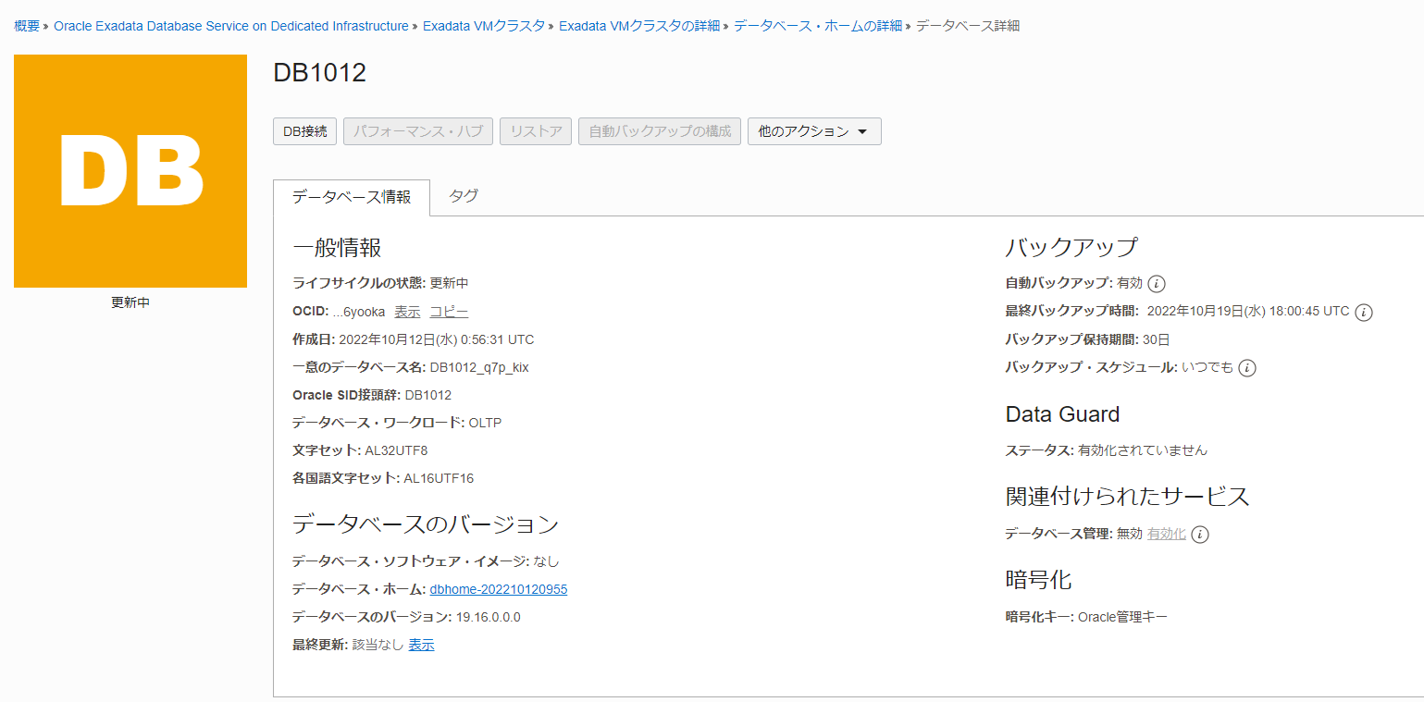

Slide 31
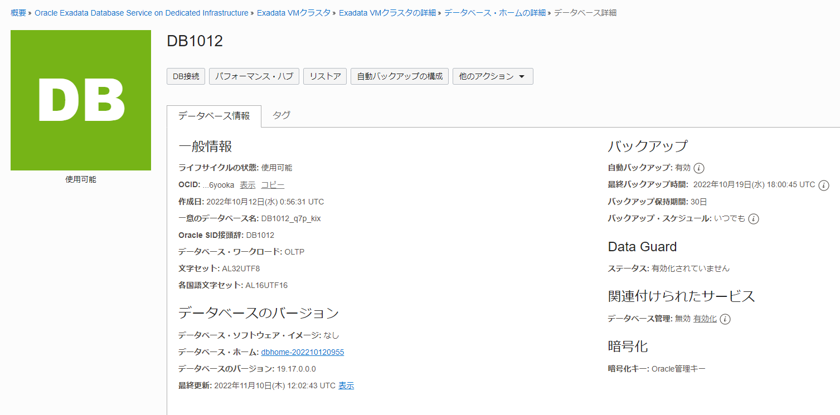

Slide 32
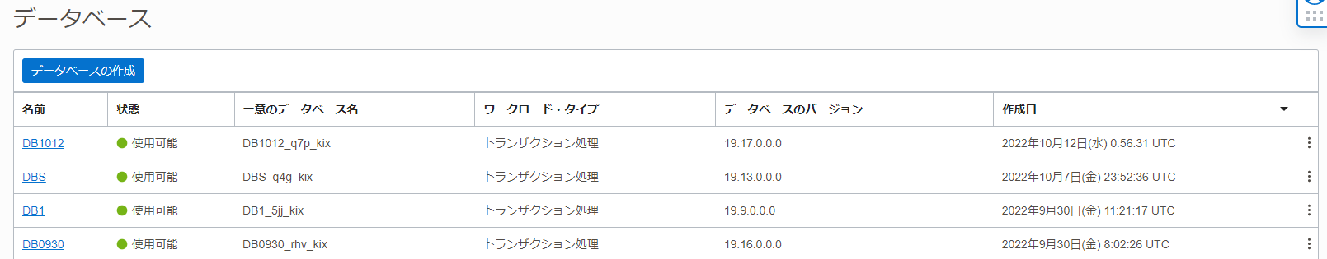

Slide 33
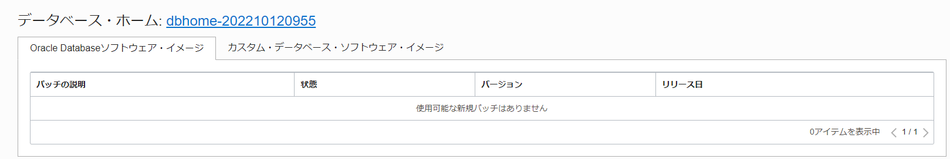

Slide 34
[oracle@wasabi-isfff1 ~]$ opatch lspatches
34571842;OCW Interim patch for 34571842
34533150;DSTV39 UPDATE - TZDATA2022C - NEED OJVM FIX
34533061;RDBMS - DSTV39 UPDATE - TZDATA2022C
33613829;RDBMS - DSTV37 UPDATE - TZDATA2021E
34422617;JDK BUNDLE PATCH 19.0.0.0.221018
34006614;RDBMS - DSTV38 UPDATE - TZDATA2022A
32327201;RDBMS - DSTV36 UPDATE - TZDATA2020E
31335037;RDBMS - DSTV35 UPDATE - TZDATA2020A
30432118;MERGE REQUEST ON TOP OF 19.0.0.0.0 FOR BUGS 28852325 29997937
33912872;DATABASE PERL UPDATE IN 19C TO V5.32-1 (CVE-2022-23990 - LIBEXPAT UPDATE)
34411846;OJVM RELEASE UPDATE: 19.17.0.0.221018 (34411846)
34419443;Database Release Update : 19.17.0.0.221018 (34419443)
OPatch succeeded.

Slide 35
[root@wasabi-isfff1 ~]# dbaascli patch tools list
DBAAS CLI version 22.3.1.1.0
Executing command patch tools list
Checking Current tools on all nodes
wasabi-isfff1: Patchid : 22.3.1.1.0_220826.0317
No applicable tools patches are available
wasabi-isfff2: Patchid : 22.3.1.1.0_220826.0317
No applicable tools patches are available
All Nodes have the same tools version

Slide 37
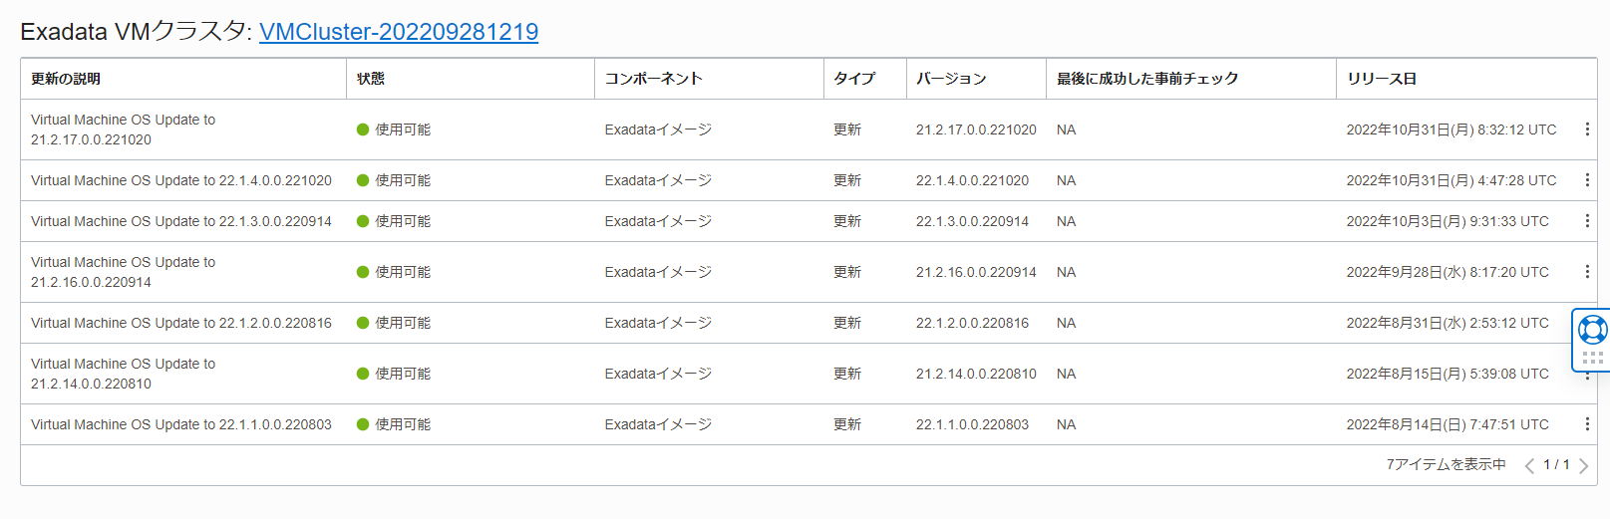

Slide 38
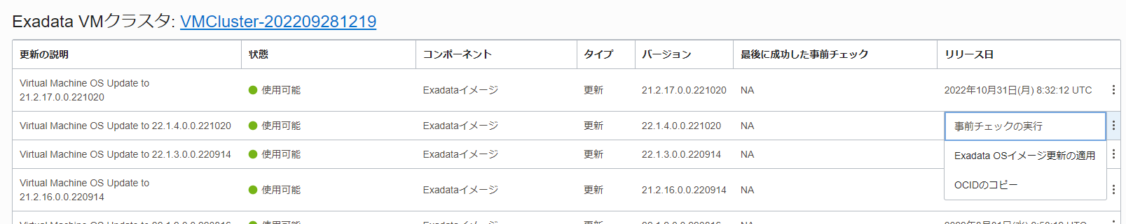

Slide 39
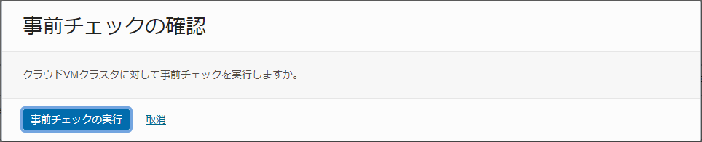

Slide 40
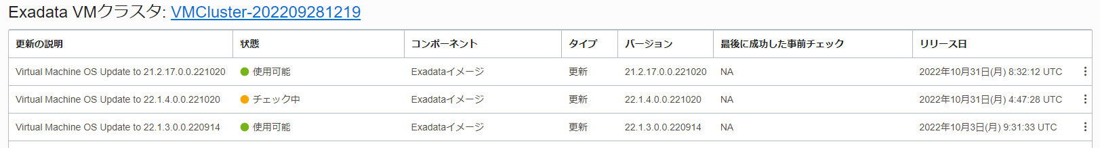

Slide 41
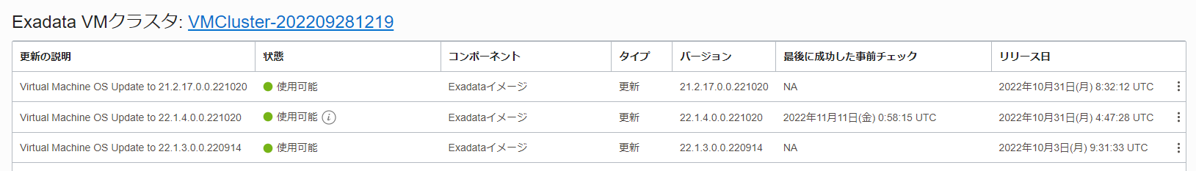

Slide 42
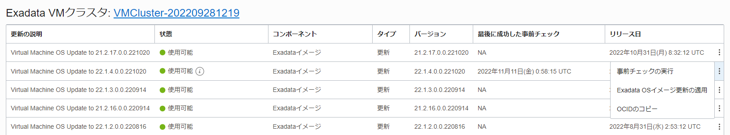

Slide 43
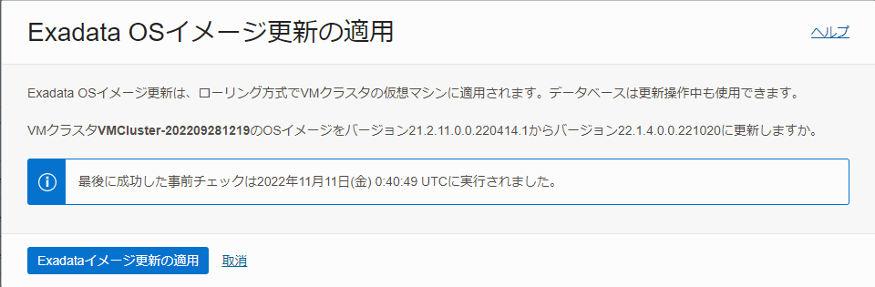

Slide 44
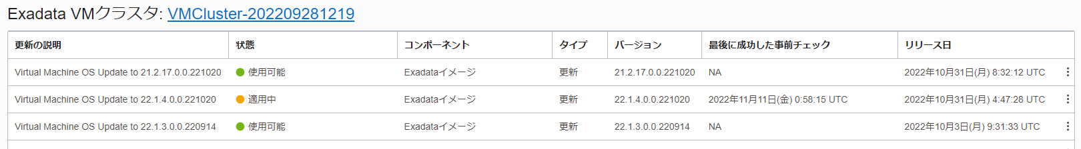

Slide 45
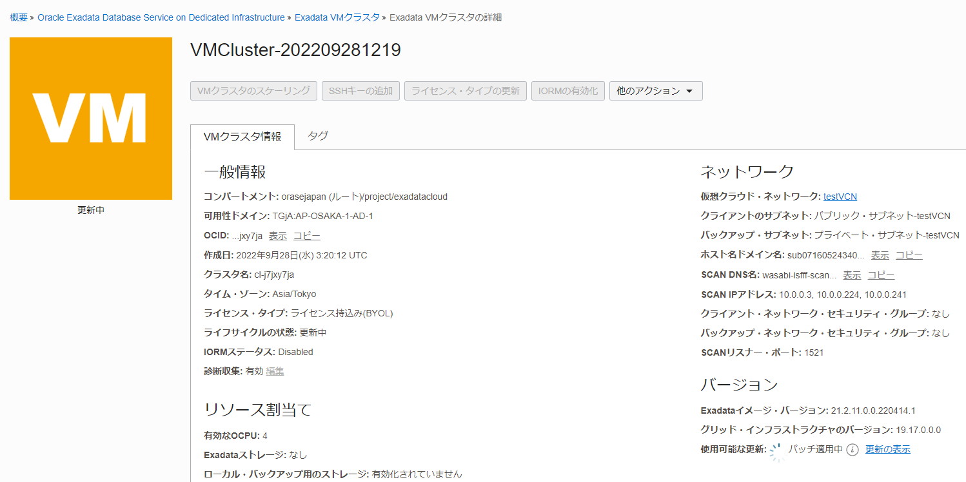

Slide 46
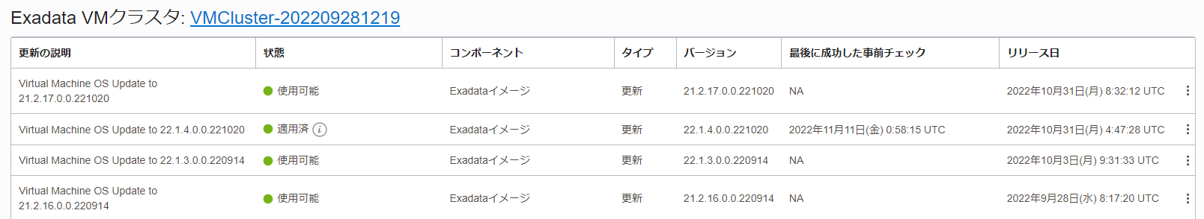

Slide 47
[root@wasabi-isfff1 ~]# imagehistory
Version : 21.2.11.0.0.220414.1
Image activation date : 2022-09-28 13:40:38 +0900
Imaging mode : fresh
Imaging status : success
Version : 22.1.4.0.0.221020
Image activation date : 2022-11-11 10:45:44 +0900
Imaging mode : patch
Imaging status : success

Slide 48
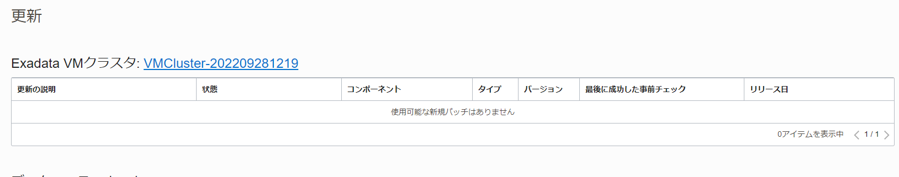

Slide 49
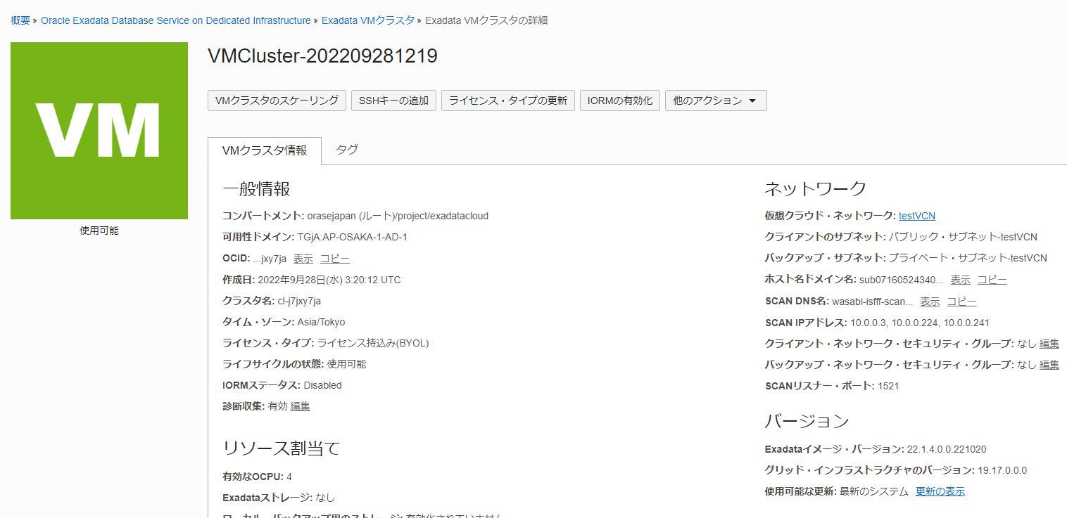

Slide 50
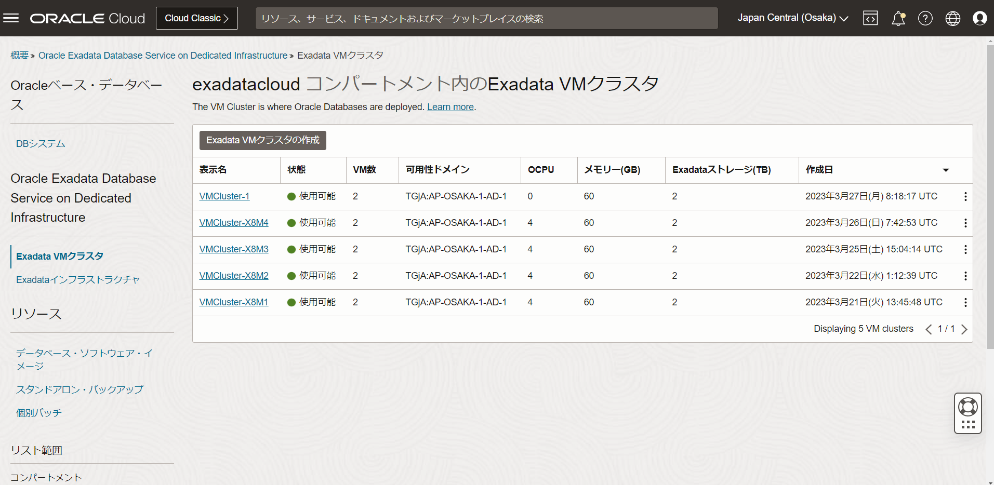

Slide 51
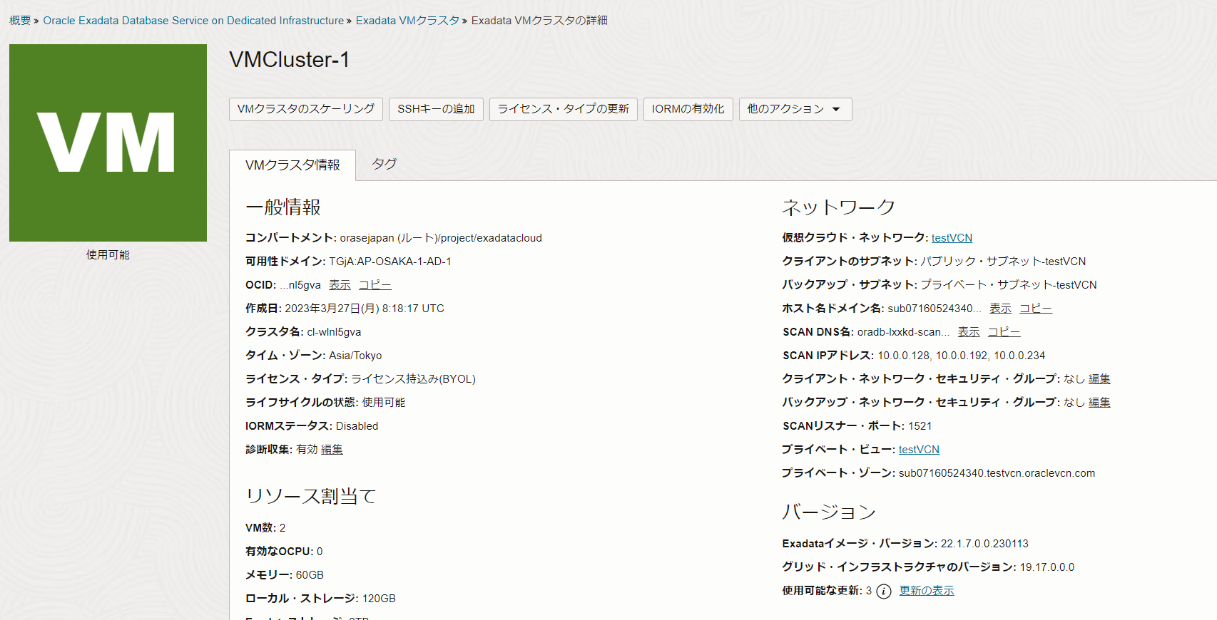

Slide 52
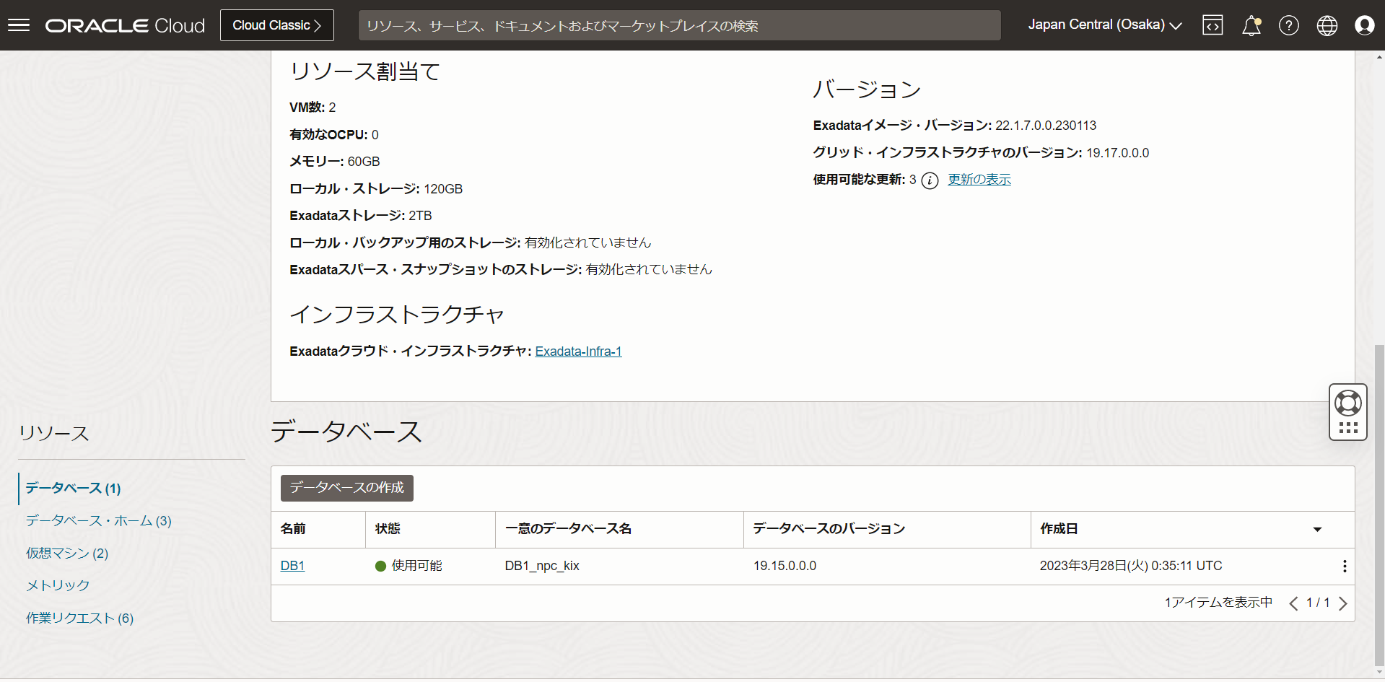

Slide 53
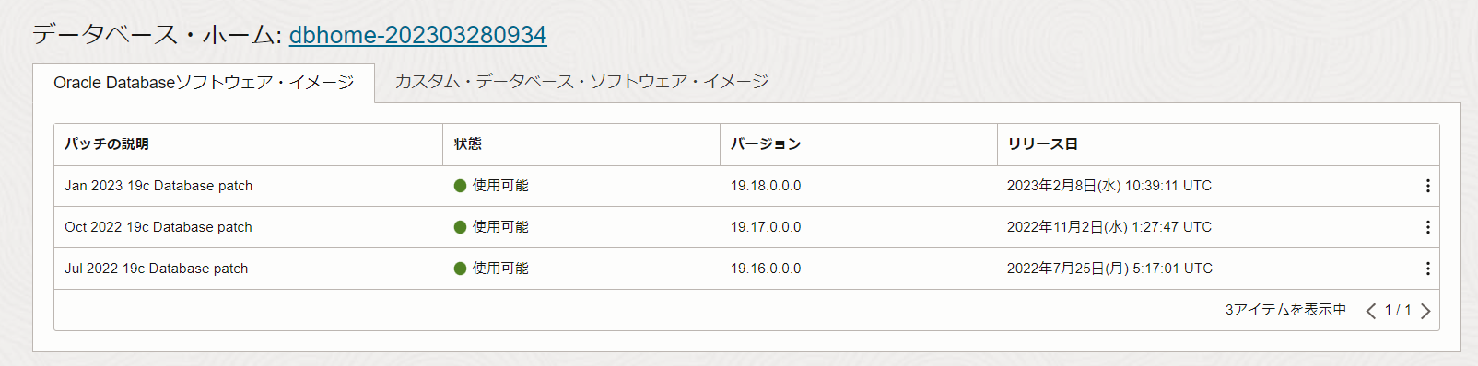

Slide 54
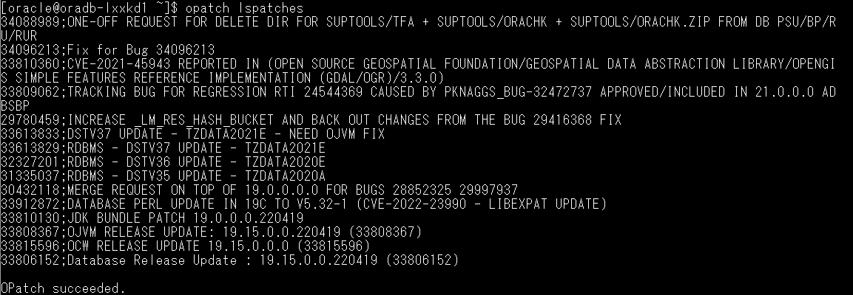
[oracle@oradb-lxxkd1 ~]$ opatch lspatches
34088989;ONE-OFF REQUEST FOR DELETE DIR FOR SUPTOOLS/TFA + SUPTOOLS/ORACHK + SUPTOOLS/ORACHK.ZIP FROM DB PSU/BP/RU/RUR
34096213;Fix for Bug 34096213
33810360;CVE-2021-45943 REPORTED IN (OPEN SOURCE GEOSPATIAL FOUNDATION/GEOSPATIAL DATA ABSTRACTION LIBRARY/OPENGIS SIMPLE FEATURES REFERENCE IMPLEMENTATION (GDAL/OGR)/3.3.0)
33809062;TRACKING BUG FOR REGRESSION RTI 24544369 CAUSED BY PKNAGGS_BUG-32472737 APPROVED/INCLUDED IN 21.0.0.0 ADBSBP
29780459;INCREASE _LM_RES_HASH_BUCKET AND BACK OUT CHANGES FROM THE BUG 29416368 FIX
33613833;DSTV37 UPDATE - TZDATA2021E - NEED OJVM FIX
33613829;RDBMS - DSTV37 UPDATE - TZDATA2021E
32327201;RDBMS - DSTV36 UPDATE - TZDATA2020E
31335037;RDBMS - DSTV35 UPDATE - TZDATA2020A
30432118;MERGE REQUEST ON TOP OF 19.0.0.0.0 FOR BUGS 28852325 29997937
33912872;DATABASE PERL UPDATE IN 19C TO V5.32-1 (CVE-2022-23990 - LIBEXPAT UPDATE)
33810130;JDK BUNDLE PATCH 19.0.0.0.220419
33808367;OJVM RELEASE UPDATE: 19.15.0.0.220419 (33808367)
33815596;OCW RELEASE UPDATE 19.15.0.0.0 (33815596)
33806152;Database Release Update : 19.15.0.0.220419 (33806152)
OPatch succeeded.
lspatchesコマンド

Slide 55
106を参考にデータベースホームの作成

Slide 56
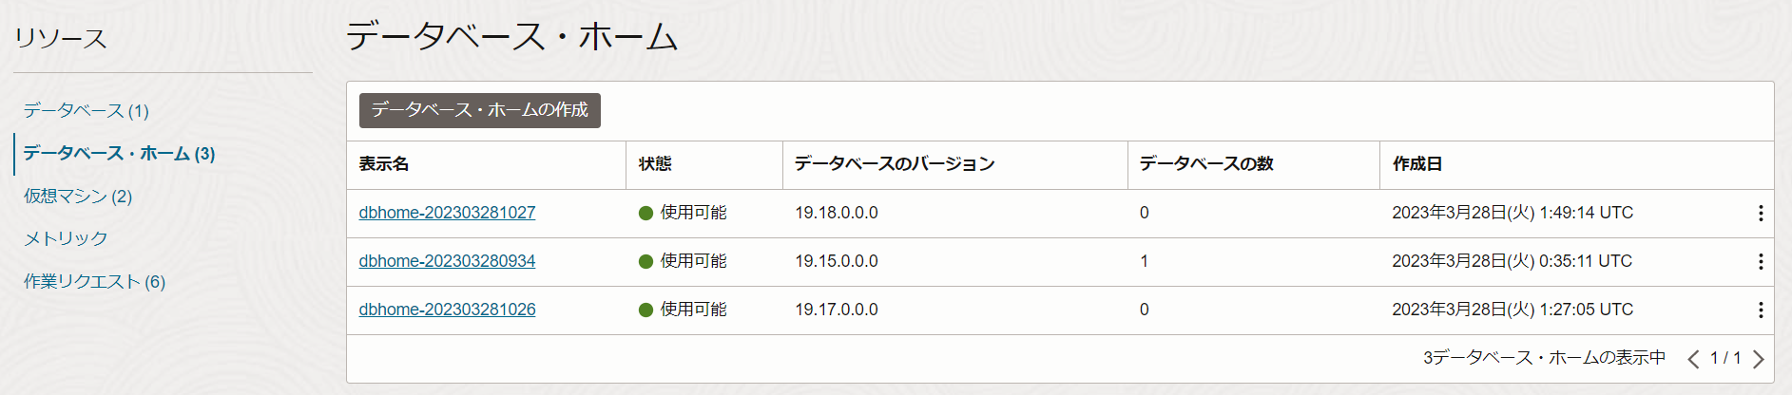

Slide 57
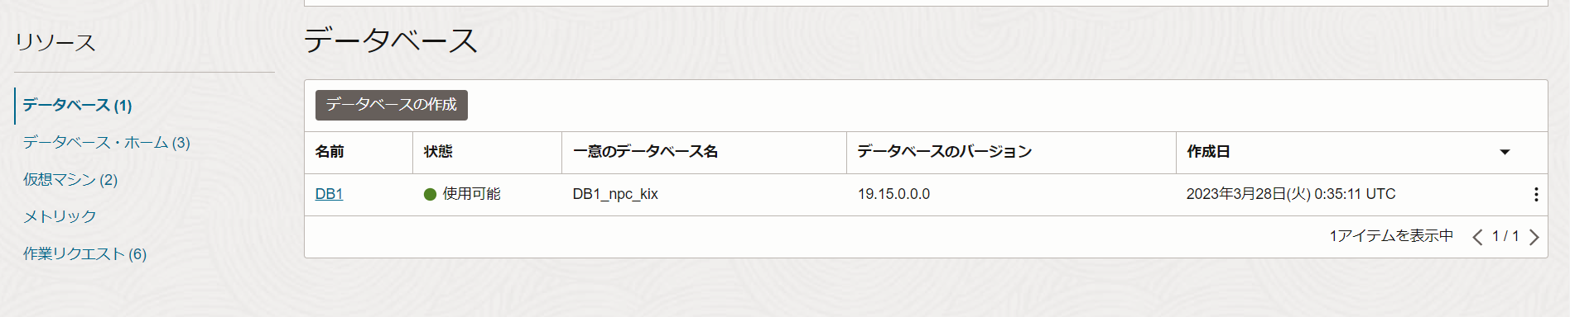

Slide 58


Slide 59


Slide 60


Slide 61


Slide 62


Slide 63


Slide 64


Slide 65


Slide 66


Slide 67


Slide 68


Slide 69


Slide 70

[oracle@oradb-lxxkd1 ~]$ $ORACLE_HOME/OPatch/opatch lspatches
34835593;REFERENCE BUG 34792490 - SCHEDULER LAYER CHANGES TO AVOID CYCLIC DEPENDENCY ON DBMS_AQADM_SYS PACKAGE
34792490;FADBRWT STRESS FA ORA-00060 DEADLOCK DETECTED DURING DATAPATCH
34699616;DSTV40 UPDATE - TZDATA2022E - NEED OJVM FIX
34777391;JDK BUNDLE PATCH 19.0.0.0.230117
34786990;OJVM RELEASE UPDATE: 19.18.0.0.230117 (34786990)
34768559;OCW RELEASE UPDATE 19.18.0.0.0 (34768559)
34765931;DATABASE RELEASE UPDATE : 19.18.0.0.230117 (REL-JAN230131) (34765931)
OPatch succeeded.

