Slide 1

Without diffusion prior
With diffusion prior

Slide 2
Without diffusion prior
With diffusion prior

Slide 5
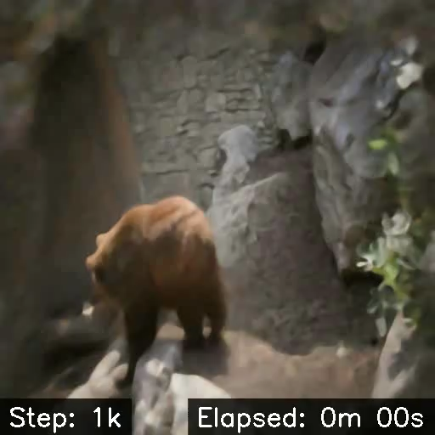
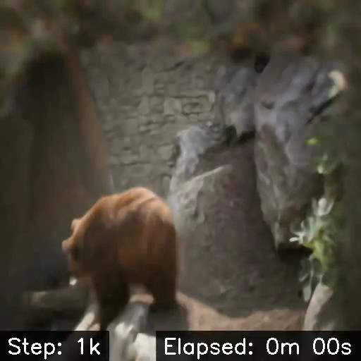
Without scheduling
Trains 14x faster
With scheduling

