Slide 1
Innovation and Entrepreneurship
Team E

Slide 2
Outlines
A
B

Slide 3
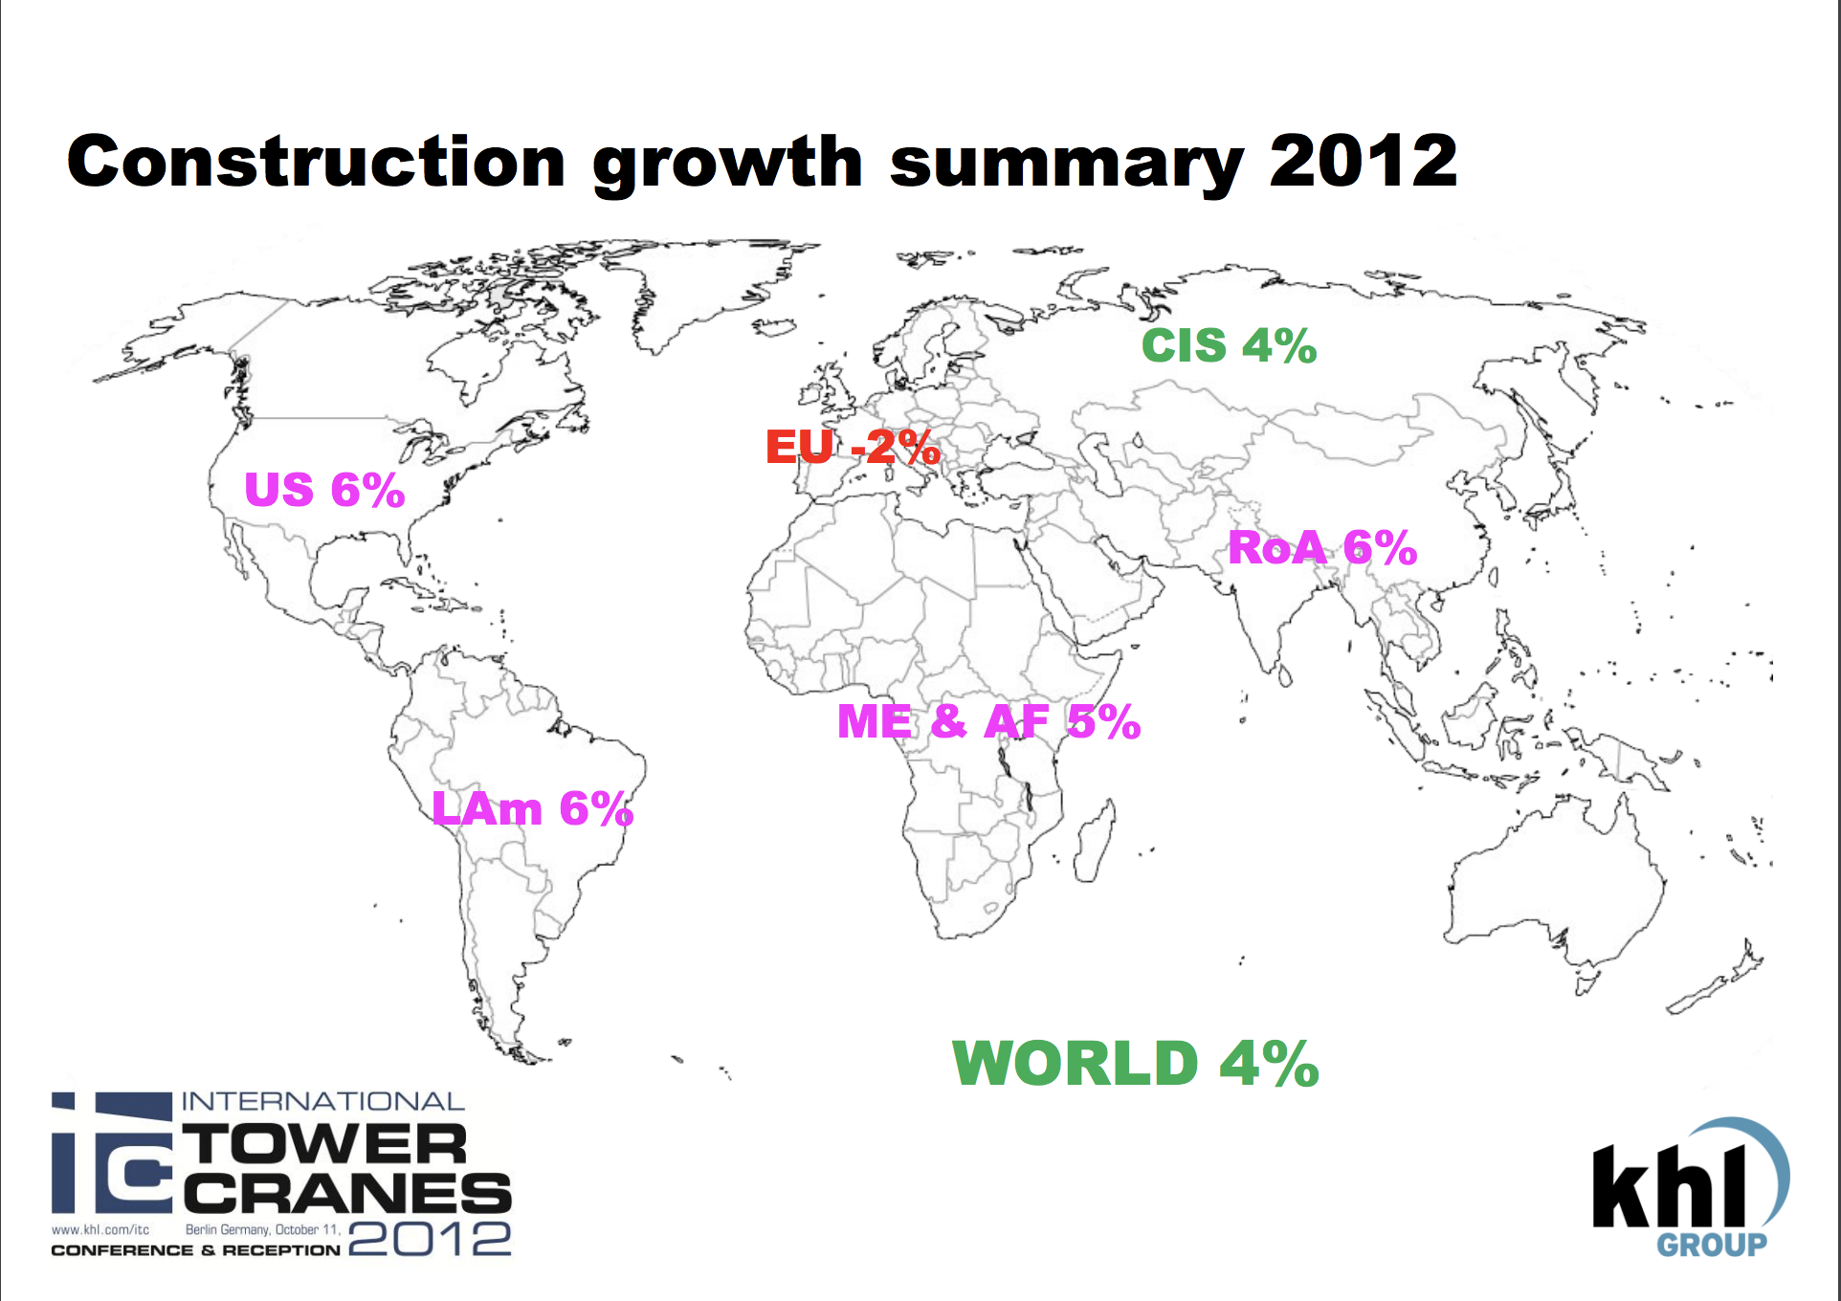
Market Penetration Analysis
[Our target]: Construction Industry (B2B)
Companies in the construction industry who would like to construct new comfortable buildings for consumers.
In Developed countries. Especially in high-tech cities which require wireless power transfer like Singapore, Silicon Valley, Shenzhen
[Market Share]:
Market size
Market growth
$250 billion
**When average of NetSales of single construction is $30,000
Notes:
https://www.census.gov/construction/nrc/index.html
http://www.e-stat.go.jp/SG1/estat/ListE.do?lid=000001197463

