Slide 1
TITLE :-
Perform EDA, statistic and SQL on a dataset (Students performance)
SUBTITLE :-
A data driven approach to understand academic success of students
Presented by :- Koina garg (Team lead)
Dharma teja (Team member)
MASAI SCHOOL

Slide 2
Project scope and objectives :-
SCOPE :- The project purpose is to analysis student academic performance using the real-world dataset.
It covers various aspects like gender , parental education , lunch type and academic records.
OBJECTIVES :- Understand and explore the structure and variable in the student performance dataset.
Perform EDA to visualize relationship and trends across student performance.
Apply STATISTIC to validate assumption.
Use SQL to query and extract meaningful patterns from the structured dataset.

Slide 3
Motivation of the project :-
1.Education impact future opportunities –understand what affects student performance .
2.This project allows hands on experience with real-world data analysis tools (Python , SQL , statistic ) and helps develop a data driven mindset.
3. It encourage critical thinking by exploring how factors like parental background , study habits, and lifestyle influence academic success.

Slide 4
Tools and Technologies used :-
PYTHON : Pandas , matplotlib, seaborn and scipy for analysis and visualization and statistics.
SQL : To extract insights through structured queries.
DBDIAGRAM : To make the scheme for better understanding the tables.

Slide 5
DATASET OVERVIEW :-
Dataset source :- Collect dataset from Kagel – Student performance dataset .
Total records :- Approx 1000 student entries.
Format :- Tabular csv file
KEY FEATURES :-
Gender
Scores in math , reading , writing .
Parental education .
Lunch type.
Ethnicity

Slide 6
Data cleaning and preprocessing :-
Handled missing values : Checked missing , null values and imputation where required.
Standardized data : Renamed columns for clarity and consistency and convert categorical into numerical if required.
Outliers Detections : Used boxplot and statistical methods to identify outliers.

Slide 7
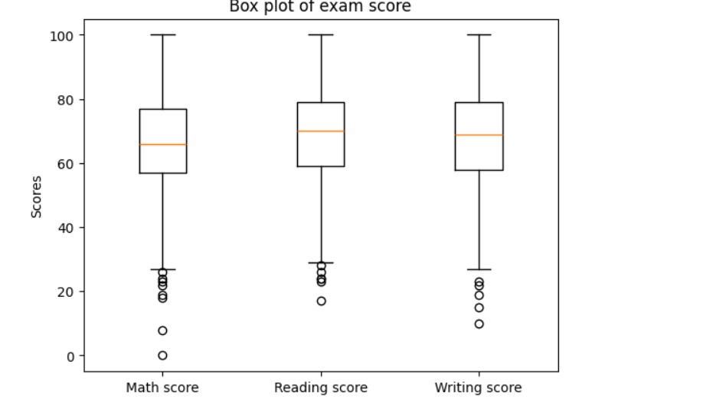
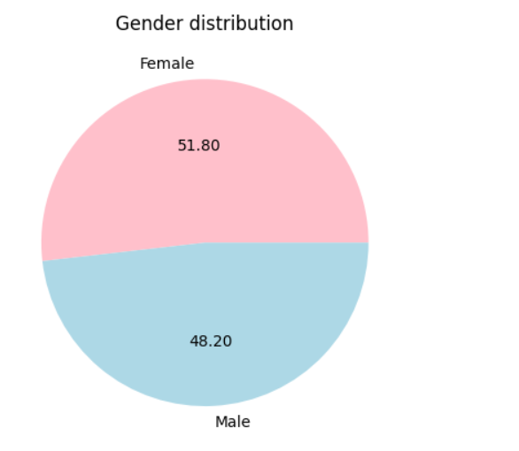
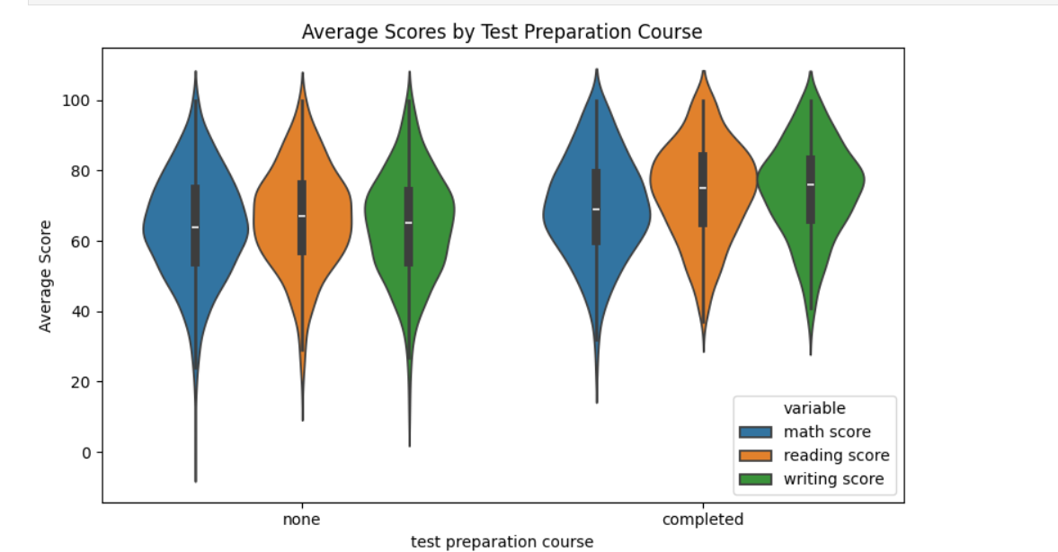
EXPLORATORY DATA ANALYSIS :-
Visual techniques used :-
Violin plot : To view the score distribution across subjects.
Pie chart : Use to analysis the distribution of gender.
Heatmap : To visualize correlation between scores of all subjects.

Slide 8
Key Statistics :-
Calculated central tendency : Mean, Median, Mode of scores.
Performed correlation analysis .
Used t-test, ANOVA test to test significance (Gender differences in performance.)

Slide 9
SQL Analysis :-
Queried student groups by parental education and job.
Aggregated average scores by gender and study time.
Filtered out top and bottom performance for focused analysis.
Used join and group by for multi-dimensional insights.

Slide 10
Conclusion
Comprehensive understanding :- Explored how academic and behavioral factors influence student performance using EDA , Statistic and SQL .
Key insights :- Lunch type and parental education strongly impact performance.
SQL helped extract group – level trends for deeper insights.
Skills Applied :- Data cleaning, Visualization , hypothesis testing, and SQL query.

