Slide 1
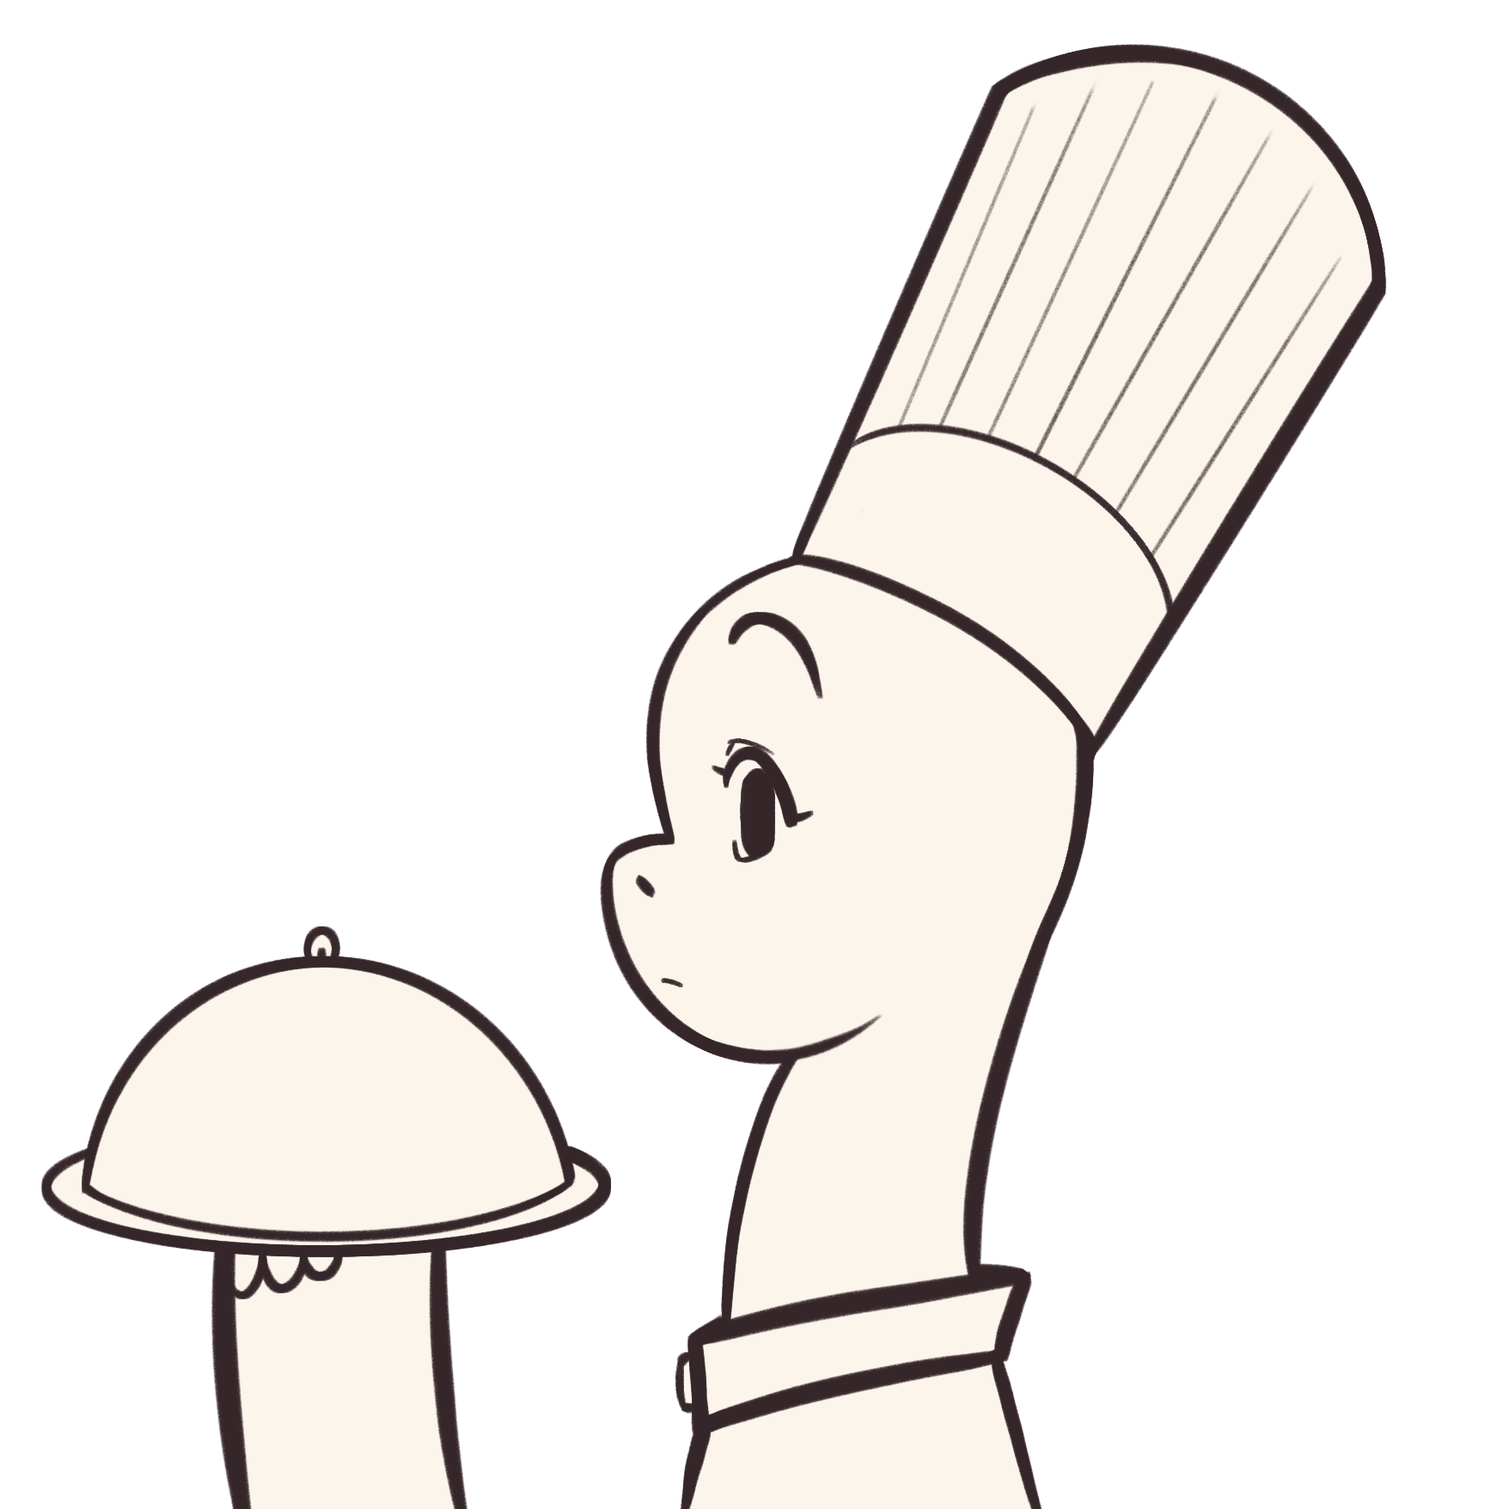
General Instructions
Handwritten Digit Recognition

Slide 2


0.1. Installing Java
You need to have java installed in order to run this.
Not sure if you have java?
Check if you have java installed by running the following command in the terminal: java –help and it should print the java help text if you have installed java.
I have java installed.
I do not have java installed.

Slide 3
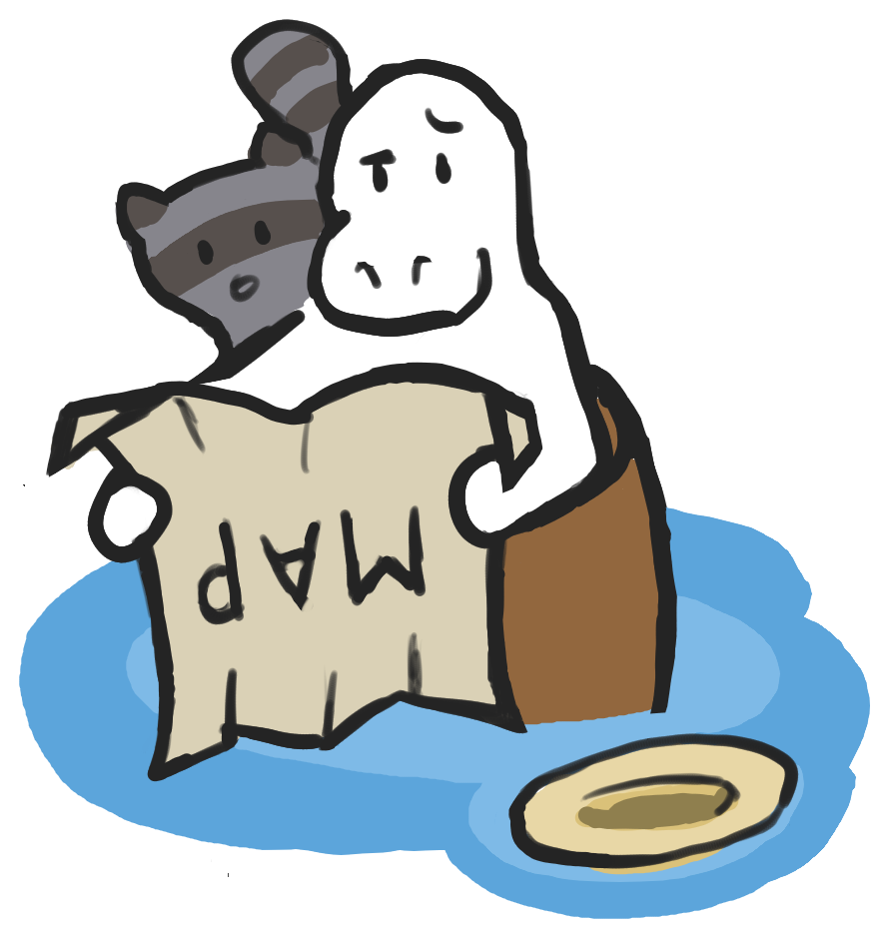
0.1. Installing Java
Bruh... You don’t have java? :skull:
Install java from this website. Just get the latest version. While installing, make sure to add it to the PATH in your system!

Slide 4

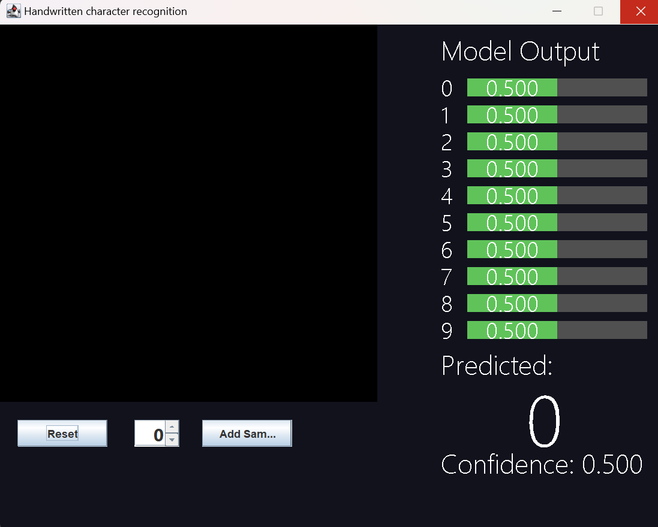

1. Open Main.jar
A .jar file is a compiled java executable.
Open the folder where Main.jar is located. Then right click and select “Open in Terminal”
Run java –jar Main.jar and it should open.
<--Something like this…

Slide 5
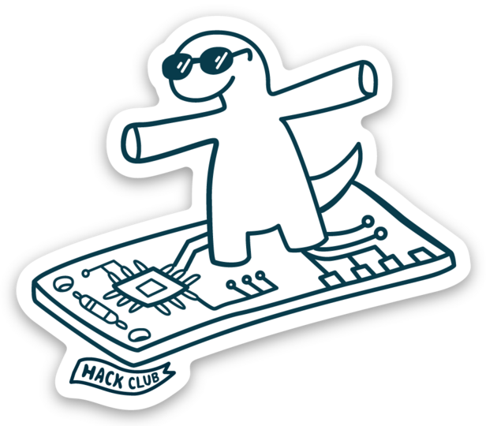
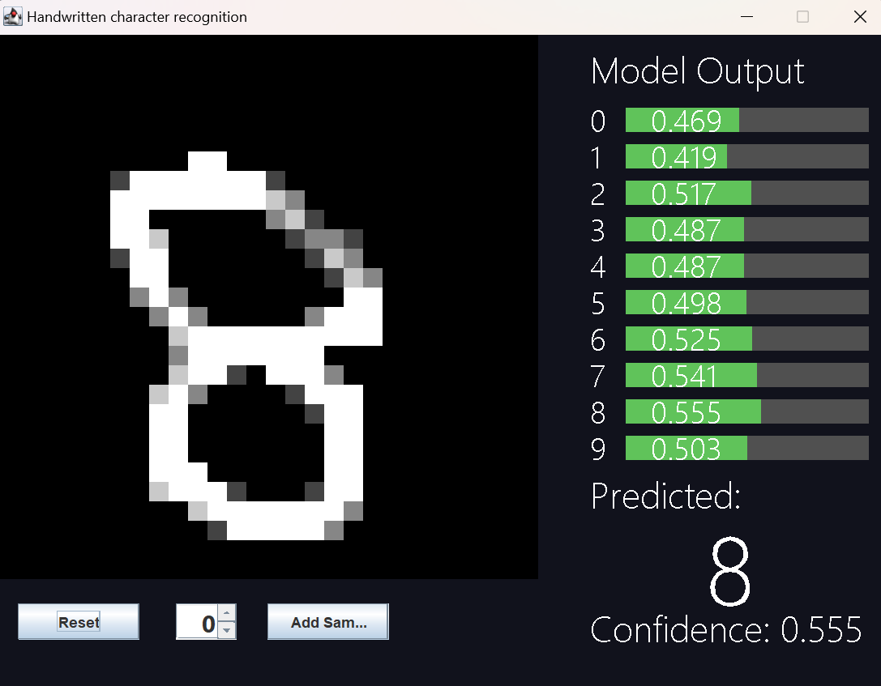
2. do stuff!
Draw numbers on the black screen on the left side.
As you draw, the network will try to guess which number you’re drawing.
The confidence values of each number is shown as bars on the right side.
Press the Reset button to erase the screen.

Slide 6

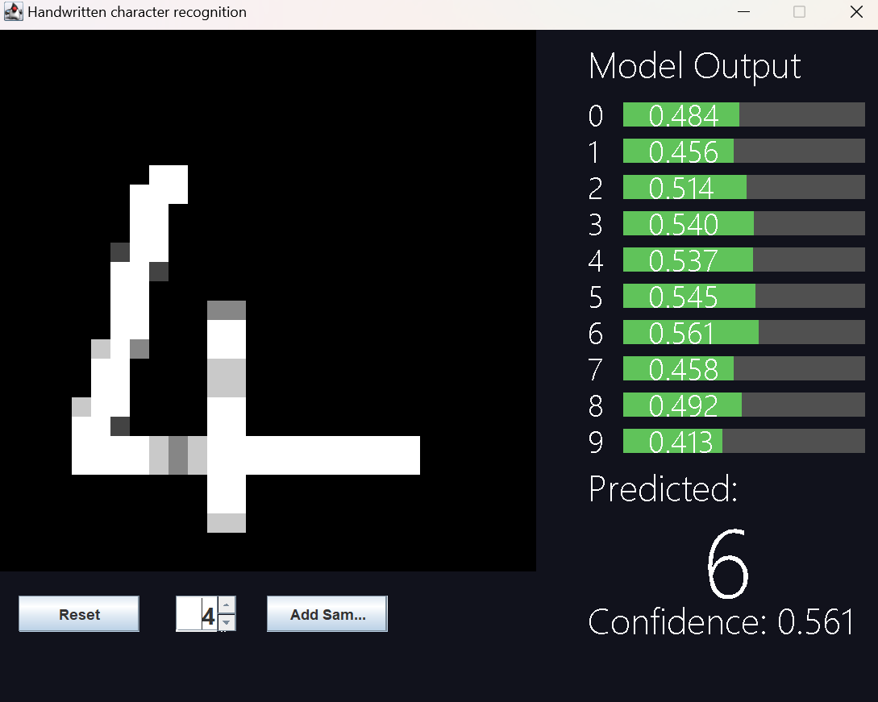
3. train stuff!
You can add your own samples to the training data! Draw the number on the screen, then select which number you drew with this spinner and press the “Add Sample” button.
This wont take effect until you retrain the network by running Train.jar and reopen the program. To run Train.jar, open the terminal in that directory and run java –jar Train.jar and wait for it to say TRAINING DONE
Since there are thousands of training samples from MNIST you need to have a lot of samples to make a difference and retraining will take very long
tl;dr just dont train it

Slide 7
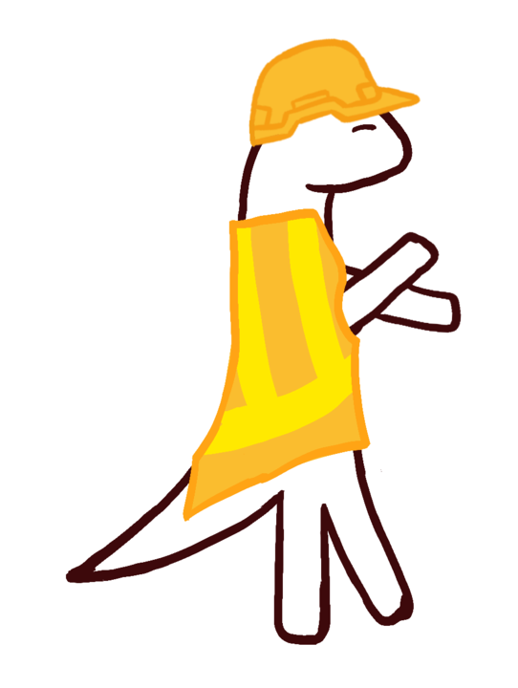
4. fix stuff
troubleshooting!
1. java : The term ‘java' is not recognized as the name of a cmdlet, function, script file, or operable program.
Solution: Java isn’t installed or isn’t in PATH.
2. Exception in thread "main" java.io.FileNotFoundException: weights.txt (The system cannot find the file specified)
Solution: Ensure weights.txt is there in the correct working directory, or run train to generate one.
3. Invalid input! error when trying to save a file
Solution: Make sure the number in the spinner is from 0-9 only.

Slide 8

ok bye
that took way too long
maybe I should have just used launch4j?

