Slide 1
Smart pet care system
Team 7
Bowen Ren 2818474r, Zhiyu Ren 2869108r, Yutong Wang 2682750w, Xiaoyu Zhang 2899211z

Slide 2

content
Introduction
Scenes to be used
Product features

Slide 3
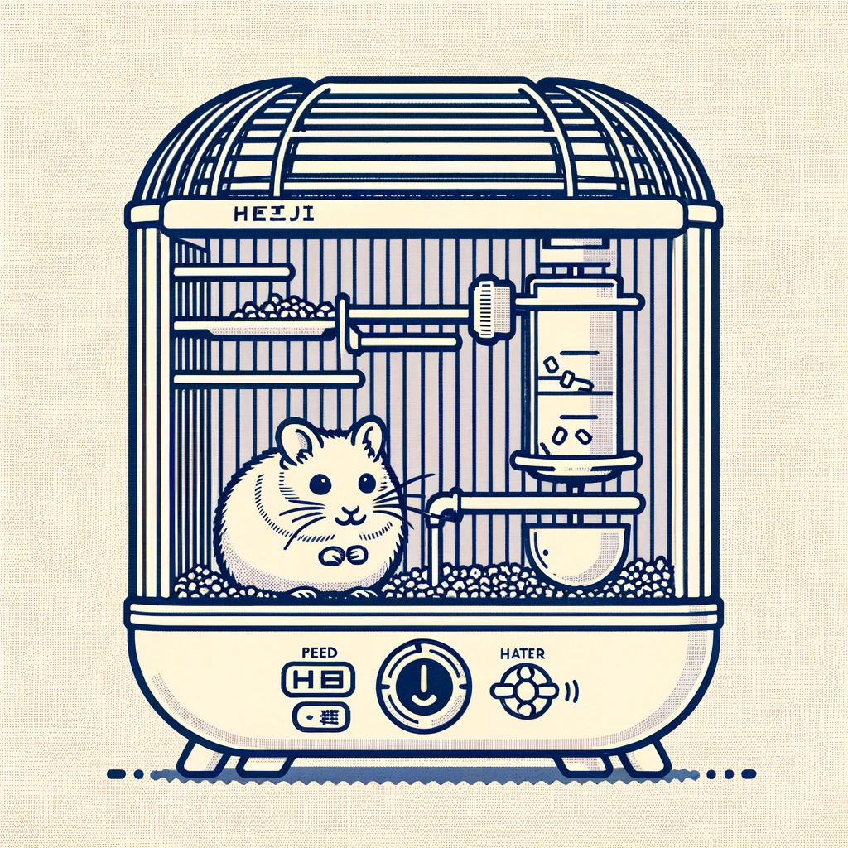
Introduction
Automatic food feeding
Automatic water feeding
Clean and fresh
Raspberry Pi
A smartphone application

Slide 4
Customors to be used
Busy pet owners
Going out for a long time on holidays
Pets with special needs (such as regular feeding or medicine)

Slide 5
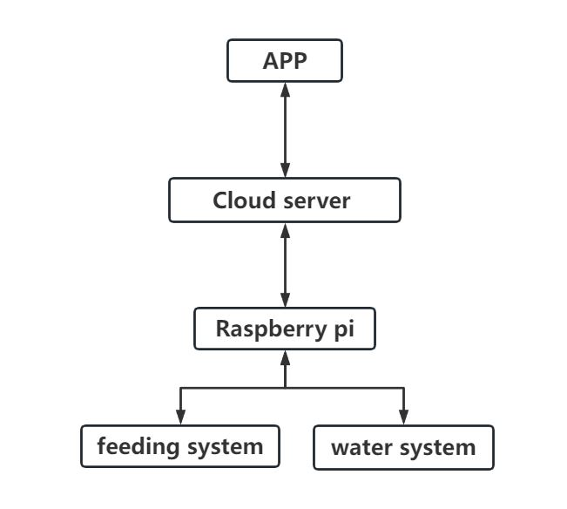
Product features

Slide 6
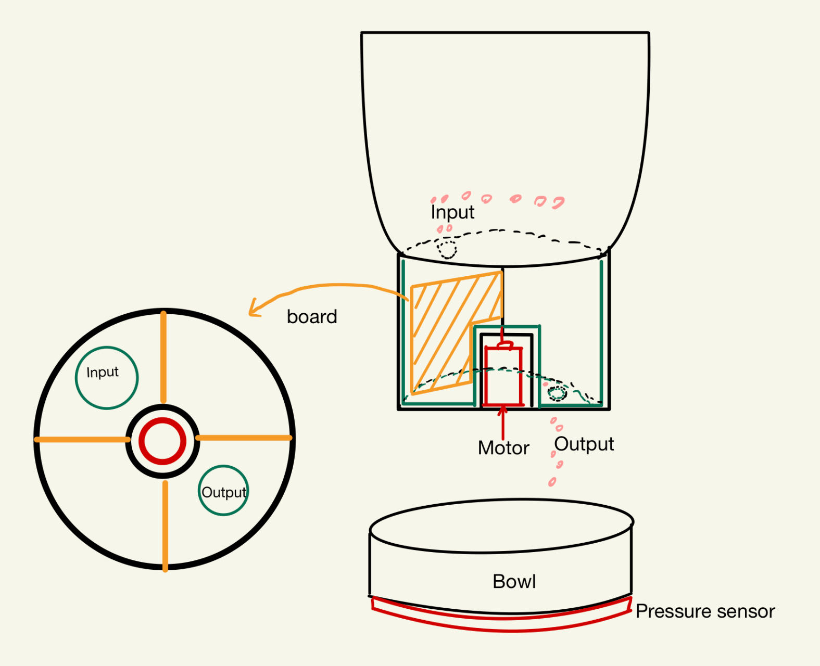
Product features – feeding system
The motor with 4 board will control the amount of the food from the input hole to the output hole
The pressure sensor under the bowl will record the weight of the food that the pet get
Food system structure

Slide 7
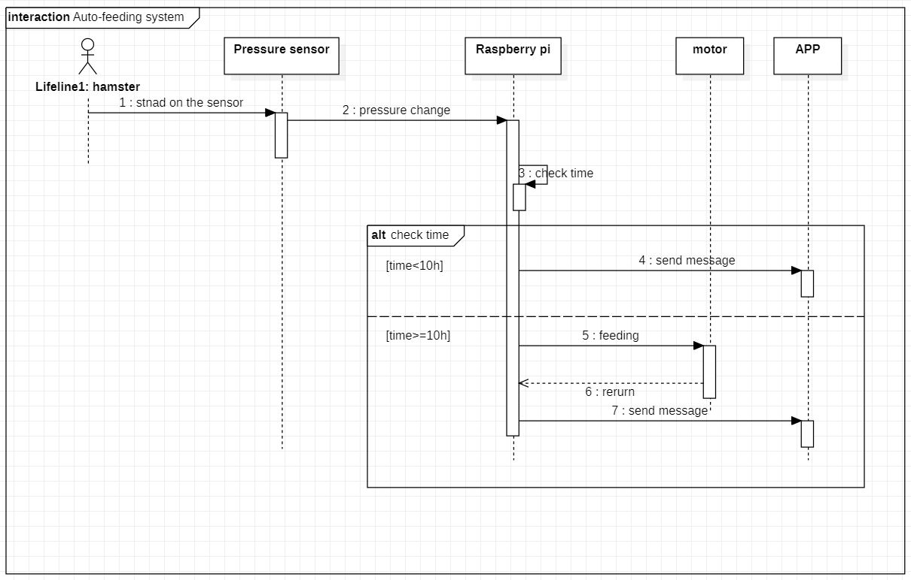
feeding system – Auto mode

Slide 8
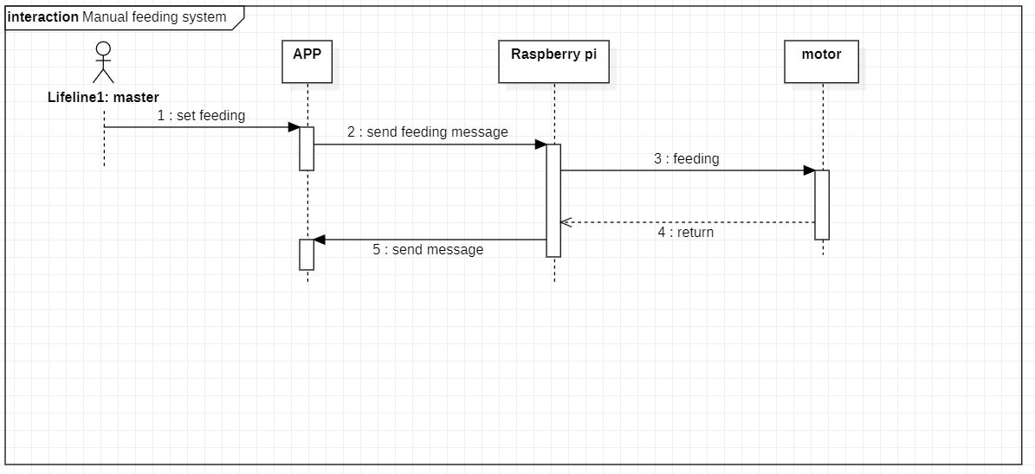
feeding system – Manual mode

Slide 9
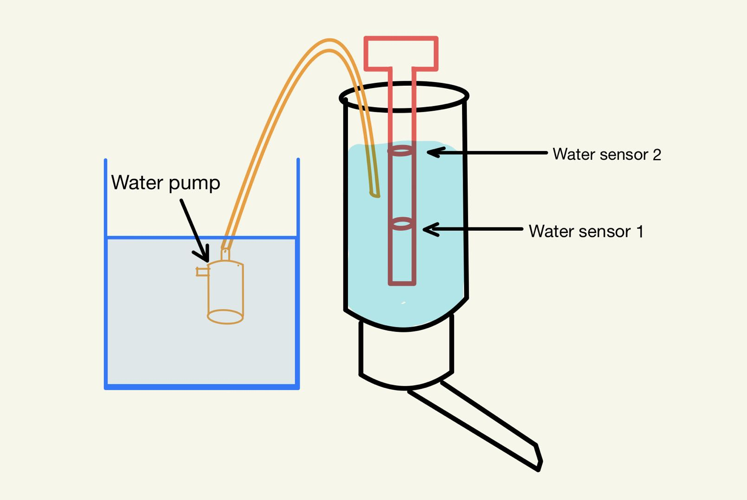
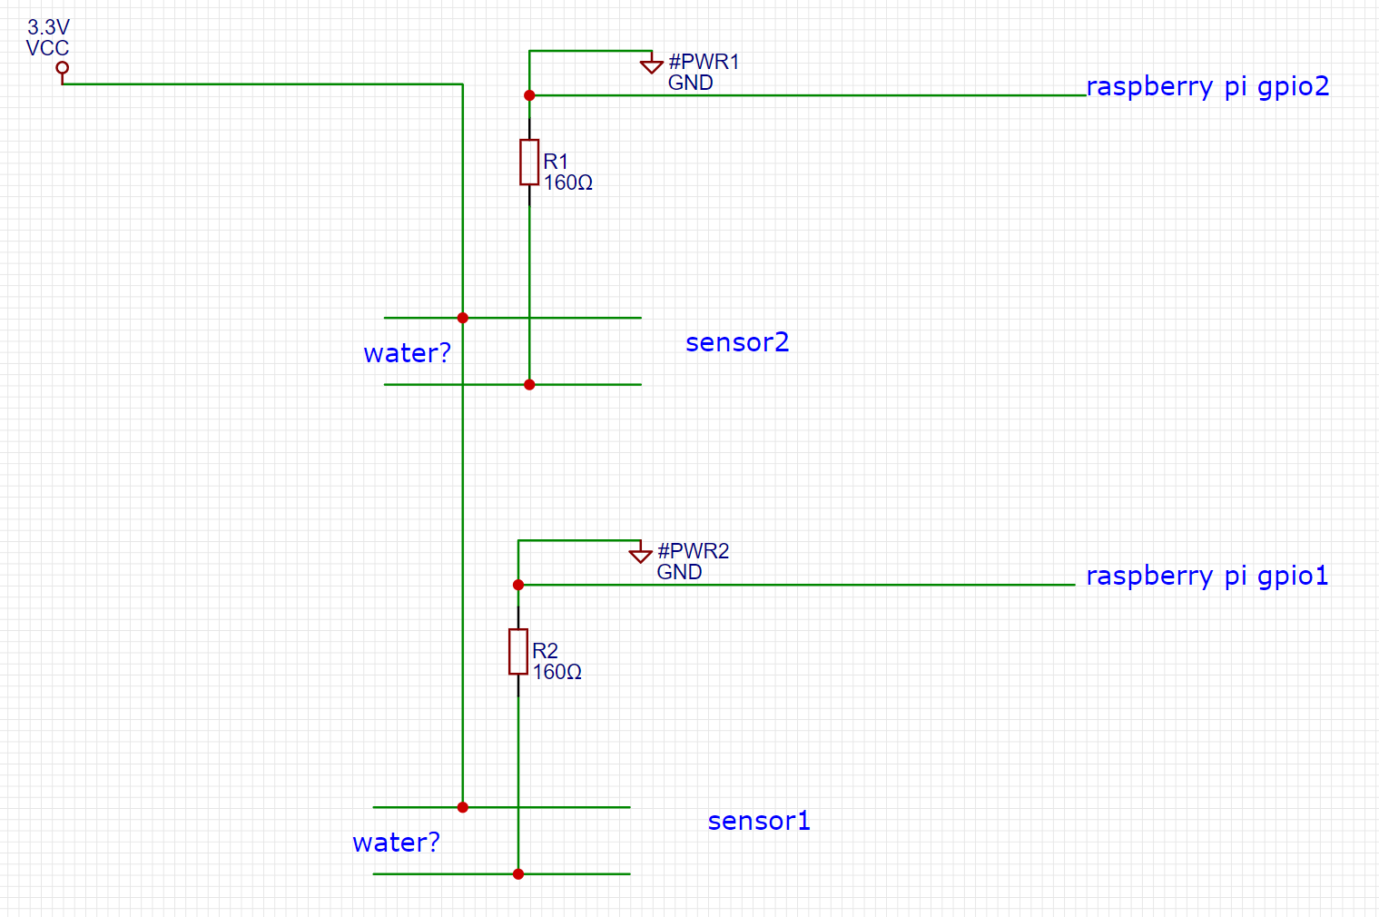
Product features – water system
Water system structure
Water sensor

Slide 10
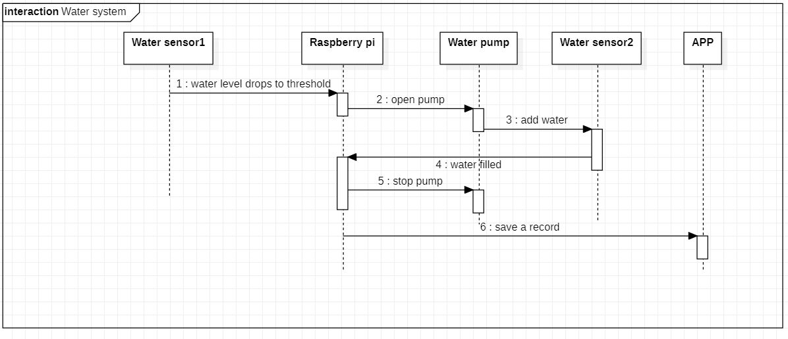
Product features – water system

Slide 11
Product features – hardware list
hardware | model
Servos | mini 180 Degree Resin Gear Servo SG90
Pressure Sensors | HX711
Water pump

Slide 12
Thank You!

