Slide 1
BASIC FRONTEND
DEVELOPMENT (HTML,CSS)
INSTRUCTOR: SANJANA KOIRALA

Slide 2
BASIC HTML
01
BASIC CSS
02
DEMO!
TABLE OF CONTENTS
04
CONNECTING THEM
03
UPCOMING EVENTS
05
QUERIES
06
Learning about tags, attributes, classes and IDs
Understanding the basic concept of css
A Demo website using HTML and CSS
Getting to know how HTML and CSS interact
Our next upcoming sessions.
Taking your queries and answering them.

Slide 3
01
BASIC HTML

Slide 4
TAGS
Heading Tag: h1, h2, h3, h4, h5, h6. Example: <h1>Hello</h1>
Paragraph: <p>This is a paragraph</p>
Anchor: a (It is a link to somewhere else). Example: <a href=“link”>LinkTitle</a>
Division: In a website having paragraphs, titles, images, etc. you’ll group each post together in a div. Example: <div> </div>
Span: <span>Span text.</span>
ol(ordered list), ul(unordered list), li(list item): Example: <ul> <li>Bob</li> <li>Marley</li> </ul>
Button: <button>HY</button>

Slide 5
TAGS
Image: Example: <img src= “______” alt=“imagediscription”/>
Input: Input tags do numbers, dates, colors, checkboxes, etc. Example: <input/>
Textarea: Example: <textarea></textarea>
Form: Example: <form> <input/> </form>
Strong: Bold. Example: <strong></strong>
Italic: <em></em>

Slide 6
ATTRIBUTES, CLASSES AND IDs
Attributes:
<input type= “checkbox” />
Classes:
<div class=“header”></div>
IDs: id should be unique and not reusable, useful to link to a part in the same page.
Syntax: <div id=“home”></div>
attribute
value

Slide 7
META HTML
<!DOCTYPE html>
<html lang="en">
<head>
<title>Document</title>
</head>
<body>
</body>
</html>
Notes:
<!DOCKTYPE html>: letting the browser know that we are using HTML5
<html lang=“en”>: letting the browser know what kind of document you are sending. (en refers to english)
<head></head>: In head, it goes all the meta information of the document. In above case we are just putting the title.
<body></body>: All the other tags: divs, classes, spans, etc.

Slide 8
02
BASIC CSS

Slide 9
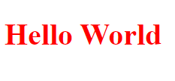
SYNTAX
Style.css h1{ color: red; }
Index.html
<h1>Hello world</h1>
h1: selector
color: property(There are about 350 properties)
red: value

Slide 10
CSS SELECTORS AND CASCADE
SELECTORS:
Class selector: .classname{ }
Id selector: #idname{ }
Element selector: p{ }
Universal selector: *{ }

Slide 11
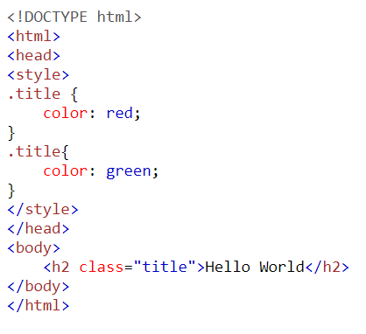

CSS SELECTORS AND CASCADE
THE CASCADE:
OUTPUT:
Comes last so it wins

Slide 12
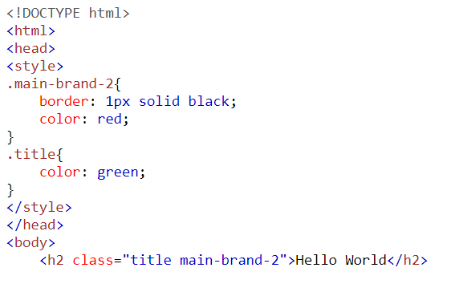

CSS SELECTORS AND CASCADE
THE CASCADE:
OUTPUT:
Since properties doesn’t conflict, it’ll have a border too
Comes last so it wins
It comes last so the h1 will be green

Slide 13
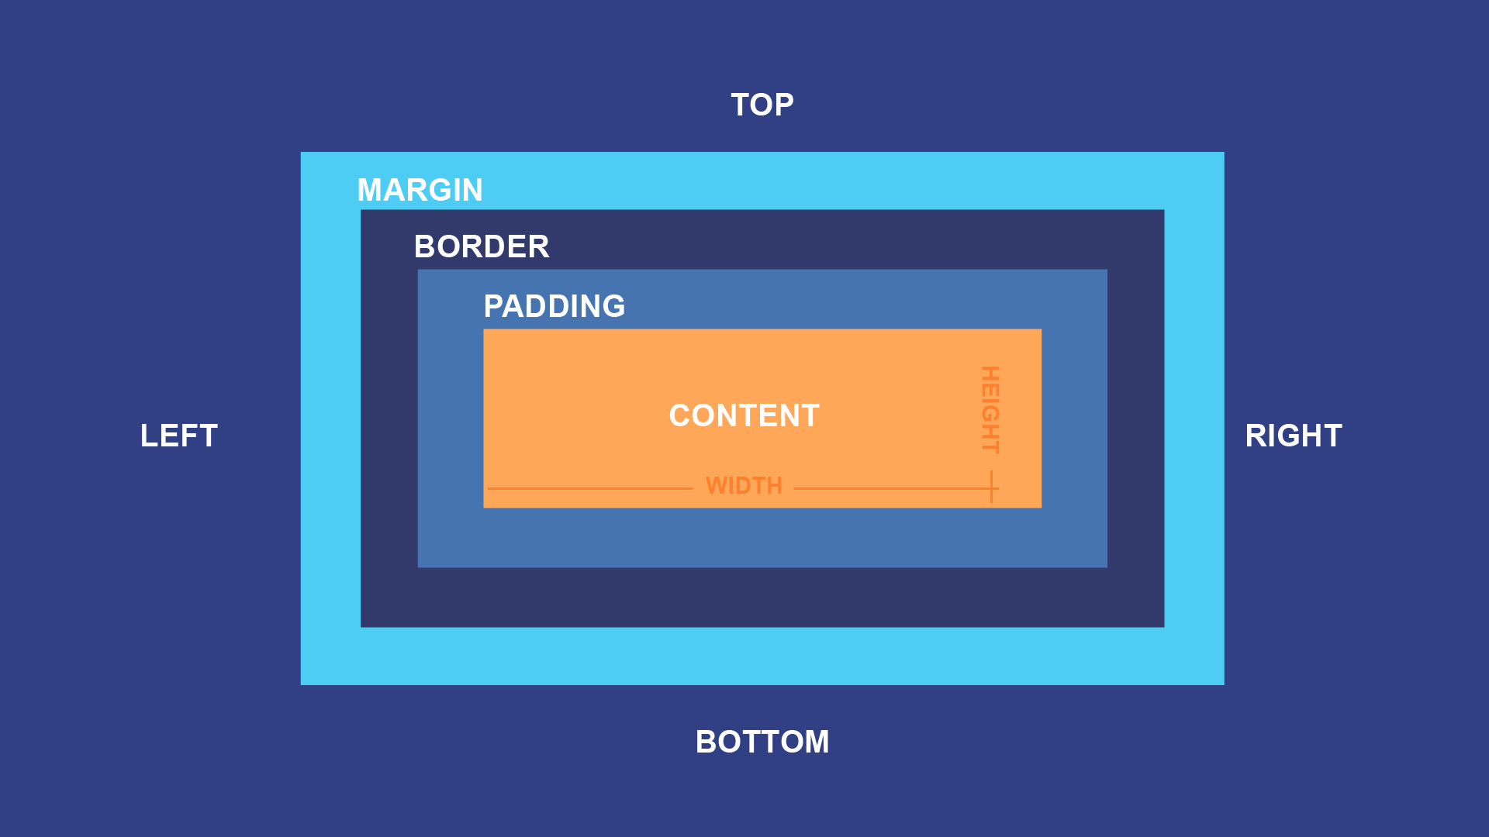
CSS BOX MODEL
HEIGHT, WIDTH, PADDING, BORDER AND MARGIN
(Properties that will make up the complete element)

Slide 14
CSS BOX MODEL
HEIGHT, WIDTH, PADDING, BORDER AND MARGIN
(Properties that will make up the complete element)
Content - The content of the box, where text and images appear
Padding - Clears an area around the content. The padding is transparent
Border - A border that goes around the padding and content
Margin - Clears an area outside the border. The margin is transparent

Slide 15
03
CONNECTING HTML AND CSS

Slide 16
CONNECTION BETWEEN HTML AND CSS
<!DOCTYPE html>
<html lang="en">
<head>
<title>Document</title>
<link rel =“stylesheet” href=“./style.css” />
</head>
<body>
</body>
</html>
In the same folder

Slide 17
04
DEMO!
Let’s move to the demo session

Slide 18


DEMO SESSION

Slide 19
05
EVENTS

Slide 20
REVIEW OF EVENTS
BASIC FRONTEND SESSION
COMING SOON..
JUNE 24
……
JUNE 19
……
…….
WHAT AFTER SEE AND +2?
COMING SOON..
COMING SOON..

Slide 21
06
QUERIES

Slide 22
THANKS
Does anyone have any questions?
engineeringitnepal@gmail.com
Hope the session was fruitful.

